Slide 1

NumPy

Slide 2

NumPy – huh, yeah – what’s it good for?
NumPy introduces a new data structure: the array
Great for storing homogeneous data, where every element in the array has the same meaning. E.g. images, sound, time series
An array is a regular, N-dimensional grid of data of the same type, typically numerical data

Slide 3

Efficient machine-native implementation
Data is stored in a contiguous chunk of memory, using machine-native data types
Separate metadata tells numpy how to interpret that memory as an array
Memory block storage
0 | 1 | 2 | 3 | 4 | 5 | 6 | 7 | 8
int64
8 bytes
NumPy view
0 | 1 | 2
3 | 4 | 5
6 | 7 | 8
NumPy array metadata
dtype | int64
ndim | 2
shape | (3, 3)
strides | (24, 8)
int64
8 bytes
Notes:
Reminder of architecture class
The standard Python implementation is written in C. This means that every Python object is simply a cleverly-disguised C structure, which contains not only its value, but metadata as well
a C integer is essentially a label for a position in memory whose bytes encode an integer value. A Python integer is a pointer to a position in memory containing all the Python object information, including the bytes that contain the integer value
NumPy handles looping over array elements near-optimally—for example, taking strides into consideration to best utilize the computer’s fast cache memory
NumPy array - single pointer to one contiguous block of data
The Python list, on the other hand, contains a pointer to a block of pointers, each of which in turn points to a full Python object

Slide 4

Is NumPy any better than a list-of-lists?
Notes:
The standard Python implementation is written in C. This means that every Python object is simply a cleverly-disguised C structure, which contains not only its value, but metadata as well
a C integer is essentially a label for a position in memory whose bytes encode an integer value. A Python integer is a pointer to a position in memory containing all the Python object information, including the bytes that contain the integer value
NumPy handles looping over array elements near-optimally—for example, taking strides into consideration to best utilize the computer’s fast cache memory
NumPy array - single pointer to one contiguous block of data
The Python list, on the other hand, contains a pointer to a block of pointers, each of which in turn points to a full Python object

Slide 5
Is NumPy any better than a list-of-lists?
Numpy arrays are implemented using machine-native data types, which means that common operations and algorithms can be implemented with less per-element overhead, making them faster than a Python list-of-lists
Faster in what sense?
It’s not going to scale any better than list-of-lists Scaling complexity is the same. E.g., square matrix multiplication is still O(N³)
Much faster for fixed-size problems
This speed advantage strictly depends on operations being made in C and Fortran. Avoid Python for-loops and use existing NumPy and SciPy functionality!
* The best matrix multiplication algorithm as of 2025 scales as O(n**2.371339). However, out-of-the-box NumPy packages usually use a Fortran library called OpenBLAS that implements a O(n**3) algorithm
Notes:
The standard Python implementation is written in C. This means that every Python object is simply a cleverly-disguised C structure, which contains not only its value, but metadata as well
a C integer is essentially a label for a position in memory whose bytes encode an integer value. A Python integer is a pointer to a position in memory containing all the Python object information, including the bytes that contain the integer value
NumPy handles looping over array elements near-optimally—for example, taking strides into consideration to best utilize the computer’s fast cache memory
NumPy array - single pointer to one contiguous block of data
The Python list, on the other hand, contains a pointer to a block of pointers, each of which in turn points to a full Python object

Slide 6
How does NumPy implement array operations?
x
NumPy view
NumPy array metadata
0 | 1 | 2
3 | 4 | 5
6 | 7 | 8
dtype | int64
ndim | 2
shape | (3, 3)
strides | (24, 8)
data
Memory block storage
int64
8 bytes
0 | 1 | 2 | 3 | 4 | 5 | 6 | 7 | 8
y = x.mean(axis=1)
Notes:
The standard Python implementation is written in C. This means that every Python object is simply a cleverly-disguised C structure, which contains not only its value, but metadata as well
a C integer is essentially a label for a position in memory whose bytes encode an integer value. A Python integer is a pointer to a position in memory containing all the Python object information, including the bytes that contain the integer value
NumPy handles looping over array elements near-optimally—for example, taking strides into consideration to best utilize the computer’s fast cache memory
NumPy array - single pointer to one contiguous block of data
The Python list, on the other hand, contains a pointer to a block of pointers, each of which in turn points to a full Python object

Slide 7
For many operations, NumPy creates a new memory block with the result
x
Array layout
NumPy array metadata
0 | 1 | 2
3 | 4 | 5
6 | 7 | 8
dtype | int64
ndim | 2
shape | (3, 3)
strides | (24, 8)
data
Memory block storage
int64
8 bytes
0 | 1 | 2 | 3 | 4 | 5 | 6 | 7 | 8
y = x.mean(axis=1)
NumPy array metadata
dtype | float64
ndim | 1
shape | (3,)
strides | (8,)
data
Array layout
Memory block storage
1.0 | 4.0 | 7.0
1.0 | 4.0 | 7.0
float64
8 bytes
Notes:
The standard Python implementation is written in C. This means that every Python object is simply a cleverly-disguised C structure, which contains not only its value, but metadata as well
a C integer is essentially a label for a position in memory whose bytes encode an integer value. A Python integer is a pointer to a position in memory containing all the Python object information, including the bytes that contain the integer value
NumPy handles looping over array elements near-optimally—for example, taking strides into consideration to best utilize the computer’s fast cache memory
NumPy array - single pointer to one contiguous block of data
The Python list, on the other hand, contains a pointer to a block of pointers, each of which in turn points to a full Python object

Slide 8
How could this operation be implemented?
x = np.arange(9)
NumPy array metadata
Array layout
dtype | int64
ndim | 1
shape | (9,)
strides | (8,)
data
0 | 1 | 2 | 3 | 4 | 5 | 6 | 7 | 8
int64
8 bytes
Memory block storage
0 | 1 | 2 | 3 | 4 | 5 | 6 | 7 | 8
y = x.reshape((3, 3))
Notes:
The standard Python implementation is written in C. This means that every Python object is simply a cleverly-disguised C structure, which contains not only its value, but metadata as well
a C integer is essentially a label for a position in memory whose bytes encode an integer value. A Python integer is a pointer to a position in memory containing all the Python object information, including the bytes that contain the integer value
NumPy handles looping over array elements near-optimally—for example, taking strides into consideration to best utilize the computer’s fast cache memory
NumPy array - single pointer to one contiguous block of data
The Python list, on the other hand, contains a pointer to a block of pointers, each of which in turn points to a full Python object

Slide 9
1) With a copy of the original data
x = np.arange(9)
NumPy array metadata
Array layout
dtype | int64
ndim | 1
shape | (9,)
strides | (8,)
data
0 | 1 | 2 | 3 | 4 | 5 | 6 | 7 | 8
int64
8 bytes
Memory block storage
0 | 1 | 2 | 3 | 4 | 5 | 6 | 7 | 8
y = x.reshape((3, 3))
NumPy array metadata
Array layout
dtype | int64
ndim | 2
shape | (3, 3)
strides | (24, 8)
data
0 | 1 | 2
3 | 4 | 5
6 | 7 | 8
Memory block storage
0 | 1 | 2 | 3 | 4 | 5 | 6 | 7 | 8
int64
8 bytes
Notes:
The standard Python implementation is written in C. This means that every Python object is simply a cleverly-disguised C structure, which contains not only its value, but metadata as well
a C integer is essentially a label for a position in memory whose bytes encode an integer value. A Python integer is a pointer to a position in memory containing all the Python object information, including the bytes that contain the integer value
NumPy handles looping over array elements near-optimally—for example, taking strides into consideration to best utilize the computer’s fast cache memory
NumPy array - single pointer to one contiguous block of data
The Python list, on the other hand, contains a pointer to a block of pointers, each of which in turn points to a full Python object
A copy always works! But it’s O(n)

Slide 10
1) With a copy of the original data
x = np.arange(9)
NumPy array metadata
Array layout
How does copying scale if the original array has N elements?
dtype | int64
ndim | 1
shape | (9,)
strides | (8,)
data
0 | 1 | 2 | 3 | 4 | 5 | 6 | 7 | 8
int64
8 bytes
Memory block storage
0 | 1 | 2 | 3 | 4 | 5 | 6 | 7 | 8
y = x.reshape((3, 3))
NumPy array metadata
Array layout
dtype | int64
ndim | 2
shape | (3, 3)
strides | (24, 8)
data
0 | 1 | 2
3 | 4 | 5
6 | 7 | 8
Memory block storage
0 | 1 | 2 | 3 | 4 | 5 | 6 | 7 | 8
int64
8 bytes
Notes:
The standard Python implementation is written in C. This means that every Python object is simply a cleverly-disguised C structure, which contains not only its value, but metadata as well
a C integer is essentially a label for a position in memory whose bytes encode an integer value. A Python integer is a pointer to a position in memory containing all the Python object information, including the bytes that contain the integer value
NumPy handles looping over array elements near-optimally—for example, taking strides into consideration to best utilize the computer’s fast cache memory
NumPy array - single pointer to one contiguous block of data
The Python list, on the other hand, contains a pointer to a block of pointers, each of which in turn points to a full Python object
A copy always works! But it’s O(n)

Slide 11
1) With a copy of the original data
x = np.arange(9)
NumPy array metadata
Array layout
How does copying scale if the original array has N elements?
O(N)
dtype | int64
ndim | 1
shape | (9,)
strides | (8,)
data
0 | 1 | 2 | 3 | 4 | 5 | 6 | 7 | 8
int64
8 bytes
Memory block storage
0 | 1 | 2 | 3 | 4 | 5 | 6 | 7 | 8
y = x.reshape((3, 3))
NumPy array metadata
Array layout
dtype | int64
ndim | 2
shape | (3, 3)
strides | (24, 8)
data
0 | 1 | 2
3 | 4 | 5
6 | 7 | 8
Memory block storage
0 | 1 | 2 | 3 | 4 | 5 | 6 | 7 | 8
int64
8 bytes
Notes:
The standard Python implementation is written in C. This means that every Python object is simply a cleverly-disguised C structure, which contains not only its value, but metadata as well
a C integer is essentially a label for a position in memory whose bytes encode an integer value. A Python integer is a pointer to a position in memory containing all the Python object information, including the bytes that contain the integer value
NumPy handles looping over array elements near-optimally—for example, taking strides into consideration to best utilize the computer’s fast cache memory
NumPy array - single pointer to one contiguous block of data
The Python list, on the other hand, contains a pointer to a block of pointers, each of which in turn points to a full Python object
A copy always works! But it’s O(n)

Slide 12
2) With a view of the original data
x = np.arange(9)
NumPy array metadata
Array layout
dtype | int64
ndim | 1
shape | (9,)
strides | (8,)
data
0 | 1 | 2 | 3 | 4 | 5 | 6 | 7 | 8
int64
8 bytes
Memory block storage
0 | 1 | 2 | 3 | 4 | 5 | 6 | 7 | 8
y = x.reshape((3, 3))
NumPy array metadata
Array layout
dtype | int64
ndim | 2
shape | (3,3)
strides | (24, 8)
data
0 | 1 | 2
3 | 4 | 5
6 | 7 | 8
int64
8 bytes
Notes:
The standard Python implementation is written in C. This means that every Python object is simply a cleverly-disguised C structure, which contains not only its value, but metadata as well
a C integer is essentially a label for a position in memory whose bytes encode an integer value. A Python integer is a pointer to a position in memory containing all the Python object information, including the bytes that contain the integer value
NumPy handles looping over array elements near-optimally—for example, taking strides into consideration to best utilize the computer’s fast cache memory
NumPy array - single pointer to one contiguous block of data
The Python list, on the other hand, contains a pointer to a block of pointers, each of which in turn points to a full Python object

Slide 13
2) With a view of the original data
x = np.arange(9)
NumPy array metadata
Array layout
dtype | int64
ndim | 1
shape | (9,)
strides | (8,)
data
How does creating a view scale if the original array has N elements?
0 | 1 | 2 | 3 | 4 | 5 | 6 | 7 | 8
int64
8 bytes
Memory block storage
0 | 1 | 2 | 3 | 4 | 5 | 6 | 7 | 8
y = x.reshape((3, 3))
NumPy array metadata
Array layout
dtype | int64
ndim | 2
shape | (3,3)
strides | (24, 8)
data
0 | 1 | 2
3 | 4 | 5
6 | 7 | 8
int64
8 bytes
Notes:
The standard Python implementation is written in C. This means that every Python object is simply a cleverly-disguised C structure, which contains not only its value, but metadata as well
a C integer is essentially a label for a position in memory whose bytes encode an integer value. A Python integer is a pointer to a position in memory containing all the Python object information, including the bytes that contain the integer value
NumPy handles looping over array elements near-optimally—for example, taking strides into consideration to best utilize the computer’s fast cache memory
NumPy array - single pointer to one contiguous block of data
The Python list, on the other hand, contains a pointer to a block of pointers, each of which in turn points to a full Python object

Slide 14
2) With a view of the original data
x = np.arange(9)
NumPy array metadata
Array layout
dtype | int64
ndim | 1
shape | (9,)
strides | (8,)
data
How does creating a view scale if the original array has N elements?
O(1)!
0 | 1 | 2 | 3 | 4 | 5 | 6 | 7 | 8
int64
8 bytes
Memory block storage
0 | 1 | 2 | 3 | 4 | 5 | 6 | 7 | 8
y = x.reshape((3, 3))
NumPy array metadata
Array layout
dtype | int64
ndim | 2
shape | (3,3)
strides | (24, 8)
data
0 | 1 | 2
3 | 4 | 5
6 | 7 | 8
int64
8 bytes
Notes:
The standard Python implementation is written in C. This means that every Python object is simply a cleverly-disguised C structure, which contains not only its value, but metadata as well
a C integer is essentially a label for a position in memory whose bytes encode an integer value. A Python integer is a pointer to a position in memory containing all the Python object information, including the bytes that contain the integer value
NumPy handles looping over array elements near-optimally—for example, taking strides into consideration to best utilize the computer’s fast cache memory
NumPy array - single pointer to one contiguous block of data
The Python list, on the other hand, contains a pointer to a block of pointers, each of which in turn points to a full Python object

Slide 15
O(1) operations in NumPy
Memory block
0 | 1 | 2 | 3 | 4 | 5 | 6 | 7 | 8 | 9 | 10 | 11 | 12
NumPy operation
NumPy array metadata
Array layout
x
ndim | 2
shape | (4, 3)
strides | (24, 8)
data
0 | 1 | 2
3 | 4 | 5
6 | 7 | 8
9 | 10 | 11
y = x.ravel()
ndim | 1
shape | (12,)
strides | (8,)
data
0 | 1 | 2 | 3 | 4 | 5 | 6 | 7 | 8 | 9 | 10 | 11
y = x.T
ndim | 2
shape | (3, 4)
strides | (8, 24)
data
0 | 3 | 6 | 9
1 | 4 | 7 | 10
2 | 5 | 8 | 11
y = x.reshape((2, 6))
ndim | 2
shape | (2, 6)
strides | (48, 8)
data
0 | 1 | 2 | 3 | 4 | 5
6 | 7 | 8 | 9 | 10 | 11
Notes:
Point to make: there are a number of array operations that take no time at all!

Slide 16
The golden rule of NumPy
Operations that can be executed by only changing the metadata return a “view “ of the original data memory block
In all other cases, it creates a “copy” with a new data memory block
Notes:
You can always make a copy by explicitly calling .copy()

Slide 17
Views vs. copies in indexing operations
Memory block
0 | 1 | 2 | 3 | 4 | 5 | 6 | 7 | 8 | 9 | 10 | 11 | 12
NumPy operation
NumPy array metadata
x
dtype | int64
ndim | 2
shape | (4, 3)
strides | (24, 8)
data
0 | 1 | 2
3 | 4 | 5
6 | 7 | 8
9 | 10 | 11
Slicing
dtype
ndim
shape
strides
data
Can this operation be executed by changing the metadata?
x[::3, ::2]
0 | 2
9 | 11
Notes:
How does the golden rule apply to indexing operations?
→ compare slices vs. fancy indexing

Slide 18
Views vs. copies in indexing operations
Memory block
0 | 1 | 2 | 3 | 4 | 5 | 6 | 7 | 8 | 9 | 10 | 11 | 12
NumPy operation
NumPy array metadata
x
dtype
ndim
shape
strides
0 | 1 | 2
3 | 4 | 5
6 | 7 | 8
9 | 10 | 11
dtype | int64
ndim | 2
shape | (4, 3)
strides | (24, 8)
data
Slicing
dtype | int64
ndim | 2
shape | (2, 2)
strides | (72, 16)
data
Can this operation be executed by changing the metadata?
YES!
x[::3, ::2]
0 | 2
9 | 11
Can it be done for all slicing operations?

Slide 19
Views vs. copies in indexing operations
Memory block
0 | 1 | 2 | 3 | 4 | 5 | 6 | 7 | 8 | 9 | 10 | 11 | 12
NumPy operation
NumPy array metadata
x
dtype | int64
ndim | 2
shape | (4, 3)
strides | (24, 8)
data
0 | 1 | 2
3 | 4 | 5
6 | 7 | 8
9 | 10 | 11
Slicing always returns a view of the original data
Slicing
dtype | int64
ndim | 2
shape | (2, 2)
strides | (72, 16)
data
Can this operation be executed by changing the metadata?
YES!
x[::3, ::2]
0 | 2
9 | 11
Can it be done for all slicing operations?
YES!

Slide 20
Views vs. copies in indexing operations
Memory block
0 | 1 | 2 | 3 | 4 | 5 | 6 | 7 | 8 | 9 | 10 | 11 | 12
NumPy operation
NumPy array metadata
x
dtype | int64
ndim | 2
shape | (4, 3)
strides | (24, 8)
data
0 | 1 | 2
3 | 4 | 5
6 | 7 | 8
9 | 10 | 11
Fancy indexing
dtype
ndim
shape
strides
data
Can this operation be executed by changing the metadata?
x[[0, 3, 2], [1, 1, 2]]
1 | 10 | 8
row indices
column indices

Slide 21
Views vs. copies in indexing operations
Memory block
0 | 1 | 2 | 3 | 4 | 5 | 6 | 7 | 8 | 9 | 10 | 11 | 12
NumPy operation
NumPy array metadata
x
dtype | int64
ndim | 2
shape | (4, 3)
strides | (24, 8)
data
0 | 1 | 2
3 | 4 | 5
6 | 7 | 8
9 | 10 | 11
Fancy indexing
dtype | int64
ndim | 1
shape | (3,)
strides | (8,)
data
Can this operation be executed by changing the metadata?
NO!
x[[0, 3, 2], [1, 1, 2]]
1 | 10 | 8
row indices
column indices
Memory block
1 | 10 | 8

Slide 22
Views vs. copies in indexing operations
Memory block
0 | 1 | 2 | 3 | 4 | 5 | 6 | 7 | 8 | 9 | 10 | 11 | 12
NumPy operation
NumPy array metadata
x
dtype | int64
ndim | 2
shape | (4, 3)
strides | (24, 8)
data
0 | 1 | 2
3 | 4 | 5
6 | 7 | 8
9 | 10 | 11
Fancy indexing always returns an array pointing to a new memory block (we still call this a “copy”)
Fancy indexing
dtype | int64
ndim | 1
shape | (3,)
strides | (8,)
data
Can this operation be executed by changing the metadata?
NO!
x[[0, 3, 2], [1, 1, 2]]
1 | 10 | 8
row indices
column indices
Memory block
1 | 10 | 8

Slide 23
View or copy? Quiz
Exercise

Slide 24

Setting up a pet shop
Live Coding
notebooks/020_numpy/ 015_assignment_by_reference.ipynb

Slide 25
Python assignment is “by reference”
cage = ["🦜"]
Global namespace
Memory
Final result
"🦜"
cage
[ ]
= ["🦜"]

Slide 26
Python assignment is “by reference”
cage = ["🦜"]
another_cage = cage
Global namespace
Memory
Final result
"🦜"
cage
[ ]
= ["🦜"]
another_cage
= ["🦜"]

Slide 27
Python assignment is “by reference”
cage = ["🦜"]
another_cage = cage
shelf = [cage, cage]
Global namespace
Memory
Final result
"🦜"
cage
[ ]
= ["🦜"]
another_cage
= ["🦜"]
shelf
[ , ]
= [["🦜"], ["🦜"]]

Slide 28
Python assignment is “by reference”
cage = ["🦜"]
another_cage = cage
shelf = [cage, cage]
cage[0]
Global namespace
Memory
Final result
"🦜"
cage
[ ]
= ["🦜"]
another_cage
= ["🦜"]
shelf
[ , ]
= [["🦜"], ["🦜"]]

Slide 29
Python assignment is “by reference”
cage = ["🦜"]
another_cage = cage
shelf = [cage, cage]
cage[0] = "🐍"
Global namespace
Memory
Final result
"🐍"
"🦜"
cage
[ ]
= ["?"]
another_cage
= ["?"]
shelf
[ , ]
= [["?"], ["?"]]

Slide 30
Python assignment is “by reference”
cage = ["🦜"]
another_cage = cage
shelf = [cage, cage]
cage[0] = "🐍"
Global namespace
Memory
Final result
"🐍"
"🦜"
cage
[ ]
= ["🐍"]
another_cage
= ["🐍"]
shelf
[ , ]
= [["🐍"], ["🐍"]]

Slide 31
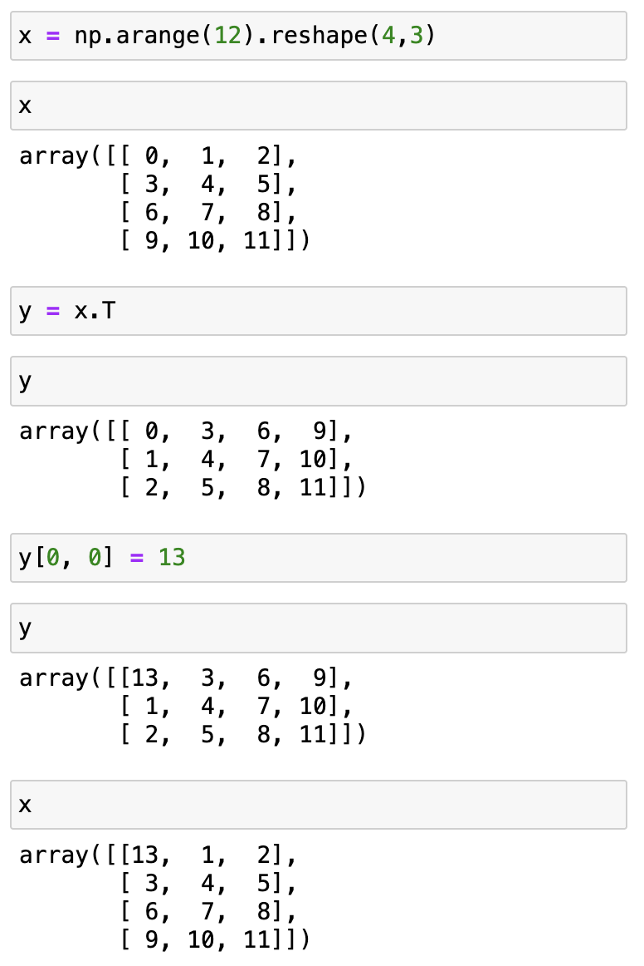
Changing one view changes them all
0 | 1 | 2 | 3 | 4 | 5 | 6 | 7 | 8 | 9 | 10 | 11 | 12
data
dtype | int64
ndim | 2
shape | (4, 3)
strides | (24, 8)
data
dtype | int64
ndim | 2
shape | (3, 4)
strides | (8, 24)
x
y

Slide 32
Changing one view changes them all
0 | 1 | 2 | 3 | 4 | 5 | 6 | 7 | 8 | 9 | 10 | 11 | 12
data
dtype | int64
ndim | 2
shape | (4, 3)
strides | (24, 8)
data
dtype | int64
ndim | 2
shape | (3, 4)
strides | (8, 24)
x
y

Slide 33
Changing one view changes them all
13 | 1 | 2 | 3 | 4 | 5 | 6 | 7 | 8 | 9 | 10 | 11 | 12
data
dtype | int64
ndim | 2
shape | (4, 3)
strides | (24, 8)
data
dtype | int64
ndim | 2
shape | (3, 4)
strides | (8, 24)
x
y

Slide 34

Passing an argument is an assignment
cage = ["🦜"]
def extract_animal(container):
return container.pop()
Global namespace
Function namespace
Memory
Final result
" "
cage
[ ]
= [" "]
extract_animal
container

Slide 35
Passing an argument is an assignment
cage = ["🦜"]
def extract_animal(container):
return container.pop()
extract_animal(cage)
Global namespace
Function namespace
Memory
Final result
" "
cage
[ ]
= [" "]
extract_animal(cage)
container
= [" "]
container = cage

Slide 36
Passing an argument is an assignment
cage = ["🦜"]
def extract_animal(container):
return container.pop()
extract_animal(cage)
Global namespace
Function namespace
Memory
Final result
" "
cage
[ ]
= [" "]
extract_animal(cage)
container
= [" "]
container.pop()

Slide 37
Passing an argument is an assignment
cage = [" "]
def extract_animal(container):
return container.pop()
extract_animal(cage)
Global namespace
Function namespace
Memory
Final result
" "
cage
[ ]
= ["?"]
extract_animal(cage)
container
= [ ]
container.pop()

Slide 38
Passing an argument is an assignment
cage = [" "]
def extract_animal(container):
return container.pop()
extract_animal(cage)
Global namespace
Function namespace
Memory
Final result
" "
cage
[ ]
= [ ]
extract_animal(cage)
container
= [ ]
container.pop()

Slide 39
Assignments and functions
Exercise
exercises/numpy_assignments/ side_effects.ipynb
Put up the GREEN sticker after you solve part A

Slide 40
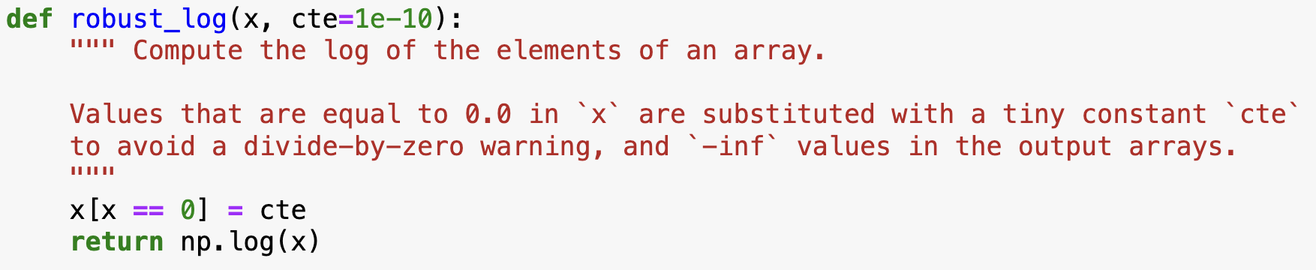
Careful with your functions

Slide 41
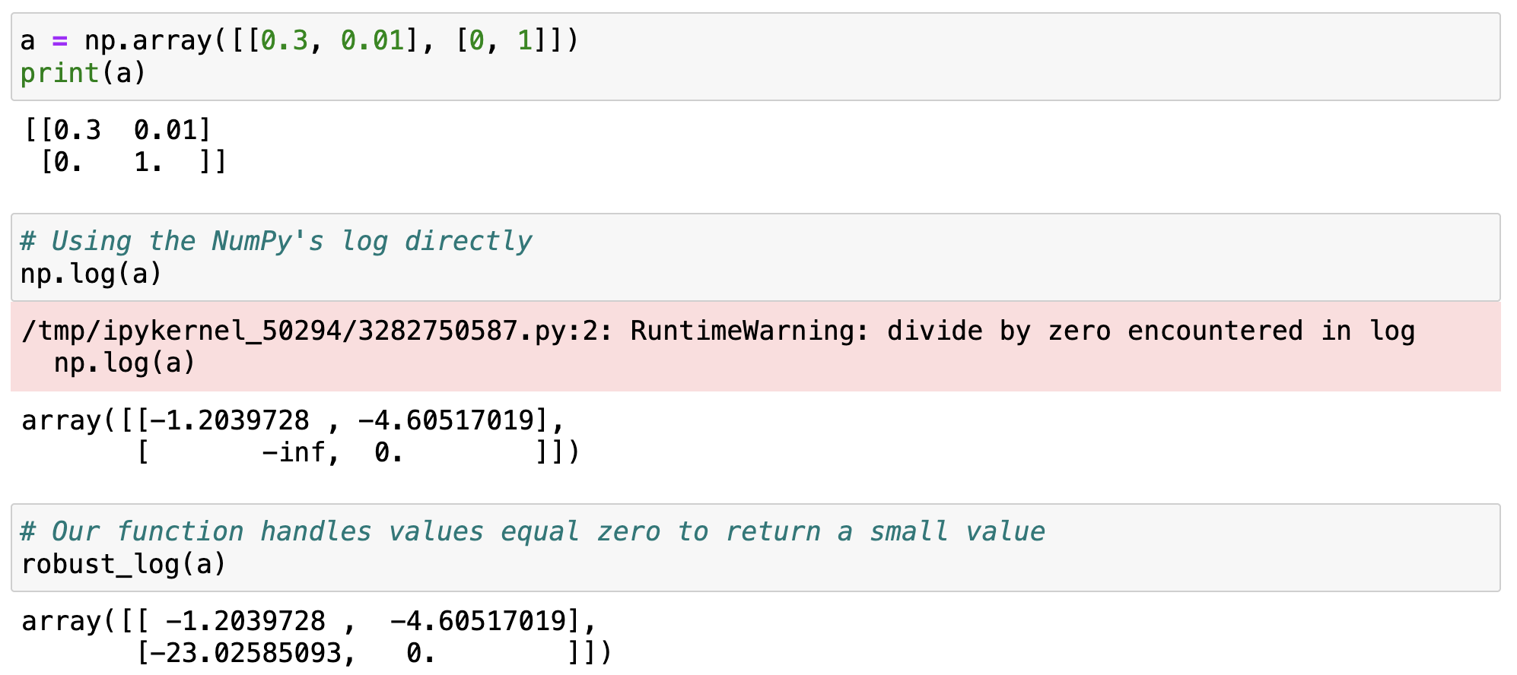
Careful with your functions
Notes:
Example .copy() usage
What can go wrong with this function?

Slide 42
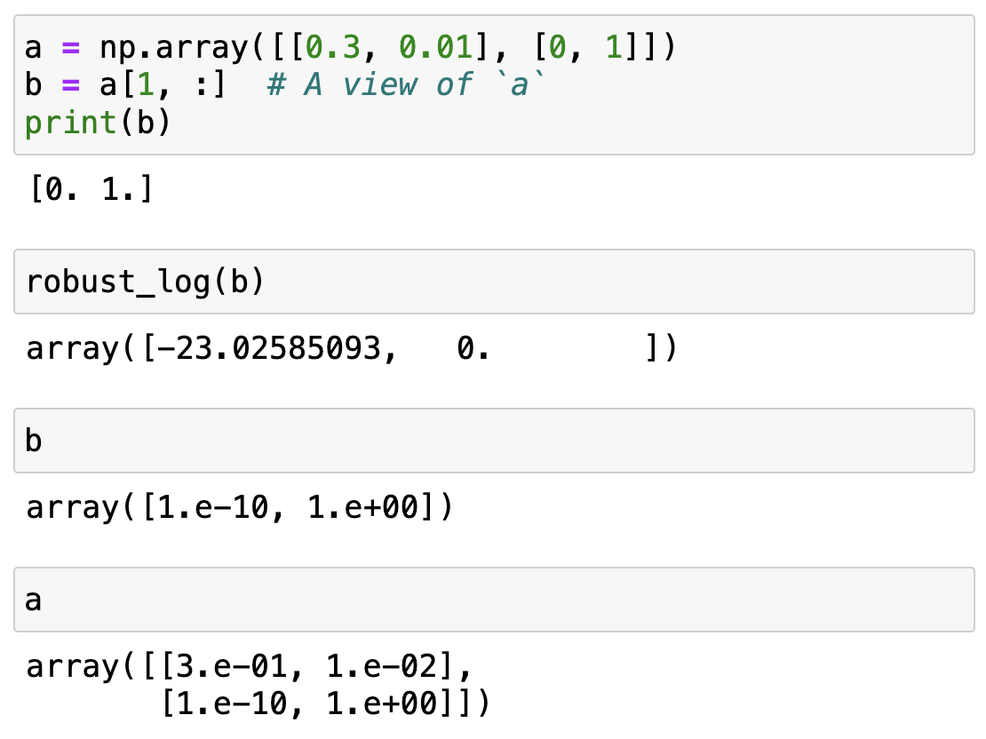
Careful with your functions
The input array has been modified!
… and so have all other views of the same data!

Slide 43
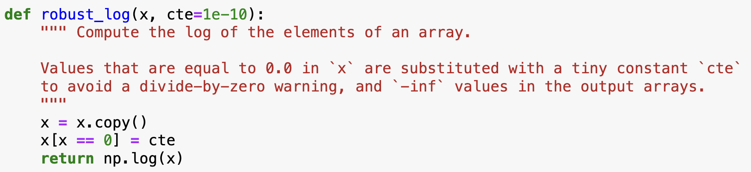
Careful with your functions
Best practice: functions that take an array as an input should avoid modifying it in place!
Always make a copy or be super extra clear in the docstring
Notes:
Discuss pros and cons with them
Pros: security that data will be always a copy.
Cons: redundancy in memory, problem for big arrays

Slide 44
NumPy views and copies summary
View
There can be multiple views of the same memory block, interpreted as different arrays
Slicing returns a view
In-place operations on a view modify the memory block and all of its views
Copy (incl. new data)
When a copy of an array needs to be created, it allocates a separate memory block and associates it with new metadata
Fancy indexing always returns copies
A copy can be forced with .copy()

Slide 45
Up next: Tabular Data

Slide 47
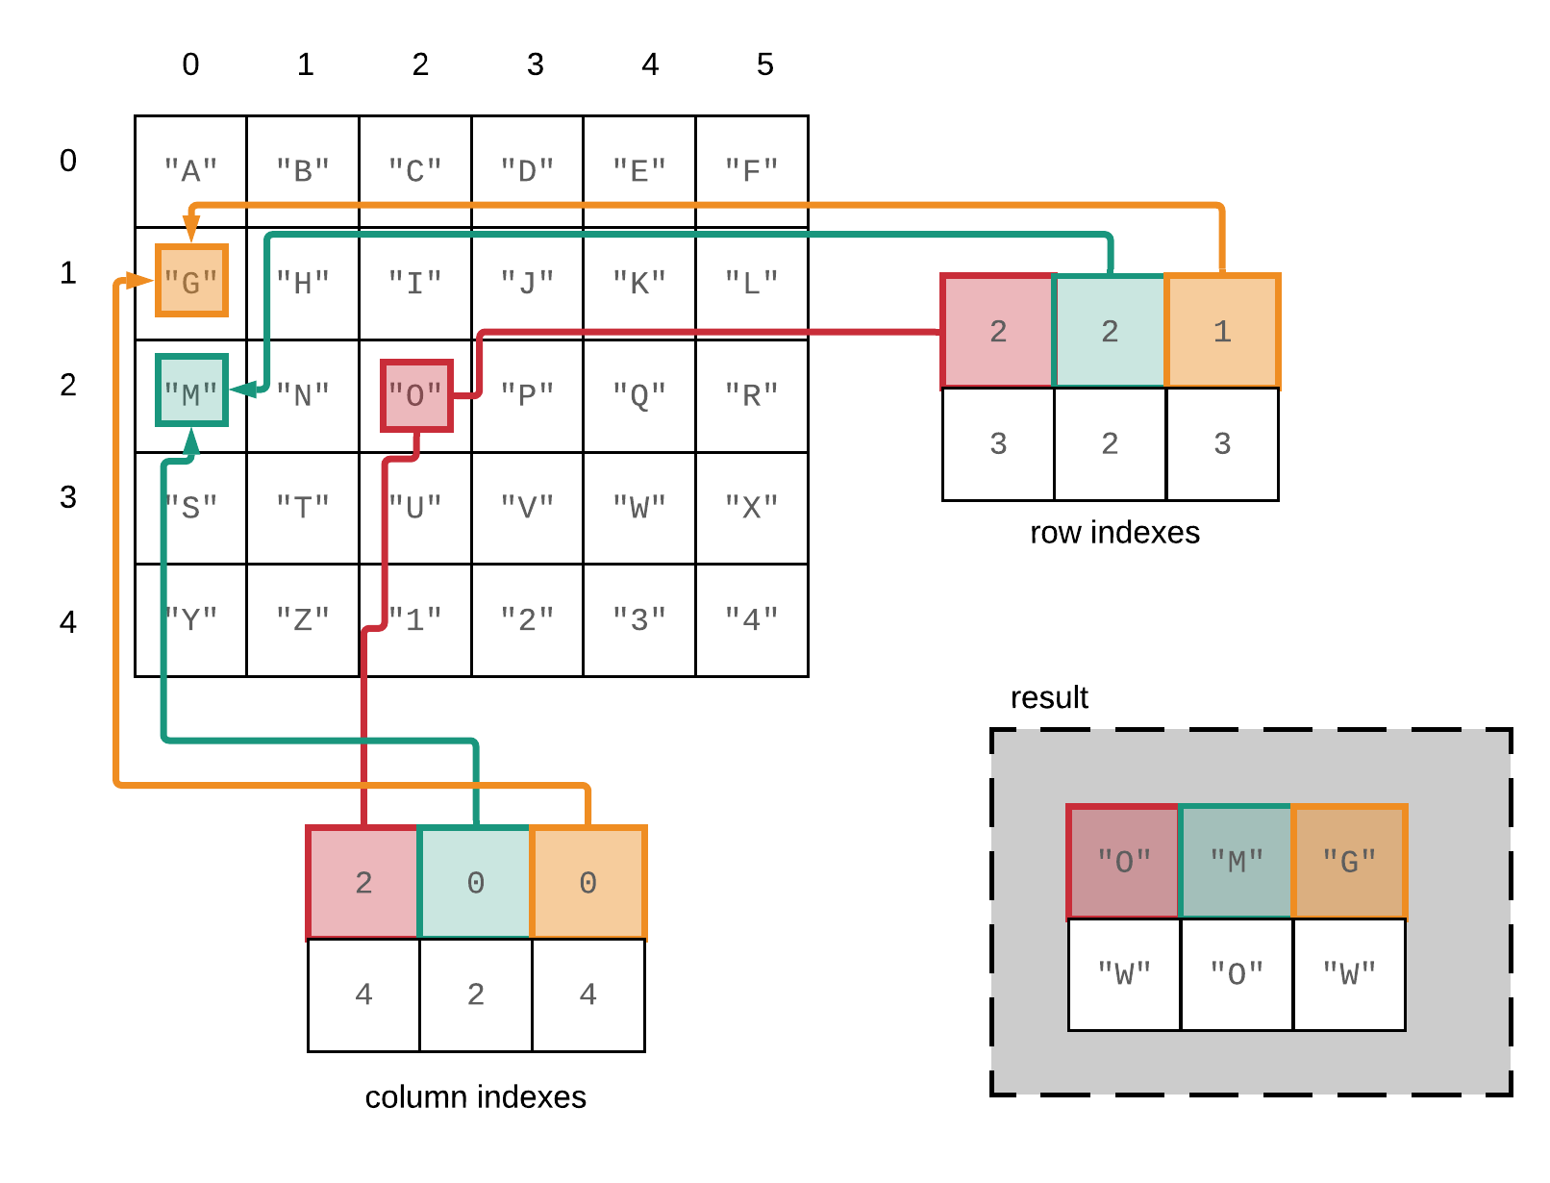
Fancy indexing in NumPy – reference slide
A[[2, 2, 1], [2, 0, 0]]

Slide 48
A special kind of view: broadcasting operations
Memory block
0 | 1 | 2 | 3 | 4 | 5 | 6 | 7 | 8
NumPy array metadata
dtype | int64
ndim | 2
shape | (4, 9)
strides | (0, 8)
The shape says we have 4 rows and 9 columns
A stride of 0 means that for each new row, we don’t move in memory
Notes:
Special case, when one of the strides is 0 → duplicates without occupying more memory
Transition, other operations that can
Braodcasting
Imagine what happens if we have a stride of 0
It allows us to replicate the sae row without allocating extra memory
What happens when it’s a 0?

Slide 49
A special kind of view: broadcasting operations
Memory block
As a result, we obtain a view with duplicated rows, without using extra memory!
0 | 1 | 2 | 3 | 4 | 5 | 6 | 7 | 8
NumPy array metadata
NumPy view
dtype | int64
ndim | 2
shape | (4, 9)
strides | (0, 8)
The shape says we have 4 rows and 9 columns
0 | 1 | 2 | 3 | 4 | 5 | 6 | 7 | 8
0 | 1 | 2 | 3 | 4 | 5 | 6 | 7 | 8
0 | 1 | 2 | 3 | 4 | 5 | 6 | 7 | 8
0 | 1 | 2 | 3 | 4 | 5 | 6 | 7 | 8
A stride of 0 means that for each new row, we don’t move in memory
Notes:
Stride == 0 → then we are not actually moving in memory, same memory, we are looping over the same thing

Slide 50
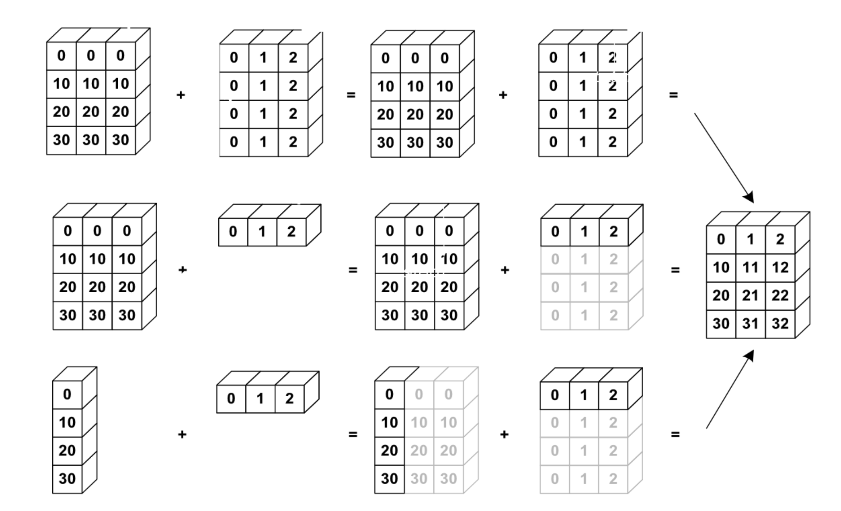
NumPy uses broadcasting to perform operation on arrays of different shape without having to allocate extra memory
Notes:
Again the kaleidoscope metaphor, it’s an aritifical way to replicate something

