Slide 1
NUMPY

Slide 2
NumPy – huh, yeah – what’s it good for?
Introduces new data structure: the array
An array could be represented as a list-of-lists
Why are NumPy arrays better than a list-of-lists?
**Tiziano’s class**
An array is a regular, N-dimensional grid of data of the same type, typically numerical data

Slide 3
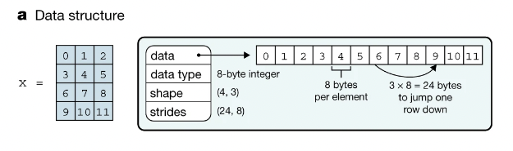
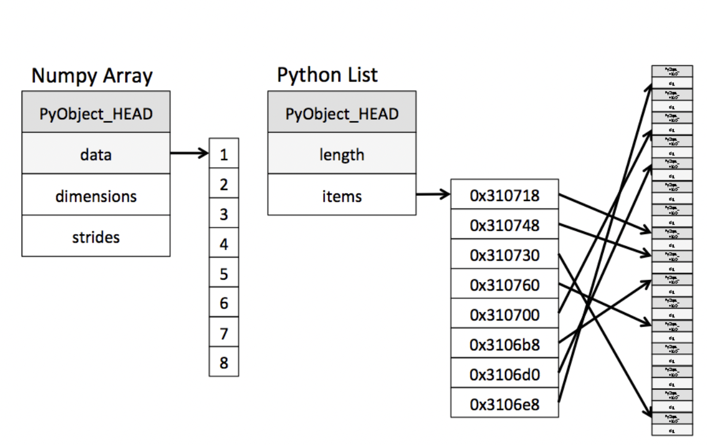
Efficiency of NumPy
Memory:
data occupies the minimum amount of memory required
some operations can be done without touching the memory at all!
Notes:
The standard Python implementation is written in C. This means that every Python object is simply a cleverly-disguised C structure, which contains not only its value, but metadata as well
a C integer is essentially a label for a position in memory whose bytes encode an integer value. A Python integer is a pointer to a position in memory containing all the Python object information, including the bytes that contain the integer value
NumPy handles looping over array elements near-optimally—for example, taking strides into consideration to best utilize the computer’s fast cache memory
Numpy array - single pointer to one contiguous block of data
The Python list, on the other hand, contains a pointer to a block of pointers, each of which in turn points to a full Python object

Slide 4
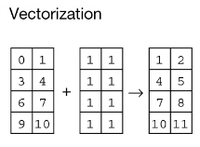
Efficiency of NumPy
Memory:
data occupies the minimum amount of memory required
some operations can be done without touching the memory at all!
Speed:
Many operations can be done very efficiently in C. For this to be useful, we need to avoid Python for-loops at all costs!
operating on entire arrays rather than their individual elements
→ “vectorize” the code
Notes:
Speed
Not only efficient storage of data but also
Numpy package comes with a efficient operations on the data done efficiently in C
Option (usually forced, when using NumPy) to operate on entire arrays rather than on their individual elements

Slide 5
NumPy’s memory efficiency

Slide 6
Memory block
The array data is stored in a contiguous memory block, using native data types
0 | 1 | 2 | 3 | 4 | 5 | 6 | 7 | 8
int64

Slide 7
Memory block
Metadata tells NumPy how to interpret the memory block
0 | 1 | 2 | 3 | 4 | 5 | 6 | 7 | 8
int64
8 bytes
24 bytes
NumPy array metadata
dtype | int64
ndim | 2
shape | (3, 3)
strides | (24, 8)

Slide 8
Memory block
Metadata tells NumPy how to interpret the memory block
0 | 1 | 2 | 3 | 4 | 5 | 6 | 7 | 8
int64
8 bytes
24 bytes
NumPy array metadata
NumPy view
dtype | int64
ndim | 2
shape | (3, 3)
strides | (24, 8)
0 | 1 | 2
3 | 4 | 5
6 | 7 | 8

Slide 9
Memory block
The same memory block can be interpreted in many ways
0 | 1 | 2 | 3 | 4 | 5 | 6 | 7 | 8
NumPy operation
NumPy view
0 | 1 | 2
3 | 4 | 5
6 | 7 | 8
What is changing?
x
x.ravel()
0 | 1 | 2 | 3 | 4 | 5 | 6 | 7 | 8
0 | 3 | 6
1 | 4 | 7
2 | 5 | 8
x.T
x[::2, ::2]
0 | 2
6 | 8
Notes:
As learned in Tiziano’s lecture, the memory block stays the same. What changes?
Metadata → how to interpret the block of memory

Slide 10

Memory block
The same memory block can be interpreted in many ways
0 | 1 | 2 | 3 | 4 | 5 | 6 | 7 | 8
NumPy operation
NumPy view
0 | 1 | 2
3 | 4 | 5
6 | 7 | 8
What is changing?
x
Only the metadata
x.ravel()
0 | 1 | 2 | 3 | 4 | 5 | 6 | 7 | 8
0 | 3 | 6
1 | 4 | 7
2 | 5 | 8
x.T
x[::2, ::2]
0 | 2
6 | 8
Notes:
As learned in Tiziano’s lecture, the memory block stays the same. What changes?

Slide 11
Memory block
Which is why some NumPy operations are super efficient, O(1)
0 | 1 | 2 | 3 | 4 | 5 | 6 | 7 | 8
NumPy operation
NumPy view
NumPy array metadata
0 | 1 | 2
3 | 4 | 5
6 | 7 | 8
dtype | int64
ndim | 2
shape | (3, 3)
strides | (24, 8)
x
dtype | int64
ndim | 1
shape | (9,)
strides | (8,)
x.ravel()
0 | 1 | 2 | 3 | 4 | 5 | 6 | 7 | 8
0 | 3 | 6
1 | 4 | 7
2 | 5 | 8
dtype | int64
ndim | 2
shape | (3, 3)
strides | (8, 24)
x.T
x[::2, ::2]
dtype | int64
ndim | 2
shape | (2, 2)
strides | (48, 16)
0 | 2
6 | 8
Notes:
The same memory block can be interpreted in many ways → that means that there are operations that cost nothing because they only change the metadata
Numpy view and operations
Operations that can only change the metadata → return a view (introduce new concept)

Slide 12

NumPy: View or copy?
Live Coding
notebooks/020_numpy/ 010_views_and_copies.ipynb
Takeaway messages:
NumPy always does the most efficient thing
Operations that only change the metadata return a view, otherwise a new memory block needs to be allocated and they return a copy

Slide 13

View or copy? If view, how is the metadata changed?
Exercise
Hands-on
exercises/view_or_copy
Operation | View?
x[::2, :]
x[1, :]
x[1]
x[[1, 2, 0], [1, 1, 2]]
x[[0, 2], :]
x.reshape((6, 2))
x.ravel()
x.T.ravel()
x[(x % 2) == 1]
y = x + 2
y = np.sort(x, axis=1)
x
0 | 1 | 2 | 3
4 | 5 | 6 | 7
8 | 9 | 10 | 11
Notes:
Notebook – delete solutions

Slide 14
Numpy – Ufuncs
Unitary
Binary
Broadcasting
- https://jakevdp.github.io/PythonDataScienceHandbook/02.05-computation-on-arrays-broadcasting.html

Slide 15
A special kind of view: broadcasting operations
Memory block
0 | 1 | 2 | 3 | 4 | 5 | 6 | 7 | 8
NumPy array metadata
dtype | int64
ndim | 2
shape | (4, 9)
strides | (0, 8)
The shape says we have 4 rows and 9 columns
A stride of 0 means that for each new row, we don’t move in memory
Notes:
Special case, when one of the strides is 0 → duplicates without occupying more memory
Transition, other operations that can

Slide 16
A special kind of view: broadcasting operations
Memory block
As a result, we obtain a view with duplicated rows, without using extra memory!
0 | 1 | 2 | 3 | 4 | 5 | 6 | 7 | 8
NumPy array metadata
NumPy view
dtype | int64
ndim | 2
shape | (4, 9)
strides | (0, 8)
The shape says we have 4 rows and 9 columns
0 | 1 | 2 | 3 | 4 | 5 | 6 | 7 | 8
0 | 1 | 2 | 3 | 4 | 5 | 6 | 7 | 8
0 | 1 | 2 | 3 | 4 | 5 | 6 | 7 | 8
0 | 1 | 2 | 3 | 4 | 5 | 6 | 7 | 8
A stride of 0 means that for each new row, we don’t move in memory
Notes:
Stride == 0 → then we are not actually moving in memory, same memory, we are looping over the same thing

Slide 17
Rules of Broadcasting
Broadcasting in NumPy follows a strict set of rules to determine the interaction between the two arrays:
Rule 1: If the two arrays differ in their number of dimensions, the shape of the one with fewer dimensions is padded with ones on its leading (left) side.
Rule 2: If the shape of the two arrays does not match in any dimension, the array with shape equal to 1 in that dimension is stretched to match the other shape.
Rule 3: If in any dimension the sizes disagree and neither is equal to 1, an error is raised.
To make these rules clear, let's consider a few examples in detail.
Notes:
Show 1,2 examples and the notebook with the rules/ their implementation

Slide 18
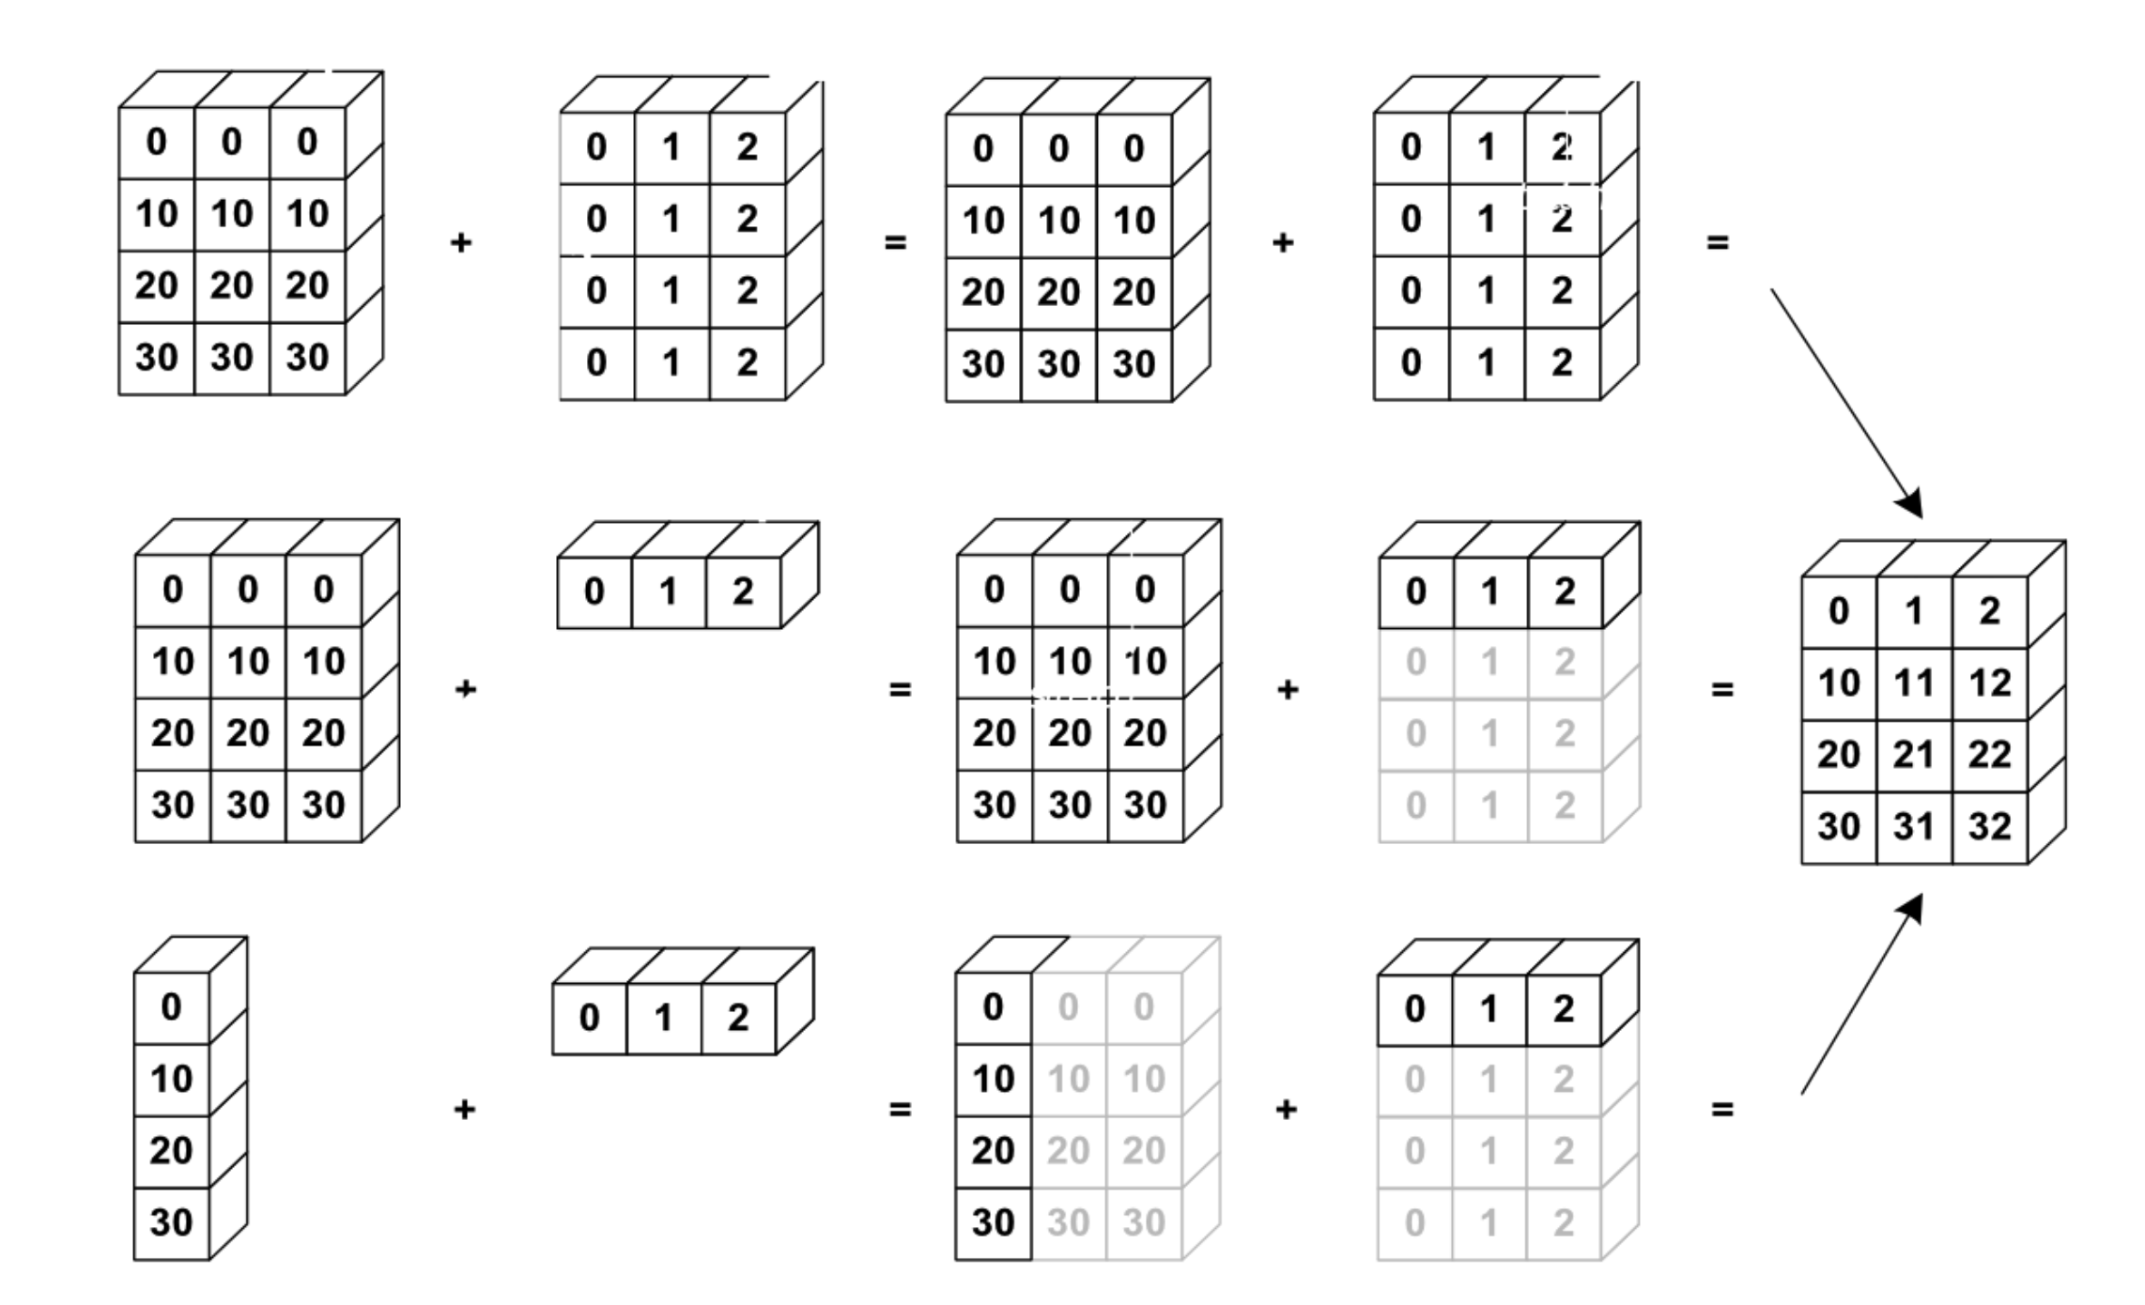
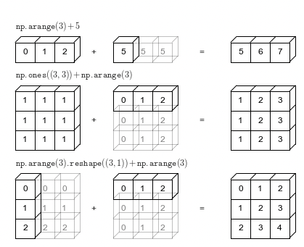
NumPy uses broadcasting to perform operation on arrays of different shape without having to allocate extra memory

Slide 19
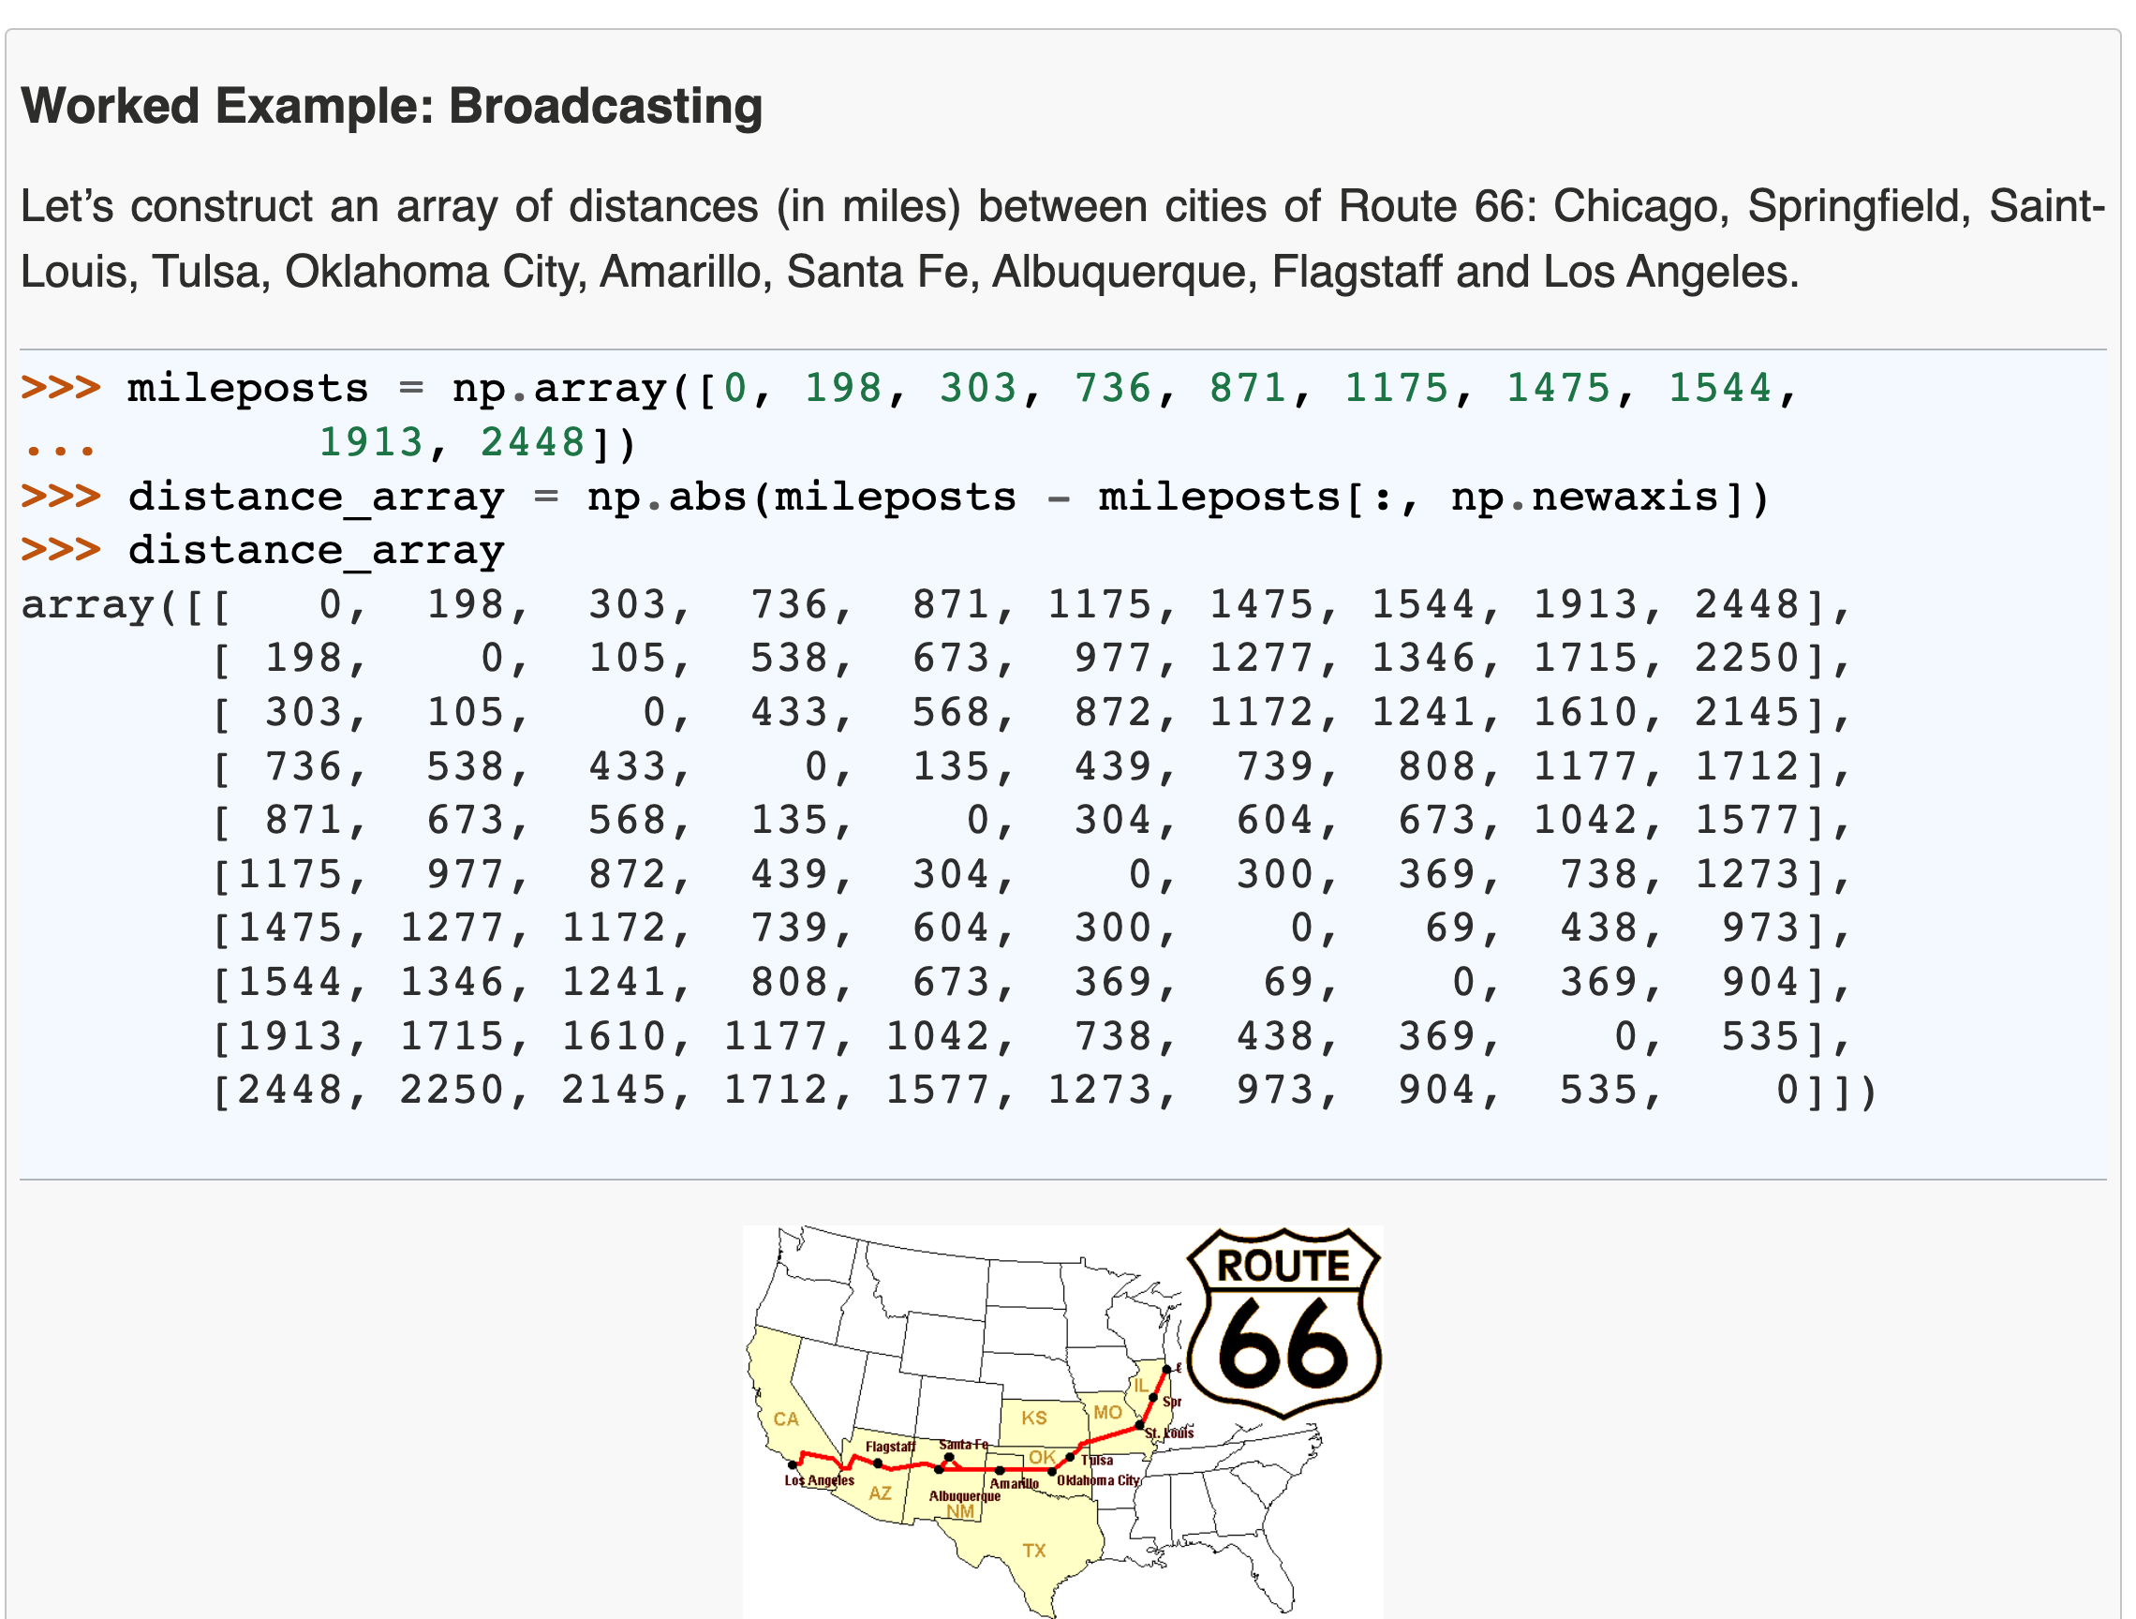
Notes:
Idea for an exercise

Slide 20
NumPy’s speed efficiency

Slide 21
For loops in C
Show how a numpy operation can be executed very fast in C
Related to memory: the data is of a C numerical type, and the layout is regular in memory. A C loop can jump from one memory location to the next by moving by “strides” bytes and accumulating the result
To get that performance, one needs to vectorize! it’s important to avoid for-loops at all costs
Question: How is efficiency of Python vs C in the Big-O sense?
Notes:
`
a = x[::2, 3]
a.sum()
start_memory_pos = a.data
a.dtype sum = 0
for i in a.shape[0]:
for j in a.shape[1]:
memory_pos = start_memory_pos + a.strides[0] * i + a.strides[1] * j
sum += cast_to(memory_pos, a.dtype)

Slide 22
Here list useful NumPy functions that help vectorize for-loop code
VM
Make a reference slide with useful things to vectorize for-loops
broadcasting
mgrid
…
Find a couple of nice examples where complicated for-loop code is nicely vectorized
Notes:
Reference slide for commands that can be used to avoid for loops

Slide 23
Exercise: give python code with for-loops and ask them to vectorize
proposal for exercise: numpy_vectorize

Slide 24
Hands on: Connecting the dots with the computer architecture class
We want to compute the sum of all elements of a sliced array, x[::step_i, ::step_j].sum() Discuss the memory and speed efficiency of this expression
Think about Verjinia and Tiziano’s architecture class
Is there any scenario where creating a copy of the sliced array could improve efficiency? x[::step_i, ::step_j].copy().sum()
see when_copying_is_convenient notebook
Keep this slide only if we can find a realistic case where this is useful, i.e. one where we don’t do
s.sum() for 1000 times
Notes:
Each element in a different memory page → slice every time you need to look at a different memory page
100 different operations on the same slice, it’s better to copy to avoid reading many memory pages
Strides larger than the memory page

Slide 25
Beyond memory (briefly, optional, probably skip)
Use memmap with NumPy (keep large array data on disk)
HFD-5 (keep large array data on disk , block-order, example from geophysics project)
blosc (compressed data) -> maybe do not present, never seen anyone use it

Slide 26
COMING UP NEXT: Tabular data

