Slide 1

The data class
Fork and clone repository
https://git.aspp.school/ASPP/2026-prague-data
Pietro Berkes & Verjinia Metodieva

Slide 2
Things one thinks about when thinking about data
Storage
Processing
Reproducibility and collaboration
Size
Access ease
Access time
Efficient processing
Organizing data so that analyses are easy
Versioning
Lineage tracing (which script / other data was used to generate this?)
Ease of sharing

Slide 3
Things one thinks about when thinking about data
Storage
Processing
Reproducibility and collaboration
Data structures
Size
Access ease
Access time
Efficient processing
Organizing data so that analyses are easy
Versioning
Lineage tracing (which script / other data was used to generate this?)
Ease of sharing

Slide 4
Hands-on What data structure would you use to represent…

Slide 5
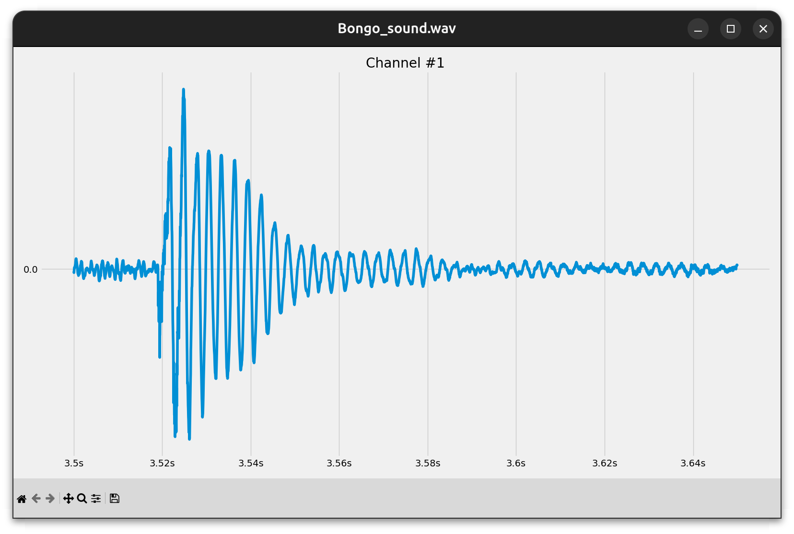
Hands-on What data structure would you use to represent…
A sound wave?

Slide 6
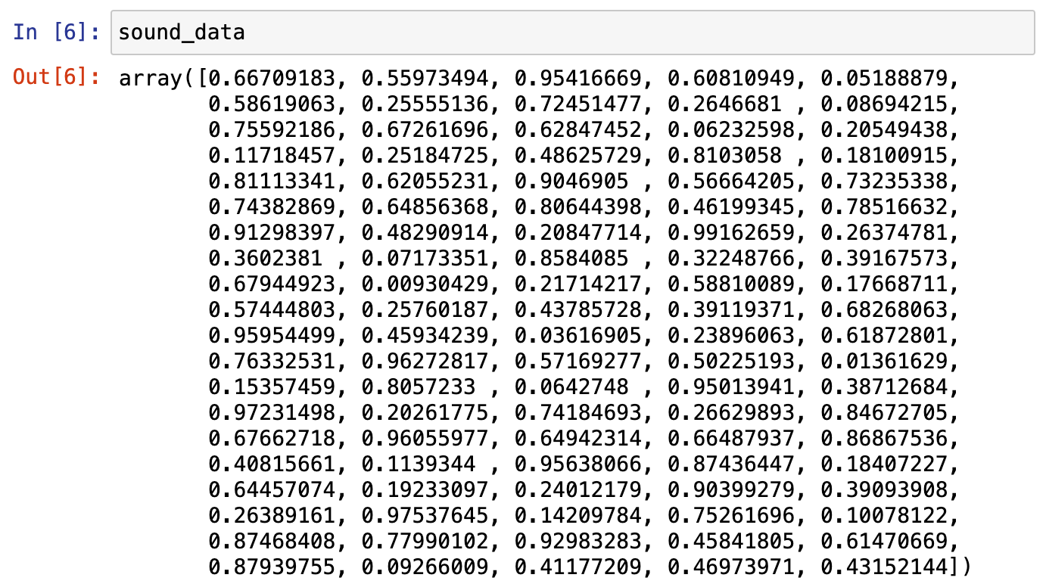
Hands-on What data structure would you use to represent…
A sound wave?
NumPy array

Slide 7
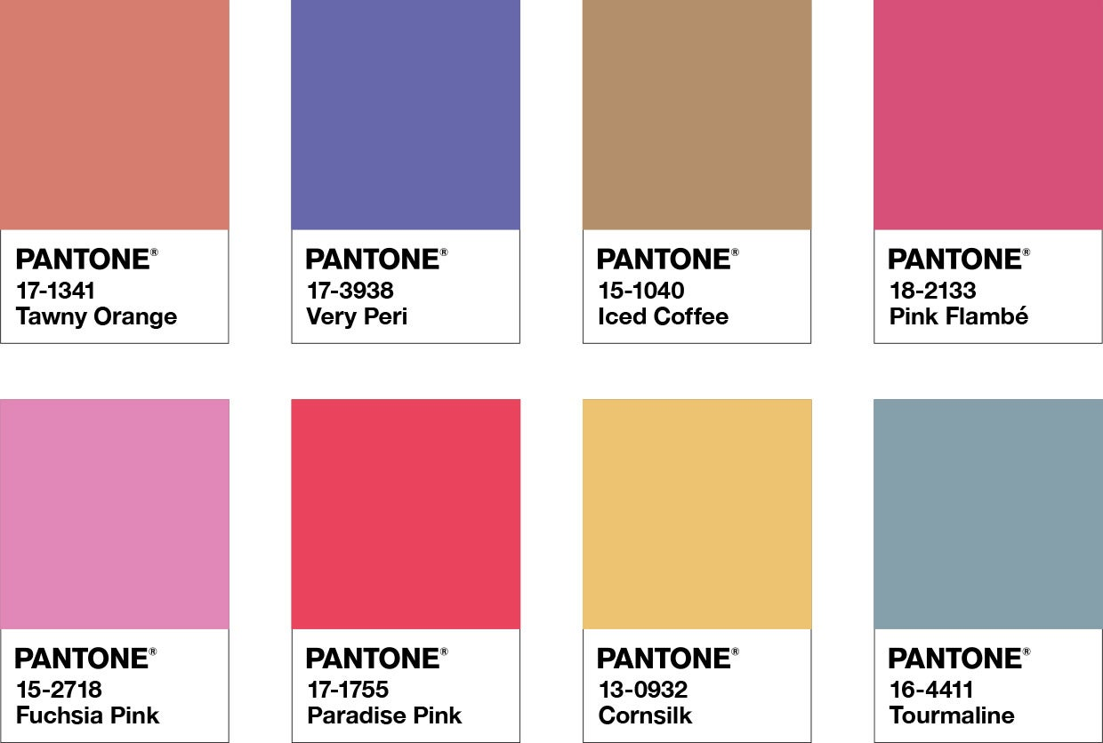
Hands-on What data structure would you use to represent…
A map between color names and RGB values?

Slide 8
Hands-on What data structure would you use to represent…
A map between color names and RGB values?
Dictionary
colors_hex = { "tawny orange": "#CD5700",
"very peri": "#6667AB",
"iced coffee": "#C5A582”,
"pink flambé": "#DC4C8B”,
# …
}

Slide 9
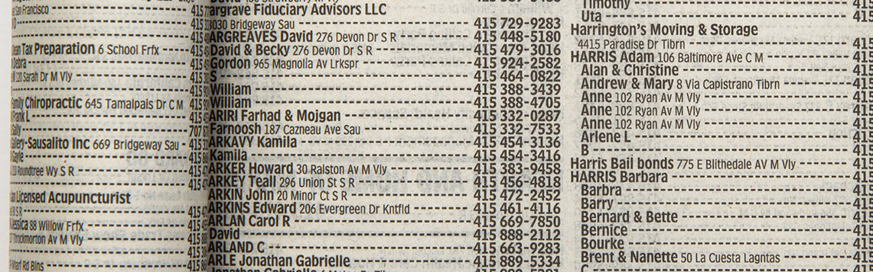
Hands-on What data structure would you use to represent…
Phone book entries?

Slide 10
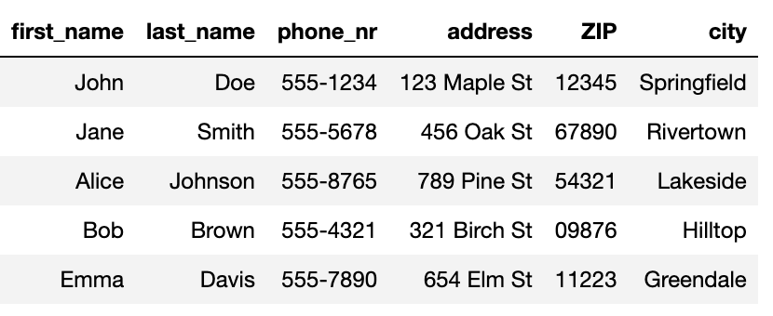
Hands-on What data structure would you use to represent…
Phone book entries?
Pandas DataFrame

Slide 11





Hands-on What data structure would you use to represent…
Friendship relations?

Slide 12
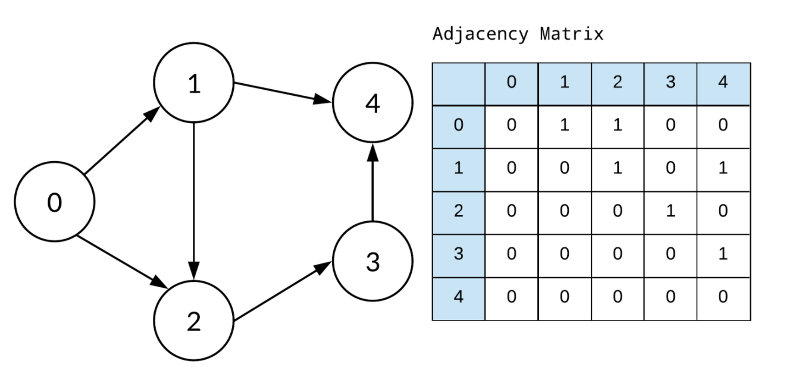
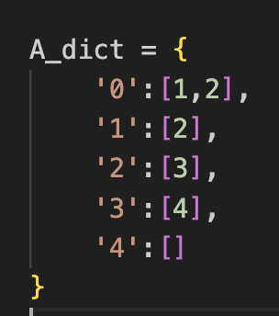
Hands-on What data structure would you use to represent…
Implemented as
Friendship relations?
Graph
Adjacency matrix (array)
Dictionary

Slide 13
You develop your code on a small data set, how is it going to scale to the complete data set?
Development data
Real data
N data points,
Processing time T
10x N data points
Processing time -> ?
We’re interested in orders of magnitude
Notes:
Data and code are related.
Nice transition from the last question. In extreme case, when the relations in the graph are dynamic/ changing a lot →using a dictionary is not a good solution. Instead, when small dataset and we are mainly interested in visualizing the relations, it might be.
The NumPy array solutions, scales much better, in case there are hundreds of dynamically changing relations to inspect.

Slide 14
Example: Find common words
Given two lists of words, extract all the words that are in common
Expected result: ['apple', 'orange', 'banana']

Slide 15
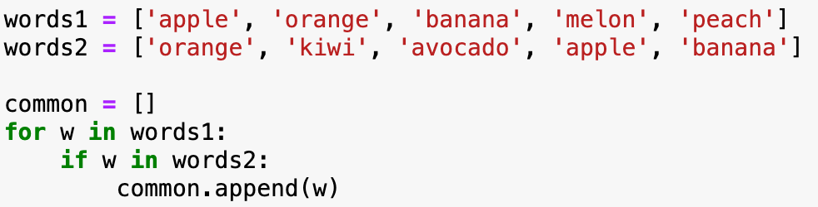
Implementation with two for-loops
How does this implementation scale?

Slide 16
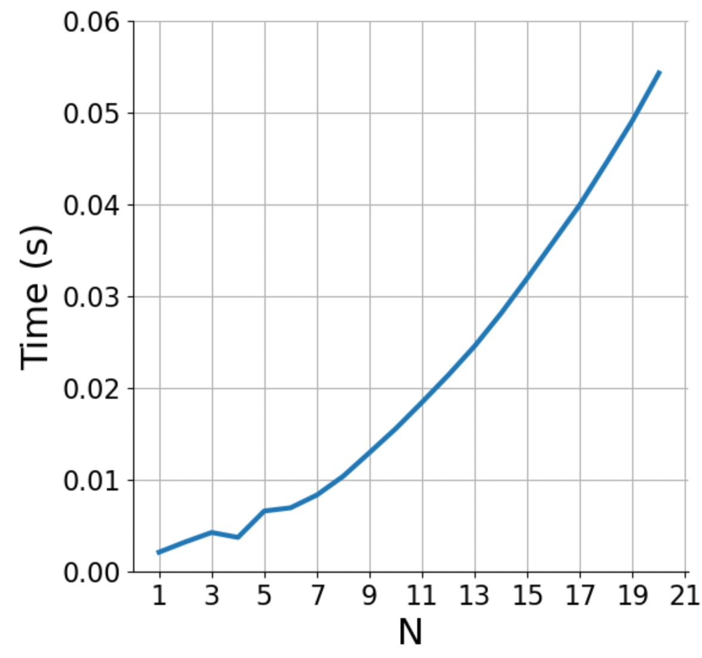
Implementation with two for-loops
# N operations
# N operations
# constant (1 operation)
How does this implementation scale?
N * N => 10x more data ~= 100x more time

Slide 17
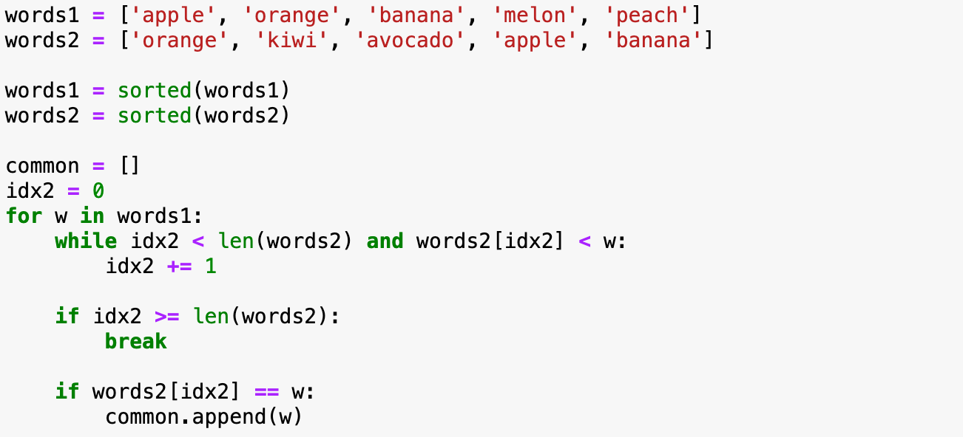
Implementation with sorted lists
How does this implementation scale?

Slide 18
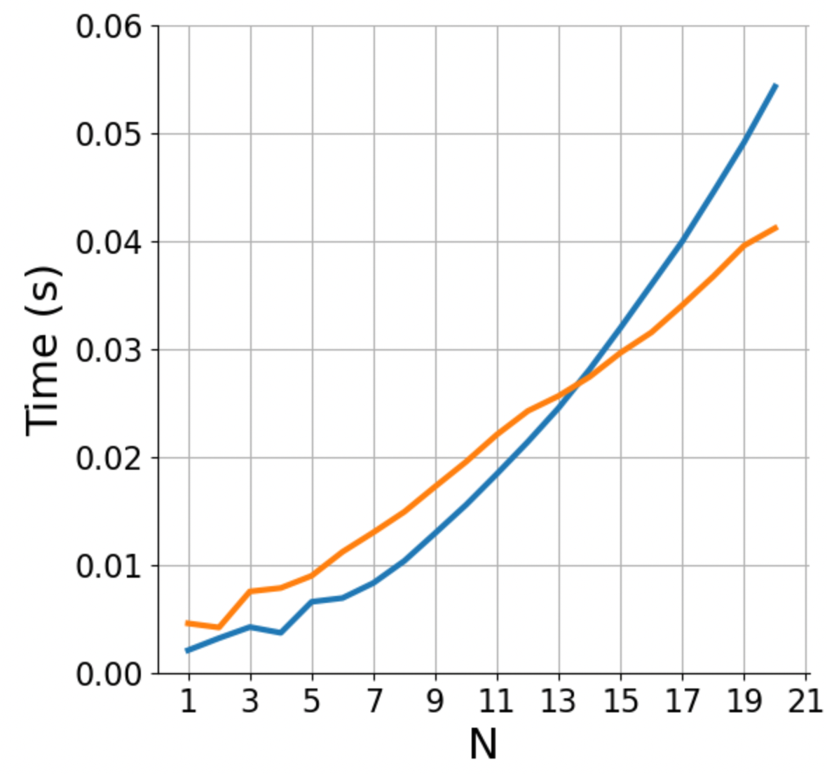

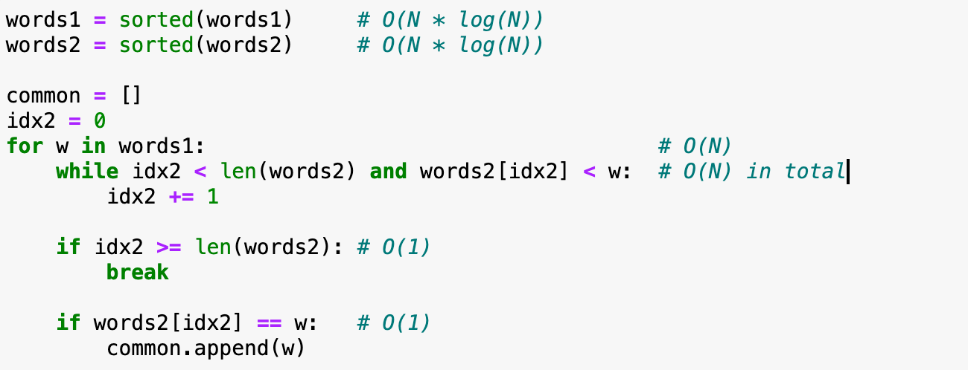
Implementation with sorted lists
# N * log(N) operations
# N * log(N) operations
# We traverse both
# lists once:
# N + N operations
How does this implementation scale?
N * log(N) => 10x more data ~= 23x more time

Slide 19
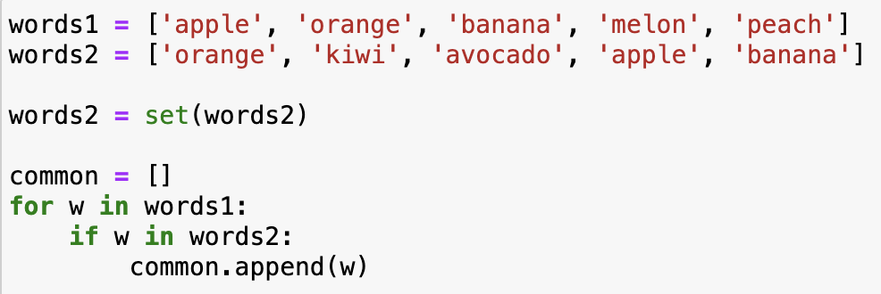
Implementation with sets
How does this implementation scale?

Slide 20
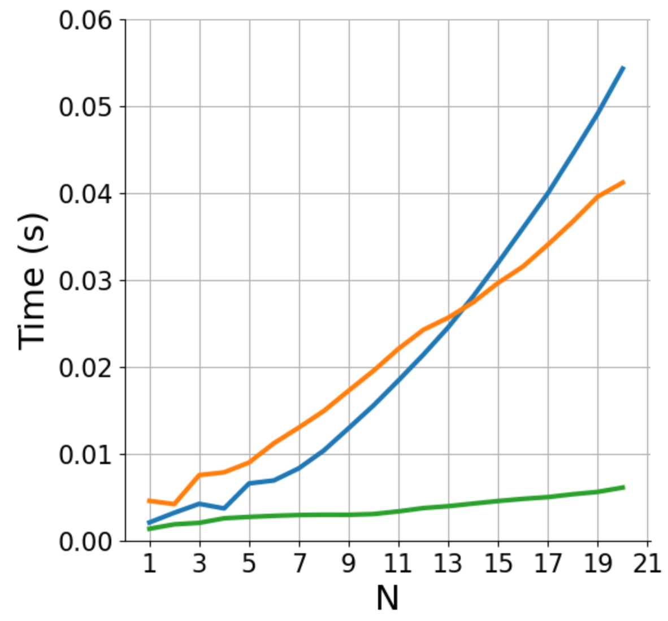
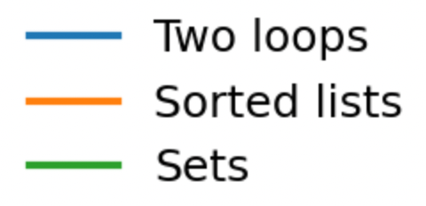
Implementation with sets
# N operations
# N operations
# constant
# constant
How does this implementation scale?
N => 10x more data ~= 10x more time

Slide 21
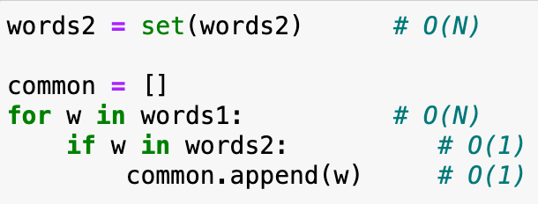
What difference does it make? N = 1’000’000
time x 1’000’000 x 1’000’000
This will never complete, even if you parallelize on 1’000 machines
# N operations
# N operations
# constant
time x 1’000’000
This will complete in seconds
# N operations
# N operations
# constant
# constant

Slide 22
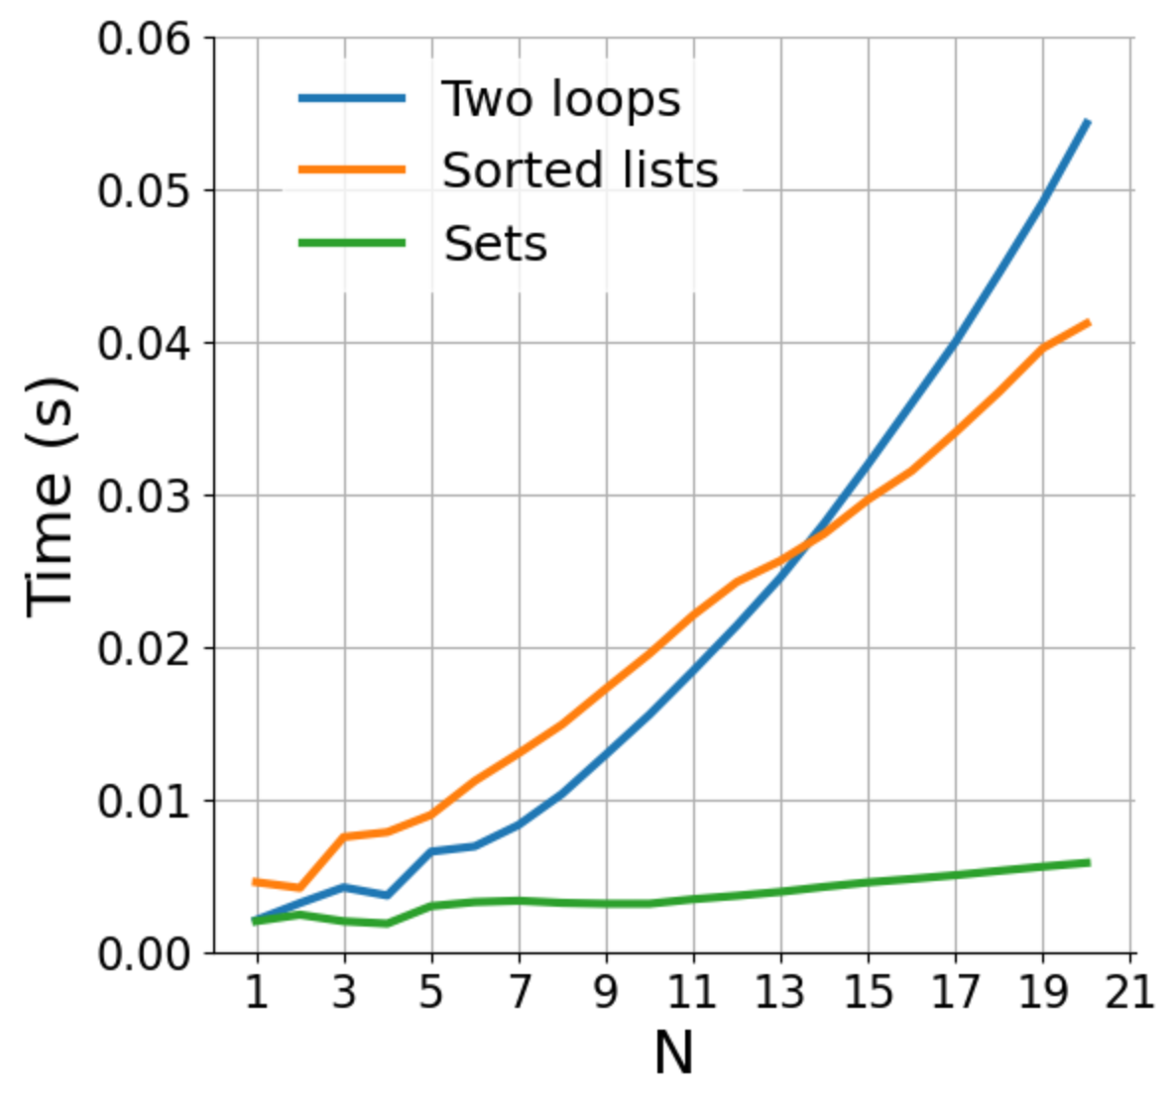
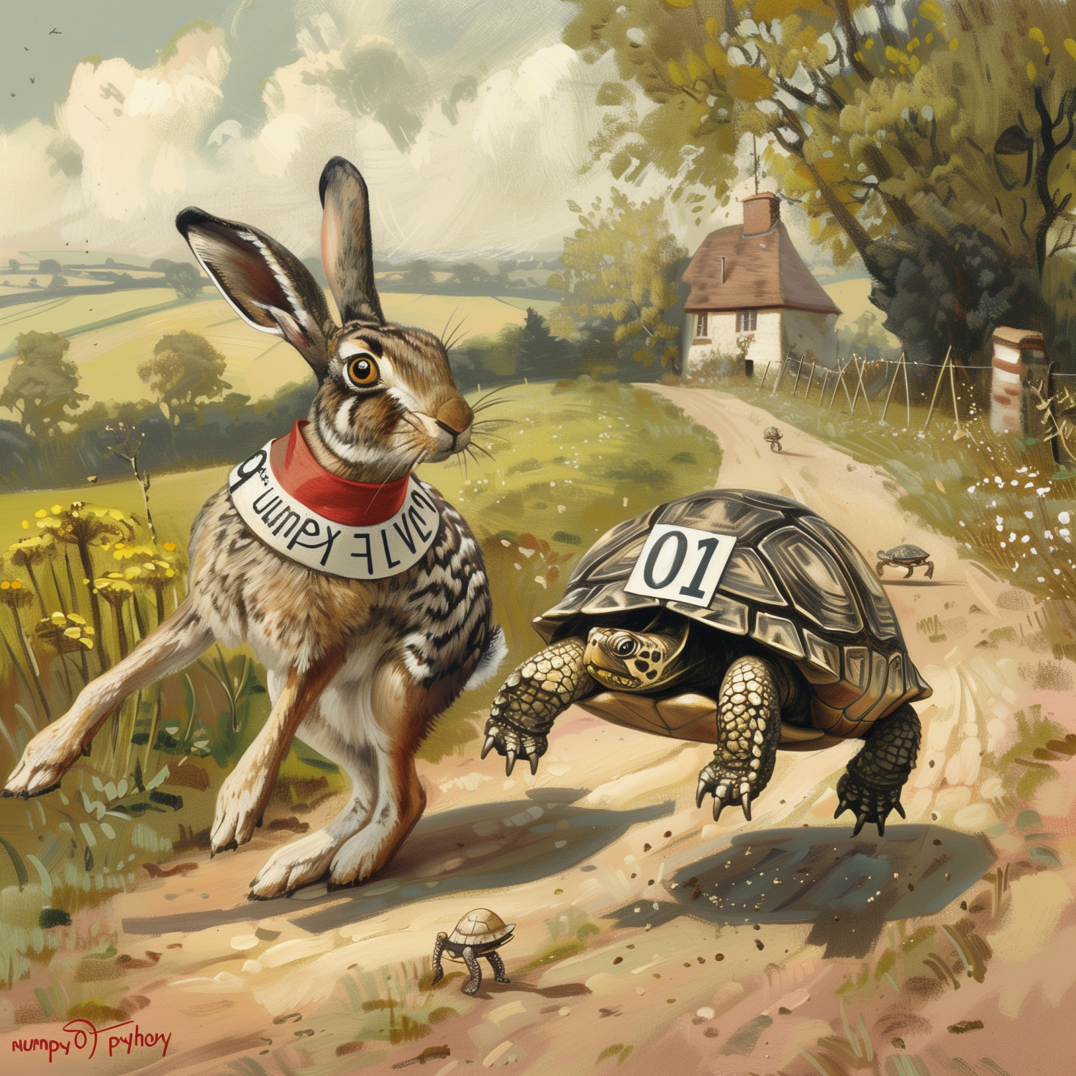
How does parallelizing change the performance? (rewriting in C, parallelization; same algorithm)
Fast code
n²
Regular code
n log n
Notes:
Parallelization lowers the curves.
For a fixed code, linear code is no necessarily faster.
Important when n is growing
Parallelization/ optimization → you can make the code faster for any fixed N, but the shape (of growth) can never change

Slide 23
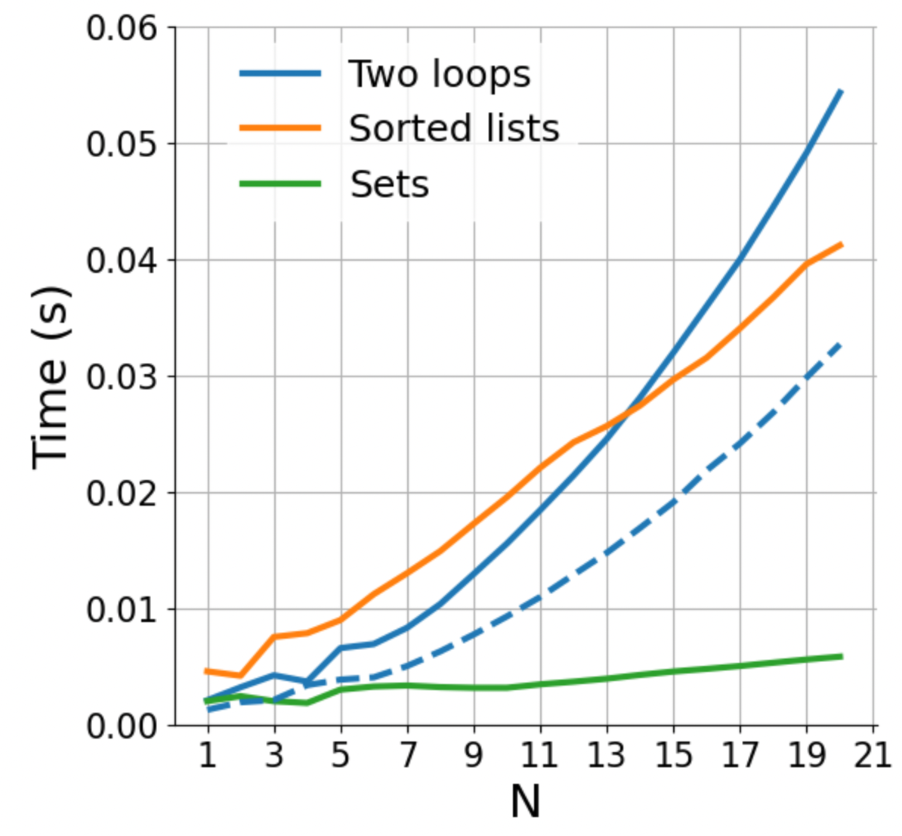
How does parallelizing change the performance? (rewriting in C, parallelization; same algorithm)
Parallelization
increases performance for fixed N
Fast code
n²
Regular code
n log n
Notes:
Parallelization lowers the curves.
For a fixed code, linear code is no necessarily faster.
Important when n is growing
Parallelization/ optimization → you can make the code faster for any fixed N, but the shape (of growth) can never change

Slide 24
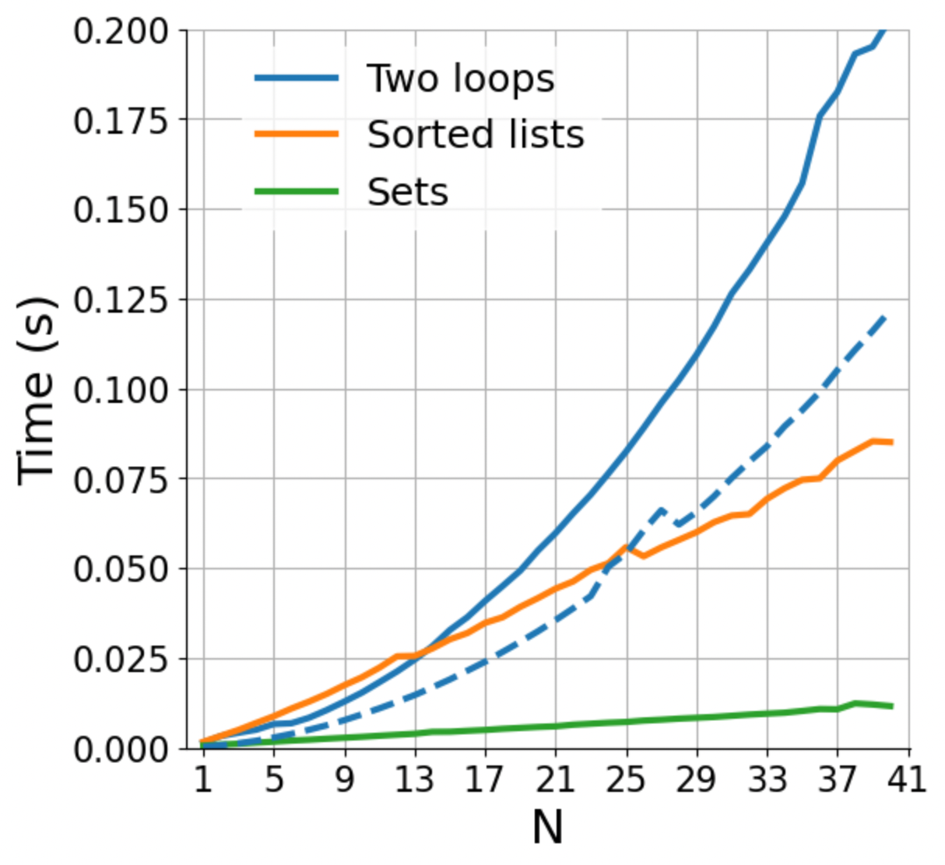
How does parallelizing change the performance? (rewriting in C, parallelization; same algorithm)
Fast code
n²
Regular code
n log n
Notes:
Parallelization lowers the curves.
For a fixed code, linear code is no necessarily faster.
Important when n is growing
Parallelization/ optimization → you can make the code faster for any fixed N, but the shape (of growth) can never change

Slide 25
How does parallelizing change the performance? (rewriting in C, parallelization; same algorithm)
Fast code
n²
We need to distinguish between “fast” in absolute terms for a fixed problem size, and “fast” in the sense of how well it scales
Regular code
n log n
Notes:
Parallelization lowers the curves.
For a fixed code, linear code is no necessarily faster.
Important when n is growing
Parallelization/ optimization → you can make the code faster for any fixed N, but the shape (of growth) can never change

Slide 26
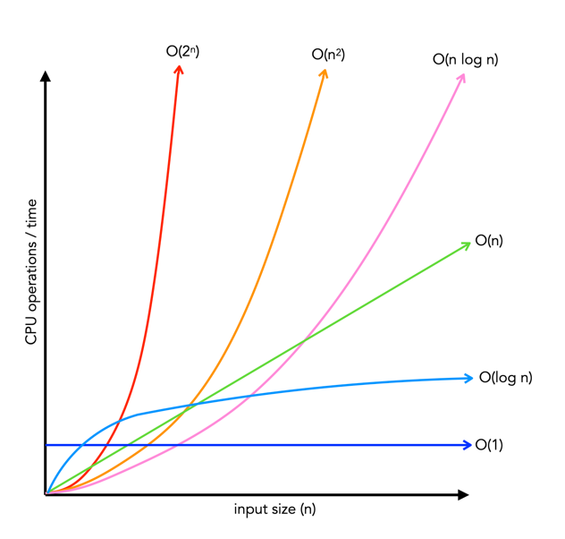
How performance scales: big-O
Big-O class | What we call it | Time increase, when data increases 10x
O(1) | constant | 1x time
O(n) | linear | 10x time
O(n²) | quadratic | 100x time
O(n * log n) | linearithmic | ~10-20x time
O(2^{n})
O(n²)
O(n log n)
O(n)
Time
O(log n)
O(1)
Input size, n

Slide 27
Basic reference sheet about Python data structures
Lists: collection of ordered, arbitrary data
Dictionaries (“hashmaps”)
Inserting | constant, O(1)
Finding a value by key (e.g., “if element in my_dict: …”) | constant, O(1)
Getting an element by index | constant, O(1)
Appending | constant, O(1)
Inserting an element at index | constant, O(1)
Sorting | O(n log n)
Finding an element (e.g., “if element in my_list: …”) | linear, O(n)
Sets: it’s dictionaries without values
Inserting | constant, O(1)
Finding a value by key (e.g., “if element in my_set: …”) | constant, O(1)
See also: https://wiki.python.org/moin/TimeComplexity
Notes:
Note that there may be different implementations of these data structures with different complexities, these are for the Python implementation.
E.g., if finding an element in a list is important, one could implement it as two dictionaries, one mapping indices to data, one mapping data to indices. Finding out the complexities of all the operations with this implementation is left as a homework.

Slide 28
Hands-on
Exercise
exercises/match_tarots
Open the notebook match_tarots, and follow the instructions!
Submit a PR for Issue #1 on git.aspp.school/ASPP/2026-prague-data

Slide 29
COMING UP NEXT: NumPy and the array data structure

Slide 31
Some data structures
list: ordered, heterogeneous storage, stack/queue, fast access by index, slow search
set: unordered
dictionary
arrays: e.g. numpy, HDF5
tables: e.g. pandas, dask, spark, SQL
graph: social network structure
tree: to rapidly search a dataset
heap
stack
queue
priority queue

