Slide 1

Tabular data
A particular type of data structure

Slide 2

Spreadsheets and databases rule the world!
Ariel Fischman holds the Guinness World Record for owning the most spreadsheet software (over 500!)
ASPP LatAm, July 2026
https://techcommunity.microsoft.com/t5/excel-blog/guinness-world-records-the-largest-collection-of-spreadsheet/ba-p/216592

Slide 3
What is tabular data?
Unlike arrays, each column can represent another type of value, with different data types
Date (index) | Wind speed | Wind direction | Rain fall (mm) | Hours of sun
7.3.2024 | 7.1 | N | 0.0 | 10
8.3.2024 | 0.3 | NW | 2.1 | 2
9.3.2024 | 1.1 | SE | 0.3 | 5
ASPP LatAm, July 2026

Slide 4
What is tabular data?
Column and rows have meaningful labels (indices) that are attached to the data for each operation
Date (index) | Wind speed | Wind direction | Rain fall (mm) | Hours of sun
7.3.2024 | 7.1 | N | 0.0 | 10
8.3.2024 | 0.3 | NW | 2.1 | 2
9.3.2024 | 1.1 | SE | 0.3 | 5
ASPP LatAm, July 2026
Notes:
One can access the data in columns and rows easily using the ‘attached’ labels

Slide 5
What is tabular data?
Date (index) | Wind speed | Wind direction | Rain fall (mm) | Hours of sun
7.3.2024 | 7.1 | N | 0.0 | 10
8.3.2024 | 0.3 | NW | 2.1 | 2
9.3.2024 | 1.1 | SE | 0.3 | 5
Subject ID (index) | Condition ID | Date | Response time (ms) | Response
VM | 732 | 7.3.2024 | 28 | LEFT
VM | 567 | 8.3.2024 | 41 | RIGHT
PB | 732 | 9.3.2024 | 73 | LEFT
ASPP LatAm, July 2026
Notes:
Here talk about how also the index can be not only numeric.

Slide 6
What is tabular data?
Does the windspeed affect response time?
Date (index) | Wind speed | Wind direction | Rain fall (mm) | Hours of sun
7.3.2024 | 7.1 | N | 0.0 | 10
8.3.2024 | 0.3 | NW | 2.1 | 2
9.3.2024 | 1.1 | SE | 0.3 | 5
Subject ID (index) | Condition ID | Date | Response time (ms) | Response
VM | 732 | 7.3.2024 | 28 | LEFT
VM | 567 | 8.3.2024 | 41 | RIGHT
PB | 732 | 9.3.2024 | 73 | LEFT
ASPP LatAm, July 2026
Notes:
And having columns containing the same information in two dataframes allows s to ask questions that require consideration of the data from both

Slide 7
Many tools to handle tabular data
Python tools
pandas: in-memory tabular data
dask: on-disk tabular data
SQL databases
Optimized for retrieving rows (tree data structure for index)
Transactional: groups of operations are either all executed, or none
Columnar DBs, Spark, Hadoop
Optimized for operations on columns
Ideal for data science tasks
Operations can be automatically distributed over multiple machines
ASPP LatAm, July 2026

Slide 8

Many tools to handle tabular data
Python tools
pandas: in-memory tabular data
dask: on-disk tabular data
SQL databases
Optimized for retrieving rows (tree data structure for index)
Transactional: groups of operations are either all executed, or none
Columnar DBs, Spark, Hadoop
Optimized for operations on columns
Ideal for data science tasks
Operations can be automatically distributed over multiple machines
Today we will see an example in pandas,
but the reasoning we will see are general
and apply to all of them
ASPP LatAm, July 2026

Slide 9
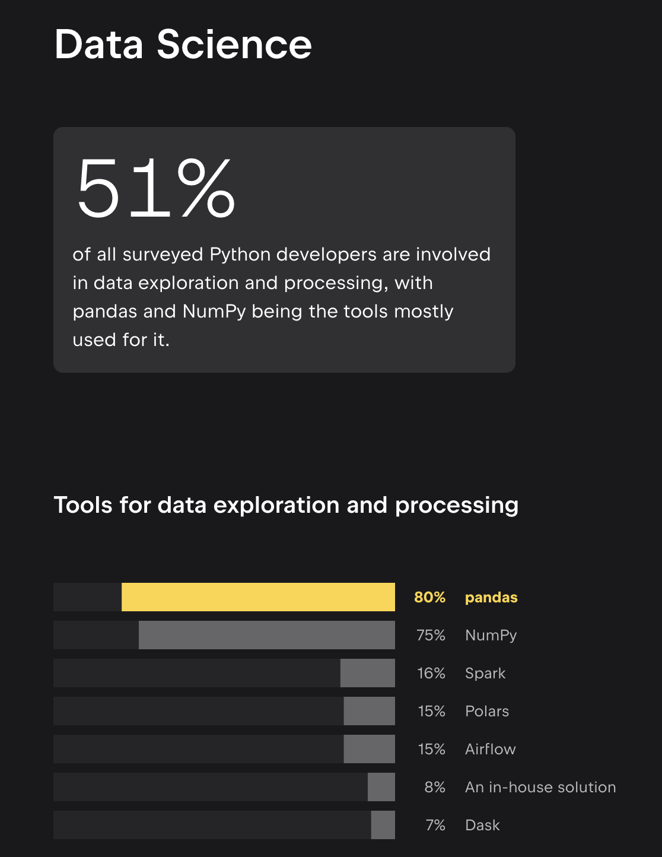
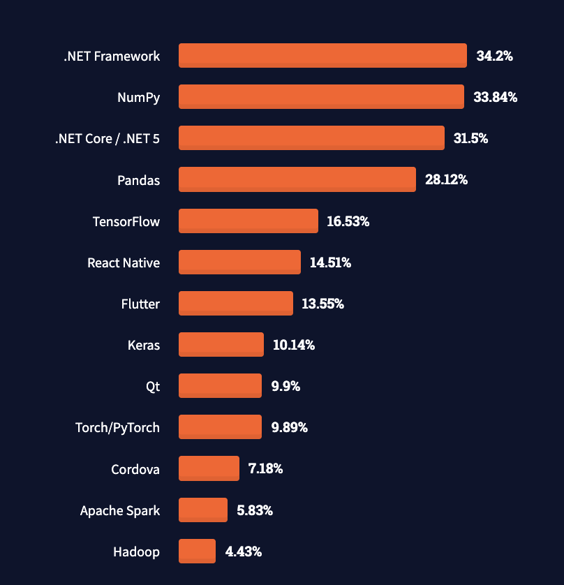
Why pandas?
Stack overflow survey 2021
Which other frameworks and libraries have
you done extensive development work in
over the past year, and which do you want
to work in over the next year?
https://survey.stackoverflow.co/2021?most-popular-technologies-misc-tech#overview
https://lp.jetbrains.com/python-developers-survey-2024/
ASPP LatAm, July 2026
Notes:
Message: concepts are not specific to pandas but general.
Not go into detail but mention that other languages or frameworks use similar concepts (e.g. SQL)

Slide 10

Hands-on
Create a single table combining the information from the two separate tabular data files
predimed_records.csv
&
predimed_locations.csv
Exercise 20 minutes
exercises/tabular_join/tabular_join.ipynb
ASPP LatAm, July 2026
Notes:
Explain the exercise. Focus on thinking about the big O complexity and different solutions

Slide 11
Hands-on
Create a single table combining the information from the two separate tabular data files
predimed_records.csv
&
predimed_locations.csv
Extra: what happens if we increase the table size? How is the performance of your solution affected?
Exercise 20 minutes
exercises/tabular_join/tabular_join.ipynb
ASPP LatAm, July 2026
Notes:
Explain the exercise. Focus on thinking about the big O complexity and different solutions

Slide 12
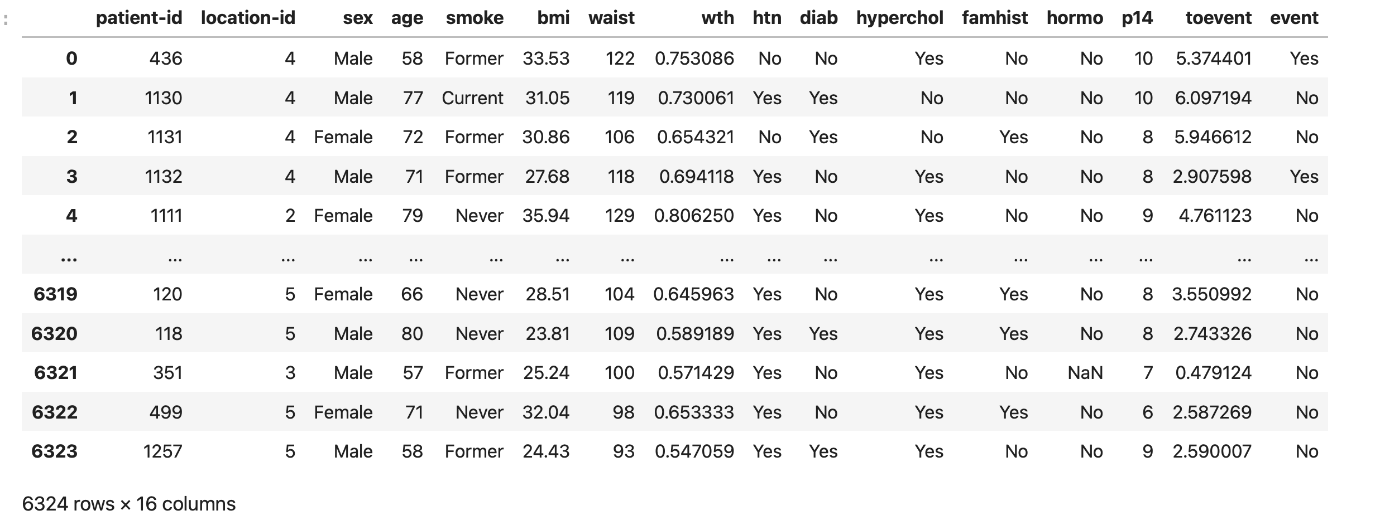
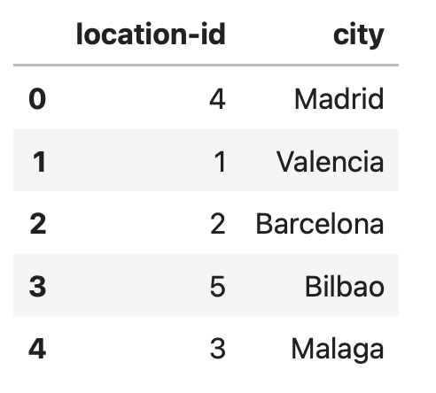
Tabular data join and performance
predimed_records
6324 (N) rows
16 columns
predimed_locations
5 (M) rows
3 columns
ASPP LatAm, July 2026

Slide 13
Solution
predimed_records.csv
N rows
predimed_locations.csv
M rows

Slide 14
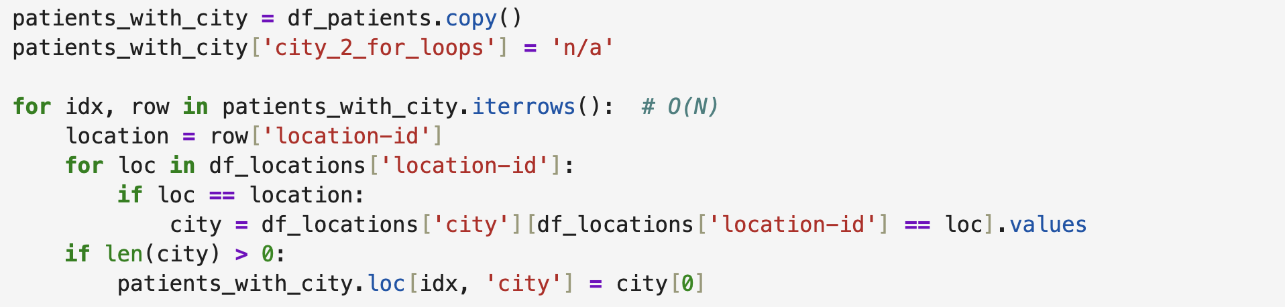
Solution
predimed_records.csv
N rows
O(N)
predimed_locations.csv
M rows

Slide 15
Solution
predimed_records.csv
N rows
O(N)
O(M)
predimed_locations.csv
M rows

Slide 16
Solution O(N*M)
two for-loops: O(N*M)
N rows
O(N)
O(M)
predimed_locations.csv
M rows
Notes:
Add plot

Slide 17
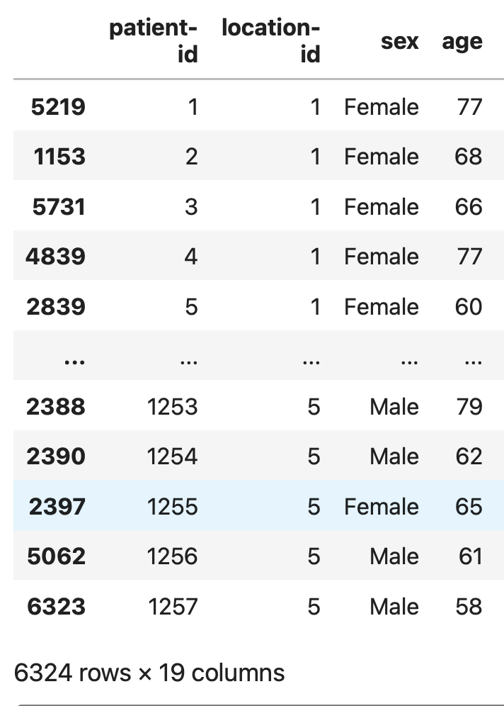
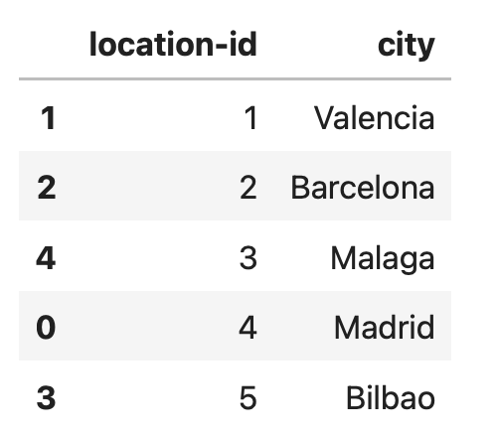
Solution sort
predimed_records.csv
N rows
N rows
sort on
location-id
predimed_locations.csv
M rows
M rows

Slide 18
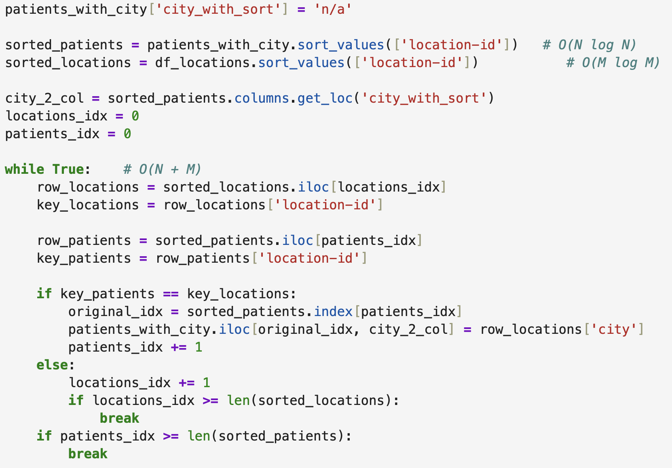
Solution sort
predimed_records.csv
O(N log N)
O(M log M)
N rows
predimed_locations.csv
M rows

Slide 19
Solution sort
predimed_records.csv
O(N log N)
O(M log M)
N rows
O(N +M)
predimed_locations.csv
M rows

Slide 20
Solution sort
O(N log N)
two for-loops: O(N*M)
sorted for loop: O(N log N + M log M)
O(M log M)
N rows
O(N +M)
predimed_locations.csv
M rows
Notes:
Add plot

Slide 21
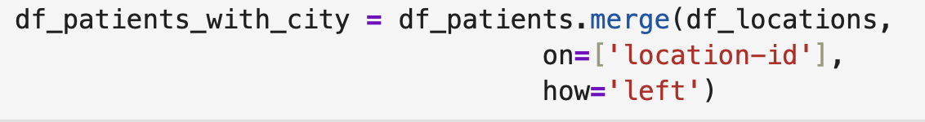
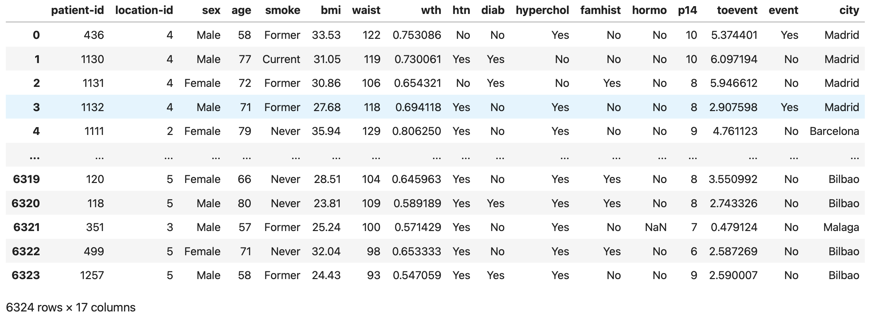
Solution join operation
Notes:
Explain what does this do by hand:
Creates a lookup table (something like a dictianry) from the location-id dataframe
Then goes through all of the rows of the patients_df dataframe (O(N) and looks up the location-id in the dictionary

Slide 22


Solution join operation
Documentation pandas.DataFrame.merge
https://pandas.pydata.org/pandas-docs/stable/reference/api/pandas.DataFrame.merge.html
column or index level
names to join on,
found in both dataframes
type of merge to be performed. Here the keys and the order of the left dataframe df_patients are kept

Slide 23
Solution join operation
Documentation pandas.DataFrame.merge
https://pandas.pydata.org/pandas-docs/stable/reference/api/pandas.DataFrame.merge.html
two for-loops: O(N*M)
sorted for loop: O(N log N + M log M)
join operation: O (N + M)
column or index level
names to join on,
found in both dataframes
type of merge to be performed. Here the keys and the order of the left dataframe df_patients are kept

Slide 24
Common operations on tabular data
Combine information across tables (join, anti-join)
Join: e.g., combine table with experiments results with table with experiments metadata (date, location, experimenter, free-form notes, …)
Anti-join: e.g. student compiles list of outliers, exclude them from the table of experiments to analyze vectorized ope
ASPP LatAm, July 2026

Slide 25
Common operations on tabular data
Combine information across tables (join, anti-join)
Join: e.g., combine table with experiments results with table with experiments metadata (date, location, experimenter, free-form notes, …)
Anti-join: e.g. student compiles list of outliers, exclude them from the table of experiments to analyze
Summary tables (split-apply-combine)
E.g., compute average measurement and standard deviation by experimental condition and treatment dosageuse vectorized operations
ASPP LatAm, July 2026

Slide 26
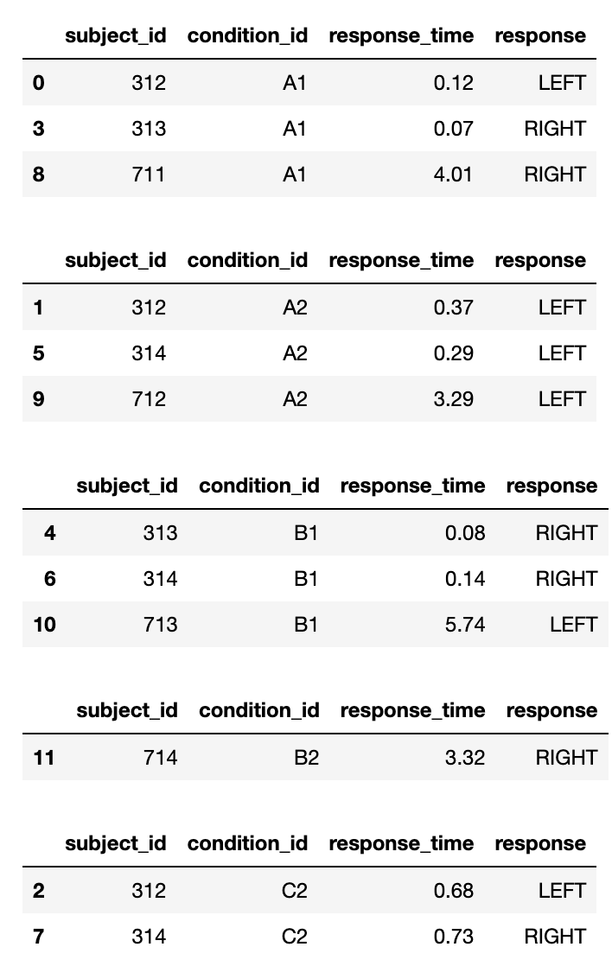
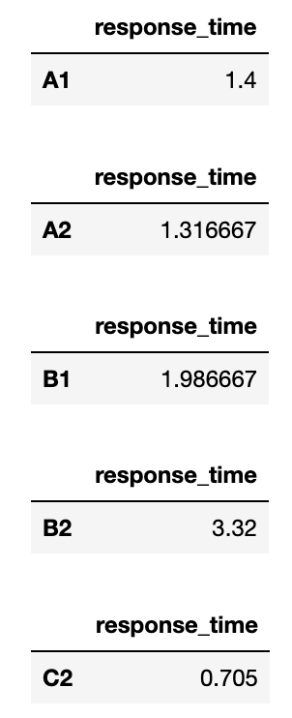
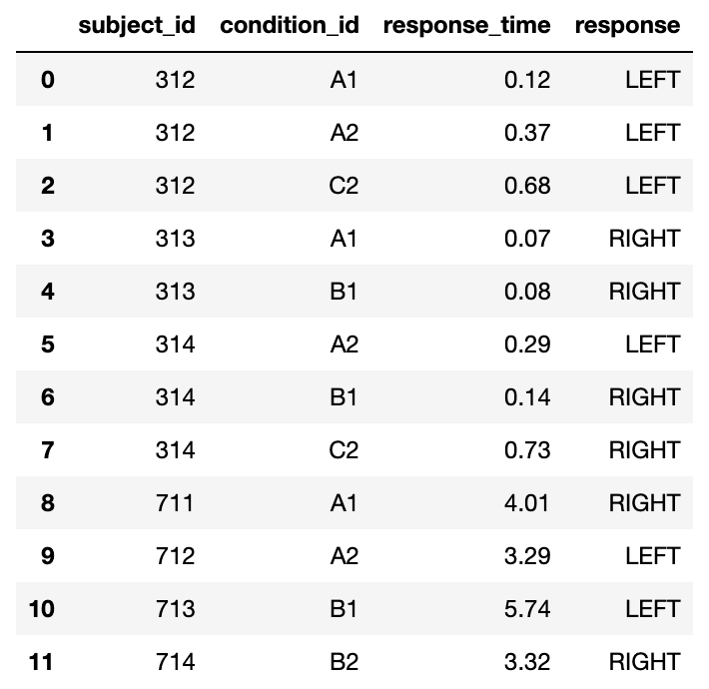
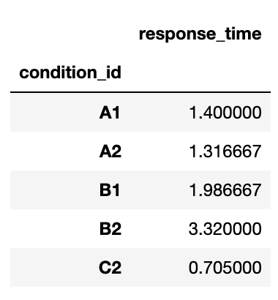
The basic structure of most numerical analyses
split
apply
combine
A1
A2
mean
B1
B2
C2
ASPP LatAm, July 2026

Slide 27
df.groupby(‘condition_id’)[‘response_time’].mean()
split
apply
combine
A1
A2
mean
B1
B2
C2
ASPP LatAm, July 2026

Slide 28
Split-apply-combine
Tabular data tools vectorize the standard split-apply-combine operations, using a “group-by” command
In addition, pandas has a “pivot-table” command that can be used to simplify the creation of more complex summary tables
ASPP LatAm, July 2026

Slide 29
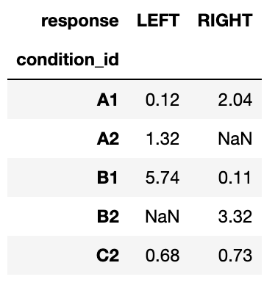
data.pivot_table( index = 'condition_id', columns = 'response', values = 'response_time', aggfunc = 'mean',
)
split
apply
combine
ASPP LatAm, July 2026

Slide 30
Hands-on
Pt1: Work with the dataset from the previous exercise to answer the question: Is the mediterranean diet associated with less cardiovascular events?
Exercise pt 1: 15 minutes
exercises/tabular_split_apply_combine/split_apply_combine_part1.ipynb
ASPP LatAm, July 2026
Notes:
Plan:
- Explain the solutions easily

Slide 31
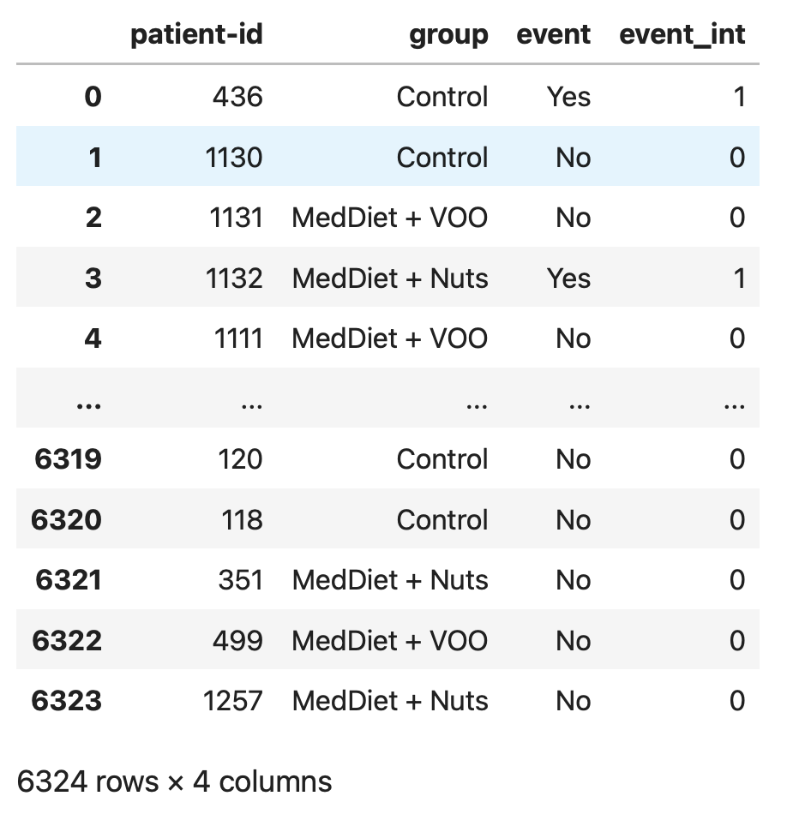
Split-apply-combine operations and performance
ASPP LatAm, July 2026
Notes:
Conclusion:
Don’t do for-loops
If you’re doing for-loops, you’re doing it wrong.

Slide 32
df_patients.groupby(‘group’)[‘event_int’].sum()
split
by diet group
apply
sum() of event counts
combine
ASPP LatAm, July 2026
Notes:
Conclusion:
Don’t do for-loops
If you’re doing for-loops, you’re doing it wrong.

Slide 33
Hands-on
Pt1: Work with the dataset from the previous exercise to answer the question: Is the mediterranean diet associated with less cardiovascular events?
Pt2: Work with the predimed_smokers.csv dataset to answer the question: What is the mean age per diet group?
Exercise pt 1: 15 minutes
exercises/tabular_split_apply_combine/split_apply_combine_part1.ipynb
Exercise pt 2: 7 minutes
exercises/tabular_split_apply_combine/split_apply_combine_part2.ipynb
ASPP LatAm, July 2026

Slide 34
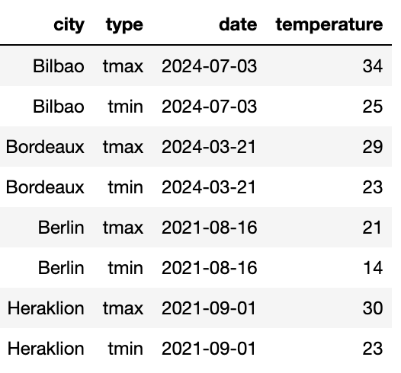
Messy data
Variables are stored in both rows and columns
😱
ASPP LatAm, July 2026

Slide 35
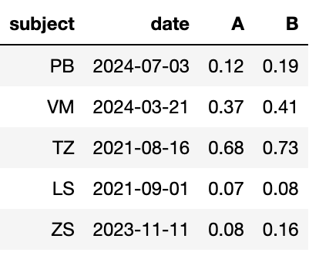
Messy data
Variables are stored in both rows and columns
😱
Column headers are values, not variable names
😱
ASPP LatAm, July 2026

Slide 36
Messy data
Variables are stored in both rows and columns
Some variables are stored in the file names
😱
😱
Column headers are values, not variable names
2024-01_prices_DE.csv 2024-01_prices_FR.csv 2024-02_prices_DE.csv 2024-02_prices_FR.csv
😱
ASPP LatAm, July 2026

Slide 37
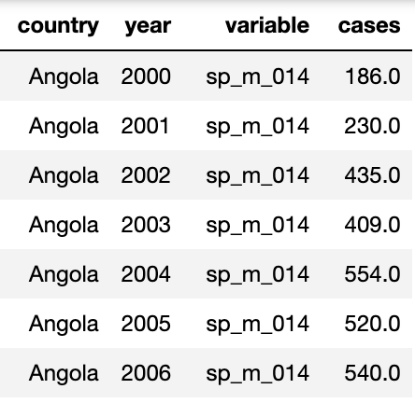
Messy data
Variables are stored in both rows and columns
Some variables are stored in the file names
😱
😱
Multiple variables are stored in one column
Column headers are values, not variable names
2024-01_prices_DE.csv 2024-01_prices_FR.csv 2024-02_prices_DE.csv 2024-02_prices_FR.csv
😱
😱
ASPP LatAm, July 2026

Slide 38
Messy data
“Tidy datasets are all alike but every messy dataset is messy in its own way” – Hadley Wickham
Variables are stored in both rows and columns
Some variables are stored in the file names
😱
😱
Multiple variables are stored in one column
Column headers are values, not variable names
2024-01_prices_DE.csv 2024-01_prices_FR.csv 2024-02_prices_DE.csv 2024-02_prices_FR.csv
😱
😱
ASPP LatAm, July 2026

Slide 39
Tidy Data
ASPP LatAm, July 2026

Slide 40
Tidy data
In tidy data:
1. Each variable forms a column 2. Each observation forms a row 3. Each type of observational unit forms a table
Variables (or features, attributes)
Variables increase when new types of measurements are introduced
Subject ID | Condition ID | Date | Response time (ms) | Response
VM | 732 | 7.3.2024 | 28 | LEFT
VM | 732 | 8.3.2024 | 41 | RIGHT
PB | 665 | 9.3.2024 | 73 | LEFT
Observations (or samples)
Observations increase when new units (dates, subjects, …) are measured
ASPP LatAm, July 2026

Slide 41
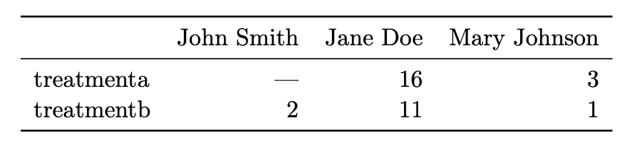
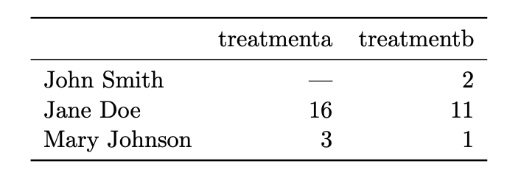
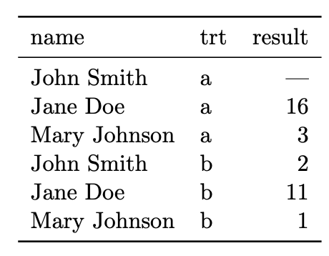
Hands on: Same data, different organization Which one is best for data analysis?
ASPP LatAm, July 2026

Slide 42
Hands on: Same data, different organization Which one is best for data analysis?
What do we want?
We want data to be in a natural format, such that we can make use of the optimizations already built in the library
(as we have already seen)
ASPP LatAm, July 2026

Slide 43
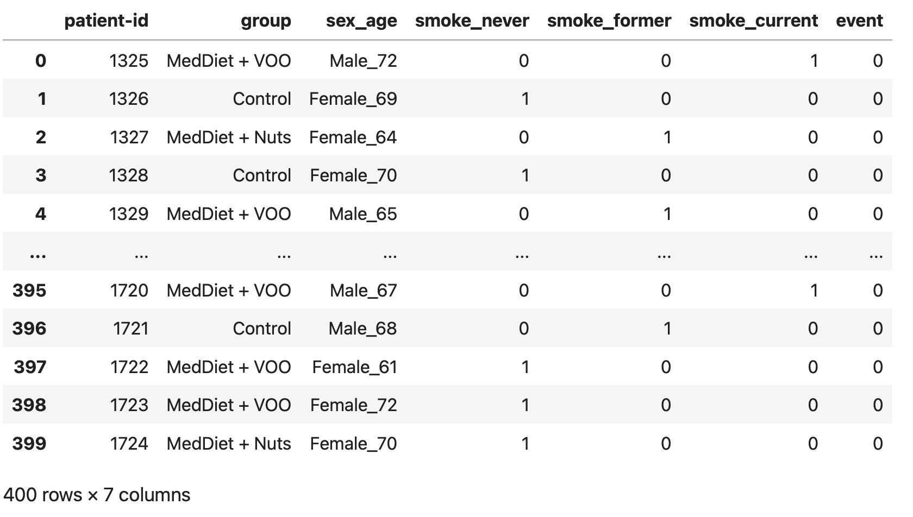
Back to the exercise
What is wrong with this data?

Slide 44
Pt2: Work with the predimed_smokers.csv dataset to answer the question:
What is the mean age per diet group?
Exercise pt 2: 7 minutes
exercises/tabular_split_apply_combine/split_apply_combine_part2.ipynb

Slide 45
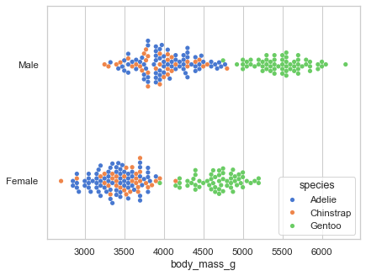
Why is tidy data good?
sns.swarmplot(
data=df,
x="body_mass_g",
y="sex",
hue="species”,
)
Many analyses require a simple sequence of steps:
Filter by individual variables to discard data that is not needed
Group and summarize
Re-arrange (e.g. sort)
Visualize
Joining tidy tables is easy!
One can write generic code that takes tidy data as input. For example, seaborn relies on tidy data to make complex plots
ASPP LatAm, July 2026

Slide 46
Common operations on tabular data
Combine information across tables (join, anti-join)
Join: e.g., combine table with experiments results with table with experiments metadata (date, location, experimenter, free-form notes, …)
Anti-join: e.g. student compiles list of outliers, exclude them from the table of experiments to analyze
ASPP LatAm, July 2026

Slide 47
Common operations on tabular data
Combine information across tables (join, anti-join)
Join: e.g., combine table with experiments results with table with experiments metadata (date, location, experimenter, free-form notes, …)
Anti-join: e.g. student compiles list of outliers, exclude them from the table of experiments to analyze
Summary tables (split-apply-combine)
E.g., compute average measurement and standard deviation by experimental condition and treatment dosage
ASPP LatAm, July 2026

Slide 48
Common operations on tabular data
Combine information across tables (join, anti-join)
Join: e.g., combine table with experiments results with table with experiments metadata (date, location, experimenter, free-form notes, …)
Anti-join: e.g. student compiles list of outliers, exclude them from the table of experiments to analyze
Summary tables (split-apply-combine)
E.g., compute average measurement and standard deviation by experimental condition and treatment dosage
ASPP LatAm, July 2026

Slide 49
Common operations on tabular data
Combine information across tables (join, anti-join)
Join: e.g., combine table with experiments results with table with experiments metadata (date, location, experimenter, free-form notes, …)
Anti-join: e.g. student compiles list of outliers, exclude them from the table of experiments to analyze
Summary tables (split-apply-combine)
E.g., compute average measurement and standard deviation by experimental condition and treatment dosage
Window functions to vectorize complex computations over groups
E.g., compute some operation considering more than one row at the time
ASPP LatAm, July 2026

Slide 50
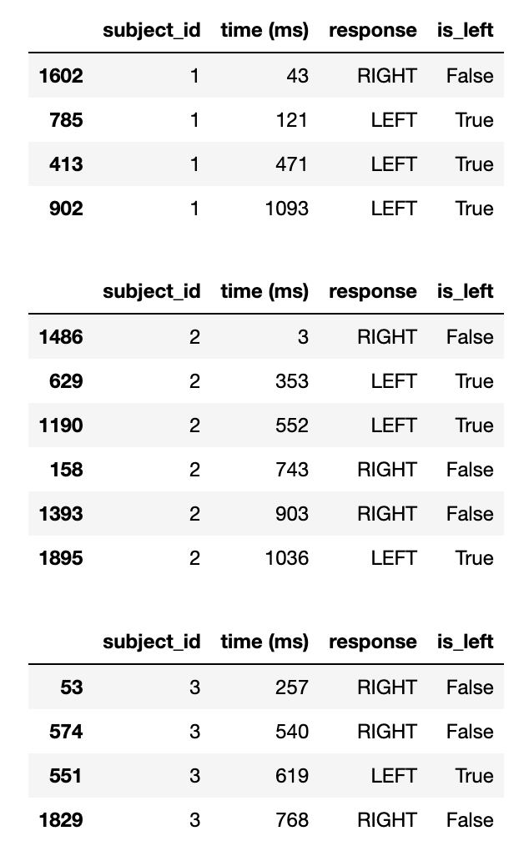
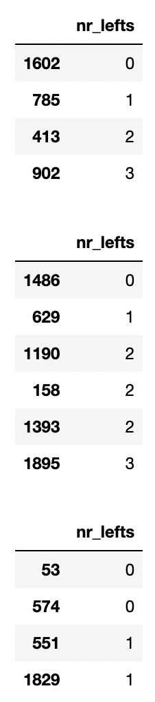
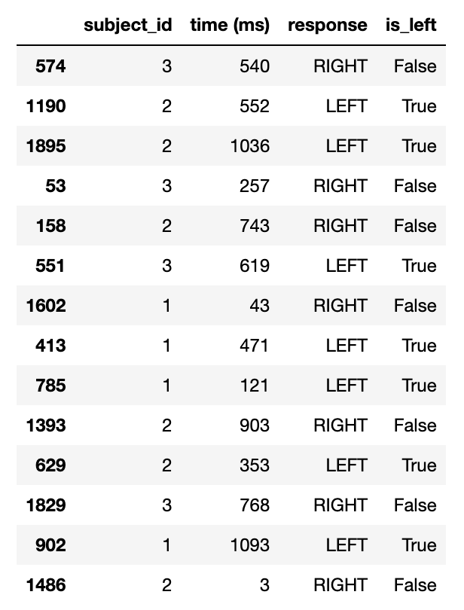
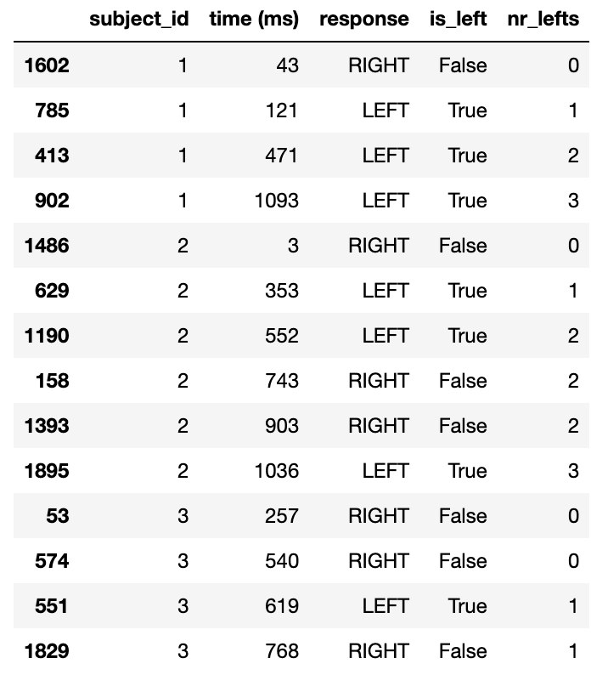
Window functions operations
df['nr_lefts'] = df.sort_values('time (ms)').groupby('subject_id')['is_left'].cumsum()
ASPP LatAm, July 2026
Notes:
Window functions perform row-by-row operations on grouped data
They are an advanced way of avoiding for loops with tabular data
In Pandas, they can be achieved with a combo of sorting and grouping-by

Slide 51
Common operations on tabular data
Combine information across tables (join, anti-join)
Join: e.g., combine table with experiments results with table with experiments metadata (date, location, experimenter, free-form notes, …)
Anti-join: e.g. student compiles list of outliers, exclude them from the table of experiments to analyze
Summary tables (split-apply-combine)
E.g., compute average measurement and standard deviation by experimental condition and treatment dosage
Window functions to vectorize complex computations over groups
E.g., compute some operation considering more than one row at the time
→ Libraries are optimized to operate on tabular data
→ The goal of today was to introduce some of these vectorized operations and why it is important to use them
ASPP LatAm, July 2026

Slide 52
Global summary
There are many different data structures, each specialized in efficiently processing one type of data.
Code performance grows differently with data size: Big-O
NumPy array efficiently store data in a C-native memory block, interpreted as an array using some metadata.
NumPy operations that only need to change the metadata do so, creating a view of the same memory block. These operations are O(1)!
Tabular data can also be vectorized using joins, anti-joins, split-apply-combine operations, and window functions.
For these operations to be efficient and painless, data should be stored in a tidy data format.
ASPP LatAm, July 2026
Notes:
1 st bullet point. Like in a house there are specialized rooms for ‘processing’ different action, you’d rarely watch TV in the bathroom, you can. But you don’t do it. And you’d never do what you do in the toile tin the living room.

Slide 53
Dealing with changes in the data
Recommendations:
NEVER overwite a data file. Treat data files as immutable
Use versioning for changes in the data file, and load the latest version for new analyses, old versions to reproduce previous results
(pond is a library Pietro is working on to automatize this process)
Like in computer code:
Adding new columns / rows is generally okey
Deleting/changing a column is not! Code will break! Add a new column instead
ASPP LatAm, July 2026

Slide 54

Thank you!
ASPP LatAm, July 2026

Slide 56
OLD SLIDES FROM HERE ONWARDS

Slide 57
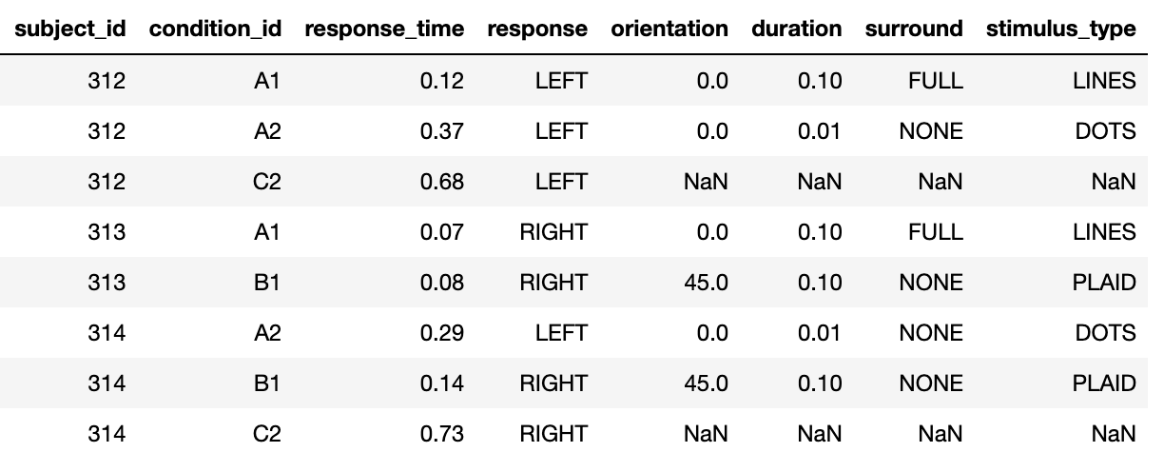
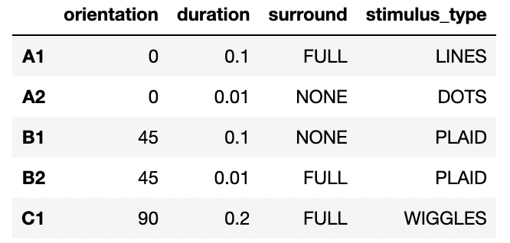
Join operations: combining informations from multiple tables
+
=
ASPP LatAm, July 2026

Slide 58

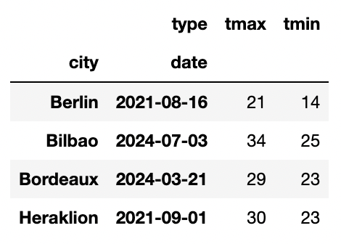
The life-changing magic of tidying up data
Pivoting – we know this one
The “type” column is storing variable names
😱
pivot
df.pivot_table( index=['city', 'date'], columns='type’, values='temperature', aggfunc='max’,
)

Slide 59
Tabular data ideas and operations – universal for all tabular data tools
Pandas
df.merge(df_info, on=[‘location-id’])
dask
df.merge(df_info, on = [‘location-id’])
PySpark
df.join(df_info, on = [‘location-id’])
SQL
SELECT *
FROM df
INNER JOIN df_info
USING (location_id);
ASPP LatAm, July 2026
Notes:
Not only is the syntax very similar, but the computation is also highly identical
Message: concepts are not specific to pandas but general.
Not go into detail but mention that other languages or frameworks use similar concepts (e.g. SQL)

Slide 60

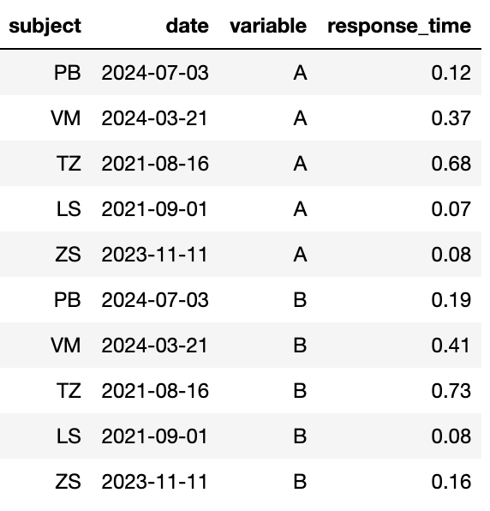
The life-changing magic of tidying up data
Melting – it’s kind of the opposite of pivoting
The treatment values are stored as a column name
😱
melt
pd.melt(data, id_vars=['subject', 'date'], value_name='response_time')
Split the columns in (A) “id_vars” and (B) non-”id_vars”. The column names in (B) are used as new values in a new column “variable”. The values in columns (B) go into a new column, “response_time”.

Slide 61

The life-changing magic of tidying up data
pd.concat – add together tables with the same variables (columns)
Some variables are stored in the file names
tables = []
for filename in filenames:
# Parse filename
year_month, _, country = filename[:-4].split('_')
# Read table and add columns for the variables
df = pd.read_csv(filename)
# Add the variables that were in the filename
df['year_month'] = year_month
df['country’] = country
# Store table
tables.append(df)
# Create complete table
tidy_df = pd.concat(tables)
😱
2024-01_prices_DE.csv 2024-01_prices_FR.csv 2024-02_prices_DE.csv 2024-02_prices_FR.csv

Slide 62
Hands-on
Exercise
Tidy up the data set in the tuberculosis exercise and compute the summary stats
Submit a PR on git.aspp.school/ASPP/ 2025-plovdiv-data
exercises/tabular_tidy_data
Multiple variables are stored in one column
😱

Slide 63
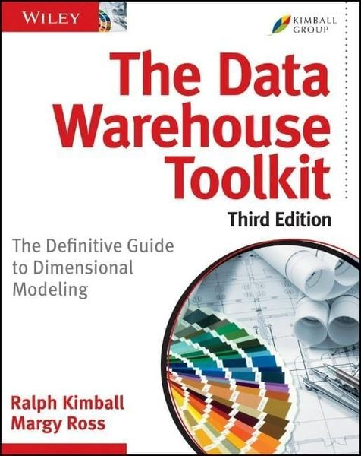
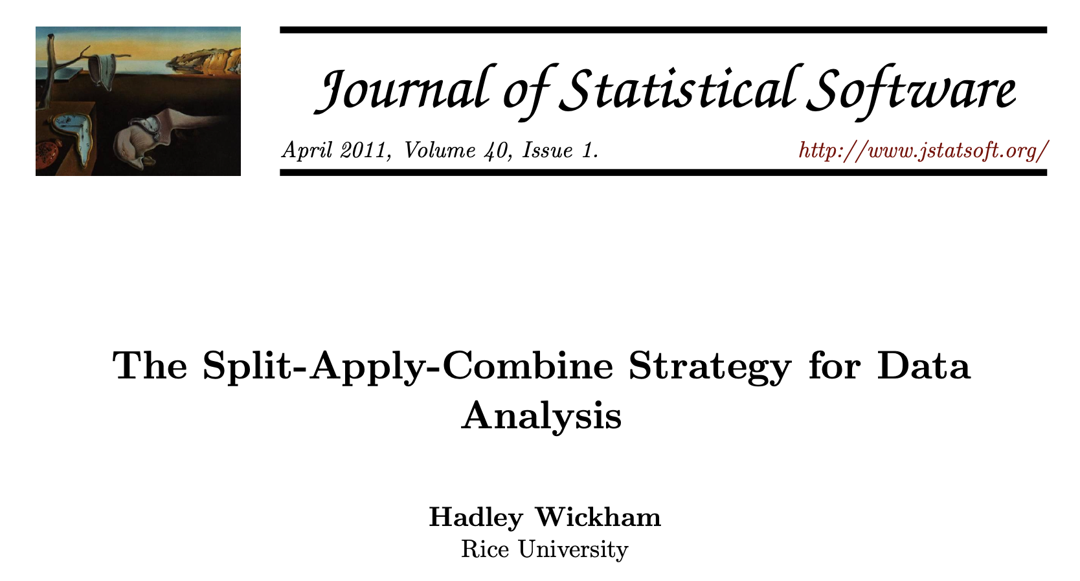
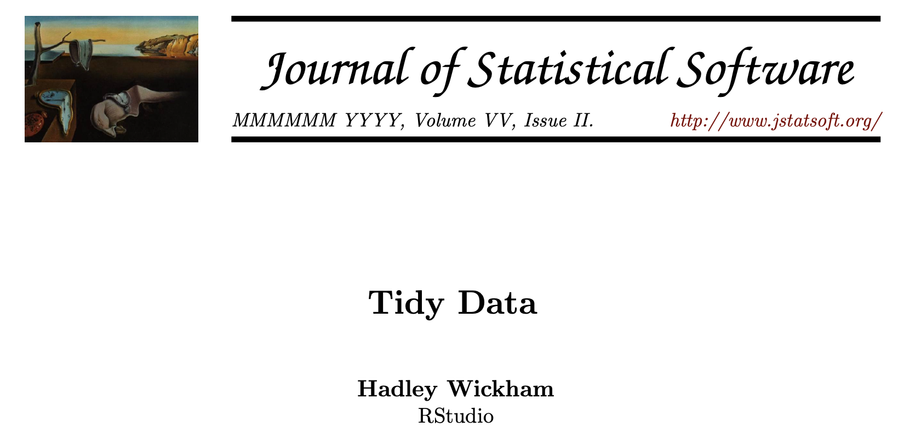
What we didn’t talk about
Other data structures: graphs, trees, priority queues, …
Options for working with large data on disk / remotely (instead of in-memory)
Best practices in data handling: versioning, lineage, sharing
Organizing a complex data set in multiple tables
… and a lot more!

Slide 64
Joins

Slide 65

Join operations
Live Coding
notebooks/tabular_data/
020_join_operations.ipynb

Slide 66
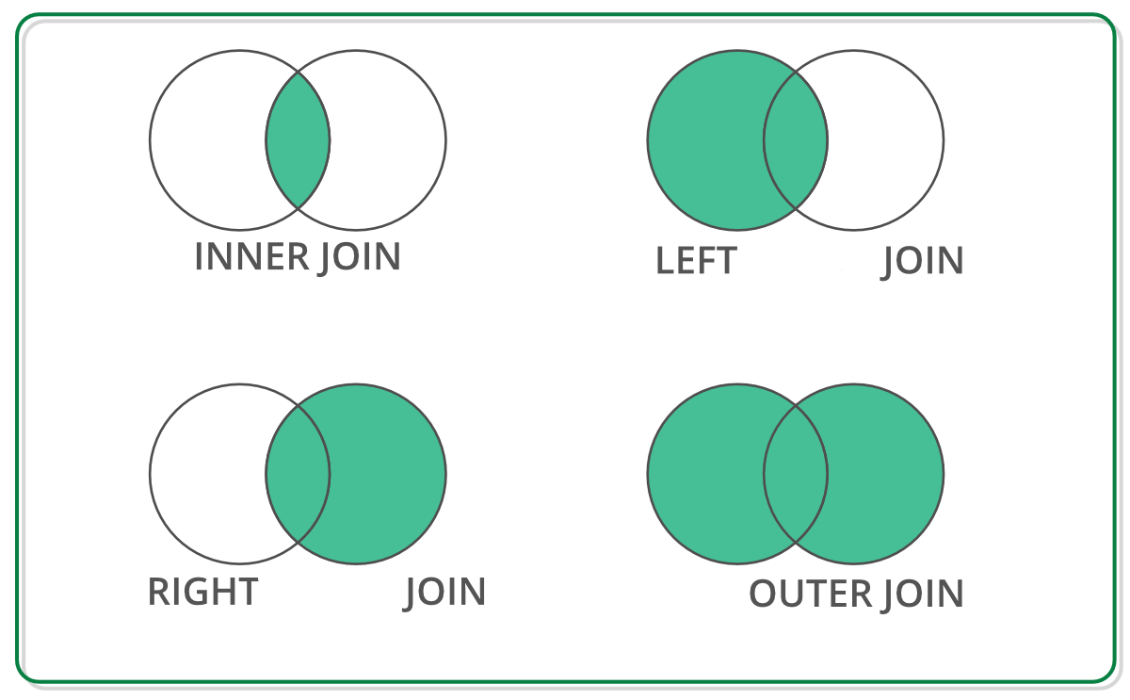
Join operations – Main points
Live Coding
Join operations can be used to combine two tables using the values of one or more columns
Different types of join:
left/right: keep all the column values that are present in the first/second table
inner: keep the column values common to both tables (intersection)
outer: keep all the column values of both tables
Anti-joins can be used to exclude the values that are present in one, but not the other table (filtering based on arbitrary criteria)
notebooks/tabular_data/
020_join_operations.ipynb

Slide 67

Example of tabular data: “Predimed” study
Research question: Does Mediterranean diet help prevent cardiovascular diseases, such as heart attacks and strokes?
Longitudinal study following > 7000 Spanish participants
Three different diets:
Mediterranean diet + extra virgin olive oil
Mediterranean diet + nuts
Control diet (low fat food items)
Estruch et al. (2018). New England Journal of Medicine

Slide 68
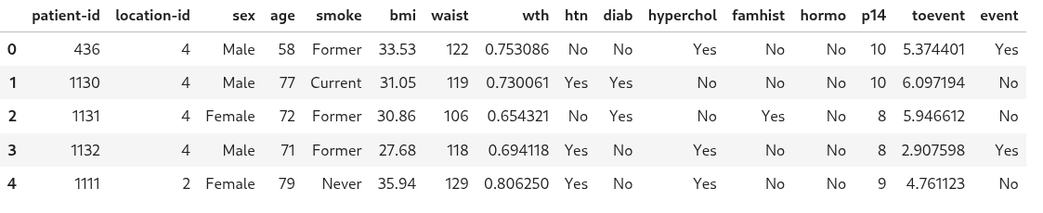
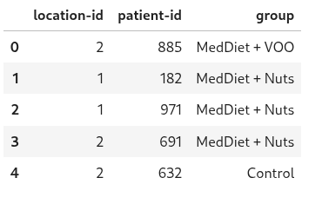
Example of tabular data: “Predimed” study
Estruch et al. (2018). New England Journal of Medicine

Slide 69
Hands-on
Exercise
Use joins to add the experimental information to the data
(who followed which diet)
Use anti-joins to correct for attrition (people who self-reported not following the diet)
Submit a PR on git.aspp.school/ASPP/2025-plovdiv-data
exercises/tabular_join

Slide 70
Split-apply-combine

Slide 71
The basic structure of most numerical analyses
split
apply
combine
A1
A2
mean
B1
B2
C2

Slide 72
Split-apply-combine operations
Live Coding
notebooks/030_tabular_data/
030_split-apply-combine.ipynb

Slide 73
Split-apply-combine operations
Live Coding
Main points:
Tabular data tools have a way to vectorize the standard split-apply-combine operations, using a “group-by” command
In addition, Pandas has got a “pivot-table” command that can be used to simplify the creation of more complex summary tables
notebooks/030_tabular_data/
030_split-apply-combine.ipynb

Slide 74
df.groupby(‘condition_id’)[‘response_time’].mean()
split
apply
combine
A1
A2
mean
B1
B2
C2

Slide 75
data.pivot_table( index='condition_id', columns='response', values='response_time', aggfunc='mean',
)
split
apply
combine

Slide 76
Hands-on
Exercise
Compute summary statistics to answer the question: Did the Mediterranean diet help prevent cardiovascular events?
Submit a PR on git.aspp.school/ASPP/2025-plovdiv-data
exercises/ tabular_split_apply_combine

Slide 77
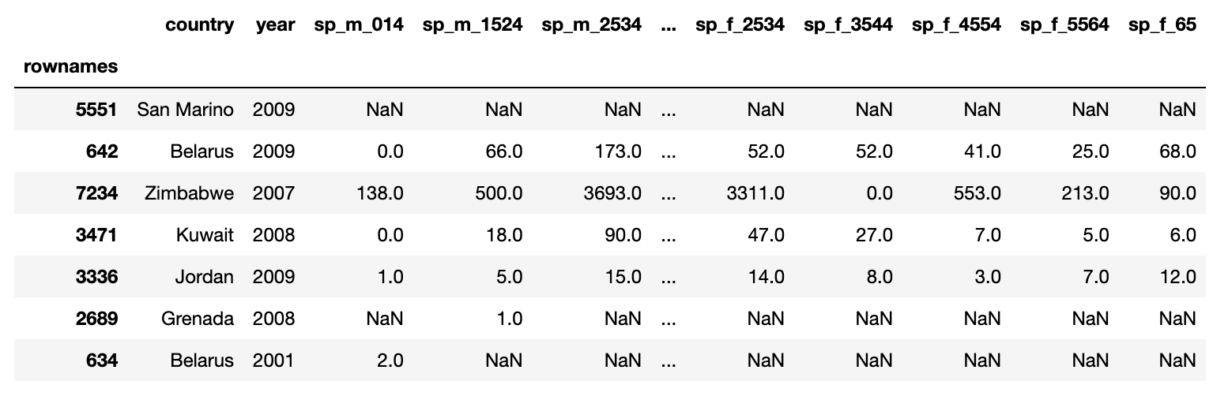
Hands-on
Exercise
Compute some summary tables for the WHO tuberculosis data
exercises/tabular_tuberculosis
Males
15-24 years

Slide 78
Window functions

Slide 79
Window functions: grouped row-by-row operations
“Window functions” are a kind of split-apply-combine operation, but instead of aggregating the data in a group and returning one value per group, they return one value per row
Examples: ranking all entries in a group; computing the distance between timestamps per group; number the rows by group in chronological order
In Pandas, most of these operations can be performed with a combination of sorting and grouping-by

Slide 80
Window functions
Live Coding
notebooks/tabular_data/
040_window_functions.ipynb

Slide 81
Window functions
Live Coding
Main points:
Window functions perform row-by-row operations on grouped data
They are an advanced way of avoiding for loops with tabular data
In Pandas, they can be achieved with a combo of sorting and grouping-by
notebooks/tabular_data/
040_window_functions.ipynb

Slide 82
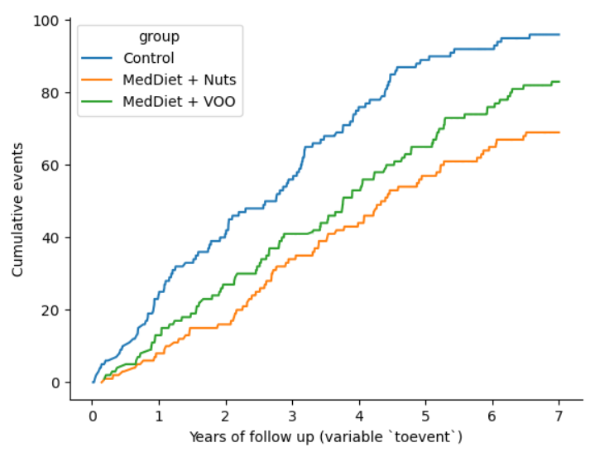
Hands-on
Exercise
Compute the cumulative number of cases across time, per diet group
Submit a PR on git.aspp.school/ASPP/2025-plovdiv-data
exercises/
tabular_window_functions

Slide 83
Data organization
Data organization concepts:
tidy data
normalized data (star organization)
data science friendly data (denormalized)

Slide 84
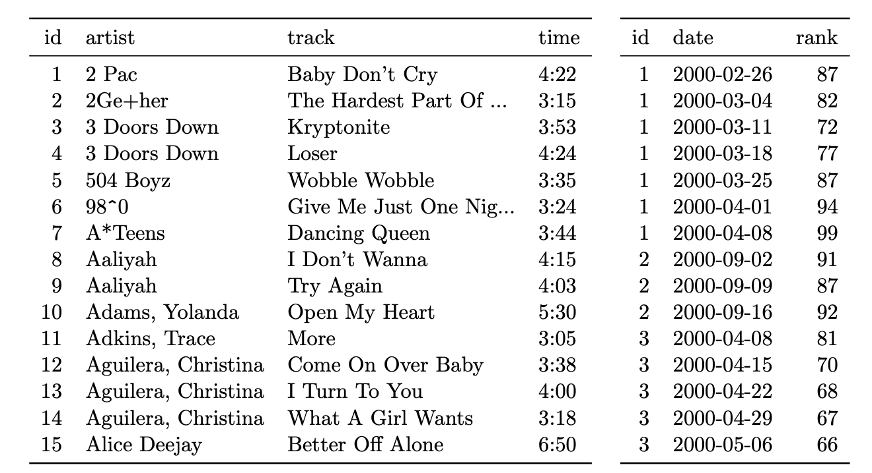
Organizing multiple tables
Dimension vs fact tables
De-normalization (but for data analys flat tables are more convienent)

