Slide 1


How to efficiently build scientific code
Mostly testing, some profiling, a little debugging
Zbigniew Jędrzejewski-Szmek
slides by: Pietro Berkes, NAGRA Insight

Slide 2
You as the Master of Research
You start a new project and identify a number of possible leads.
You quickly develop a prototype of the most promising ones; once a prototype is finished, you can confidently decide whether that lead is a dead end, or worth continuing.
Once you find an idea that is worth spending energy on, you take the prototype and easily re-organize and optimize it so that it scales up to the full size of your problem.
As expected, the scaled up experiment delivers good results and your next paper is under way.

Slide 3

Reaching Enlightenment
How do we get to the blessed state of confidence and efficiency?
Being a Python expert is not sufficient, good programming practices make a big difference
We can learn a lot from the development methods developed for commercial and open source software
lambda
Notes:
Me: Java during studies, in neuroscience everybody assumed I could use Matlab, luckily I had some Python background

Slide 4
Warm-up project
Write a function that finds the position of local maxima in a list of numbers

Slide 5
Warm-up project
Write a function that finds the position of local maxima in a list of numbers
Check your solution with these inputs:
  Input: [1, 4, -5, 0, 2, 1] Expected result: [1, 4]
  Input: [-1, -1, 0, -1] Expected result: [2]
  Input: [4, 2, 1, 3, 1, 5] Expected result: [0, 3, 5]
  Input: [1, 2, 2, 1] Expected result: [1] (or [2], or [1, 2])

Slide 6
Outline
The agile programming cycle
Testing scientific code
Profiling and optimization
Debugging

Slide 7
Before we start
Clone the repository with the material for this class:
https://github.com/ASPP/testing_debugging_profiling.git

Slide 8
The agile development cycle
Pick your next feature
Write tests
to check that feature works
Write simplest code
that makes tests pass
Run tests and debug
until all tests pass
Refactor and optimize
only if necessary
Notes:
As opposed to waterfall model
Reminder
1) describe cycle
2) short development cycles: granularity of chosen feature is important
3) for all of these steps there are python tools to help you; there’s no tool yet for writing the code, unfortunately

Slide 9
Python tools for agile development
Pick your next feature
Write tests
to check that feature works
pytest
Write simplest code
that makes tests pass
Run tests and debug
until all tests pass
pdb
timeit
cProfile
line_profiler
Refactor and optimize
only if necessary
Notes:
3) for all of these steps there are python tools to help you; there’s no tool yet for writing the code, unfortunately

Slide 10
Testing scientific code

Slide 11
Why write tests?
Confidence:
  Write the code once and use it confidently everywhere else:
  avoid the negative result effect!
  Correctness is main requirement for scientific code
  You must have a strategy to ensure correctness

Slide 12
Effect of software bugs in science
frequency
bug severity
oops, wrong labels!
need to send errata corrige
end of career
Notes:
Made up plot, not backed by any data; and no error bars!
This slide is supposed to scare you into listening to the rest
didn’t properly shuffle my data for the control, a couple of results are not statistically significant any more… errata

Slide 13
The unfortunate story of Geoffrey Chang
Science, Dec 2006: 5 high-profile retractions (3x Science, PNAS, J. Mol. Biol.) because ”an in-house data reduction program introduced a change in sign for anomalous differences”
Notes:
When you get a crappy result, you triple check your code for bugs. If the results come out just the way you want them to, how much effort are you going to put into double-checking?
For two errors reported and retraced, many more undetected or not reported.

Slide 14

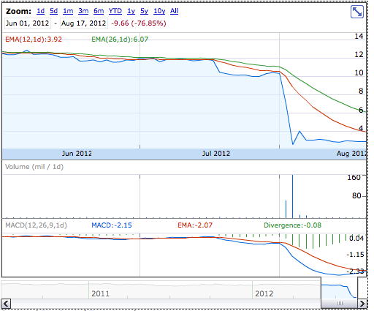
Meanwhile on Wall Street…
Source: Google Finance
NYT, 2 August 2012
Notes:
These slides were supposed to scare you into listening to the rest of the presentation: obviously, we need strategies to prevent this problems, and the agile programming techniques that Valentin talked about yesterday, and testing in particular, go a long way in this direction.

Slide 15
Meanwhile on Wall Street…
… but it worked on my machine!
Source: Google Finance
NYT, 2 August 2012
Notes:
These slides were supposed to scare you into listening to the rest of the presentation: obviously, we need strategies to prevent this problems, and the agile programming techniques that Valentin talked about yesterday, and testing in particular, go a long way in this direction.

Slide 16
The agile development cycle
Pick your next feature
Write tests
to check that feature works
pytest
Write simplest code
that makes tests pass
Run tests and debug
until all tests pass
pdb
timeit
cProfile
line_profiler
Refactor and optimize
only if necessary

Slide 17
Testing basics

Slide 18

Testing frameworks for Python
unittest
nosetests
pytest

Slide 19
Test suites in Python with pytest
Writing tests with pytest is simple:
  Each test is a function whose name begins by “test_”
  Each test tests one feature in your code, and checks that it behaves correctly using “assertions”. An exception is raised if it does not work as expected.

Slide 20
Testing with Python
Tests are automated:
  External software runs the tests and provides reports and statistics
  The answer is automatic too: either “yes” or “no”
$ pytest-3 test_massmail.py -v
================= test session starts ============================
platform linux -- Python 3.6.3, pytest-3.2.3, py-1.4.34, pluggy-0.4.0 -- /usr/bin/python3
cachedir: .cache
rootdir: /var/tmp/massmail, inifile:
collected 5 items
test_massmail.py::test_dummy PASSED
test_massmail.py::test_command_help PASSED
test_massmail.py::test_parse_parameter_file PASSED
test_massmail.py::test_local_sending PASSED
test_massmail.py::test_fake_sending PASSED
=============== 5 passed in 1.06 seconds =========================
Notes:
everybody “tests” his software, little toy problems, or just run it and use it for a while and see than nothing breaks

Slide 21
Hands-on!
Go to massmail
Execute the tests:
pytest -v
Notes:
PyAnno: describe context a little bit; how are annotations represented
Show directory structure
Open file, comment on content
Show next slide: all the ways to execute a test

Slide 22
How to run tests
1) Discover all tests in all subdirectories
pytest -v
2) Execute all tests in one module
pytest -v test_massmail.py
3) Execute one single test
pytest –v test_massmail.py::test_local_sending

Slide 23
Possibly your first test file
Create a new file, test_something.py:
Save it, and execute the tests
def test_arithmetic():
assert 1 == 1
assert 2 * 3 == 6
def test_len_list():
lst = ['a', 'b', 'c']
assert len(lst) == 3
Notes:
Import unittest
Define a test unit as a subclass of TestCase
Define a series of methods beginning with ‘test_’ that test some aspect of the code
When unittest.main() is called, the method automatically finds the tests and executes them one by one giving back a report

Slide 24
Assertions
assert statements check that some condition is met, and raise an exception otherwise
Check that statement is true/false:
assert 'Hi'.islower() => fail
assert not 'Hi'.islower() => pass
Check that two objects are equal:
assert 2 + 1 == 3 => pass
assert [2] + [1] == [2, 1] => pass
assert 'a' + 'b' != 'ab' => fail
assert can be used to compare all sorts of objects, and py.test will take care of producing an approriate error message

Slide 25
Hands-on!
Add a new test to test_something.py:
test that 1+2 is 3
Execute the tests

Slide 26
Hands-on!
Add a new test to test_something.py:
test that 1+2 is 3
Execute the tests
Now test that 1.1 + 2.2 is 3.3

Slide 27
Floating point equality
Real numbers are represented approximately as “floating point” numbers. When developing numerical code, we have to allow for approximation errors.
Check that two numbers are approximately equal:
from math import isclose
def test_floating_point_math():
assert isclose(1.1 + 2.2, 3.3) => pass
abs_tol controls the absolute tolerance:
assert isclose(1.121, 1.2, abs_tol=0.1) => pass
assert isclose(1.121, 1.2, abs_tol=0.01) => fail
rel_tol controls the relative tolerance:
assert isclose(120.1, 121.4, rel_tol=0.1) => pass
assert isclose(120.4, 121.4, rel_tol=0.01) => fail
Notes:
If you’re working with floating point numbers two number are rarely exactly the same

Slide 28
Hands-on!
One more equality test: check that the sum of these two NumPy arrays:
x = numpy.array([1, 1])
y = numpy.array([2, 2])
is equal to
z = numpy.array([3, 3])

Slide 29
Testing with NumPy arrays
def test_numpy_equality():
x = numpy.array([1, 1])
y = numpy.array([2, 2])
z = numpy.array([3, 3])
assert x + y == z
__________________________________ test_numpy_equality __________________________________
def test_numpy_equality():
x = numpy.array([1, 1])
y = numpy.array([2, 2])
z = numpy.array([3, 3])
> assert x + y == z
E ValueError: The truth value of an array with more than one element is ambiguous. Use a.any() or a.all()
code.py:47: ValueError
Notes:
The intention was to test for equality element-by-element

Slide 30
Testing with numpy arrays
numpy.testing defines appropriate functions:
assert_array_equal(x, y)
assert_array_almost_equal(x, y, decimal=6)
If you need to check more complex conditions:
  numpy.all(x): returns True if all elements of x are true
  numpy.any(x): returns True is any of the elements of x is true
  numpy.allclose(x, y, rtol=1e-05, atol=1e-08): returns True if two arrays are element-wise equal within a tolerance
  combine with logical_and, logical_or, logical_not:
  # test that all elements of x are between 0 and 1
  assert all(logical_and(x > 0.0, x < 1.0))
Notes:
The right way to do this is using …
If you need to check more complex conditions
allclose:
The tolerance values are positive, typically very small numbers. The
relative difference (`rtol` * abs(`b`)) and the absolute difference
`atol` are added together to compare against the absolute difference
between `a` and `b`.

Slide 31
Testing error control
Check that an exception is raised:
from pytest import raises
def test_raises():
with raises(SomeException):
do_something()
do_something_else()
For example:
with raises(ValueError):
int('XYZ’)
passes, because
int('XYZ’)
ValueError: invalid literal for int() with base 10: 'XYZ'
Notes:
Finally

Slide 32
Testing error control
Use the most specific exception class, or the test may pass because of collateral damage:
# Test that file "None" cannot be opened.
with raises(IOError):
open(None, 'r')
as expected, but
with raises(Exception):
open(None, 'r’)
=> fail
=> pass

Slide 33
Hands-on!
In exercises/dot , there are two empty test functions. Write their implementation!

Slide 34
Hands-on!
Have a look at the docstring of parse_command_line_options :
It says the function raises an error if the arguments are invalid, but -P 0 is not rejected!
Add a test checking that the function raises an error if we pass invalid -P argument:
1) below 1
2) above 65535 (which is 0xFFFF)

Slide 35
Testing patterns

Slide 36
What a good test looks like
What does a good test looks like? What should I test?
Good:
  Short and quick to execute
  Easy to read
  Exercise one thing
Bad:
  Relies on data files
  Messes with “real-life” files, servers, databases

Slide 37
Basic structure of test
A good test is divided in three parts:
  Given: Put your system in the right state for testing
    Create data, initialize parameters, define constants…
  When: Execute the feature that you are testing
    Typically one or two lines of code
  Then: Compare outcomes with the expected ones
    Define the expected result of the test
    Set of assertions that check that the new state of your system matches your expectations

Slide 38
Test simple but general cases
Start with simple, general case
  Take a realistic scenario for your code, try to reduce it to a simple example
Tests for ‘lower’ method of strings
def test_lower():
# Given
string = 'HeLlO wOrld'
expected = 'hello world'
# When
output = string.lower()
# Then
assert output == expected

Slide 39
Test special cases and boundary conditions
Code often breaks in corner cases: empty lists, None, NaN, 0.0, lists with repeated elements, non-existing file, …
This often involves making design decision: respond to corner case with special behavior, or raise meaningful exception?
def test_lower_empty_string():
# Given
string = ''
expected = ''
# When
output = string.lower()
# Then
assert output == expected
Other good corner cases for string.lower():
  ‘do-nothing case’: string = 'hi'
  symbols: string = '123 (!'
Notes:
First of all, you should start with testing your code with
explain typical test structure
show general case: two words, upper case chars randomly dispersed
special cases
SHOW THIS (cut & paste code)

Slide 40
Common testing pattern
Often these cases are collected in a single test:
def test_lower():
# Given
# Each test case is a tuple of (input, expected_result)
test_cases = [('HeLlO wOrld', 'hello world'),
('hi', 'hi'),
('123 ([?', '123 ([?'),
('', '')]
for string, expected in test_cases:
# When
output = string.lower()
# Then
assert output == expected

Slide 41
Hands-on!
Go back to the tests you wrote so far in test_something.py and exercises/dot/test_dot.py,
and reorganize test to follow clearly
the Given / When / Then pattern
5 minutes

Slide 42
Numerical fuzzing
Use deterministic test cases when possible
In most numerical algorithm, this will cover only over-simplified situations; in some, it is impossible
Fuzz testing: generate random input
  Outside scientific programming it is mostly used to stress-test error handling, memory leaks, safety
  For numerical algorithm, it is often used to make sure one covers general, realistic cases
  The input may be random, but you still need to know what to expect
  Make failures reproducible by saving or printing the random seed
Notes:
In textbooks about testing you will read that tests should always be deterministic
For example, if you want to test a function that computes the Fourier components of a signal: one can define simple deterministic cases (single sine wave), but it’s not general enough
GOOD EXAMPLE: better is random mixtures of sine waves, colored noise, signal with stationary statistics => compute the eigenvalues of the covariance matrix

Slide 43
Numerical fuzzing example
def test_mean_deterministic():
x = numpy.array([-2.0, 2.0, 6.0])
expected = 2.0
assert isclose(numpy.mean(x), expected)
def test_mean_fuzzing():
rand_state = numpy.random.RandomState(1333)
N, D = 100000, 5
# Goal means: [0.1 , 0.45, 0.8 , 1.15, 1.5]
expected = numpy.linspace(0.1, 1.5, D)
# Generate random, D-dimensional data with the desired mean
x = rand_state.randn(N, D) + expected
means = numpy.mean(x, axis=0)
numpy.testing.assert_allclose(means, expected, rtol=1e-2)

Slide 44
Hands-on!
Write two tests for the function numpy.var :
1) First, a deterministic test
2) Then, a numerical fuzzing test

Slide 45
Numerical fuzzing – solution
def test_var_deterministic():
x = numpy.array([-2.0, 2.0])
expected = 4.0
assert isclose(numpy.var(x), expected)
def test_var_fuzzing():
rand_state = numpy.random.RandomState(8393)
N, D = 100000, 5
# Goal variances: [0.1 , 0.45, 0.8 , 1.15, 1.5]
expected = numpy.linspace(0.1, 1.5, D)
# Generate random, D-dimensional data
x = rand_state.randn(N, D) * numpy.sqrt(expected)
variance = numpy.var(x, axis=0)
numpy.testing.assert_allclose(variance, expected, rtol=1e-2)
Notes:
… generate 5 vectors with 100000 elements, such that each vector has a goal variance, which I set here to be 5 numbers between 0.1 and 1.5
Discuss: Precision of test

Slide 46
Testing learning algorithms
Learning algorithms can get stuck in local maxima, the solution for general cases might not be known (e.g., unsupervised learning)
Turn your validation cases into tests
Stability tests:
  Start from final solution; verify that the algorithm stays there
  Start from solution and add a small amount of noise to the parameters; verify that the algorithm converges back to the solution
Generate data from the model with known parameters
  E.g., linear regression: generate data as y = a*x + b + noise
  for random a, b, and x, then test that the algorithm is able to recover a and b
Notes:
…
There is no general rule for testing these algorithm, for each specific algorithm there are usually validation cases (e.g, a classifier might be validated using two classes of very different objects)

Slide 47
Other common cases
Test general routines with specific ones
  Example: test polynomial_expansion(data, degree)
  with quadratic_expansion(data)
Test optimized routines with brute-force approaches
  Example: test function computing analytical derivative with numerical derivative

Slide 48
Example: eigenvector decomposition
Consider the function values, vectors = eigen(matrix)
Test with simple but general cases:
  use full matrices for which you know the exact solution
  (from a table or computed by hand)
Test general routine with specific ones:
  use the analytical solution for 2x2 matrices
Numerical fuzzing:
  generate random eigenvalues, random eigenvector; construct the matrix; then check that the function returns the correct values
Test with boundary cases:
  test with diagonal matrix: is the algorithm stable?
  test with a singular matrix: is the algorithm robust? Does it raise appropriate error when it fails?

Slide 49
Hands-on!
Write a test for your find_maxima function
Correct the function if the function was incorrect, or clean it up if it wasn’t
Run the test again and watch it pass

Slide 50
Let’s talk about Continuous Integration
Have tests run automatically whenever a Pull Request is submitted
Don’t rely on the submitter or the reviewers to run them! They are only humans.
It’s easy with freely available services like TravisCI
… let’s have a look at massmail again ...
  PR with tick
  .travis.yml

Slide 51
Hands-on!
Let’s fix issue #7 in massmail together:
  Volunteer 1: Write a test that reproduces the issue
  Volunteer 2: Fix the code so that the test passes
  Volunteer 3: Write a test for the $$ issue
  Volunteer 4: Fix that as well
  Volunteer 5: Do the git dance, submit a PR, observe how TravisCI is happy
  Everyone: Celebrate!

Slide 52
Testing is good for your self-esteem
Immediately: Always be confident that your results are correct, whether your approach works of not
In the future: save your future self some trouble!
If you are left thinking “it’s cool but I cannot test my code because XYZ”, talk to me over the break and I’ll show you how to do it ;-)
Notes:
in Python2 environment:
py.test -v mdp/test/test_node_covariance.py
and
py.test mdp/test/
(it takes one minute)

Slide 53
Optimization and profiling

Slide 54
Testing makes you efficient, too!
An additional big bonus of testing is that your code is ready for improvements
Code can change, and correctness is assured by tests
Happily scale your code up!

Slide 55
The agile development cycle
Pick your next feature
Write tests
to check that feature works
pytest
Write simplest code
that makes tests pass
Run tests and debug
until all tests pass
pdb
timeit
cProfile
line_profiler
Refactor and optimize
only if necessary

Slide 56
Be careful with optimization
Python is slower than C, but not prohibitively so
In scientific applications, this difference is often not noticeable: the costly parts of numpy, scipy, … are written in C or Fortran
In many cases, scientist time, not computer time is the bottleneck
  Researchers need to be able to explore many different ideas
  Always weight the time you spend on a task vs benefits
  Keep this diagram around: https://xkcd.com/1205/

Slide 57
Optimization methods hierarchy
(This is mildly controversial)
In order of preference:
  Don’t do anything
  Vectorize your code using numpy
  Spend some money on better hardware (faster machine, SSD), optimized libraries (e.g., Intel’s MKL)
  Use a “magic optimization” tool, like numexpr, or numba;
  or a “magic parallelization” tool, like joblib or dask
  Use GPU acceleration
  Use Cython
  Parallelize your code

Slide 58
How to optimize
Usually, a small percentage of your code takes up most of the time
Identify time-consuming parts of the code
Where’s the bottleneck? Computations? Disk I/O?
Memory I/O? (see also Tiziano’s lecture)
Use a profiler!
Only optimize those parts of the code
Keep running the tests to make sure that code is not broken
Stop optimizing as soon as possible

Slide 59
Measuring time: timeit
IPython magic command: %timeit
Precise timing of a function/expression
Test different versions of a small amount of code, often used in interactive Python shell
In [6]: %timeit cube(123)
10000000 loops, best of 3: 185 ns per loop

Slide 60
Hands-on!
Write a dot product function in pure Python and time it in IPython using %timeit:
dot_product(x, y) is
x[i, k] = sum(x[i, k] * y[k, j]
for k in range(x.shape[1]))
Write a version using numpy (vectorized), time it again
Time numpy.dot
Try with large (50 elements) and small vectors (5 elements)

Slide 61
factorial
Follow with me while we profile the file
hands_on/factorial/factorial.py

Slide 62
Measuring time: time
On *nix systems, the command time gives a quick way of measuring time:
“real” is wall clock time
“user” is CPU time executing the script
“sys” is CPU time spent in system calls
$ time python your_script.py
real 0m0.135s
user 0m0.125s
sys 0m0.009s

Slide 63
cProfile
standard Python module to profile an entire application
(profile is an old, slow profiling module)
Running the profiler from command line:
Sorting options:
python -m cProfile –s cumulative myscript.py
tottime : time spent in function only
cumtime : time spent in function and sub-calls
calls : number of calls
Notes:
what it is
first, you need to have the profiler collect information while your program is running

Slide 64
cProfile
Or save results to disk for later inspection:
Explore with
python -m cProfile –o filename.prof myscript.py
python –m pstats filename.prof
stats [n | regexp]: print statistics
sort [cumulative, time, ...] : change sort order
callers [n | regexp]: show callers of functions
callees [n | regexp]: show callees of functions
Notes:
what it is
first, you need to have the profiler collect information while your program is running

Slide 65
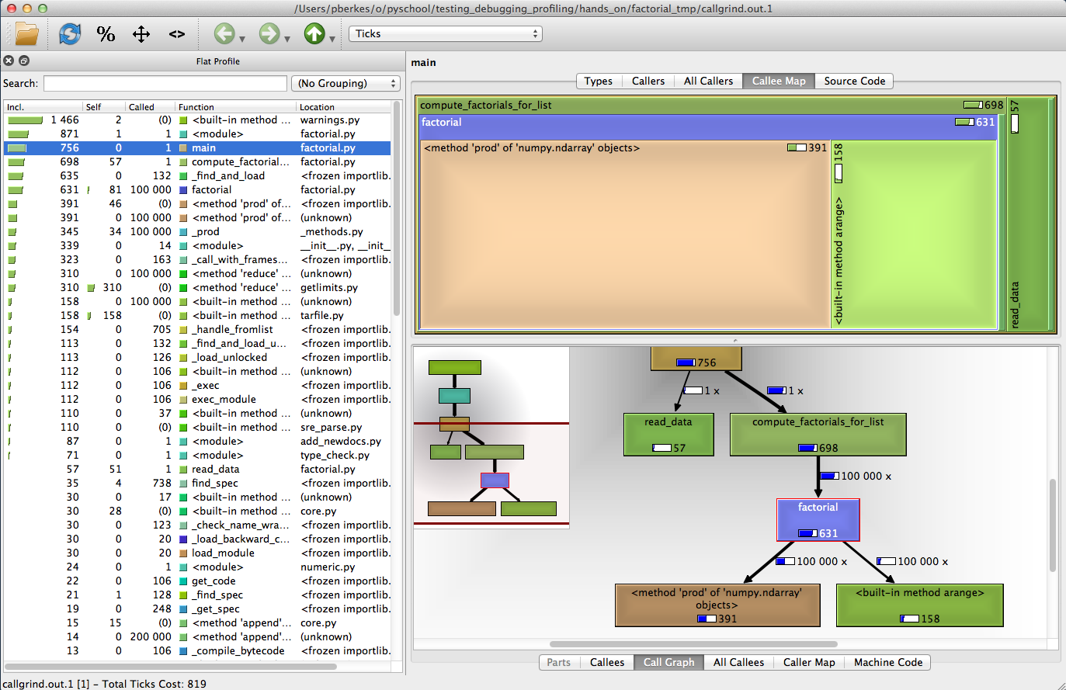
Callgrind

Slide 66
Using callgrind
Callgrind gives graphical representation of profiling results:
Run profiler:
python -m cProfile -o factorial.prof factorial.py
Transform results in callgrind format:
pyprof2calltree -i factorial.prof -o callgrind.out.1
Run callgrind:
qcallgrind callgrind.out.1
or
kcachegrind callgrind.out.1
Notes:
How to properly open qcachegrind on my Mac: open ~/Applications/qcachegrind.app

Slide 67
Hands-on
Make sure you can profile and run cachegrind
Optimize the factorial funciton
  Modify the code
  Run tests to make sure it still works
  Profile and measure progress

Slide 68
Fine-grained profiling: kernprof
You can profile a subset of all functions by decorating them with @profile
kernprof –b -v factorial.py
Line-by-line profiling
kernprof -b -l -v factorial.py

Slide 69
Debugging

Slide 70
The agile development cycle
Pick your next feature
Write tests
to check that feature works
unittest
Write simplest code
that makes tests pass
Run tests and debug
until all tests pass
pdb
timeit
cProfile
line_profiler
Refactor and optimize
only if necessary

Slide 71
Debugging
The best way to debug is to avoid bugs
  By writing tests, you anticipate the bugs
Your test cases should already exclude a big portion of the possible causes
Core idea in debugging: you can stop the execution of your application at the bug, look at the state of the variables, and execute the code step by step
Avoid littering your code with print statements
Notes:
Bugs are inevitable

Slide 72
pdb, the Python debugger
Command-line based debugger
pdb opens an interactive shell, in which one can interact with the code
  examine and change value of variables
  execute code line by line
  set up breakpoints
  examine calls stack

Slide 73
debugger

Slide 74
Entering the debugger
Enter debugger at the start of a file:
python –m pdb myscript.py
Enter at a specific point in the code (alternative to print):
If you have it installed, use ipdb instead:
# some code here
# the debugger starts here
import pdb;
pdb.set_trace()
# rest of the code
import ipdb;
ipdb.set_trace()

Slide 75
Entering the debugger from ipython
From ipython:
%pdb – preventive
%debug – post-mortem

Slide 76
Static checking
One of the problems with debugging in Python is that most bugs only appear when the code executes.
“Static checking” tools analyze the code without executing it.
pep8: check that the style of the files is compatible with PEP8
pyflakes: look for errors like defined but unused variables, undefined names, etc.
flake8: pep8 and pyflakes in a single, handy command
Notes:
Run flake8 on the *initial* pyanno code.

Slide 77
Hands-on!
Run pyflakes on massmail, and fix all complaints.

Slide 78
Final thoughts
Good programming practices, with testing in the front line, will help you becoming confident about your results, and efficient at navigating your research project
For maximum efficiency, check out how these tools can be integrated with your editor / IDE

Slide 79
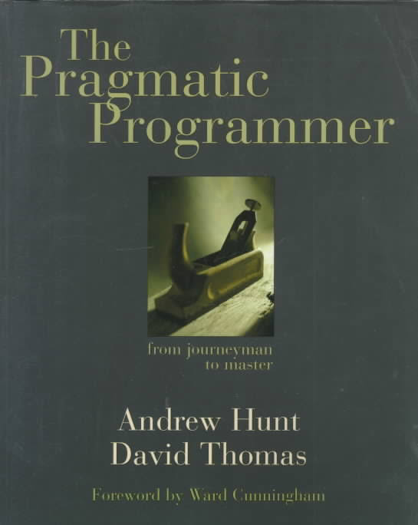

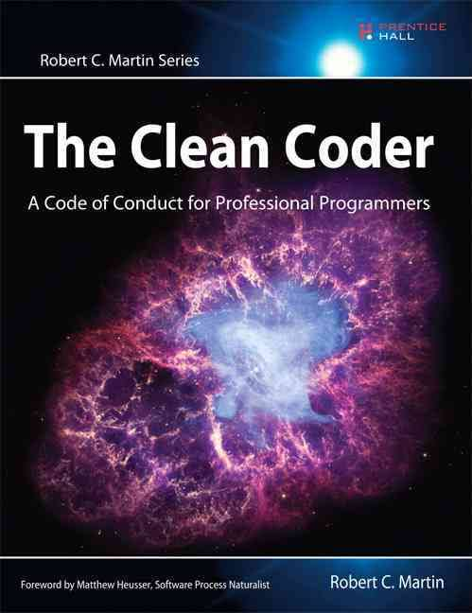
Recommended readings

Slide 80
The End
Thank you!

Slide 81
Exercises

