Slide 1

Testing scientific code Because you’re worth it
Lisa Schwetlick and Carlos Echeverría
Notes:
materials by Pietro
Testing is about confidence in scientific code, especially when results may look plausible but be wrong.
> Today is about making scientific code safer to change. Many of us have code that once worked in a notebook or script, but later became hard to modify because we were afraid of breaking the result. Testing gives us a way to turn assumptions into executable checks.
> We are going to use `pytest`, but the main idea is not pytest syntax. The main idea is the workflow: define expected behavior, run it automatically, read failures, and use tests as protection while improving code.
> Before we talk about testing tools, let’s start with a small function where the expected behavior looks obvious — until we hit edge cases.

Slide 2

You, as the Master of Research
You start a new project, let’s say with a new simulation method or a new dataset and have a few ideas for possible analyses.
You implement the analyses as prototypes; once each prototype is finished, you can confidently decide whether it is is a dead end, or worth pursuing.
Once you find an idea on which it is worth spending energy, you take the prototype and easily re-organize and optimize it so that it scales up to the full size of your problem.
As expected, the scaled-up experiment delivers good results, and your next paper is under way.
August 2026, CC BY-SA 4.0
Testing scientific code, v16.0
Notes:
The ideal research workflow is: prototype quickly, decide whether the idea is useful, reorganize, optimize, scale, and trust the result.
The problem is that without tests, refactoring and scaling become risky.
> This slide describes the workflow we all want: prototype quickly, decide whether the idea is useful, then reorganize, optimize, and scale it. The problem is that after the prototype phase, many scientific codebases become fragile. You want to clean them up, but you are not sure whether a change silently changed the result.
Ask:
> What usually prevents you from refactoring old research code?
- I am afraid of changing the results.
- There is no reference output.
- It only works in one notebook.
- I do not know which scripts still matter.
- The original environment changed.
> Tests are how we preserve scientific intent while changing implementation.

Slide 3

How to reach enlightenment
How do we get to the blessed state of confidence and efficiency?
Being a Python expert is not sufficient, good programming practices make a big difference
We can learn a lot from the development methods developed for commercial and open source software
August 2026, CC BY-SA 4.0
Testing scientific code, v16.0
Notes:
How do we reach this dream state where we are so efficient to just write code and re-use it without problem, and we are confident that it gives the correct result.
Being good at Python is one thing, but there are also general programming behaviours that can help you and in this lecture we will go over a few of them.
> Python knowledge is necessary, but not sufficient. The bigger issue is engineering workflow: version control, testing, debugging, profiling, and automation. Today we start with testing, because it supports all the others.
Then:
> Debugging without tests often means fixing the same bug repeatedly. Profiling without tests can make wrong code faster.

Slide 4
Outline
The agile programming cycle
Testing scientific code basics
Testing patterns for scientific code
Debugging
August 2026, CC BY-SA 4.0
Testing scientific code, v16.0
Notes:
> The full course covers the agile programming cycle, testing basics, scientific testing patterns, and debugging. This first part focuses on the basics: how to write and run tests, how to interpret failures, and how to handle numerical and NumPy-specific comparisons.
> We will go back and forth between slides and terminal. I will not only show the correct code; I want us to intentionally create failures and read them.
> Let’s begin with a small function: find the local maxima in a list.

Slide 5
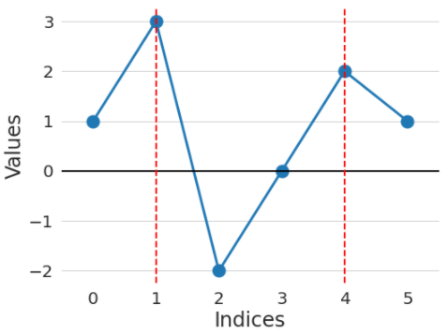
Warm-up project
Go to the directory called hands_on/local_maxima
In the file called local_maxima.py, write a function find_maxima that finds the indices of local maxima in a list of numbers
For example, find_maxima([1, 3, -2, 0, 2, 1]) should return [1, 4]
August 2026, CC BY-SA 4.0
Testing scientific code, v16.0
Notes:
> This function is currently a stub. It has a docstring saying what it should do, but the implementation always returns an empty list.
explain the example: find_maxima([1, 3, -2, 0, 2, 1]) Expected: [1, 4]
Inside Python:
from local_maxima import find_maxima
find_maxima([1, 3, -2, 0, 2, 1]) ->[ ]
> The current result is `[]` because the function is not implemented yet. That is fine. We now have our first expected behavior: this input should produce `[1, 4]`.
> A local maximum happens when we came from below and then go down. For plateaus, we keep the left-most index of the plateau.
Just use python
Loops
Do not use numpy
At end of exercise: Show of hands, who is confident in their solution

Slide 6
Warm-up project
Write a function find_maxima that finds the indices of local maxima in a list of numbers
Check your solution with these inputs:
Input: [1, 3, -2, 0, 2, 1] Expected result: [1, 4]
Input: [4, 2, 1, 3, 1, 5] Expected result: [0, 3, 5]
Input: [] Expected result: []
Input: [1, 2, 2, 1] Expected result: [1] (or [2], or [1, 2])
Input: [1, 2, 2, 3, 1] Expected result: [3]
August 2026, CC BY-SA 4.0
Testing scientific code, v16.0
Notes:
The real challenge is not only writing code. It is deciding what the function should mean in boundary and ambiguous cases.
### What to say
> The first example was straightforward. But a function is not specified by one example. We need to decide what happens at boundaries, for empty input, and for equal neighboring values.
Walk through examples.
Ask: For `[1, 2, 2, 1]`, should the answer be `[1]`, `[2]`, `[1, 2]`, or something else?
For a flat maximum plateau, return the left-most index of the plateau.
find_maxima([1, 2, 2, 1]) == [1]
> These examples are not just checks. They are the specification of the function. The next step is to stop checking them manually and turn them into automated tests.

Slide 7

The agile programming cycle
August 2026, CC BY-SA 4.0
Testing scientific code, v16.0
Notes:
This was interesting, right? Your solution worked for some cases but not in others.
Scientists are not the only ones who have to check that their code is working correctly or as expected. This is a main component of software engineering.
> We just implemented `find_maxima` manually. That worked for a small exercise, but in real scientific code this approach does not scale. We need a repeatable cycle.
Let’s talk about how we programme in a software development environment and why adopting some of these practices can be really beneficial for scientific research.
```text
1. Pick a small behavior or feature.
2. State what correct behavior means.
3. Implement the simplest version.
4. Check whether it behaves correctly.
5. If it fails, inspect and fix.
6. Once it works, clean up or optimize only if needed.
```
Connect to `find_maxima`:
> For `find_maxima`, the first behavior was: for `[1, 3, -2, 0, 2, 1]`, return `[1, 4]`. Then we added more behaviors: boundaries, empty input, and plateaus. That is exactly this cycle, but so far we checked it manually.

Slide 8

The agile development cycle
Pick your next feature
Write tests to check that feature works
Write simplest code that makes tests pass
Run tests and debug until all tests pass
Refactor and optimize only if necessary
August 2026, CC BY-SA 4.0
Testing scientific code, v16.0
Notes:
As opposed to waterfall model
Reminder
1) describe cycle
Agile programming is a repeated cycle of planning, building, testing, reviewing, and improving.
We begin by identifying a small, high-priority scientific or technical question.
The team then develops a simple working version, tests it with real data, and reviews the results with users or collaborators. Based on that feedback, we update the requirements and begin the next cycle.
The key idea is to work in short iterations rather than trying to design the entire solution perfectly at the start. Each cycle produces something usable, reduces uncertainty, and allows the software to adapt as the scientific understanding evolves.
2) short development cycles: granularity of chosen feature is important
3) for all of these steps there are python tools to help you
Change one thing, check one thing, then continue.
> This slide shows the same idea, but now we name the activities. First, we decide what behavior matters. Then we check that behavior. If something is wrong, we debug. Only after the behavior is correct do we refactor or optimize.
Anti-patterns:
```text
1. Refactoring before checking behavior.
2. Optimizing code whose correctness is unknown.
3. Debugging from intuition instead of from a reproducible failure.
```
Connect to `find_maxima`:
> If we had optimized `find_maxima` before deciding the plateau rule, we would be making fast code for an undefined problem. If we refactor it later, we need checks to ensure the behavior stays the same.
> Correctness comes before elegance, and correctness comes before speed.

Slide 9
Python tools for agile development
Pick your next feature
Write tests to check that feature works
pytest
Write simplest code that makes tests pass
Run tests and debug until all tests pass
pdb
timeit
cProfile
line_profiler
Refactor and optimize only if necessary
August 2026, CC BY-SA 4.0
Testing scientific code, v16.0
Notes:
3) for all of these steps there are python tools to help you
> Now that we have the cycle, we can attach concrete Python tools to each step. The important thing is not to memorize tool names. The important thing is knowing which tool answers which question.
Tool mapping:
```text
Expected behavior? pytest
Wrong internal state? pdb
Small timing question? timeit
Whole-program bottleneck? cProfile
Line-level bottleneck? line_profiler
```
`pytest`:
> For automated tests, we will use `pytest`. It lets us write small functions that check whether our code behaves as expected, and then run all of those checks automatically.
`pdb`:
> When a test fails, the next question is why. Python has an interactive debugger called `pdb` that lets us pause execution, inspect variables, and step through code.
`timeit`:
> For small timing experiments, Python has `timeit`.
`cProfile`:
> For whole-program profiling, Python has `cProfile`.
`line_profiler`:
> Once we know which function is slow, `line_profiler` can measure time line by line.

Slide 10

Why test scientific code?
August 2026, CC BY-SA 4.0
Testing scientific code, v16.0
Notes:
Show of hands, who is absolutely confident that the code they have written for their research is completely correct and has no bugs.
> One reason we test is confidence when reusing code. Today `find_maxima` is a small function in an exercise. But in real scientific work, a function like this might later become part of a data-processing pipeline. Once that happens, you do not want to manually inspect every output after every change.
Connect:
> We already manually checked cases like empty input, boundary maxima, and plateaus. If we reuse this function later, we do not want to manually type those examples again. We want them saved as executable checks.

Slide 11
Why write tests at all?
Confidence while re-using code:
Write the code once and use it confidently everywhere else: avoid the negative result effect!
Confidence while editing code:
When you have tests, you can change any part of your code and you will be confident that you have not changed the result
change any line in the code
Refactor to improve readability/speed/memory usage
Confidence in correctness:
Correctness is main requirement for scientific code
You must have a strategy to ensure correctness
August 2026, CC BY-SA 4.0
Testing scientific code, v16.0
Notes:
1) Even if you never work with anyone else, write all your code into one jupyter notebook that noone ever edits, then you still would like to be sure that it actually does what it does
2) Most code is not written perfectly the first time. We often need to rename variables, split functions, optimize loops, remove duplication, or make code easier to read. But if we do that without tests, every cleanup is dangerous.
Refactoring principle:
Refactoring should change structure, not behavior.
Tests are how we verify that behavior did not change.
Connect to `find_maxima`:
> Suppose we rewrite the function and accidentally make endpoints no longer count as maxima. That might not show up in the first simple example, but it should be caught by a boundary test.
[… slide …]
If we think about correctness in computational science - there is incorrect and there is INCORRECT

Slide 12
Effect of software bugs in science
frequency
bug severity
oops, wrong labels!
need to send errata corrige
end of career
August 2026, CC BY-SA 4.0
Testing scientific code, v16.0
Notes:
Made up plot, not backed by any data; and no error bars!
This slide is supposed to scare you into listening to the rest
cientific code can produce wrong results without crashing.
### What to say
> In scientific code, the program often does not crash when it is wrong. It just gives a number, an array, a figure, or a fitted parameter. The output may look reasonable even when the implementation is wrong.
Then:
> That means we need explicit checks against things we already know: simple examples, analytical solutions, conservation laws, boundary cases, symmetries, or previously validated results.
Scientific examples:
```text
- A numerical solver should reproduce a known analytical solution.
- A fitting routine should recover known parameters from synthetic data.
- A simulation should conserve mass, energy, or probability if the model says it should.
- A data-cleaning function should preserve row counts except where filtering is intended.
- A random process should be reproducible when the seed is fixed.
```
### Key phrase
> A test is an executable scientific claim.

Slide 13
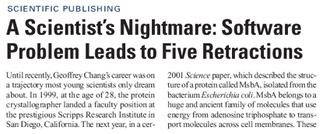
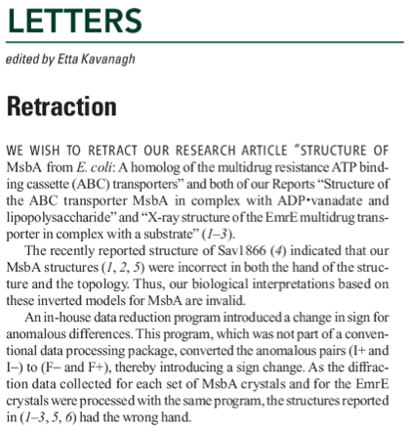
The unfortunate story of Geoffrey Chang
Science, Dec 2006: 5 high-profile retractions (3x Science, PNAS, J. Mol. Biol.) because ”an in-house data reduction program introduced a change in sign for anomalous differences”
August 2026, CC BY-SA 4.0
Testing scientific code, v16.0
Notes:
When you get a crappy result, you triple check your code for bugs. If the results come out just the way you want them to, how much effort are you going to put into double-checking?
For two errors reported and retraced, many more undetected or not reported.
Software mistakes can affect scientific conclusions and may be discovered late.
### What to say
> This kind of failure is especially painful in research because the output can look authoritative. It may be plotted, published, reused, and cited before anyone notices the bug.
Then:
> Tests cannot guarantee that a scientific result is true. But they reduce the chance that the result is wrong because of a simple implementation mistake.
Important distinction:
```text
No tests: unknown behavior.
Some tests: checked behavior for specific claims.
Good tests: many important claims checked automatically.
```

Slide 14
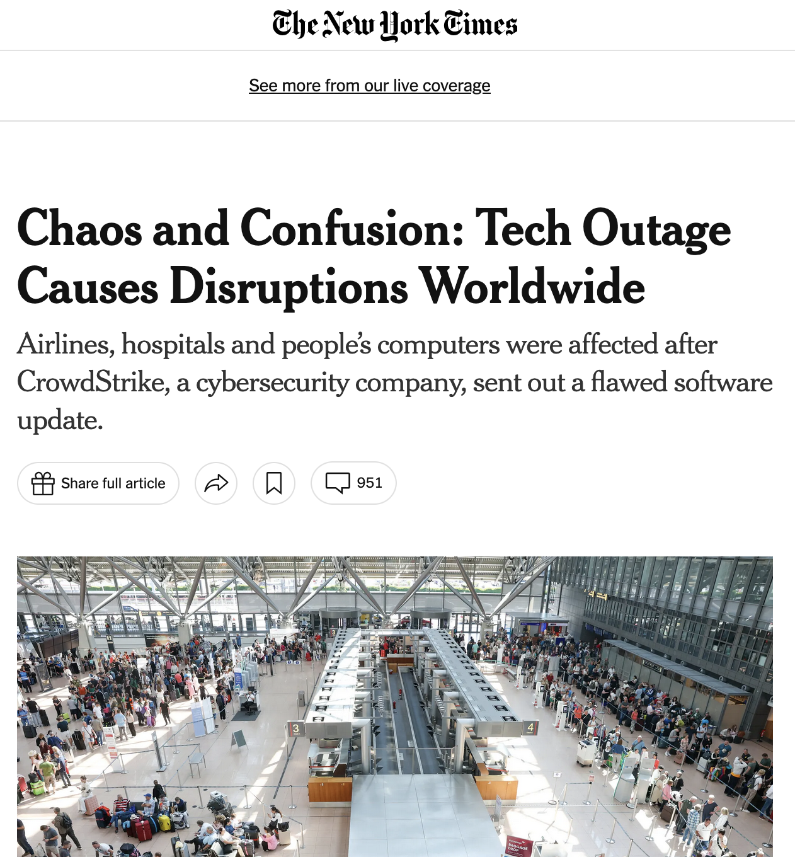
2024 CrowdStrike incident
A software update by CrowdStrike resulted in 8.5 million Microsoft Windows-based systems crashing, unable to restart (across hospitals, airports, companies, …)
—> largest outage in the history of information technology
They changed one array from 20 entries to 21 entries, which caused a fatal error.
They did not test this change properly:
their unit tests only tested the most basic case (happy path)
their manual test only tested valid data
August 2026, CC BY-SA 4.0
Testing scientific code, v16.0
Notes:
tests were a bit like you only using the obvious array to test your find_maxima function, but not testing on an empty list or maxima at the ends etc.
> A common testing failure is testing only the happy path: the normal input, the clean dataset, the example from the tutorial. But many serious failures happen on malformed input, boundary cases, unexpected shapes, empty data, missing values, or rare combinations.
Connect to `find_maxima`:
```text
Happy path: [1, 3, -2, 0, 2, 1]
Boundary case: []
Endpoint behavior: [4, 2, 1, 3, 1, 5]
Ambiguous case: [1, 2, 2, 1]
```
### Classroom question
> What is the equivalent of an empty list or plateau in your own data?
Expected examples:
```text
- empty CSV file
- missing column
- NaN values
- duplicate timestamps
- all-zero measurements
- one-row dataset
- non-monotonic time axis
- unexpected units
```
### Transition
> Now that we have the motivation, we can start writing actual automated tests.

Slide 15

Testing basics
August 2026, CC BY-SA 4.0
Testing scientific code, v16.0
Notes:
I hope I have given you enough motivation. So let‘s get into testing.
A test is just code that calls other code and checks the result.
### Terminal
From `hands_on/local_maxima`:
```bash
cd ../first
cat first.py
sed -n '1,160p' test_first.py
```
Expected `first.py`:
```python
def times_3(x):
return x * 3
```
### What to say
> This is intentionally simple. The goal is not to learn multiplication. The goal is to learn the shape of a test.
Explain the test pattern:
```python
value = 7
expected = 21
result = times_3(value)
assert result == expected
```
Say:
> This is the basic pattern: prepare input, compute result, compare result to expectation.
Optional term:
```text
Arrange → Act → Assert
```

Slide 16
A test is just another function
Imagine we wrote this new function, and we wanted to test it
def times_3(x):
"""Multiply x by 3.
Parameters
----------
x : The item to multiply by 3.
"""
return x * 3
August 2026, CC BY-SA 4.0
Testing scientific code, v16.0
Notes:
DEMO
1. test manually:
- write result = times_3(2) into file and run it → correct result.
- change 2 → “a” and run again
I just tested my function. Cool.
How can I improve this? NO CODING
keep both tests in file
write what the expected value is
if name == main
what if you write many more functions
You know what would be really cool?
If I could move all of this code somewhere else, into a different directory and be able to collect all of the test cases and be able to run them any time I want.
Tadaaa – this is where we get to Pytest, which enables us to do all of that.
DEMO
### Terminal
`first.py`:
```python
def times_3(x):
return x * 3
```
> This is intentionally simple. The goal is not to learn multiplication. The goal is to learn the shape of a test.
Explain the test pattern:
input = 7
expected = 21
result = times_3(input
result == expected
Say:
> This is the basic pattern: prepare input, compute result, compare result to expectation.
Optional term:
```text
Arrange → Act → Assert
```
1. test manually: write result = times_3(2) into file and run it → correct result.
- write result = times_3(2) into file and run it → correct result.
- change 2 → “a” and run again
I just tested my function. Cool.
How can I improve this? NO CODING
keep both tests in file
write what the expected value is
if name == main
what if you write many more functions
You know what would be really cool?
If I could move all of this code somewhere else, into a different directory and be able to collect all of the test cases and be able to run them any time I want.
Tadaaa – this is where we get to Pytest, which enables us to do all of that.

Slide 17
Testing frameworks
The collection of tests written to test a package is called a “test suite”
Execution of a test suite is automated: external software runs the tests and provides reports and statistics
Main testing frameworks for python:
unittest: in the standard library
pytest: what is most commonly used
=============================================== test session starts ================================================
platform darwin -- Python 3.11.3, pytest-7.3.1, pluggy-1.0.0
collected 2 items
test_first.py::test_times_3_integer PASSED [ 50%]
test_first.py::test_times_3_string PASSED [100%]
================================================ 2 passed in 0.00s =================================================
August 2026, CC BY-SA 4.0
Testing scientific code, v16.0
Notes:
Pytest is a testing framework for Python.
It collects all of your tests and runs them for you and tells you whether they passed or failed.
A test suite is a collection of tests that can be run automatically.
### What to say
> Earlier, we typed examples into Python manually. That works once, but it does not scale. A test suite saves those examples and runs them automatically.
Explain:
> `pytest` found the file `test_first.py`, found functions whose names start with `test_`, ran them, and reported whether each one passed or failed.
### Key caveat
> A passing test does not mean the whole program is correct. It means this particular behavior matched this particular expectation.

Slide 18
Hands-on!
Go to hands_on/first
Discover all tests in all subdirectories pytest –v
Execute all tests in one module pytest -v test_first.py
Execute one single test pytest -v test_first.py::test_times_3_string
Look into test_first.py. What do you see?
August 2026, CC BY-SA 4.0
Testing scientific code, v16.0
Notes:
After exercise: Ask what they saw in the test file.
test file name
tests names
assertions
structure of tests – setup, expected, result, assertion
pytest -x -v
```
Explain:
```text
-x stop after the first failure
-v verbose output
```
### What to say
> During active development, a common pattern is to run one failing test repeatedly until it passes, then run the full suite before committing.
Workflow:
```text
1. Run the failing test only.
2. Fix the code.
3. Run the full test suite.
```

Slide 19
Test suites in Python with pytest
Writing tests with pytest is simple:
Tests are collected in files called test_abc.py , which usually contains tests for the functions defined in a corresponding module abc
Each test is a function called test_jkl_feature, and usually it tests feature feature of a function called jkl
Each test tests one feature in your code, and checks that it behaves correctly using “assertions”. An exception is raised if it does not work as expected.
August 2026, CC BY-SA 4.0
Testing scientific code, v16.0
Notes:
> Let’s look carefully at the test function. It is ordinary Python. The only special thing is the naming convention and the `assert`.
Show:
```python
def test_times_3_integer():
value = 7
expected = 21
result = times_3(value)
assert result == expected
```
Explain line by line:
```text
value input
expected expected output
result actual output
assert check
```
### Key phrase
> Good tests are readable. A future reader should understand what behavior is being checked.
[… slide …]
The one thing you may be unfamiliar with are assertions, so let‘s atlk about them a bit.

Slide 20
Assertions
assert statements check that some condition is met, and raise an exception otherwise
Check that statement is true/false: assert 'Hi'.islower() => fail assert not 'Hi'.islower() => pass
Check that two objects are equal: assert 2 + 1 == 3 => pass assert [2] + [1] == [2, 1] => pass assert 'a' + 'b' != 'ab' => fail
assert can be used to compare all sorts of objects, and pytest will take care of producing an appropriate error message
August 2026, CC BY-SA 4.0
Testing scientific code, v16.0
Notes:
Assertions can check many kinds of conditions, not only numeric equality.
Examples:
```python
assert 2 + 1 == 3
assert 2 + 1 != 4
assert "hello".islower()
assert [2] + [1] == [2, 1]
assert len([1, 2, 3]) == 3
```
### Optional failure-output demo
Add temporarily to `test_first.py`:
```python
def test_assertion_message_for_lists():
assert [2] + [1] == [1, 2]
```
Run:
```bash
pytest -v test_first.py::test_assertion_message_for_lists
```
Expected failure shape:
```text
E assert [2, 1] == [1, 2]
E At index 0 diff: 2 != 1
```
Then remove the temporary failing test.
> pytest’s failure output is part of the tool. Read it carefully before changing code.

Slide 21
Hands-on! Possibly your first test
Inside test_first.py, test that times_3([1]) returns what you would expect
Try to change the expected result in the test to [2] (or anything you want) and watch the test break. Look at the error message and make sure you understand what’s going on
August 2026, CC BY-SA 4.0
Testing scientific code, v16.0
Notes:
> We already tested `times_3` with an integer and with a string. Now let’s add one more case: a list.
Ask:
> What does Python do with `[1] * 3`?
Expected:
```python
[1, 1, 1]
```
Add to `test_first.py`:
```python
def test_times_3_list():
value = [1]
expected = [1, 1, 1]
result = times_3(value)
assert result == expected
```
Run:
```bash
pytest -v test_first.py::test_times_3_list
pytest -v
```
### Intentional failure
Temporarily change:
```python
expected = [2]
```
Run:
```bash
pytest -v test_first.py::test_times_3_list
```
Say:
> In this case, the code is not wrong. The test expectation is wrong. A failing test means implementation and expectation disagree; we still have to decide which side is wrong.
Restore:
```python
expected = [1, 1, 1]
```

Slide 22
Hands-on! Possibly your first test
Create a new file, test_plus.py: write a test that asserts that 1+2 is 3
Execute the test
August 2026, CC BY-SA 4.0
Testing scientific code, v16.0
Notes:
Write the test, it does not have to call a function, it can just assert that 1 + 2 == 3
What do you expect to happen, will the test pass or fail (show of hands)

Slide 23
Hands-on! Possibly your first test
Create a new file, test_plus.py: write a test that asserts that 1+2 is 3
Execute the test
Then write a new test and assert that 1.1 + 2.2 is 3.3
Execute the tests
August 2026, CC BY-SA 4.0
Testing scientific code, v16.0
Notes:
Next one
What do you expect to happen, will the test pass or fail (show of hands)
Afterwards:
Did anyone find out why this fails?
DEMO:
terminal: evaluate 3.3, then evaluate 1.1 + 2.2 → 3.300000003
### Point of the slide
Exact equality is often wrong for floating-point arithmetic.
### Create `test_plus.py`
```bash
vim test_plus.py
```
Add:
```python
def test_integer_addition():
assert 1 + 2 == 3
```
Run:
```bash
pytest -v test_plus.py
```
Now add:
```python
def test_float_addition_exact():
assert 1.1 + 2.2 == 3.3
```
Run:
```bash
pytest -v test_plus.py
```
Expected: the float test fails.
Inspect:
```bash
python - <<'PY'
print(1.1 + 2.2)
print(repr(1.1 + 2.2))
print(repr(3.3))
PY
```
Expected:
```text
3.3000000000000003
3.3000000000000003
3.3
```
### What to say
> Mathematically, we expect `1.1 + 2.2` to be `3.3`. But in binary floating-point arithmetic, these decimal numbers are not stored exactly.
### Point of the slide
For floating-point values, test closeness, not exact equality.
### Edit `test_plus.py`
At top:
```python
from math import isclose
```
Change failing assertion to:
```python
def test_float_addition_approximate():
assert isclose(1.1 + 2.2, 3.3)
```
Run:
```bash
pytest -v test_plus.py
```
### What to say
> This test now matches the numerical reality. The values are not exactly identical, but they are close enough under the default tolerance.
### Key point
> The tolerance is not just a technical detail. In scientific code, the tolerance should reflect the scale and accuracy required by the problem.

Slide 24
Floating point equality
Real numbers are represented approximately as “floating point” numbers. When developing numerical code, we have to allow for approximation errors.
Check that two numbers are approximately equal: from math import isclose def test_floating_point_math(): assert isclose(1.1 + 2.2, 3.3) => pass
abs_tol controls the absolute tolerance: assert isclose(1.121, 1.2, abs_tol=0.1) => pass assert isclose(1.121, 1.2, abs_tol=0.01) => fail
rel_tol controls the relative tolerance: assert isclose(120.1, 121.4, rel_tol=0.1) => pass assert isclose(120.4, 121.4, rel_tol=0.01) => fail
August 2026, CC BY-SA 4.0
Testing scientific code, v16.0
Notes:
If you’re working with floating point numbers two number are rarely exactly the same
DEMO
show that isclose works.
### Point of the slide
“Close enough” must be specified.
### What to say
> Absolute tolerance says the error may be at most this fixed amount. Relative tolerance says the error may be small compared with the size of the number.
Examples:
```python
isclose(1.121, 1.2, abs_tol=0.1) # passes
isclose(1.121, 1.2, abs_tol=0.01) # fails
```
Add tests:
```python
def test_absolute_tolerance_passes():
assert isclose(1.121, 1.2, abs_tol=0.1)
def test_absolute_tolerance_fails():
assert not isclose(1.121, 1.2, abs_tol=0.01)
```
Run:
```bash
pytest -v test_plus.py
```
### Key phrase
> Floating-point tests should not ask “are these exactly equal?” They should ask “is the numerical error acceptable for this problem?”

Slide 25
Hands-on!
One more equality test: check that the sum of these two NumPy arrays: x = np.array([1, 1]) y = np.array([2, 2]) is equal to z = np.array([3, 3])
August 2026, CC BY-SA 4.0
Testing scientific code, v16.0
Notes:
Show of hands, who thinks this will work?
### Point of the slide
NumPy arrays do element-wise comparison. That gives an array of booleans, not one single `True` or `False`.
### Terminal
From `hands_on/first`:
```bash
cd ../numpy_equality
sed -n '1,200p' test_numpy_equality.py
pytest -v
```
Expected failure shape:
```text
ValueError: The truth value of an array with more than one element is ambiguous.
```
### Mini experiment
```bash
python
```
```python
import numpy as np
x = np.array([1, 1])
y = np.array([2, 2])
z = np.array([3, 3])
x + y
(x + y) == z
bool((x + y) == z)
```
Expected:
```python
array([3, 3])
array([ True, True])
ValueError
```
Exit:
```python
exit()
```
### Teaching point
> For arrays, use array-aware assertions. Do not use plain `assert array1 == array2`.

Slide 26
Testing with numpy arrays
def test_numpy_equality(): x = np.array([1, 1]) y = np.array([2, 2]) z = np.array([3, 3]) assert x + y == z
__________________________________ test_numpy_equality __________________________________
def test_numpy_equality():
x = numpy.array([1, 1])
y = numpy.array([2, 2])
z = numpy.array([3, 3])
> assert x + y == z
E ValueError: The truth value of an array with more than one element is ambiguous. Use a.any() or a.all()
code.py:47: ValueError
August 2026, CC BY-SA 4.0
Testing scientific code, v16.0
Notes:
The intention was to test for equality element-by-element
### Point of the slide
Use `numpy.testing` helpers for array comparisons.
Exact comparison:
```python
from numpy.testing import assert_equal
```
Approximate floating-point comparison:
```python
from numpy.testing import assert_allclose
```
### Edit `test_numpy_equality.py`
At top:
```python
from numpy.testing import assert_equal, assert_allclose
```
Replace exact integer-array assertions:
```python
assert_equal(x + y, z)
```
Do not write:
```python
assert assert_equal(x + y, z)
```
because these helper functions raise `AssertionError` themselves.
### What to say
> NumPy provides test helpers that understand arrays. They check shape and element-wise values, then report useful differences when something fails.

Slide 27
Testing with numpy arrays
The module np.testing defines helper functions: assert_equal(x, y) assert_allclose(x, y, rtol=1e-07, atol=0)
If you need to check more complex conditions:
np.all(x): returns True if all elements of x are true np.any(x): returns True is any of the elements of x is true
combine with logical_and, logical_or, logical_not: # test that all elements of x are between 0 and 1 assert all(logical_and(x > 0.0, x < 1.0))
August 2026, CC BY-SA 4.0
Testing scientific code, v16.0
Notes:
To get the element-by-element check we want, we need to be more specific
DEMO that assert_equal works here as well
If you need to check more complex conditions, you can combine stuff
Just to show you all and any
DEMO python in terminal
import numpy as np
a = np.array([1, 2, 3])
assert np.all(a > 1)
assert np.all(a >= 1)
assert np.any(a > 1)
a > 1
a >= 1
allclose:
The tolerance values are positive, typically very small numbers. The
relative difference (`rtol` * abs(`b`)) and the absolute difference
`atol` are added together to compare against the absolute difference
between `a` and `b`.
### Point of the slide
Scalar floating-point values need approximate equality; NumPy floating-point arrays need approximate array equality.
Add or fix a test:
```python
def test_allclose():
x = np.array([1.1, 2.2])
y = np.array([2.2, 3.3])
z = np.array([3.3, 5.5])
assert_allclose(x + y, z)
```
Run:
```bash
pytest -v
```
### What to say
> `assert_allclose` also has tolerances, similar in spirit to `isclose`. We can pass `rtol` and `atol` when the default is not appropriate.
Example:
```python
assert_allclose(actual, expected, rtol=1e-7, atol=1e-12)
```

Slide 28
Watch out for nans!
In general, nan is not equal to itself (IEEE standard)
assert_equal and assert_allclose consider nans equal by default
In [2]: np.nan == np.nan
Out[2]: False
def test_allclose_with_nan():
x = np.array([1.1, np.nan])
y = np.array([2.2, np.nan])
z = np.array([3.3, np.nan])
assert_allclose(x + y, z)
test_numpy_equality.py::test_allclose_with_nan PASSED
August 2026, CC BY-SA 4.0
Testing scientific code, v16.0
Notes:
### Point of the slide
`NaN` is not equal to itself under normal equality, but NumPy testing helpers can treat matching NaNs as acceptable.
### What to say
> In scientific data, `NaN` often means missing, invalid, or undefined value. This creates another equality trap.
Experiment:
```bash
python
```
```python
import numpy as np
from numpy.testing import assert_equal, assert_allclose
np.nan == np.nan
np.array([np.nan]) == np.array([np.nan])
assert_equal(np.array([np.nan]), np.array([np.nan]))
assert_allclose(np.array([1.1, np.nan]), np.array([1.1, np.nan]))
```
Expected visible output:
```python
False
array([False])
```
The assertion helper calls should produce no output.
Exit:
```python
exit()
```
### Key point
> Matching NaNs are often acceptable in tests because they mean the missing or undefined value appears in the expected location. But this is a policy decision.
If you want to require no NaNs:
```python
assert not np.isnan(result).any()
```

Slide 29
Write a working version of find_maxima, with testing
Read carefully the description of Issue #1 on GitHub
Submit a Pull Request for Issue #1
Fork the repository (if you haven’t already)
Create a new branch on the fork called e.g. fix-1
Solve the issue with one or more commits
Push the branch to your GitHub fork
On GitHub, go to “Pull Requests” and open a pull request against branch main of the official ASPP repository
In the PR description write “Fixes #1” somewhere, this is going to create an automatic link to the issue, and close the issue if the PR is merged
August 2026, CC BY-SA 4.0
Testing scientific code, v16.0
Notes:
## Point of the slide
A real code change should include both implementation and tests.
### Terminal
From `hands_on/numpy_equality`:
```bash
cd ../local_maxima
pwd
sed -n '1,160p' local_maxima.py
```
Create a branch:
```bash
git status
git switch -c fix-local-maxima-tests
```
Fallback for older Git:
```bash
git checkout -b fix-local-maxima-tests
```
### Create `test_local_maxima.py`
```python
from local_maxima import find_maxima
def test_find_maxima_simple_case():
assert find_maxima([1, 3, -2, 0, 2, 1]) == [1, 4]
def test_find_maxima_boundaries():
assert find_maxima([4, 2, 1, 3, 1, 5]) == [0, 3, 5]
def test_find_maxima_empty_input():
assert find_maxima([]) == []
def test_find_maxima_plateau_returns_leftmost_index():
assert find_maxima([1, 2, 2, 1]) == [1]
def test_find_maxima_plateau_before_higher_value_is_not_maximum():
assert find_maxima([1, 2, 2, 3, 1]) == [3]
```
Run:
```bash
pytest -v
```
### What to say
> These two plateau tests are especially important because they define ambiguous behavior. Returning the left-most plateau index is a specification choice, and now that choice is executable.
### Commit
```bash
git status
git diff
git add local_maxima.py test_local_maxima.py
git commit -m "Add tested local maxima implementation"
```
If the course issue says to reference Issue #1, PR/MR description:
```text
Fixes #1
This implements find_maxima and adds tests for:
- ordinary interior maxima
- endpoint maxima
- empty input
- flat maxima, returning the left-most plateau index
- plateaus followed by a higher value
```
### Key phrase
> The important habit is not just writing tests. The important habit is attaching tests to the behavior you are changing.

Slide 30

Up next: Testing patterns
August 2026, CC BY-SA 4.0
Testing scientific code, v16.0
Notes:
### What to say
> So far, we have covered the basic mechanics: write a function whose name starts with `test_`, call the code under test, and use an assertion to check expected behavior.
Summarize:
```text
- Plain equality works for integers, strings, lists, and other exact objects.
- Floating-point values usually need approximate comparison.
- NumPy arrays need NumPy-aware assertions.
- Edge cases should be explicit tests, not manual checks.
```
Then:
> The next step is testing patterns: how to test expected failures, how to organize repeated cases, and how to make tests readable and maintainable.

Slide 31
August 2026, CC BY-SA 4.0
Testing scientific code, v16.0

Slide 32
Timings: 4,5 h
Part 1: 1,25
Part 2: 2,25
Debugging: 0,75
CI: 0,25
August 2026, CC BY-SA 4.0
Testing scientific code, v16.0

Slide 33
The agile development cycle
Pick your next feature
Write tests to check that feature works
debug
Write simplest code that makes tests pass
Run tests until all tests pass
Refactor + optimize only if necessary
August 2023, CC BY-SA 4.0
Testing scientific code, v16.0
Notes:
As opposed to waterfall model
Reminder
1) describe cycle
2) short development cycles: granularity of chosen feature is important
3) for all of these steps there are python tools to help you
======
Actually maybe it's better to show test and debug cycle?

Slide 34

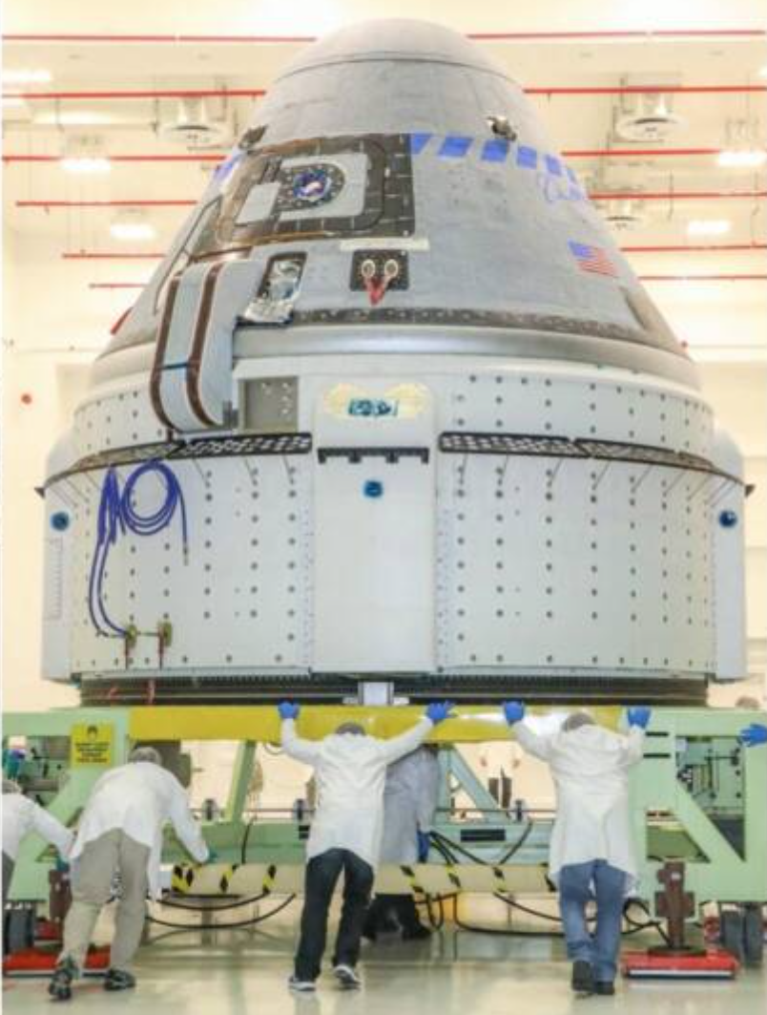
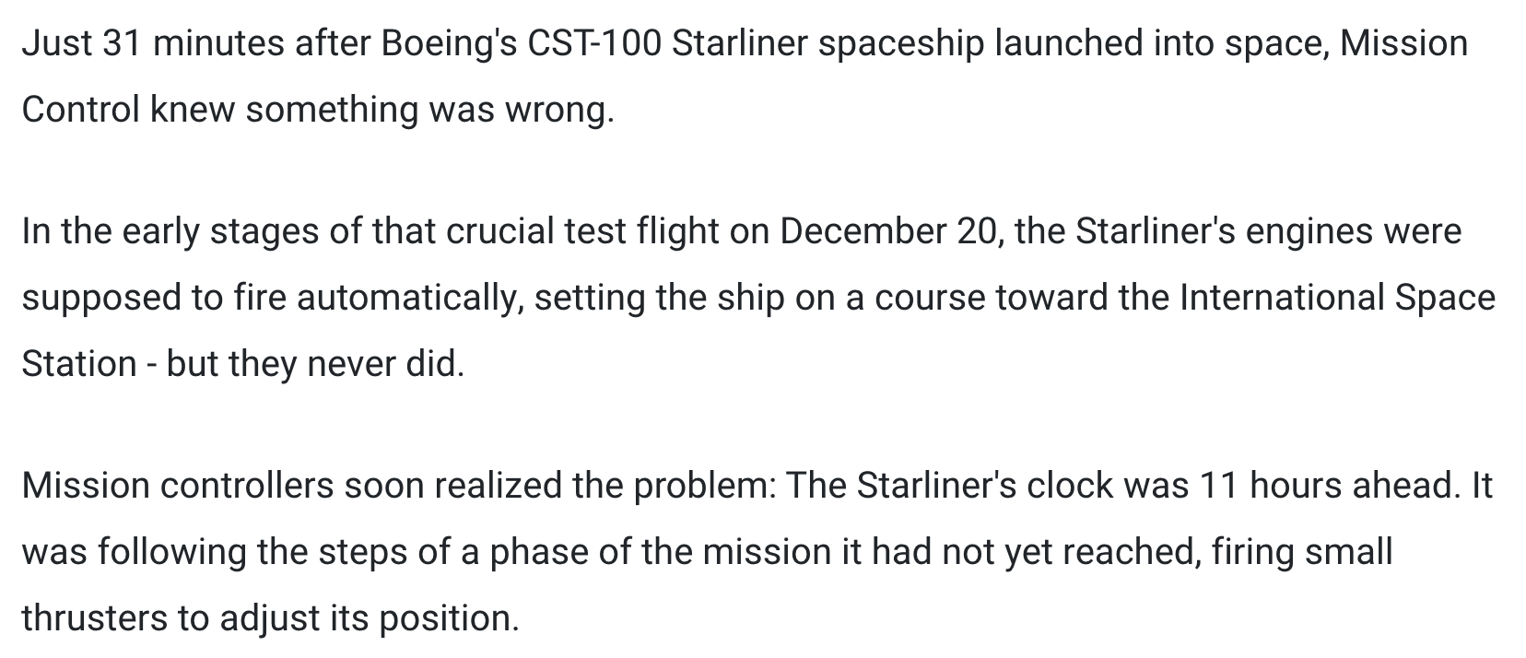
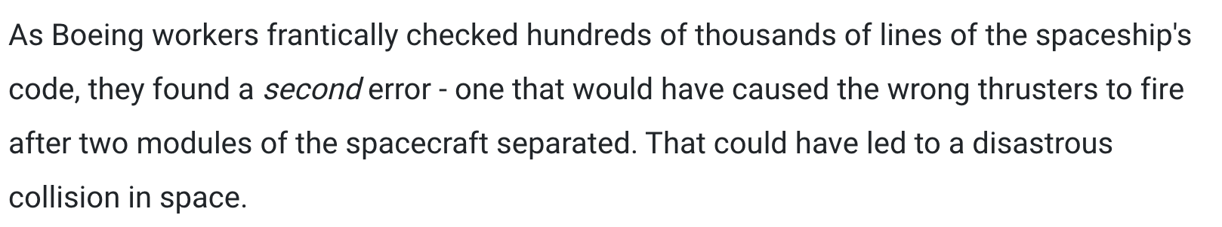
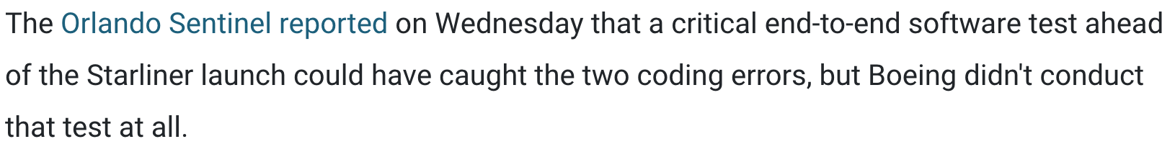
[...]
August 2023, CC BY-SA 4.0
Testing scientific code, v16.0
https://www.businessinsider.fr/us/boeing-software-errors-jeopardized-starliner-spaceship-737-max-planes-2020-2

Slide 35
Testing error control
Check that an exception is raised: from py.test import raises def test_raises(): with raises(SomeException): do_something() do_something_else()
For example: with raises(ValueError): int('XYZ’) passes, because int('XYZ’) ValueError: invalid literal for int() with base 10: 'XYZ'
August 2026, CC BY-SA 4.0
Testing scientific code, v16.0
Notes:
Finally

Slide 36
Testing error control
Use the most specific exception class, or the test may pass because of collateral damage: # Test that file "None" cannot be opened. with raises(IOError): open(None, 'r') as expected, but with raises(Exception): open(None, 'r’)
=> fail
=> pass
August 2026, CC BY-SA 4.0
Testing scientific code, v16.0

