Slide 1
Python tools for writing scientific code
Pietro Berkes, Twitter Cx

Slide 2
Python tools for agile development
Write tests to check that feature works
Write simplest code that makes tests pass
Run tests and debug until all tests pass
Refactor and optimize only if necessary
Pick your next feature
py.test
timeit
cProfile
callgrind
line_profiler
Notes:
3) for all of these steps there are python tools to help you; there’s no tool yet for writing the code, unfortunately

Slide 3
Outline
Testing scientific code
Mocking
Profiling and optimization
Packaging

Slide 4
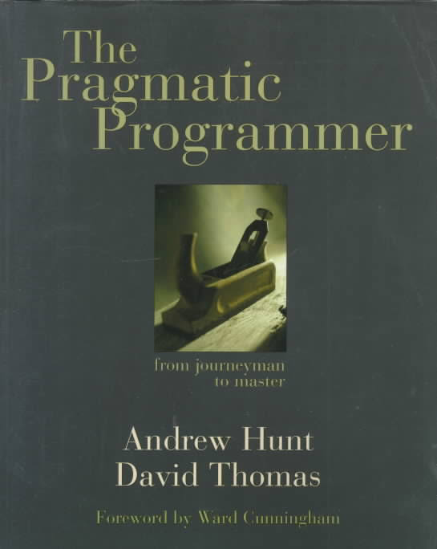
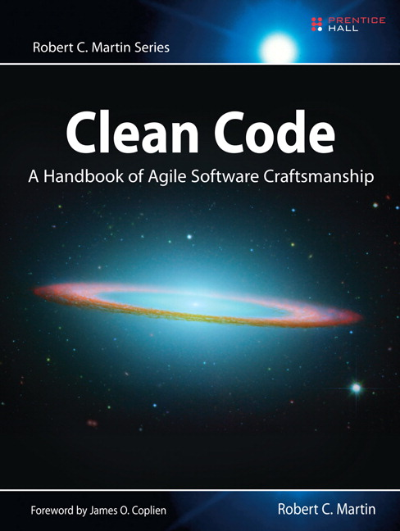

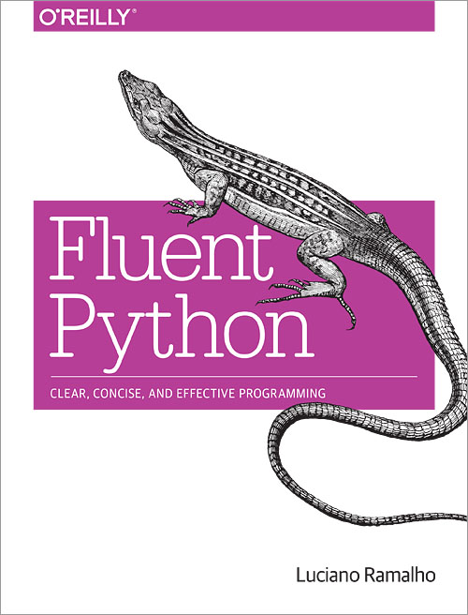
Recommended readings

Slide 5
Before we start
Unzip the materials in your favorite directory

Slide 6
Testing scientific code

Slide 7
The agile development cycle
Write tests to check that feature works
Write simplest code that makes tests pass
Run tests and debug until all tests pass
Refactor and optimize only if necessary
Pick your next feature
py.test
pdb
timeit
cProfile
line_profiler

Slide 8
Testing is good for you
Confidence:
Write the code once and use it confidently everywhere else (the negative result effect)
Correctness is main requirement for scientific code
Save your future self some trouble

Slide 9
Testing is good for your team
Keep your code open for scalability and optimization
Team members, new hires, and intern can start contributing immediately
Example: Porting a codebase to Python 3 is a matter of half a day, if the code is well exercised by tests

Slide 10
Effect of software bugs in science
frequency
bug severity
oops, wrong labels!
need to quickly push update
end of career
Notes:
Made up plot, not backed by any data; and no error bars!
This slide is supposed to scare you into listening to the rest
didn’t properly shuffle my data for the control, a couple of results are not statistically significant any more… errata

Slide 11
The unfortunate story of Geoffrey Chang
Science, Dec 2006: 5 high-profile retractions (3x Science, PNAS, J. Mol. Biol.) because ”an in-house data reduction program introduced a change in sign for anomalous differences”
Notes:
When you get a crappy result, you triple check your code for bugs. If the results come out just the way you want them to, how much effort are you going to put into double-checking?
For two errors reported and retraced, many more undetected or not reported.

Slide 12

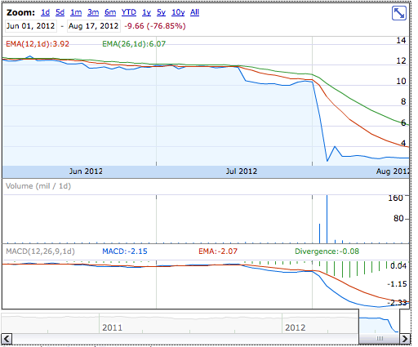
Meanwhile on Wall Street…
Source: Google Finance
NYT, 2 August 2012
Notes:
These slides were supposed to scare you into listening to the rest of the presentation: obviously, we need strategies to prevent this problems, and the agile programming techniques that Valentin talked about yesterday, and testing in particular, go a long way in this direction.

Slide 13
Meanwhile on Wall Street…
… but it worked on my machine!
Source: Google Finance
NYT, 2 August 2012
Notes:
These slides were supposed to scare you into listening to the rest of the presentation: obviously, we need strategies to prevent this problems, and the agile programming techniques that Valentin talked about yesterday, and testing in particular, go a long way in this direction.

Slide 14
Testing basics

Slide 15
Testing frameworks for Python
unittest
nosetests
py.test

Slide 16
Test suites in Python with py.test
Writing tests with py.test is simple:
Each test is a function whose name begins by “test_”
Each test tests one feature in your code, and checks that it behaves correctly using “assertions”. An exception is raised if it does not work as expected.

Slide 17
Testing with Python
Tests are automated:
Write test suite in parallel with your code
External software runs the tests and provides reports and statistics
============================ test session starts ================================
platform darwin -- Python 3.5.2, pytest-2.9.2, py-1.4.31, pluggy-0.3.1 -- /Users/pberkes/miniconda3/envs/gnode/bin/python
cachedir: .cache
rootdir: /Users/pberkes/o/pyschool/testing_debugging_profiling/hands_on/pyanno_voting_solution, inifile:
collected 4 items
pyanno/tests/test_voting.py::test_labels_count PASSED
pyanno/tests/test_voting.py::test_majority_vote PASSED
pyanno/tests/test_voting.py::test_majority_vote_empty_item PASSED
pyanno/tests/test_voting.py::test_labels_frequency PASSED
========================= 4 passed in 0.23 seconds ==============================
Notes:
everybody “tests” his software, little toy problems, or just run it and use it for a while and see than nothing breaks

Slide 18
Hands-on!
Go to hands_on/pyanno_voting
Execute the tests: py.test
Notes:
PyAnno: describe context a little bit; how are annotations represented
Show directory structure
Open file, comment on content
Show next slide: all the ways to execute a test

Slide 19
How to run tests
1) Discover all tests in all subdirectories py.test -v
2) Execute all tests in one module py.test -v pyanno/tests/test_voting.py
3) Execute one single test py.test –v test_voting.py::test_majority_vote

Slide 20
Warm up your fingers!
Create a new file, test_something.py:
Save it, and execute the tests
def test_arithmetic(): assert 1 == 1 assert 2 * 3 == 6 def test_len_list(): lst = ['a', 'b', 'c'] assert len(lst) == 3
Notes:
Import unittest
Define a test unit as a subclass of TestCase
Define a series of methods beginning with ‘test_’ that test some aspect of the code
When unittest.main() is called, the method automatically finds the tests and executes them one by one giving back a report

Slide 21
Assertions
assert statements check that some condition is met, and raise an exception otherwise
Check that statement is true/false: assert 'Hi'.islower() => fail assert not 'Hi'.islower() => pass
Check that two objects are equal: assert 2 + 1 == 3 => pass assert [2] + [1] == [2, 1] => pass assert 'a' + 'b' != 'ab' => fail
assert can be used to compare all sorts of objects, and py.test will take care of producing an approriate error message

Slide 22
Hands-on!
Add a new test to test_something.py: test that 1+2 is 3
Execute the tests

Slide 23
Hands-on!
Add a new test to test_something.py: test that 1+2 is 3
Execute the tests
Now test that 1.1 + 2.2 is 3.3

Slide 24
Floating point equality
Real numbers are represented approximately as “floating point” numbers. When developing numerical code, we have to allow for approximation errors.
Check that two numbers are approximately equal: from math import isclose def test_floating_point_math(): assert isclose(1.1 + 2.2, 3.3) => pass
abs_tol controls the absolute tolerance: assert isclose(1.121, 1.2, abs_tol=1e-1) => pass assert isclose(1.121, 1.2, abs_tol=1e-2) => fail
rel_tol controls the relative tolerance: assert isclose(120.1, 121.4, rel_tol=1e-1) => pass assert isclose(120.4, 121.4, rel_tol=1e-2) => fail
Notes:
If you’re working with floating point numbers two number are rarely exactly the same

Slide 25
Hands-on!
One more equality test: check that the sum of these two NumPy arrays: x = numpy.array([1, 1]) y = numpy.array([2, 2]) is equal to z = numpy.array([3, 3])

Slide 26
Testing with NumPy arrays
def test_numpy_equality(): x = numpy.array([1, 1]) y = numpy.array([2, 2]) z = numpy.array([3, 3]) assert x + y == z
__________________________________ test_numpy_equality __________________________________
def test_numpy_equality():
x = numpy.array([1, 1])
y = numpy.array([2, 2])
z = numpy.array([3, 3])
> assert x + y == z
E ValueError: The truth value of an array with more than one element is ambiguous. Use a.any() or a.all()
code.py:47: ValueError
Notes:
The intention was to test for equality element-by-element

Slide 27
Testing with numpy arrays
numpy.testing defines appropriate functions: assert_array_equal(x, y) assert_array_almost_equal(x, y, decimal=6)
If you need to check more complex conditions:
numpy.all(x): returns True if all elements of x are true numpy.any(x): returns True is any of the elements of x is true numpy.allclose(x, y, rtol=1e-05, atol=1e-08): returns True if two arrays are element-wise equal within a tolerance
combine with logical_and, logical_or, logical_not: # test that all elements of x are between 0 and 1 assert all(logical_and(x > 0.0, x < 1.0))
Notes:
The right way to do this is using …
If you need to check more complex conditions
allclose:
The tolerance values are positive, typically very small numbers. The
relative difference (`rtol` * abs(`b`)) and the absolute difference
`atol` are added together to compare against the absolute difference
between `a` and `b`.

Slide 28
Hands-on!
Fix the test before: check that the sum of these two NumPy arrays: x = numpy.array([1, 1]) y = numpy.array([2, 2]) is equal to z = numpy.array([3, 3])

Slide 29
Hands-on! (time permitting)
In voting , there is an empty function, labels_frequency. Write a test for it, then an implementation.
def labels_frequency(annotations, nclasses): """Compute the total frequency of labels in observed annotations. Example: >>> labels_frequency([[1, 1, 2], [-1, 1, 2]], 4) array([ 0. , 0.6, 0.4, 0. ]) Arguments --------- annotations : array-like object, shape = (n_items, n_annotators) annotations[i,j] is the annotation made by annotator j on item i nclasses : int Number of label classes in `annotations` Returns ------- freq : ndarray, shape = (n_classes, ) freq[k] is the frequency of elements of class k in `annotations`, i.e. their count over the number of total of observed (non-missing) elements """

Slide 30
Testing error control
Check that an exception is raised: from py.test import raises def test_raises(): with raises(SomeException): do_something() do_something_else()
For example: with raises(ValueError): int('XYZ’) passes, because int('XYZ’) ValueError: invalid literal for int() with base 10: 'XYZ'
Notes:
Finally

Slide 31
Testing error control
Use the most specific exception class, or the test may pass because of collateral damage: # Test that file "None" cannot be opened. with raises(IOError): open(None, 'r') as expected, but with raises(Exception): open(None, 'r’)
=> fail
=> pass

Slide 32
Hands on!
Update test_image_sample_point in mpt/face_tracking/test_dataset.py to use raises

Slide 33
Testing patterns

Slide 34
What a good test looks like
What does a good test looks like?
Good:
Short and quick to execute
Easy to read
Exercise one thing
Bad:
Relies on data files
Messes with productions files, servers, databases

Slide 35
Basic structure of a test
A good test is divided in three parts:
Given: Put your system in the right state for testing
Create data, initialize parameters, define constants…
When: Execute the feature that you are testing
Typically one or two lines of code
Then: Compare outcomes with the expected ones
Define the expected result of the test
Set of assertions that check that the new state of your system matches your expectations

Slide 36
Test simple but general cases
Start with simple, general case
Take a realistic scenario for your code, try to reduce it to a simple example
Tests for ‘lower’ method of strings
def test_lower(): # Given string = 'HeLlO wOrld' expected = 'hello world' # When output = string.lower() # Then assert output == expected

Slide 37
Test special cases and boundary conditions
Code often breaks in corner cases: empty lists, None, NaN, 0.0, lists with repeated elements, non-existing file, …
This often involves making design decision: respond to corner case with special behavior, or raise meaningful exception?
def test_lower_empty_string(): # Given string = '' expected = '' # When output = string.lower() # Then assert output == expected
Other good corner cases for string.lower():
‘do-nothing case’: string = 'hi'
symbols: string = '123 (!'
Notes:
First of all, you should start with testing your code with
explain typical test structure
show general case: two words, upper case chars randomly dispersed
special cases
SHOW THIS (cut & paste code)

Slide 38
Common testing pattern
Often these cases are collected in a single test:
def test_lower(): # Given # Each test case is a tuple of (input, expected_result) test_cases = [('HeLlO wOrld', 'hello world'), ('hi', 'hi'), ('123 ([?', '123 ([?'), ('', '')] for string, expected in test_cases: # When output = string.lower() # Then assert output == expected

Slide 39
Even better with py.test
This is better as it shows which test case fails (if any):
import pytest @pytest.mark.parametrize( "string, expected", [('HeLlO wOrld', 'hello world'), ('hi', 'hi'), ('123 ([?', '123 ([?'), ('', '')]) def test_lower(string, expected): output = string.lower() assert output == expected

Slide 40
Numerical fuzzing
Use deterministic test cases when possible
In most numerical algorithm, this will cover only over-simplified situations; in some, it is impossible
Fuzz testing: generate random input
Outside scientific programming it is mostly used to stress-test error handling, memory leaks, safety
For numerical algorithm, it is often used to make sure one covers general, realistic cases
The input may be random, but you still need to know what to expect
Make failures reproducible by saving or printing the random seed
Notes:
In textbooks about testing you will read that tests should always be deterministic
For example, if you want to test a function that computes the Fourier components of a signal: one can define simple deterministic cases (single sine wave), but it’s not general enough
GOOD EXAMPLE: better is random mixtures of sine waves, colored noise, signal with stationary statistics => compute the eigenvalues of the covariance matrix

Slide 41
Hands-on!
Write two tests for the function numpy.var : 1) First, a deterministic test 2) Then, a numerical fuzzing test

Slide 42
Numerical fuzzing – solution
def test_var_deterministic(): x = numpy.array([-2.0, 2.0]) expected = 4.0 assert isclose(numpy.var(x), expected) def test_var_fuzzing(): rand_state = numpy.random.RandomState(8393) N, D = 100000, 5 # Goal variances: [0.1 , 0.45, 0.8 , 1.15, 1.5] expected = numpy.linspace(0.1, 1.5, D) # Generate random, D-dimensional data x = rand_state.randn(N, D) * numpy.sqrt(expected) variance = numpy.var(x, axis=0) numpy.testing.assert_allclose(variance, expected, rtol=1e-2)
Notes:
… generate 5 vectors with 100000 elements, such that each vector has a goal variance, which I set here to be 5 numbers between 0.1 and 1.5
Discuss: Precision of test

Slide 43
Testing learning algorithms
Learning algorithms can get stuck in local maxima, the solution for general cases might not be known (e.g., unsupervised learning)
Turn your validation cases into tests
Stability tests:
Start from final solution; verify that the algorithm stays there
Start from solution and add a small amount of noise to the parameters; verify that the algorithm converges back to the solution
Generate data from the model with known parameters
E.g., linear regression: generate data as y = a*x + b + noise for random a, b, and x, then test that the algorithm is able to recover a and b
Notes:
…
There is no general rule for testing these algorithm, for each specific algorithm there are usually validation cases (e.g, a classifier might be validated using two classes of very different objects)

Slide 44
Other common cases
Test general routines with specific ones
Example: test polynomial_expansion(data, degree) with quadratic_expansion(data)
Test optimized routines with brute-force approaches
Example: test function computing analytical derivative with numerical derivative

Slide 45
Example: eigenvector decomposition
Consider the function values, vectors = eigen(matrix)
Test with simple but general cases:
use full matrices for which you know the exact solution (from a table or computed by hand)
Test general routine with specific ones:
use the analytical solution for 2x2 matrices
Numerical fuzzing:
generate random eigenvalues, random eigenvector; construct the matrix; then check that the function returns the correct values
Test with boundary cases:
test with diagonal matrix: is the algorithm stable?
test with a singular matrix: is the algorithm robust? Does it raise appropriate error when it fails?

Slide 46
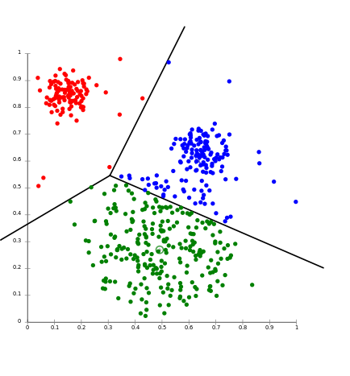
Code Kata
Write k-means implementation using TDD
+
+
+

Slide 47
Mocking

Slide 48
Mock objects for testing
Mock object: object that mimics the behavior of a real object, but doesn’t actually do much
Main reasons to use mocking:
Code would have undesired side effect
Commit to central database
Post to Twitter
Take a very long time to complete
Results depends on things we don’t control
E.g. current time, or temperature
Python3 ships with a unittest.mock package, on Python2 you need to pip install mock

Slide 49
Example: how do we test this function?
report_template = """ Report ====== The experiment was a {judgment}! Let's do this again, with a bigger budget. """ def send_report(result, smtp): if result > 0.5: judgment = 'big success' else: judgment = 'total failure' report = report_template.format(judgment=judgment) smtp.send_message( report, from_addr='pony@magicpony.com', to_addrs=['ferenc@magicpony.com'], )

Slide 50
The Mock object
The superstar of the library, Mock, absorbs everything you throw at it:
>>> from unittest.mock import Mock >>> mock = Mock() >>> print mock.x <Mock name='mock.x' id='24379952'> >>> mock.x = 3 >>> print mock.x 3 >>> mock.whatever(3, key=2) <Mock name='mock.whatever()' id='24470128'>

Slide 51
Interactions are recorded
>>> mock=Mock() >>> mock.foo(2,3) >>> mock.foo('a')
>>> mock.foo.called True >>> mock.baz.called False
>>> mock.f.call_args call('a') >>> mock.f.call_count 2 >>> mock.f.call_args_list [call(2, 3), call('a')]

Slide 52
Support for testing
>>> mock=Mock() >>> mock.foo(2,3) >>> mock.foo('a')
>>> mock.foo.assert_called_with('a')
>>> mock.foo.assert_called_once_with('a') Traceback (most recent call last): AssertionError: Expected to be called once. Called 2 times.
>>> mock.foo.assert_called_with(2, 3) Traceback (most recent call last): AssertionError: Expected call: f(2, 3) Actual call: f('a')
>>> mock.foo.assert_any_call(2, 3)

Slide 53
Mimicking an existing class
Use spec to inherit interface from class:
>>> from smtplib import SMTP >>> mock_smtp = Mock(spec=SMTP) >>> isinstance(mock_smtp, SMTP) True >>> mock_smtp.<TAB> mock_smtp.assert_any_call mock_smtp.attach_mock mock_smtp.assert_called_once_with mock_smtp.auth mock_smtp.assert_called_with mock_smtp.auth_cram_md5 mock_smtp.assert_has_calls mock_smtp.auth_login mock_smtp.assert_not_called mock_smtp.auth_plain ...

Slide 54
Mimicking an existing class
Use spec to inherit interface from class:
>>> mock_smtp.bogus --------------------------------------------------------------------------- AttributeError Traceback (most recent call last) <ipython-input-17-4856e93b6e10> in <module>() ----> 1 mock_smtp.bogus /Users/pberkes/miniconda3/envs/gnode/lib/python3.5/unittest/mock.py in __getattr__(self, name) 576 elif self._mock_methods is not None: 577 if name not in self._mock_methods or name in _all_magics: --> 578 raise AttributeError("Mock object has no attribute %r" % name) 579 elif _is_magic(name): 580 raise AttributeError(name) AttributeError: Mock object has no attribute 'bogus’
Notes:
TODO: can I enforce the signature in a function?

Slide 55
Returning values
Use return_value for a single return value: >>> mock=Mock() >>> mock.bar.return_value = 7 >>> mock.bar(32) 7 >>> mock.bar(one=2, two=4) 7
Use side_effect for a list of return values, one per call: >>> mock.bar.side_effect = [1, 4, 5] >>> mock.bar() 1 >>> mock.bar() 4 >>> mock.bar() 5 >>> mock.bar() Traceback (most recent call last): StopIteration

Slide 56
Side effects
Mock calls with side effects:
>>> mock.baz.side_effect = lambda x: x.append(2) >>> a=[1] >>> mock.baz(a) >>> a [1, 2]
Raising exceptions:
>>> mock.baz.side_effect = Exception('Noooo') >>> mock.baz(2) Traceback (most recent call last): Exception: Noooo

Slide 57
Example: how do we test this function?
report_template = """ Report ====== The experiment was a {judgment}! Let's do this again, with a bigger budget. """ def send_report(result, smtp): if result > 0.5: judgment = 'big success' else: judgment = 'total failure' report = report_template.format(judgment=judgment) smtp.send_message( report, from_addr='pony@magicpony.com', to_addrs=['ferenc@magicpony.com'], )

Slide 58
Example: use mock!
from unittest.mock import Mock
def test_send_report_success(): smtp = Mock() send_report(0.6, smtp) assert smtp.send_message.call_count == 1 pos_args, kw_args = smtp.send_message.call_args message = pos_args[0] assert 'success' in message smtp.reset_mock() send_report(0.4, smtp) assert smtp.send_message.call_count == 1 args, kwargs = smtp.send_message.call_args message = args[0] assert 'failure' in message

Slide 59
Patches
Most of the time, Mock objects are not created from scratch. Rather, one momentarily substitute an object with a mock.
The patch context manager is used for patching objects only within a block of code: with mock.patch('my_module.MyObject'): # here MyObject is patched with a Mock object # here MyObject is restored to normal
It automatically handle the un-patching for you, even if exceptions are raised

Slide 60
Demo
Expensive telescope

Slide 61
Hands-on!
Timed experiment

Slide 62
Optimization and profiling

Slide 63
Testing makes you efficient, too!
An additional big bonus of testing is that your code is ready for improvements
Code can change, and correctness is assured by tests
Happily scale your code up!

Slide 64
The agile development cycle
Write tests to check that feature works
Write simplest code that makes tests pass
Run tests and debug until all tests pass
Refactor and optimize only if necessary
Pick your next feature
unittest
pdb
timeit
cProfile
callgrind
line_profiler

Slide 65
Be careful with optimization
Python is slower than C, but not prohibitively so
In scientific applications, this difference is often not noticeable: the costly parts of numpy, scipy, … are written in C or Fortran
In many practical cases, scientist time, not computer time is the bottleneck
Researchers need to be able to explore many different ideas
Always weight the time you spend on optimizing code vs benefits
Keep this diagram around: https://xkcd.com/1205/

Slide 66
Optimization methods hierarchy
(This is mildly controversial)
In order of preference:
Don’t do anything
Vectorize your code using numpy
Use a “magic optimization” tool, like numexpr, or numba
Spend some money on better hardware (faster machine, SSD), optimized libraries (e.g., Intel’s MKL)
Use Cython
Use GPU acceleration
Parallelize your code

Slide 67
How to optimize
Usually, a small percentage of your code takes up most of the time
Identify time-consuming parts of the code Where’s the bottleneck? Computations? Disk I/O? Memory I/O? Use a profiler! (see also Francesc Alted’s videos)
Only optimize those parts of the code
Keep running the tests to make sure that code is not broken
Stop optimizing as soon as possible

Slide 68
Measuring time: timeit
IPython magic command: %timeit
Precise timing of a function/expression
Test different versions of a small amount of code, often used in interactive Python shell In [6]: %timeit cube(123) 10000000 loops, best of 3: 185 ns per loop

Slide 69
Hands-on!
Write a dot product function in pure Python and time it in IPython using %timeit: dot_product(x, y) is x[1] * y[1] + x[2] * y[2] + … + x[N] * y[N]
Write a version using numpy (vectorized), time it again
Time numpy.dot
Try with large (1000 elements) and small vectors (5 elements)

Slide 70
factorial
Follow with me while we profile the file hands_on/factorial/factorial.py

Slide 71
Measuring time: time
On *nix systems, the command time gives a quick way of measuring time:
“real” is wall clock time
“user” is CPU time executing the script
“sys” is CPU time spent in system calls
$ time python your_script.py
real 0m0.135s
user 0m0.125s
sys 0m0.009s

Slide 72
cProfile
standard Python module to profile an entire application (profile is an old, slow profiling module)
Running the profiler from command line:
Sorting options:
python -m cProfile –s cumulative myscript.py
tottime : time spent in function only
cumtime : time spent in function and sub-calls
calls : number of calls
Notes:
what it is
first, you need to have the profiler collect information while your program is running

Slide 73
cProfile
Or save results to disk for later inspection:
Explore with
python -m cProfile –o filename.prof myscript.py
python –m pstats filename.prof
stats [n | regexp]: print statistics
sort [cumulative, time, ...] : change sort order callers [n | regexp]: show callers of functions
callees [n | regexp]: show callees of functions
Notes:
what it is
first, you need to have the profiler collect information while your program is running

Slide 74
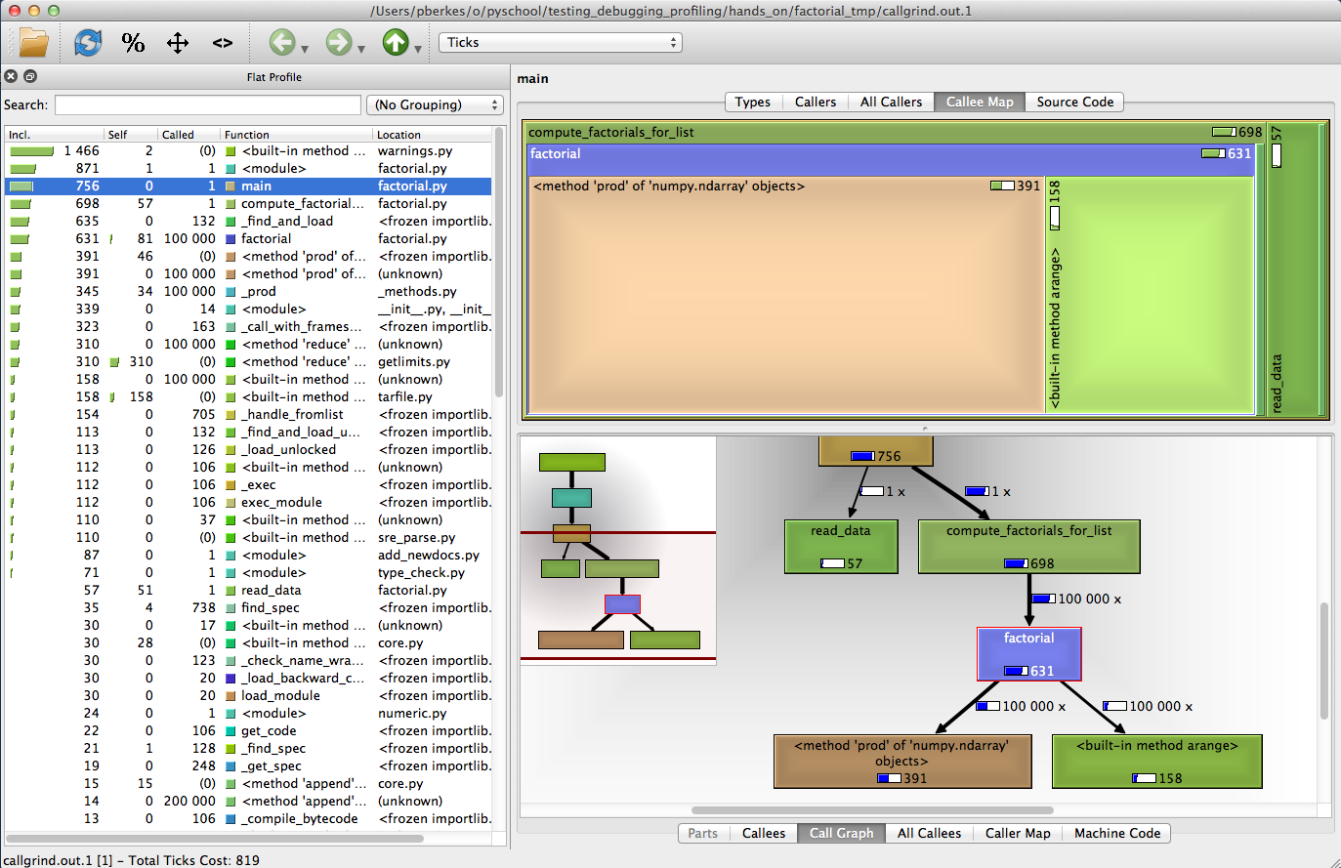
Callgrind

Slide 75
Using callgrind
Callgrind gives graphical representation of profiling results:
Run profiler: python -m cProfile -o factorial.prof factorial.py
Transform results in callgrind format: pyprof2calltree -i factorial.prof -o callgrind.out.1
Run callgrind: qcallgrind callgrind.out.1 or kcachegrind callgrind.out.1

Slide 76
Hands-on
Make sure you can profile and run cachegrind
Optimize the factorial funciton
Modify the code
Run tests to make sure it still works
Profile and measure progress

Slide 77
Fine-grained profiling: line_profiler
You can profile a subset of all functions by decorating them with @profile kernprof –b -v factorial.py
Line-by-line profiling kernprof -b -l -v factorial.py

Slide 78
What about Theano?
Compiled Theano function will show up in the profiling statistics as any other Python function
If you want to profile the Theano graph:
Set the profile and/or profile_memory flags to True
Add profile=True when creating a Theano function
Theano will print out a profiling report when script exists, or upon request: func.profile.summary()

Slide 79
Demo
residuals

Slide 80
Hands on! (time permitting)
Profile the NLP distance function

Slide 81
Packaging

Slide 82
Standard structure of Python projects
root
package
__init__.py
module1.py
module2.py
tests
test_module1.py
test_module2.py
docs
LICENSE.txt
README.txt
setup.py

Slide 83
setup.py
Describes the project content: packages, data, etc
Contains project metadata: authors, version numers, etc
Can be used to install packages, create eggs, upload to PyPI

Slide 84
Minimal setup.py
from setuptools import setup, find_packages
setup( name=’noiser', version='1.0', packages=find_packages(), )

Slide 85
Cython extensions
from Cython.Build import cythonize import numpy from setuptools.extension import Extension from setuptools import setup, find_packages
extensions = [ Extension( "noiser.utils", ["noiser/utils.pyx"], include_dirs=[numpy.get_include()], ), ]
setup( name='PyAnnoExample', version='1.0', packages=find_packages(), ext_modules=cythonize(extensions), )

Slide 86
Entry points
from Cython.Build import cythonize import numpy from setuptools.extension import Extension from setuptools import setup, find_packages
extensions = [ Extension( "noiser.utils", ["noiser/utils.pyx"], include_dirs=[numpy.get_include()], ), ]
setup( name='PyAnnoExample', version='1.0', packages=find_packages(), ext_modules=cythonize(extensions), entry_points={ 'console_scripts': [ 'baboon=noiser.main:main', ], } )

Slide 87
Package data
from Cython.Build import cythonize import numpy from setuptools.extension import Extension from setuptools import setup, find_packages
extensions = [ Extension( "noiser.utils", ["noiser/utils.pyx"], include_dirs=[numpy.get_include()], ), ]
setup( name='PyAnnoExample', version='1.0', packages=find_packages(), ext_modules=cythonize(extensions), entry_points={ 'console_scripts': [ 'baboon=noiser.main:main', ], }, package_data={'noiser': ['images/*.png’]} )

Slide 88
Hands-on!
In research/research create a setup.py file
Include the mpt package
Move content of mpt/core/setup.py
Create a binary wheel, make sure that it contains the cython code
Run python setup.py develop

Slide 89
Final thoughts
Testing is your best shot at keeping shared code flexible
For maximum efficiency, check out how these tools can be integrated with PyCharm

Slide 90
The End
Thank you!

Slide 92
Code organization

Slide 93
A matter of style
Style is subjective, but standards are very helpful when working in a team
What matters: usability, longevity of code
Consistency helps people find and read code

Slide 94
What helps in my experience
Agree on interfaces
This is crucial to avoid mistakes: e.g., format of images
Pick a style, enforce it with flake8
flake8 can be customized to match your style
Avoids extremes: inconsistency and never ending PR discussions on style
Extra step is to have CI fail if flake8 fails
Take backwards compatibility seriously
Do not break backwards compatibility
Semantic versioning
Delete unused code

Slide 95
Static checking
One of the problems with debugging in Python is that most bugs only appear when the code executes.
“Static checking” tools analyze the code without executing it.
pep8: check that the style of the files is compatible with PEP8
pyflakes: look for errors like defined but unused variables, undefined names, etc.
flake8: pep8 and pyflakes in a single, handy command
Notes:
Run flake8 on the *initial* pyanno code.

Slide 96
Hands-on!
In research/research create a tox.ini file: [flake8] exclude = build,dist,doc,notebooks max-line-length = 120
Run flake8 on our libraries: flake8
Errors and warnings we don’t care about can be silenced by adding them to config file, e.g.: [flake8] ... ignore = F405,E226

Slide 97
Data structures

Slide 98
Performance of data structures
Demo: complaining brother

Slide 99
Performance of data structure operations
 | insert | remove | find | ordered
list | linear | linear | linear | ✓
set | constant | constant | constant | ✗
dict | constant | constant | constant | ✗

Slide 100
Hands-on
Sentiment analysis

