Slide 1
Continuous Integration Because you’re worth it, continuously
Lisa Schwetlick and Pamela Hathway

Slide 2
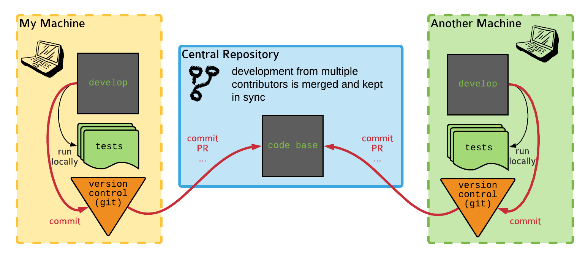
Collaborative Development without CI
Potential issues
The tests might pass on one machine and/or the other, but not in a third-party environment (versions, OS, etc.)
A maintainer needs to ensure that the software works on all the supported combinations of versions / OSs
A maintainer needs to create and upload artifacts like binary packages, documentation, etc

Slide 3

Continuous Integration
Continuous Integration is a set of tools and practices to make sure that a project with many contributors (>= 1) runs smoothly
One goal is to automatize the non-coding tasks:
make sure that the tests always pass
check for style consistency
build packages for distribution on multiple architectures
build documentation
Another goal is to solve the “it works on my machine” problem
Notes:
Continuous integration originally meant the programming practice merging the code of multiple contributor often, multiple times a day. Before git, that was a a big problem, and it could even be some person’s job to do the merges

Slide 4
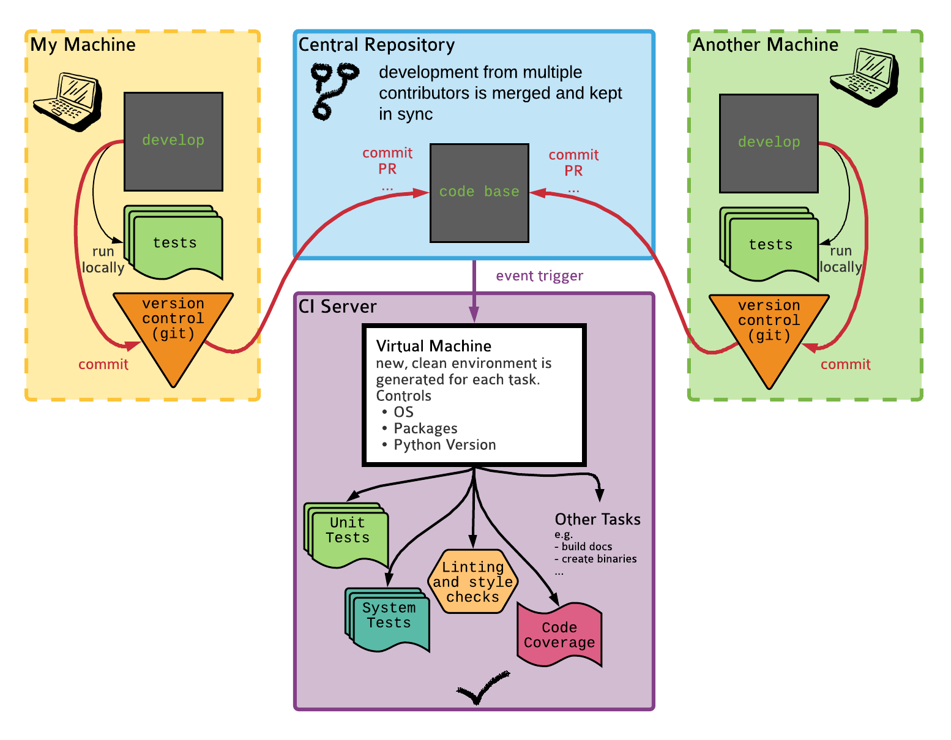
Collaborative Development with CI

Slide 5
The CI tasks that you’ll find 95% of the time
Task 1: Run test when a PR is created
Event trigger: PR is created
Action: Run all tests for different Python versions
Task 2: Release package when version is bumped
Event trigger: Version is bumped
Action: Create binary packages for Linux, Mac, Windows and upload them to a package repository
Task 3: Publish documentation on request
Event trigger: Repository is tagged in a certain way
Action: Build and publish the documentation

Slide 6


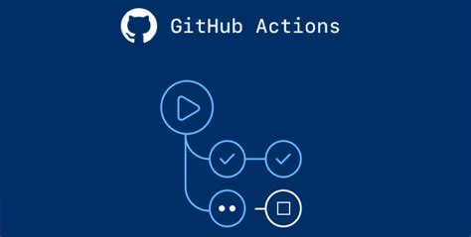
CI options
GitHub Actions is at the moment the preferred choice for many open source projects. It is very flexible and well integrated with GitHub.

Slide 7
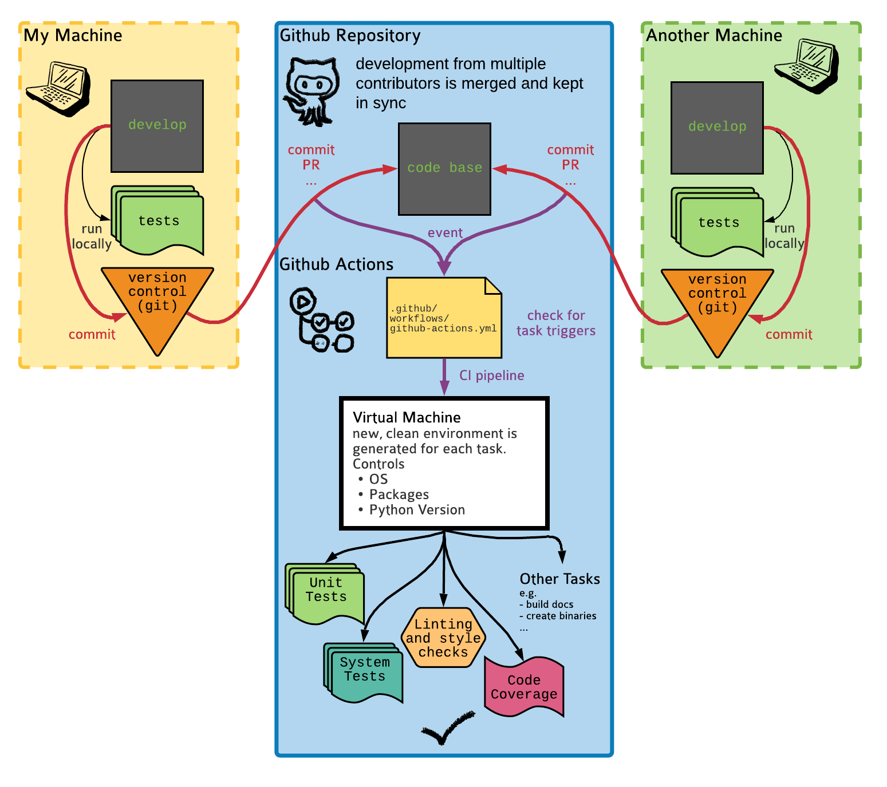
Collaborative Development with GitHub Actions
GitHub acts as both the central repository and the CI server, but the rest is the same

Slide 8
https://github.com/lschwetlick/ASPP_testing_project_ci
EXAMPLE:

Slide 9

Conclusions
It takes a bit of time to set up and debug a Continuous Integration workflow, but it’s a good investment that can save you a lot of time later on!

Slide 10


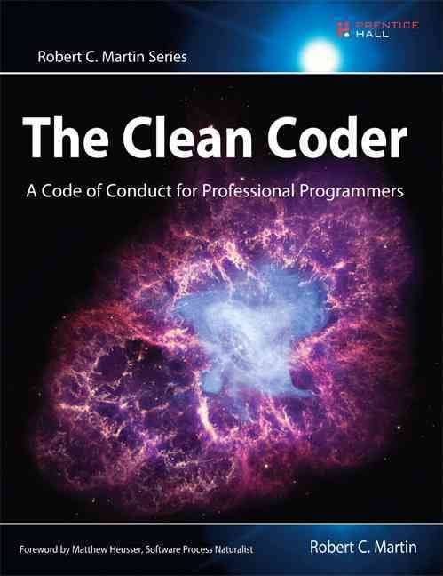
Recommended reading

Slide 11
Thank you!

Slide 12
GitHub Actions basic ideas
An event occurs, it has an associated commit SHA (e.g., a PR is opened or a commit tag is pushed)
GitHub searches for config files in .github/workflows at that SHA, and looks if there is a trigger that matches the event
It then creates a virtual machine as specified in the config file and runs the commands listed there

Slide 13
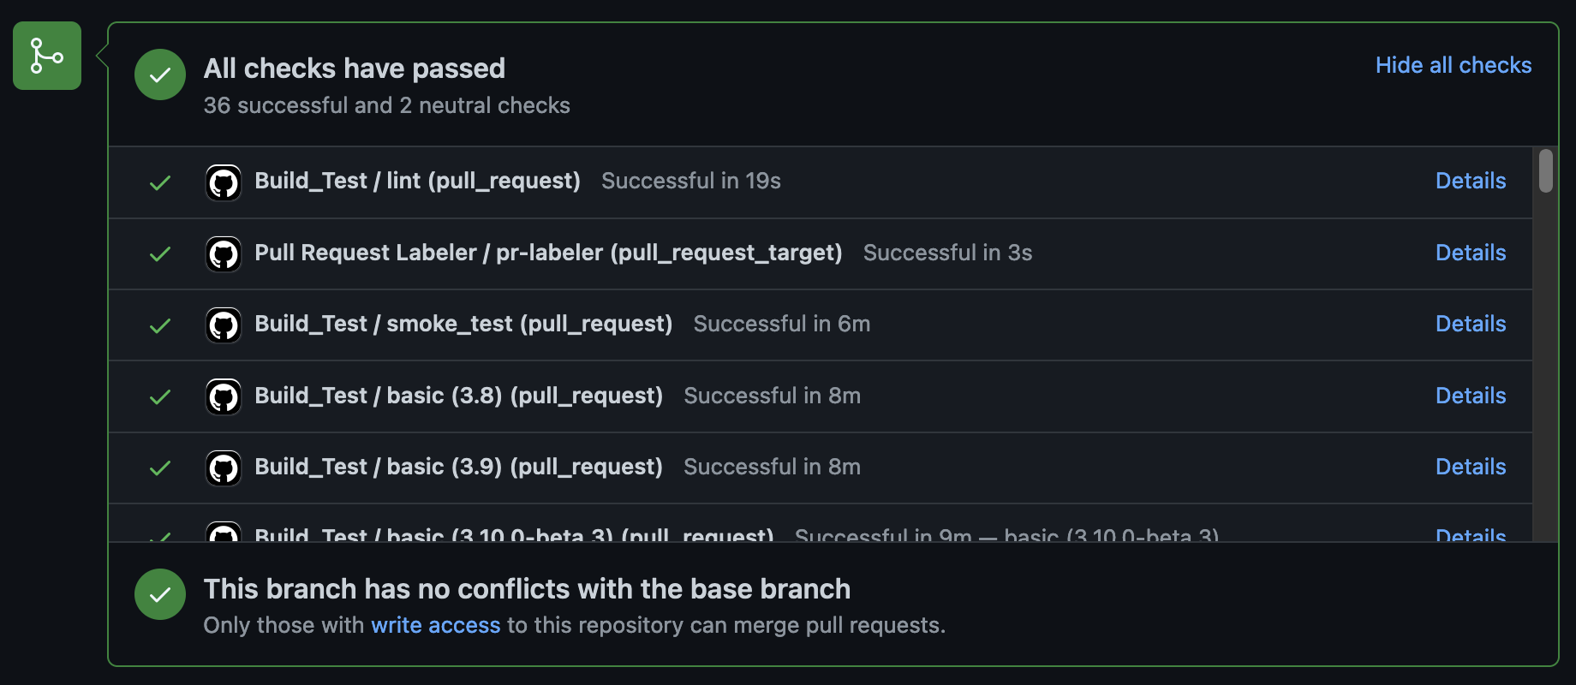
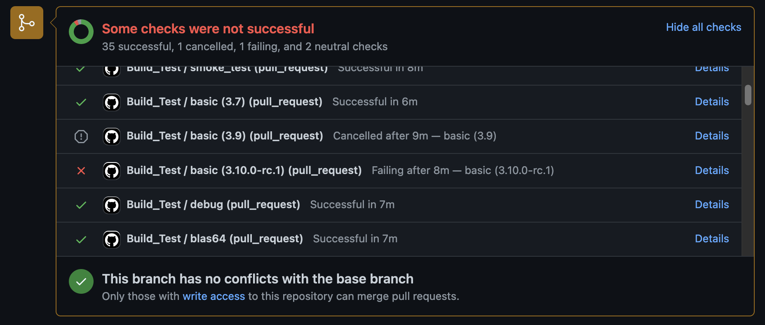
GitHub Actions basic ideas
The outcome is logged and if the job exits cleanly it is marked as ”passed” otherwise “failed”

Slide 14
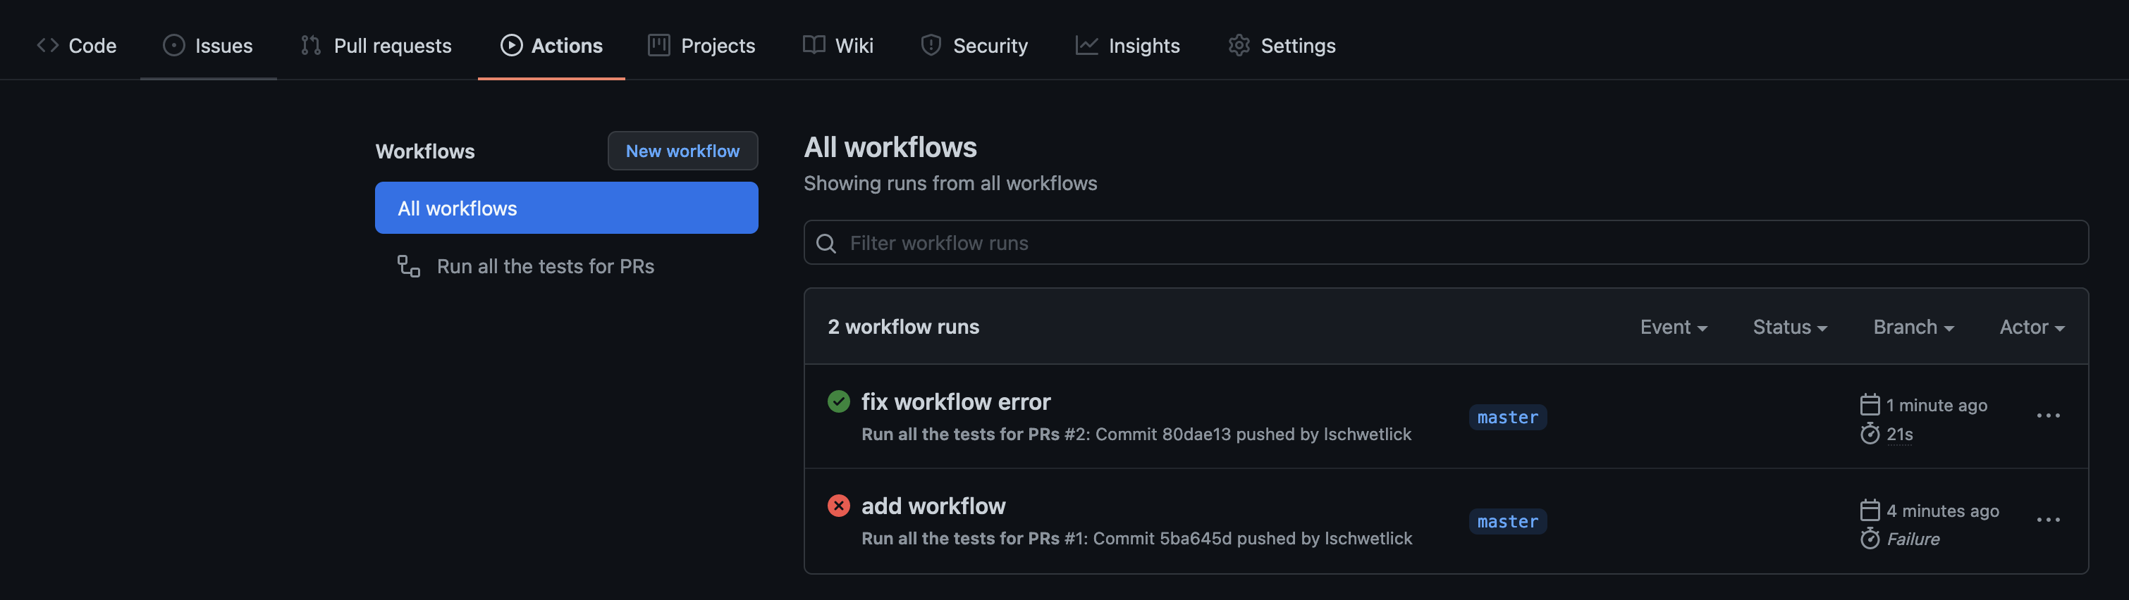
GitHub Actions

Slide 15
GitHub config file: Example Run tests every time a PR is opened or a commit is pushed
The configuration file is saved in .github/workflows , with a name related to its task, e.g. run-tests.yml
name: Run all the tests for PRs
on:
[push, pull_request]
jobs:
run-tests:
runs-on: ubuntu-latest
steps:
- uses: actions/checkout@v2
- name: Set up Python
uses: actions/setup-python@v2
with:
python-version: 3.9
- name: Install dependencies
run:
python -m pip install pytest numpy
- name: Test with pytest
run:
pytest -sv hands_on/pyanno_voting
Specifies the events that trigger the jobs below
The type of virtual machine used to run the workflow
Multiple steps are used to set up the environment so that we can run the tests. Notice the use of community actions
The command that we wanted to execute all along

Slide 16
GitHub Actions reference
Introduction: https://docs.github.com/en/actions/learn-github-actions/introduction-to-github-actions
Events that can trigger actions, and their config options: https://docs.github.com/en/actions/reference/events-that-trigger-workflows#pull_request
Catalog of community actions: https://github.com/marketplace?type=actions

Slide 17
Hands On!
Add a CI pipeline to your logistic function project!
In your local version of the project make a folder .github/workflows
Create a file called run_test_on_push.yml
Write your configuration file to run the tests every time someone pushes some commits or every time someone creates a pull request
Commit and push the changes to GitHub
Check the actions tab of your GitHub repo to see if it worked
Bonus: check the GitHub actions documentation and modify the configuration file so that the tasks run only for pushes and PRs against the branch main

Slide 18
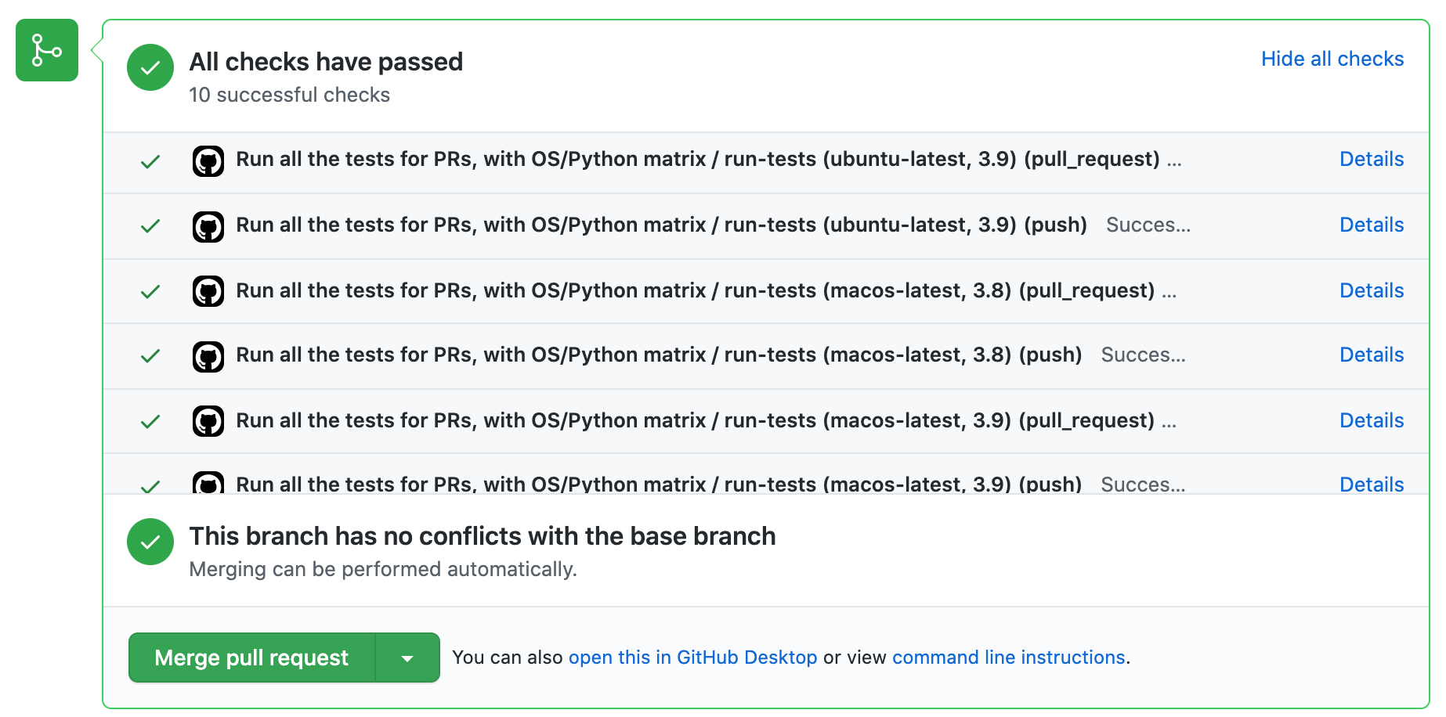
Matrix configuration
If your project supports multiple OSes, Python versions, and library version, you might want to run our tests on all the combinations of those

Slide 19
GitHub Actions workflow with matrix config
Name: Run all the tests for PRs, with OS/Python matrix
on:
[push, pull_request]
jobs:
run-tests:
runs-on: ${{ matrix.os }}
strategy:
matrix:
os: [ubuntu-latest, macos-latest]
python-version: [3.8, 3.9]
steps:
- uses: actions/checkout@v2
- name: Set up Python ${{ matrix.python-version }}
uses: actions/setup-python@v2
with:
python-version: ${{ matrix.python-version }}
- name: Install dependencies
run:
python -m pip install pytest numpy
- name: Test with pytest
run:
pytest -sv hands_on/pyanno_votin
The strategy/matrix section specifies lists of parameters. The workflow is run for all combinations

Slide 20
GitHub Actions workflow with matrix config
Name: Run all the tests for PRs, with OS/Python matrix
on:
[push, pull_request]
jobs:
run-tests:
runs-on: ${{ matrix.os }}
strategy:
matrix:
os: [ubuntu-latest, macos-latest]
python-version: [3.8, 3.9]
steps:
- uses: actions/checkout@v2
- name: Set up Python ${{ matrix.python-version }}
uses: actions/setup-python@v2
with:
python-version: ${{ matrix.python-version }}
- name: Install dependencies
run:
python -m pip install pytest numpy
- name: Test with pytest
run:
pytest -sv hands_on/pyanno_votin
This is how we refer to the matrix parameters in the config file

Slide 21
GitHub Actions reference
Types of virtual machines available on GitHub Actions: https://docs.github.com/en/actions/using-github-hosted-runners/about-github-hosted-runners#supported-runners-and-hardware-resources
setup-python community action, all available Python flavors and versions: https://github.com/marketplace/actions/setup-python

Slide 22
Hands On!
Adapt your git actions configuration file run_test_on_push.yml to run the testing workflow on Python 3.7, 3.8, 3.9, and on Linux and Windows

Slide 24
Bonus: Security
Some tasks require “secrets” like usernames and passwords, for instance to upload the documentation to a remote machine.
Do not push passwords and other sensitive information to a repository, not even a private one! Each CI system has a way to deal with secret safely.
Top Secret

Slide 25
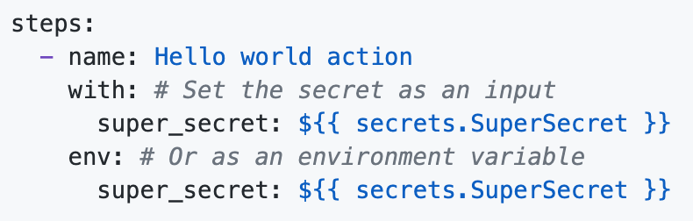
Bonus: Security
Secrets in GitHub actions can be added under Settings -> Secrets. The secret is stored encrypted by GitHub, and decrypted at the moment of running the workflow
Secrets can then be referred to in the workflow as

Slide 26
Bonus: Examples of handling secrets
name: Reveal a secret when the repository is tagged as something starting by secret
on:
push:
tags:
- 'secret*'
jobs:
reveal-secret:
runs-on: ubuntu-latest
steps:
- shell: bash
env:
SECRET_MSG: ${{ secrets.TOP_SECRET }}
run: |
echo The secret is "$SECRET_MSG"
if [ "$SECRET_MSG" = 'do not tell anyone' ]; then
echo matches
fi
Details available at https://docs.github.com/en/actions/reference/encrypted-secrets

