Slide 1
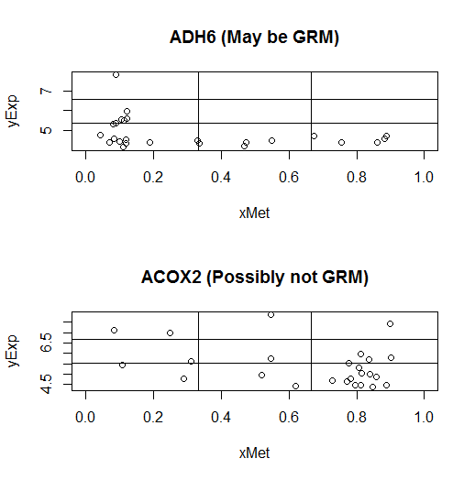
☺ | 😐 | ☹
☺ | 😐 | 😐
☺ | ☺ | ☺
Permitted, indistinct and forbidden regions
To score an L shape on a grid
L-shape (GRM) vs non L-shape

Slide 2
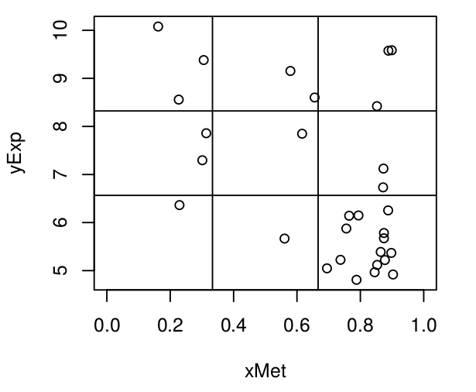

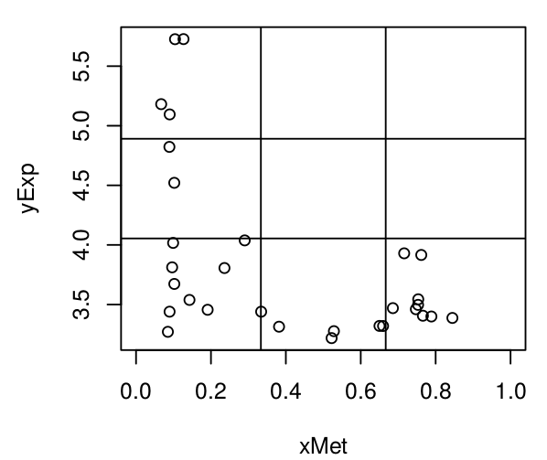

Non L-shape
L-shape

Slide 3
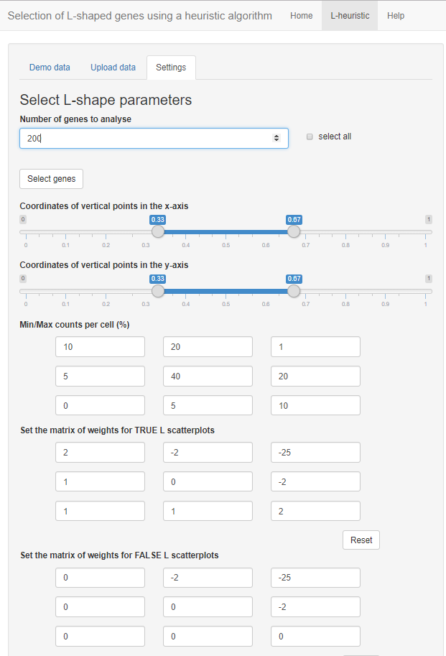
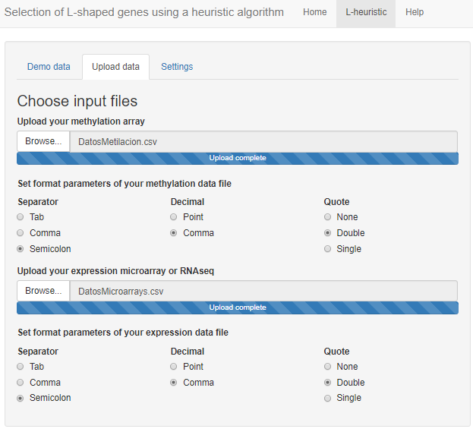

Slide 4
A
10 | 20 | 1
5 | 40 | 20
0 | 5 | 10
B
4 | 20 | 5
1 | 40 | 20
0 | 1 | 4

