Slide 1
The microarray data analysis process

Slide 2
Goals
Overview
  Types of studies
  The basic “pipe-line”
Get familiar with the process
  Input/Output for each step,
  Problems and solutions
  Interpretations
Examples.

Slide 3
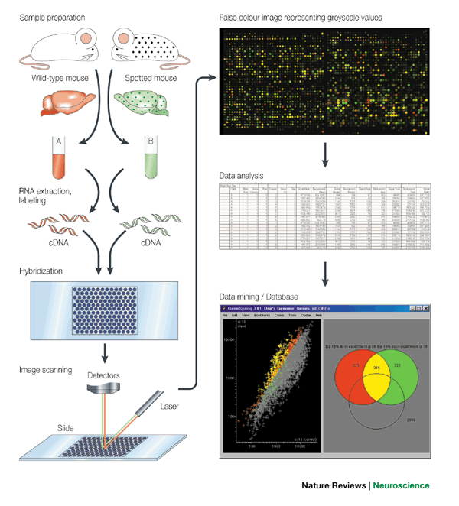
(1): Class comparison

Slide 4
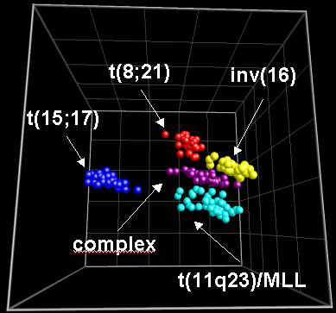
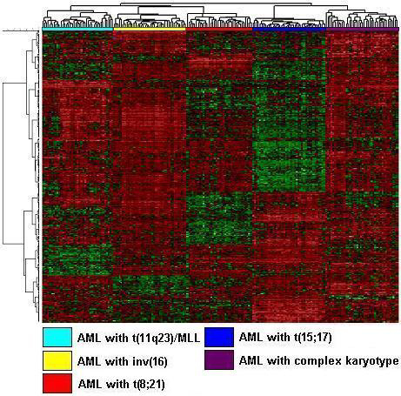
(2): Class discovery

Slide 5
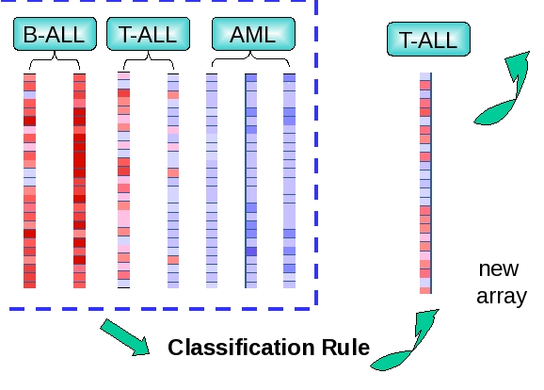
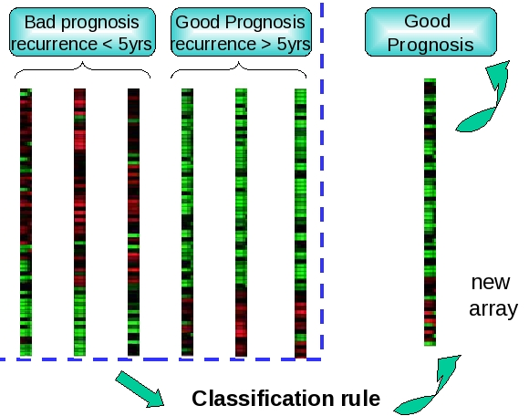
(3): Class prediction

Slide 6
And many, many more …
Time Course
Pathway Analysis-(Systems Biology)
Whole Genome,
CGH,
Alternative Splicing

Slide 7
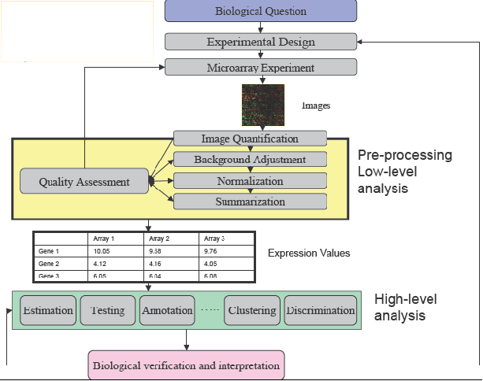
The microarray analysis process

Slide 8
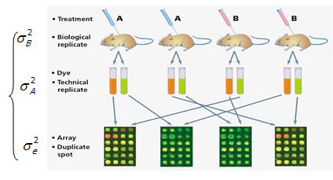
(0) Experimental design
Variability
  Sistematic
    Calibrate/Normalize
  Random
    Experimental design
    Statistical inference
Must decide about:
  Replicates
  Batches (“Batch effect”)
  Pools …

Slide 9
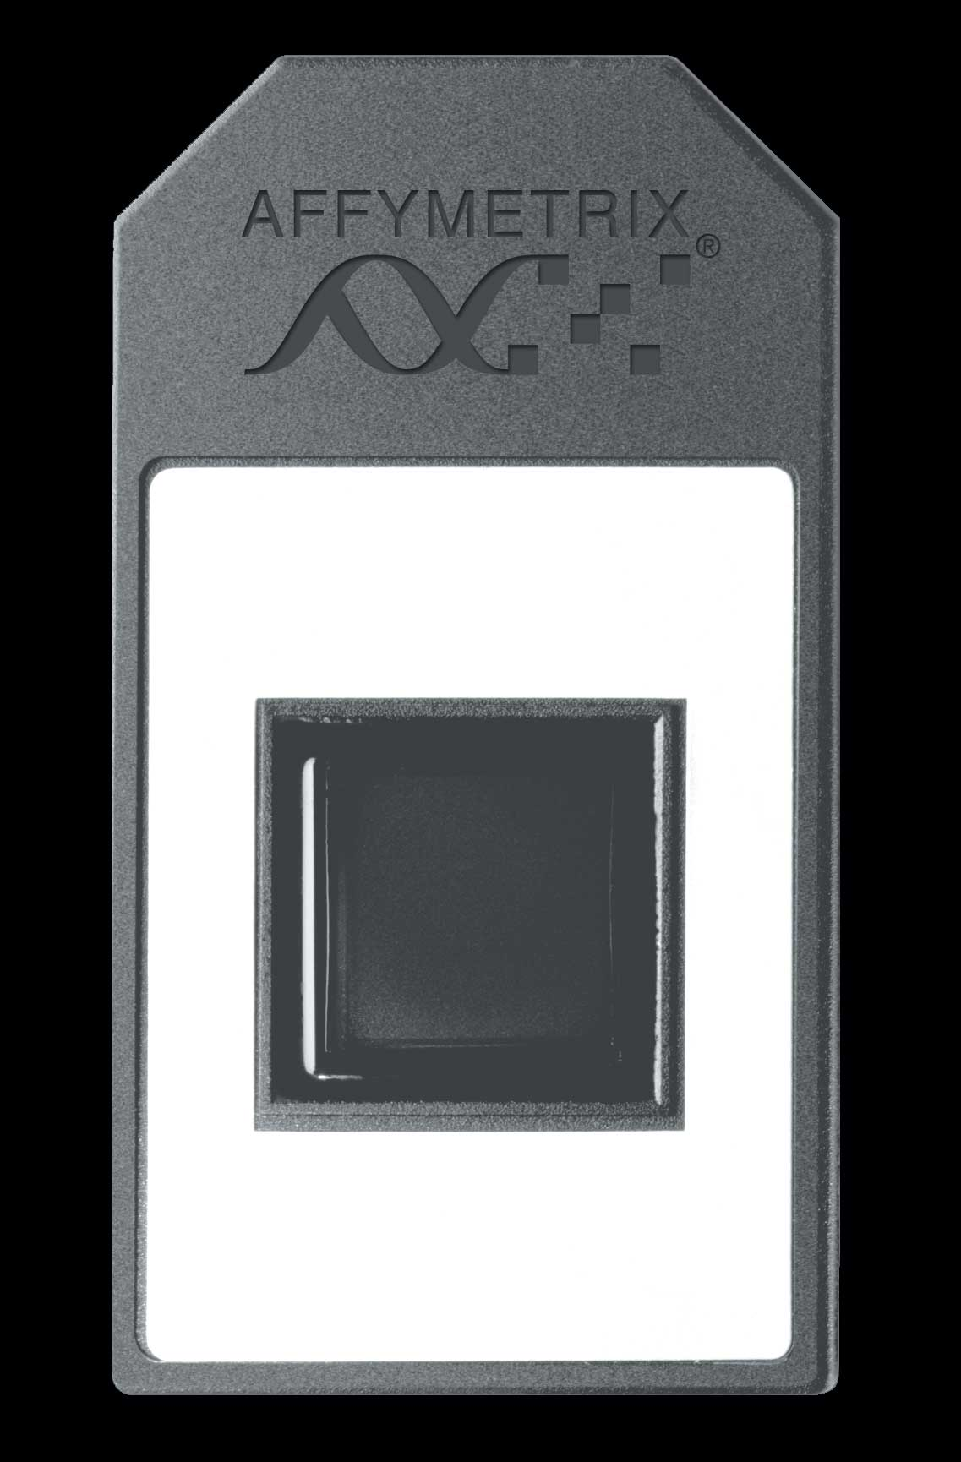
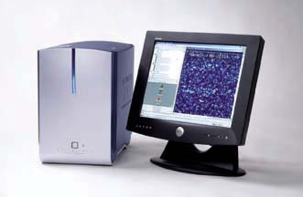
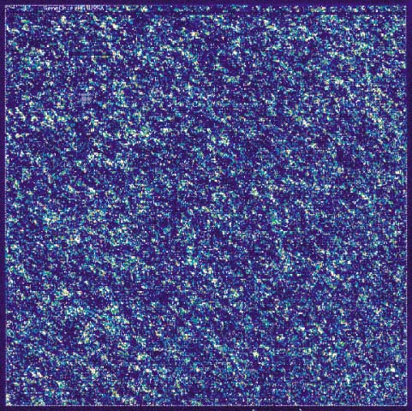
(1) Image obtention
…
Input: Microarrays
Output:
  Images (1/chip)
Information for each individual probe
Data to be used for
Quality control
Preprocess
Summarization
…
1.cel, 1.chp
2.cel, 2.chp

Slide 10


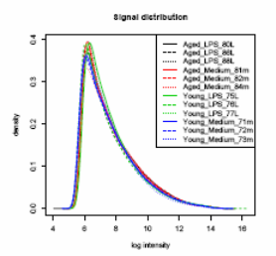
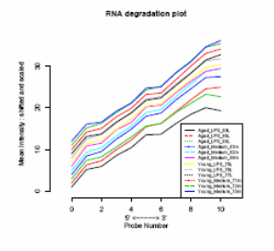
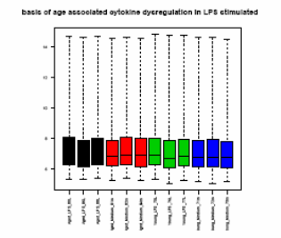
(2) Quality control
Input:
  Images (.CEL, ...)
Process
  Diagnostsics
  Quality checks
Output:
  Plots
  Quality indexes
…
1.cel, 1.chp
2.cel, 2.chp

Slide 11



(3) Preprocess
…
Input:
  Images
Process
  Noise filtering
  Normalization
  Summarization
  Filtering
Output:
  Expression marix
1.cel, 1.chp
2.cel, 2.chp
C01-001.CEL C02-001.CEL C03-001.CEL
1415670_at 8.954387 9.088924 8.833863
1415671_at 10.700876 10.639307 10.610953
1415672_at 10.377266 10.510106 10.461701
1415673_at 7.320335 7.252635 7.112313
1415674_a_at 8.381129 8.332256 8.393718
1415675_at 8.120937 8.082713 8.051514
1415676_a_at 10.322229 10.287371 10.282812
1415677_at 9.038344 8.979641 8.905711

Slide 12
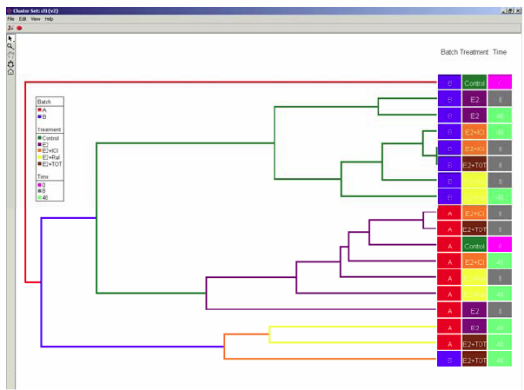
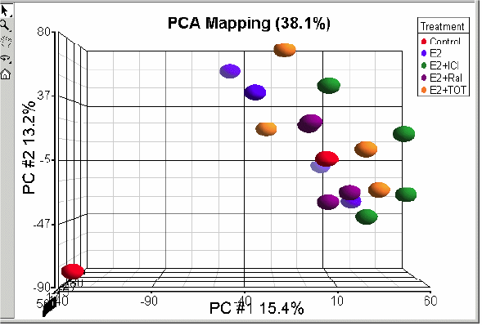
(4) Exploration
C01-001.CEL C02-001.CEL C03-001.CEL
1415670_at 8.954387 9.088924 8.833863
1415671_at 10.700876 10.639307 10.610953
1415672_at 10.377266 10.510106 10.461701
1415673_at 7.320335 7.252635 7.112313
1415674_a_at 8.381129 8.332256 8.393718
1415675_at 8.120937 8.082713 8.051514
1415676_a_at 10.322229 10.287371 10.282812
1415677_at 9.038344 8.979641 8.905711
Input
  Expression matrix
Process
  PCA, Cluster, MDS
  2D/3D plots
Output
Visualizations
  Possible unexplained groupings (e..g. batch effect) detected

Slide 13
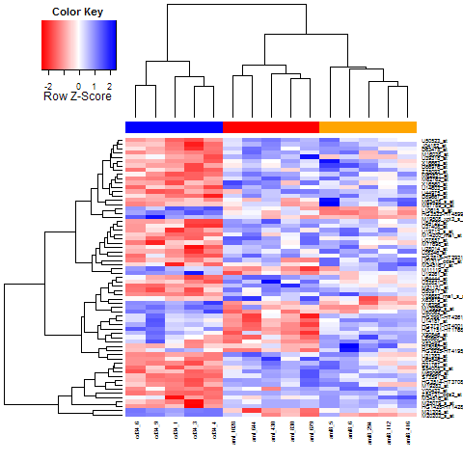
(5) Statistical analysis (i):
Selecting differentially expressed genes
C01-001.CEL C02-001.CEL C03-001.CEL
1415670_at 8.954387 9.088924 8.833863
1415671_at 10.700876 10.639307 10.610953
1415672_at 10.377266 10.510106 10.461701
1415673_at 7.320335 7.252635 7.112313
1415674_a_at 8.381129 8.332256 8.393718
1415675_at 8.120937 8.082713 8.051514
1415676_a_at 10.322229 10.287371 10.282812
1415677_at 9.038344 8.979641 8.905711
Input:
  Expression matrix
  Analysis models
Process
  t-tests, ANOVA
    P-value adjustment
Output
  Gene lists
  Fold change, p.values
  Plots
  Expression profiles

Slide 14
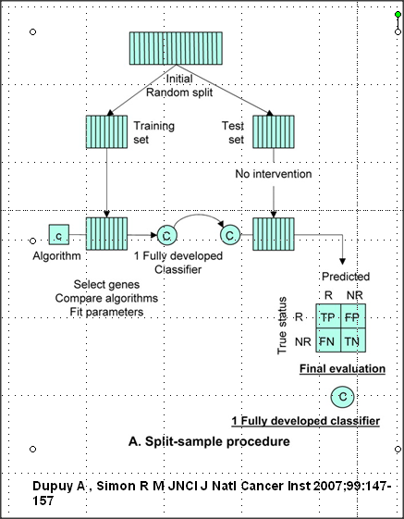
(5) Statistical analysis (ii):
Building and validating a predictor
Input:
  Expression matrix
Process
  Variable selection
  Model fitting
  Validation
Output
  Predictive models
  Measures of sensitivity and reproducibility

Slide 15
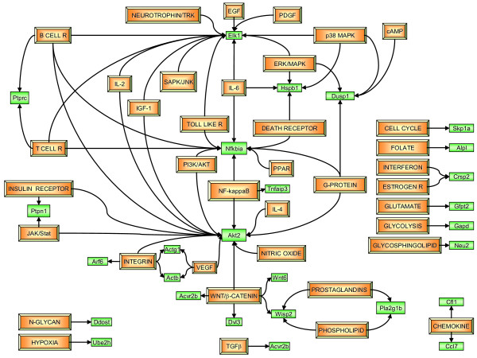
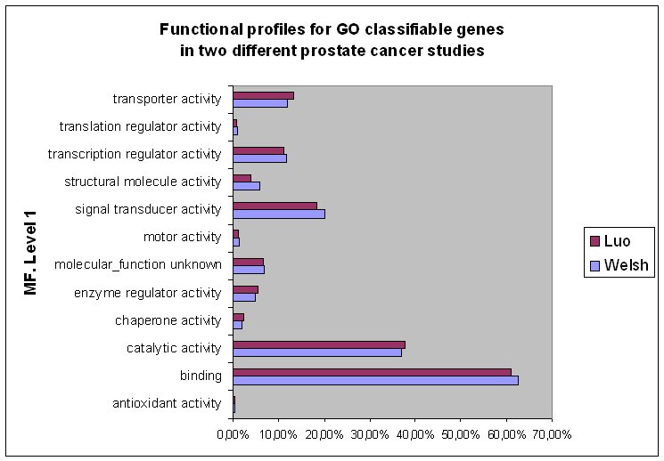
(6) Biological significance
Input
  Gene lists
Process
  GEA, GSEA,
  Network analysis
Output:
  Relevant GO or KEGG terms
  Relevant pathways
  Networks

Slide 16
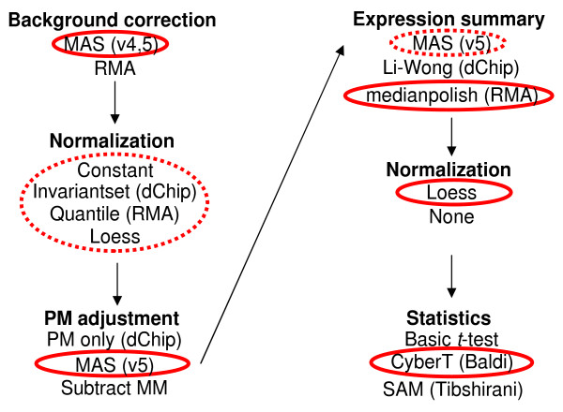
Each step can be done differently ☹
Empirical Bayes (Efron)
Preferred analysis methods for Affymetrix GeneChips ….
Genome Biology 2005, 6:R16

