Slide 1
Introduction to R/Bioconductor
Pieta Schofield

Slide 2
Motivation
“Let us save what remains: not by vaults and locks which fence them from the public eye and use, in consigning them to the waste of time, but by such a multiplication of copies, as shall place them beyond the reach of accident.”
Thomas Jefferson

Slide 3
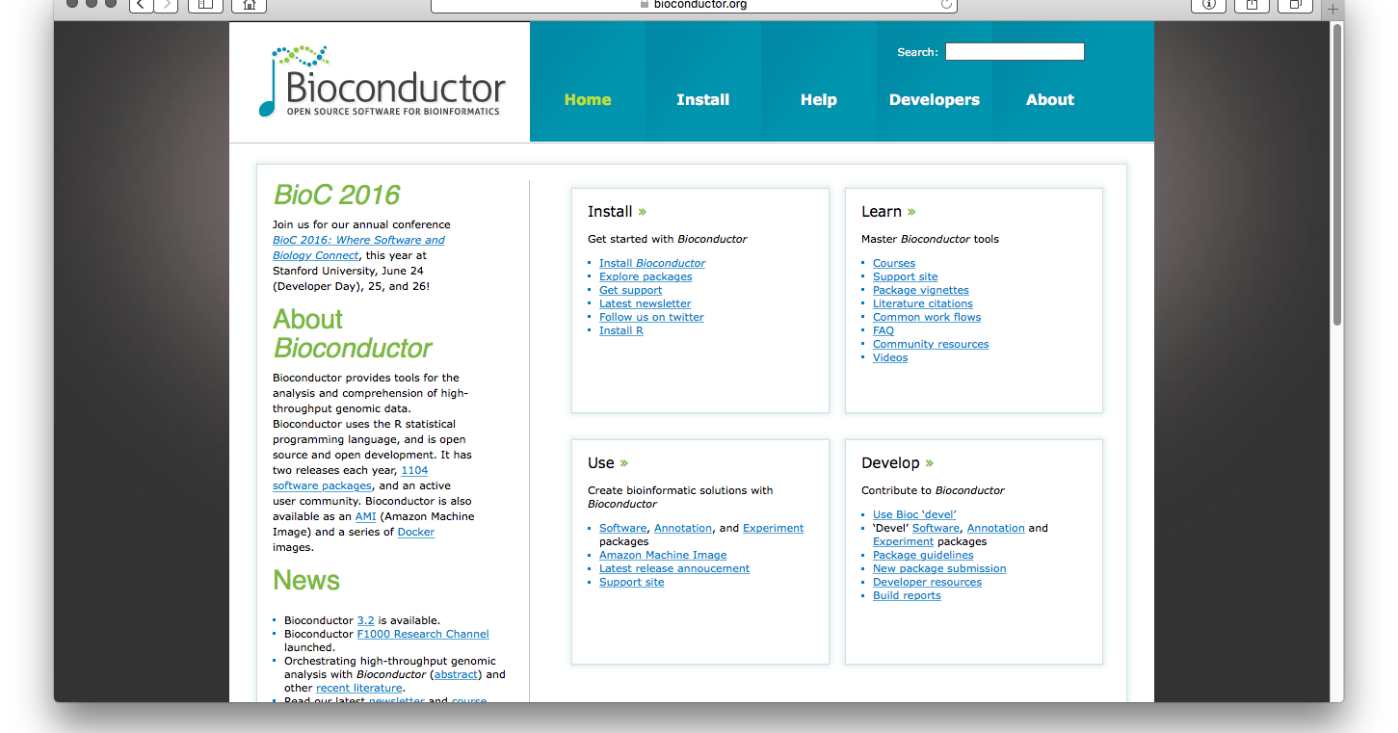
bioconductor.org

Slide 4
Bioconductor
Collection of packages or libraries for R that provide:
Software
Functions to perform certain types of statistical and data analysis tasks
Data structures for holding and manipulation biological data
Annotation Data
Annotation databases
Functions to access and download existing online databases of data and annotations
Experimental Data
Datasets of experimental results

Slide 5
Resources
Bioconductor Resources
Course Materials
Support forum
Package vignettes
Common work flows
YouTube Video Channel
Rdocumentation web site for searching for packages from
Comprehensive R Archive Network (CRAN)
install.packages()
Bioconductor
biocLite() in the BiocInstaller package
Also many packages on GitHub
install_github() in the devtools package

Slide 6
Bioconductor For NGS
There are many Bioconductor packages for RNA-seq
QC (though it is hard to beat FastQC)
ShortRead, EDASeq, htSeqTools...
Alignment
Rsubread, gmapR, Rbowtie..
Data handling
Biostrings, GenomicRanges, GenomicAlignments, Rsamtools...
Differential Expression
edgeR, DESeq, DESeq2, baySeq, EBSeq, RUVSeq, metaseqR...
Annotation Enrichment Analysis
STRINGdb, gage, topGO, pathview, FGNet...

Slide 7
Data Structures
Biostrings:
structures for efficiently holding sequences of amino acids or nucleotides and multiple alignments of sequences.
functions for searching manipulating and pairwise alignment of sequences
GenomicRanges:
structures for holding genomic annotations that occur over 1D regions of sequences
functions for searching, manipulation and calculation with 1D regions
GenomicAlignments:
structures for holding gapped short read alignments
functions for manipulation and calculation over alignments eg. coverage calculation and overlap summation.

Slide 8
Practical
Go to the practical pages

