Slide 1
Example of Microarray
Data Analysis

Slide 2

Locate the data to analyze
GENE EXPRESSION ONMIBUS DATABASE
Public functional genomic repository from NCBI
Array and sequence-based data are accepted
It is mandatory to upload your microarrays CEL files before publishing any article about them
http://www.ncbi.nlm.nih.gov/geo/

Slide 3

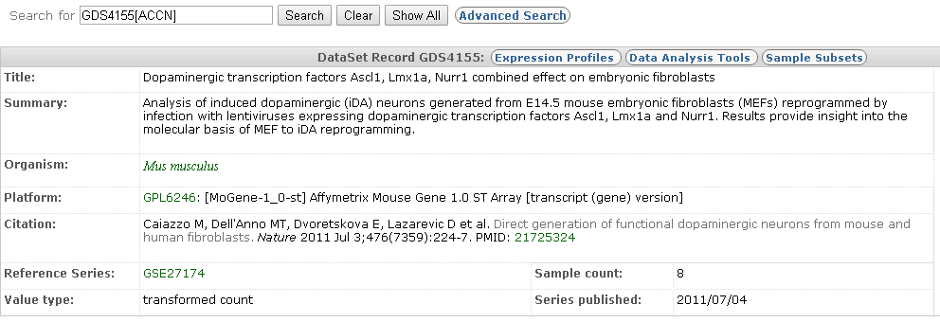
Identify a dataset
GENE EXPRESSION ONMIBUS DATABASE
The data for the example: GDS4155

Slide 4
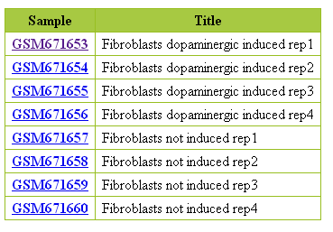
Identify groups in data
INDUCED
WT

Slide 5
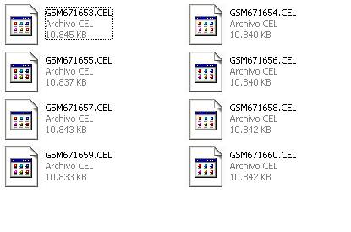
Download celfiles & Prepare targets
Two types of files are necessary to begin the data analysis:
  CEL files
  Targets file
fileName | grupos | ShortName | Colors
GSM671653.CEL | Induced | 53_Ind | red
GSM671654.CEL | Induced | 54_Ind | red
GSM671655.CEL | Induced | 55_Ind | red
GSM671656.CEL | Induced | 56_Ind | red
GSM671657.CEL | WT | 57_WT | blue
GSM671658.CEL | WT | 58_WT | blue
GSM671659.CEL | WT | 59_WT | blue
GSM671660.CEL | WT | 60_WT | blue

