Slide 1
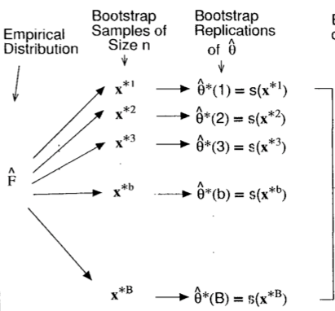






Bias estimate
$$−\hat{θ}$$
$$−\hat{θ}$$
$$−\hat{θ}$$
$$−\hat{θ}$$
$$−\hat{θ}$$

Slide 2
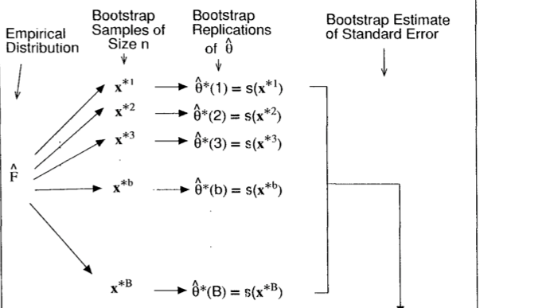
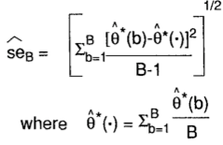

Slide 3
