Slide 1
Microarray Data Analysis
Class discovery and Class prediction:
Clustering and Discrimination
Notes:
Ben Bolstad
August 17, 2004
(c) 2004 CGDN

Slide 2
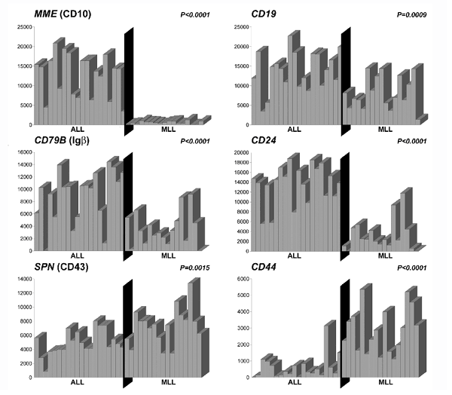
Gene expression profiles
Many genes show definite changes of expression between conditions
These patterns are called gene profiles
Notes:
Ben Bolstad
August 17, 2004
(c) 2004 CGDN

Slide 3
Motivation (1):
The problem of finding patterns
It is common to have hybridizations where conditions reflect temporal or spatial aspects.
  Yeast cycle data
  Tumor data evolution after chemotherapy
  CNS data in different part of brain
Interesting genes may be those showing patterns associated with changes.
Our problem seems to be distinguishing interesting or real patterns from meaningless variation, at the level of the gene
Notes:
Ben Bolstad
August 17, 2004
(c) 2004 CGDN

Slide 4
Finding patterns: Two approaches
If patterns already exist →
Profile comparison (Distance analysis)
  Find the genes whose expression fits specific, predefined patterns.
  Find the genes whose expression follows the pattern of predefined gene or set of genes.
If we wish to discover new patterns →
Cluster analysis (class discovery)
  Carry out some kind of exploratory analysis to see what expression patterns emerge;
Notes:
Ben Bolstad
August 17, 2004
(c) 2004 CGDN

Slide 5
Motivation (2): Tumor classification
A reliable and precise classification of tumours is essential for successful diagnosis and treatment of cancer.
Current methods for classifying human malignancies rely on a variety of morphological, clinical, and molecular variables.
In spite of recent progress, there are still uncertainties in diagnosis. Also, it is likely that the existing classes are heterogeneous.
DNA microarrays may be used to characterize the molecular variations among tumours by monitoring gene expression on a genomic scale. This may lead to a more reliable classification of tumours.
Notes:
Ben Bolstad
August 17, 2004
(c) 2004 CGDN
4

Slide 6
Tumor classification, cont
There are three main types of statistical problems associated with tumor classification:
  The identification of new/unknown tumor classes using gene expression profiles - cluster analysis;
  The classification of malignancies into known classes - discriminant analysis;
  The identification of “marker” genes that characterize the different tumor classes - variable selection.
Notes:
Ben Bolstad
August 17, 2004
(c) 2004 CGDN
4

Slide 7
Cluster and Discriminant analysis
These techniques group, or equivalently classify, observational units on the basis of measurements.
They differ according to their aims, which in turn depend on the availability of a pre-existing basis for the grouping.
  In cluster analysis (unsupervised learning, class discovery) , there are no predefined groups or labels for the observations,
  Discriminant analysis (supervised learning, class prediction) is based on the existence of groups (labels)
Notes:
Ben Bolstad
August 17, 2004
(c) 2004 CGDN

Slide 8
Clustering microarray data
Cluster can be applied to genes (rows), mRNA samples (cols), or both at once.
  Cluster samples to identify new cell or tumour subtypes.
  Cluster rows (genes) to identify groups of co-regulated genes.
  We can also cluster genes to reduce redundancy e.g. for variable selection in predictive models.
Notes:
Ben Bolstad
August 17, 2004
(c) 2004 CGDN

Slide 9
Advantages of clustering
Clustering leads to readily interpretable figures.
Clustering strengthens the signal when averages are taken within clusters of genes (Eisen).
Clustering can be helpful for identifying patterns in time or space.
Clustering is useful, perhaps essential, when seeking new subclasses of cell samples (tumors, etc).
Notes:
Ben Bolstad
August 17, 2004
(c) 2004 CGDN

Slide 10
Applications of clustering (1)
  Alizadeh et al (2000) Distinct types of diffuse large B-cell lymphoma identified by gene expression profiling.
    Three subtypes of lymphoma (FL, CLL and DLBCL) have different genetic signatures.
    (81 cases total)
    DLBCL group can be partitioned into two subgroups with significantly different survival. (39 DLBCL cases)
Notes:
Ben Bolstad
August 17, 2004
(c) 2004 CGDN

Slide 11
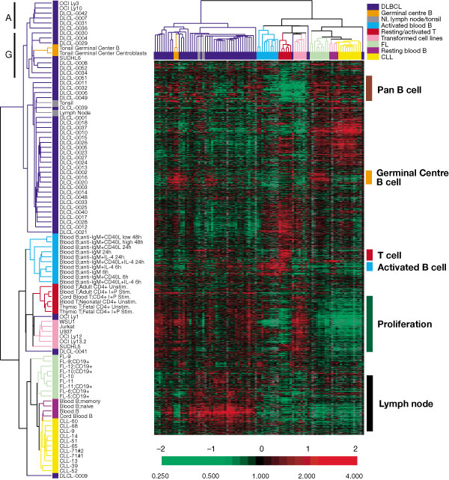
Clusters on both genes and arrays
Taken from
Nature February, 2000
Paper by Allizadeh. A et al
Distinct types of diffuse large
B-cell lymphoma identified by
Gene expression profiling,
Notes:
Ben Bolstad
August 17, 2004
(c) 2004 CGDN
6

Slide 12
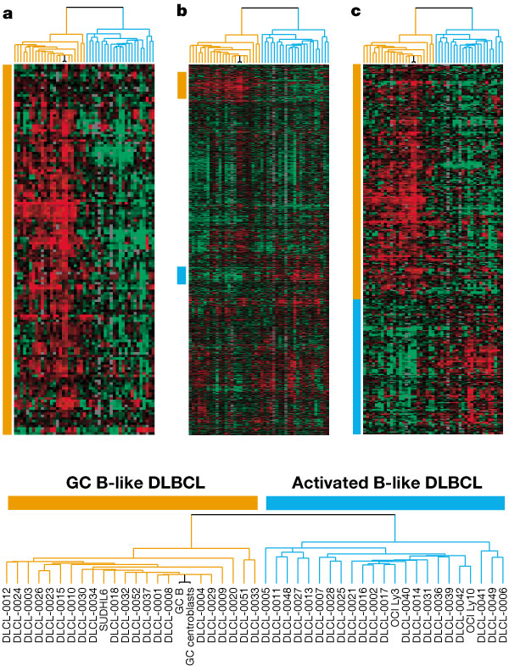
Discovering tumor subclasses
DLBCL is clinically heterogeneous
Specimens were clustered based on their expression profiles of GC B-cell associated genes.
Two subgroups were discovered:
  GC B-like DLBCL
  Activated B-like DLBCL
Notes:
Ben Bolstad
August 17, 2004
(c) 2004 CGDN
7

Slide 13
Applications of clustering (2)
A naïve but nevertheless important application is assessment of experimental design
If one has an experiment with different experimental conditions, and in each of them there are biological and technical replicates…
We would expect that the more homogeneous groups tend to cluster together
  Tech. replicates < Biol. Replicates < Different groups
Failure to cluster so suggests bias due to experimental conditions more than to existing differences.

Slide 14
Basic principles of clustering
Aim: to group observations that are “similar” based on predefined criteria.
Issues: Which genes / arrays to use?
  Which similarity or dissimilarity measure?
  Which clustering algorithm?
It is advisable to reduce the number of genes from the full set to some more manageable number, before clustering. The basis for this reduction is usually quite context specific, see later example.
Notes:
Ben Bolstad
August 17, 2004
(c) 2004 CGDN

Slide 15
Two main classes of measures of dissimilarity
Correlation
Distance
  Manhattan
  Euclidean
  Mahalanobis distance
  Many more ….
Notes:
Ben Bolstad
August 17, 2004
(c) 2004 CGDN

Slide 16
Two basic types of methods
Partitioning
Hierarchical
Notes:
Ben Bolstad
August 17, 2004
(c) 2004 CGDN

Slide 17
Partitioning methods
Partition the data into a pre-specified number k of
mutually exclusive and exhaustive groups.
Iteratively reallocate the observations to clusters
until some criterion is met, e.g. minimize within
cluster sums of squares.
Examples:
  k-means, self-organizing maps (SOM), PAM, etc.;
  Fuzzy: needs stochastic model, e.g. Gaussian mixtures.
Notes:
Ben Bolstad
August 17, 2004
(c) 2004 CGDN

Slide 18
Hierarchical methods
Hierarchical clustering methods produce a tree or dendrogram.
They avoid specifying how many clusters are appropriate by providing a partition for each k obtained from cutting the tree at some level.
The tree can be built in two distinct ways
  bottom-up: agglomerative clustering;
  top-down: divisive clustering.
Notes:
Ben Bolstad
August 17, 2004
(c) 2004 CGDN

Slide 19
Agglomerative methods
Start with n clusters.
At each step, merge the two closest clusters using a measure of between-cluster dissimilarity, which reflects the shape of the clusters.
Between-cluster dissimilarity measures
  Mean-link: average of pairwise dissimilarities
  Single-link: minimum of pairwise dissimilarities.
  Complete-link: maximum& of pairwise dissimilarities.
  Distance between centroids
Notes:
Ben Bolstad
August 17, 2004
(c) 2004 CGDN

Slide 20
Distance between centroids
Single-link
Complete-link
Mean-link
Notes:
Ben Bolstad
August 17, 2004
(c) 2004 CGDN

Slide 21
Divisive methods
Start with only one cluster.
At each step, split clusters into two parts.
Split to give greatest distance between two new clusters
Advantages.
    Obtain the main structure of the data, i.e. focus on upper levels of dendogram.
Disadvantages.
  Computational difficulties when considering all possible divisions into two groups.
Notes:
Ben Bolstad
August 17, 2004
(c) 2004 CGDN

Slide 22
Illustration of points
In two dimensional space
Agglomerative
1
5
2
3
4
4
1,2,3,4,5
3
1,2,5
5
3,4
1,5
1
2
1
5
2
3
4
Notes:
Ben Bolstad
August 17, 2004
(c) 2004 CGDN

Slide 23
Tree re-ordering?
Agglomerative
2
1
5
3
4
1
5
2
3
4
4
1,2,3,4,5
3
1,2,5
5
3,4
1,5
1
2
1
5
2
3
4
Notes:
Ben Bolstad
August 17, 2004
(c) 2004 CGDN

Slide 24
Partitioning or Hierarchical?
Partitioning:
  Advantages
    Optimal for certain criteria.
    Genes automatically assigned to clusters
  Disadvantages
    Need initial k;
    Often require long computation times.
    All genes are forced into a cluster.
Hierarchical
  Advantages
    Faster computation.
    Visual.
  Disadvantages
    Unrelated genes are eventually joined
    Rigid, cannot correct later for erroneous decisions made earlier.
    Hard to define clusters.
Notes:
Ben Bolstad
August 17, 2004
(c) 2004 CGDN

Slide 25
Hybrid Methods
Mix elements of Partitioning and Hierarchical methods
  Bagging
    Dudoit & Fridlyand (2002)
  HOPACH
    van der Laan & Pollard (2001)
Notes:
Ben Bolstad
August 17, 2004
(c) 2004 CGDN

Slide 26
Three generic clustering problems
Three important tasks (which are generic) are:
  1. Estimating the number of clusters;
  2. Assigning each observation to a cluster;
  3. Assessing the strength/confidence of cluster assignments for individual observations.
Not equally important in every problem.
Notes:
Ben Bolstad
August 17, 2004
(c) 2004 CGDN
2

Slide 27
Estimating number of clusters using silhouette
Define silhouette width of the observation as :
S = (b-a)/max(a,b)
Where a is the average dissimilarity to all the points in the cluster and b is the minimum distance to any of the objects in the other clusters.
Intuitively, objects with large S are well-clustered while the ones with small S tend to lie between clusters.
How many clusters: Perform clustering for a sequence of the number of clusters k and choose the number of components corresponding to the largest average silhouette.
Issue of the number of clusters in the data is most relevant for novel class discovery, i.e. for clustering samples
Notes:
Ben Bolstad
August 17, 2004
(c) 2004 CGDN

Slide 28
Estimating number of clusters using the bootstrap
There are other resampling (e.g. Dudoit and Fridlyand, 2002) and non-resampling based rules for estimating the number of clusters (for review see Milligan and Cooper (1978) and Dudoit and Fridlyand (2002) ).
The bottom line is that none work very well in complicated situation and, to a large extent, clustering lies outside a usual statistical framework.
It is always reassuring when you are able to characterize a newly discovered clusters using information that was not used for clustering.
Notes:
Ben Bolstad
August 17, 2004
(c) 2004 CGDN

Slide 29
Limitations
Cluster analyses:
Usually outside the normal framework of statistical inference;
less appropriate when only a few genes are likely to change.
Needs lots of experiments
Always possible to cluster even if there is nothing going on.
Useful for learning about the data, but does not provide biological truth.
Notes:
Ben Bolstad
August 17, 2004
(c) 2004 CGDN

Slide 30
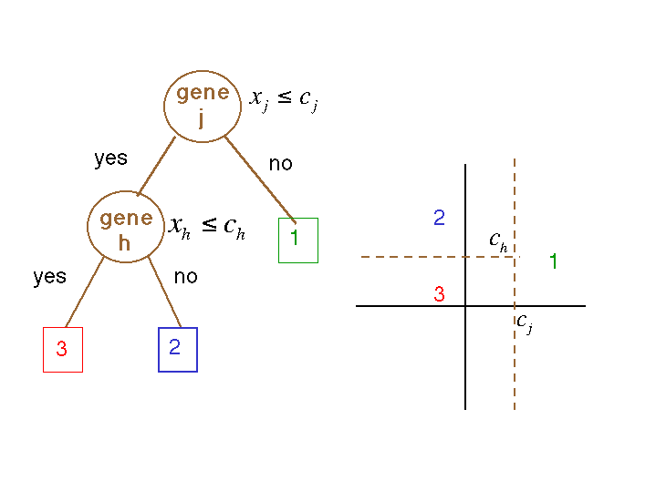
Discrimination
or Class prediction
or Supervised Learning
Notes:
Ben Bolstad
August 17, 2004
(c) 2004 CGDN

Slide 31
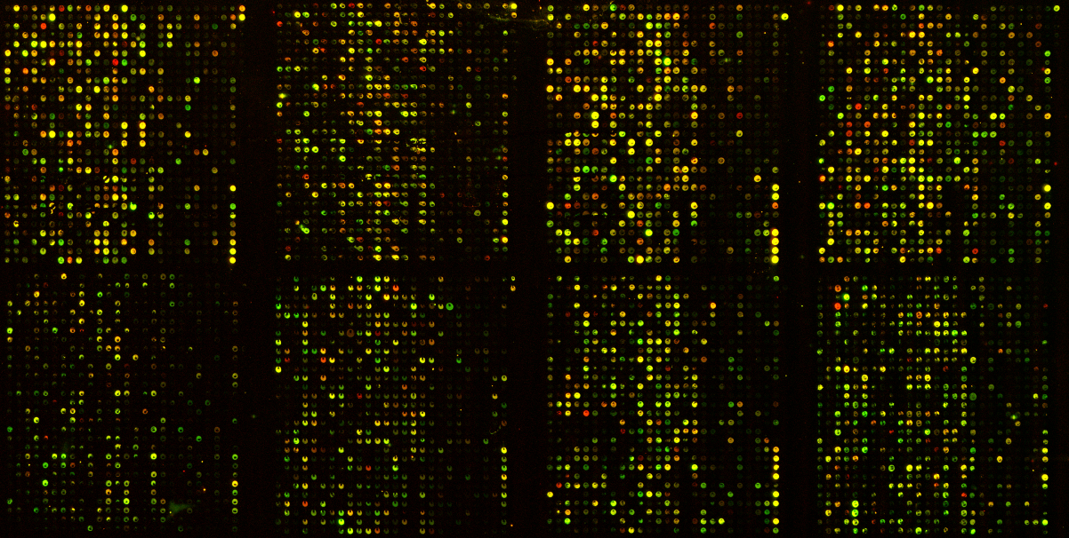
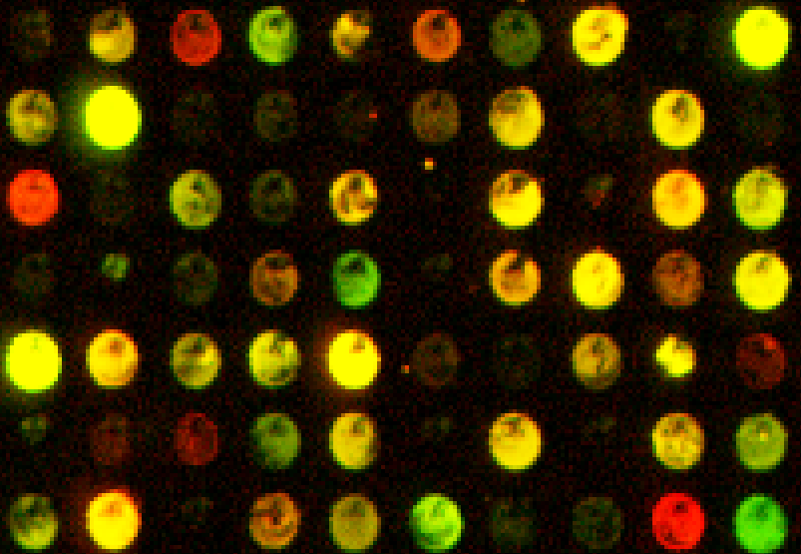
Motivation: A study of gene expression on breast tumours (NHGRI, J. Trent)
cDNA Microarrays
Parallel Gene Expression Analysis
How similar are the gene expression profiles of BRCA1 and BRCA2 (+) and sporadic breast cancer patient biopsies?
Can we identify a set of genes that distinguish the different tumor types?
Tumors studied:
  7 BRCA1 +
  8 BRCA2 +
  7 Sporadic
6526 genes /tumor
Notes:
Ben Bolstad
August 17, 2004
(c) 2004 CGDN

Slide 32
Discrimination
A predictor or classifier for K tumor classes partitions the space X of gene expression profiles into K disjoint subsets, A₁, ..., A_{K}, such that for a sample with expression profile x=(x₁, ...,x_{p}) ∈ A_{k} the predicted class is k.
Predictors are built from past experience, i.e., from observations which are known to belong to certain classes. Such observations comprise the learning set
L = (x₁, y₁), ..., (x_{n},y_{n}).
A classifier built from a learning set L is denoted by
C( . ,L): X → {1,2, ... ,K},
with the predicted class for observation x being C(x,L).
Notes:
Ben Bolstad
August 17, 2004
(c) 2004 CGDN

Slide 33
Discrimination and Allocation
Learning Set
Data with known classes
Prediction
Classification
rule
Data with unknown classes
Classification
Technique
Class
Assignment
Discrimination
Notes:
Ben Bolstad
August 17, 2004
(c) 2004 CGDN

Slide 34
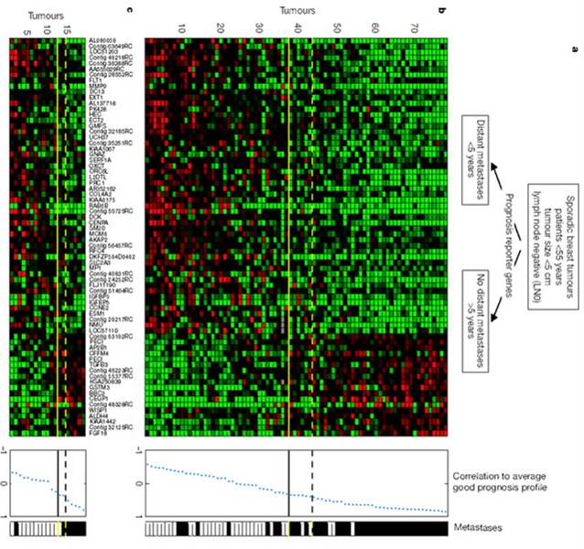
Learning set
Bad prognosis
recurrence < 5yrs
Good Prognosis
recurrence > 5yrs
?
Good Prognosis
Matesis > 5
Predefine
classes
Clinical
outcome
Objects
Array
Feature vectors
Gene
expression
new
array
Reference
L van’t Veer et al (2002) Gene expression profiling predicts clinical outcome of breast cancer. Nature, Jan.
.
Classification
rule
Notes:
Ben Bolstad
August 17, 2004
(c) 2004 CGDN

Slide 35
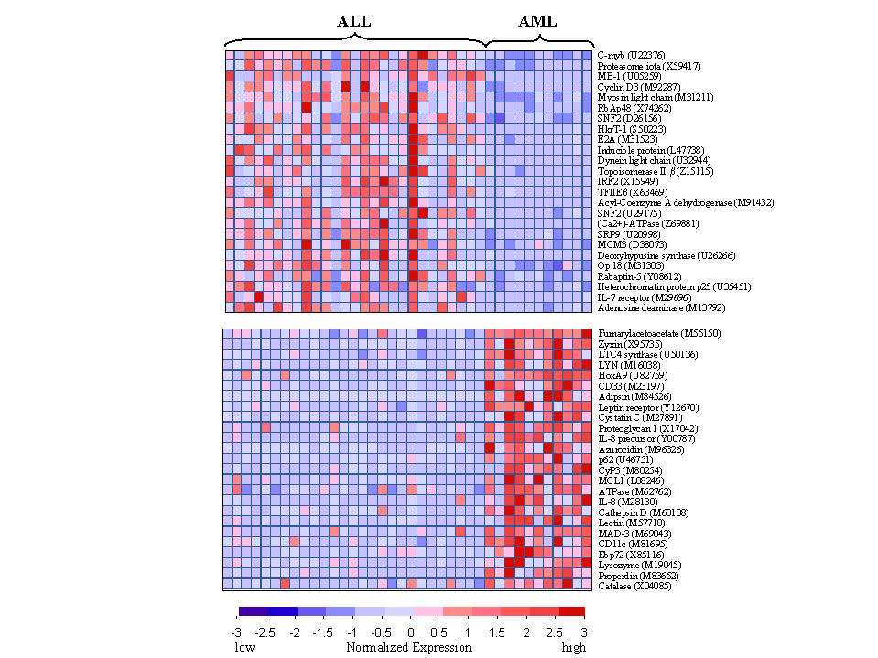
Learning set
Predefine
classes
Tumor type
B-ALL
T-ALL
AML
T-ALL
?
Objects
Array
Feature vectors
Gene
expression
new
array
Reference
Golub et al (1999) Molecular classification of cancer: class discovery and class prediction by gene expression monitoring. Science 286(5439): 531-537.
Classification
Rule
Notes:
Ben Bolstad
August 17, 2004
(c) 2004 CGDN

Slide 36
Components of class prediction
Choose a method of class prediction
  LDA, KNN, CART, ....
Select genes on which the prediction will be base: Feature selection
  Which genes will be included in the model?
Validate the model
  Use data that have not been used to fit the predictor
Notes:
Ben Bolstad
August 17, 2004
(c) 2004 CGDN

Slide 37
Prediction methods
Notes:
Ben Bolstad
August 17, 2004
(c) 2004 CGDN

Slide 38
Choose prediction model
Prediction methods
  Fisher linear discriminant analysis (FLDA) and its variants
    (DLDA, Golub’s gene voting, Compound covariate predictor…)
  Nearest Neighbor
  Classification Trees
  Support vector machines (SVMs)
  Neural networks
  And many more …
Notes:
Ben Bolstad
August 17, 2004
(c) 2004 CGDN

Slide 39
Fisher linear discriminant analysis
First applied in 1935 by M. Barnard at the suggestion of R. A. Fisher (1936), Fisher linear discriminant analysis (FLDA) consists of
  i. finding linear combinations x a of the gene expression profiles x=(x₁,...,x_{p}) with large ratios of between-groups to within-groups sums of squares - discriminant variables;
  ii. predicting the class of an observation x by the class whose mean vector is closest to x in terms of the discriminant variables.
Notes:
Ben Bolstad
August 17, 2004
(c) 2004 CGDN

Slide 40
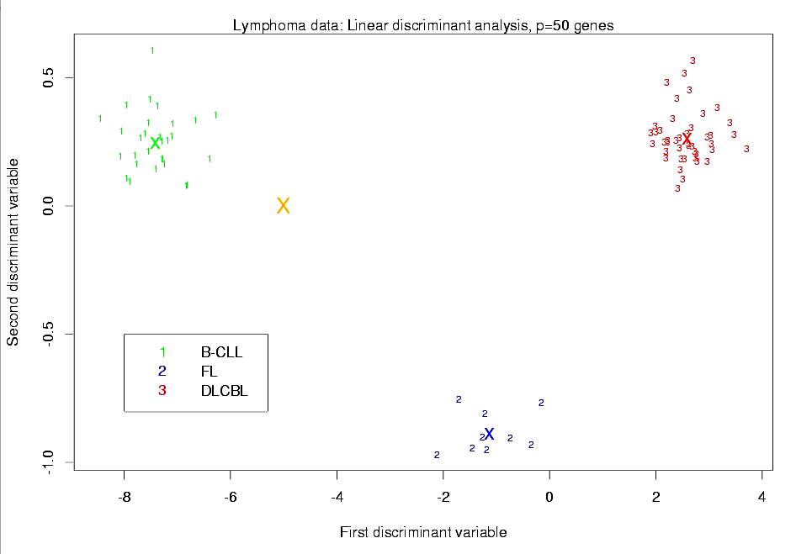
FLDA
Notes:
Ben Bolstad
August 17, 2004
(c) 2004 CGDN

Slide 41
Classification rule
Maximum likelihood discriminant rule
A maximum likelihood estimator (MLE) chooses the parameter value that makes the chance of the observations the highest.
For known class conditional densities p_{k}(X), the maximum likelihood (ML) discriminant rule predicts the class of an observation X by
C(X) = argmax_{k} p_{k}(X)
Notes:
Ben Bolstad
August 17, 2004
(c) 2004 CGDN

Slide 42
Gaussian ML discriminant rules
For multivariate Gaussian (normal) class densities X|Y= k ~ N(μ_{k}, Σ_{k}), the ML classifier is
C(X) = argmin_{k} {(X - μ_{k}) Σ_{k}⁻¹ (X - μ_{k})’ + log| Σ_{k} |}
In general, this is a quadratic rule (Quadratic discriminant analysis, or QDA)
In practice, population mean vectors μ_{k} and covariance matrices Σ_{k} are estimated by corresponding sample quantities
Notes:
Ben Bolstad
August 17, 2004
(c) 2004 CGDN

Slide 43
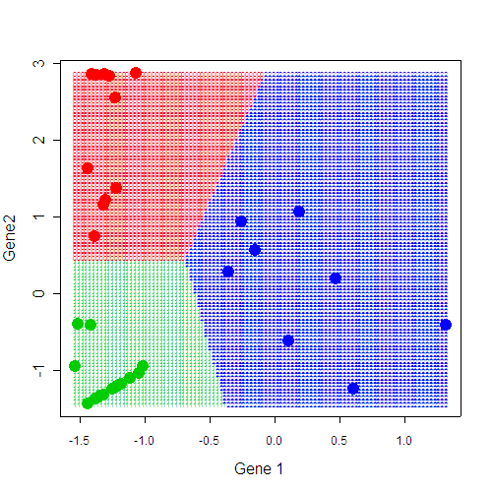
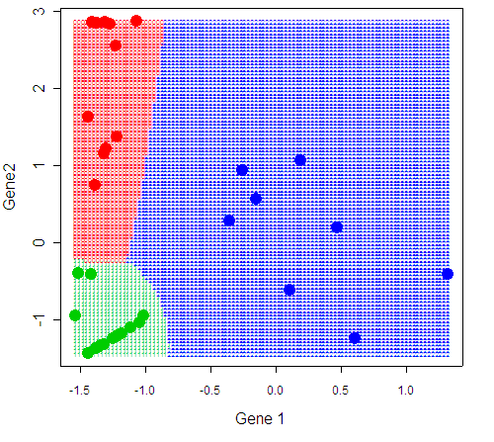
ML discriminant rules - special cases
[DLDA]
Diagonal linear discriminant analysis
class densities have the same diagonal
covariance matrix ∇= diag(s₁², …, s_{p}²)
[DQDA]
Diagonal quadratic discriminant analysis)
class densities have different diagonal
covariance matrix ∇_{k}= diag(s_{1k}², …, s_{pk}²)
Note. Weighted gene voting of Golub et al. (1999) is a minor variant of DLDA for
two classes (different variance calculation).
Notes:
Ben Bolstad
August 17, 2004
(c) 2004 CGDN
What was an example for this?

Slide 44
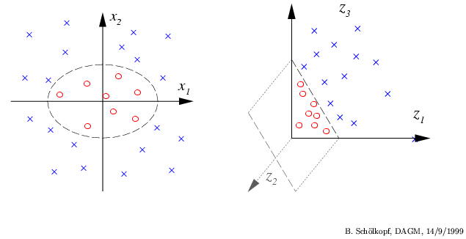
Classification with SVMs
Generalization of the ideas of separating hyperplanes in the original space.
Linear boundaries between classes in higher-dimensional space lead to
the non-linear boundaries in the original space.
Adapted from internet
Notes:
Ben Bolstad
August 17, 2004
(c) 2004 CGDN

Slide 45
Nearest neighbor classification
Based on a measure of distance between observations (e.g. Euclidean distance or one minus correlation).
k-nearest neighbor rule (Fix and Hodges (1951)) classifies an observation x as follows:
  find the k observations in the learning set closest to x
  predict the class of x by majority vote, i.e., choose the class that is most common among those k observations.
The number of neighbors k can be chosen by cross-validation (more on this later).
Notes:
Ben Bolstad
August 17, 2004
(c) 2004 CGDN

Slide 46
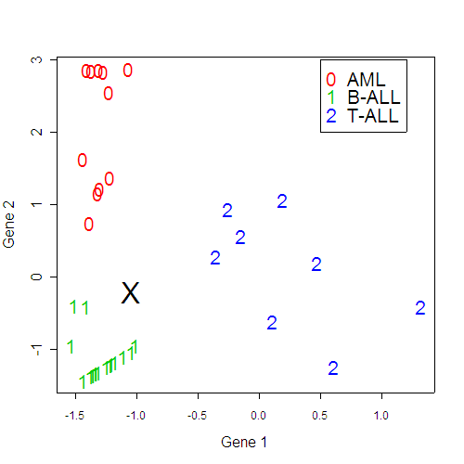
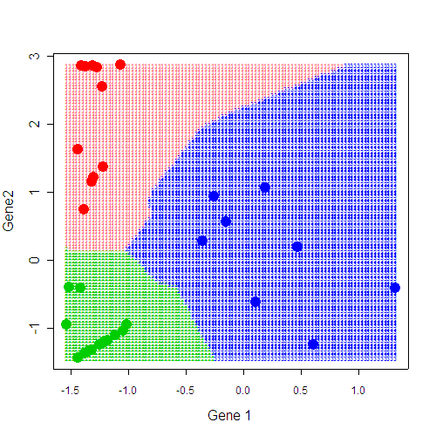
Nearest neighbor rule
Notes:
Ben Bolstad
August 17, 2004
(c) 2004 CGDN

Slide 47
Classification tree
Binary tree structured classifiers are constructed by repeated splits of subsets (nodes) of the measurement space X into two descendant subsets, starting with X itself.
Each terminal subset is assigned a class label and the resulting partition of X corresponds to the classifier.
Notes:
Ben Bolstad
August 17, 2004
(c) 2004 CGDN

Slide 48
Classification trees
M_{i1} < 1.4
Node 1
Class 1: 10
Class 2: 10
yes
Gene 1
no
M_{i2} > -0.5
Node 2
Class 1: 6
Class 2: 9
Node 3
Class 1: 4
Class 2: 1
Prediction: 1
yes
Gene 2
no
Node 4
Class 1: 0
Class 2: 4
Prediction: 2
M_{i2} > 2.1
Node 5
Class 1: 6
Class 2: 5
Gene 3
Node 6
Class 1: 1
Class 2: 5
Prediction: 2
Node 7
Class 1: 5
Class 2: 0
Prediction: 1
Notes:
Ben Bolstad
August 17, 2004
(c) 2004 CGDN

Slide 49
Three aspects of tree construction
Split selection rule:
  Example, at each node, choose split maximizing decrease in impurity (e.g. Gini index, entropy, misclassification error).
Split-stopping: The decision to declare a node as terminal or to continue splitting.
  Example, grow large tree, prune to obtain a sequence of subtrees, then use cross-validation to identify the subtree with lowest misclassification rate.
The assignment: of each terminal node to a class
  Example, for each terminal node, choose the class minimizing the resubstitution estimate of misclassification probability, given that a case falls into this node.
Supplementary slide
Notes:
Ben Bolstad
August 17, 2004
(c) 2004 CGDN

Slide 50
Other classifiers include…
Support vector machines
Neural networks
Bayesian regression methods
Projection pursuit
....
Notes:
Ben Bolstad
August 17, 2004
(c) 2004 CGDN

Slide 51
Aggregating predictors
Breiman (1996, 1998) found that gains in accuracy could be obtained by aggregating predictors built from perturbed versions of the learning set.
In classification, the multiple versions of the predictor are aggregated by voting.
Notes:
Ben Bolstad
August 17, 2004
(c) 2004 CGDN

Slide 52
Aggregating predictors
1. Bagging. Bootstrap samples of the same size as the original learning set.
  - non-parametric bootstrap, Breiman (1996); - convex pseudo-data, Breiman (1998).
2. Boosting. Freund and Schapire (1997), Breiman (1998).
The data are resampled adaptively so that the weights in the resampling are increased for those cases most often misclassified.
The aggregation of predictors is done by weighted voting.
Notes:
Ben Bolstad
August 17, 2004
(c) 2004 CGDN

Slide 53
Prediction votes
For aggregated classifiers, prediction votes assessing the strength of a prediction may be defined for each observation.
The prediction vote (PV) for an observation x is defined to be
PV(x) = max_{k} ∑_{b} w_{b} I(C(x,L_{b}) = k) / ∑ _{b}w_{b} .
When the perturbed learning sets are given equal weights, i.e., w_{b} =1, the prediction vote is simply the proportion of votes for the “winning'' class, regardless of whether it is correct or not.
Prediction votes belong to [0,1].
Notes:
Ben Bolstad
August 17, 2004
(c) 2004 CGDN

Slide 54
Another component in classification rules: aggregating classifiers
Resample 1
Classifier 1
Resample 2
Classifier 2
Training
Set
X₁, X₂, … X₁₀₀
Aggregate
classifier
Resample 499
Classifier 499
Examples:
Bagging
Boosting
Random Forest
Resample 500
Classifier 500
Notes:
Ben Bolstad
August 17, 2004
(c) 2004 CGDN

Slide 55
Aggregating classifiers:
Bagging
Test
sample
Resample 1
X*₁, X*₂, … X*₁₀₀
Tree 1
Class 1
Resample 2
X*₁, X*₂, … X*₁₀₀
Tree 2
Class 2
Training
Set (arrays)
X₁, X₂, … X₁₀₀
Lets the
tree
vote
90% Class 1
10% Class 2
Resample 499
X*₁, X*₂, … X*₁₀₀
Tree 499
Class 1
Resample 500
X*₁, X*₂, … X*₁₀₀
Tree 500
Class 1
Notes:
Ben Bolstad
August 17, 2004
(c) 2004 CGDN

Slide 56
Feature selection
Notes:
Ben Bolstad
August 17, 2004
(c) 2004 CGDN

Slide 57
Feature selection
A classification rule must be based on a set of variables which contribute useful information for distinguishing the classes.
This set will usually be small because most variables are likely to be uninformative.
Some classifiers (like CART) perform automatic feature selection whereas others, like LDA or KNN, do not.
Notes:
Ben Bolstad
August 17, 2004
(c) 2004 CGDN

Slide 58
Approaches to feature selection
Filter methods perform explicit feature selection prior to building the classifier.
  One gene at a time: select features based on the value of an univariate test.
  The number of genes or the test p-value are the parameters of the FS method.
Wrapper methods perform FS implicitly, as a part of the classifier building.
  In classification trees features are selected at each step based on reduction in impurity.
  The number of features is determined by pruning the tree using cross-validation.
Notes:
Ben Bolstad
August 17, 2004
(c) 2004 CGDN

Slide 59
Why select features
Lead to better classification performance by removing variables that are noise with respect to the outcome
May provide useful insights into etiology of a disease.
Can eventually lead to the diagnostic tests (e.g., “breast cancer chip”).
Notes:
Ben Bolstad
August 17, 2004
(c) 2004 CGDN

Slide 60
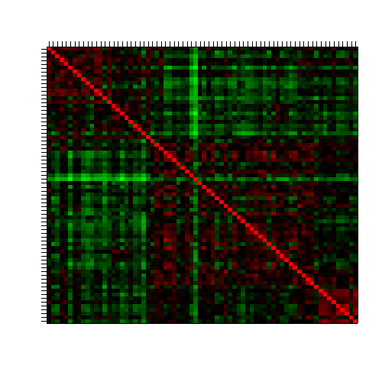
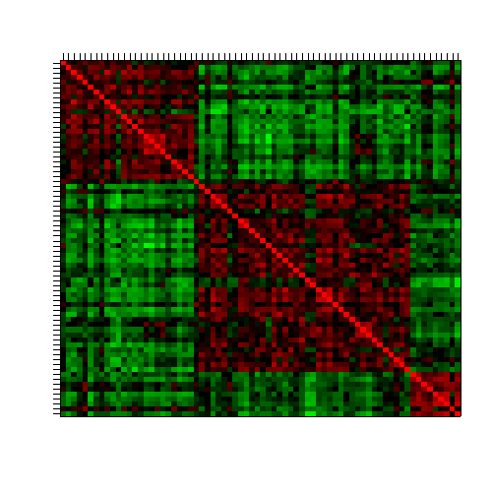
Why select features?
No feature
selection
Top 100
feature selection
Selection based on variance
Correlation plot
Data: Leukemia, 3 class
-1
+1
Notes:
Ben Bolstad
August 17, 2004
(c) 2004 CGDN
That should go under clustering as well?

Slide 61
Performance assessment
Notes:
Ben Bolstad
August 17, 2004
(c) 2004 CGDN

Slide 62
Performance assessment
Before using a classifier for prediction or prognostic one needs a measure of its accuracy.
The accuracy of a predictor is usually measured by the
Missclassification rate: The % of individuals belonging to a class which are erroneously assigned to another class by the predictor.
An important problem arises here
  We are not interested in the ability of the predictor for classifying current samples
  One needs to estimate future performance based on what is available.
Notes:
Ben Bolstad
August 17, 2004
(c) 2004 CGDN

Slide 63
Estimating the error rate
Using the same dataset on which we have built the predictor to estimate the missclassification rate may lead to erroneously low values due to overfitting.
  This is known as the resubstitution estimator
We should use a completely independent dataset to evaluate the classifier, but it is rarely available.
We use alternatives approaches such as
  Test set estimator
  Cross validation
Notes:
Ben Bolstad
August 17, 2004
(c) 2004 CGDN

Slide 64
Performance assessment (I)
Resubstitution estimation: Compute the error rate on the learning set.
  Problem: downward bias
Test set estimation: Proceeds in two steps
  Divide learning set into two sub-sets, L and T;
  Build the classifier on L and compute error rate on T.
  This approach is not free from problems
    L and T must be independent and identically distributed.
    Problem: reduced effective sample size
Notes:
Ben Bolstad
August 17, 2004
(c) 2004 CGDN

Slide 65
Diagram of performance assessment (I)
Classifier
Training
Set
Resubstitution
estimation
Performance
assessment
Training
set
Test set
estimation
Classifier
Independent
test set
Notes:
Ben Bolstad
August 17, 2004
(c) 2004 CGDN

Slide 66
Performance assessment (II)
V-fold cross-validation (CV) estimation: Cases in learning set randomly divided into V subsets of (nearly) equal size. Build classifiers by leaving one set out; compute test set error rates on the left out set and averaged.
  Bias-variance tradeoff: smaller V can give larger bias but smaller variance
  Computationally intensive.
Leave-one-out cross validation (LOOCV).
  Special case for V=n.
  Works well for stable classifiers (k-NN, LDA, SVM)
Notes:
Ben Bolstad
August 17, 2004
(c) 2004 CGDN

Slide 67
Diagram of performance assessment (II)
Classifier
Training
Set
Resubstitution
estimation
(CV) Learning
set
Cross
Validation
Training
set
Classifier
Performance
assessment
(CV) Test
set
Classifier
Test set
estimation
Independent
test set
Notes:
Ben Bolstad
August 17, 2004
(c) 2004 CGDN

Slide 68
Performance assessment (III)
Common practice
  To do feature selection using the learning,
  To do CV only for model building and classification.
However, usually features are unknown and the intended inference includes feature selection →
  CV estimates as above tend to be downward biased.
Features (variables) should be selected only from the learning set used to build the model (and not the entire set).
Notes:
Ben Bolstad
August 17, 2004
(c) 2004 CGDN

Slide 69
Examples
Notes:
Ben Bolstad
August 17, 2004
(c) 2004 CGDN

Slide 70
Learning set
Classification
Rule
Case studies
Bad
Good
Feature selection.
Correlation with class
labels, very similar to t-test.
Using cross validation to
select 70 genes
Reference 1
Retrospective study
L van’t Veer et al Gene expression profiling predicts clinical outcome of breast cancer. Nature, Jan 2002.
.
Reference 2
Cohort study
M Van de Vijver et al. A gene expression signature as a predictor of survival in breast cancer. The New England Jouranl of Medicine, Dec 2002.
295 samples selected
from Netherland Cancer Institute
tissue bank (1984 – 1995).
Results” Gene expression profile is a more
powerful predictor then standard systems
based on clinical and histologic criteria
Agendia (formed by reseachers from the Netherlands Cancer Institute)
Has started in Oct, 2003
5000 subjects [Health Council of the Netherlands]
5000 subjects New York based Avon Foundation.
Custom arrays are made by Agilent including
70 genes + 1000 controls
Reference 3
Prospective trials.
Aug 2003
Clinical trials
http://www.agendia.com/
Notes:
Ben Bolstad
August 17, 2004
(c) 2004 CGDN
Van viver – cohort, not retrospective
What is ref 3?

Slide 71
Van’t Veer breast cancer study study
Investigate whether tumor ability for metastasis is
obtained later in development or inherent in the initial
gene expression signature.
Retrospective sampling of node-negative women: 44 non-recurrences within 5 years of surgery and 34 recurrences. Additionally, 19 test sample (12 recur. and 7 non-recur)
Want to demonstrate that gene expression profile is significantly associated with recurrence independent of the other clinical variables.
Nature, 2002
Notes:
Ben Bolstad
August 17, 2004
(c) 2004 CGDN

Slide 72
Predictor development
Identify a set of genes with correlation > 0.3 with the binary outcome. Show that there are significant enrichment for such genes in the dataset.
Rank-order genes on the basis of their correlation
Optimize number of genes in the classifier by using CV-1
Classification is made on the basis of the correlations of the expression profile of leave-out-out sample with the mean expression of the remaining samples from the good and bad prognosis patients, respectively.
N. B.: The correct way to select genes is within rather than outside cross-validation, resulting in different set of markers for each CV iteration
N. B. : Optimizing number of variables and other parameters should be done via 2-level cross-validation if results are to be assessed on the training set.
The classification indicator is included into the logistic model along with other clinical variables. It is shown that gene expression profile has the strongest effect. Note that some of this may be due to overfitting for the threshold parameter.
Notes:
Ben Bolstad
August 17, 2004
(c) 2004 CGDN

Slide 73
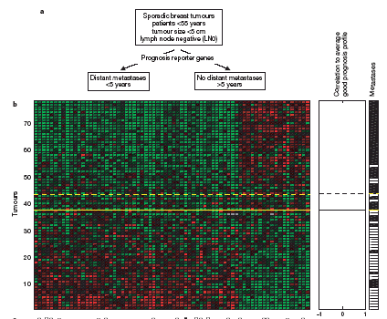
Van ‘t Veer, et al., 2002
Notes:
Ben Bolstad
August 17, 2004
(c) 2004 CGDN

Slide 74
van de Vuver’s breast data
(NEJM, 2002)
295 additional breast cancer patients, mix of node-negative and node-positive samples.
Want to use the predictor that was developed to identify patients at risk for metastasis.
The predicted class was significantly associated with time to recurrence in the multivariate cox-proportional model.
Notes:
Ben Bolstad
August 17, 2004
(c) 2004 CGDN

Slide 75
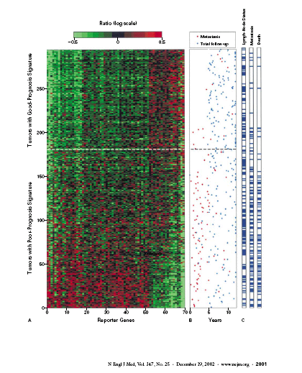
Notes:
Ben Bolstad
August 17, 2004
(c) 2004 CGDN

Slide 76
Acknowledgments
Many of the slides in this course notes are based on web materials made available by their authors.
I wish to thank specially
  Yee Hwa Yang (UCSF),
  Ben Boldstat, Sandrine Dudoit & Terry Speed, U.C. Berkeley.
  The Bioconductor Project
  "Estadística I Bioinformàtica" research group at the University of Barcelona
Notes:
Ben Bolstad
August 17, 2004
(c) 2004 CGDN

