Slide 1
Statistics Background for Metabolomics
Alex Sánchez-Pla

Slide 2
Introduction

Slide 3
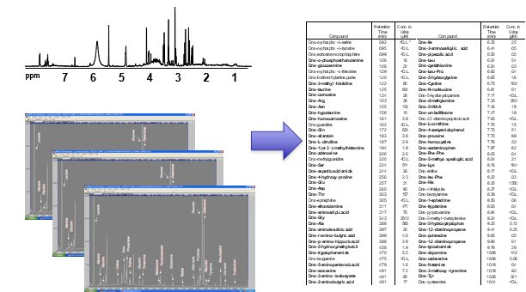
Where we come from

Slide 4
Where we come from
From spectra and Images to Data Tables

Slide 5
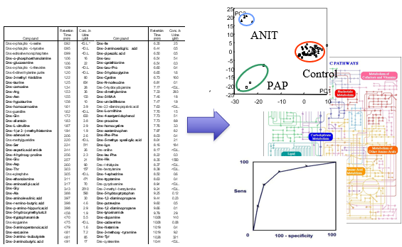
Where we are heading
Making sense of the data with Statistical and Bioinformatical methods and tools

