Slide 2

Quality Assurance Using Computer Vision
Domantas Jurkus

Slide 3

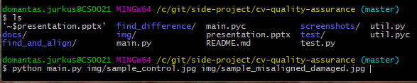

General Use
PRODUCTS
CONSULTING
SUPPORT
Control
Quality score
Script
Query

Slide 4
Approach
Load control and query images
Find and match features (distinctive areas)
Crop and align query image
Subtract images
Present difference in numeric format

Slide 5
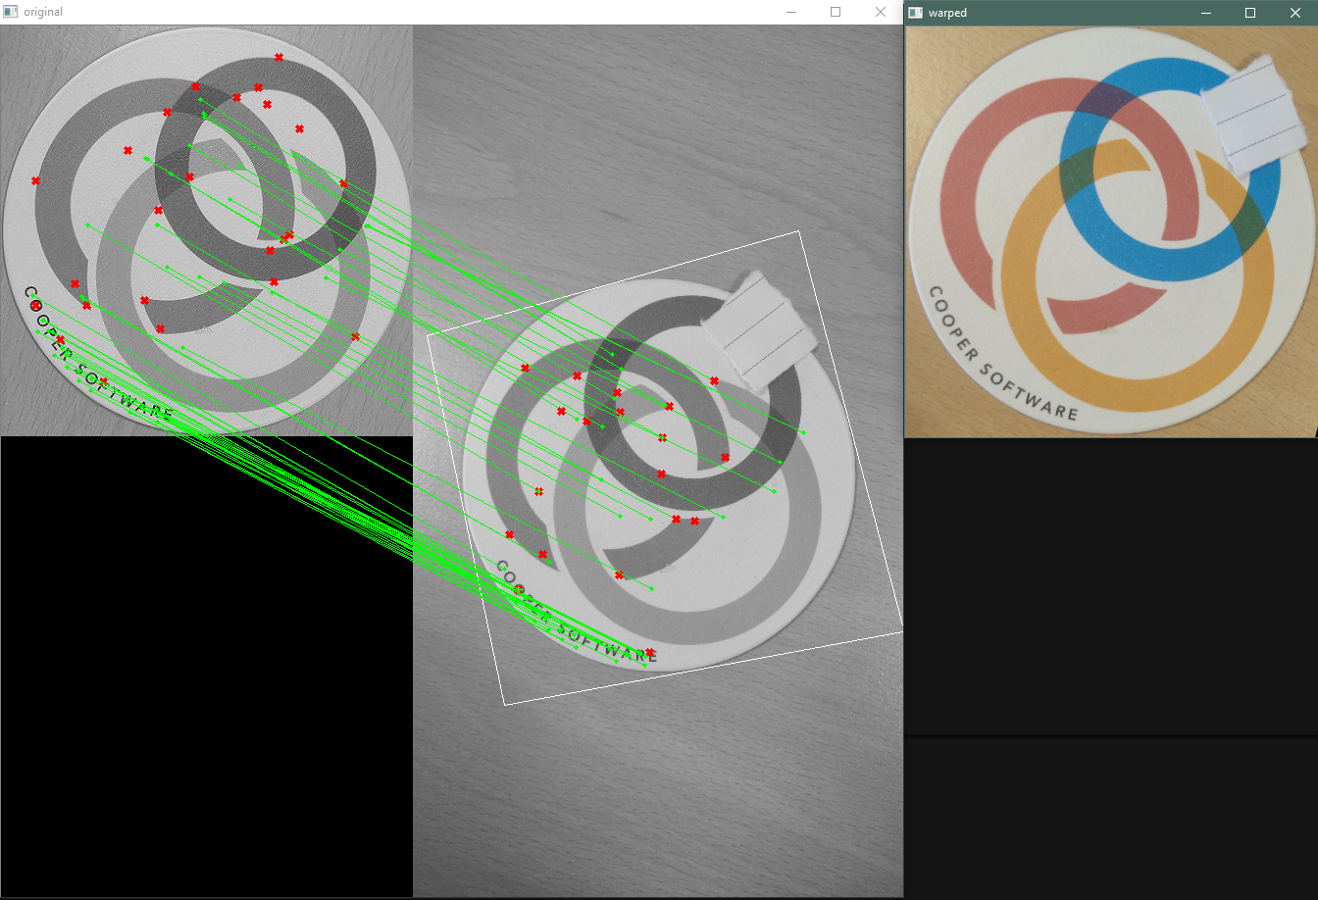

Slide 6
Questions
?

