Slide 1

Basic Banking Application
Project Summary of Week 1
Presented by: D.ASRITHA
Date: 11/01/2025
Internship ID: JP100089
Domain: Java Programming
College: Saveetha School of Engineering
by ASRITHA
DataSoftixs Internship Program

Slide 2
Project Overview
Objective
Platform
Purpose
Simulate basic banking operations
Java Programming Language
Hands-on OOP experience
DataSoftixs Internship Program

Slide 3
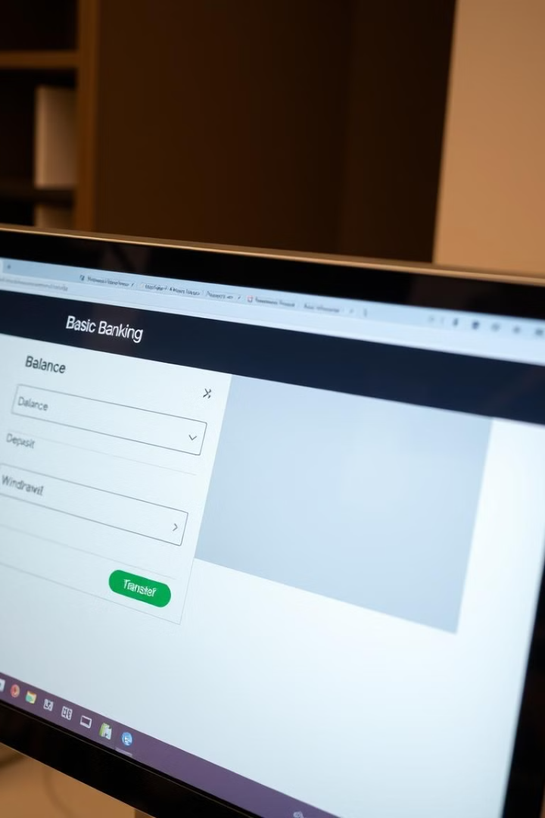
Application Features
Check Balance
Deposit
View account balance
Add funds to the account
Withdraw
Transfer
Remove funds from the account
Move funds between accounts
DataSoftixs Internship Program

Slide 4
Code Structure
BankAccount Class
BankApp Class
Account Number, Holder, Balance
User Menu: Handle user interaction
checkBalance(), deposit(), withdraw(), transfer()
Loop: Continuous operation
DataSoftixs Internship Program

Slide 5
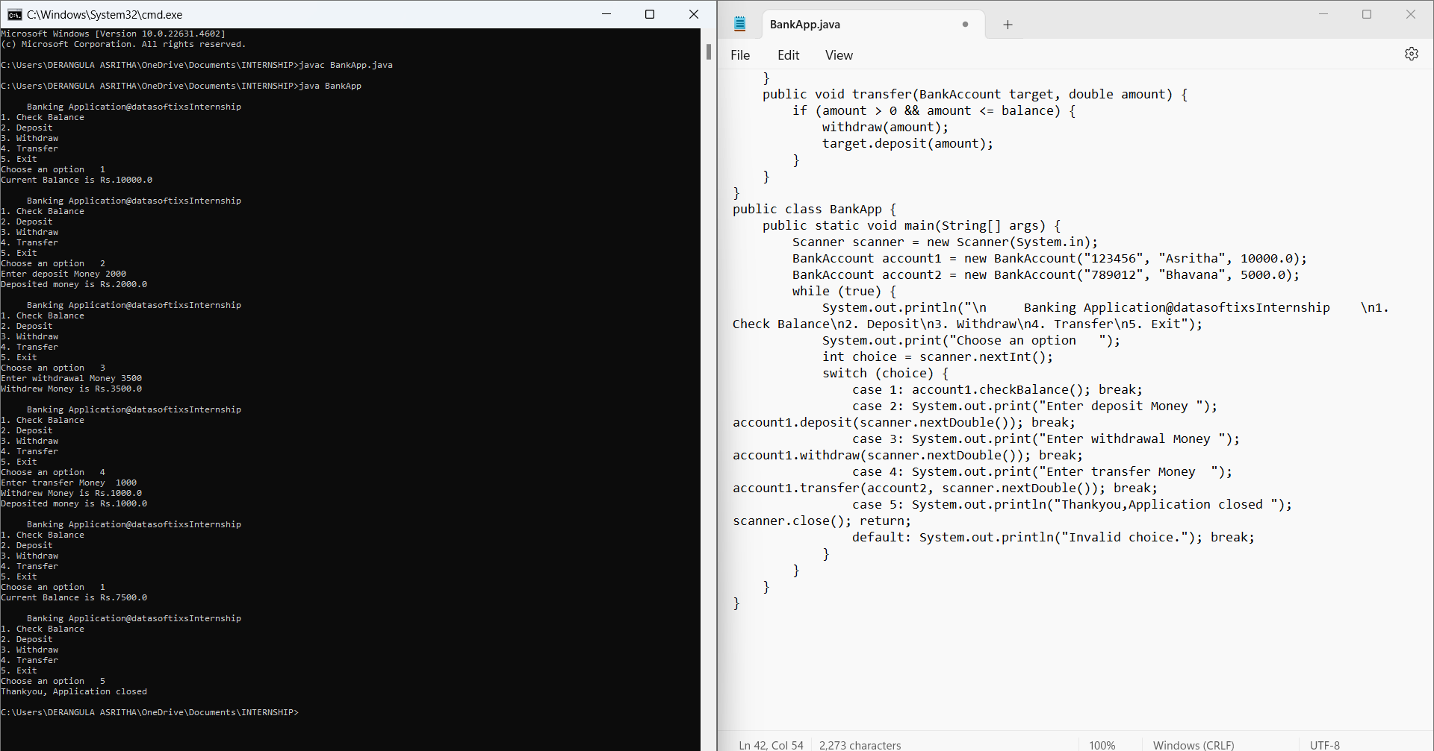
Code Example - BankAccount Class
class BankAccount {
private String accountNumber, accountHolder;
private double balance;
public BankAccount(String accountNumber, String accountHolder, double initialBalance) {
this.accountNumber = accountNumber;
this.accountHolder = accountHolder;
this.balance = initialBalance;}
public void checkBalance() {
System.out.println("Current Balance is Rs." + balance);}
public void deposit(double amount) {
if (amount > 0) balance += amount;
System.out.println(amount > 0 ? "Deposited money is Rs." + amount : "Invalid deposit amount.");}
public void withdraw(double amount) {
if (amount > 0 && amount <= balance) balance -= amount;
System.out.println(amount > 0 && amount <= balance ? "Withdrew Money is Rs." + amount : "Invalid or insufficient funds.");}}
DataSoftixs Internship Program

Slide 6
Code Example - User Menu
public class BankApp {
public static void main(String[] args) {
Scanner scanner = new Scanner(System.in);
BankAccount account1 = new BankAccount("123456", "Asritha", 10000.0);
BankAccount account2 = new BankAccount("789012", "Bhavana", 5000.0);
while (true) { System.out.println("\nBanking Application\n1. Check Balance\n2. Deposit\n3. Withdraw\n4. Transfer\n5. Exit");
System.out.print("Choose an option: ");
int choice = scanner.nextInt();
switch (choice) { case 1: account1.checkBalance(); break;
case 2: System.out.print("Enter deposit amount: "); account1.deposit(scanner.nextDouble()); break;
case 3: System.out.print("Enter withdrawal amount: "); account1.withdraw(scanner.nextDouble()); break;
case 4: System.out.print("Enter transfer amount: "); account1.transfer(account2, scanner.nextDouble()); break;
case 5: System.out.println("Thank you, application closed."); scanner.close(); return;
default: System.out.println("Invalid choice."); break;}}}}
DataSoftixs Internship Program

Slide 7

Challenges & Key Learnings
Challenges
Learnings
Input validation, managing account transfers, testing multiple scenarios
OOP concepts, handling real-world requirements
DataSoftixs Internship Program

Slide 8





Future Enhancements
Database Integration
GUI
Persistent account data storage
User-friendly graphical interface
Multi-user
Account Statements
Support multiple users
Generate account history reports
DataSoftixs Internship Program

Slide 9
OUT PUT SCREENSHORT:
DataSoftixs Internship Program

Slide 10

Thank You!
provide feedback
DataSoftixs Internship Program

