Slide 1

Simple Student Management System
Project Summary
Presented by D.ASRITHA
Date: 18/01/2025
Internship ID: JP100089
Domain: Java Programming
College: Saveetha School of Engineering
by ASRITHA
DataSoftixs Internship Program

Slide 2
Project Overview
Objective
Platform
Purpose
Manage student records
Java Programming Language
Enhance programming skills, simplify management
DataSoftixs Internship Program

Slide 3
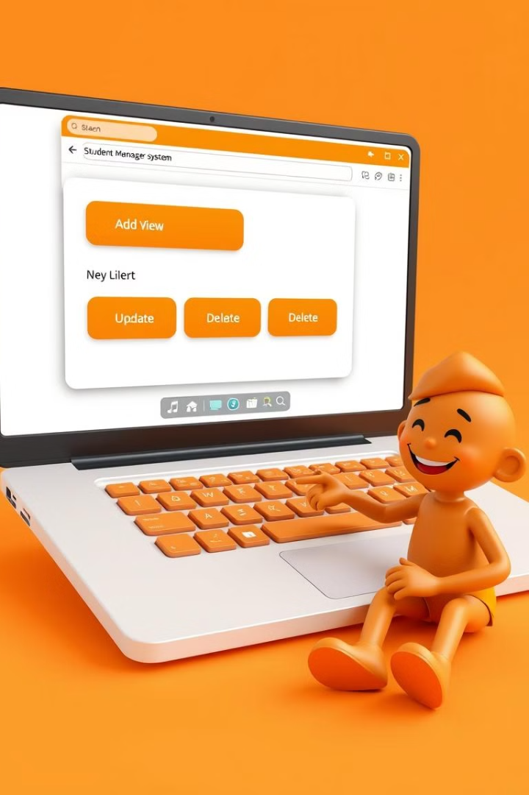
Application Features
Add
View
Student ID, Name, Marks
All student records
Update
Delete
Existing student details
Student records
DataSoftixs Internship Program

Slide 4
Code Structure
Student Class
StudentManagementSystem Class
ID, Name, Marks
HashMap to store records
Constructor, toString()
Menu for CRUD operations
DataSoftixs Internship Program

Slide 5

Code Example - Student Class
class Student {
int id;
String name;
int marks;
Student(int id, String name, int marks) {
this.id = id;
this.name = name;
this.marks = marks;
}
public String toString() {
return "ID: " + id + ", Name: " + name + ", Marks: " + marks;
}
}
DataSoftixs Internship Program

Slide 6
Code Example-User Menu
public class StudentManagementSystem {
private static Map<Integer, Student> students = new HashMap<>();
public static void main(String[] args) {
Scanner sc = new Scanner(System.in);
int choice;
do {
System.out.println("\nStudent Management System\n1. Add 2. View 3. Update 4. Delete 5. Exit");
choice = sc.nextInt();
switch (choice) {
case 1 -> {
System.out.print("ID: ");
int id = sc.nextInt();
sc.nextLine();
System.out.print("Name: ");
String name = sc.nextLine();
System.out.print("Marks: ");
int marks = sc.nextInt();
students.put(id, new Student(id, name, marks));
}
case 2 -> students.values().forEach(System.out::println);
case 3 -> {
System.out.print("ID to update: ");
int id = sc.nextInt();
sc.nextLine();
if (students.containsKey(id)) {
System.out.print("New Name: ");
String name = sc.nextLine();
System.out.print("New Marks: ");
int marks = sc.nextInt();
students.put(id, new Student(id, name, marks));
} else {
System.out.println("Not found.");
}}
case 4 -> {
System.out.print("ID to delete: ");
int id = sc.nextInt();
students.remove(id);
}
case 5 -> System.out.println("Thank you, application closed");
default -> System.out.println("Invalid choice.");
}}
while (choice != 5);
}}
DataSoftixs Internship Program

Slide 7
Challenges & Learning
Challenges
Key Learnings
Efficient HashMap management
Effective use of Java Collections
Data validation, testing CRUD
Scalable and maintainable program structure
User-friendly menu-driven systems
DataSoftixs Internship Program

Slide 8

Possible Improvements
1
Database Integration
2
Sorting & Searching
Persistent storage of records
Enhanced functionalities
3
Graphical User Interface
4
Import/Export
Data transfer from/to files
Improved usability
DataSoftixs Internship Program

Slide 9
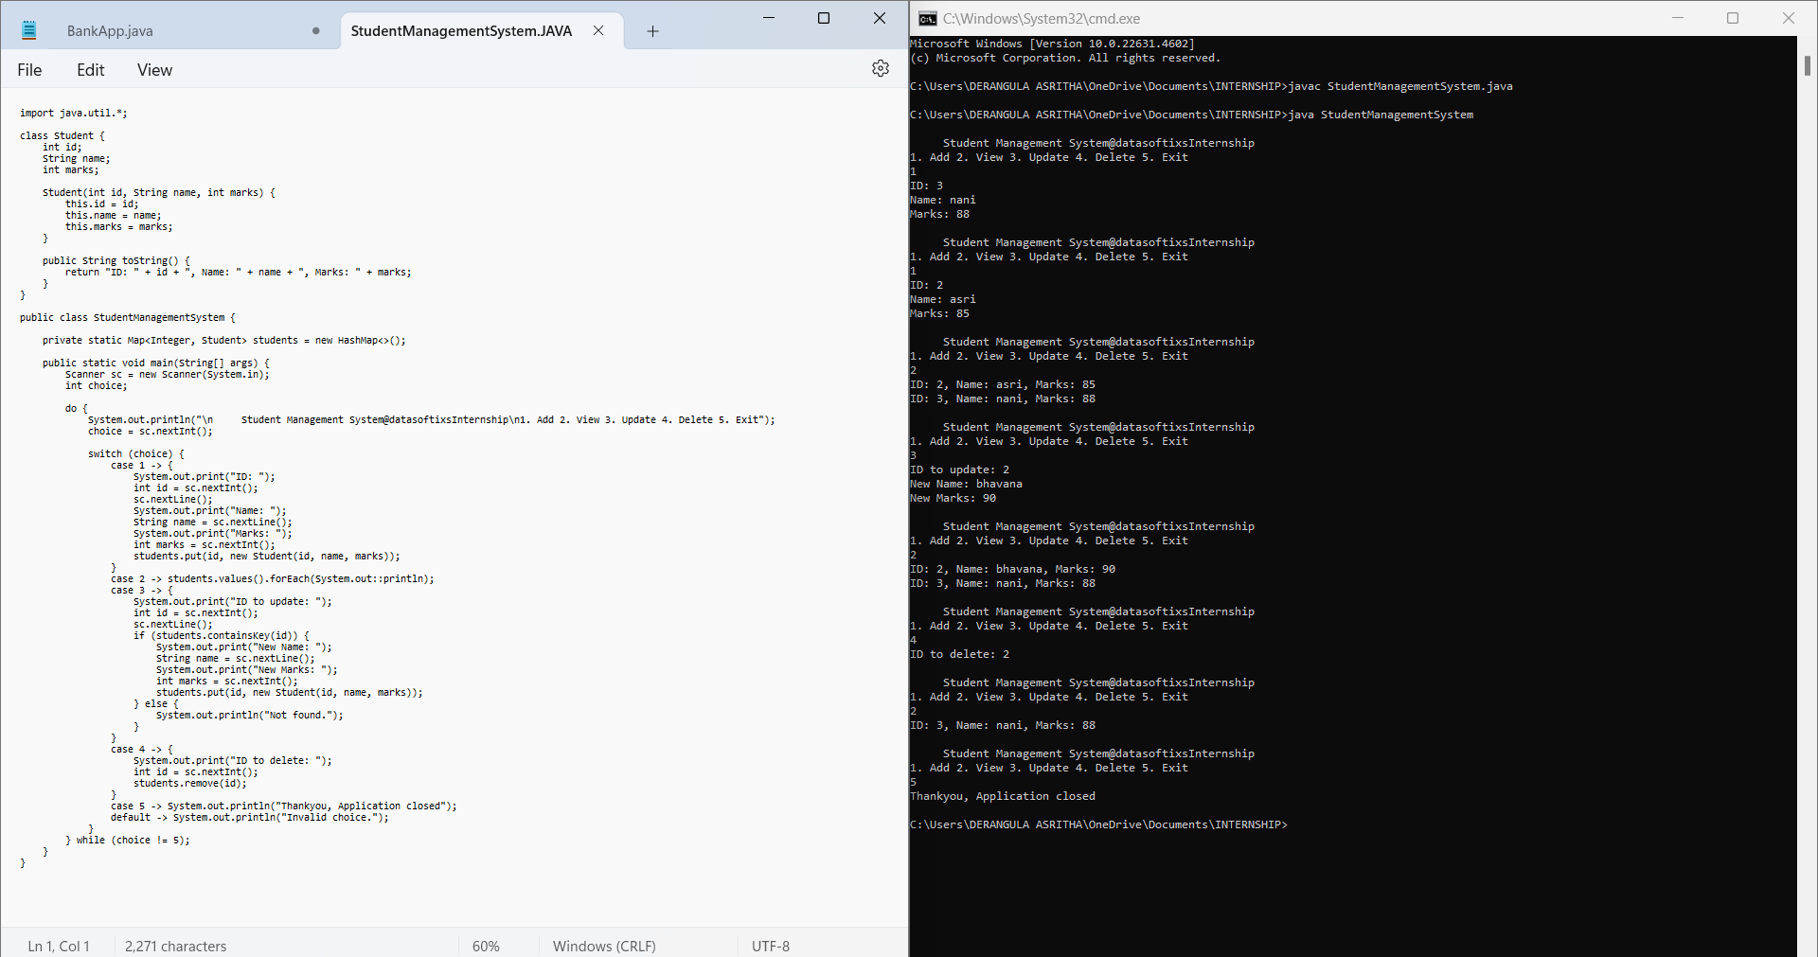
OUT PUT SCREENSHORT:
DataSoftixs Internship Program

Slide 10

Thank You!
Provide feedback!
DataSoftixs Internship Program

