Slide 1


DataSoftixs Internship: Java To-Do List
Internship ID: JP100089, Domain: Java Programming, College: Saveetha School of Engineering
by ASRITHA
DataSoftixs Internship Program

Slide 2
User-Friendly To-Do List Manager
Core Functionalities
Data Storage
Add, edit, delete tasks
Tasks stored in an ArrayList for efficient management.
Mark tasks complete
View pending/completed tasks
DataSoftixs Internship Program

Slide 3
Code Structure: Classes and Methods
Class: Task
Class: ToDoListApplication
Attributes: `description`, `isComplete`
Manages tasks using ArrayList
Methods: `markComplete()`, `toString()`
Menu-driven control with do-while loop
DataSoftixs Internship Program

Slide 4
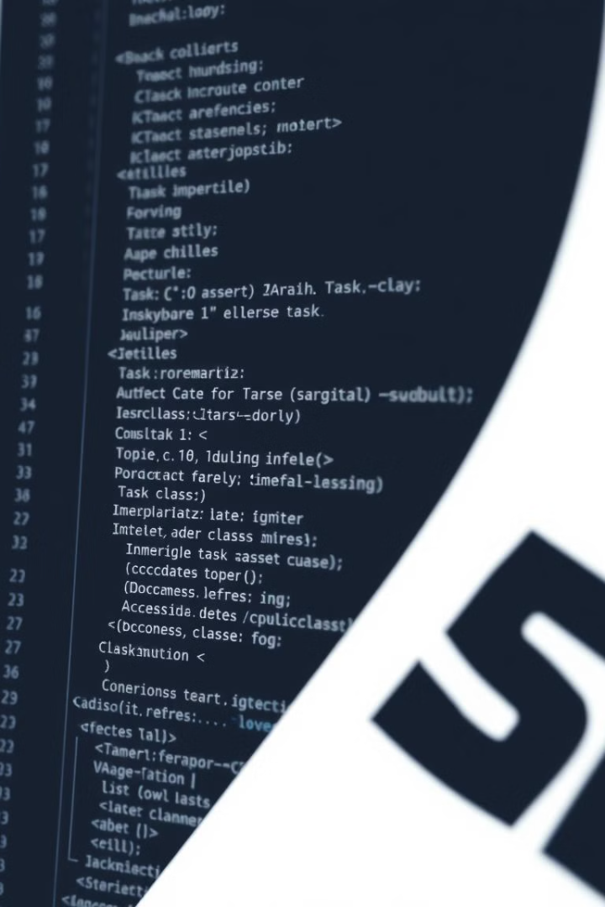
Code Example: Class Task
class Task { String description; boolean isComplete; Task(String description) { this.description = description; this.isComplete = false; } void markComplete() { this.isComplete = true; } public String toString() { return (isComplete ? "[Completed] " : "[Pending] ") + description; } }
DataSoftixs Internship Program

Slide 5
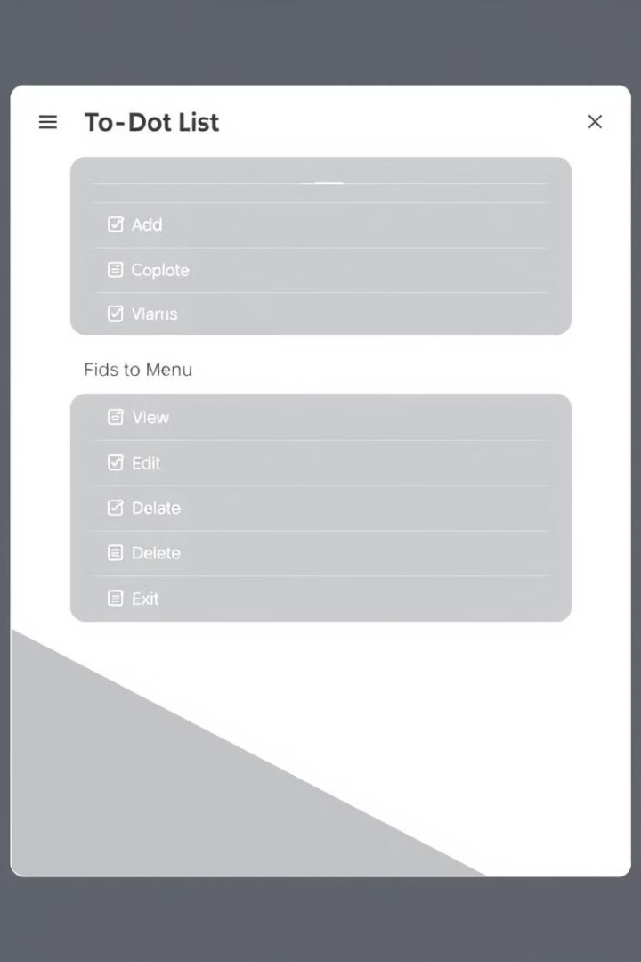
Code Example: Menu Structure
System.out.println("\nTo Do List Application@DataSoftixsInternship"); System.out.println("1. Add 2. View 3. Edit 4. Delete 5. Complete 6. Exit"); choice = sc.nextInt(); sc.nextLine(); switch (choice) { case 1 -> { System.out.print("Task: "); tasks.add(new Task(sc.nextLine())); } case 2 -> tasks.forEach(t -> System.out.println((tasks.indexOf(t) + 1) + ". " + t)); case 3 -> { System.out.print("Task #: "); int idx = sc.nextInt() - 1; sc.nextLine(); if (idx >= 0 && idx < tasks.size()) { System.out.print("New Task: "); tasks.get(idx).description = sc.nextLine(); } } }
DataSoftixs Internship Program

Slide 6
Challenges & Key Features
Challenges Faced
Key Features
Managing dynamic user input
Intuitive task management interface
Efficient task management
Dynamic task status updates
Testing and debugging
Simple and efficient code structure
DataSoftixs Internship Program

Slide 7

Future Enhancements
1
File-based Storage
2
GUI Implementation
Persist tasks across sessions.
Enhanced usability and user experience.
3
Search & Filter
4
Priority Levels
Find tasks quickly and efficiently.
Categorize tasks based on importance.
DataSoftixs Internship Program

Slide 8
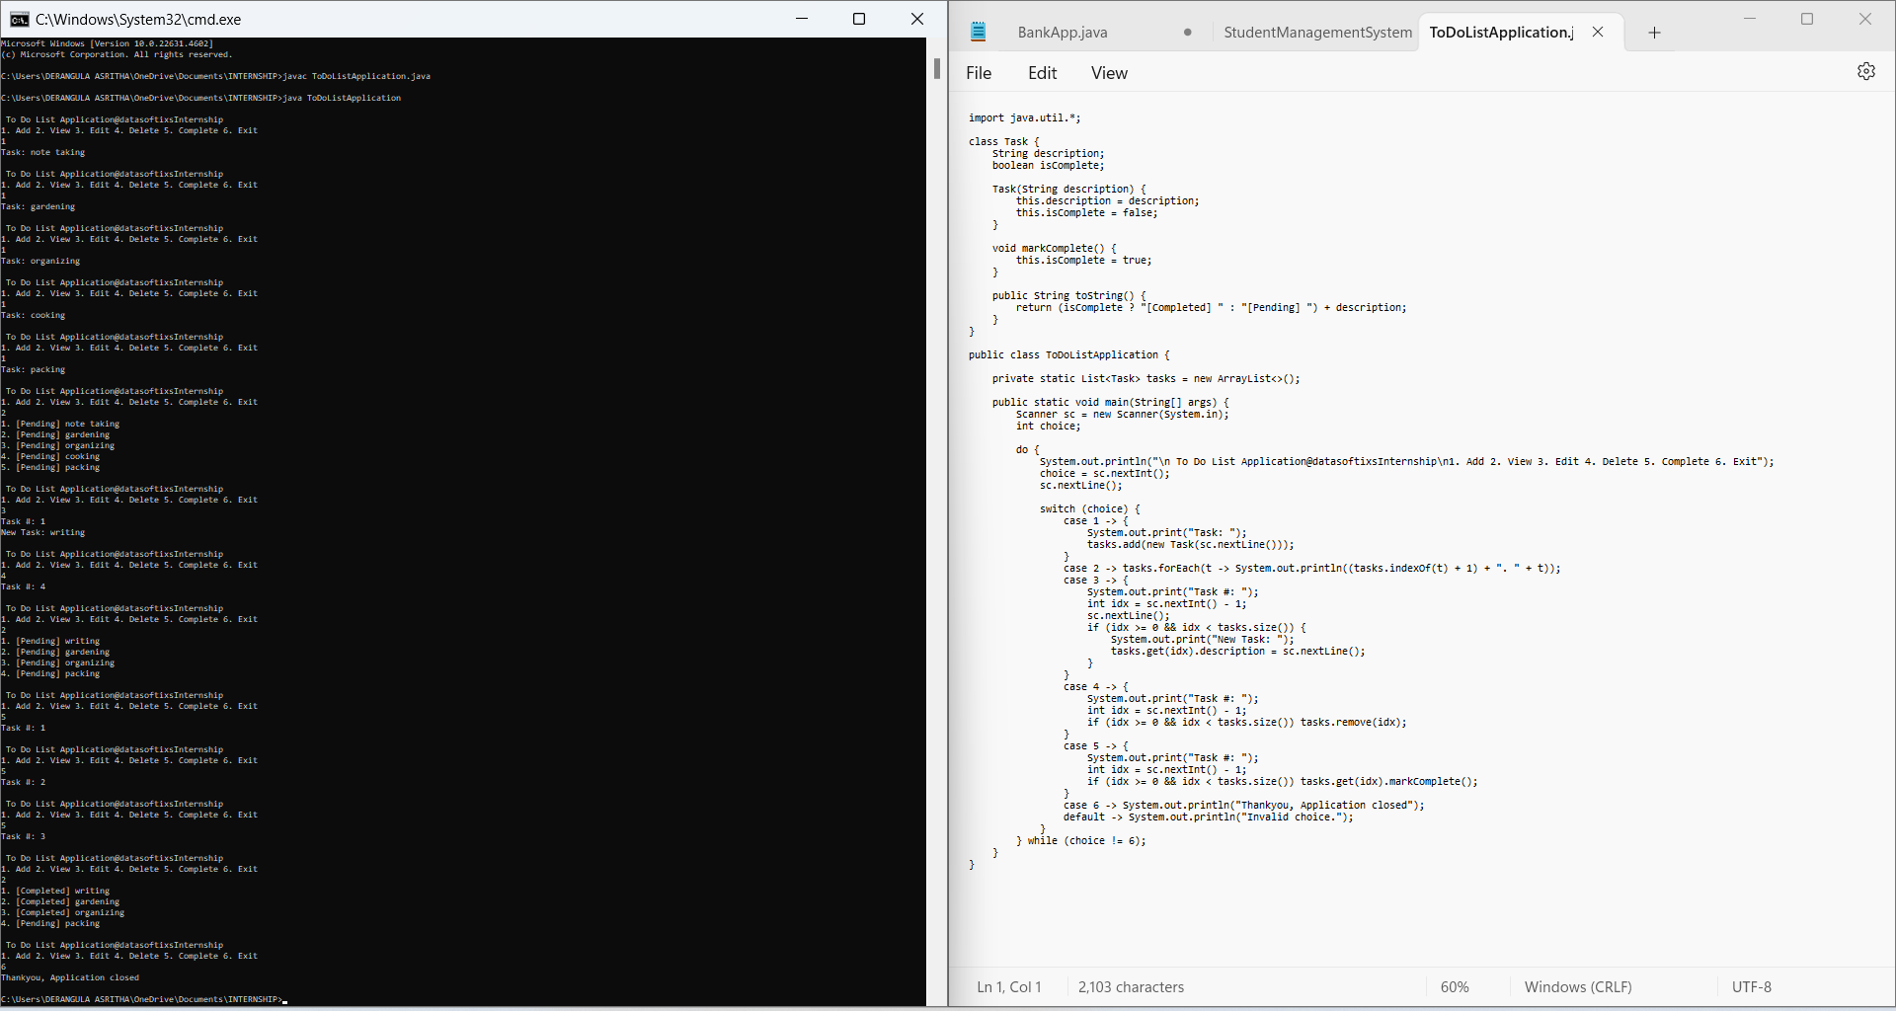
OUT PUT SCREENSHORT:
DataSoftixs Internship Program

Slide 9

Thank You
Acknowledgment to DataSoftixs Internship Program. Looking forward to applying these skills to future projects.
DataSoftixs Internship Program
DataSoftixs Internship Program

