Slide 1
Algorithms
Branching & pseudocode

Slide 2
Algorithm
A sequence of instructions is called an algorithm
There are two commonly used tools to help to document program logic (the algorithm). These are flowcharts and Pseudocode.

Slide 3
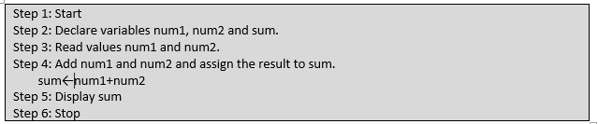
Pseudocode
Program to add two numbers enter by user

Slide 4
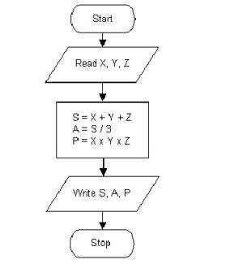
Steps from start to finish

Slide 5
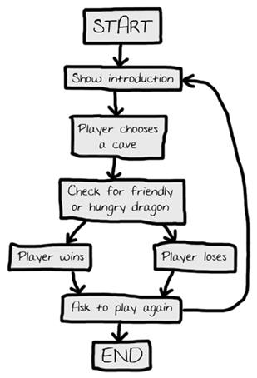
Another Flow Chart Example

Slide 6
Flowchart Symbols
start
Input some variables
Decision
Process something
stop
Output something

Slide 7
Now Your turn
Write a program the adds two numbers

Slide 8
A program that adds two numbers
start
Num1, num2, sum
Decision
Sum= Num1 + num 2
Sum
stop

