Slide 1


Slide 2
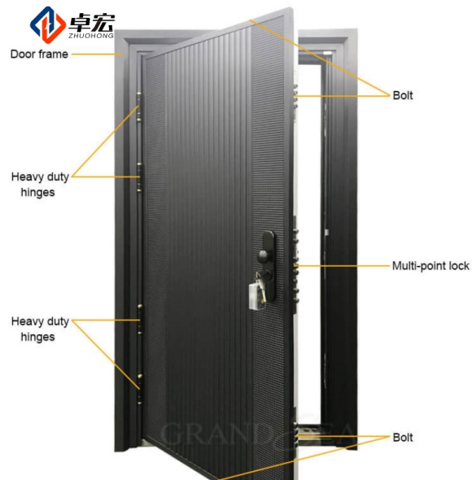

Standard Sizes
Single Door:
900 × 2100 mm
950 × 2050 mm
960 × 2050 mm
1000 × 2100 mm
Double Door:
1200 × 2100 mm
1500 × 2100 mm
1800 × 2100 mm
Custom Sizes Available
Security Features
✓ Anti-Pry Design
✓ Reinforced Lock Area
✓ Anti-Drill Protection Plate
✓ Anti-Lift Hinge Bolts
✓ Multi-Point Locking System
✓ Heavy Duty Steel Construction

Slide 3
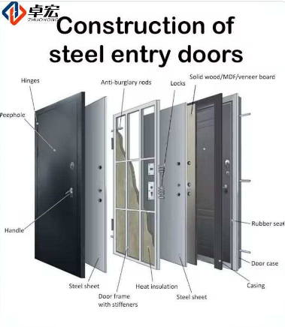
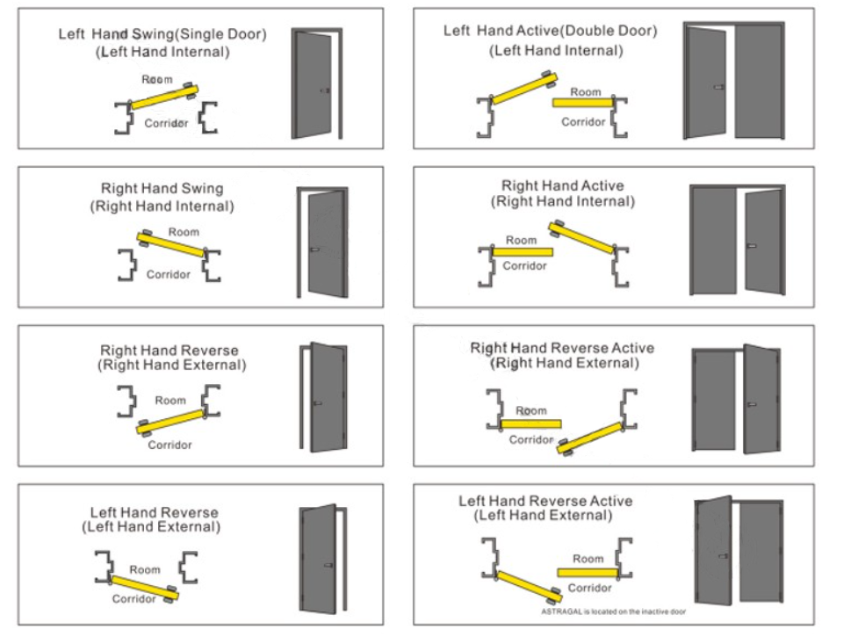
Openning Direction:
#Door leaf is infilled with mainly Perlite fireproof board
*Optional

Slide 4
ASSA ABLOY Steel Entry Door Specification
Certifications | GB /CE/UL
Filling Material | Mainly HONEYCOMB PAPER+skeleton
Fire rated time | 30mins
Doorframe sheet | 1.5 mm galvanized steel sheet
Door leaf sheet | 1.0mmgalvanized steel sheet
Surface finish | Door leaf and frame powder coated or wood grain heat transfer
Frame thickness | 50/70/90mm
Frame depth | 100-300mm or adjustable
Opening direction | Swing Inward / Outward Left/Right
Color | RAL color system, could be customized as well.
Accessories | Lockset including cylinder with keys,handle,hinges,door viewer,door closer(optional),threshold(optional)
Application | Building project, business, home decoration(Office, hotel, church, home etc.)
Package | Inside:PE paper, Outside: carton box and wooden pallets.
Vision panel | With or without as requsted
Louver | With or with as requsted
Size | Can be customised

Slide 5
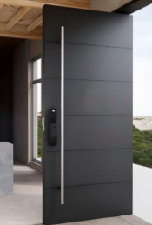
Product Name: Security Steel Door
Door Type: Single Leaf / Double Leaf Security Door
Application: Residential / Apartment / Villa / Commercial Building
Performance
Corrosion Resistance:
Suitable for Indoor and Outdoor Applications
Weather Resistance:
Available with Weather Seal
Sound Insulation:
Up to 30–35 dB (Depending on Configuration)
Thermal Insulation:
Optional Thermal Core Construction
Door Leaf Construction
Door Leaf Thickness:
50 mm / 70 mm / 90 mm (Customizable)
Steel Sheet Thickness:
Door Skin: 0.8 mm – 1.2 mm Galvanized Steel
Reinforcement Plate: 1.5 mm – 2.0 mm Steel
Core Material:
• Honeycomb Paper
• Rock Wool
• Polyurethane Foam (Optional)
Door Leaf Structure:
Double-layer galvanized steel construction with internal reinforcement.
Door Frame
Frame Material:
Galvanized Steel
Frame Thickness:
1.2 mm – 2.0 mm
Frame Depth:
100 mm – 300 mm (Customizable)
Frame Type:
• Standard Frame
• Adjustable Frame
• Welded Frame
Surface Finish:
Powder Coating / Wood Grain Transfer Printing

Slide 6
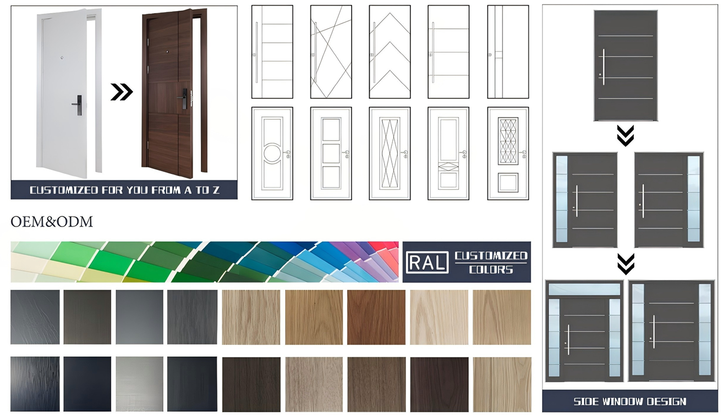
Surface Finishes
Available Colors:
• Matte Black
• Dark Grey
• Light Grey
• White
• Coffee Brown
• Wood Grain Oak
• Walnut
• Teak
Custom RAL Colors Available

Slide 7
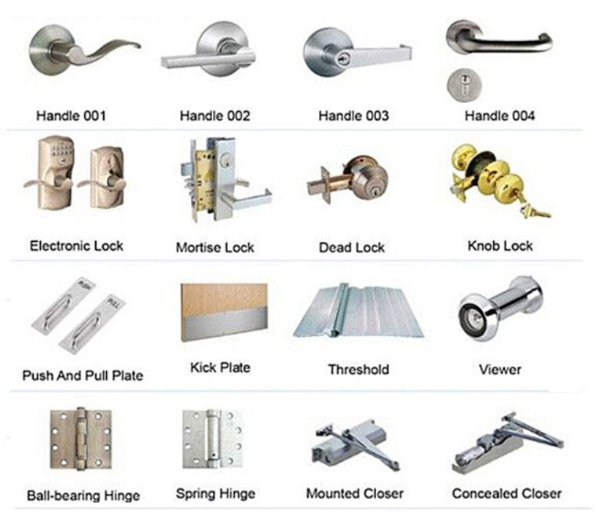
Hardware Included
• Security Lock
• Cylinder and Keys
• Hinges
• Handle Set
• Door Viewer (Optional)
• Door Closer (Optional)
• Threshold (Optional)

Slide 8
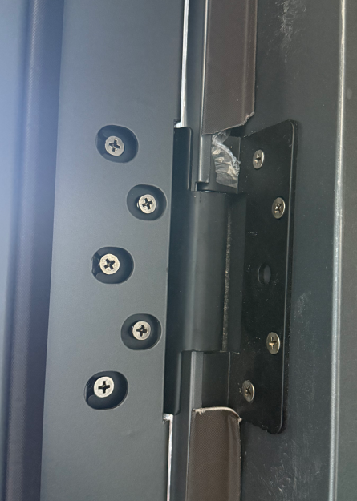
Hinges
Hinge Type:
Heavy Duty Ball Bearing Hinges
Quantity:
3–4 Hinges per Leaf
Optional:
Concealed Hinges

Slide 9
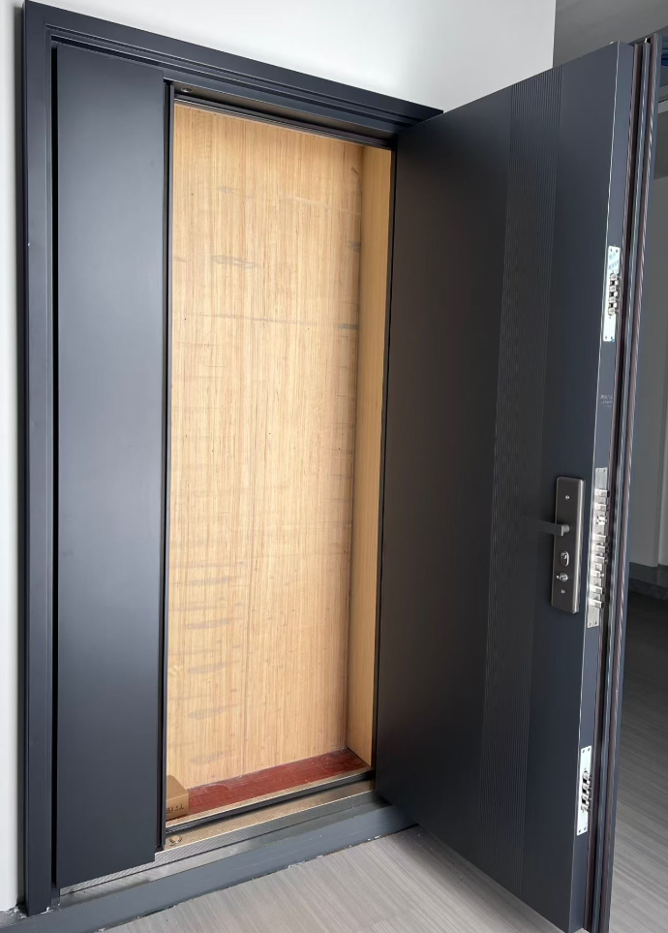
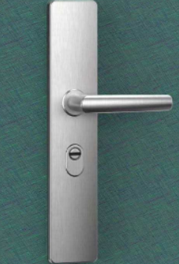
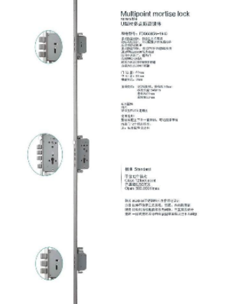
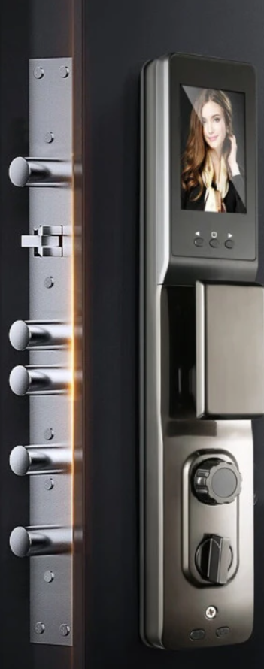
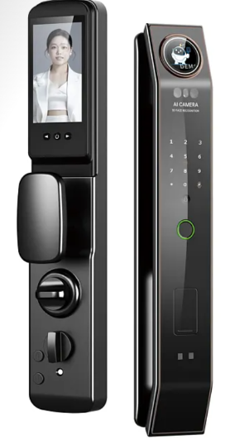
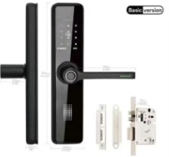
Locking System
Lock Type:
Multi-Point Security Lock
Locking Points:
4 / 6 / 8 / 12 Points
Cylinder:
High Security Anti-Pick Cylinder
Keys:
5 Mechanical Keys Included
Optional:
• Smart Lock
• Fingerprint Lock
• Digital Keypad Lock

Slide 10
