Slide 1
(Permanently Affiliated to University of Mumbai)
Speech To Code Converter
GROUP 10
MEMBERS:
445-Rishabh Pandey
448-Soumik Paul
449-Omkar Pednekar

Slide 2
(Permanently Affiliated to University of Mumbai)
CHAPTERS
Abstract
Introduction
Problem Definition
Proposed System
Implementation
Technology used

Slide 3
(Permanently Affiliated to University of Mumbai)
ABSTRACT
Our team is building a software which helps the user to write a code just by speaking in the microphone . For now our software is limited to one coding language i.e. PYTHON, we will take user’s voice as input and display that input in our code editor so that the user can run this code.

Slide 4
(Permanently Affiliated to University of Mumbai)
INTRODUCTION
Being a IT engineer is a difficult task as one has to be in front of the pc and type codes for long hours, this can cause pain in the arms, fingers, wrist, migraine, back pain etc. So to overcome this problem we are creating this software which helps the user to write code in a easy and convenient way just by saying the syntax out loud instead of typing it.

Slide 5
(Permanently Affiliated to University of Mumbai)
PROBLEM DEFINITION
Recent Studies have shown that a lot of programmers face health issues regarding their posture, severe pain in hand,wrist,fingers etc. since the have to sit for long hours in front of the pc and write codes.

Slide 6
(Permanently Affiliated to University of Mumbai)
PROPOSED SYSTEM
In our system user will give the input just by speaking in the microphone.
Our software will convert this input from speech to text and display this text in our code editor.
Our software is user friendly and easy to use as it has autocomplete syntax

Slide 7
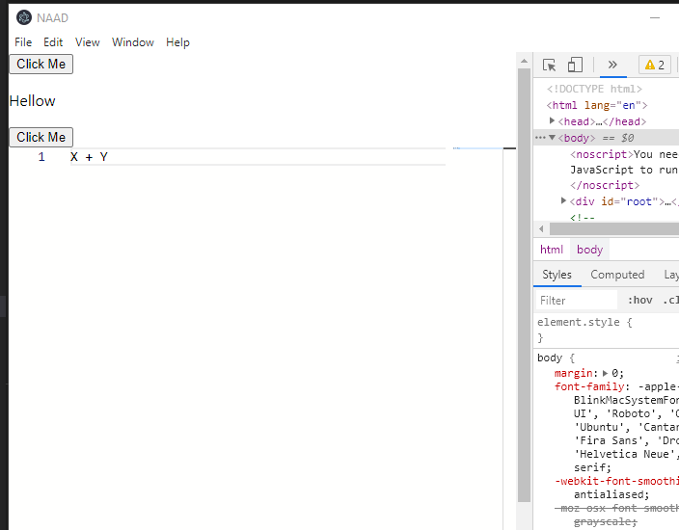
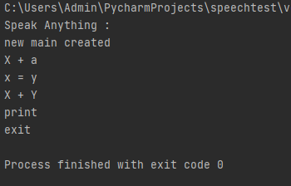
(Permanently Affiliated to University of Mumbai)
CURRENT IMPLEMETATION

Slide 8
(Permanently Affiliated to University of Mumbai)
TECHNOLOGY USED
Desktop and Laptop
Windows OS
Python (Pycharm IDE)
React.js
Monaco
Electron.js
Github.com

