Slide 1



HTML, CSS, JavaScript
INTRODUCTION AND BASIC CONCEPTS
www.arobs.com

Slide 2

Content
1. Introduction
2. HTML - Structure
3. HTML Tags
4. HTML Attributes
5. CSS
6. JavaScript
7. Locators
8. Useful links
www.arobs.com

Slide 3
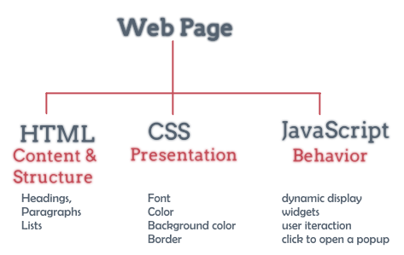
Introduction
Hypertext Markup Language
markup language - a system for annotating a document in a way that is syntactically distinguishable from the text.
Cascading Style Sheets
is style sheet language used for describing the presentation of a document written in a markup language like HTML.
JavaScript
an object-oriented computer programming language commonly used to create interactive effects within web browsers.
www.arobs.com

Slide 4
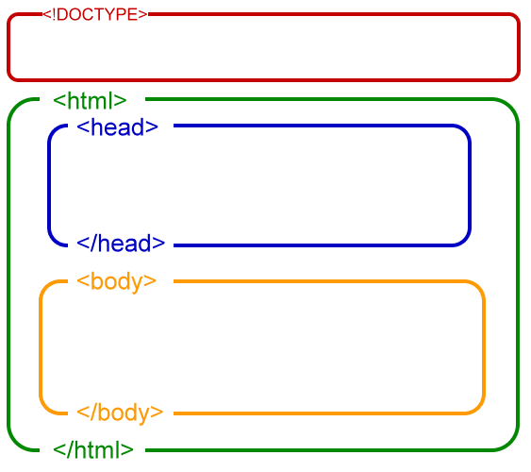
HTML - Structure
The doctype declaration must be the very first thing in your HTML document, before the html tag. The declaration is not an HTML tag; it is an instruction to the web browser about what version of HTML the page is written in.
Head section is a container for metadata (data about data). Metadata typically define the document title, character set, styles, links, scripts, and other meta information.
The body contains the information that constitutes the page; all the contents of an HTML document, such as text, hyperlinks, images, tables, lists, etc.
www.arobs.com

Slide 5
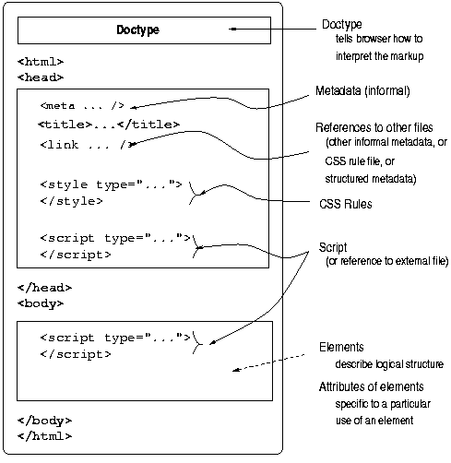
HTML - Structure
www.arobs.com

Slide 6
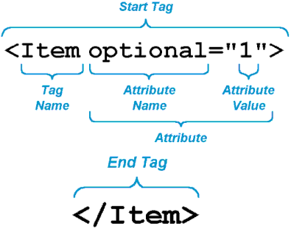
HTML Tags
HTML tags are used to mark-up HTML elements
Surrounded by angle brackets < and >
HTML tags normally come in pairs, like <tagname> (start tag) and </tagname> (end tag)
The text between the start and end tags is the element content
Not case-sensitive(for basic HTML)
www.arobs.com

Slide 7
HTML Attributes
Tags can have attributes that provide additional information to an HTML elements
Attributes always come in name/value pairs like: name=“value”
Attributes are always specified in the start tag
Attribute values should always be enclosed in quotes. Double quotes are most common.
Also case-insensitive: however, lowercase is recommended
<tagname a1=“v1” a2=“v2”></tagname>
For example, <table border=“0”> is a start tag that defines a table that has no borders
All HTML tags : https://www.w3schools.com/tags/
www.arobs.com

Slide 8
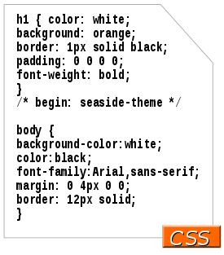
CSS
Controls format:
Font, color, spacing
Alignment
User override of styles
Layers
Layout
User Interface
Cascade Precedence: resolves conflicting style rules
Inline style sheets
Embedded sheets
External style sheets
www.arobs.com

Slide 9




Java Script
Compact object-based scripting language
Code be embedded into HTML file
HTML tag : <script language=“javascript”>CODE</script>
Also be in a separate file FILENAME.js
HTML tag - <SCRIPT LANGUAGE="JavaScript" SRC=“FILENAME.js"></SCRIPT>
Main objectives:
User interface, CGI capabilities without involving server
Client side compilation
Server provides no support
www.arobs.com

Slide 10
Locators
A locator is a query that results in 1-N elements being returned to you - the majority of the time it’ll be a single element.
An element is an HTML element from the page such as an input field or an anchor.
Methods:
Using the ID
Using Name
Using CSS Selector
Using ClassName
Using TagName
Using Link Text
Using the XPath
www.arobs.com

Slide 11
Useful links
http://frontendbabel.info/articles/webpage-rendering-101/
https://www.html5rocks.com/en/tutorials/internals/howbrowserswork/
https://www.tutorialspoint.com/ajax/what_is_ajax.htm
https://automationintesting.com/selenium/java/lessons/locators.html
https://msdn.microsoft.com/en-us/library/ms256471(v=vs.110).aspx
www.arobs.com

Slide 12




THANK YOU!
GET IN TOUCH
Olimpia Muntea
Software Developer
olimpia.muntea@arobs.com

