Slide 1
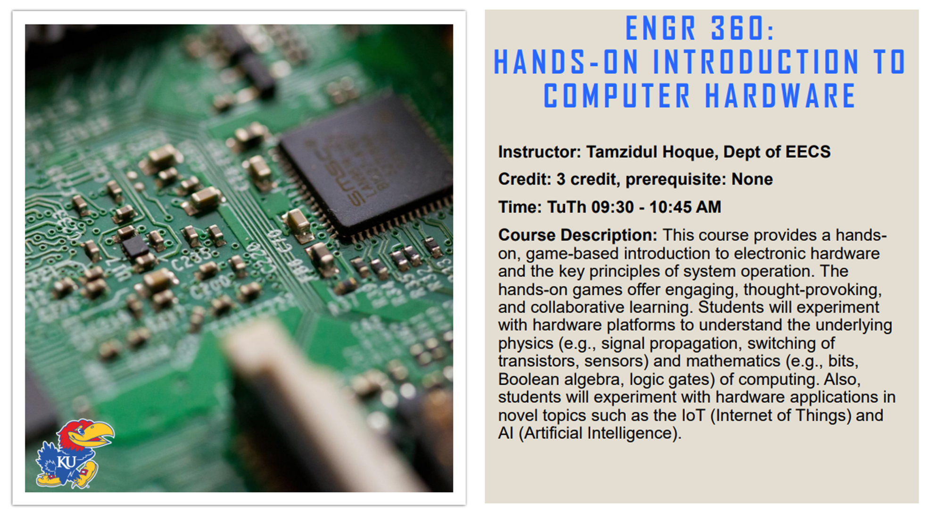
Announcement

Slide 2
EECS 388:
Embedded Systems
A practical session on how to do binary reverse engineering

Slide 3
Why we are learning security
Modern life is device dependent, and their security is critical!
There is a shortage of skilled workforce in cybersecurity
Security can be a way to improve the understanding of the design concept!
Why not use revise our design topics by applying them to implement security concepts

Slide 4
Overview
What is Bitstream/Binary/Software Reverse Engineering(RE)?
Motivation
Systematic way of doing RE
Our goal
Intro to 8051 ISA
Intro to KEIL
Example
Assignment :')

Slide 5
Introduction
1
Skeletal Source Program
Skeletal Source Program
6
Language Processing System
2
Pre-process
Pre-process
5
Source Program
3
Compile
Compile
4
Target Assembly Program
4
Assembler
Assembler
3
Relocatable Machine Code
5
Loader
Loader
2
Library, Relocatable Object Files
Machine Code
Machine Code
1
6

Slide 6
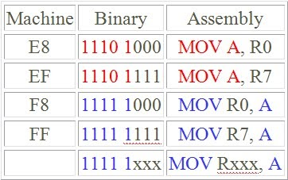
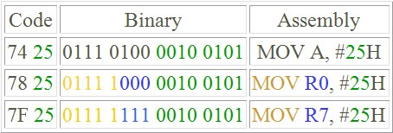
Bitstream/Binary/Software Rev. Eng.
Understand the properties of machine code/object code.
Each architecture has fixed set of opcode, operand and register naming.
Can be Static or Dynamic.
MicroController 4 All: Session 5 : 8051 Addressing Modes

Slide 7
Why Rev. Eng. is helpful for Embedded System
RE requires investigation of the ISA to understand the structure of the binary
Requires analysis of the binary execution
Hence, performing RE will improve our understanding of the ISA, code compilation process, and code simulation

Slide 8
Rev. Eng. For Cybersecurity ?
Legitimate purposes
  Understand the program
  Identify vulnerabilities/weakness
  Analyze security vulnerabilities
Malicious purposes
  Unauthorized overproduction / IP piracy
  Develop malware / create malicious version
  Trojan insertion
Notes:
In March 2021, a supply chain attack on Codecov, a software testing company, was discovered. The attackers used reverse engineering techniques to gain access to Codecov's source code and insert a malicious code that allowed them to steal credentials and sensitive information from Codecov's clients
The attackers used the malware to gain access to the networks of several US government agencies, including the Departments of Defense, State, Treasury, and Homeland Security. The attackers were able to steal sensitive information and install additional malware on the compromised systems.
The SolarWinds attack is one of the most significant supply chain attacks in recent years, and it has highlighted the importance of software security and supply chain integrity.

Slide 9
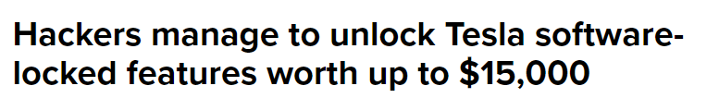
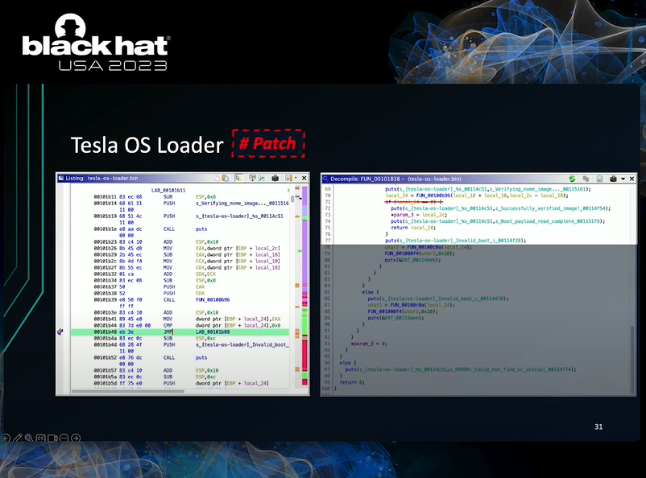
Real world Rev Eng Attack
Attack involved reverse engineering the binary and modifying code
Understanding the boot process of the software system
YouTube link
Notes:
https://electrek.co/2023/08/03/hackers-manage-unlock-tesla-software-locked-features/

Slide 10
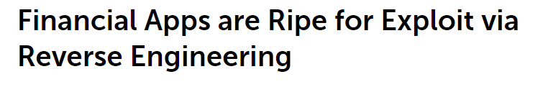

White Hat Rev Eng for security analysis
Source
“A white hat hacker reverse engineered 30 mobile financial applications and found sensitive data buried in the underlying code of nearly all apps examined.”
“With this information a hacker could, for example, recover application programming interface (API) keys and use them to attack the vendor’s backend servers and compromise user data”

Slide 11
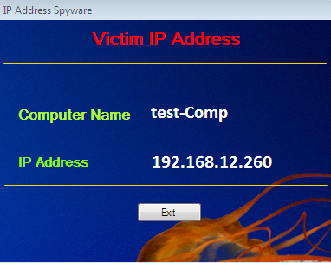
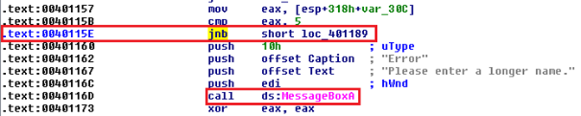
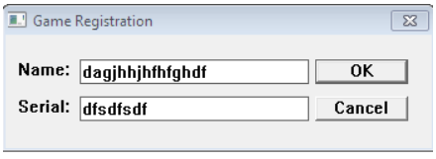
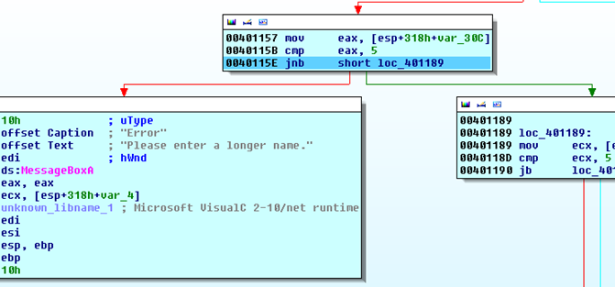
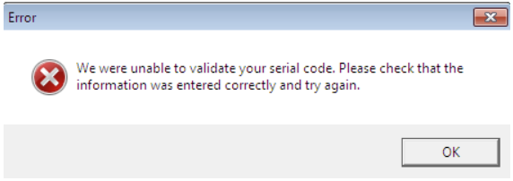
Example: deploy A spyware in a simple Game Registration executable
The Game Registration typically requires serial keys to validate
Step 1
spyware program will show the machine name and IP address of the computer where it runs and sends back such critical information to the hacker serve
We want this Error message box would become the entry point of the malicious covert code
Tool used: IDA Pro
Notes:
Our goal is to insert some code to perform additional analysis whenever there is a mismatch between name and serial.
This Error message box would become the entry point of the malicious covert code. The moment when the user is confronted with the aforesaid Error message box, the spyware becomes executed. That is what we are trying to achieve in this paper.
The ISA is x86 for the example
Jnb--"JNB" stands for "Jump if Not Below," which is a conditional jump instruction. It is used to compare two values and jump to a different part of the program if the first value is not less than the second value, effectively checking if the first value is greater than or equal to the second value.
The JNB (Jump if Not Below) instruction knows the result of the preceding CMP (Compare) instruction through the use of flags in the CPU's status register, often referred to as the flags register. The flags register is a special-purpose register used within the CPU to indicate the current state or outcome of various operations, including arithmetic and logical instructions. The CMP instruction, specifically, affects flags in this register based on the result of comparing two values.

Slide 12
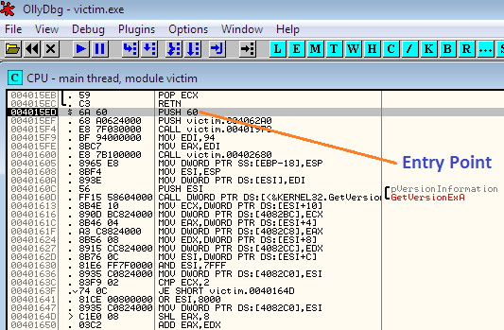
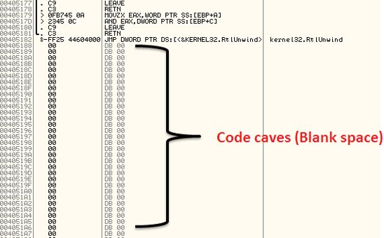
Idnetify Entry point of Malicious code
we can identify the first message box occurrence after the 0040115E offset.
Step 2
Tool used: OllyDbg
Step 1
Address | Hex | Assembly
Step 3
Executables have some empty space referred or Code Caves where we can place or inject new code.
Notes:
Entry Point in OllyDbg
In OllyDbg, the Entry Point is the address in the executable code where the program begins executing when it is loaded into memory. This is the starting point of the program's execution, and it is typically the address of the program's main function.
When you open an executable file in OllyDbg, it automatically sets a breakpoint at the Entry Point address. This allows you to easily begin debugging the program from its starting point. You can use OllyDbg to step through the program's instructions, inspect its memory and registers, and analyze its behavior.
To insert additional code we first find empty space in the reversed binary

Slide 13
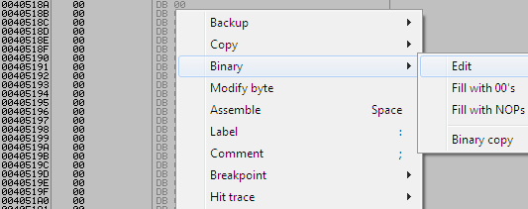
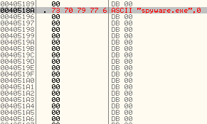
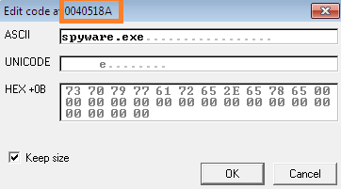

example
Select a couple code caves instructions and edit
Step 3
Step 4
Address | Hex | Assembly
label the spyware program executable as spyware.exe in the ASCII box while editing address 0040518A
Corresponding hex code is automatically generated and placed at the 0040518A offset.
Step 5
We also have to add code to push the starting address of the malicious code
Notes:
We are editing the binary and including an executable spyware.exe

Slide 14

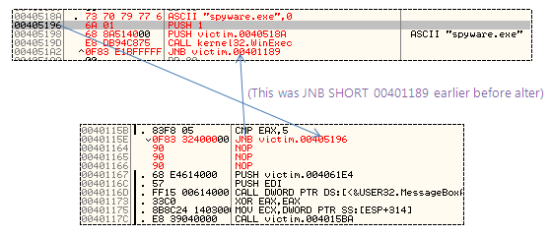
example
Step 6
Our spyware program is having an *.exe format. To run it, we have to use CALL WinExec instruction
Step 7
Before edit
After edit
Source : Injecting spyware in an EXE (code injection) |Infosec Resources (infosecinstitute.com)
Notes:
after entering the user name and serial key in the victim.exe, first the error message box would display and then our spyware program would activate.

Slide 15
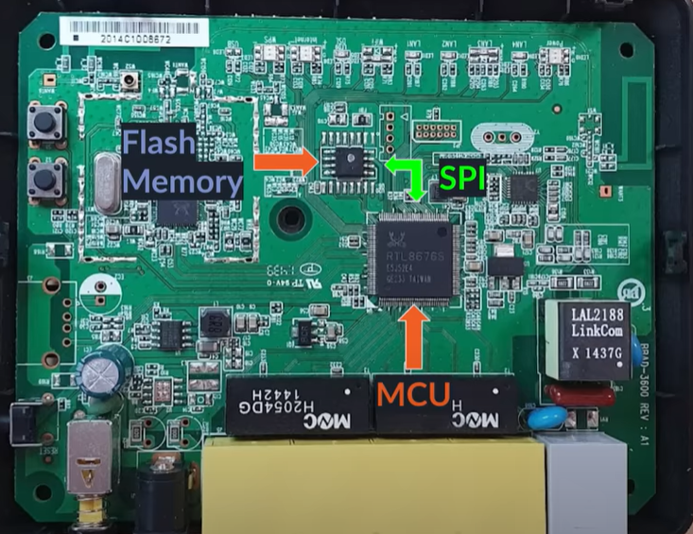
REv. Eng. In Embedded Devices
Loading a program onto an embedded device required following steps:
  Writing the program in behavior level i.e. C or C++
  Compile the code into a machine readable format
  Load the binary/executable image in device memory
Can an attacker with physical access to the device steal the binary image?
Yes! It is possible to extract the binary from its memory using tools such as JTAG debugger, logic analyzer, or firmware extraction tool.
Note: Using SPI (Serial Peripheral Interface) bus, MCU communicate with flash memory.

Slide 16
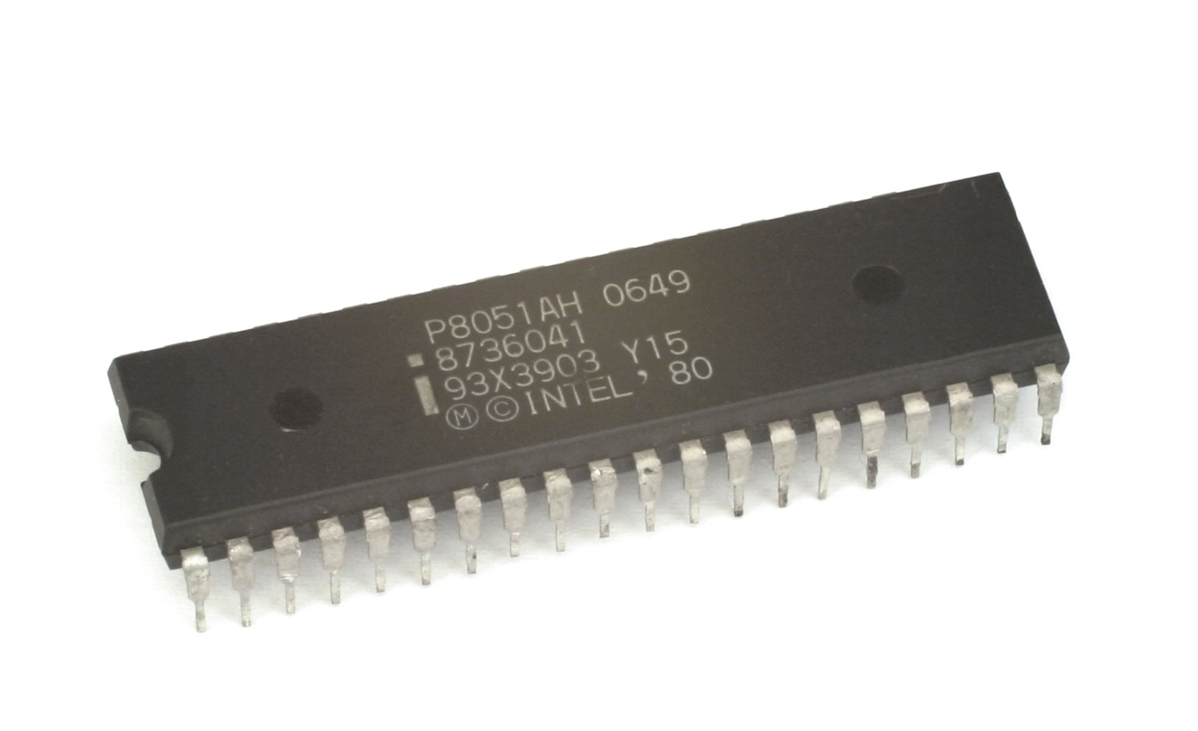
Intro to 8051 MCU:
8-bit architecture introduced by intel in 1980s.
8-bit CPU, 4 KB of ROM, 128 bytes of RAM and 32 I/O pins
Simple instruction set and can execute one instruction per cycle
Can be programmed in assembly language or high-level languages such as C
Still used today for embedded applications that require low power consumption, small size and most important for its simplicity.
Source: Intel 8051 - Wikipedia
Notes:
One of the key advantages of the 8051 microcontrollers is its simplicity, which makes it an excellent choice for a wide range of applications. The 8051 microcontrollers are widely used in applications such as automotive systems, industrial control systems, consumer electronics, and medical devices.

Slide 17
Intro to 8051 MCU ISA:
OPCODE | USAGES | Details
MOV | Data Memory ⇔ Registers | Any data from internal 256 bytes of RAM
MOVC | Code Memory ⇔ Registers | Used for constants or an array of data
MOVX | Registers ⇔ External Memory | Same as MOV, but instead of internal data memory, it is used for external data memory
ADD | ADD op1, op2 ADD A, R1 ⇔ result in A(acc) ADD R1, R2 ⇔ ERROR! | One can be immediate, and the other must be some memory locations(register, accumulator(A), data memory).
SUBB | SUBB A, R1 ⇔ A - R1 result in A(acc) SUBB R1, R2 ⇔ ERROR! | Subtract with borrow. If A > R1 = no issues! If A < R1 = Borrow stores automatically!
DIV | DIV A, B ⇔ CORRECT! DIV A, R1 ⇔ ERROR! | A & B register can only be used! Result stored in A
MUL | MUL A, B ⇔ CORRECT! MUL A, R1 ⇔ ERROR! | A & B register can only be used!

Slide 18
8051 Registers:
CPU Registers | Details
Program Counter | Keeps track of where the processor is in its execution of a program.
Accumulator | Special purpose register. The accumulator is typically a processor register that is optimized for fast access and is used in conjunction with arithmetic and logic operations.
Stack Pointer | Holds the memory address of the top of the stack
Instruction Register | Holds the current instruction that the processor is executing
Address Register | Holds the address of the next instruction to be executed
Index Register | Holds a memory address offset or an index value for data access operations. The index register is typically used to access data structures, such as arrays or tables, efficiently.

Slide 19
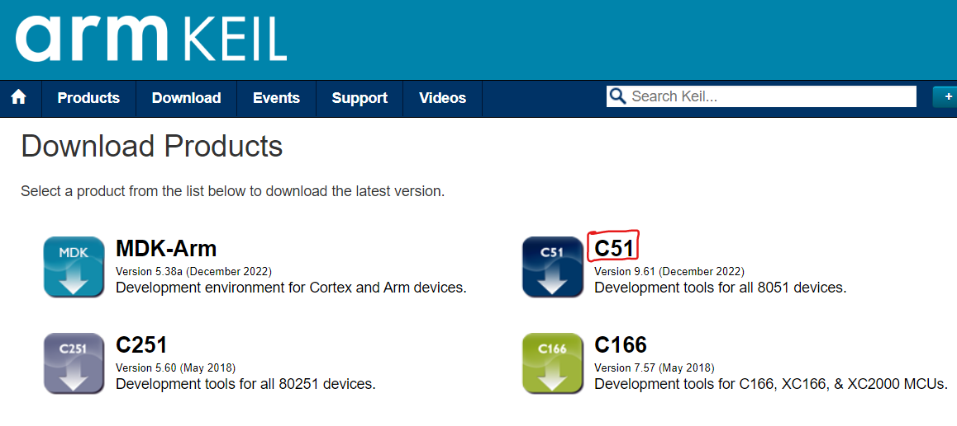
PROGRAMMING IN KEIL:
KEIL C51 is a cross-compiler for the 8051 microcontroller family.
It supports a wide range of 8051 variants and extensions, such as code banking, memory models, and bit-addressable data types.
IDE with a project manager, editor, debugger, and simulator.
It includes a library of standard and vendor-specific header files, startup code, and runtime routines.
It generates compact and efficient code that can be optimized for speed or size using various directives and options.
Download Link: Keil Product Downloads
How to Install: https://youtu.be/MG595VN4r70
Note: Run as administrator after installing the tool.
Keil doesn't support on MAC :(
Statement: GENERAL: Keil MDK 5 on a Mac (arm.com)
Solution: Virtual box / Cycle server

Slide 20
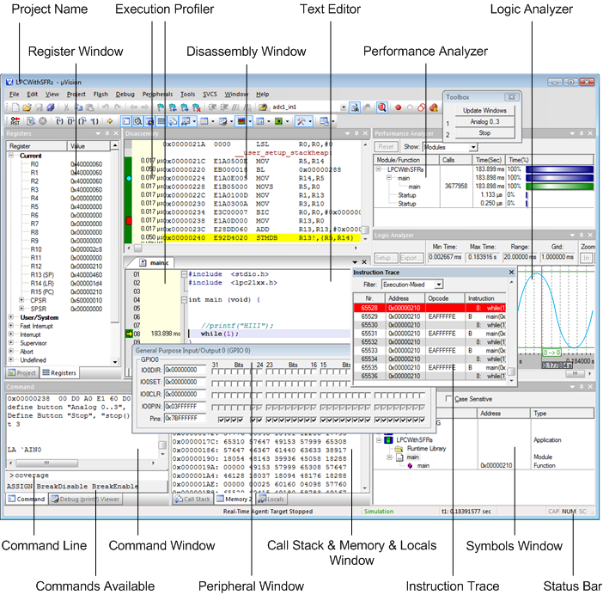
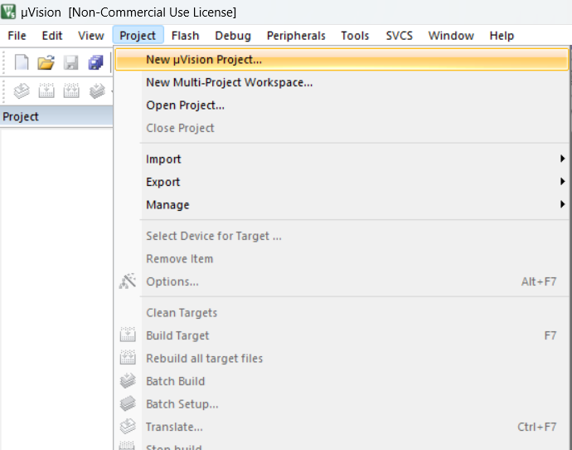
KEIL tutorial
1
Project > New uVision Project

Slide 21
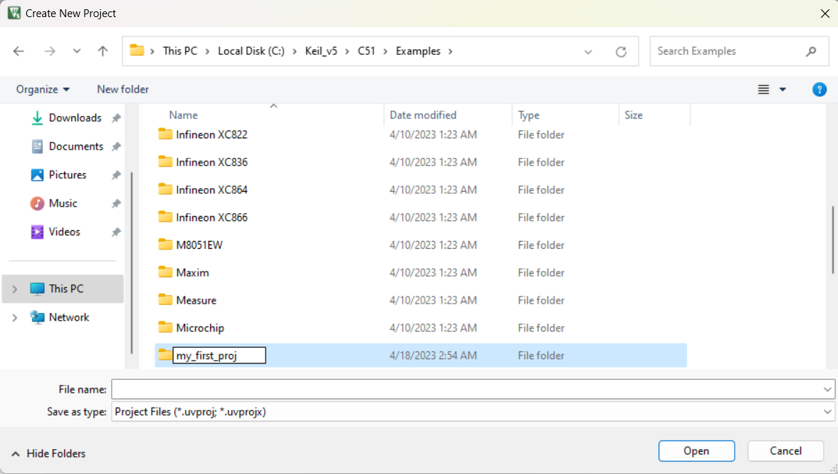
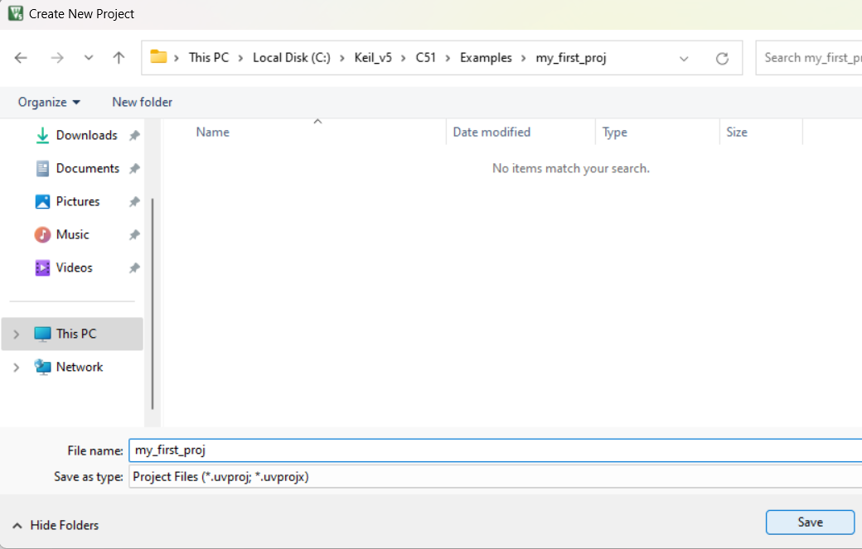
KEIL tutorial
2
3
Click "New folder" > give a name > click "Open"
Same name as folder > click "Save"

Slide 22
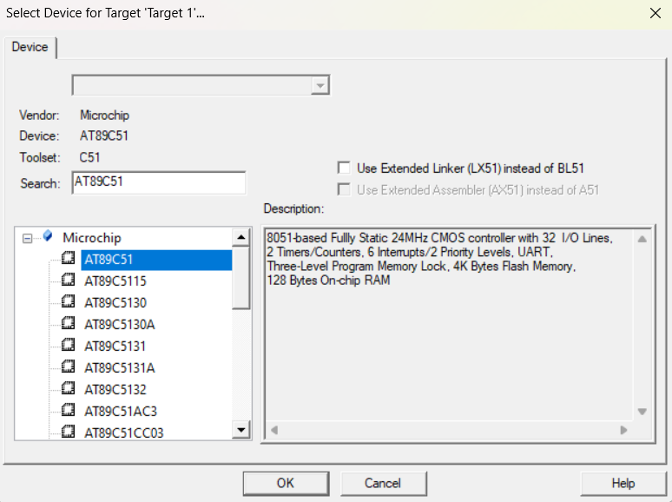
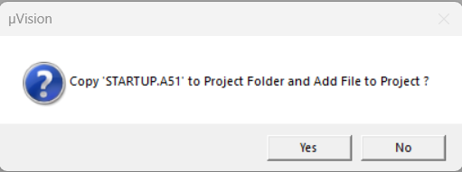
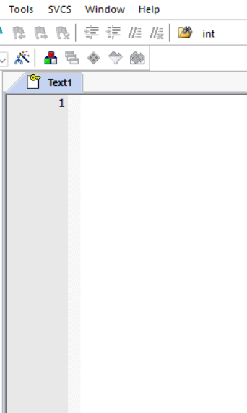
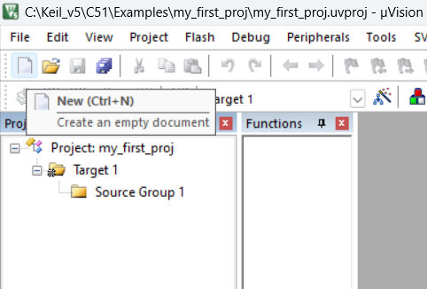
KEIL tutorial
5
click "No"
4
Search "AT89C51" > Select from "Microchip" > click "OK"
7
A new text window will appear...
6
click "New" or "Ctrl+N"

Slide 23
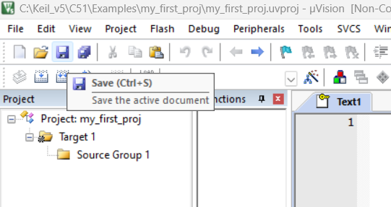
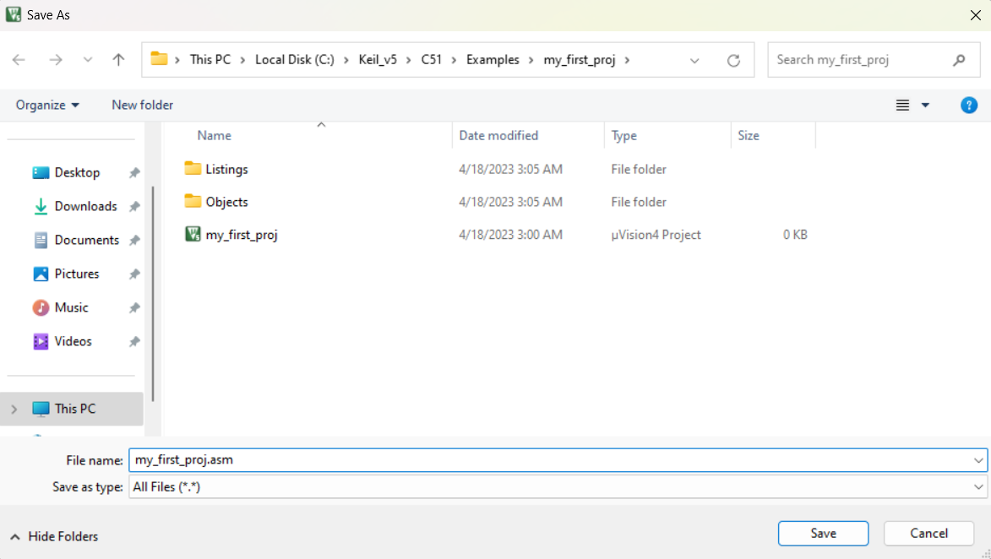
KEIL tutorial
8
click "Save"
9
Same name as folder with extension .asm > click "Save"

Slide 24
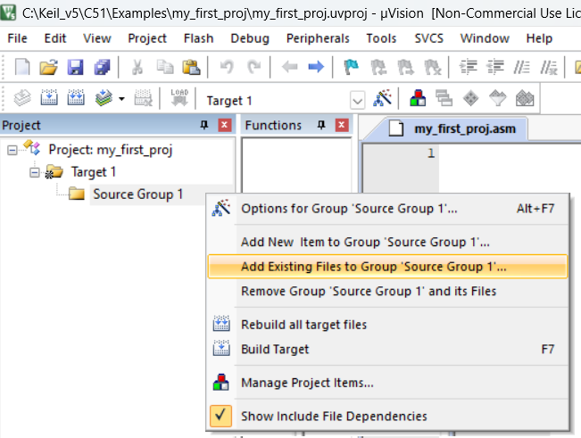
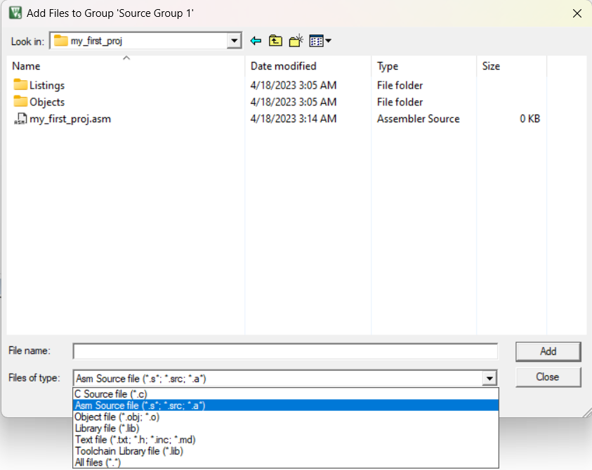
KEIL tutorial
10
11
Right Click "Source Group 1" > Click "Add Existing Files to Group 'Source Group 1' ..."
Change "Files of type" to "Asm Source file" > click *.asm file > click "Add" > click "close"

Slide 25
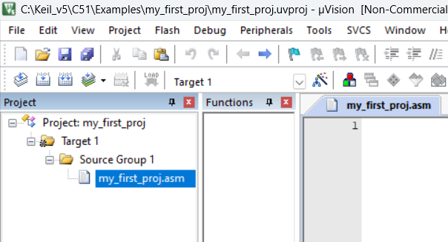
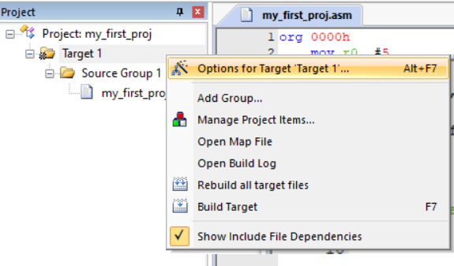
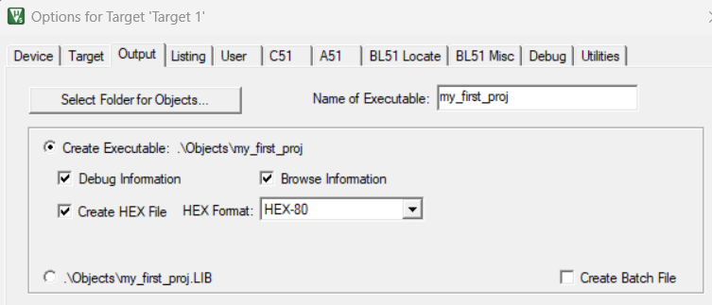
KEIL tutorial
12
13
Our assembly file is added with the project. Let’s write our first 8051 program which is to find factorial of a number :'). For 1st exercise we will write an assembly code
Right click "Target 1" > click "Options for Target 'Target 1'..."
14
click "Output" > check "Create HEX File"

Slide 26
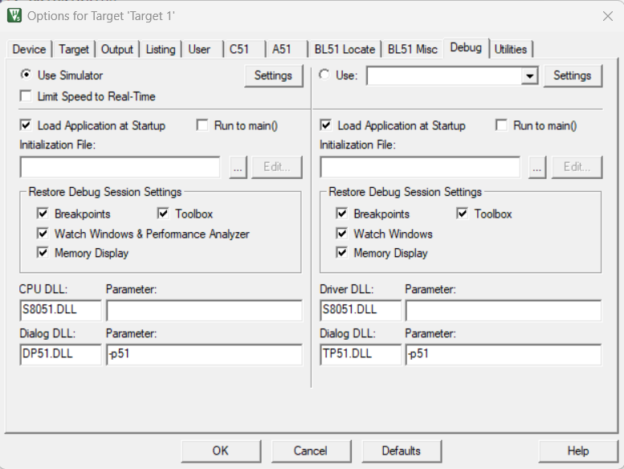
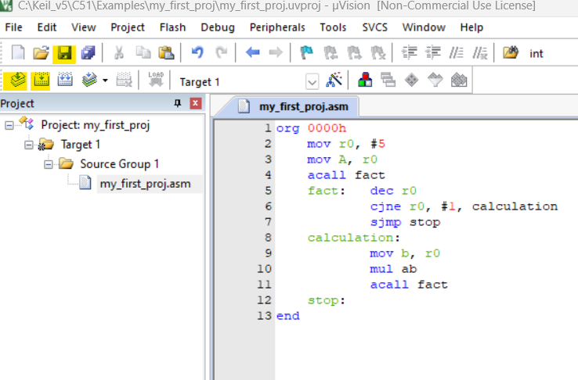
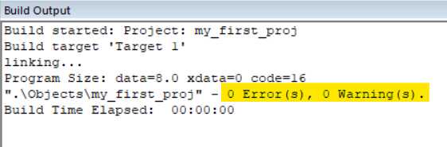
KEIL tutorial
15
Un-check "Run to main()"(left side) as we are not running a C program > Click "OK"
16
click "Save" > click "Translate" > click "Build"
We should get 0 error and 0 warning after "Translate" and "Build"
17

Slide 27
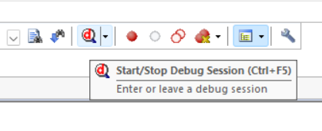
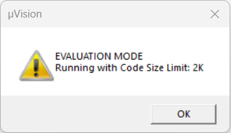
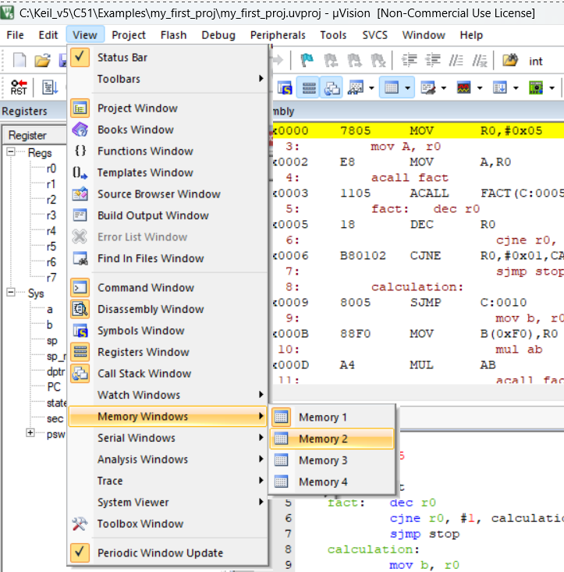
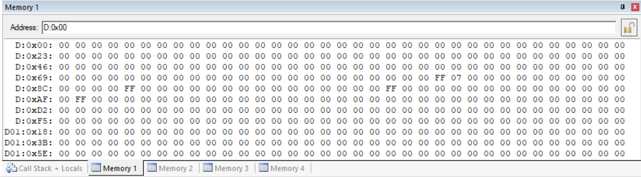
KEIL tutorial
18
19
Now click "Start/Stop Debug Session"
Click "OK"
21
In "Memory 1" "Address" type "D:0x00" and it will show all the internal data memory (256 byte). In "Memory 2" "Address" type "C:0x0000" and it will show the External memory (ROM) and the hex format machine codes.
20
click "View" and you can Memory window to observe RAM and ROM data.

Slide 28
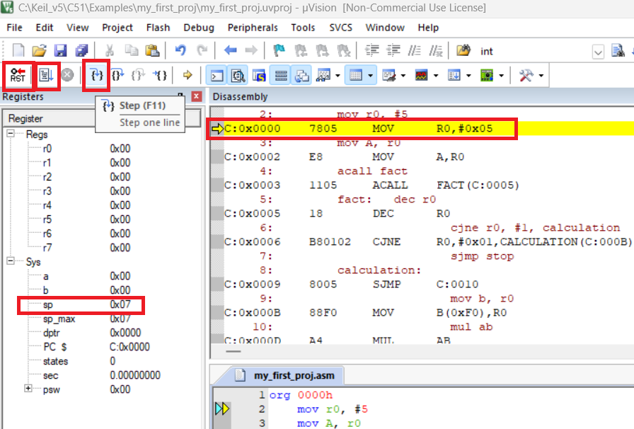
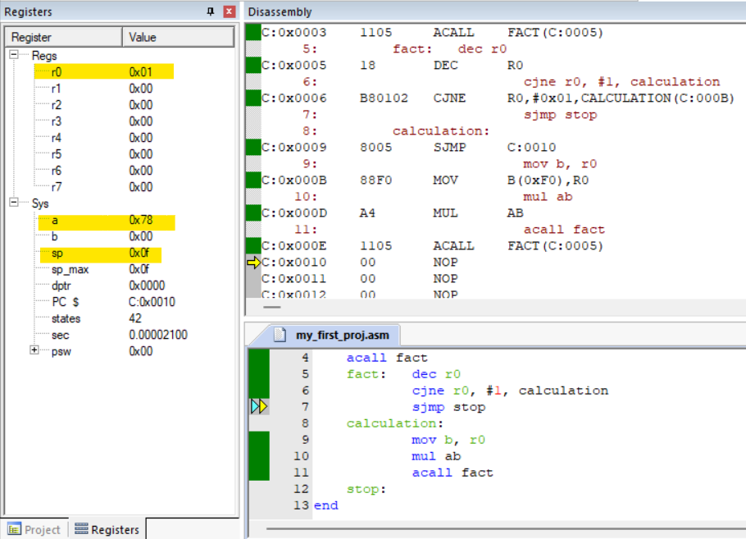
KEIL tutorial
22
23
Continuously click on "Step" to observe the data flow among registers and reach the final output. Note that the current "sp" stack pointer is at "0x07" address, and it will store the return address after the function call on top of it.
The final output is in accumulator register and the value is in hex "0x78" which is equivalent to 120 in decimal. Repeat step 18 to close the debugger window. Close the project from "Project" window.

