Slide 1
EECS 388:
Embedded Systems
Binary reverse engineering

Slide 2
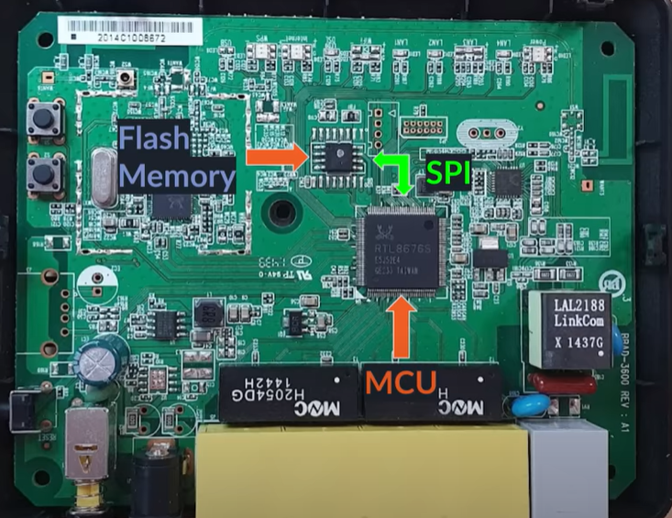
REv. Eng. In Embedded Devices
Loading a program onto an embedded device required following steps:
  Writing the program in behavior level i.e. C or C++
  Compile the code into a machine readable format
  Load the binary/executable image in device memory
Can an attacker with physical access to the device steal the binary image?
Yes! It is possible to extract the binary from its memory using tools such as JTAG debugger, logic analyzer, or firmware extraction tool.
Note: Using SPI (Serial Peripheral Interface) bus, MCU communicate with flash memory.

Slide 3
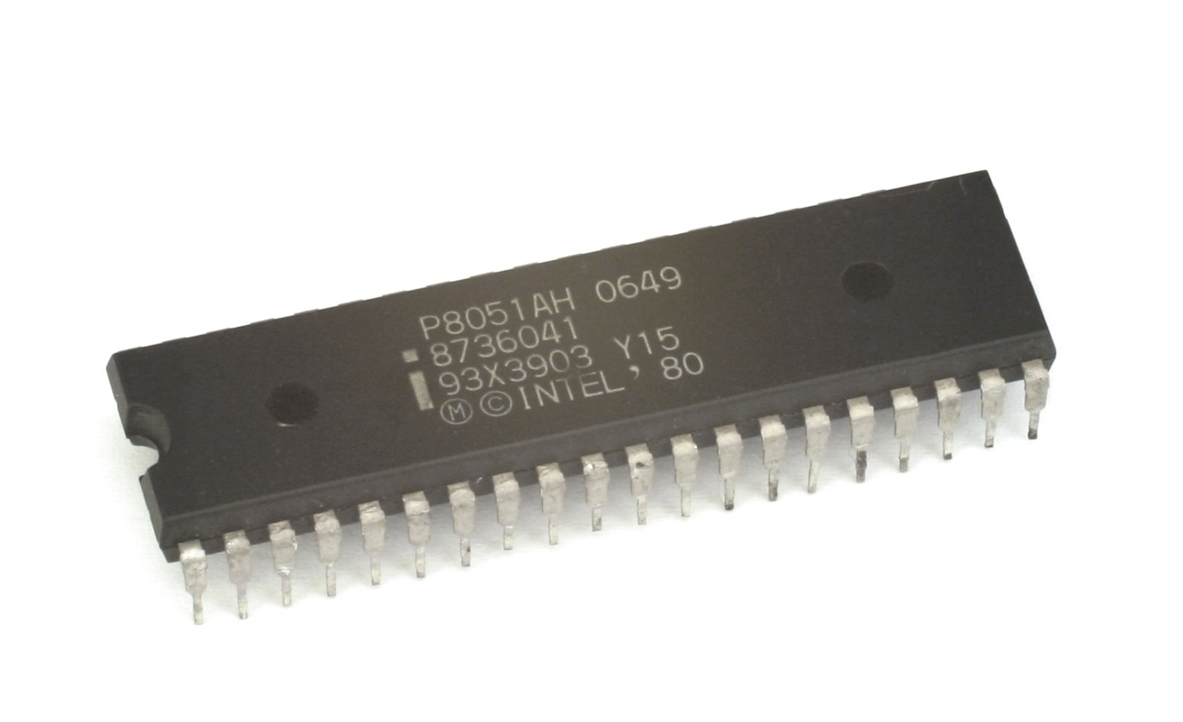
Intro to 8051 MCU:
8-bit architecture introduced by intel in 1980s.
8-bit CPU, 4 KB of ROM, 128 bytes of RAM and 32 I/O pins
Simple instruction set and can execute one instruction per cycle
Can be programmed in assembly language or high-level languages such as C
Still used today for embedded applications that require low power consumption, small size and most important for its simplicity.
Source: Intel 8051 - Wikipedia
Notes:
One of the key advantages of the 8051 microcontrollers is its simplicity, which makes it an excellent choice for a wide range of applications. The 8051 microcontrollers are widely used in applications such as automotive systems, industrial control systems, consumer electronics, and medical devices.

Slide 4
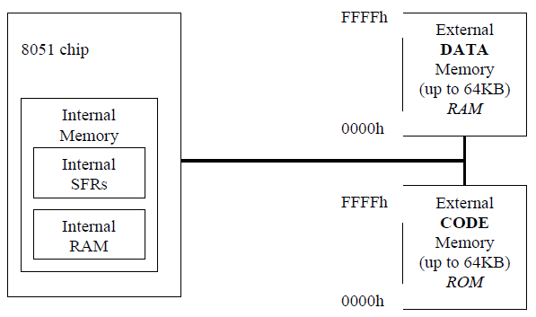
8051 Architecture
The 8051 microcontroller's memory is divided into Program Memory and Data Memory.
Program Memory (ROM) is used for permanent saving program being executed
Data Memory (RAM) is used for temporarily storing and keeping intermediate results and variables.

Slide 5
8051 Architecture
External Code Memory: The executable program code is stored in this code memory. The code memory size is limited to 64KB (in a standard 8051).
The code memory is read-only in normal operation and is programmed under special conditions
External RAM Data Memory: This is read-write memory and is available for storage of data. Up to 64KB of external RAM data memory is supported (in a standard 8051).
Internal Memory:
The 8051’s on-chip memory consists of 256 bytes of internal memory

Slide 6
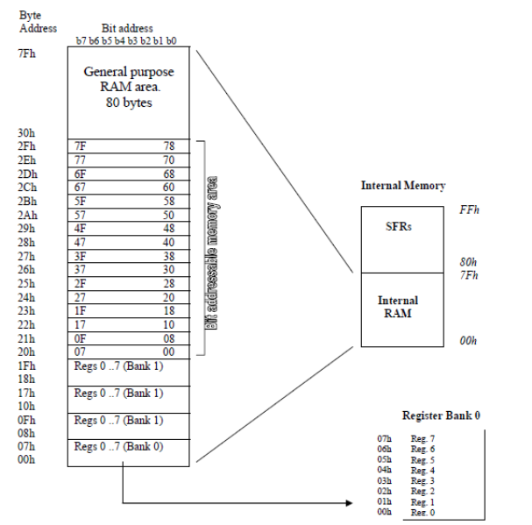
Internal Mem
Up to 256 bytes of internal data memory are available
The internal data memory of 8051 is divided into two groups: Internal RAM and SFR.

Slide 7
Internal Mem
Register Banks
8051 has 32 General Purpose Registers divided into 4 banks
but only one register bank can be used at any point in time
Bank 0 is used by default
The address range 00H to 07H is used to access Eight registers R0 toR7 (Bank 0)
MCU can switch to a different register bank for a task or interrupt rather than saving all 8 registers on the stack

Slide 8
Internal Mem
Bit Addressable RAM: 20h to 2Fh
The 8051 supports a special feature which allows access to bit variables.
This is where individual memory bits in Internal RAM can be set or cleared.
In all there are 128 bits numbered 00h to 7Fh.
Example:
SETB 25h ; sets the bit 25h
CLR 25h ; clears bit 25h

Slide 9
Internal Mem
Stack Area
The remaining segment is for stack
When all register banks are being used, the stack location will be in range 30H to 7FH.
The general purpose RAM can be accessed using direct or indirect addressing modes.

Slide 10
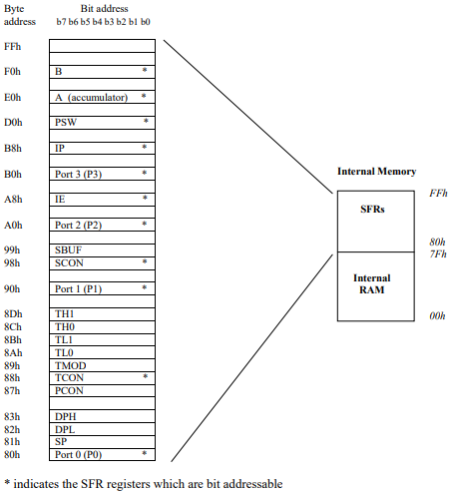
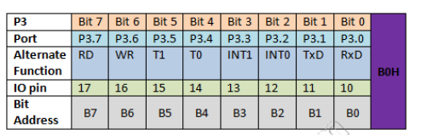
Special Function Registers (SFR)
There are 21 SFRs in standard 8051.
Allows configuring and controlling peripherals.
SFRs are grouped in three categories:
  I/O Ports SFR (PORT0, PORT1, PORT2, PORT3)
  Control SFR: (TCON, TMOD, PCON, SCON, IE, IP, PSW )
  Auxiliary SFR (SP, DPL, DPH, TL0, TL1, TH0, TH1, SBUFF, ACC, B)

Slide 11
Intro to 8051 MCU ISA:
OPCODE | USAGES | Details
MOV | Data Memory ⇔ Registers | MOV destination, source Any data from internal 256 bytes of RAM
MOVC | Code Memory ⇔ Registers | Used for constants or an array of data
MOVX | Registers ⇔ External Memory | Same as MOV, but instead of internal data memory, it is used for external data memory
ADD | ADD op1, op2 ADD A, R1 ⇔ result in A(acc) ADD R1, R2 ⇔ ERROR! | One can be immediate, and the other must be some memory locations(register, accumulator(A), data memory).
SUBB | SUBB A, R1 ⇔ A - R1 result in A(acc) SUBB R1, R2 ⇔ ERROR! | Subtract with borrow. If A > R1 = no issues! If A < R1 = Borrow stores automatically!
DIV | DIV A, B ⇔ CORRECT! DIV A, R1 ⇔ ERROR! | A & B register can only be used! Result stored in A
MUL | MUL A, B ⇔ CORRECT! MUL A, R1 ⇔ ERROR! | A & B register can only be used!

Slide 12
Intro to 8051 MCU ISA:
OPCODE | USAGES | Details
CJNE | CJNE OP1, OP2, LOC OP1 != OP2, LOC⇔ JUMP LOC OP1 == OP2 ⇔ NOT JUMP | Compare Jump if Not Equal OP1 = A, R0-R7, @R0 - @R7 OP2 = immediate(direct value followed by #) LOC = Label, 1000H, 5000H etc.. SUBB makes a comparison between OP1 & OP2. If OP1 < OP2 ? C =1 : C = 0
DJNZ | DJNZ OP1, LOC OP1 != 0 ⇔ JUMP LOC and OP1-- OP1 == 0 ⇔ NOT JUMP | Decrement & JUMP on Non-Zero For i = 10; i <= 0; i - - OP1 = A, R0-R7, @R0 - @R7 LOC = Label, 1000H, 5000H etc..
JZ | JZ, LOC (relative address) | A is 0? JUMP to LOC : NOT JUMP
JNZ | JNZ, LOC (relative address) | A is not 0? JUMP to LOC : NOT JUMP
JC | JC, LOC (relative address) | If carry bit(C) is SET? JUMP to LOC : NOT JUMP C is located at PSW (Program Status Word) register.
JNC | JNC, LOC (relative address) | If carry bit is not SET ? JUMP to LOC : NOT JUMP
AJMP | AJMP, LOC (relative address) | Absolute Jump, Unconditional, No range
LJMP | LJMP, LOC (relative address) | Long Jump, Unconditional
SJMP | SJMP, LOC (relative address) | Short Jump, Unconditional, -127 to 127

Slide 13
8051 MCU addressing mode:
OPCODE Destination, Source | Source = {Data, Reg, Mmory Location}
Immediate Addressing Mode ⇒ MOV A, #5h # is followed by hex data | Des not require any reference to the memory. MOV destination, source Note: ⇒ MOV A, #Fh ⇔ ERROR! , ⇒ MOV A, #0Fh ⇔ CORRECT!
Register Addressing Mode ⇒ MOV A, R1 ⇒ MOV R2, R1 ⇔ ERROR! | Here, Source = Register 8051 is an ACCUMULATOR-based architecture.
Direct or Absolute Addressing What if the # is missing? ⇒ MOV A, 5h | Here, Source = Memory Location This is identified as the address. It will go to the address for 5h and pick up the data from the address. Direct addressing always requires a reference to the memory.
Indirect Addressing ⇒ MOV R0, #20h ⇒ MOV A, @R0 ⇒ INC R0 # Now R0 = #21h | Here, Source = Array of data in memory, starting with “@” R0 and R1 registers are only involved in indirect addressing ⇒ “@R0” has the address where the data is located
Index Addressing ⇒ mov dptr, LOC ⇒ clr a ⇒ movc a, @a+dptr ⇒ inc dptr | Here, Source = 16-bit address DPTR ⇔ Data fetched from code memory DPTR ⇔ Data fetched from external RAM or data memory

Slide 14
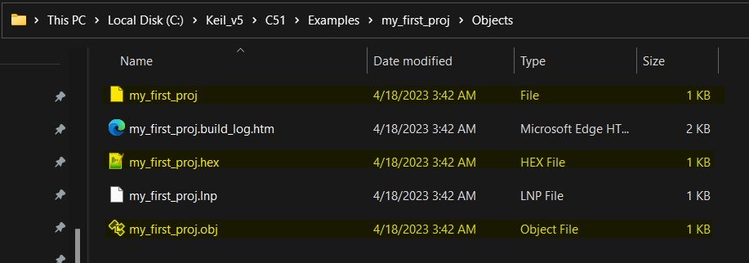
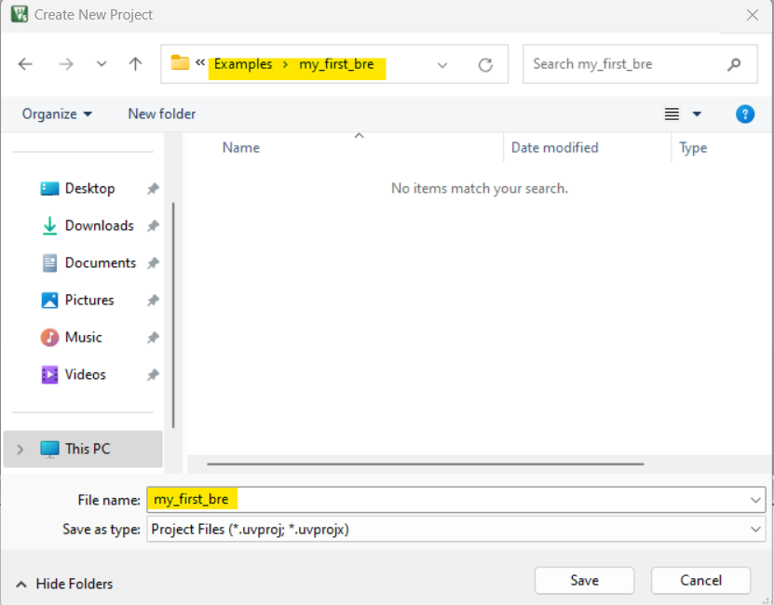
REVERSE ENGINEERING USING KEIL:
1
In the "Objects" folder inside the project directory we should see all the available output files. File "my_first_proj" is the compiled binary file and ready to load into the memory of AT89C51. Now we will observe how to load this binary file in Keil and extract information using disassembler.
2
Repeat step 1,2,3,4, and 5 to create a new project for reverse engineering.

Slide 15
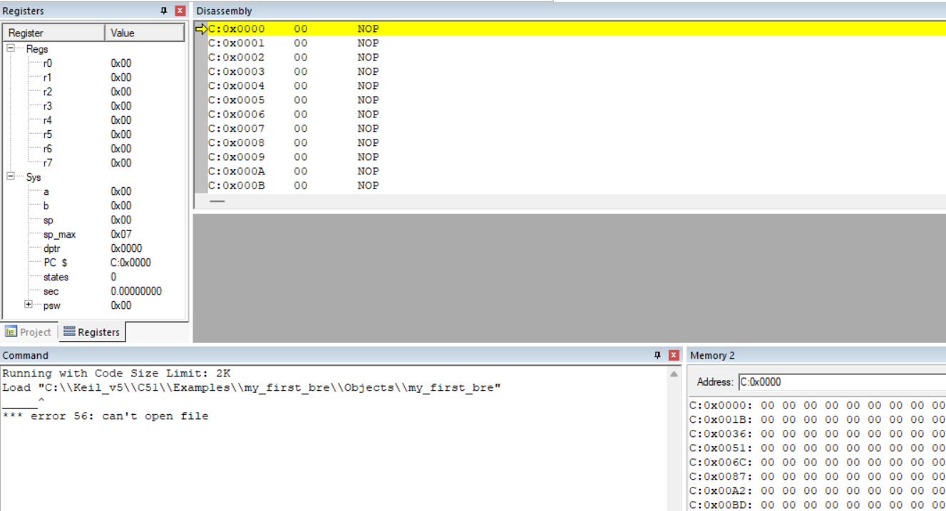
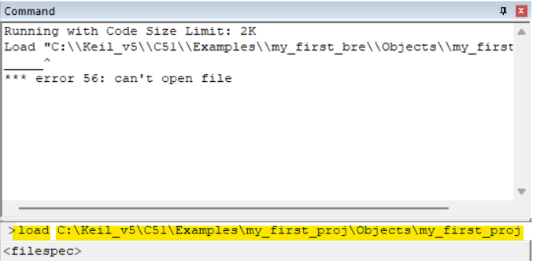
REVERSE ENGINEERING USING KEIL:
4
Use "load" command to read the binary file from previous "*project*/Objects" directory. If the tool load the file successfully, it will give no error.
3
Repeat step 18 and 19 to enter the debugging mode. Ignore the error.

Slide 16
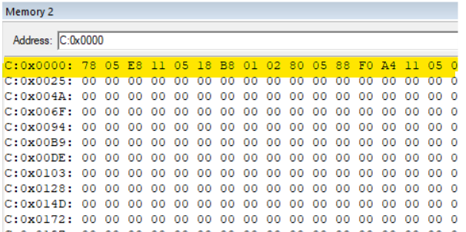
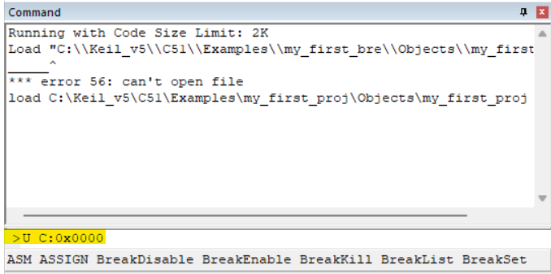
REVERSE ENGINEERING USING KEIL:
5
6
In the external memory we should observe the hex machine code. Now we will disassemble it.
Using "U <starting memory location>" we can disassemble the binary file.

Slide 17
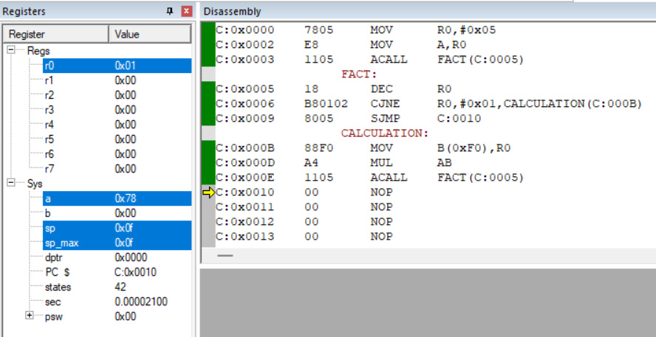
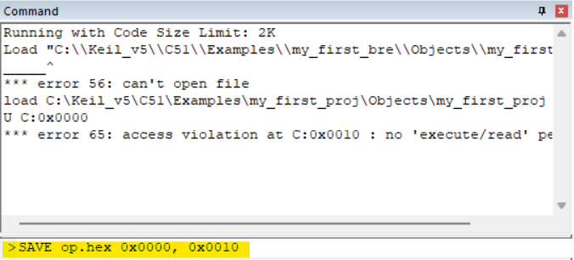
Reverse Engineering using keil:
8
Let's save the program state in hex format from external code region.
7
We should observe the above assembly code in "Disassembly" window. After running the assembly file, in the accumulator register we got "0x78"
Congratulation! You successfully completed the reverse engineering!!

Slide 18
Example Homework Question
The binary is generated from a program that maintains stable room temperatures in the hospital rooms of critical patients. The program collects temperature every 10 minutes from memory where a sensor writes the temperate data
Based on the program behavior through the disassembly window of Keil (as shown in the class), find out the following information from the binary:
How many times does the program collect the data from external memory (ROM)?
What temperature values in decimal did you observe in the external memory? Also, report their locations.
Is there any signal sent based on the temperature data found in the memory?

