Slide 1
EECS 388:
Embedded Systems
Understanding memory layout through Buffer overflow

Slide 2
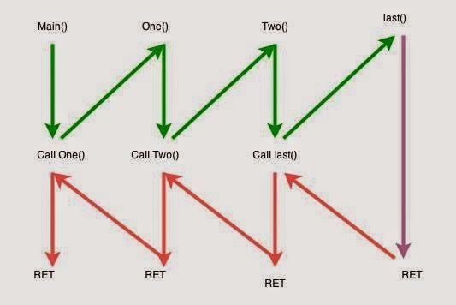
Example program flow

Slide 3
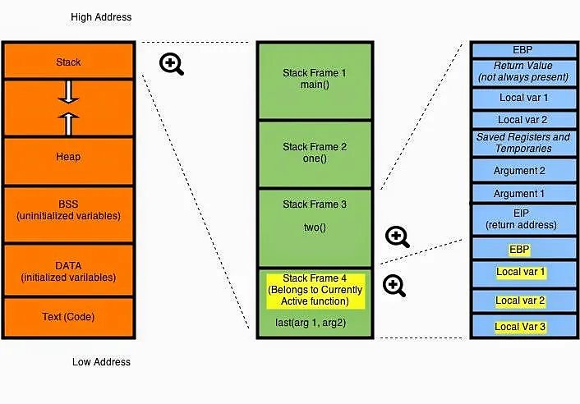
EBP ( Extended Base pointer): points to the top of the stack.
ESP (Extended Stack Pointer)

Slide 4
Registers related to stack
EBP ( Extended Base pointer): points to the base of the stack
ESP (Extended Stack Pointer): points to the top of the stack
EIP: Extended Instruction pointer register, which points to the next instruction to be executed at any point of time
  We have known it as the return address (RA) register
  EIP is always the last thing to be saved on the stack frame of a given function

Slide 5
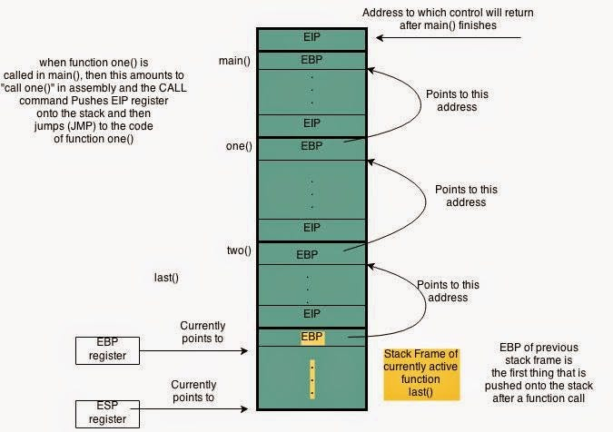
The value of base pointer (EBP) and stack pointer (ESP) continuously change during function call and return
The figure shows the state of EBP and ESP, when we are executing the function last()
EBP points to the start of the current function’s stack frame
The first item that is pushed on the stack frame of a function is EBP of the previous function’s stack frame.
The last thing on the stack is EIP, which is the return address

Slide 6
Takeaway
Modifying the return address could alter the flow of code execution
This could be done by overwriting on the EIP or EBP that is saved onto the stack
What is the benefit of changing program flow execution?
How an attacker can overwrite EBP/ESP

Slide 7
Purpose of buffer overflow attack
  Arbitrary code execution
    Spawn a remote shell or execute malicious code
  Denial of service
    Cause software to crash

Slide 8
What malicious code execution can do?
The Equifax Data Breach: In 2017, Equifax, one of the largest credit reporting agencies in the US, suffered a massive data breach.
Hackers exploited a vulnerability in the Apache Struts web application framework using a combination of attakcs
The specific vulnerability, identified as CVE-2017-5638, allowed attackers to execute arbitrary code on the server
The breach resulted in the theft of sensitive information of over 143 million customers, including social security numbers, birth dates, and addresses.

Slide 9
How we can execute malicious code using overflow?
The general idea is to overflow a buffer so that it overwrites the return address.
When the function is done it will jump to whatever address is on the stack.
We put some code in the buffer and set the return address to point to it!

Slide 10
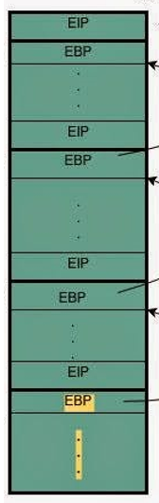
EBP (Base Adrs)
local variables,
saved and temp, return values
arguments for the
next function
EIP (Return Adrs)

Slide 11
EBP (Base Adrs)
Lets say our current program has a line
local variables,
saved and temp, return values
arguments for the
next function
char buf[100];
Stack of earlier function
The line declares an array of characters buf with a fixed size of 100
This is the stack segment of the memory
But can potentially Overwrite the previous functions EIP
EIP (Return Adrs)
Buffer
Stack of current func
Notes:
char *s: This declares a parameter s which is a pointer to a character.
Pointers are variables that store memory addresses. Here, s is expected to point to the first character of a zero-terminated string,
allowing foo to work with strings of text. The function can then manipulate or read the string starting from this address.
char buf[100];: This line declares an array of characters buf with a fixed size of 100 characters.
This is meant to serve as a buffer for some operation inside the function.

Slide 12
EBP (Base Adrs)
local variables,
saved and temp, return values
arguments for the
next function
void foo(char *s) {
char buf[100];
strcpy(buf,s);
…
AAAAAAAAAAAAAAAAAAAAAAAAAAAAAAAAAAAAAAAAAAAAAAAAAAAAAAAAAAAAAAAAAAAAAAAAAAAAAAAAAAAAAAAAAAAAAAAAAAAAAAAA
We can pass any value to S.
If its larger than 100, it will over flow the buffer
EIP (Return Adrs)
Buffer
AAAAAAAAAAAAAAAAAAAAAAAAAAAAAAAAAAAAAAA
Notes:
The vulnerability arises from the fact that strcpy does not check the length of the input string (s).
If the string s is longer than 99 characters (remember, one space is needed for the terminating null byte \0), it will write past the end of the buffer buf, causing a buffer overflow.
strcpy(buf,s); This line calls the function strcpy from the C standard library,
which copies the string pointed to by s (including the terminating null byte) into the array buf.

Slide 13
EBP (Base Adrs)
local variables,
saved and temp, return values
arguments for the
next function
void foo(char *s) {
char buf[100];
strcpy(buf,s);
…
Stack of earlier function
Therefore we can overwrite EIP/EBP of a previous function using an active function with strcpy
EIP (AAAAAAAAAA)
Buffer
Stack of current func
AAAAAAAAAAAAAAAAAAAAAAAAAAAAAAA
Notes:
The vulnerability arises from the fact that strcpy does not check the length of the input string (s).
If the string s is longer than 99 characters (remember, one space is needed for the terminating null byte \0), it will write past the end of the buffer buf, causing a buffer overflow.
strcpy(buf,s); This line calls the function strcpy from the C standard library,
which copies the string pointed to by s (including the terminating null byte) into the array buf.

Slide 14
EBP (Base Adrs)
local variables,
saved and temp, return values
arguments for the
next function
void foo(char *s) {
char buf[100];
strcpy(buf,s);
…
Now when the program flow returns to the previous function, it has a return address
EIP (AAAAAAAAA)
Buffer
AAAAAAAAAAAAAAAAAAAAAAAAAAAAAAAAA
Notes:
The vulnerability arises from the fact that strcpy does not check the length of the input string (s).
If the string s is longer than 99 characters (remember, one space is needed for the terminating null byte \0), it will write past the end of the buffer buf, causing a buffer overflow.
strcpy(buf,s); This line calls the function strcpy from the C standard library,
which copies the string pointed to by s (including the terminating null byte) into the array buf.

Slide 15
Steps of buffer overflow
  Inject attack code into buffer
  Overflow return address
  Redirect control flow to attack code
  Execute attack code

Slide 16
EBP (Base Adrs)
local variables,
saved and temp, return values
arguments for the
next function
We could also provide a custom overflow data such that the return address becomes the first address of the buffer
At the same time include malicious code onto the buffer
Now our program will return to the malicious code
EIP (starting adrs of buffer)
Buffer
Malicious code
Notes:
The vulnerability arises from the fact that strcpy does not check the length of the input string (s).
If the string s is longer than 99 characters (remember, one space is needed for the terminating null byte \0), it will write past the end of the buffer buf, causing a buffer overflow.
strcpy(buf,s); This line calls the function strcpy from the C standard library,
which copies the string pointed to by s (including the terminating null byte) into the array buf.

Slide 17
In summary
Program fails to ensure that a write to a buffer is always within its bound.
  When a buffer overflow happens, data structures in memory will be corrupted, potentially changing the program’s behavior.
  In many cases it can lead to the execution of arbitrary code by attackers

