Slide 1
EECS 388:
Embedded Systems
A practical session on how to do buffer overflow attack

Slide 2
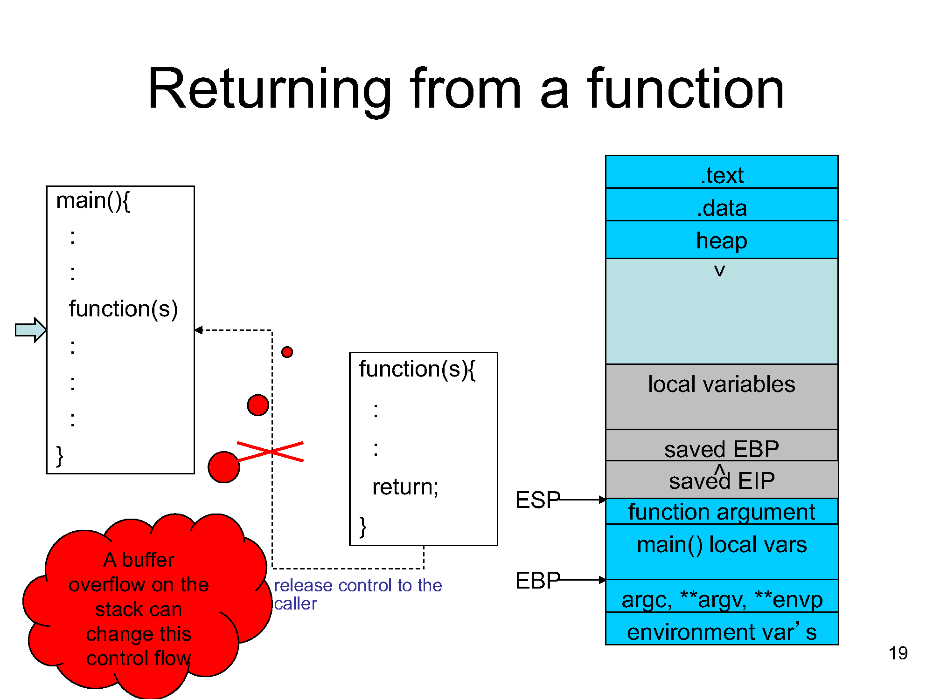

Slide 3
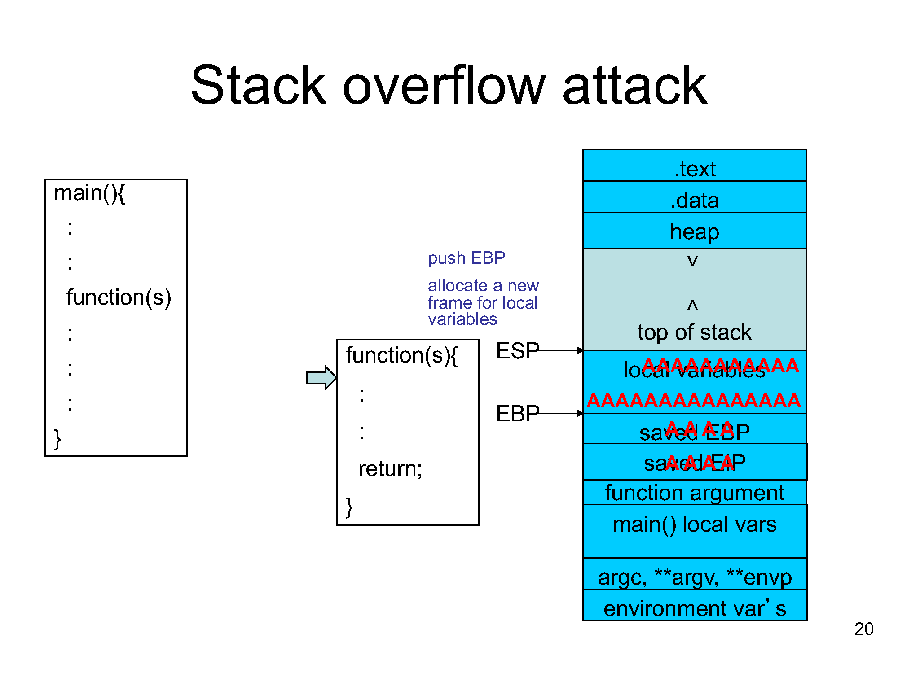

Slide 4
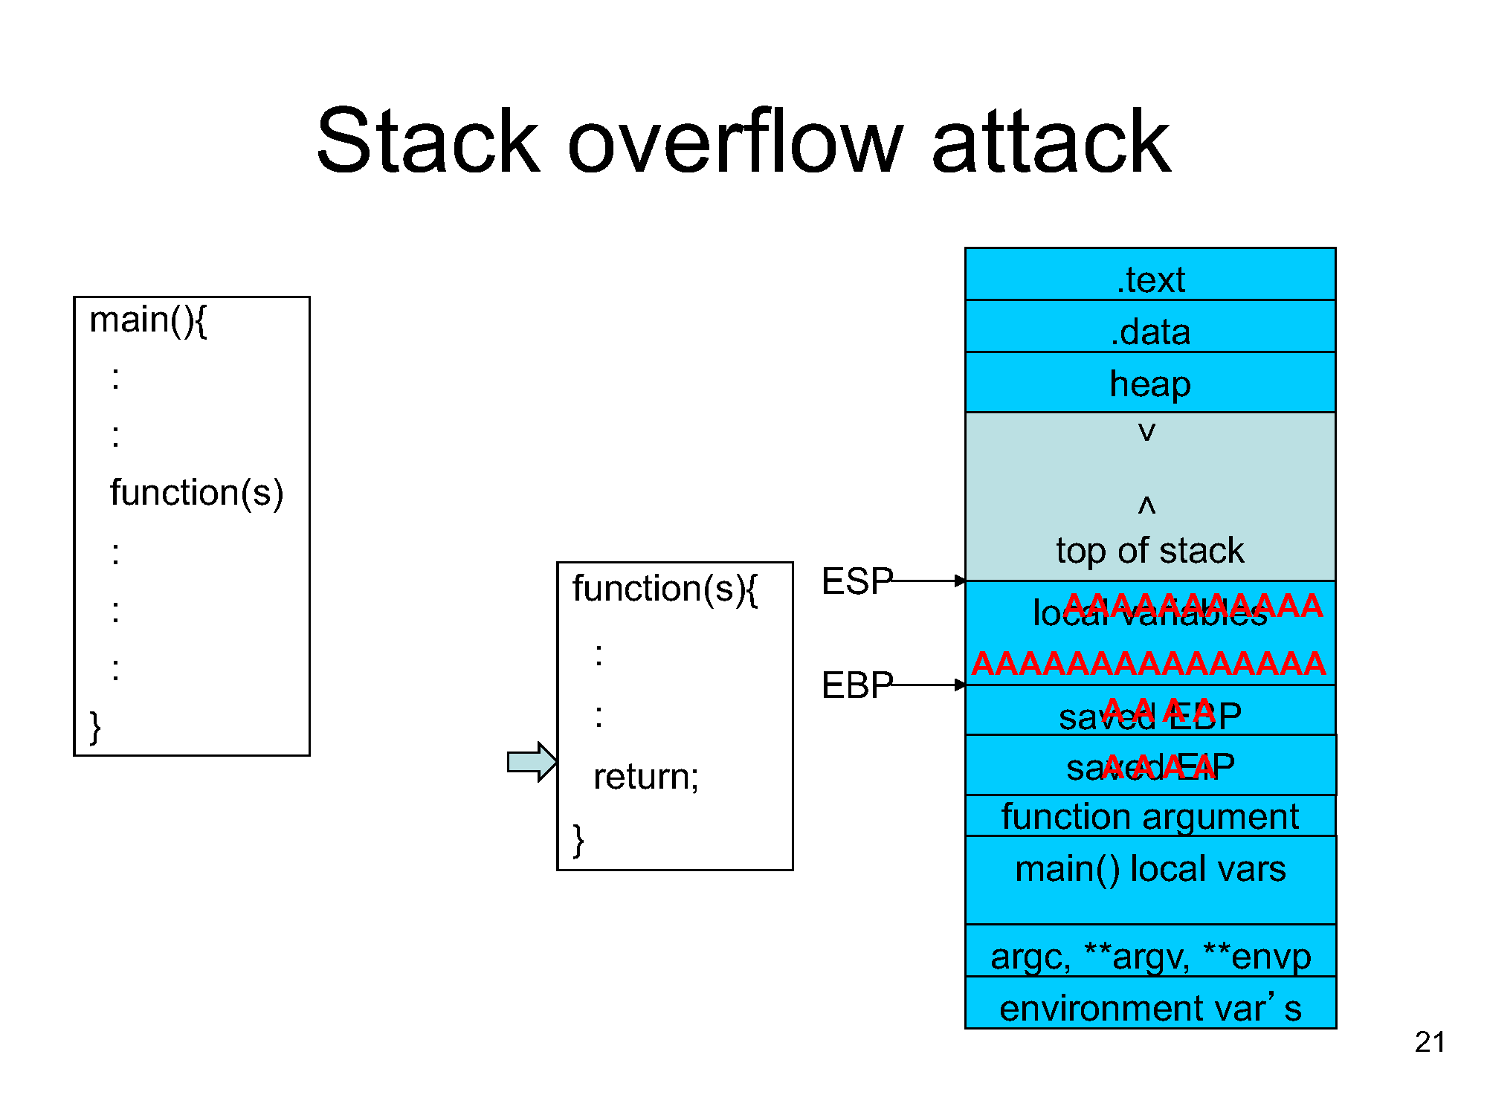

Slide 5
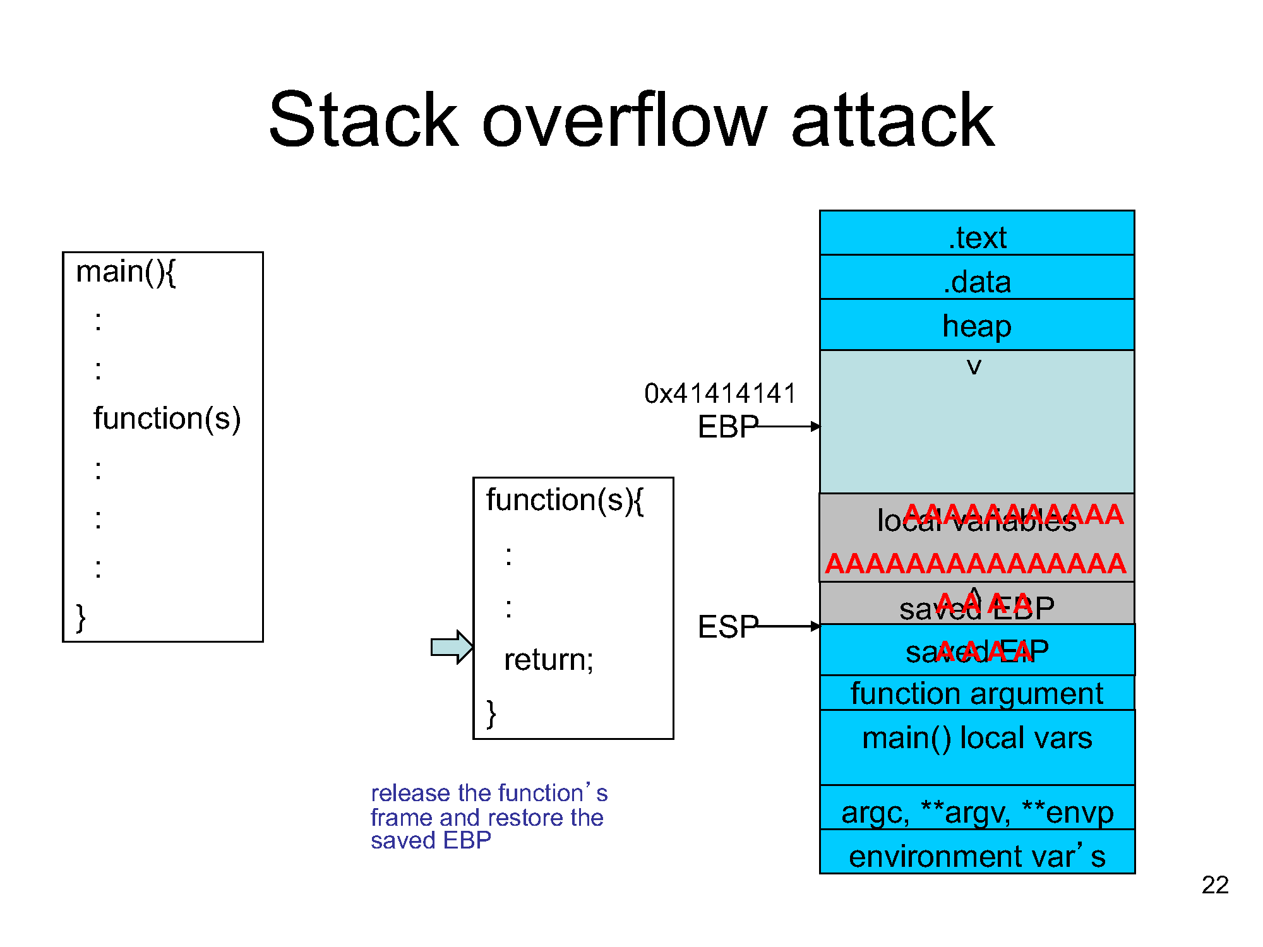

Slide 6
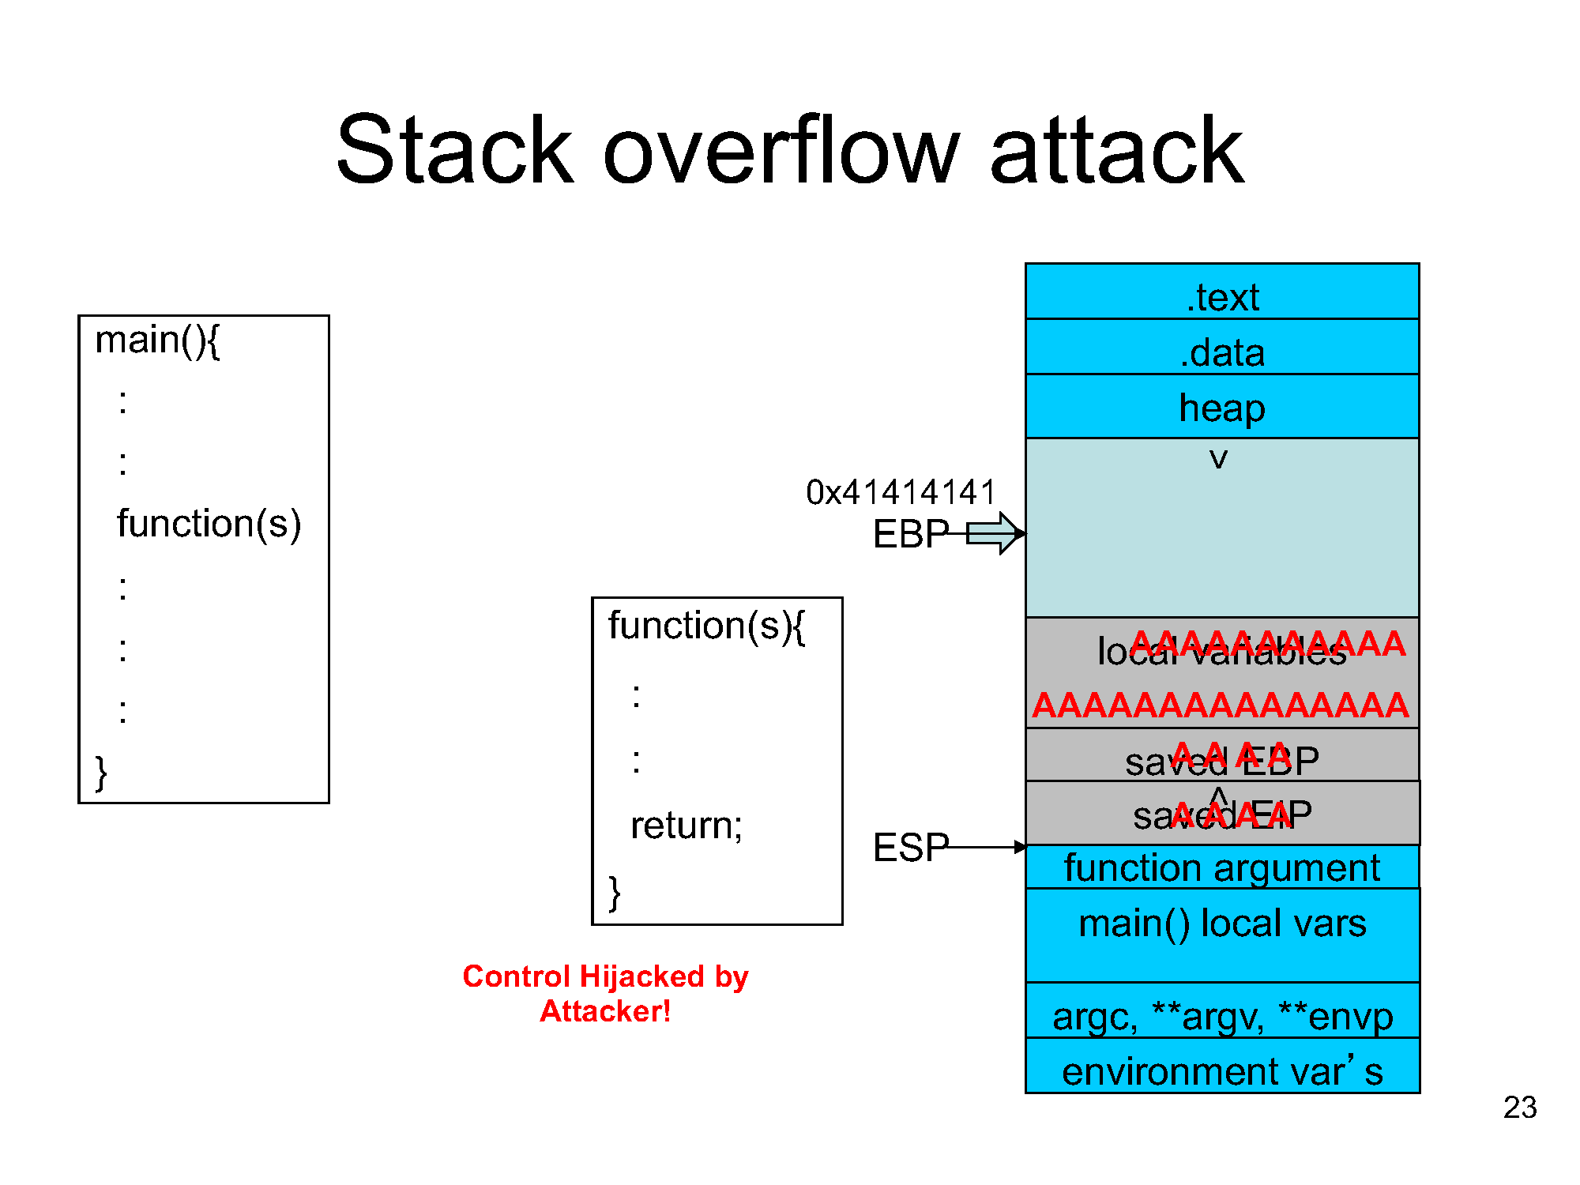

Slide 7
Buffer overflow vulnerability
In summary
Program fails to ensure that a write to a buffer is always within its bound.
  When a buffer overflow happens, data structures in memory will be corrupted, potentially changing the program’s behavior.
  In many cases it can lead to the execution of arbitrary code by attackers

Slide 8
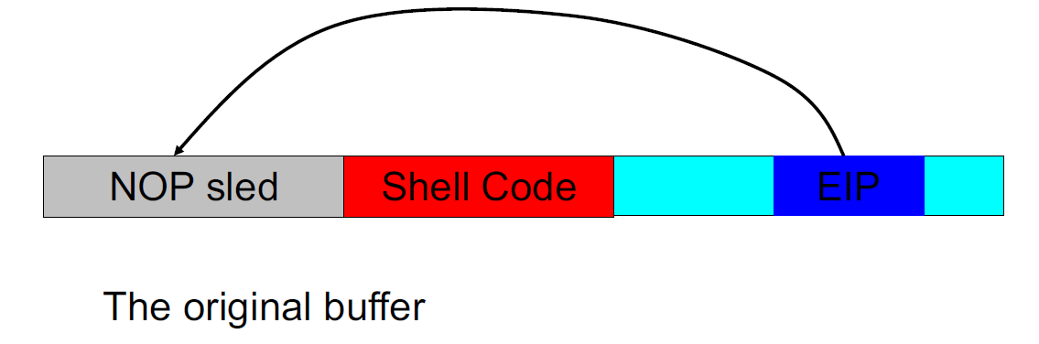
Creating a malicious input
How long should be the input be?
Where should we put the EIP in the input?
What value of EIP should be put in?
Source: Alex Bardas's EECS 765 slides

Slide 9
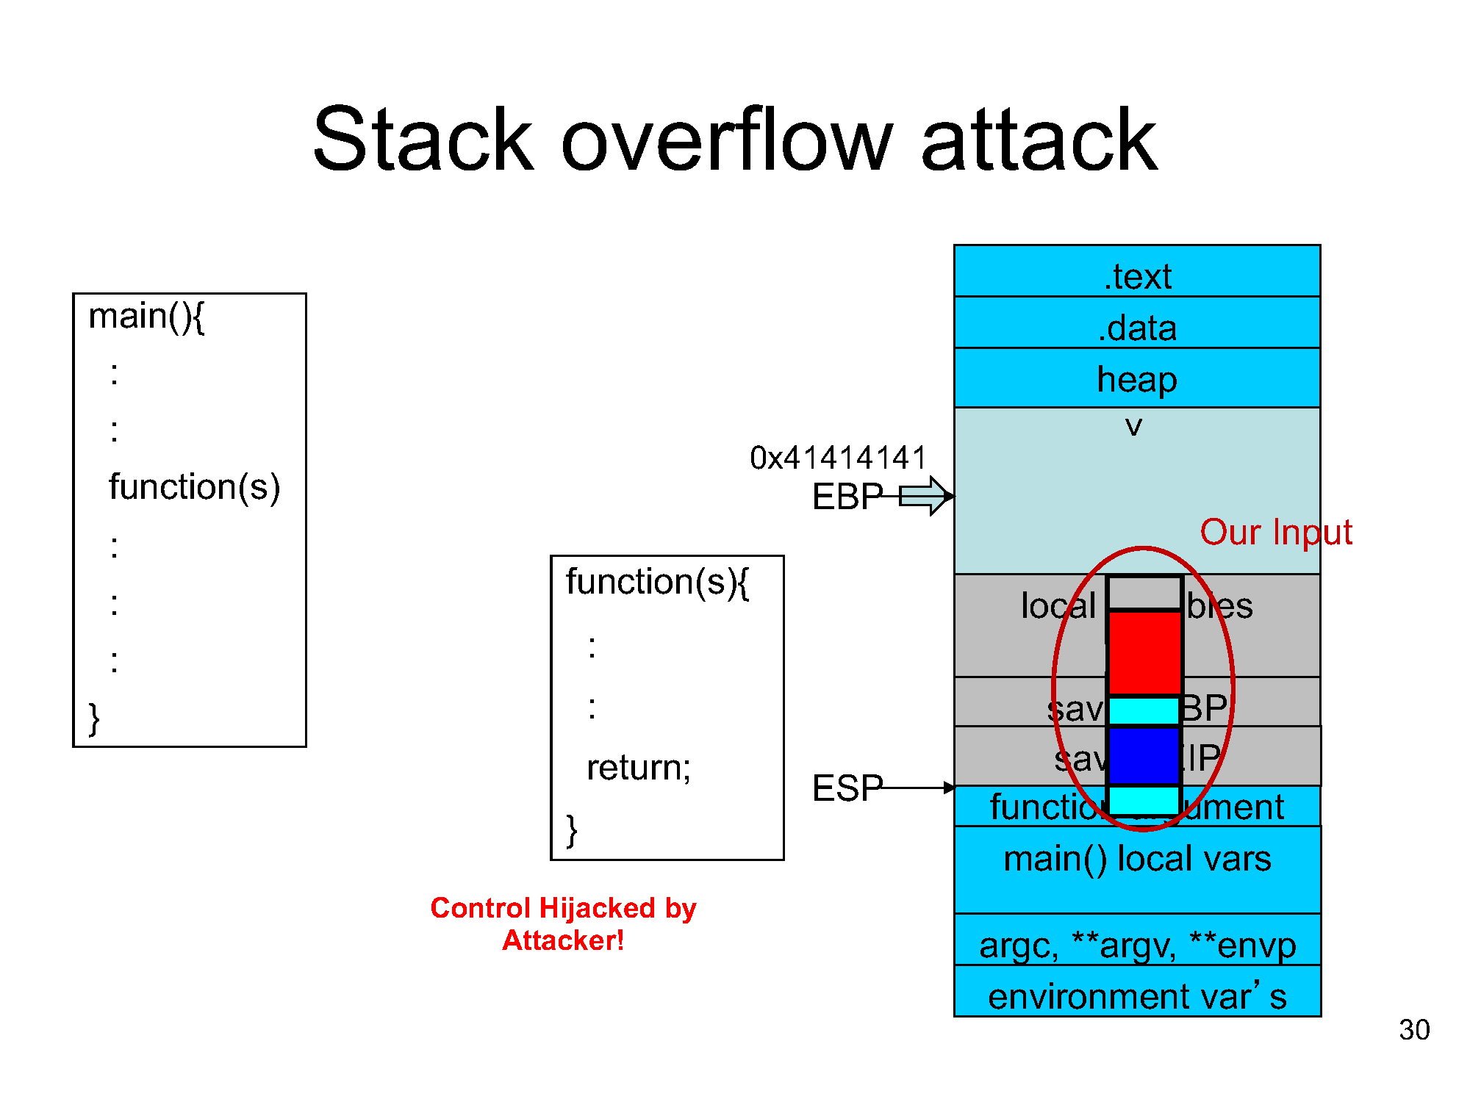
Source: Alex Bardas's EECS 765 slides

Slide 10
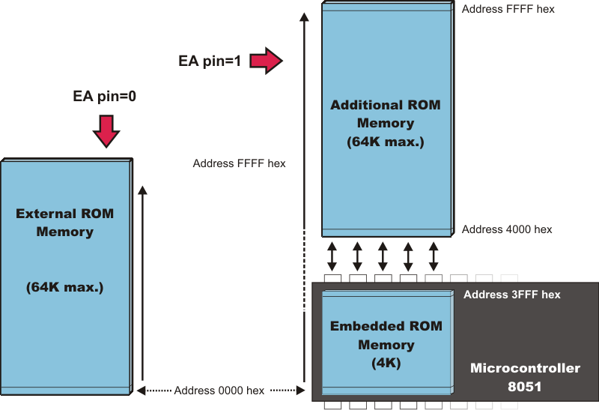
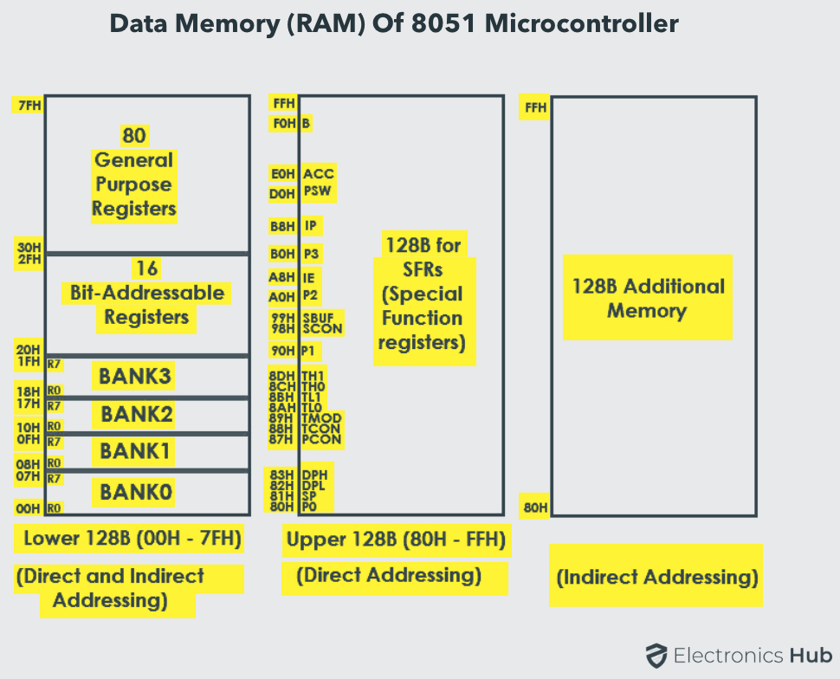
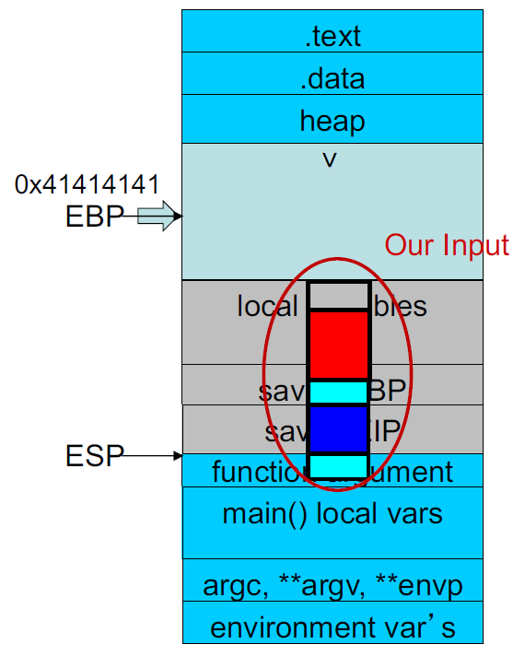
Stack overflow in Embedded System
The concept remains the same
Attack strategy change based on memory organization
ROM 8051:
Code being executed
Read only
RAM 8051:
Up to 256 bytes &
stack starts from Bank 1
Common Memory Architecture:
Unified

Slide 11
Agent.c program
#include <reg51.h>
#include <stdlib.h>
#include <string.h>
#include <stdio.h>
typedef struct {
char *key;
int value;
} ListItem;
ListItem list[] = {
{"01012008", 88},
{"01012007", 87},
{"01012006", 86},
{"01012005", 85},
{"01012004", 84}
};
const int list_length = sizeof(list) / sizeof(ListItem);
int get_item_from_list(char* str1);
int main() {
int flag;
char* input_char = "01012007";
int result = get_item_from_list(input_char);
flag = 1;
return result;
}
int get_item_from_list(char* str1) {
// Iterate over the list and find the matching item
int i; char j;
char buf[9];
strcpy (buf, str1);
for (i = 0; i < list_length; i++) {
j = strcmp (list[i].key , buf);
if (j == 0) {
return list[i].value;
}
} // If no matching item is found, return NULL
return NULL;
}

Slide 12
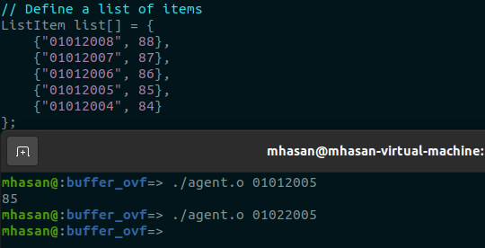
Let's find out the problem
Let's guess a govt. organization need a program that reports the SSN based on the agent's date of birth.
Requirements:
  Every person can only get his/her SSN number
  Maintain all public SSN number in a list/file
  User can provide their input through an interface (i.e., Keyboard)
Notes:
The thing is software remain vulnerable. every few weeks new data breaches occur in fact 90% of today's attacks actually use attack technique called rop or return oriented programming which you may be familiar with but I will run through it quickly in the next slide.

Slide 13
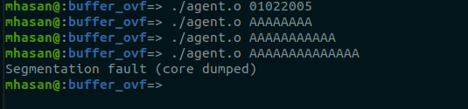
SECURITY PROBLEMS IN the program
Threat analysis
What are the potential risks and their implications?
How to mitigate the risk?
Let's try below input pattern
Is it vulnerability!!!
Notes:
There is a vulnerability in the agent.c program!!! If we run this program on a linux machine we should get a core file that describes where the segmentation fault occurred.

Slide 14
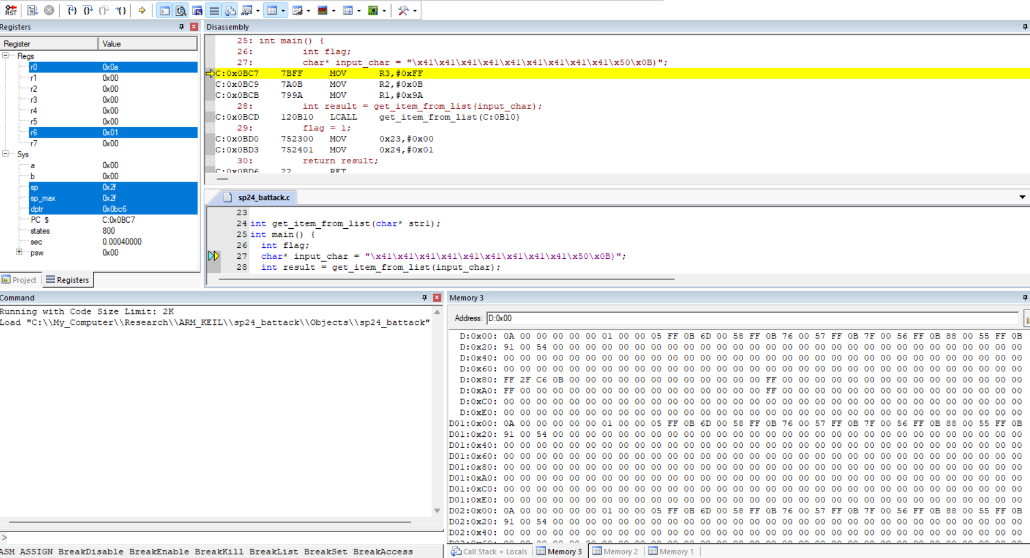
Run all the ins.
Run next ins
Run next ins but step over the function
Starting point in assembly
Registers
Stack
Starting point in C. Instead of correct input attacker is trying to fit a long input character

Slide 15
Run all the ins.
Run next ins
Run next ins but step over the function
Starting point in assembly
Registers
Stack
Starting point in C
0x00
0x01
0x06
0x0A
0x0F
0x10
Data Memory region starting from D: 0x00
0x0F

Slide 16
Run all the ins.
Run next ins
Run next ins but step over the function
Starting point in assembly
Registers
Stack
Starting point in C
Secret 1
Secret 2
Secret 3
Secret 4
Data Memory region starting from D: 0x00
0x0F
Secret 5

Slide 17
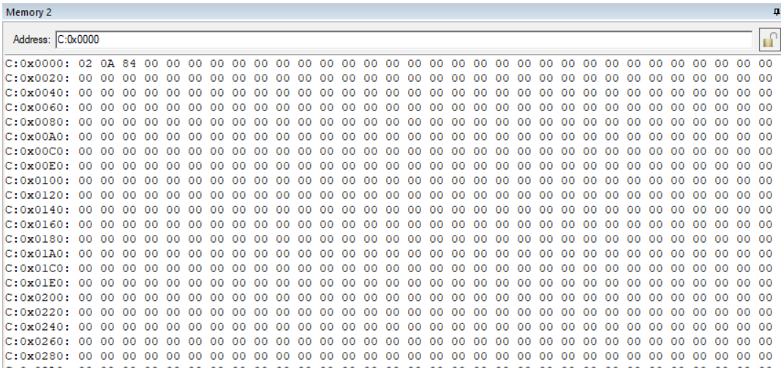
Run all the ins.
Run next ins
Run next ins but step over the function
Starting point in assembly
Registers
Stack
Starting point in C
Code Memory region starting from
C:0x0000

Slide 18
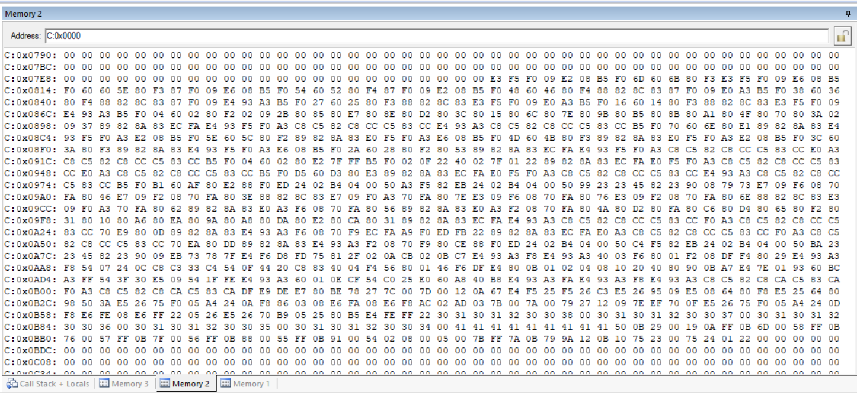
Vulnerable program inside Code region
Can you see any familiar pattern?

Slide 19
Vulnerable program inside Code region
Can you see any familiar pattern?

Slide 20
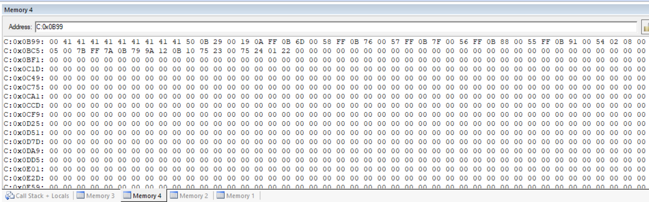
Vulnerable program inside Code region
Can you see any familiar pattern?

Slide 21
Run all the ins.
Run next ins
Run next ins but step over the function
Starting point in assembly
Telling us from where it will start loading the data from code memory region to data memory region
Registers
Stack
Starting point in C
Code Memory region starting from
C:0x0000

Slide 22
Run all the ins.
Run next ins
Run next ins but step over the function
Starting point in assembly
Telling us from where it will start loading the data from code memory region to data memory region
Registers
Stack
If we increase the input char size it will eventually overwrite the secret in data memory region
Code Memory region starting from
C:0x0000

Slide 23
Agent.c program
#include <reg51.h>
#include <stdlib.h>
#include <string.h>
#include <stdio.h>
typedef struct {
char *key;
int value;
} ListItem;
ListItem list[] = {
{"01012008", 88},
{"01012007", 87},
{"01012006", 86},
{"01012005", 85},
{"01012004", 84}
};
const int list_length = sizeof(list) / sizeof(ListItem);
int get_item_from_list(char* str1);
int main() {
int flag;
char* input_char = "01012007";
int result = get_item_from_list(input_char);
flag = 1;
return result;
}
int get_item_from_list(char* str1) {
// Iterate over the list and find the matching item
int i; char j;
char buf[9];
strcpy (buf, str1);
for (i = 0; i < list_length; i++) {
j = strcmp (list[i].key , buf);
if (j == 0) {
return list[i].value;
}
} // If no matching item is found, return NULL
return NULL;
}

Slide 24
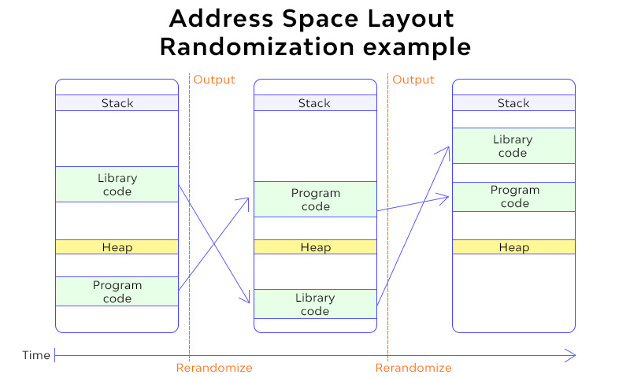
Mitigation
Address Space Layout Randomization(ASLR)
  OS prevent exploitation of memory vulnerabilities by randomly arranging the positions of key data areas of a process
  The chance of the attacker can guess the correct stack location is slim
  Where shall EIP point to?

Slide 25
Mitigation
Address Space Layout Randomization(ASLR)
  The segments of process memory that are typically randomized by ASLR include:
  Base of the Executable
  Position of Libraries
  Stack, Heap, etc.

Slide 26
Mitigation
StackGuard(canary)
  The term "canary" is analogous to the canaries (birds) that were once used in coal mining as an early warning system for toxic gases.
  If the canary became sick or died, the miners knew that the environment was unsafe.
  In the context of computing, a "canary" is a special value that is placed on the stack between the buffer and control data, such as the return address or frame pointer.

Slide 27
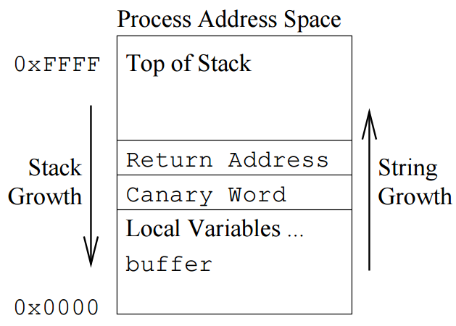
Mitigation
StackGuard(canary)
  A compile-time mechanism that detects/prevents the modification of return address during function execution
  When the function starts, a “canary word” is put on the stack in between the function’s local variables and saved return address
  If a local buffer is overrun, the canary will have to be “killed” before the return address can be modified
Source: Alex Bardas's EECS 765 slides

