Slide 1
EECS 388:
Embedded Systems
Side Channel Attacks

Slide 2
What Really is Side-Channel Attack?
Motivation:
  Extract secret data being processed inside a hardware (e.g., cryptographic keys)
  Extract information on the internal operation of the hardware (e.g., algorithmic steps)
  Other forms of eavesdropping
How?
  Without directly looking at the internal bus or data in memory
  Observe indirect data that is emitted during the execution of a computational process
Notes:
Side-channel attacks bypass the theoretical strength of cryptographic algorithms and aim at nonprime, side-channel inputs and outputs. Commonly exploited side-channel outputs include: power consumption, electromagnetic emissions, light, timing and sound. Commonly exploited side-channel inputs include: supply voltage, temperature, light and other primary signal inputs unrelated to cryptographic block. This presentation focuses on physical attacks specific to side-channel outputs.

Slide 3
What Really is Side-Channel Attack?
Five commonly exploited side-channel emissions:
  Power Consumption
  Timing and Delay
  Electro-Magnetic
  Optical
  Acoustic
Notes:
Side-channel attacks bypass the theoretical strength of cryptographic algorithms and aim at nonprime, side-channel inputs and outputs. Commonly exploited side-channel outputs include: power consumption, electromagnetic emissions, light, timing and sound. Commonly exploited side-channel inputs include: supply voltage, temperature, light and other primary signal inputs unrelated to cryptographic block. This presentation focuses on physical attacks specific to side-channel outputs.

Slide 4
Side channel in Embedded Systems
Side channel is particularly more important for embedded systems
Remote computing systems like servers are generally not accessible to end users→ makes SCA difficult
Embedded devices are generally accessible to end users (smart watch, smart automotive)
However, there are few remote SCA attacks!

Slide 5
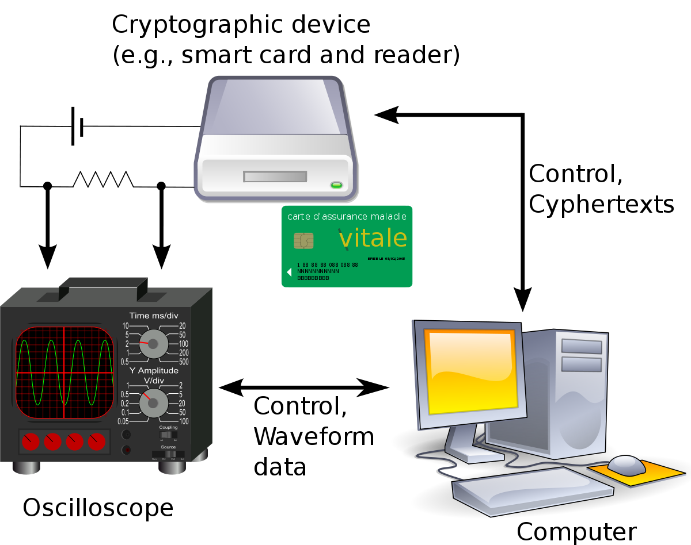
Power Side channel
Attack Setup:
The attacker needs physical access to the device or be able to measure the power consumption remotely.
They collect power usage data while the device is performing cryptographic operations.
This is often done using a high-resolution oscilloscope connected to the power line of the device.
Source

Slide 6
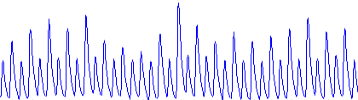
Circuit Operation vs Power Signature
Not average power over time, not peak power
Instantaneous power over time
  Trace or curve, many samples
Every operation within the device, such as fetching data from memory, processing, and storing data, has a unique power signature.
Cryptographic operations, in particular, tend to cause noticeable fluctuations in power usage because they are computationally intensive.
Power Consumption
Time

Slide 7
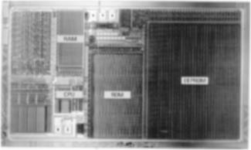

Why different operation consume different power
Logic Circuit Operation: constant supply voltage, supply current varies
Predominant technology: CMOS
  Low static power consumption
  Relatively high dynamic power consumption
  Power consumption depends on input
CMOS inverter:
Input | Output | Current
0 → 0 | 1 → 1 | Low
0 → 1 | 1 → 0 | Discharge
1 → 0 | 0 → 1 | Charge
1 → 1 | 0 → 0 | Low
0-1 transition

Slide 8
Identifying Patterns
By analyzing how the power consumption varies, an attacker can identify patterns that correlate with specific cryptographic operations.
For instance, operations like modular exponentiation in RSA or S-box lookups in AES consume power in distinct patterns.
Key Extraction from patterns:
Once the attacker identifies the patterns associated with certain operations, they can use statistical methods to extract the secret keys.
For instance, by correlating the timing of certain power spikes with known operations or data being processed, attackers can make educated guesses about the values being used in the cryptographic computations.
Repeating the process enough times with different inputs can allow full or partial recovery of the encryption keys.
With the extracted key, an attacker can decrypt sensitive data, impersonate entities, or perform other malicious activities.

Slide 9
Simple Power Analysis (SPA)
Originally proposed by Paul Kocher, 1996
Monitor the device’s power consumption to deduce information about data and operation
Example: SPA on Data encryption standard (DES) algorithm
  The internal structure is shown on the next slide
Notes:
The concept of simple power analysis is first proposed by Paul Kocher in 1996. The basic idea is to monitor the device’s power consumption to deduce information about data and operation. A typical application example of SPA is cryptanalysis on data encryption standard(DES), commonly employed to encrypt smart cards. DES is established based on Lucifer proposed by IBM in 1974 and tested by NSA and the general public. DES is a block cipher combining substitutions and permutations with 16 rounds iterations on input bits. Each round has a round key generated from the user-supplied key.
visual examination vs statistical analysis

Slide 10
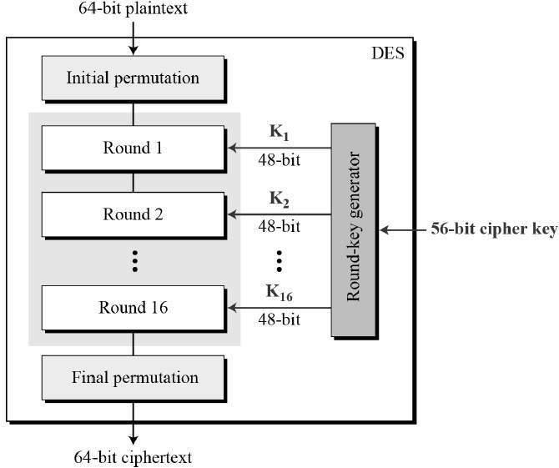
DES Basic Structure
Input: 64 bits (a block)
Ki - round key or subkey:
  56 bits used +8 unused
  (unused for encryption but often used for error checking)
Output: 64 bits (a block)
All basic op’s are simple logical ops
  Left shift / XOR
The heart of this cipher is the DES function
-Inside the function, permutation, substitution, XOR and other operations occur
Notes:
The basic structure of DES is shown as the right figure. Both input and output are 64-bit blocks. The input block is divided into left and right half (32 bits) for iteration. Substitution and permutation are combined for confusion and diffusion respectively. A user-supplied key is used at first. Each round has a 64-bit round key, among which 56 bits are used for encryption and 8 bits are used for error checking, including odd and even check. The left half would be generated directly from the right half of former round. All basic encryption operations are simple logical operations like left shift and XOR.

Slide 11
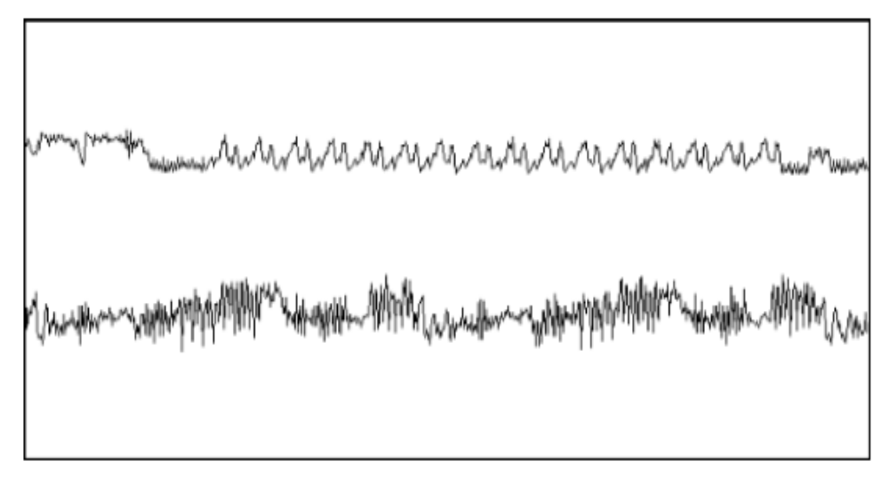
Observing DES Rounds
Rounds
1
2
3
16
The upper trace – entire encryption, including the initial phase, 16 DES rounds, and the final permutation
The lower trace – detailed view of the second and third rounds
The power trace can reveal the instruction sequence
Notes:
This figure displays the power traces of SPA on DES, which reveal the instruction sequence. The upper trace shows the entire encryption process, including the initial phase, 16 DES rounds, and initial permutation. The lower trace shows the detailed view of the second and third rounds.

Slide 12
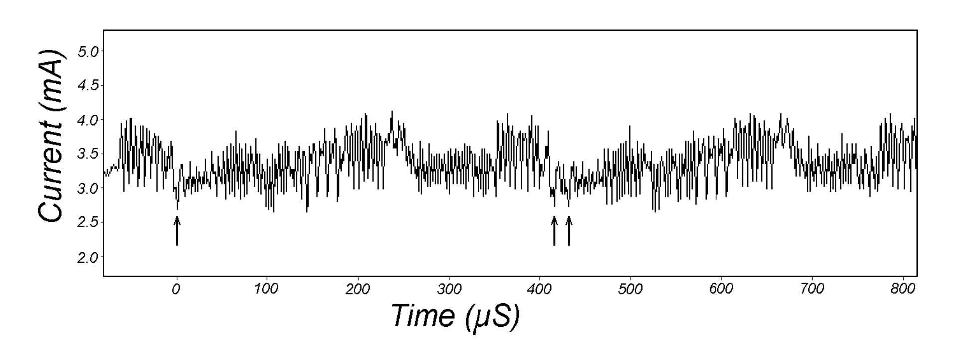
Observing DES Rounds
Difference across rounds
  In DES algorithm, 56-bit keys are used, which are split into two 28-bit halves known as the C and D registers.
  These registers undergo a series of left shifts or "rotations" as part of the key scheduling process, which generates the subkeys for each of the 16 rounds of the DES encryption process.
  The reason for varying the number of rotations is to increase the complexity of the key schedule, thus providing more security against certain types of cryptanalytic attacks,
In the figure, 28-bit DES key registers C and D are rotated once in round 2 (left arrow) and twice in round 3 (right arrows)→therefore, small variations in trace can be perceived
Notes:
“detailed view of the same trace showing the second and third rounds of a DES encryption operation. Many details of the DES operation are now visible. For example, the 28-bit DES key registers C and D are rotated once in round 2 (left arrow) and twice in round 3 (right arrows). In Figure 2, small variations between the rounds just can be perceived. Many of these discernable features are SPA weaknesses caused by conditional jumps based on key bits and computational intermediates.”
DES key schedule: The DES key schedule computation involves rotating 28- bit key registers. A conditional branch is commonly used to check the bit shifted off
the end so that \1" bits can be wrapped around. The resulting power consumption traces for a \1" bit and a \0" bit will contain dierent SPA features if the execution paths take dierent branches

Slide 13
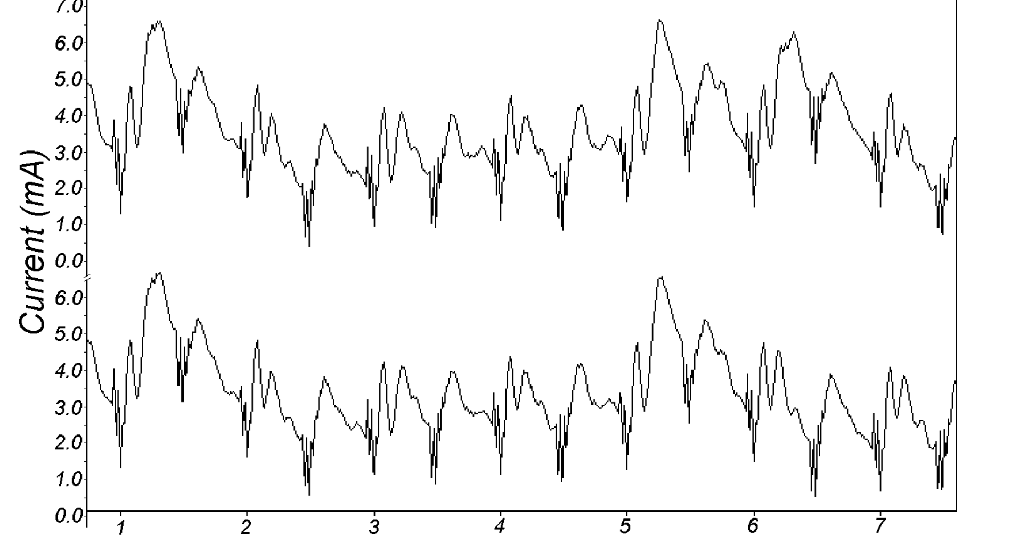
More Operations
Jump vs no Jump
Notes:
execution path through an SPA feature where a jump instruction is performed, and the lower trace shows a case where the jump is not taken. The point of divergence is at clock cycle 6 and is clearly visible.

Slide 14
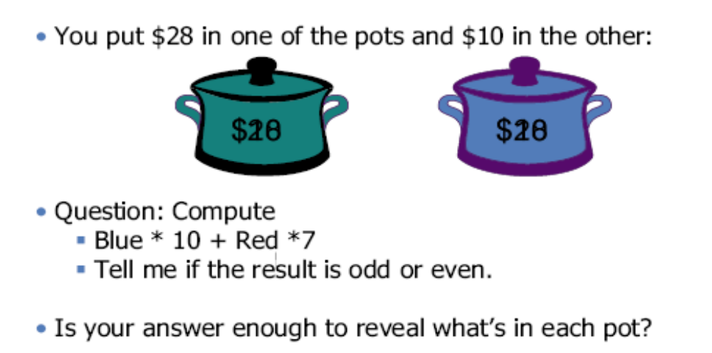
Timing attacks
Running time of a crypto processor can be used as an information channel
The idea was proposed by Kocher, Crypto’96
Notes:
Running time of a crypto processor can be also used as an information channel. For example, imagine you put $28 in one pot and $10 in the other. If there are 10 notes in the blue pot and 7 notes in the red pot, you cannot determine what is in each pot according to whether the result is odd or even.

Slide 15
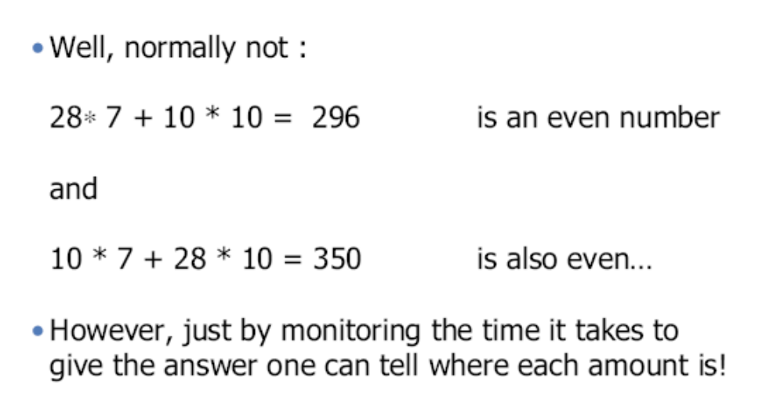
Timing attacks (cont’d)
Notes:
However, one can discern where each amount is by monitoring the time it takes to give the answer.

Slide 16
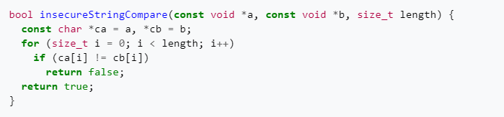
Simple Example
The following C code demonstrates a typical insecure string comparison which stops testing as soon as a character doesn't match.
For example, when comparing "ABCDE" with "ABxDE" it will return after 3 loop iterations:
Source: https://en.wikipedia.org/wiki/Timing_attack

Slide 17
Timing Attack on RSA Cryptosystem
Modular exponentiation is a fundamental operation in many cryptographic algorithms, including RSA and Diffie-Hellman.
The security of RSA relies on the difficulty of factoring the large modulus n, which is derived from two large prime numbers.
Modular exponentiation is used because it allows for this one-way function—easy to compute in one direction (encryption) and hard to reverse (decryption) without the private key.
Notes:
Security of RSA cryptosystem relies on the assumption that it is difficult to factor a large prime.

Slide 18
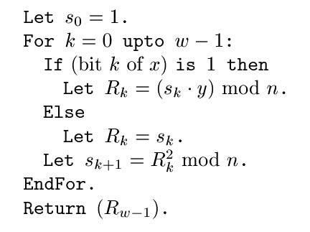
Kocher’s Observation
Whether iteration takes a long time
depends on the k^{th} bit of secret exponent
This takes a while
to compute
This is instantaneous
Notes:
Different mathematical operations in the process of decryption take different time.

Slide 19
Outline of Kocher’s Attack
Idea: guess some bits of the exponent and predict how long decryption will take
If guess is correct, we will observe correlation; if incorrect, then prediction will look random
  This is a signal detection problem, where signal is timing variation due to guessed exponent bits
  The more bits you already know, the stronger the signal, thus easier to detect (error-correction property)
Start by guessing a few top bits, look at correlations for each guess, pick the most promising candidate and continue
Notes:
The basic idea of Kocher’s attack is to guess some bits of the exponent and predict how long decryption will take. If guess is correct, correlation would be observed, or else prediction would look random.

