Slide 1
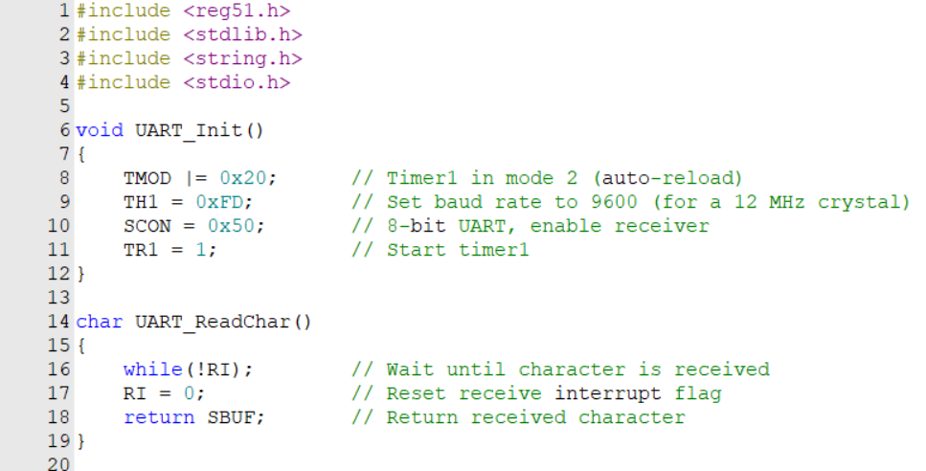
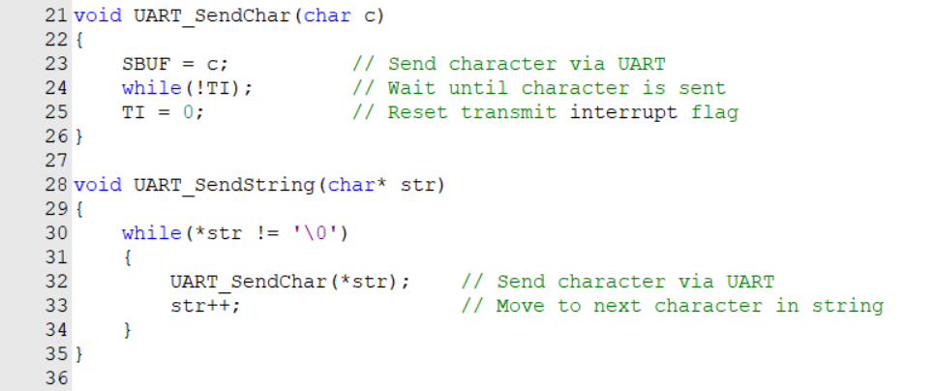
An Example on timing Attack
1
2

Slide 2
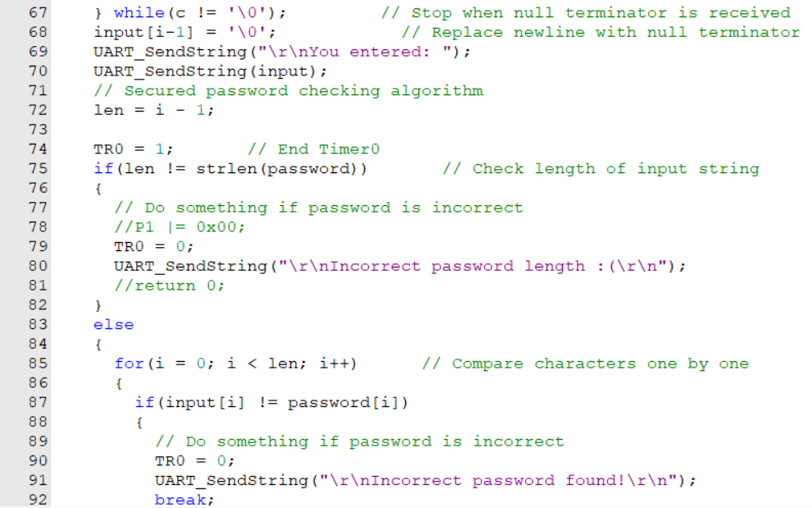
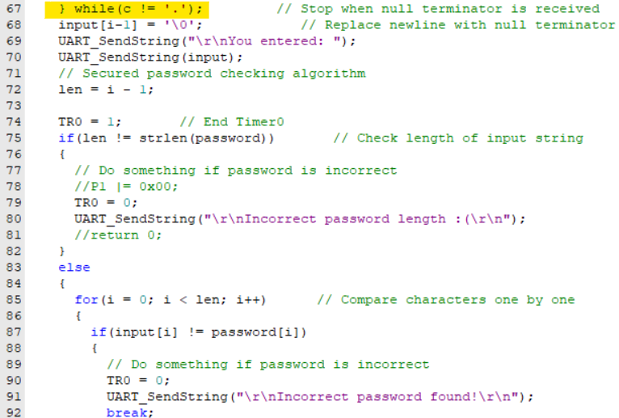
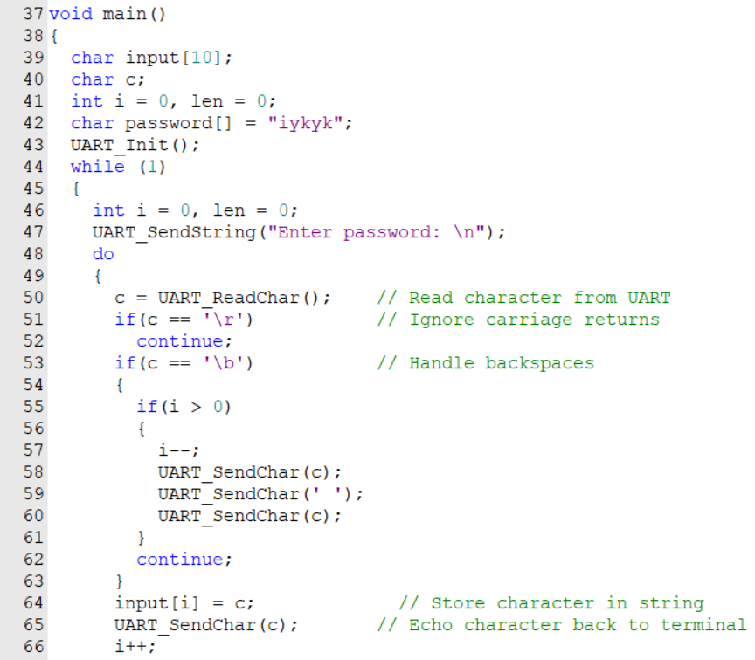
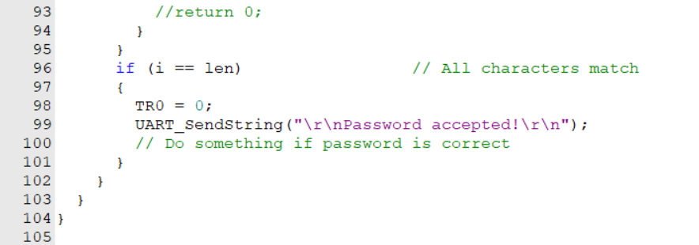
An Example on timing Attack
4
3
5

Slide 3
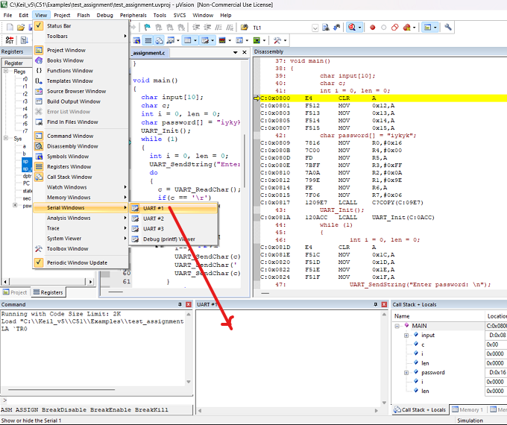
An Example on timing Attack
6
After Writing the code, translate it, build it and go to debug mode.
6
Click "View" => "Serial Windows" => "UART #1"
Note: You can drag and move the window as this screenshot view.

Slide 4
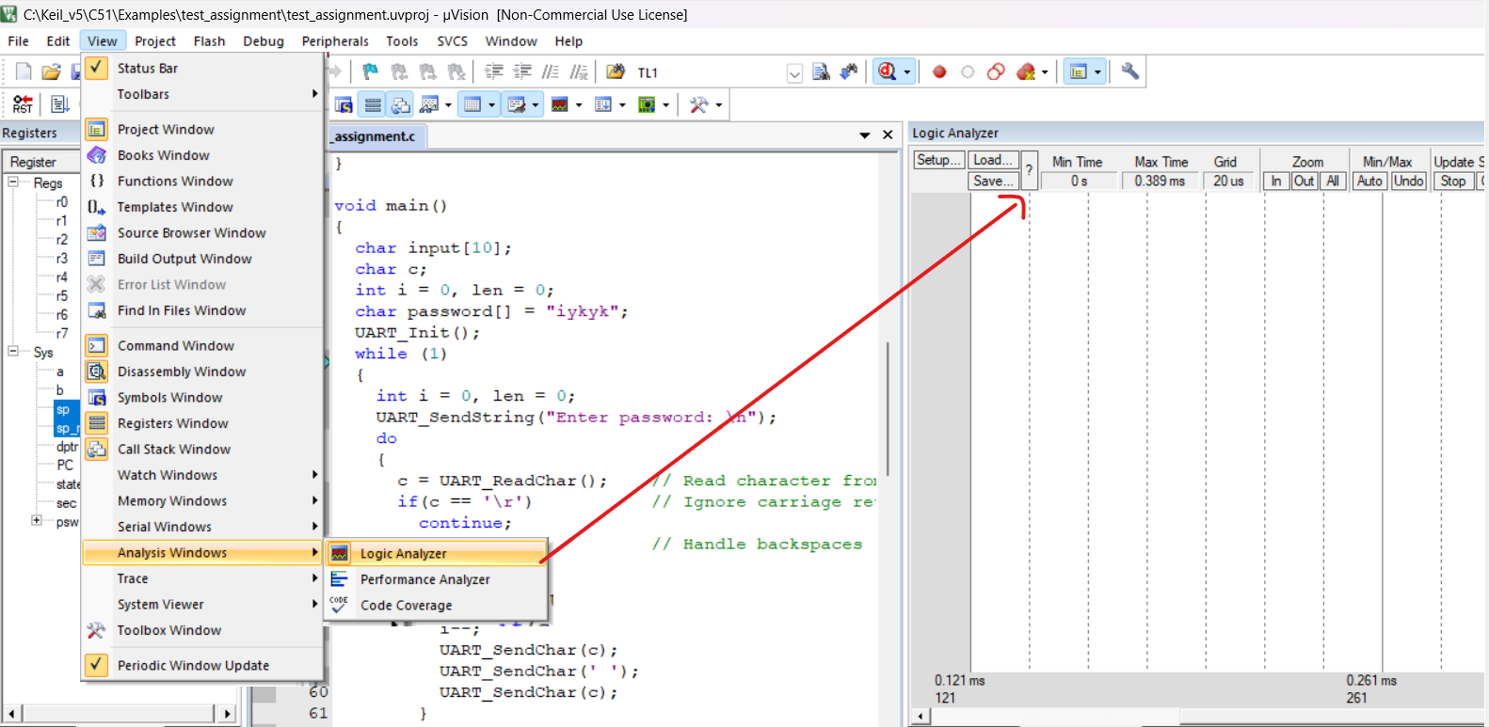
An Example on timing Attack
7
7
Click "View" => "Analysis Windows" => "Logic Analyzer"
Note: You can drag and move the window as this screenshot view.

Slide 5
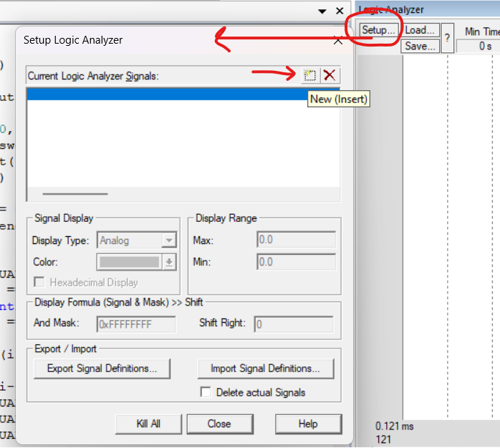
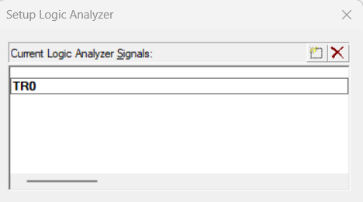
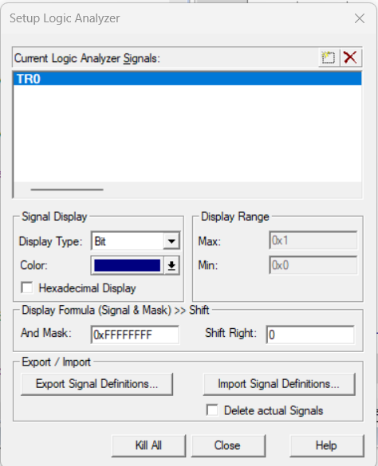
An Example on timing Attack
Write "TR0" and click anywhere in the window. (The last character is zero not "O")
Click "Setup" in the Logic Analyzer window and you will see the "Setup Logic Analyzer" window.
Click "New(Insert)" icon
Click on the signal "TR0" >> change "Display Type" to "Bit" >> click "Close"

Slide 6
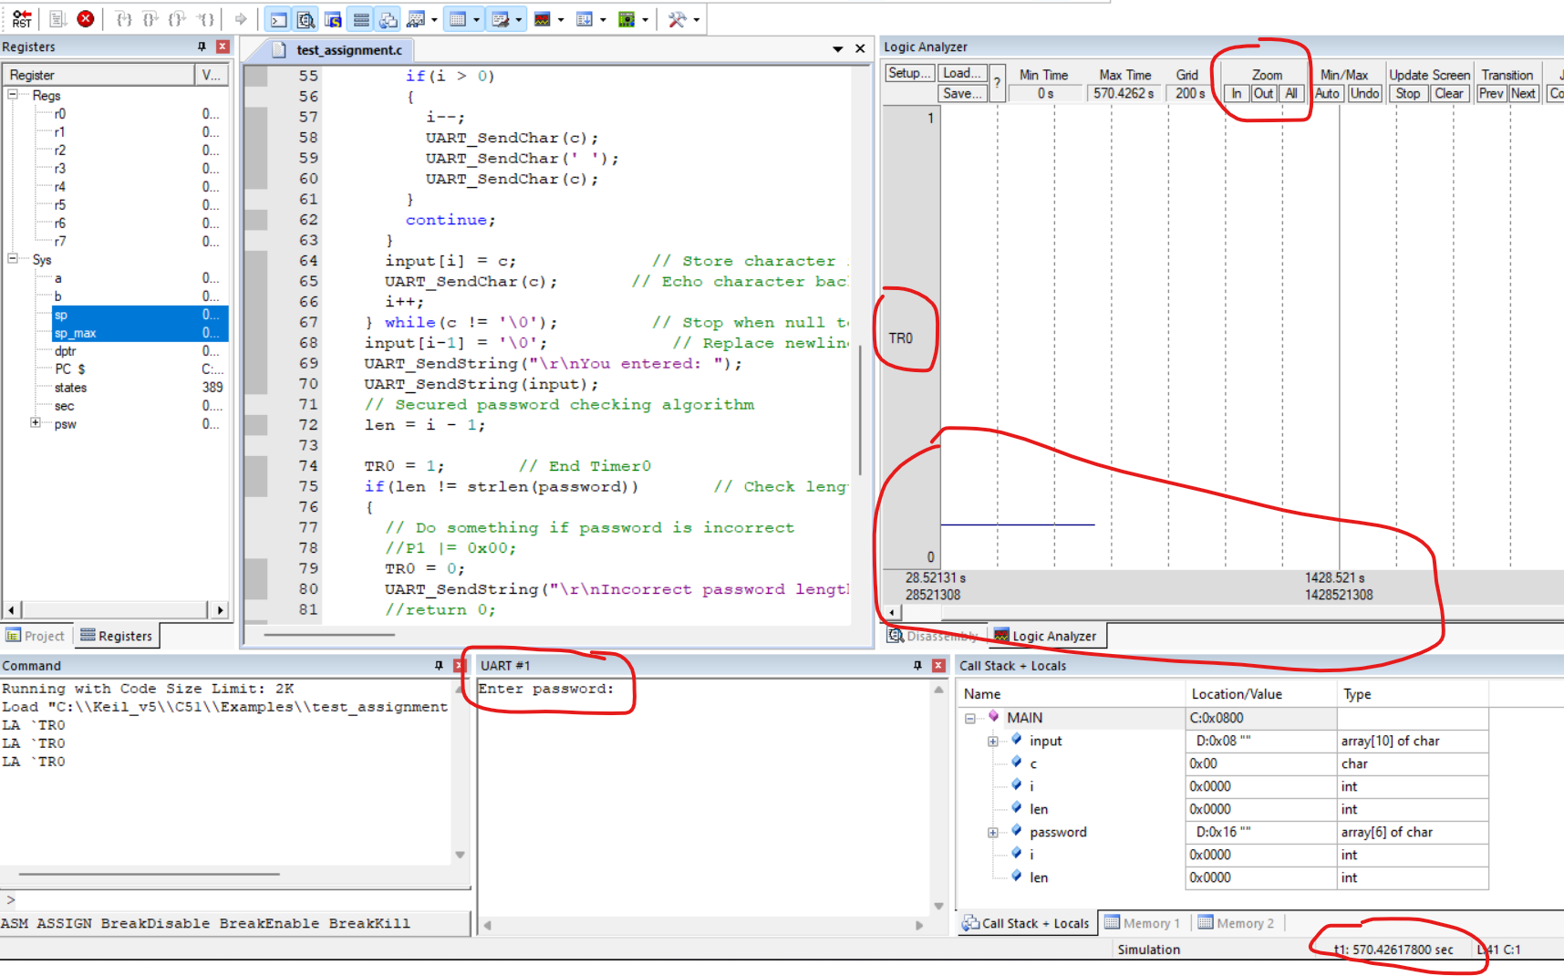
An Example on timing Attack
Click "Run".
You will observe that in the "UART #1" terminal the program is asking for the password from the user!
Also, in the logic analyzer window zoom out the signal and you should observe that the value of "TR0" is low.

Slide 7
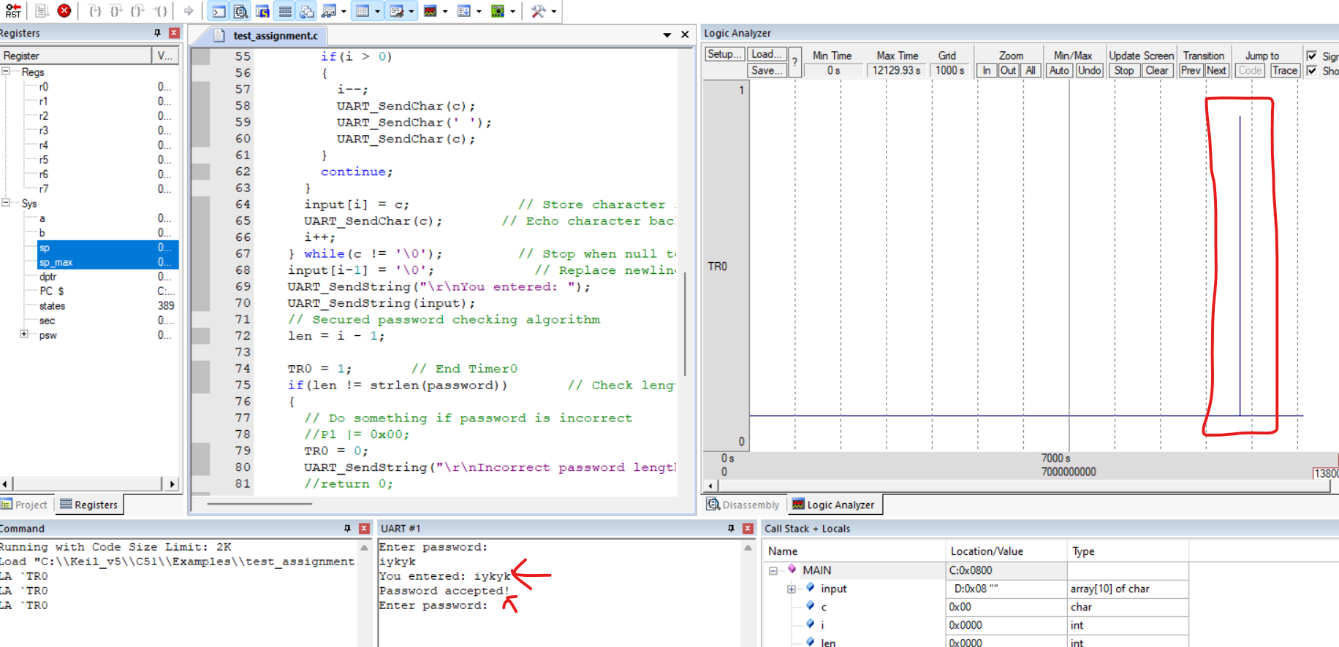
An Example on timing Attack
Any input for the password will create a transition in "TR0" signal. From the transition we can calculate the difference of correct and incorrect character in the password!

Slide 8
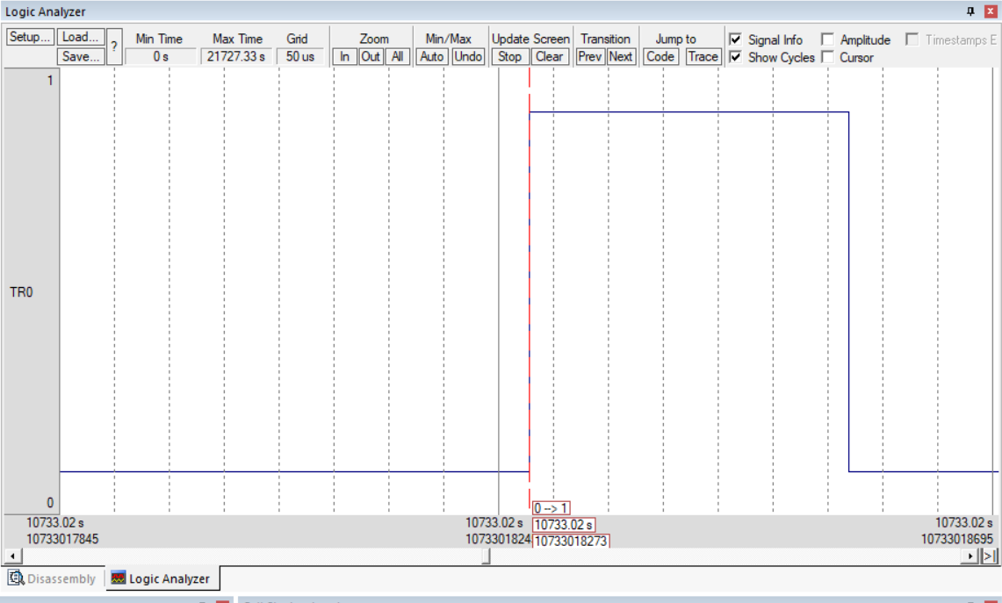
An Example on timing Attack
Click on the rising edge and zoom in up to a level so that we can calculate the difference! The difference between rising edge and falling edge is the execution time for one password check function.

Slide 9
An Example on timing Attack
Hello => 196438187 – 196438339 = 152
Howareyou => 8546 – 8668 = 122
Iello => 5463 – 5644 = 181
Iykpp => 5508 – 5748 = 240
Iykyk => 9003 – 9294 = 291
Aaaaa => 9641 – 9793 = 152
Baaaa => 5922 – 6065 = 143
Iaaaa => 7706 – 7894 = 188

