Slide 1
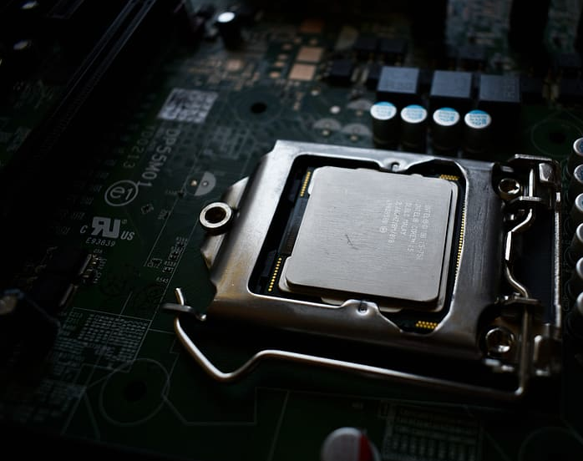

EECS 645: Computer Architecture, Fall 2024
Cache Side-Channel Attacks
Part-1
Tanvir Hossain

Slide 2

What is Cache?

Slide 3
Cache in Microarchitecture
CPU
CPU
Registers
Registers
L1
Cache
L2
L3
DRAM
(main memory)
DRAM
(main memory)

Slide 4
Cache in Microarchitecture
Level 1 Cache (L1)
Closest to CPU cores; smallest and fastest.
Divided into two types
L1 Instruction Cache (L1i): Stores instructions.
L1 Data Cache (L1d): Stores data.
Level 2 Cache (L2):
Larger and slightly slower than L1.
Can be shared between cores in some architectures.
Level 3 Cache (L3):
Largest and slowest among the cache levels.
Typically shared among all CPU cores.
CPU
DRAM
(main memory)
Registers

Slide 5
Cache Characteristics
Key Attributes:
Size: Total storage capacity (e.g., 32 KB, 256 KB, 8 MB).
Associativity (Ways): Number of ways in a set-associative cache.
Line Size: Size of each cache line (e.g., 64 bytes).
Type: Instruction (i), Data (d), or Unified (u) cache.

Slide 6
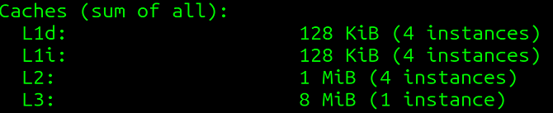
Observing Cache Information in Linux
username@nephrite:~$ lscpu
CPU0
CPU1
CPU2
CPU3
L1d (128kib)
L1d (128kib)
L1d (128kib)
L1d (128kib)
L1i (128KiB)
L1i (128KiB)
L1i (128KiB)
L1i (128KiB)
L2 (1MiB)
L2 (1MiB)
L2 (1MiB)
L2 (1MiB)
Explanation
L1d cache: Level 1 Data Cache size.
L1i cache: Level 1 Instruction Cache size.
L2 cache: Level 2 Cache size.
L3 cache: Level 3 Cache size
L3 (8 MiB)

Slide 7
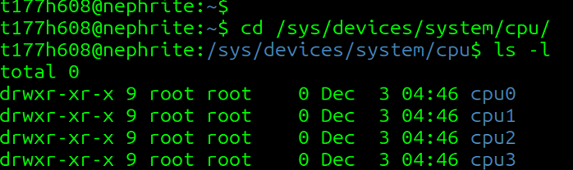
Exploring /sys/devices/system/cpu/
t177h608@nephrite:~$
cd /sys/devices/system/cpu/
CPU0
CPU1
CPU2
CPU3
t177h608@nephrite:/sys/devices/system/cpu/cpu0/cache$
cat index0/level
cat index0/type
cat index0/size
cat index0/ways_of_associativity
cat index0/coherency_line_size
1
Data
32K
8
64

Slide 8
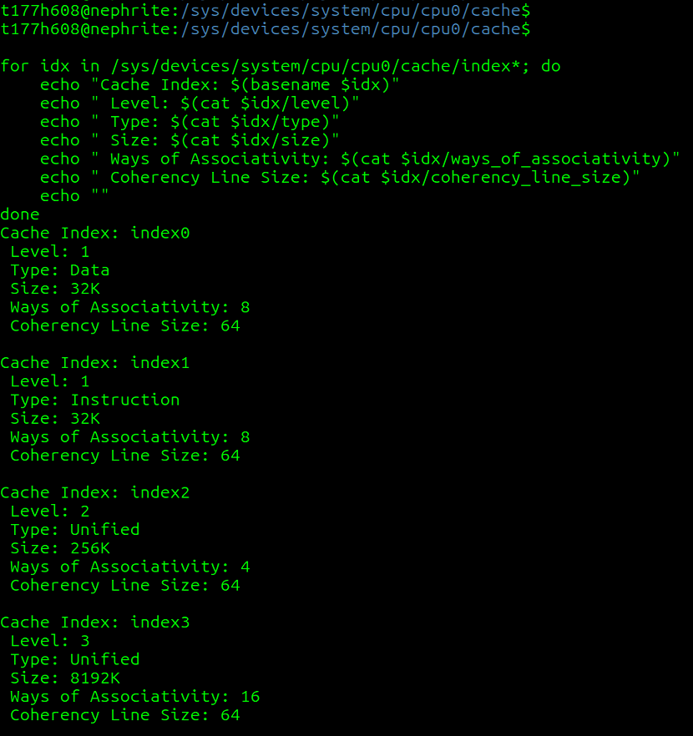
Exploring /sys/devices/system/cpu/
for idx in /sys/devices/system/cpu/cpu0/cache/index*; do
echo "Cache Index: $(basename $idx)"
echo " Level: $(cat $idx/level)"
echo " Type: $(cat $idx/type)"
echo " Size: $(cat $idx/size)"
echo " Ways of Associativity: $(cat $idx/ways_of_associativity)"
echo " Coherency Line Size: $(cat $idx/coherency_line_size)"
echo ""
done
CPU0
CPU1
CPU2
CPU3
L1d (128kib)
L1d (128kib)
L1d (128kib)
L1d (128kib)
L1i (128KiB)
L1i (128KiB)
L1i (128KiB)
L1i (128KiB)
L2 (1MiB)
L2 (1MiB)
L2 (1MiB)
L2 (1MiB)
L3 (8 MiB)

Slide 9
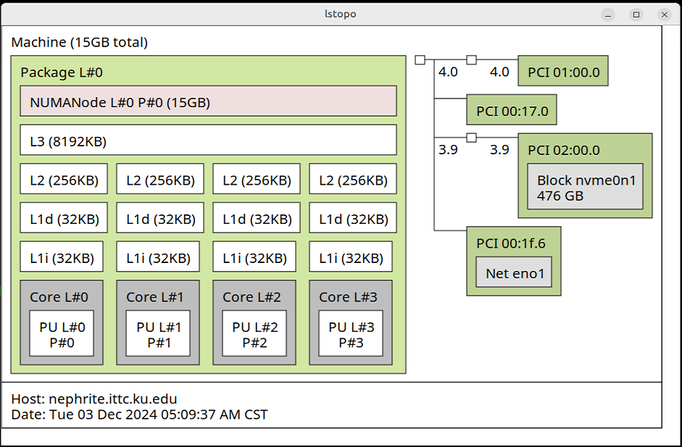
Exploring a Cool Tool
Portable Hardware Locality (hwloc)
sudo apt-get install hwloc
-> lstopo

Slide 10
Understanding Cache Associativity Types
Direct-Mapped Cache:
  Each block maps to exactly one cache line.
  Associativity: 1-way.
Set-Associative Cache:
  Each block can map to any line within a set.
  Associativity: n-way (e.g., 2-way, 4-way).
Fully Associative Cache:
  Any memory block can be placed in any cache line.
  Associativity: Equal to the number of lines.
Higher Associativity:
  Pros: Reduces conflict misses.
  Cons: Increases complexity and access time.
Lower Associativity:
  Pros: Simpler design, faster access.
  Cons: More prone to conflict misses.

Slide 11
Attack!
Cache Side-Channel Attack

Slide 12

Attack!
Cache Side-Channel Attack
A side-channel attack is an indirect measurement of a computational result via an auxiliary mechanism

Slide 13
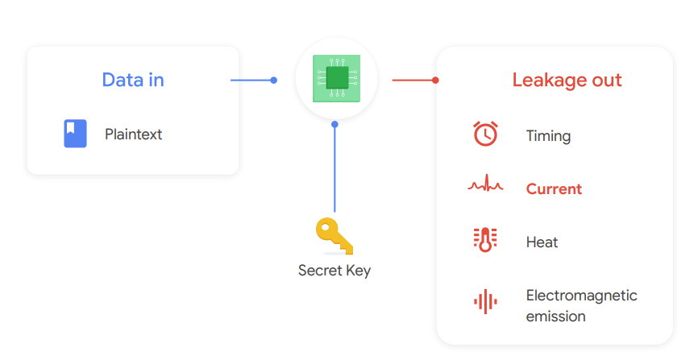
Attack!
Cache Side-Channel Attack

Slide 14

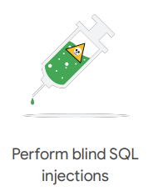


SCA Real-World Applications
Attack!

Slide 15

Attack!
Cache Side-Channel Attack

Slide 16

Cache Side-Channel
Basic Idea of Cache Side-channel Attack:
Find a cache set that the attacker shares with the victim
and
then monitor its usage over time.

Slide 17
Cache Side-Channel
Cache Timing Variations: Cache memory is faster than main memory. Cache side-channel attacks exploit timing differences between cache hits (data found in cache) and cache misses (data fetched from main memory).
Observation of Access Patterns: By monitoring or manipulating cache access patterns, attackers can deduce sensitive operations or data, such as cryptographic keys or user behavior.
Shared Resource Exploitation: These attacks often occur in environments where multiple processes or users share the same hardware, such as in cloud computing or multi-user systems.
Common techniques include:
  Flush+Reload: Evict a cache line and observe reload times to determine if a victim accessed it.
  Prime+Probe: Fill the cache with attacker data, then measure access times to detect victim's cache usage.

Slide 18
Common Terms of Cache Side-channel Attacks
Cache Hits: When data requested by the CPU is found in the cache, resulting in faster access.
Cache Miss: When data requested by the CPU is not found in the cache, requiring retrieval from slower main memory.
Flush: The process of invalidating or clearing specific cache lines to remove stored data.
Reload: Accessing data again to measure how quickly it can be fetched, indicating if it's still in the cache.
Evict: Forcing specific data out of the cache, making space for other data or invalidating cache lines.
Prime: Filling the cache with specific data to observe later access patterns.
Probe: Measuring access times to determine if specific cache lines have been used or modified by another process.

Slide 19
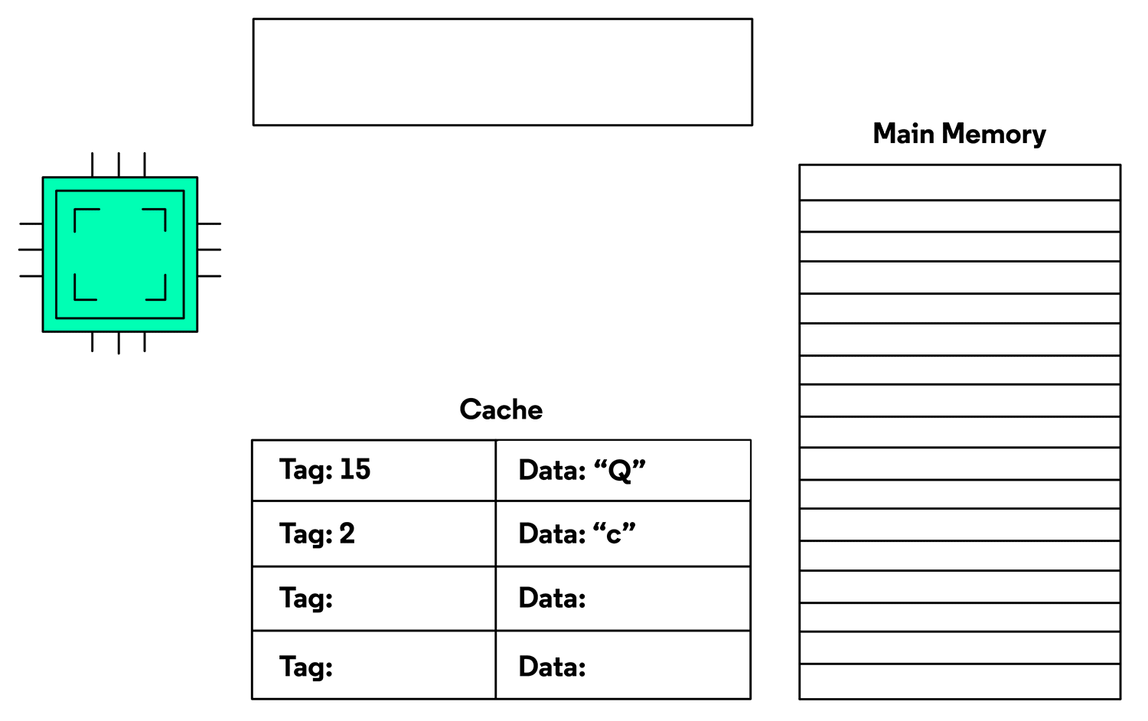
Common Terms of Caches
Cache Hits:
A Cache Hit occurs when a line is referenced and is in the cache. The cached data will be retrieved instead of accessing main memory.
Download the PPTX file to play the animation.
Gif source: https://www.codecademy.com/learn/cspath-computer-architecture/modules/cache/cheatsheet

Slide 20
Cache hits in Real
// cache_hit.c
#include <stdio.h>
#include <stdlib.h>
#include <time.h>
#define ITERATIONS 1000000
int main() {
int *array = malloc(sizeof(int) * 1024);
volatile int temp;
clock_t start, end;
// Access the array once to load it into the cache
for(int i = 0; i < 1024; i++) {
array[i] = i;
}
// Measure the time taken for cache hits
start = clock();
for(int i = 0; i < ITERATIONS; i++) {
temp = array[0]; // Repeatedly access the same element
}
end = clock();
double cpu_time_used = ((double)(end - start)) / CLOCKS_PER_SEC;
printf("Time taken with cache hits: %f seconds\n", cpu_time_used);
free(array);
return 0;
}
Storing the memory
Accessing the same memory location multiple times and measuring the access time to show faster access due to cache hits.

Slide 21
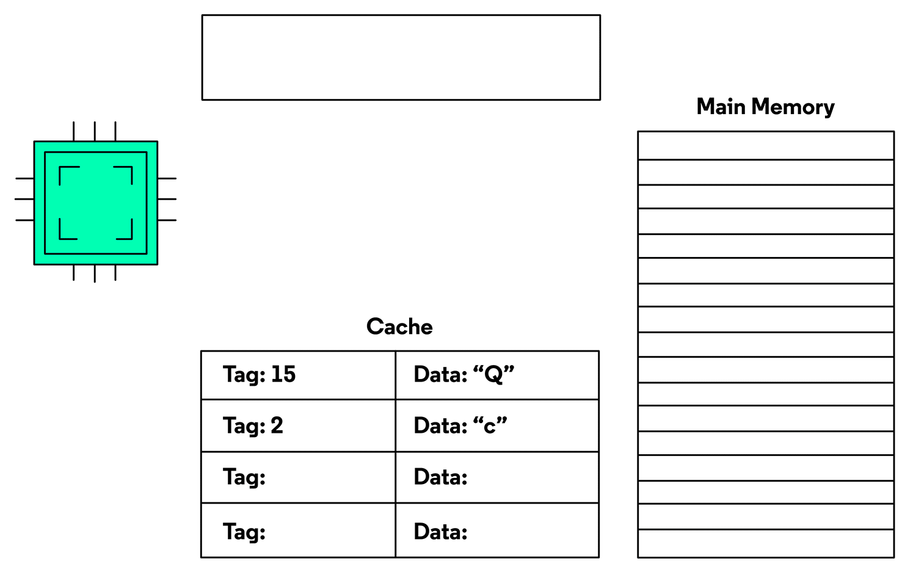
Common Terms of Caches
Cache Miss:
A Cache Miss occurs when a line is referenced and is not in the cache. The data will be fetched from main memory, passing through the cache, possibly evict other line to ensure enough storage.
Download the PPTX file to play the animation.
Gif source: https://www.codecademy.com/learn/cspath-computer-architecture/modules/cache/cheatsheet

Slide 22
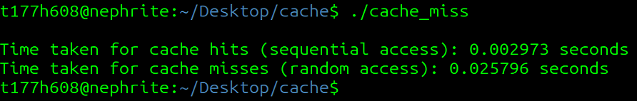
Cache Miss in Real
#include <stdio.h>
#include <stdlib.h>
#include <time.h>
#define ARRAY_SIZE (1024 * 1024) // Adjust size to exceed cache capacity
int main() {
int *array = malloc(sizeof(int) * ARRAY_SIZE);
if (!array) {
perror("Memory allocation failed");
return 1;
}
volatile int temp;
clock_t start, end;
// Initialize the array
for (int i = 0; i < ARRAY_SIZE; i++) {
array[i] = i;
}
// Sequential access (cache hits)
start = clock();
for (int i = 0; i < ARRAY_SIZE; i++) {
temp = array[i]; // Sequential access
}
end = clock();
double hit_time = ((double)(end - start)) / CLOCKS_PER_SEC;
printf("Time taken for cache hits (sequential access): %f seconds\n", hit_time);
// Random access (cache misses)
start = clock();
for (int i = 0; i < ARRAY_SIZE; i++) {
temp = array[rand() % ARRAY_SIZE]; // Random access
}
end = clock();
double miss_time = ((double)(end - start)) / CLOCKS_PER_SEC;
printf("Time taken for cache misses (random access): %f seconds\n", miss_time);
free(array);
return 0;
}
Output:
Cache Hits (Sequential Access): Accesses array elements in a sequential order, utilizing spatial locality for high cache efficiency.
Cache Misses (Random Access): Accesses array elements using random indices (rand() % ARRAY_SIZE), disrupting spatial and temporal locality and increasing cache misses.

Slide 23
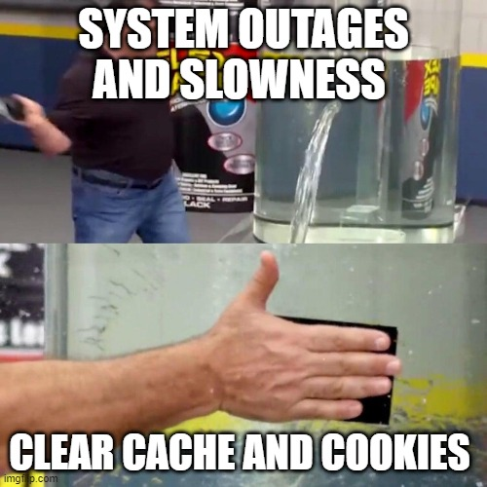
Common Terms of Caches
Flush
The process of invalidating or clearing specific cache lines to remove stored data.

Slide 24
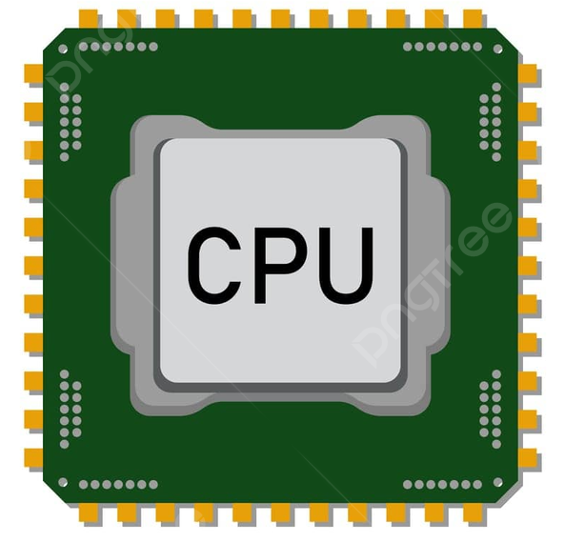
Shared Memory
Process 1
Access
Process 2
Access
Shared Memory

Slide 25
Shared Memory
Process 1
flush
Access
Process 2
Access
Shared Memory

Slide 26
Shared Memory
Process 1
flush
Access
Process 2
Access

Slide 27

Common Terms of Caches
Reload:
Process of accessing a specific memory location (or cache line) after it has been flushed from the CPU cache.
Less time to fetch
Yes
Is in the cache?
Reload
Longer time to fetch data from main memory
No

Slide 28
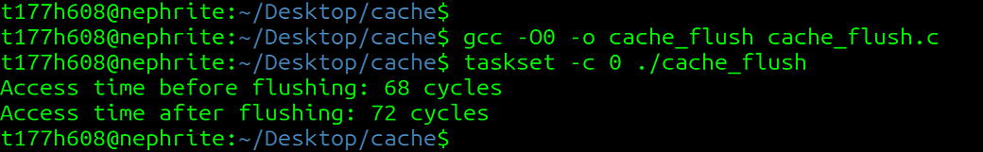
Common Terms of Caches
#include <stdio.h>
#include <stdlib.h>
#include <x86intrin.h>
int main() {
int *data = malloc(sizeof(int) * 1024);
if (!data) {
perror("Memory allocation failed");
return 1;
}
// Initialize data
data[0] = 42;
// Measure access time before flushing (should be fast if in cache)
unsigned long long start, end;
start = __rdtsc(); // Read timestamp counter
volatile int temp = data[0]; // Access data
end = __rdtsc();
printf("Access time before flushing: %llu cycles\n", end - start);
// Flush cache line containing data[0]
_mm_clflush(&data[0]);
// Measure access time after flushing (should be slower)
start = __rdtsc();
temp = data[0]; // Access data again
end = __rdtsc();
printf("Access time after flushing: %llu cycles\n", end - start);
free(data);
return 0;
}
taskset –c 0 Run the program on a Single Core
gcc –o0 disable the complier optimization
Access Time Measurement: Used the __rdtsc() intrinsic to measure the number of CPU cycles taken to access data[0].The first measurement (Access time before flushing) captures the time to access data[0] when it is likely in the cache.
Cache Flush: _mm_clflush(&data[0]) flushes the cache line containing data[0] from all levels of the cache hierarchy.
Reaccess After Flush: The second measurement (Access time after flushing) captures the time to access data[0] after it has been flushed. This access should take longer because the data must be fetched from main memory.

Slide 29
Common Terms of Caches
Evict:
The process of forcing specific data or cache lines to be removed (evicted) from the CPU cache, ensuring that subsequent accesses to that data will result in a cache miss.
Why Eviction?
  Creates Controlled Cache State: Ensures a predictable starting state by clearing specific cache lines.
  Monitors Victim's Access Patterns: Detects whether a victim has accessed a specific memory location.
  Exploits Shared Resources: Interferes with a victim's cache usage in shared environments.
  Measures Cache Behavior: Distinguishes cache hits and misses by observing timing differences.
  Bypasses Prefetching: Forces data out of the cache, overcoming CPU optimizations like prefetching.

Slide 30
Common Terms of Caches
Prime:
The process of filling specific cache sets with the attacker’s own data.
Prime is done to establish a known initial state in the cache, which can later be analyzed to detect whether the victim has accessed the same cache sets and evicted the attacker's data.
Why Priming?
Monitor Victim Activity: If the victim accesses data that maps to the same cache set, it will evict the attacker’s data, leaving a detectable signature.
Measure Cache Interference: The attacker probes the cache after priming to measure how much of their data has been evicted, revealing the victim’s behavior.

Slide 31
Common Terms of Caches
Probe:
The process of re-accessing the data previously used in the cache to measure the access time.
The purpose of probing is to determine whether the attacker’s data has been evicted from the cache, which indicates that the victim may have accessed memory that maps to the same cache set.
Why Priming?
  Detect Cache Evictions: By measuring access times, the attacker can determine if the victim has accessed memory that overlaps with the attacker's targeted cache set.
  Infer Victim Behavior: Patterns in cache evictions reveal information about the victim’s memory access patterns, which can be used to extract sensitive data (e.g., cryptographic keys).

Slide 32

Curious!
Have we seen Probing before in this lecture?
Probing in a cache side-channel attack is directly related to cache hit or miss timing calculation, but it has a specific purpose within the context of the attack.

Slide 33
Cache Side-Channel Attacks
Flush+Reload
Evict+Reload
Prime+Probe
Prime+Abort
Flush+Flush

Slide 34
Intel Skylake
Virtual Address
Reset 36 bits | L1 index 6 bits | Offset 6 bits
8 cache ways
Page
Translation
L1 Cache
32 KB
64 cache sets
Physical Address
4 cache ways
Reset 32 bits | L2 index 10 bits | Offset 6 bits
L2 Cache
256 KB
1024 cache sets
16 cache ways
Reset 31 bits | L3 index 11 bits | Offset 6 bits
L3 Cache
2 MB
2048 cache sets

Slide 35
End
Any Question?
Tanvir Hossain
Email: tanvir@ku.edu (Preferred)
Office: Eaton 2045
Office Hours
Wednesday, 11:15 am to 1:15 PM

