Slide 1
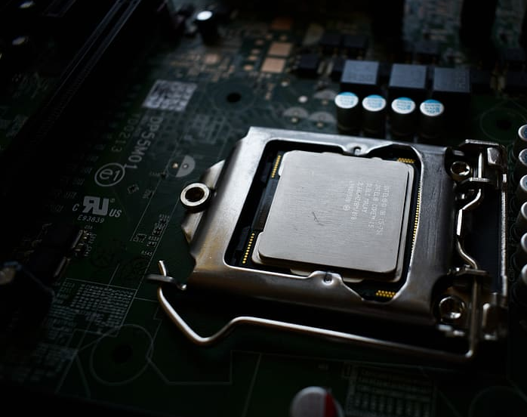

EECS 645: Computer Architecture, Fall 2024
Cache Side-Channel Attacks
Part-2
Tanvir Hossain

Slide 2
Cache Side-Channel Attacks
Flush+Reload
Prime+Probe
Flush+Flush
Evict+Reload
Prime+Abort

Slide 3
Flush + Reload Cache Attack
Requirements
Shared Memory: The attacker and victim must have access to the same physical memory addresses, typically through shared libraries or memory-mapped files.
High-Resolution Timer: The attacker needs a precise timing mechanism (e.g., rdtsc instruction) to measure access times accurately.
Cache flushing access: The attacker must be able to flush specific cache lines (e.g., using instructions like _mm_clflush) to evict the target data from the cache.
Last Level Cache (LLC): The attack typically targets the shared Last Level Cache (LLC) because it is accessible by all cores in a multi-core system. This allows the attacker to monitor victim activity across CPU cores, making the LLC an ideal target for observing shared memory access patterns.

Slide 4

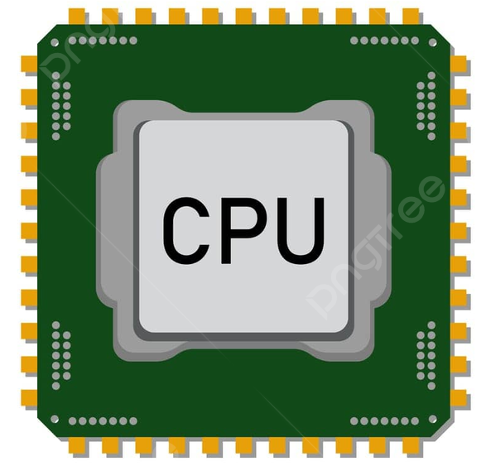

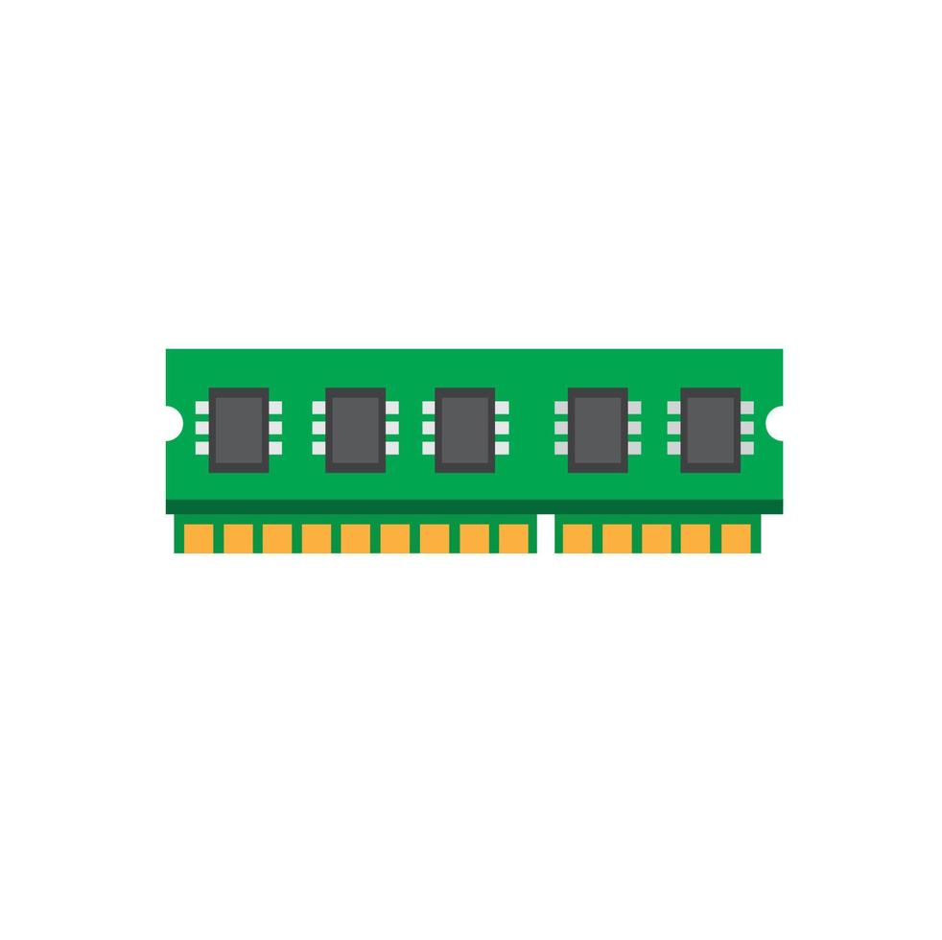
Flush + Reload Cache Attack
Shared Server
b
Cache Memory
a
Shared Memory
1
2

Slide 5
Flush + Reload Cache Attack
Shared Server
b
Cache Memory
a
b
a
1
2

Slide 6
Flush + Reload Cache Attack
Shared Server
b
Cache Memory
Flush the Cache
a
b
a
1
2

Slide 7
Flush + Reload Cache Attack
Shared Server
b
Cache Memory
Flush the Cache
a
b
1
a
2

Slide 8
Reload
Shared Server
b
Cache Memory
Reload the cache
a
1
a
2
b

Slide 9
Reload
Shared Server
Cache Hit
b
Cache Memory
Reload the cache
a
1
a
2
Cache Miss
b

Slide 10
Reload
a : cache Hit
Cycles: 200
b : cache miss
Cycles: 500

Slide 11

Reload
What was the last input from the Voter?
a

Slide 12
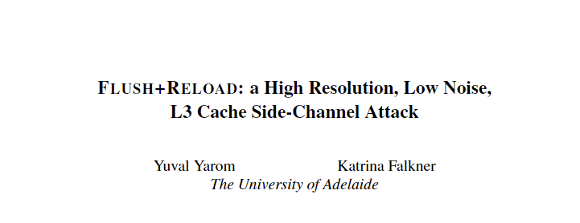
Flush and Reload Cache Attack
Yarom, Yuval, and Katrina Falkner. "{FLUSH+ RELOAD}: A high resolution, low noise, l3 cache {Side-Channel} attack." 23rd USENIX security symposium (USENIX security 14). 2014.

Slide 13






Timing of F LUSH +RELOAD Cache Attack [Ref: Yarom et al. 2014]
A) No Victim Access
(B) With Victim Access
(C) Victim Access Overlap
(D) Partial Overlap
(E) Multiple Victim Accesses

Slide 14
Flushing Cache using C
This header provides access to various Intel-specific intrinsics, including memory barrier functions (_mm_mfence, _mm_lfence) and cache management instructions (_mm_clflush).
  #include <x86intrin.h>
  _mm_mfence();
  _mm_clflush(&variable);
  _mm_mfence();
  _mm_lfence();
Ensures completion of all prior memory operations before proceeding.
Flushes the cache line containing variable to invalidate it.
Ensures the flush operation is completed before proceeding further.
Ensures all prior read operations are completed before executing subsequent instructions.

Slide 15
Reloading Cache using C
  time1 = __rdtsc();
  _mm_lfence();
  <operations>
  _mm_lfence();
  time2 = __rdtsc();
  _mm_lfence();
  msl = time2 - time1;
Reads the timestamp counter to set the starting timer value.
Placeholder for operations that should trigger a cache miss.
Reads the timestamp counter to get the ending timer value.
Computes the elapsed cycles by subtracting the starting timer value

Slide 16
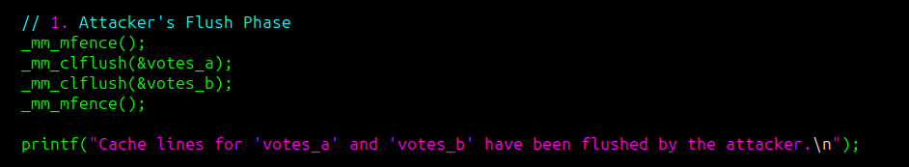
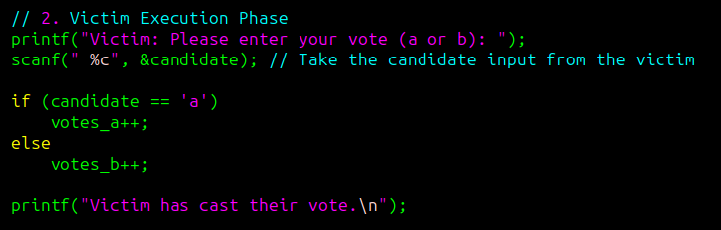
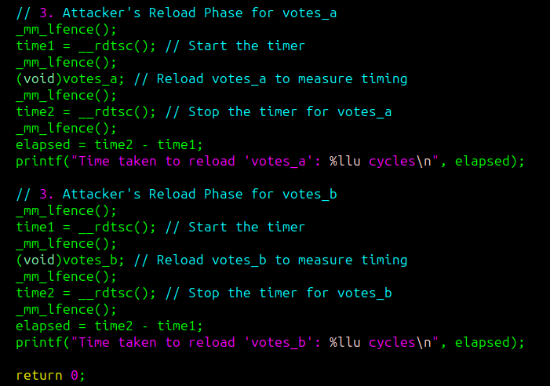
Flush + Reload Cache Attack

Slide 17
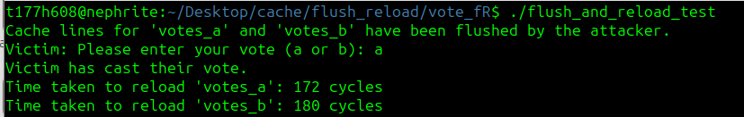
Flush + Reload Cache Attack

Slide 18
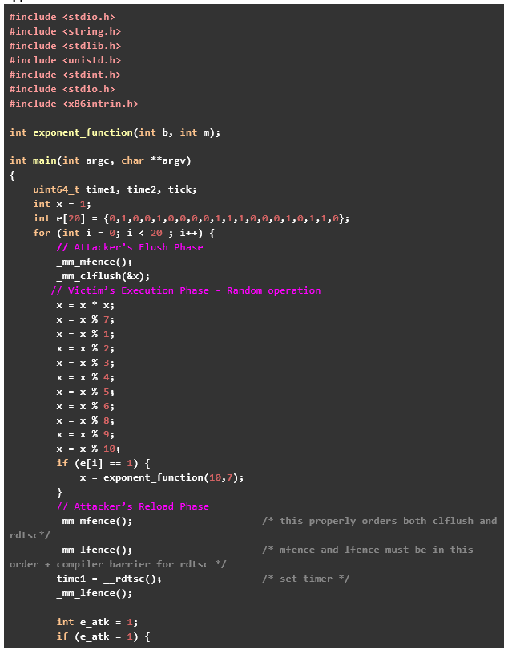
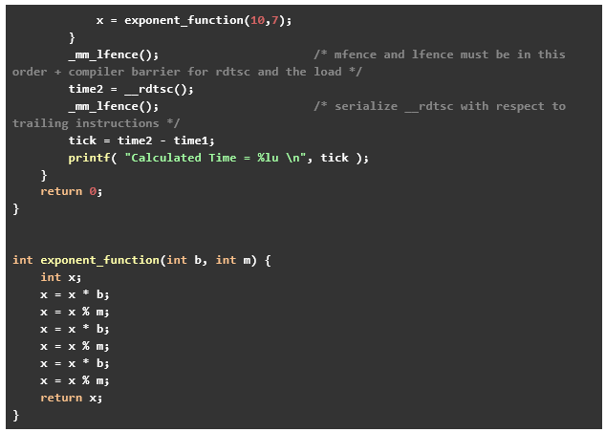
Flush + Reload Cache Attack Analysis

Slide 19
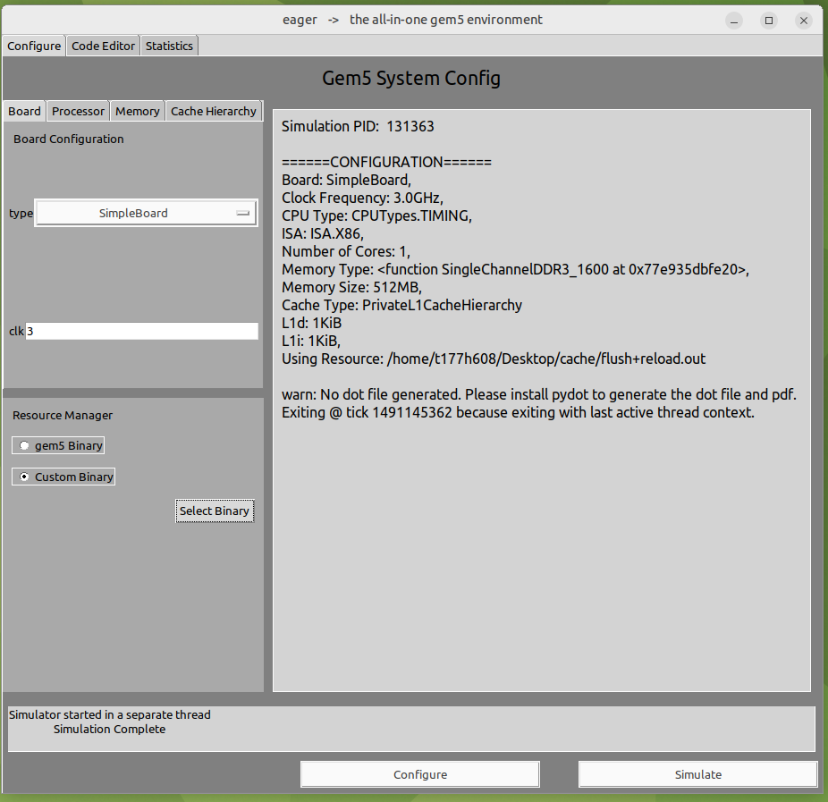
Flush + Reload Cache Attack Analaysis

Slide 20
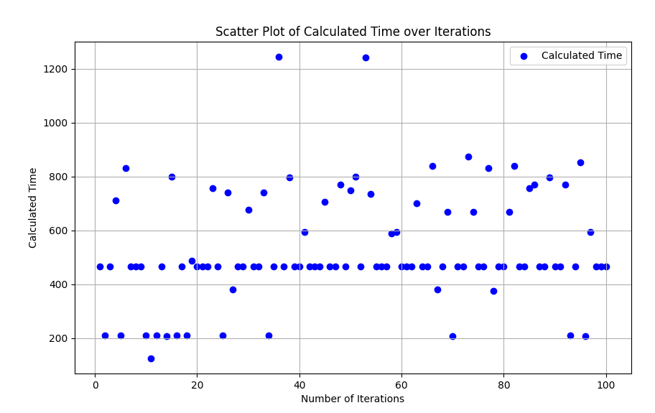
Flush + Reload Cache Attack Analaysis
Threshold of Hit and Miss

Slide 21
Prime + Probe Cache Attack
It exploits the temporal characteristics of cache memory to deduce what memory locations a victim process accesses.

Slide 22
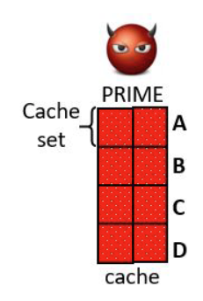
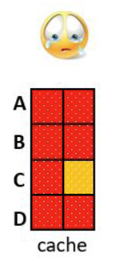
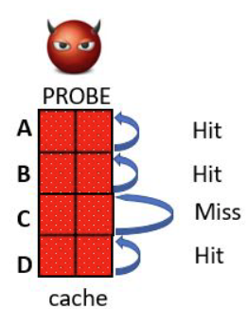
Prime + Probe Cache Attack
Prime: The attacker primes the cache by reading memory lines from its own exclusive memory (no shared memory).
Victim: The attacker lets the victim evict (or notevict) lines while running, depending on the victim’s behavior.
Probe: The attacker probes data in a similar way of the prime step but with the measurement of how much time it takes to load the lines (Hit / Miss), for each cache set, the attacker determines if the cache set has been accessed
Time [CPU Ticks]

Slide 23
Prime + Probe Cache Attack
#include <x86intrin.h>
#include <stdio.h>
#include <stdint.h>
#include <stdlib.h>
#include <unistd.h>
#define CACHE_LINE_SIZE 64
#define ARRAY_SIZE 1024 * 1024 // 1 MB
char array[ARRAY_SIZE]; // Large array to simulate cache lines
// Function to access specific cache lines (prime or probe)
void access_memory(size_t start, size_t step, size_t num_accesses) {
for (size_t i = 0; i < num_accesses; i++) {
volatile char temp = array[start + i * step]; // Access cache lines
(void)temp; // Prevent compiler optimization
}
}
// Function to measure access time to a specific memory address
uint64_t measure_access_time(char *address) {
uint64_t start, end;
start = __rdtsc();
(void)*address;
end = __rdtsc();
return end - start;
}
int main() {
size_t num_lines = ARRAY_SIZE / CACHE_LINE_SIZE; // Number of cache lines
size_t step = CACHE_LINE_SIZE; // Step to next cache line
size_t prime_set = num_lines / 4; // Subset to prime
uint64_t times[num_lines]; // Store access times
// Open a CSV file for writing results
FILE *file = fopen("prime_probe_results.csv", "w");
if (file == NULL) {
perror("Error opening file");
return 1;
}
// Write the CSV header
fprintf(file, "Cache Line,Access Time (cycles)\n");
// Prime phase: Fill a subset of the cache
printf("Priming cache...\n");
access_memory(0, step, prime_set);
// Simulate victim access: Victim accesses random lines
printf("Victim accessing cache lines...\n");
usleep(50000); // Simulate time delay for victim process
for (size_t i = 0; i < 10; i++) {
size_t victim_index = (rand() % prime_set) * step;
volatile char temp = array[victim_index];
(void)temp; // Prevent optimization
}
// Probe phase: Measure access time to the same lines
printf("Probing cache...\n");
for (size_t i = 0; i < prime_set; i++) {
size_t index = i * step;
times[i] = measure_access_time(&array[index]);
fprintf(file, "%zu,%llu\n", i, times[i]); // Write line and time to CSV
}
// Close the CSV file
fclose(file);
printf("Results stored in 'prime_probe_results.csv'.\n");
return 0;
}

Slide 24
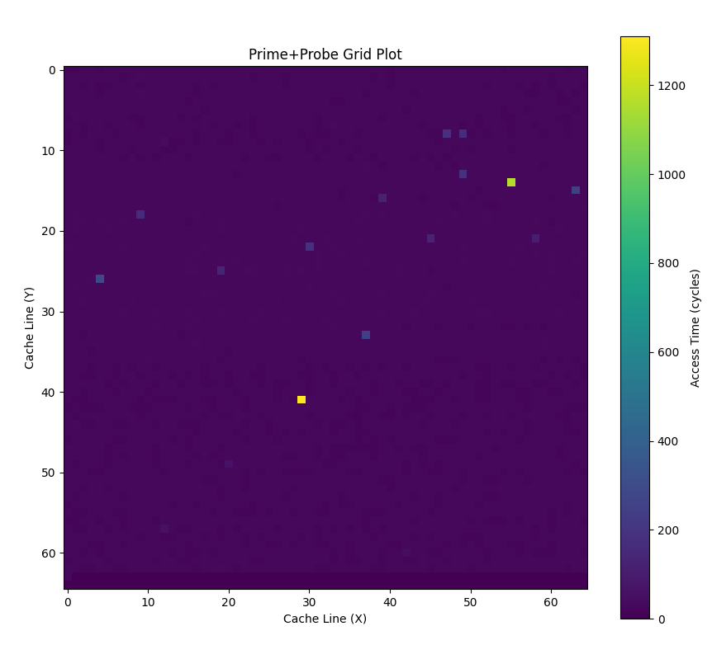
Prime + Probe Cache Attack

Slide 25
End
Any Question?
Tanvir Hossain
Email: tanvir@ku.edu (Preferred)
Office: Eaton 2045
Office Hours
Wednesday, 11:15 am to 1:15 PM

