Slide 1
Classifying the Radiation Belts
PhD discussion

Slide 2

What shall I talk about?
Intro to radiation belts
Space weather
Importance
My project

Slide 3
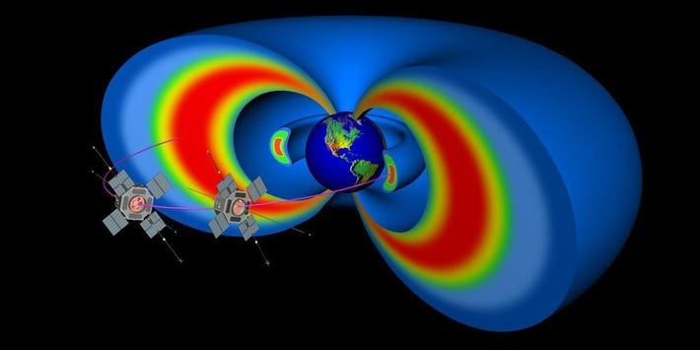
Radiation Belts
Inner belt
Lies around 1 – 2 Re
Relativistic protons
10s MeV - GeV
Outer belt
Extends from 3 - ~6 Re
Energetic electrons
100keV – 10 MeV
https://www.forbes.com/sites/jillianscudder/2017/06/16/astroquizzical-van-allen-belts-barrier-spaceflight/?sh=6f7979d06f8d
Notes:
Location of belts
How they are highly variable – boundaries are not fixed in space

Slide 4
Why Should I Care?

Slide 5
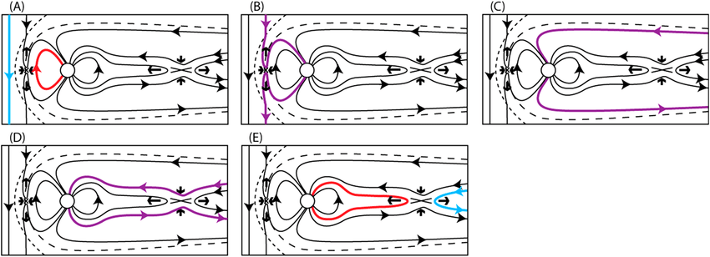
Space Weather
N(B) = N(E) -> normal
N(B) > N(E) -> substorm
N(B) >> N(E) -> geomagnetic storm
Notes:
Radiation belts are highly variable. These variations can be caused by changes in the Earth’s magnetic field – for example by enhancements to particle flux due to interactions with the solar wind.
Dove went through the Dungey cycle a few weeks ago, but as a quick recap the dungey cycle describes what happens to our magnetic field when it interacts with the solar wind and IMF under certain conditions. If the incoming IMF is southward pointing, it will reconnect with the opposite Earth field line

Slide 6

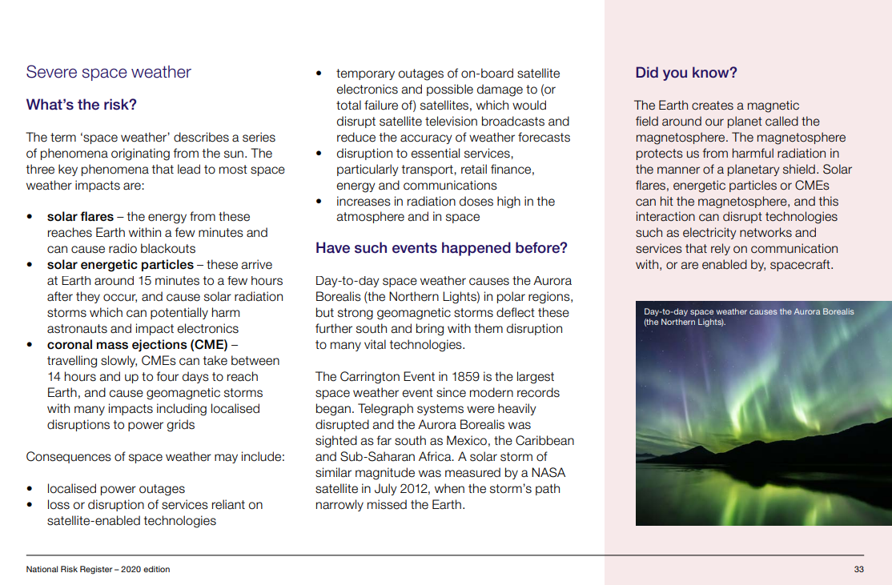
Consequences
Damage satellites
Disrupt communication and navigation
Inconsistent data measurements
Changes in composition and density
Brighter aurora (pretty)
Notes:
Damage satellites -> penetrate surfaces, damage the internal electronics – ‘killer electrons’. Energetic particles cause a build-up of charge

Slide 7

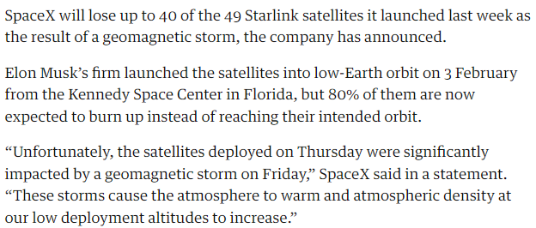
RIP
https://www.theguardian.com/science/2022/feb/09/spacex-to-lose-up-to-40-starlink-satellites-after-geomagnetic-storm

Slide 8
What am I going to (try to) do?
Classification using unsupervised machine learning
Determine physical properties and phenomena
Identify and examine outliers

Slide 9
Unsupervised Learning
Finds relationships in data without training
Doesn’t know what to look for
Will classify the particle distributions without pre-identifying groups

Slide 10
Will it work?

Slide 11
