Slide 1


Andrew Taylor 2/12/2022
Employee Attrition
Link – GitHub Repository
Link – Video Presentation

Slide 2

Data & Strategy
Employee Dataset 870 - Employees
36 - Variables
Modified Dataset
14 - Numerical (Range)
9 - Numerical (Bins)
2 - Numerical (Specific)
8 - Categorical
3 - Redundant
Numerical Bins
Analysis
Unmodified
Exploratory Analysis
For Reference
Modeling
KNN
Naïve Bayes
Linear Regression
Random Forest
Numerical Representation
Removed
Conclusions & Predictions

Slide 3
Employee Salaries

Slide 4
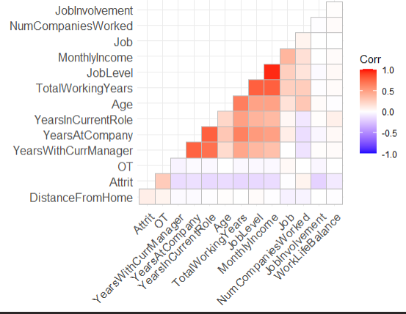
Correlation
Variable Correlation
Monthly Incomes appear to correlate strongest with:
Job Level (categorical)
Job Role (categorical)
Total Years Working (continuous)

Slide 5
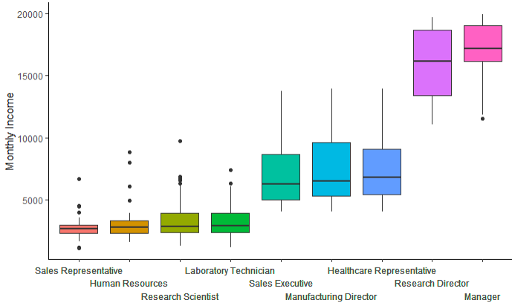
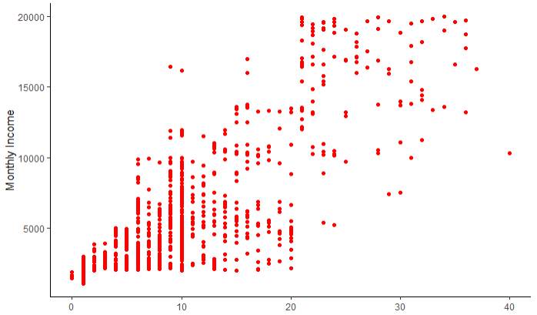
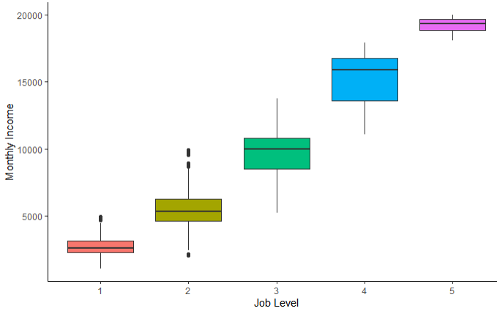
Trends
Job Role
Working Years
Job Level

Slide 6
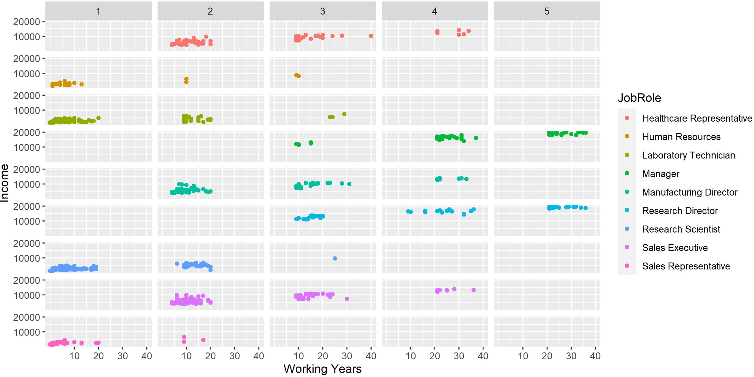
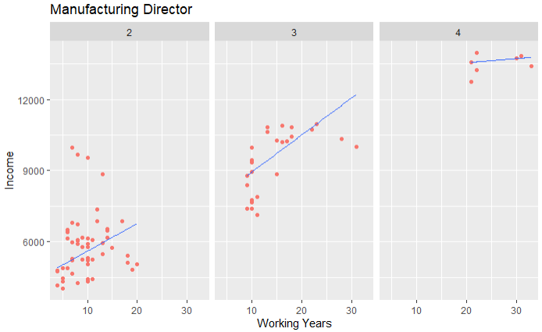
Trends

Slide 7

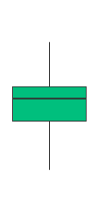
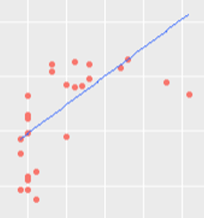
Salary Prediction
Filter by Job Role
Filter by Job Level
Linear Regression Model
Salary Prediction
Manufacturing Director
Job Level 3
Working 20 Years
$10,500

Slide 8
Employee Attrition

Slide 9
Correlation
Variable
Overtime (Yes/No)
Job Involvement (1-4)
Total Working Years (range)
Job Level (1-5)
Years in Current Role (range)
Monthly Income (range)
Correlation
27%
19%
17%
16%
16%
15%

Slide 10
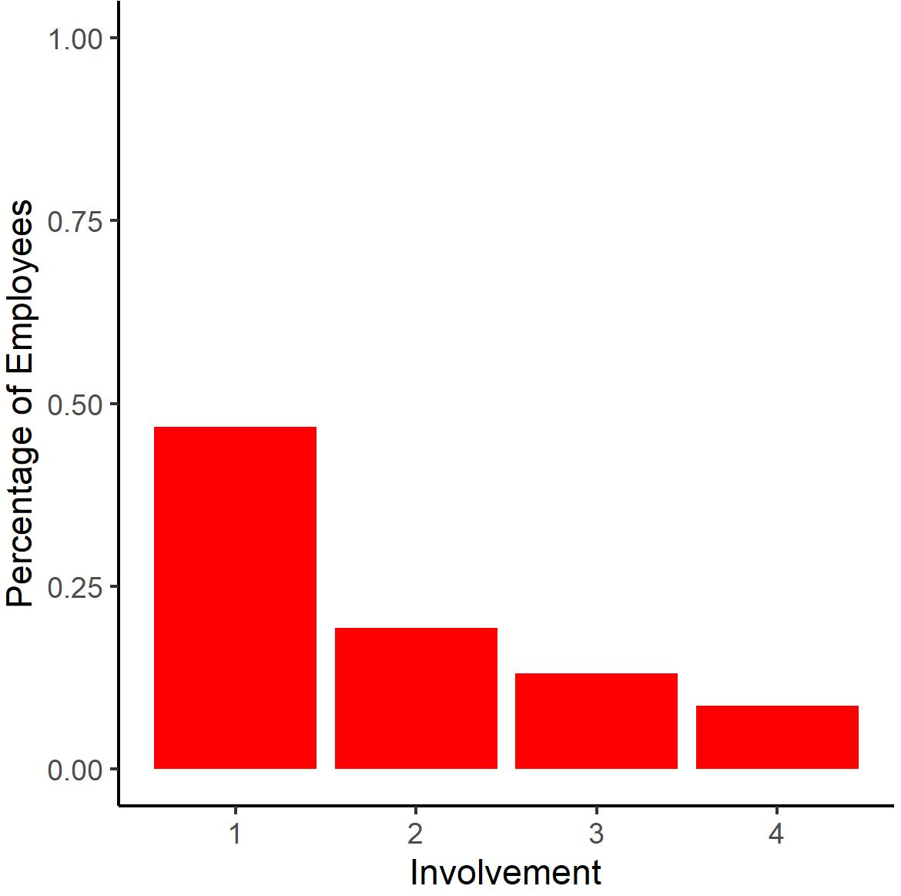
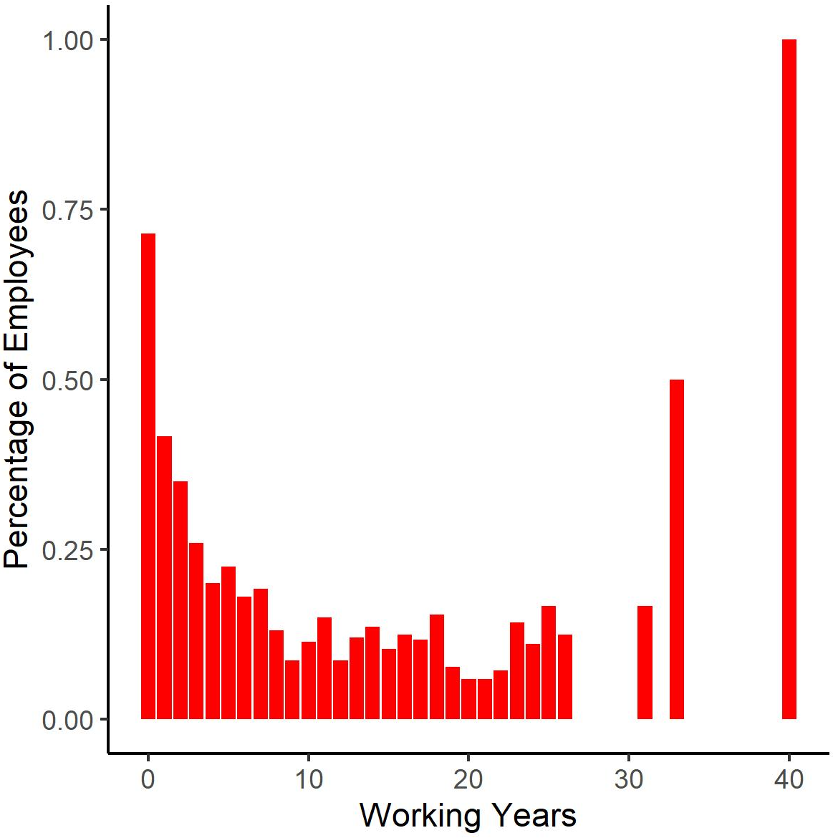
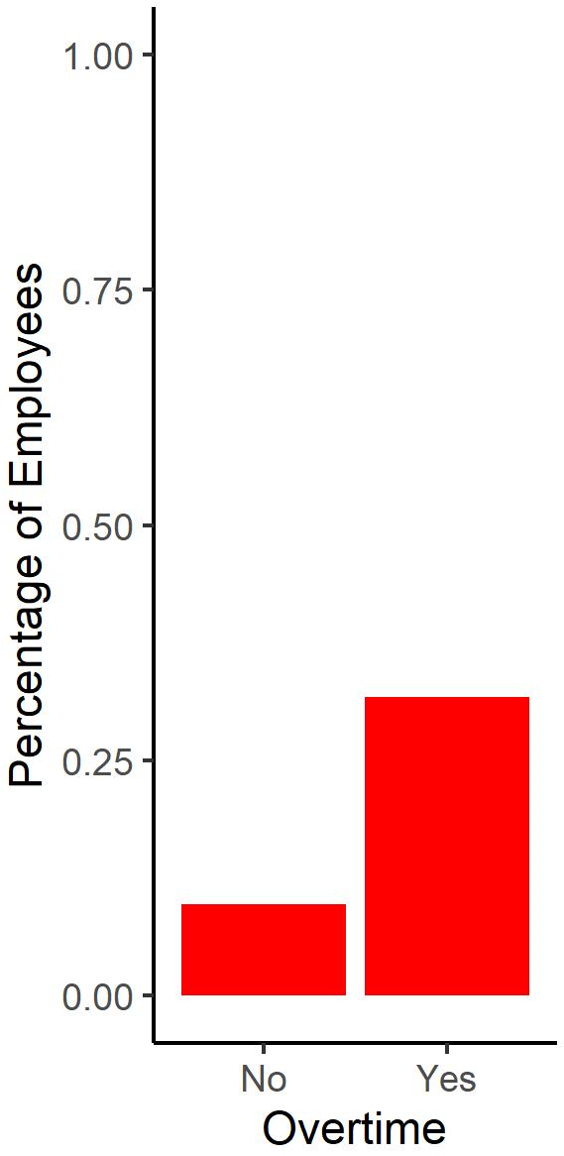
Trends
Overtime
Job Involvement
Working Years
Non-exempt (hourly) employees
Lower Involvement
Lower and higher working years

Slide 11
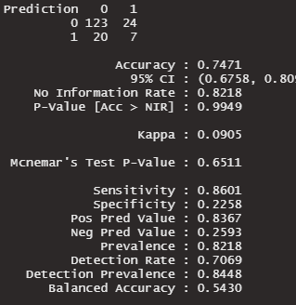
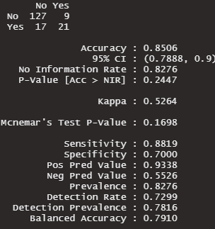
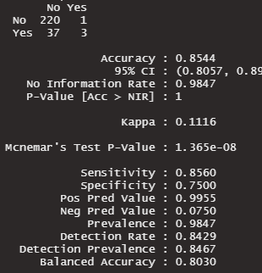
Models
K-NN
Top 3 = 79% (94%, 10%)
Top 3 (scaled) = 81% (93%, 23%)
Top 6 (scaled) = 74% (86%, 23%)
All (scaled) = 76% (87%, 29%)
Naïve Bayes
All = 82% (86%, 58%)
(average of 50 train cycles)
Random Forest
Top 3 = 84% (86%, 54%)
Top 6 = 85% (86%, 58%)
Top 12 = 85% (86%, 70%)

Slide 12
Conclusion
Salary
Can be predicted within $500 using categorical linear regression
Given top 3 contributing variables
Job Role
Job Level
Total Working Years of an Employee
Attrition
Overall attrition rate for employees is 16%
Can be predicted with 85% accuracy using Random Forest model
Sensitivity = 85%
Specificity = 70%
Job Role
Attrition rates by position:
45% - Sales Representative
22% - Human Resources
20% - Laboratory Technician
19% - Research Scientist
17% - Sales Executive
11% - Healthcare Representative
8% - Manager
2% - Manufacturing Director
2% - Research Director

Slide 13
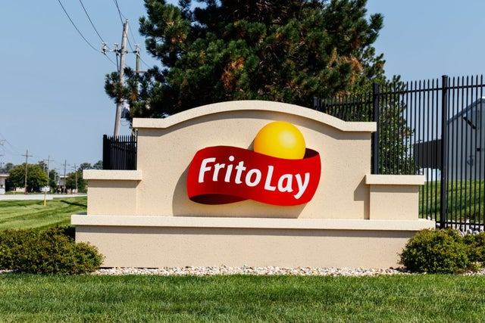
Thank You

