Slide 1
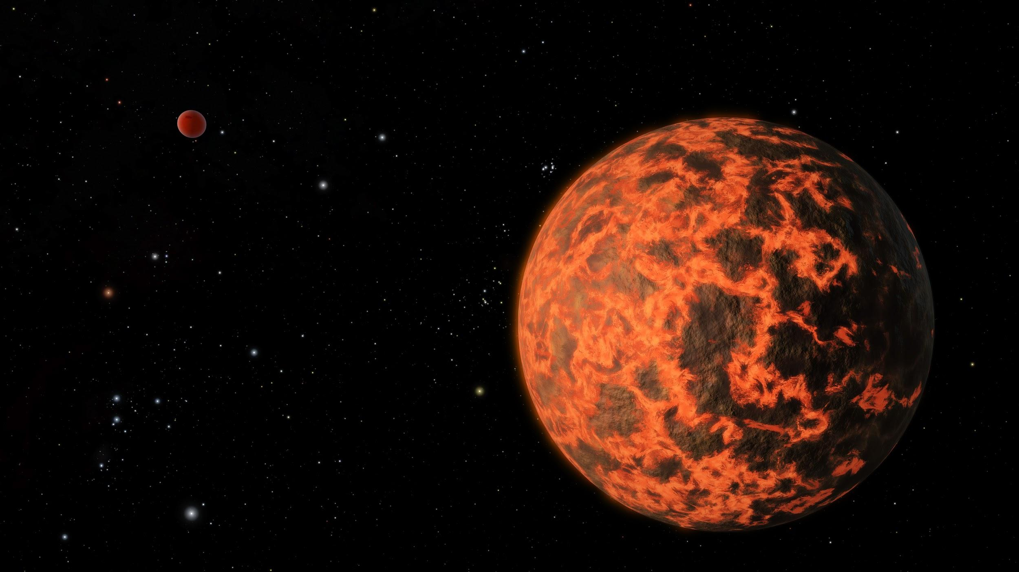
Limb-Darkening of WASP-55
Edgar Escalante, Kezman Saboi, Tiancheng Gong.
Our code is available at: https://github.com/ASU-CompMethodsPhysics-PHY494/final-2017-wasp_analyzer/tree/master/Work

Slide 2
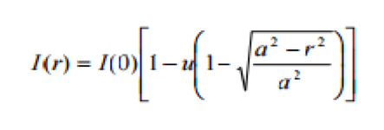
Background
Limb-darkening is a phenomenon observed from a star in which it’s brightness reduces radially with increasing distance from its center. This implies that the star’s limb (edge) tends to appear relatively dark.
This project primarily focuses on studying limb-darkening of WASP-55 through observations of light curves generated as WASP-55 b transits across it’s surface.
Below is the most vital equation to simulate, study and analyze for the limb-darkening of WASP-55 and the light curves associated.

Slide 3
Methods
The Python algorithm used in the project is largely based on boolean matrices and masking.
Vital parameters used are:
The radius of WASP-55, and that of WASP-55 b.
Limb-darkening coefficient of WASP-55
And surface brightness variation
Transit path of WASP-55 b over WASP-55

Slide 4
Methods
Tasks completed include:
Building a star to show its brightness using the limb darkening equation.
Build a planet and mask it over the star.
Taking the sum of total matrix excluding all values where planet overlays the star.

Slide 5
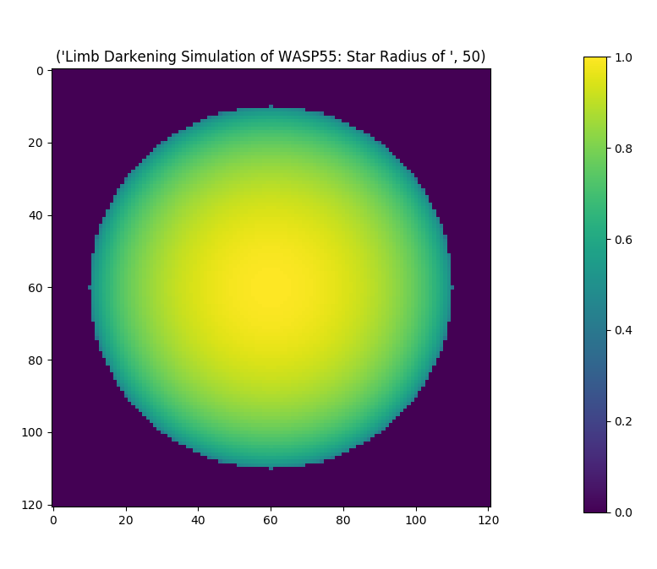
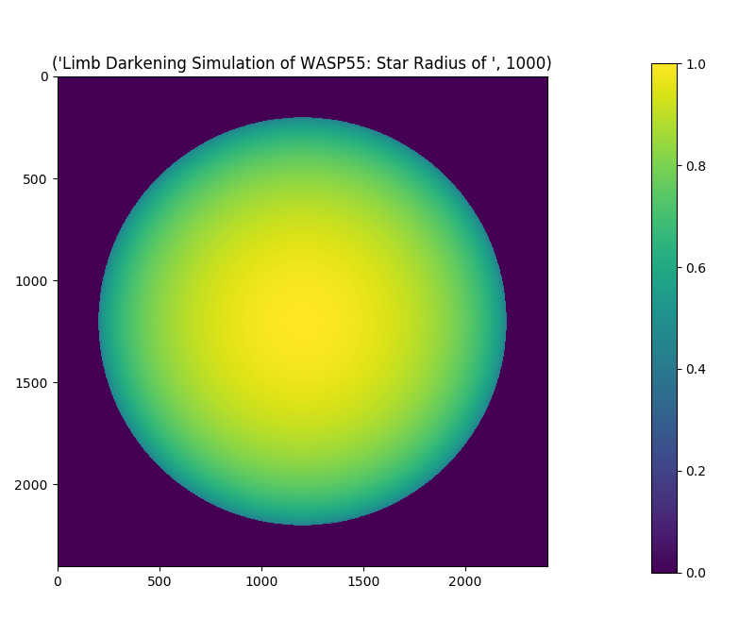
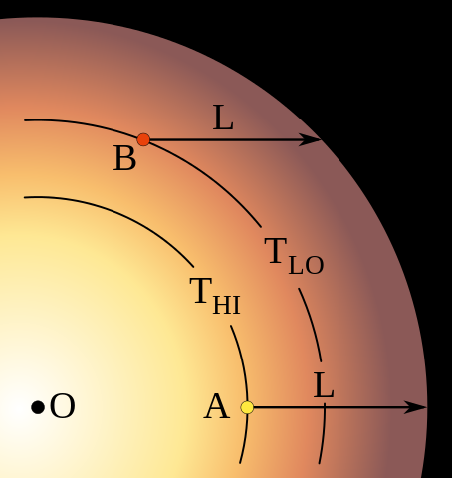
Results of Star Simulation

Slide 6
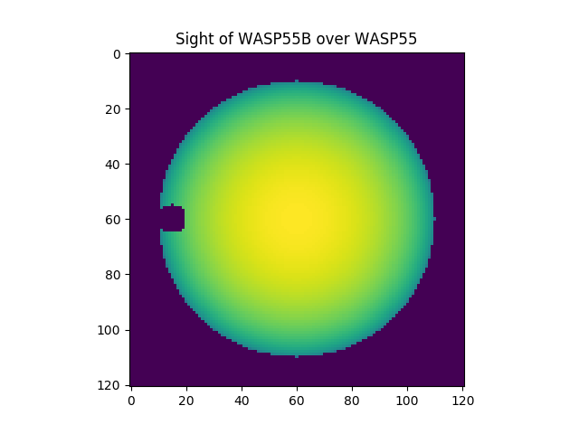
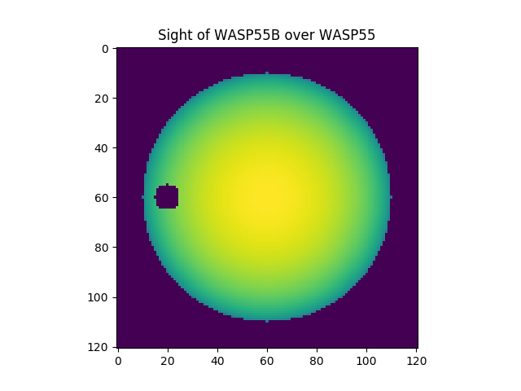
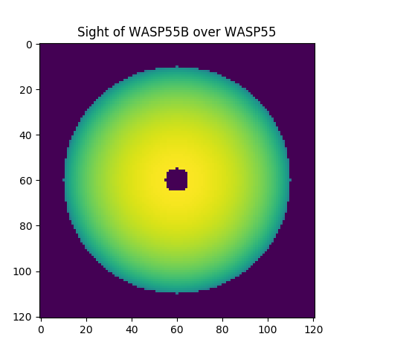
More Results
Transition of WASP-55 b across WASP-55 at center.

Slide 7
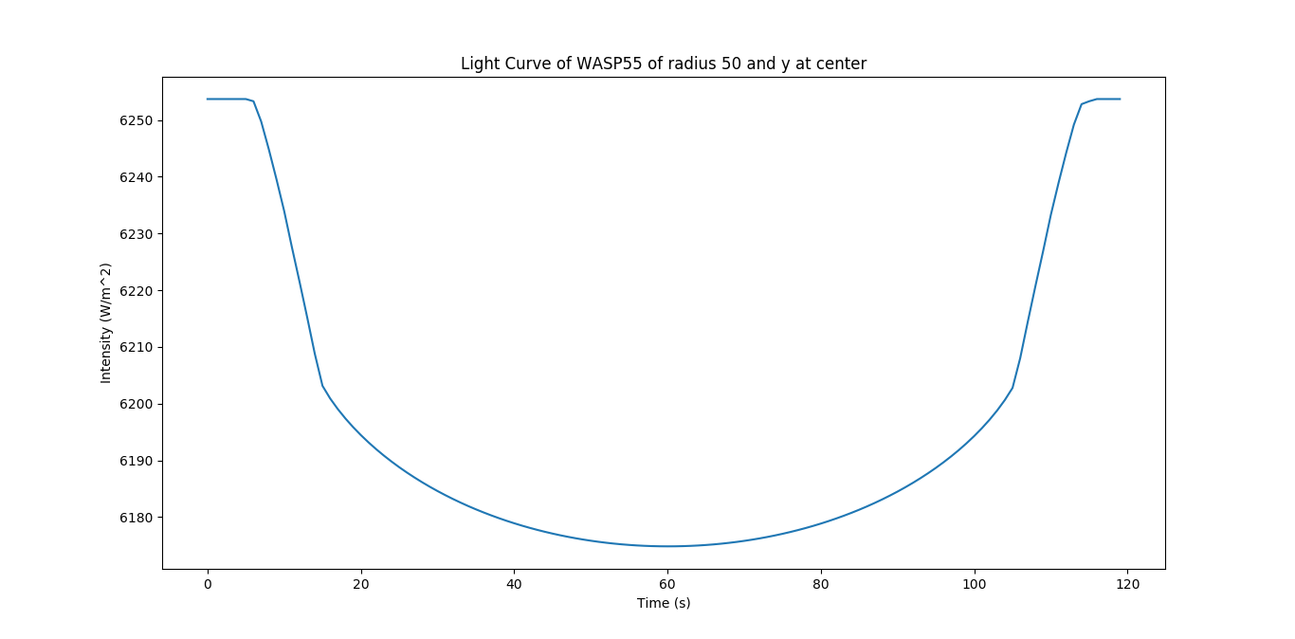
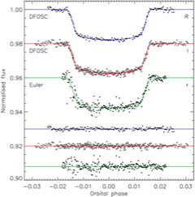
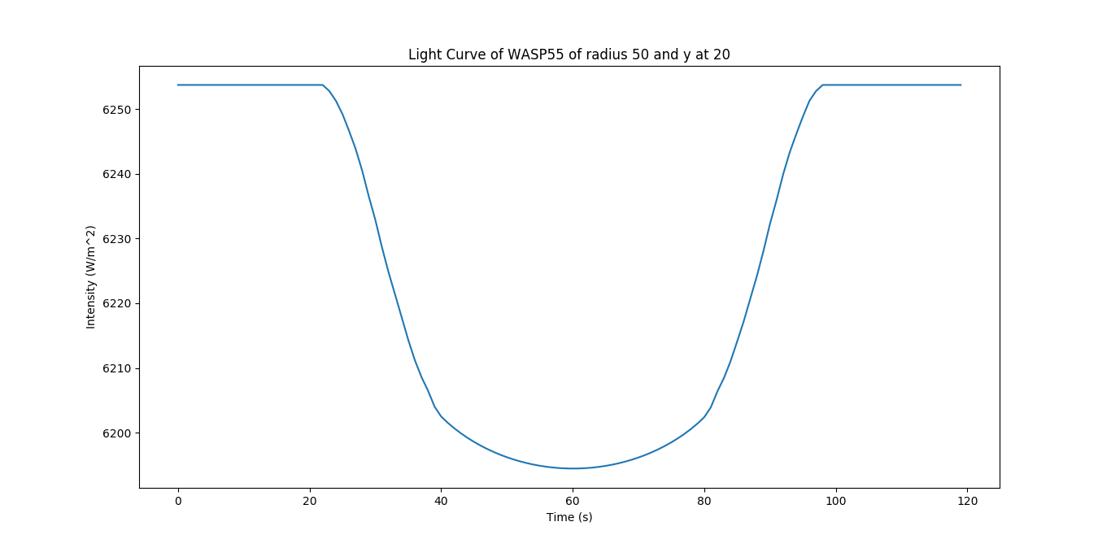
Form of expected Light Curve
Source: https://academic-oup-com.ezproxy1.lib.asu.edu/mnras/article-lookup/doi/10.1093/mnras/stw279

Slide 8
Summary
Accomplishments from the project:
Development of algorithm that efficiently calculates the limb-darkening effect and light curves associated
Light curves simulated are in line with those from previous research done by other research group.
Algorithm which will position a planet over a matrix and move it.

Slide 9
References
The Exoplanet Transit Method. Retrieved from https://www.paulanthonywilson.com/exoplanets/exoplanet-detection-techniques/the-exoplanet-transit-method/
Planet WASP-55 b. Retrieved from http://exoplanet.eu/catalog/wasp-55_b/ AND https://exoplanets.findthedata.com/l/752/WASP-55-b
Sing.D.K. (2009). Stellar limb-darkening coefficients for CoRot and Kepler (Research Note). Retrieved from http://www.aanda.org/articles/aa/pdf/2010/02/aa13675-09.pdf
Retrieved from http://stackoverflow.com/questions/16492830/colorplot-of-2d-array-matplotlib

