Slide 1
Limb-Darkening of WASP-55 ​
Edgar Escalante
Kezman Saboi
Tiancheng Gong

Slide 2

Background
Limb-darkening refers to a phenomenon that is observed about a star that indicates that the star’s brightness reduces radially with increasing distance from its center. This implies that the star’s limb (edge) tends to appear relatively dark.
This project primarily focuses on studying limb-darkening of WASP-55 through observations of light curves generated as WASP-55 b transits across it’s surface. From data obtained, the surface brightness of WASP-55 with respect the it radius will be analyzed.

Slide 3
method
Build a star to show its brightness with limb darkening equation.
Build a matrix of brightness.
Take the sum of matrix in a small circle area.

Slide 4
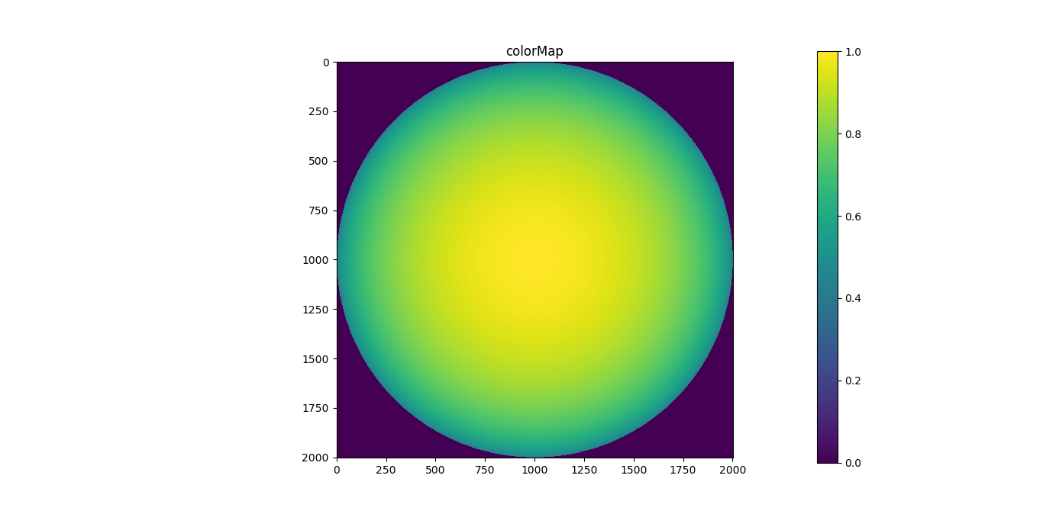
result
Brightness of the star

Slide 5
Ref

