Slide 1
Housing Structural Heat Analysis
Authors:
Marko Gonzales, Zhichao Ma, Milan Patel
Code Repository URL:
https://github.com/ASU-CompMethodsPhysics-PHY494/final-2018-494_heat_wizards

Slide 2
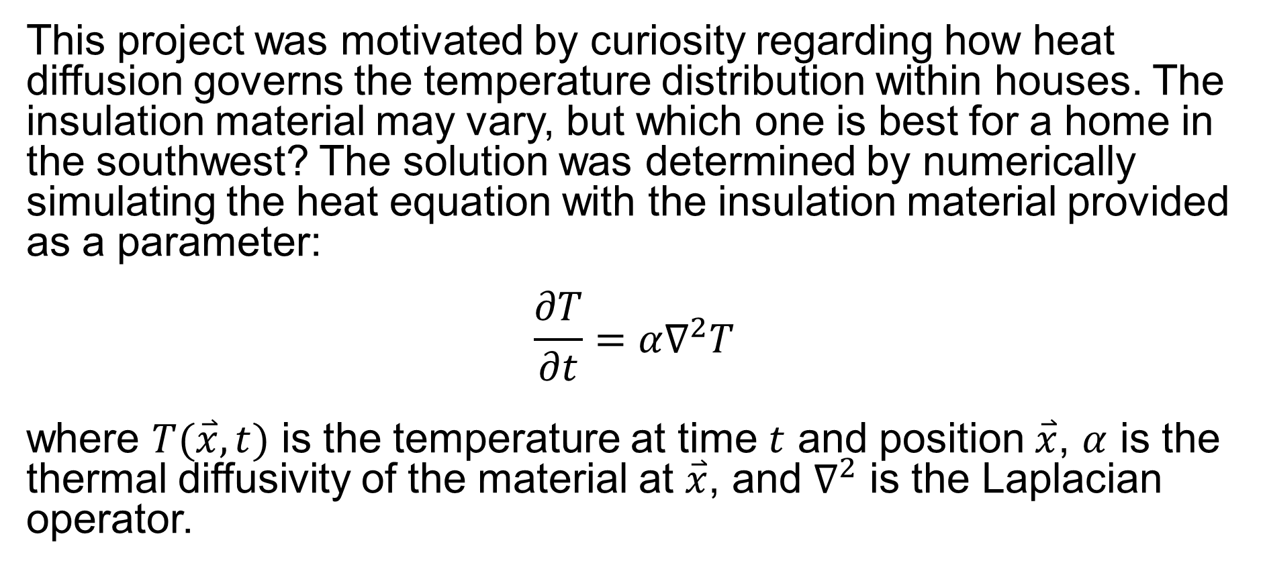
Background
This project was motivated by curiosity regarding how heat diffusion governs the temperature distribution within houses. The insulation material may vary, but which one is best for a home in the southwest? The solution was determined by numerically simulating the heat equation with the insulation material provided as a parameter:
$$\frac{∂T}{∂t}=α∇^{2}T$$
where $T(\overset{⃑}{x},t)$ is the temperature at time $t$ and position $\overset{⃑}{x}$, $α$ is the thermal diffusivity of the material at $\overset{⃑}{x}$, and $∇^{2}$ is the Laplacian operator.

Slide 3
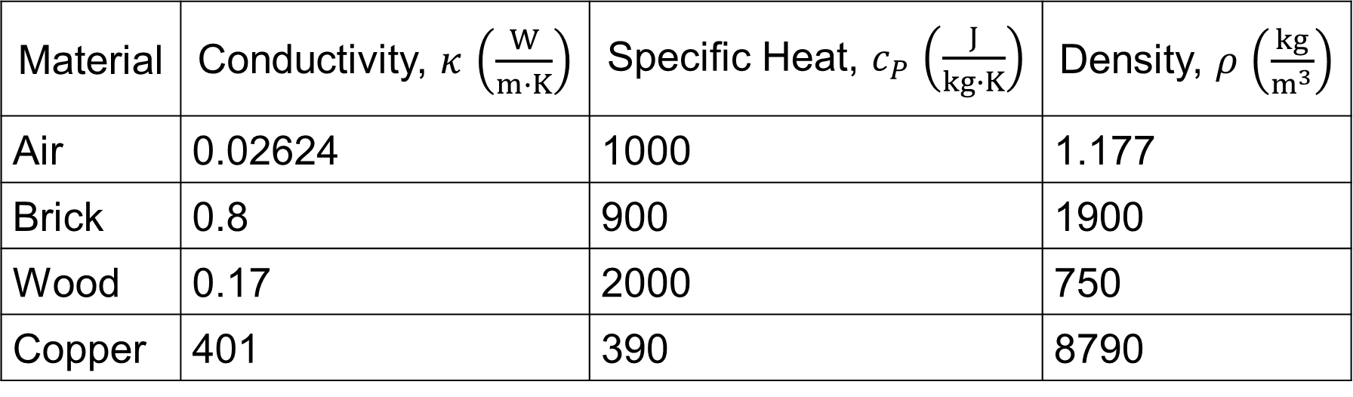

Methodology
Upon investigation, insulation materials vary far and wide, with subcategories in rare cases. Thus, only four materials are considered in order to truncate the problem.
Note: $α=κ/c_{P}ρ$
Material | Conductivity, $κ$ $\left(\frac{W}{m∙K}\right)$ | Specific Heat, $c_{P}$ $\left(\frac{J}{kg∙K}\right)$ | Density, $ρ$ $\left(\frac{kg}{m^{3}}\right)$
Air | 0.02624 | 1000 | 1.177
Brick | 0.8 | 900 | 1900
Wood | 0.17 | 2000 | 750
Copper | 401 | 390 | 8790

Slide 4
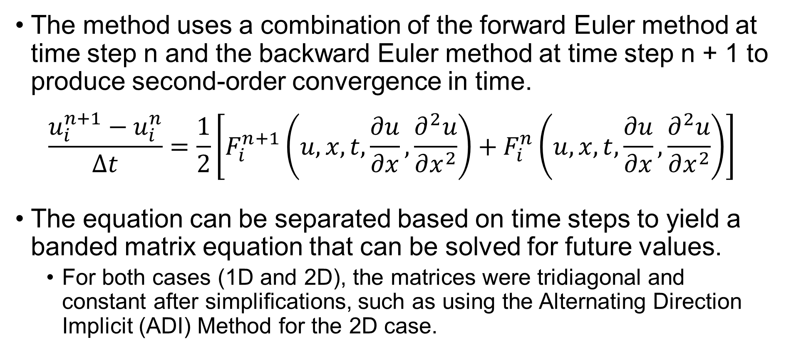
Crank-Nicolson Algorithm
The method uses a combination of the forward Euler method at time step n and the backward Euler method at time step n + 1 to produce second-order convergence in time.
$$\frac{u_{i}^{n+1}−u_{i}^{n}}{Δt}=\frac{1}{2}\left[F_{i}^{n+1}\left(u,x,t,\frac{∂u}{∂x},\frac{∂^{2}u}{∂x^{2}}\right)+F_{i}^{n}\left(u,x,t,\frac{∂u}{∂x},\frac{∂^{2}u}{∂x^{2}}\right)\right]$$
The equation can be separated based on time steps to yield a banded matrix equation that can be solved for future values.
For both cases (1D and 2D), the matrices were tridiagonal and constant after simplifications, such as using the Alternating Direction Implicit (ADI) Method for the 2D case.

Slide 5
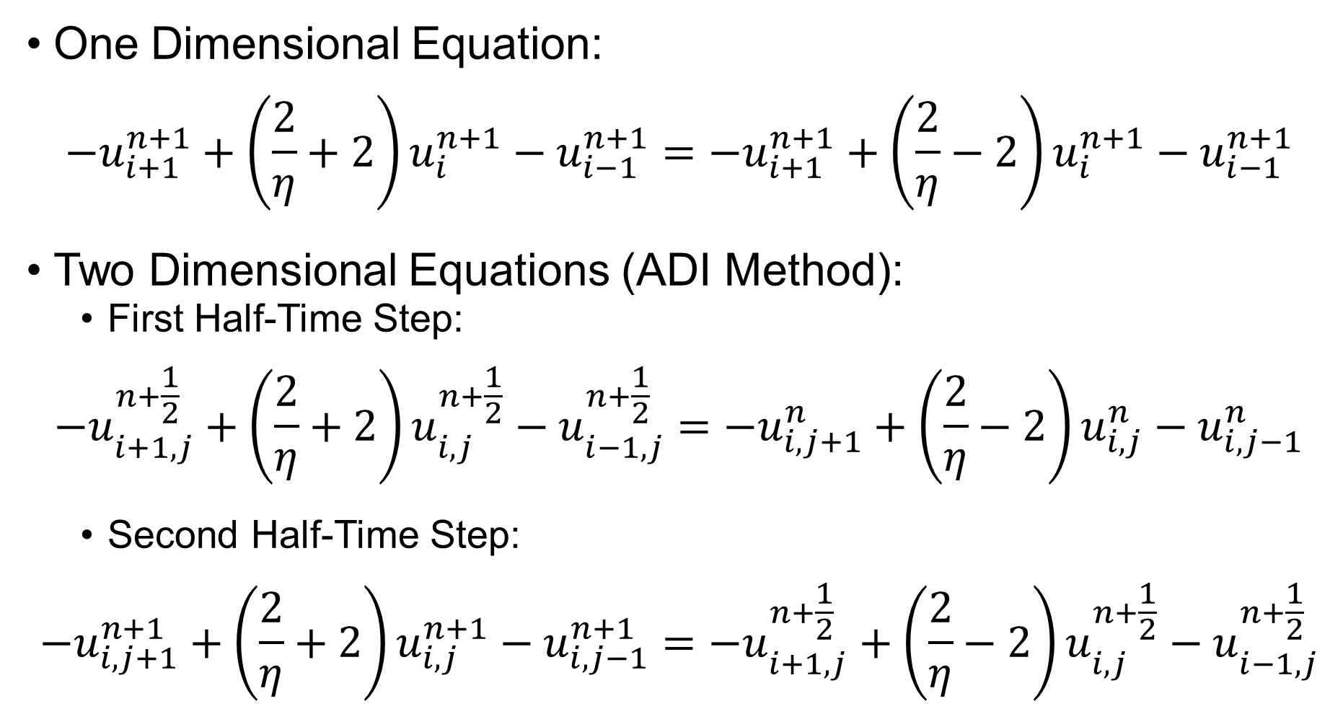
One Dimensional Equation:
$$−u_{i+1}^{n+1}+\left(\frac{2}{η}+2\right)u_{i}^{n+1}−u_{i−1}^{n+1}=−u_{i+1}^{n+1}+\left(\frac{2}{η}−2\right)u_{i}^{n+1}−u_{i−1}^{n+1}$$
Two Dimensional Equations (ADI Method):
First Half-Time Step:
$$−u_{i+1,j}^{n+\frac{1}{2}}+\left(\frac{2}{η}+2\right)u_{i,j}^{n+\frac{1}{2}}−u_{i−1,j}^{n+\frac{1}{2}}=−u_{i,j+1}^{n}+\left(\frac{2}{η}−2\right)u_{i,j}^{n}−u_{i,j−1}^{n}$$
Second Half-Time Step:
$$−u_{i,j+1}^{n+1}+\left(\frac{2}{η}+2\right)u_{i,j}^{n+1}−u_{i,j−1}^{n+1}=−u_{i+1,j}^{n+\frac{1}{2}}+\left(\frac{2}{η}−2\right)u_{i,j}^{n+\frac{1}{2}}−u_{i−1,j}^{n+\frac{1}{2}}$$

Slide 6
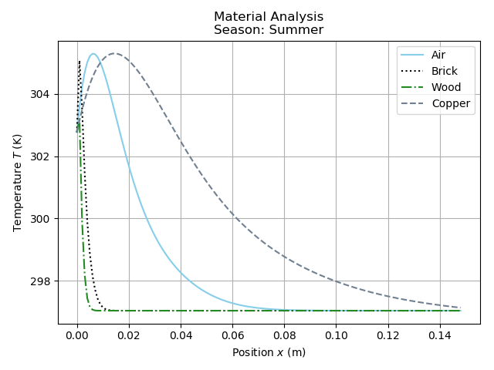
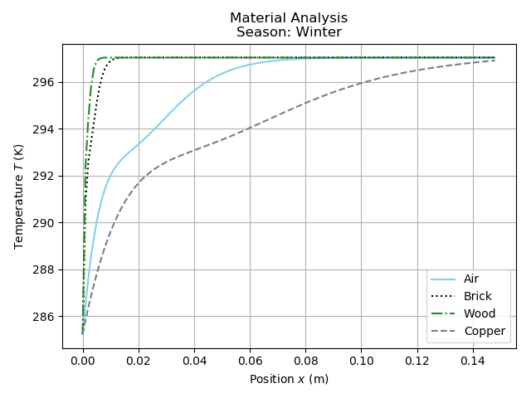
Results
Temperature distribution within a standard walls for all materials during a typical summer (left) and winter (right) after a 2-day period.

Slide 7
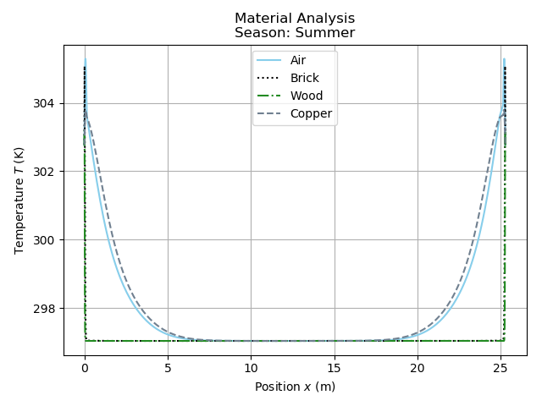
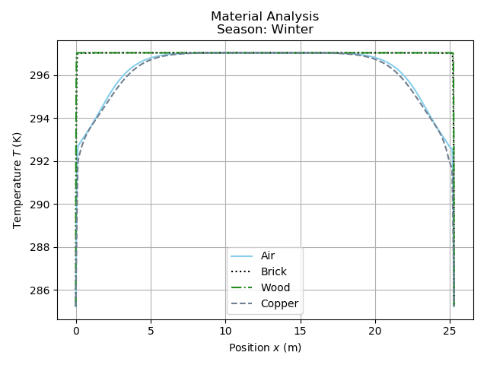
Temperature distribution within a standard house (both walls included) for all materials during a typical summer (left) and winter (right) after a 2-day period.

Slide 8
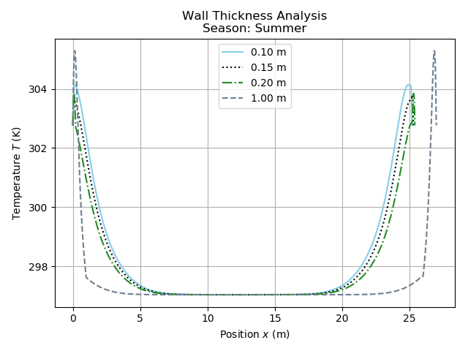
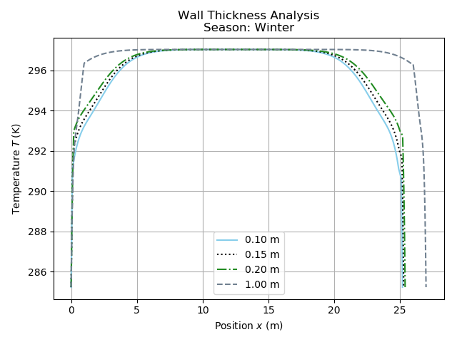
Temperature distribution within a house (both walls included) for copper and various wall thicknesses during a typical summer (left) and winter (right) after a 2-day period.

Slide 9
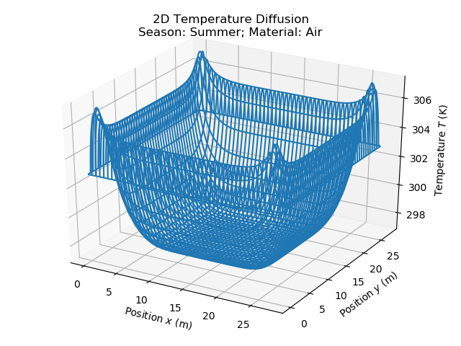
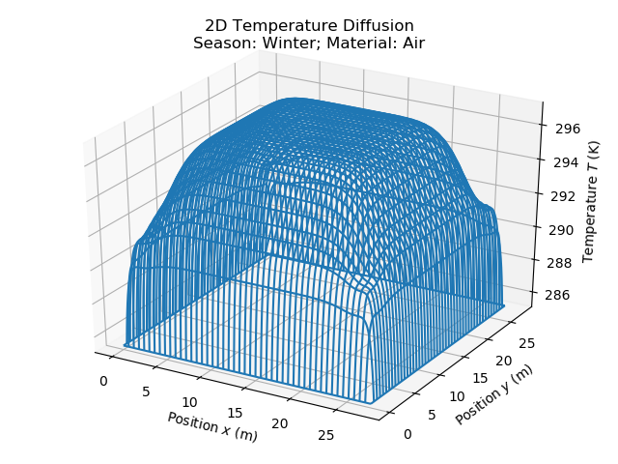
Temperature distribution within a standard house (all four walls included) for air during a typical summer (left) and winter (right) after a 2-day period.

Slide 10
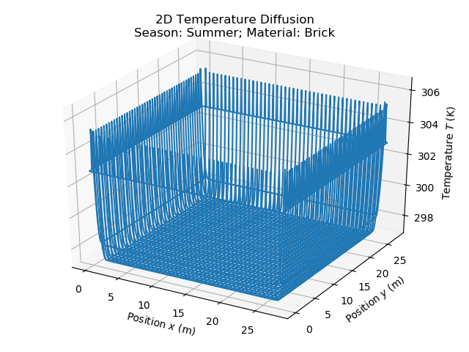
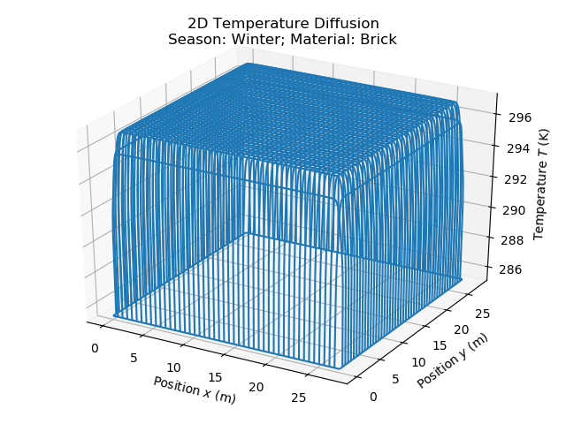
Temperature distribution within a standard house (all four walls included) for brick during a typical summer (left) and winter (right) after a 2-day period.

Slide 11
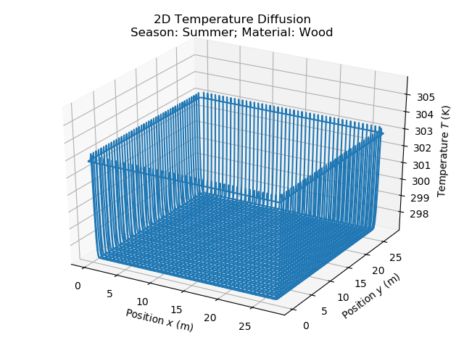
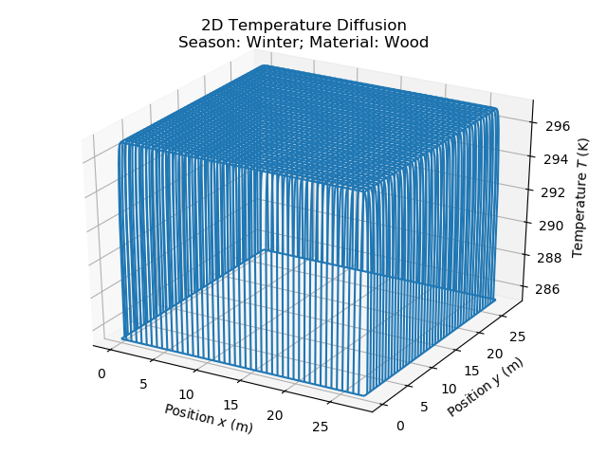
Temperature distribution within a standard house (all four walls included) for wood during a typical summer (left) and winter (right) after a 2-day period.

Slide 12
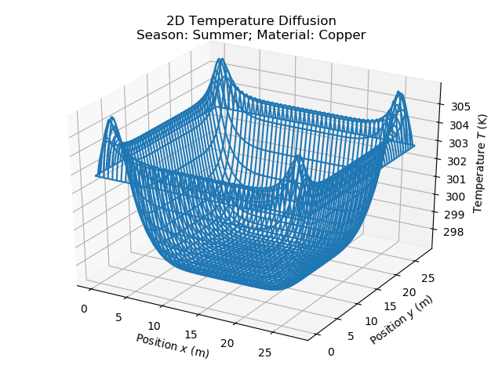
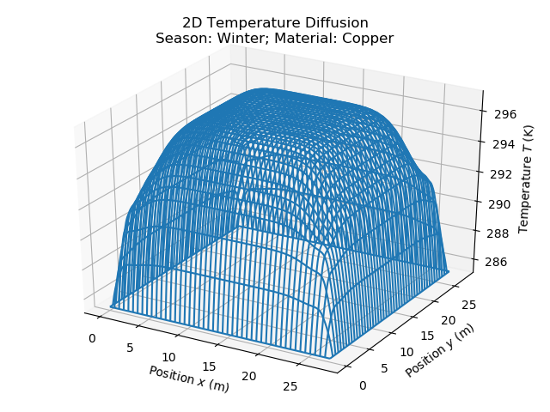
Temperature distribution within a standard house (all four walls included) for copper during a typical summer (left) and winter (right) after a 2-day period.

Slide 13
Summary and Future Work
By solving the heat equation in 1D and 2D, the resulting plots show that wood is the best simulated insulator while copper is the worst. Furthermore, though more difficult to quantify, the wall thickness has a direct role to play in mitigating external effects on the interior temperature of the house.
If you are planning to build a house, the results imply that the best solution is to insulate the house with material with a low thermal diffusivity (low thermal conductivity, high specific heat, and/or high density) or construct thick walls.
Future work will involve improving the realism of the simulation by accounting for structural outlets such as windows and doors as well as extending the simulation into 3D and including the roof.

Slide 14
References/Acknowledgements
Data Sources:
https://www.engineeringtoolbox.com
https://www.currentresults.com/Weather/Arizona/Places/phoenix-temperatures-by-month-average.php
Algorithm Information:
https://en.wikipedia.org/wiki/Crank%E2%80%93Nicolson_method
https://en.wikipedia.org/wiki/Alternating_direction_implicit_method

