Slide 1
Housing Structural Heat Analysis
Authors:
Marko Gonzales, Zhichao Ma, Milan Patel
Code Repository URL:
https://github.com/ASU-CompMethodsPhysics-PHY494/final-2018-494_heat_wizards

Slide 2
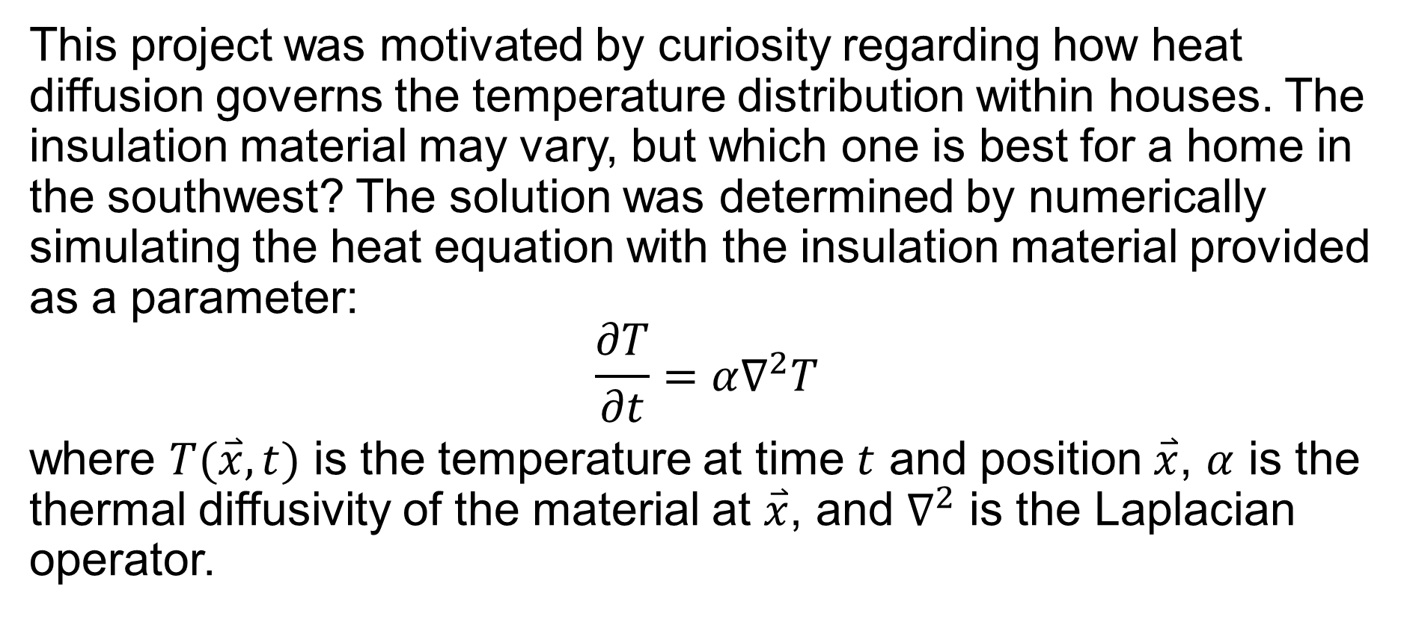
Background
This project was motivated by curiosity regarding how heat diffusion governs the temperature distribution within houses. The insulation material may vary, but which one is best for a home in the southwest? The solution was determined by numerically simulating the heat equation with the insulation material provided as a parameter:
$$\frac{∂T}{∂t}=α∇^{2}T$$
where $T(\overset{⃑}{x},t)$ is the temperature at time $t$ and position $\overset{⃑}{x}$, $α$ is the thermal diffusivity of the material at $\overset{⃑}{x}$, and $∇^{2}$ is the Laplacian operator.

Slide 3
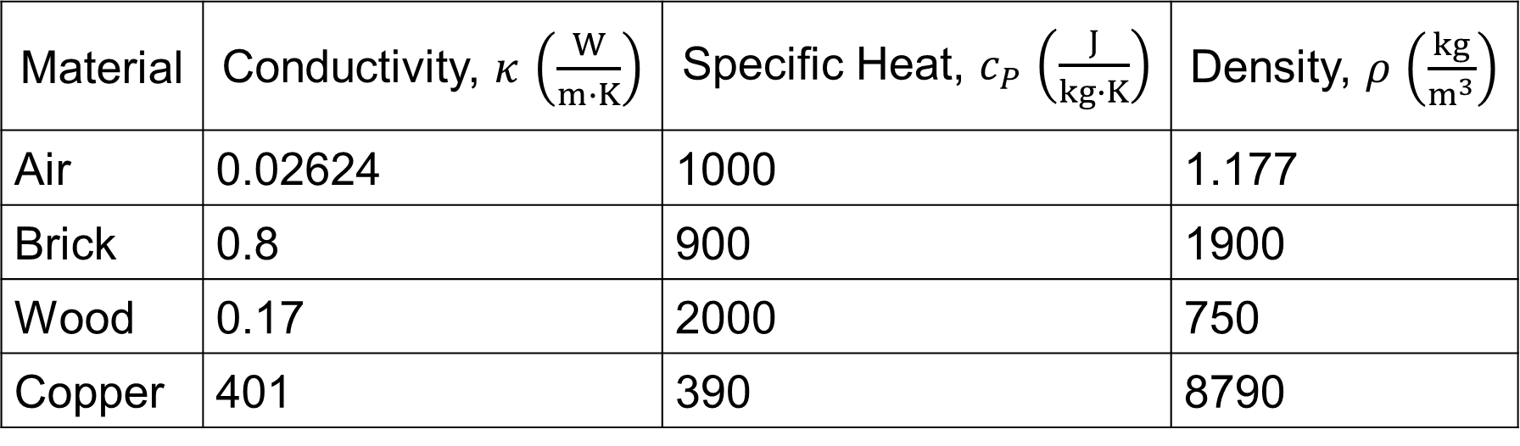

Methodology
Upon investigation, insulation materials vary far and wide, with subcategories in rare cases. Thus, only four materials are considered in order to truncate the problem.
Note: $α=κ/c_{P}ρ$
Material | Conductivity, $κ$ $\left(\frac{W}{m∙K}\right)$ | Specific Heat, $c_{P}$ $\left(\frac{J}{kg∙K}\right)$ | Density, $ρ$ $\left(\frac{kg}{m^{3}}\right)$
Air | 0.02624 | 1000 | 1.177
Brick | 0.8 | 900 | 1900
Wood | 0.17 | 2000 | 750
Copper | 401 | 390 | 8790

Slide 4
Crank-Nicolson Algorithm

Slide 5
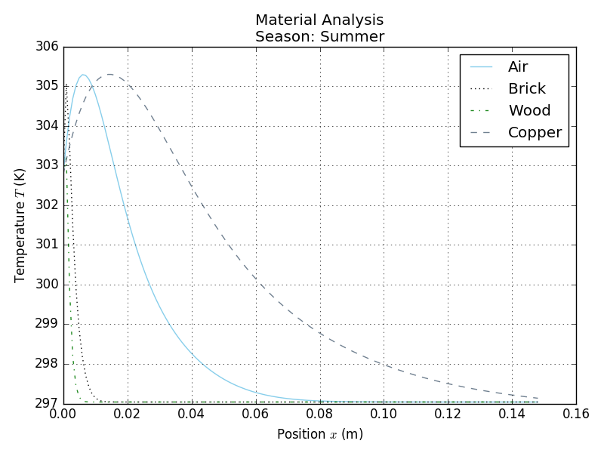
Results
Temperature distribution inside of walls

Slide 6
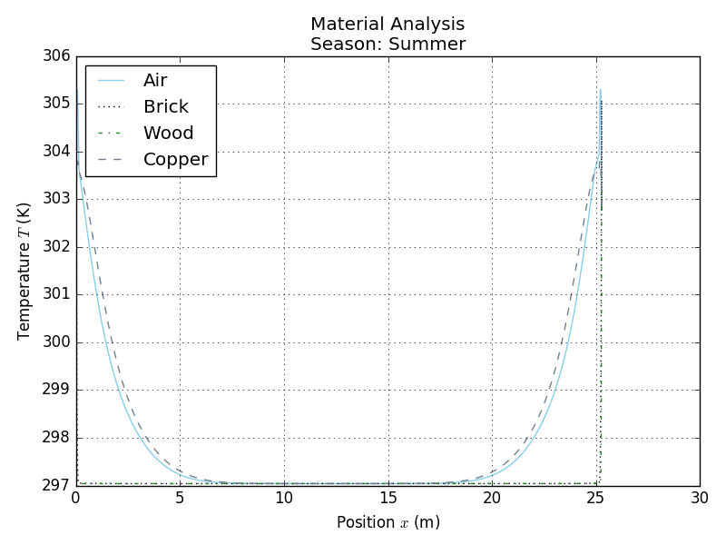
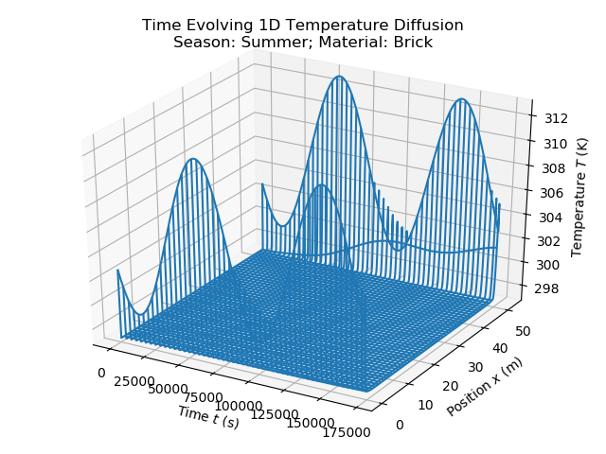
Temperature distribution inside home

Slide 7
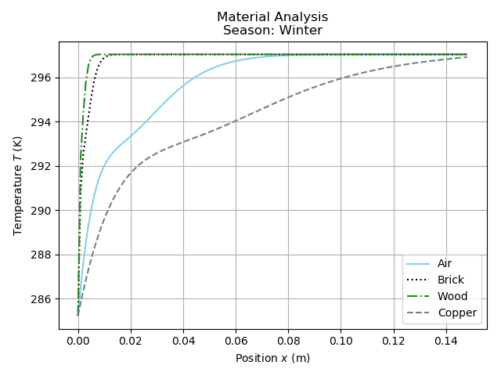
Temperature distribution inside walls

Slide 8
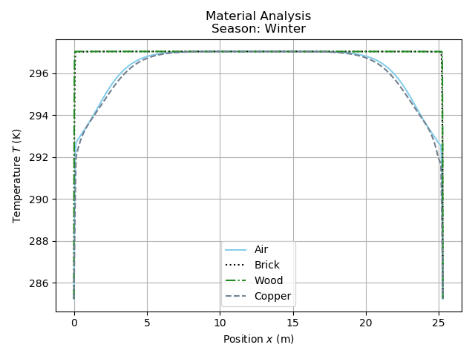
Temperature distribution inside home

Slide 9
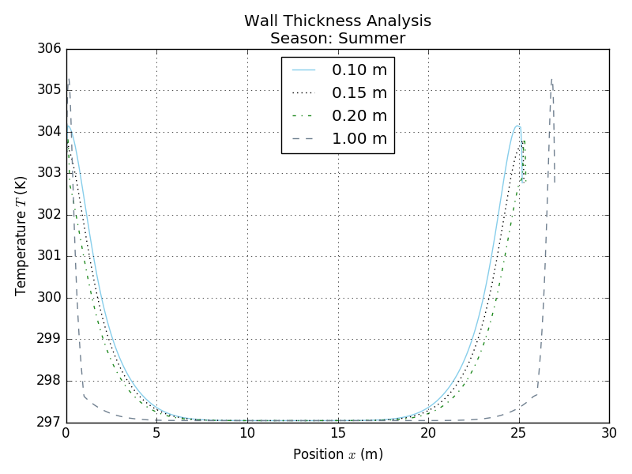
Temperature distribution

Slide 10
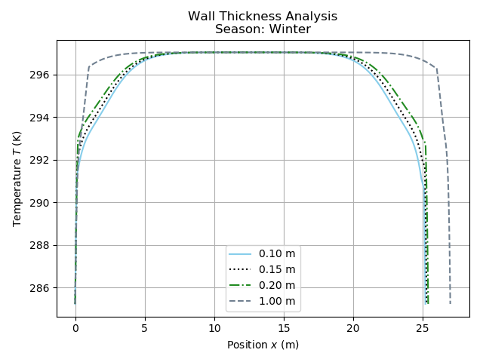
Temperature distribution

Slide 11
Summery
From solving the Heat equation numerically we can see from the plots of the temperature distributions that wood is the best insulator and copper is the worst, from the chosen materials. Also, it can be seen that the temperature gradient is the highest at the outside boundary, which is expected, this also means the flow of thermal energy is the highest at this point. This is also where all the thermal energy is gained or lost depending on the sign of the temperate difference. This is where an air conditioning unit comes into play to restore the inside temperature to some set amount desired by the occupants.

Slide 12
references
url: https://www.engineeringtoolbox.com

