Slide 1
Housing Structural Heat Analysis
Authors:
Marko Gonzales, Zhichao Ma, Milan Patel
Code Repository URL:
https://github.com/ASU-CompMethodsPhysics-PHY494/final-2018-494_heat_wizards

Slide 2
Background
This project was motivated by curiosity regarding how heat diffusion governs the temperature distribution within houses.

Slide 3
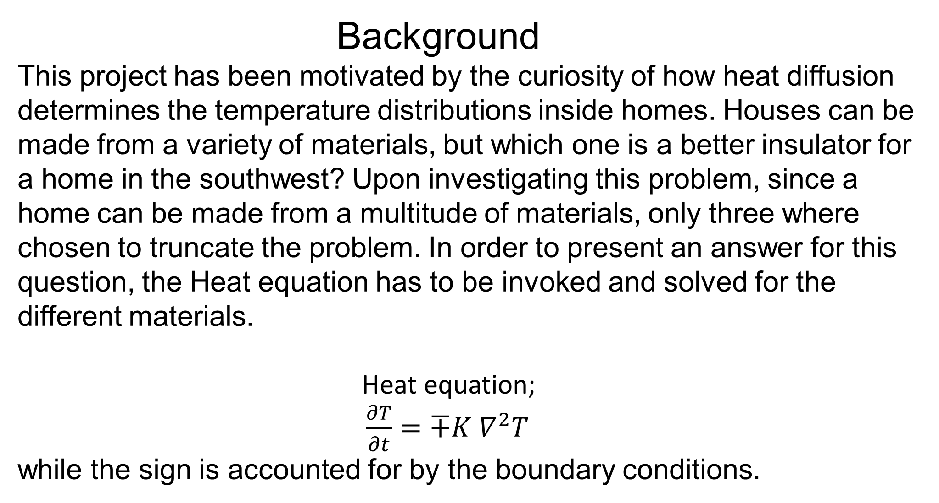
Background
This project has been motivated by the curiosity of how heat diffusion determines the temperature distributions inside homes. Houses can be made from a variety of materials, but which one is a better insulator for a home in the southwest? Upon investigating this problem, since a home can be made from a multitude of materials, only three where chosen to truncate the problem. In order to present an answer for this question, the Heat equation has to be invoked and solved for the different materials.
Heat equation;
$\frac{∂T}{∂t}=∓K ∇^{2}T$ while the sign is accounted for by the boundary conditions.

Slide 4
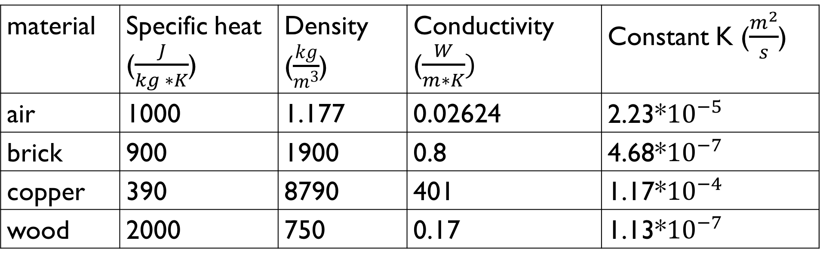
Methods How to solve Heat equation
Crank-Nicolson algorithm was used to solve the Heat equation with the boundary conditions set based on common temperatures in Arizona
parameters
material | Specific heat ($\frac{J}{kg ∗K}$) | Density ($\frac{kg}{m^{3}}$) | Conductivity ($\frac{W}{m∗K})$ | Constant K ($\frac{m^{2}}{s}$)
air | 1000 | 1.177 | 0.02624 | 2.23*${10}^{−5}$
brick | 900 | 1900 | 0.8 | 4.68*${10}^{−7}$
copper | 390 | 8790 | 401 | 1.17*${10}^{−4}$
wood | 2000 | 750 | 0.17 | 1.13*${10}^{−7}$

Slide 5
Libraries used
Numpy
matplotlib.pyplot
mpl_toolkits.mplot3d

Slide 6
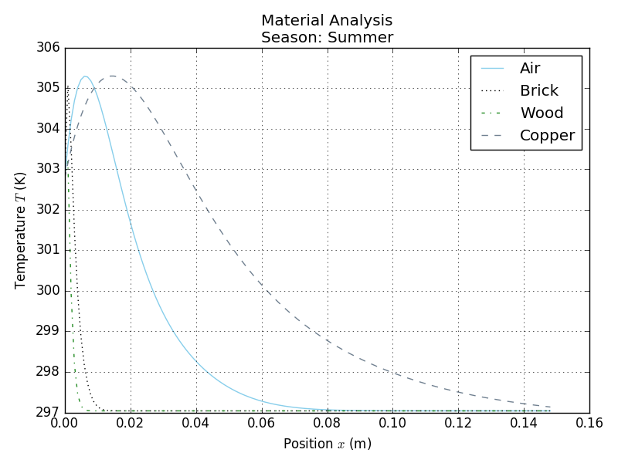
Results
Temperature distribution inside of walls

Slide 7
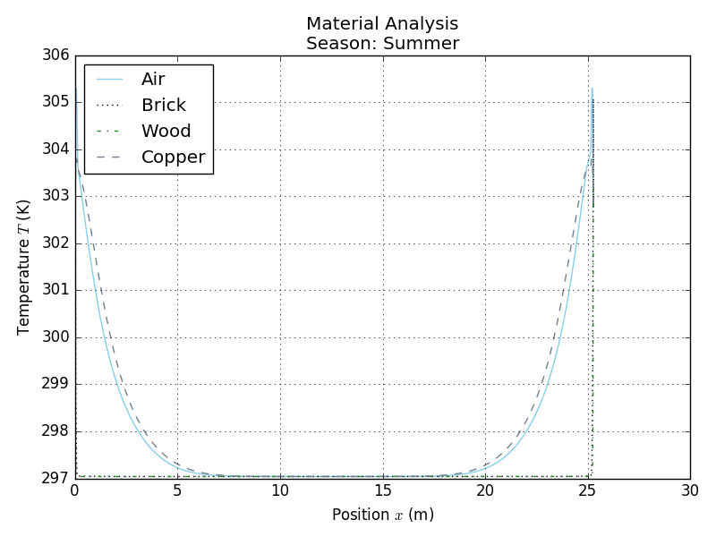
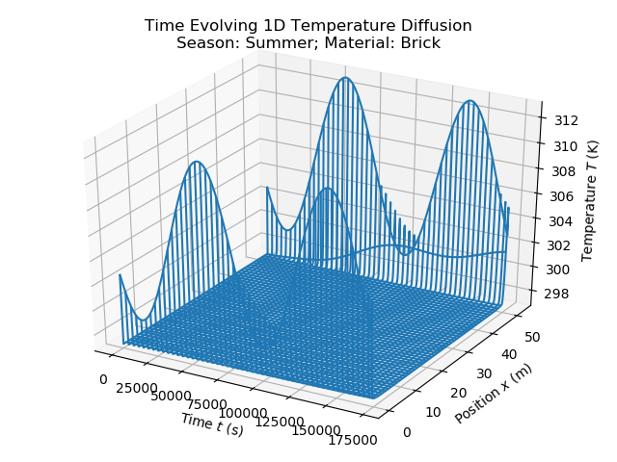
Temperature distribution inside home

Slide 8
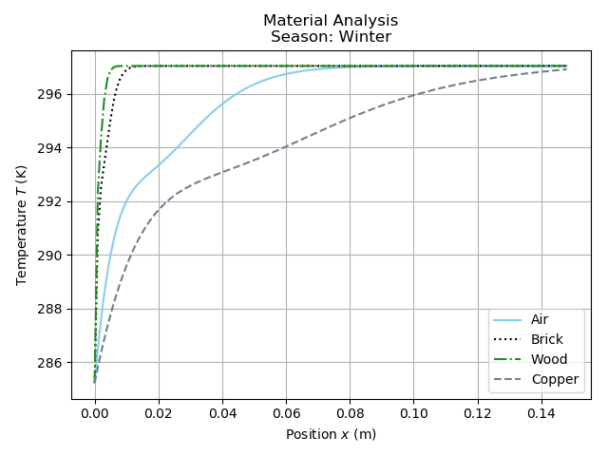
Temperature distribution inside walls

Slide 9
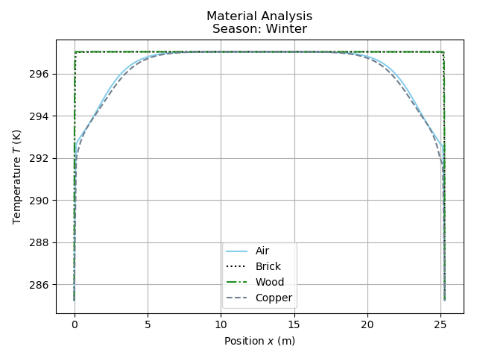
Temperature distribution inside home

Slide 10
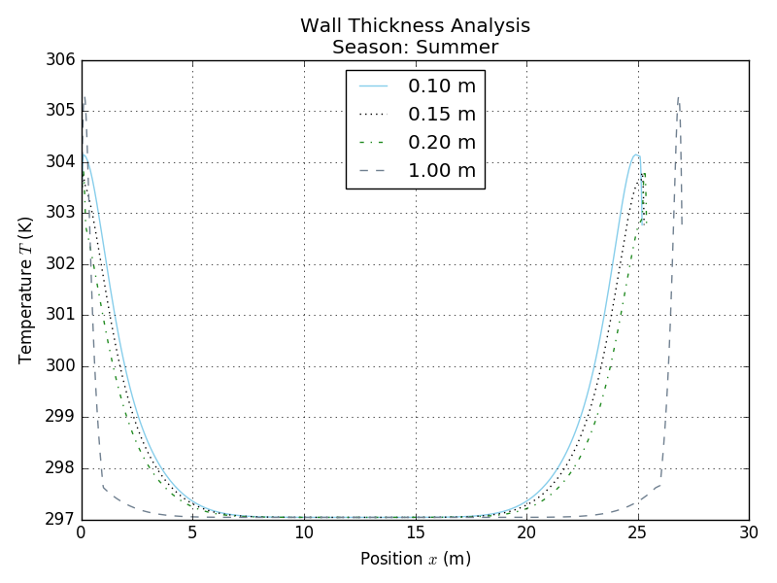
Temperature distribution

Slide 11
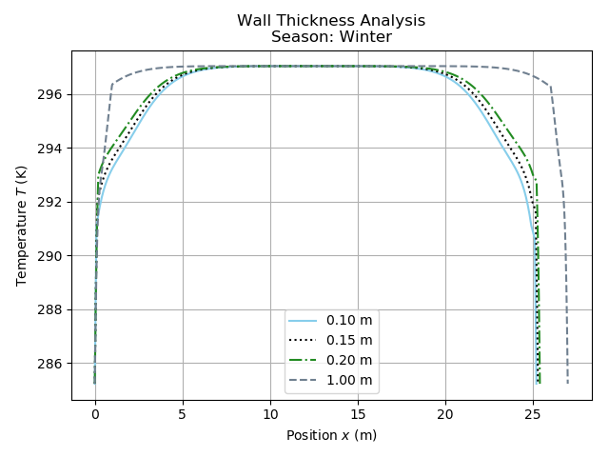
Temperature distribution

Slide 12
Summery
From solving the Heat equation numerically we can see from the plots of the temperature distributions that wood is the best insulator and copper is the worst, from the chosen materials. Also, it can be seen that the temperature gradient is the highest at the outside boundary, which is expected, this also means the flow of thermal energy is the highest at this point. This is also where all the thermal energy is gained or lost depending on the sign of the temperate difference. This is where an air conditioning unit comes into play to restore the inside temperature to some set amount desired by the occupants.

Slide 13
references
url: https://www.engineeringtoolbox.com

