Slide 1
Heat diffusion in homes
Authors: Milan Patel, Gonzales Marko, Zhichao Ma
URL: https://github.com/ASU-CompMethodsPhysics-PHY494/final-2018-494_heat_wizards

Slide 2
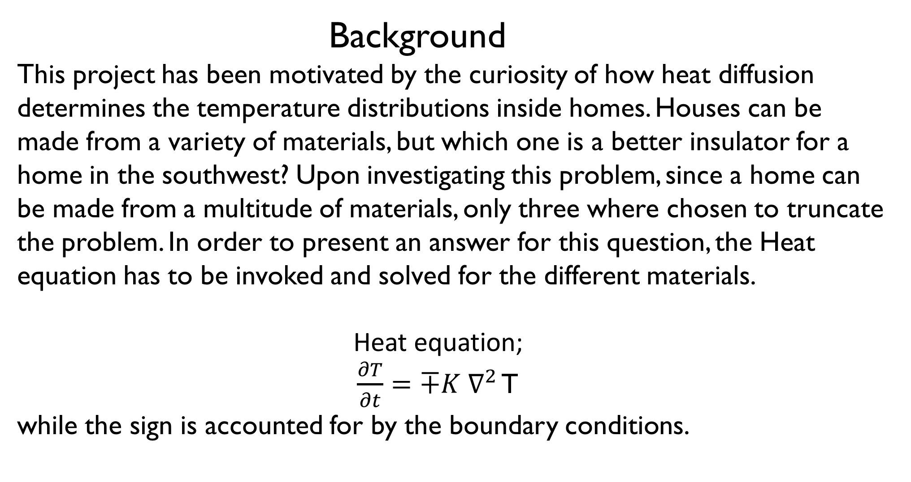
Background
This project has been motivated by the curiosity of how heat diffusion determines the temperature distributions inside homes. Houses can be made from a variety of materials, but which one is a better insulator for a home in the southwest? Upon investigating this problem, since a home can be made from a multitude of materials, only three where chosen to truncate the problem. In order to present an answer for this question, the Heat equation has to be invoked and solved for the different materials.
Heat equation;
$\frac{∂T}{∂t}=∓K ∇^{2}$ T while the sign is accounted for by the boundary conditions.

Slide 3
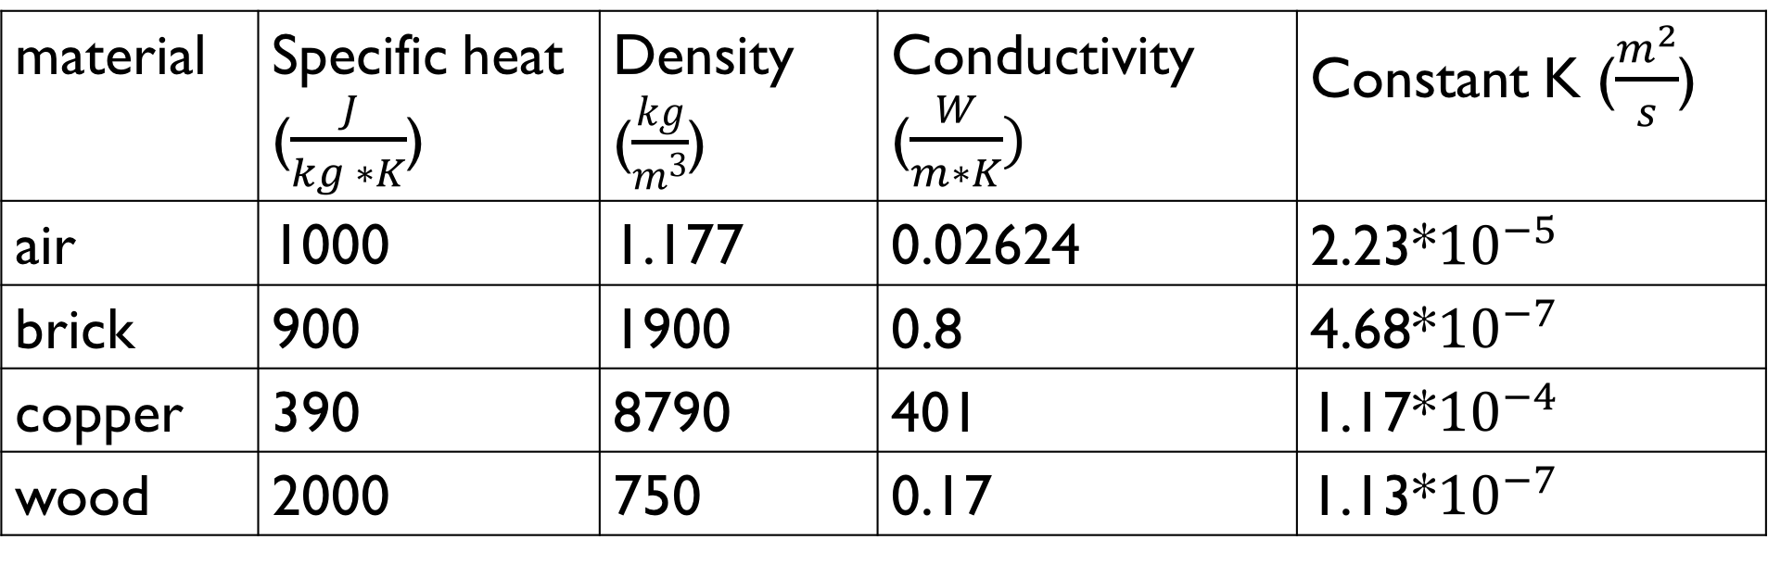
Methods How to solve Heat equation
Crank-Nicolson algorithm was used to solve the Heat equation with the boundary conditions set based on common temperatures in Arizona
parameters
material | Specific heat ($\frac{J}{kg ∗K}$) | Density ($\frac{kg}{m^{3}}$) | Conductivity ($\frac{W}{m∗K})$ | Constant K ($\frac{m^{2}}{s}$)
air | 1000 | 1.177 | 0.02624 | 2.23*${10}^{−5}$
brick | 900 | 1900 | 0.8 | 4.68*${10}^{−7}$
copper | 390 | 8790 | 401 | 1.17*${10}^{−4}$
wood | 2000 | 750 | 0.17 | 1.13*${10}^{−7}$

Slide 4
Libraries used
Numpy
matplotlib.pyplot
mpl_toolkits.mplot3d

Slide 5
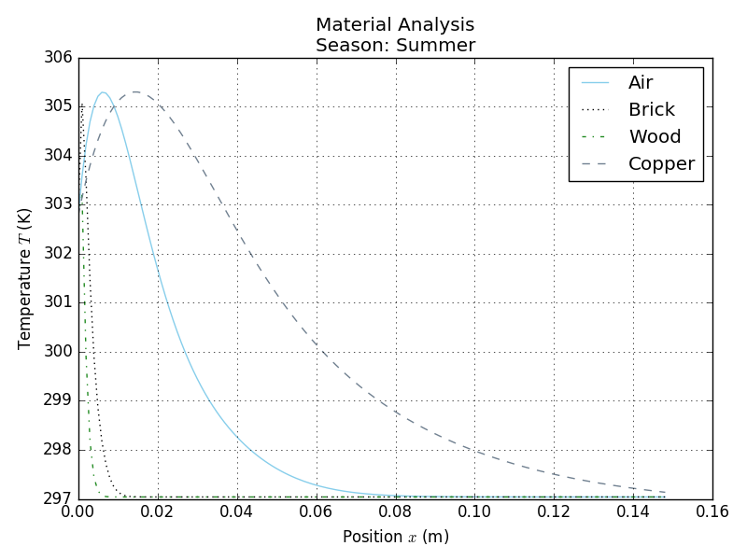
Results
Temperature distribution inside of walls

Slide 6
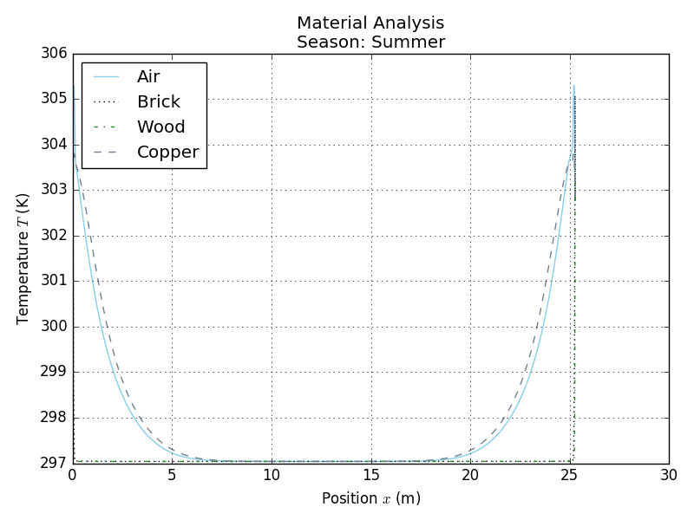
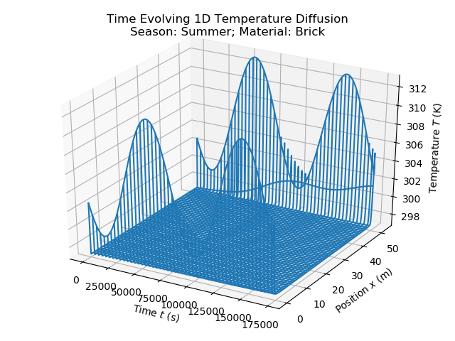
Temperature distribution inside home

Slide 7
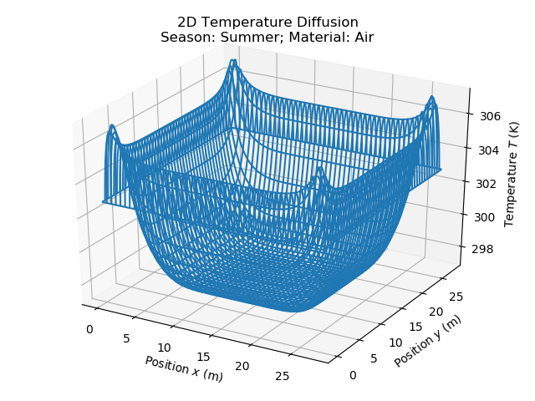
2-D Temperature distribution for Air

Slide 8
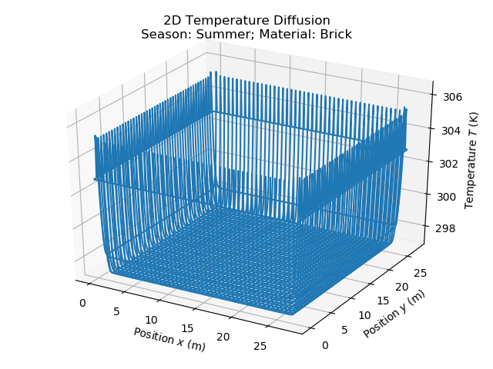
2-D Temperature distribution for brick

Slide 9
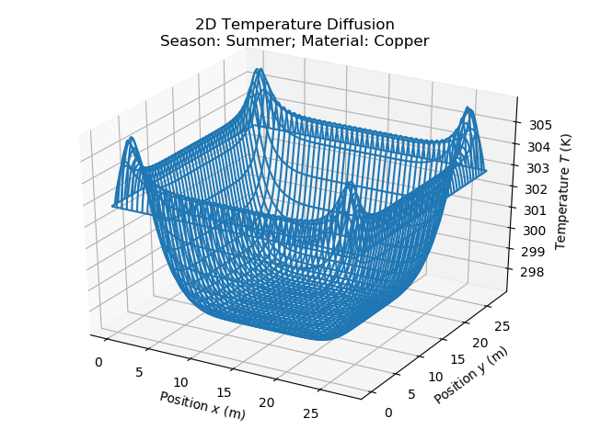
2-D Temperature distribution for copper

Slide 10
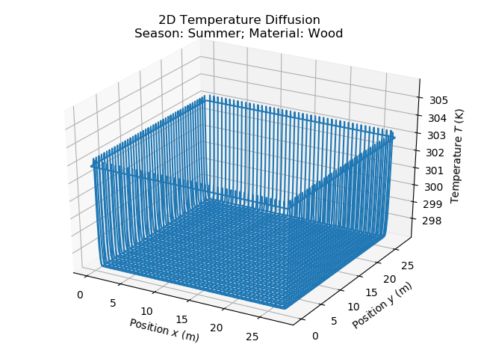
2-D Temperature distribution for Wood

Slide 11
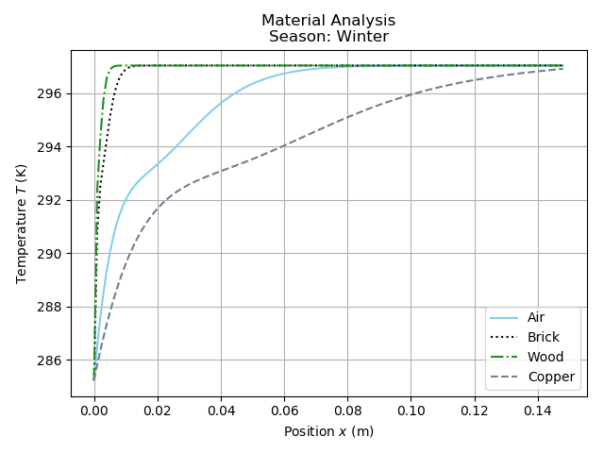
Temperature distribution inside walls

Slide 12
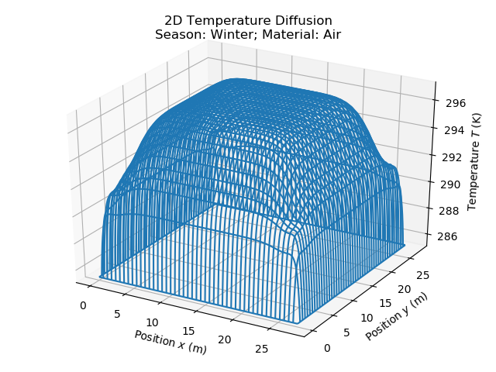
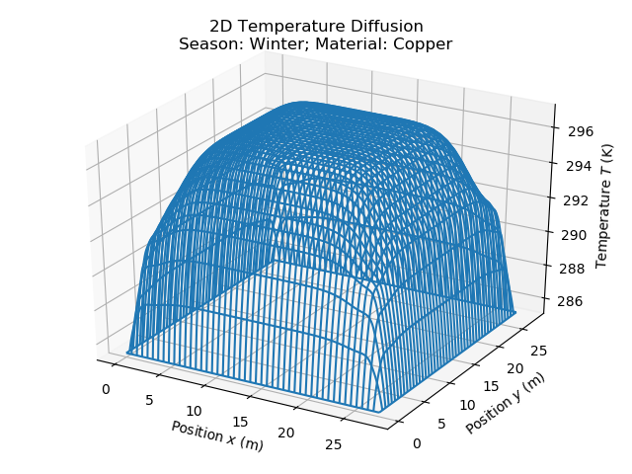
2-D Temperature distributions for air (left), & copper (right)

Slide 13
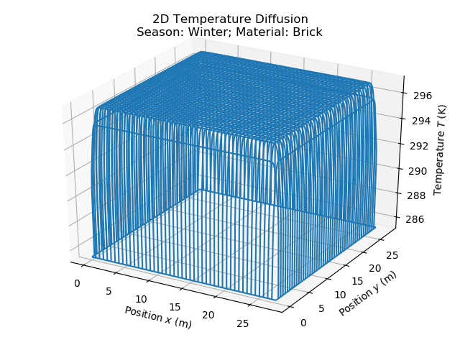
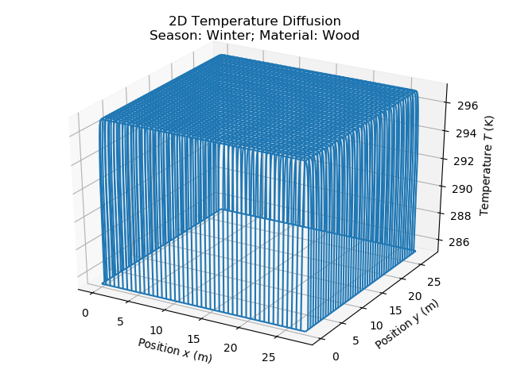
2-D Temperature distributions for brick (left), & Wood (right)

Slide 14
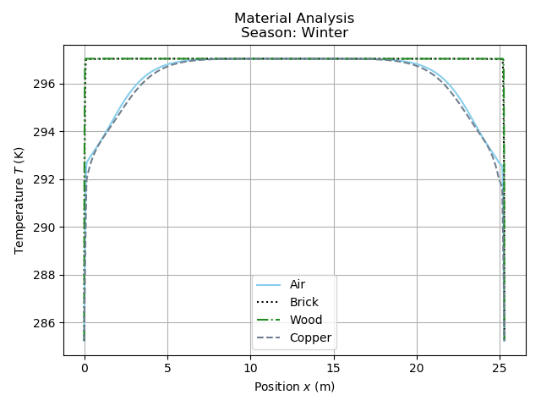
Temperature distribution inside home

Slide 15
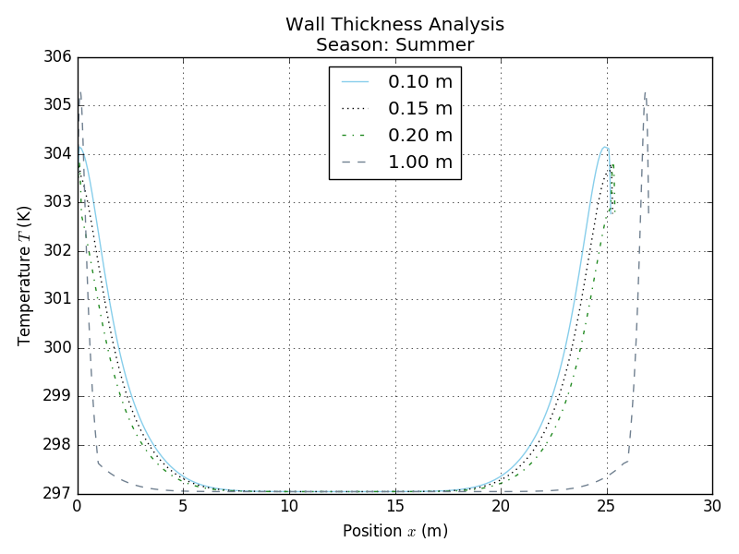
Temperature distribution

Slide 16
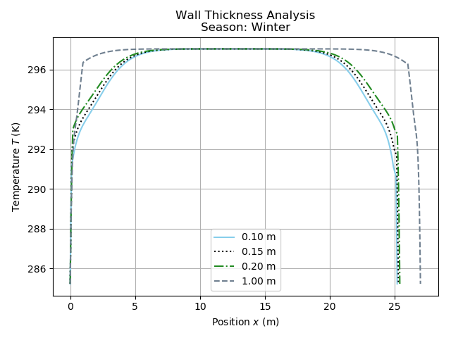
Temperature distribution

Slide 17
Summery
From solving the Heat equation numerically, by means of the Crank-Nicolson algorithm, we can see clearly from the plots of the temperature distributions that wood is the best insulator and copper is the worst. Also, it can be seen that the temperature gradient is the highest at the outside boundary, which is expected, this also means the flow of thermal energy is the highest at this point. This is also where all the thermal energy is gained or lost to the outside, depending on the sign of the temperate difference. This is where an air conditioning unit comes into play to restore the inside temperature to some set amount desired by the occupants. So, if you are going to build a home make sure to use a material that has a low thermal conductivity and high specific heat value.

Slide 18
references
url: https://www.engineeringtoolbox.com

