Slide 1


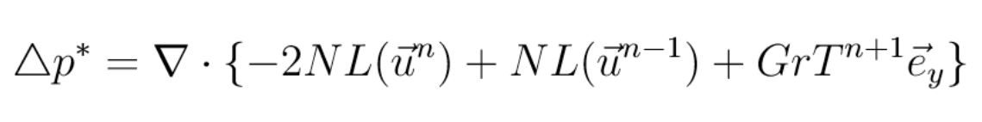
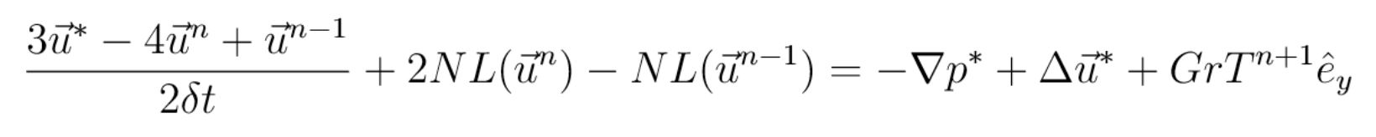
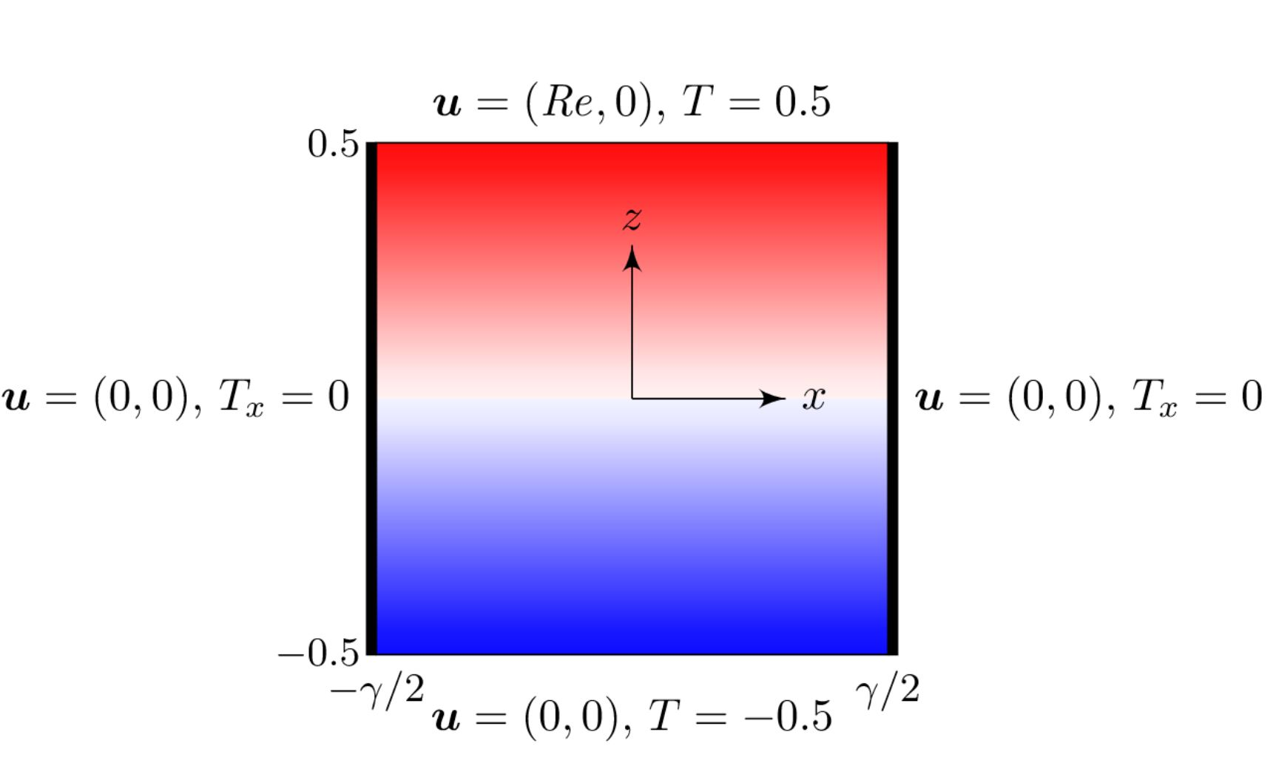
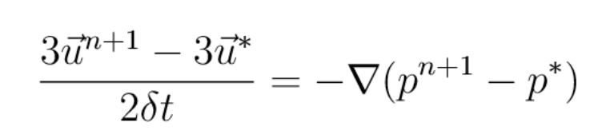
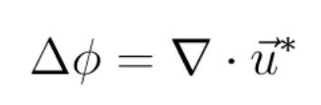
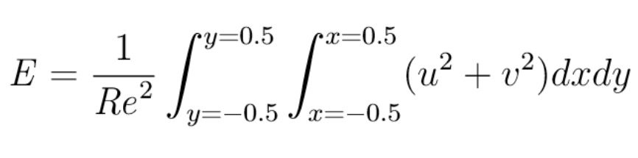
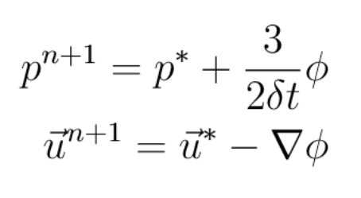
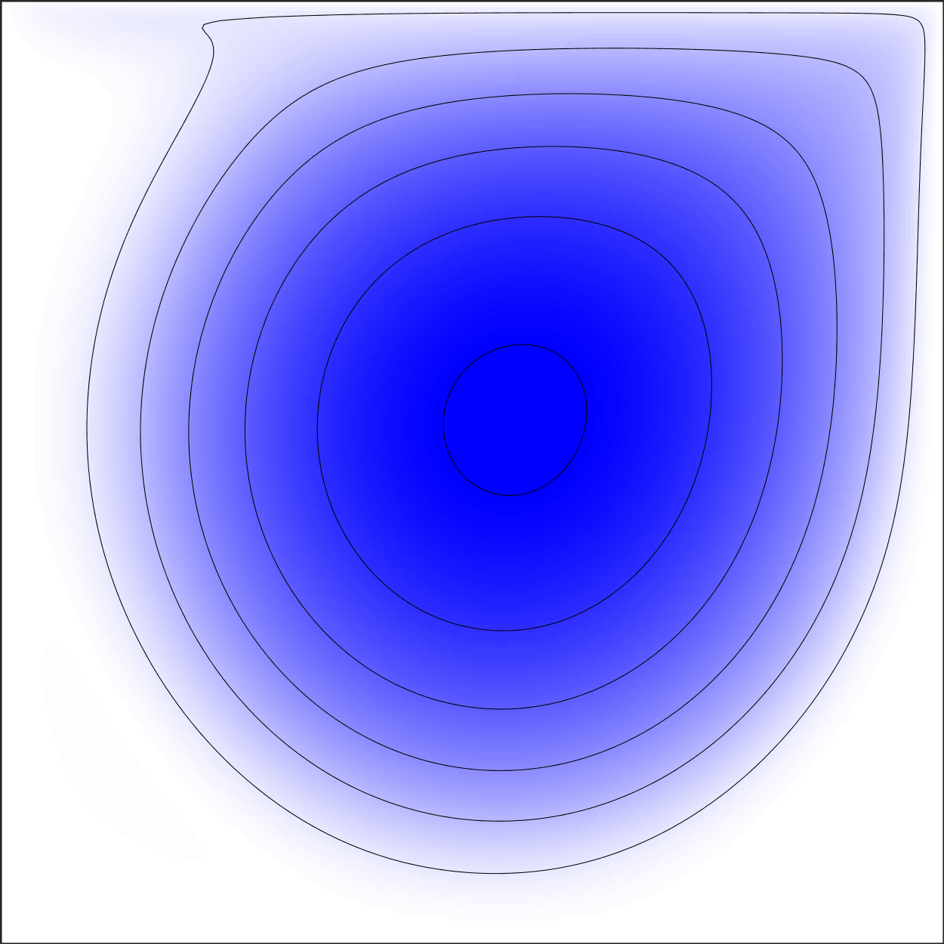
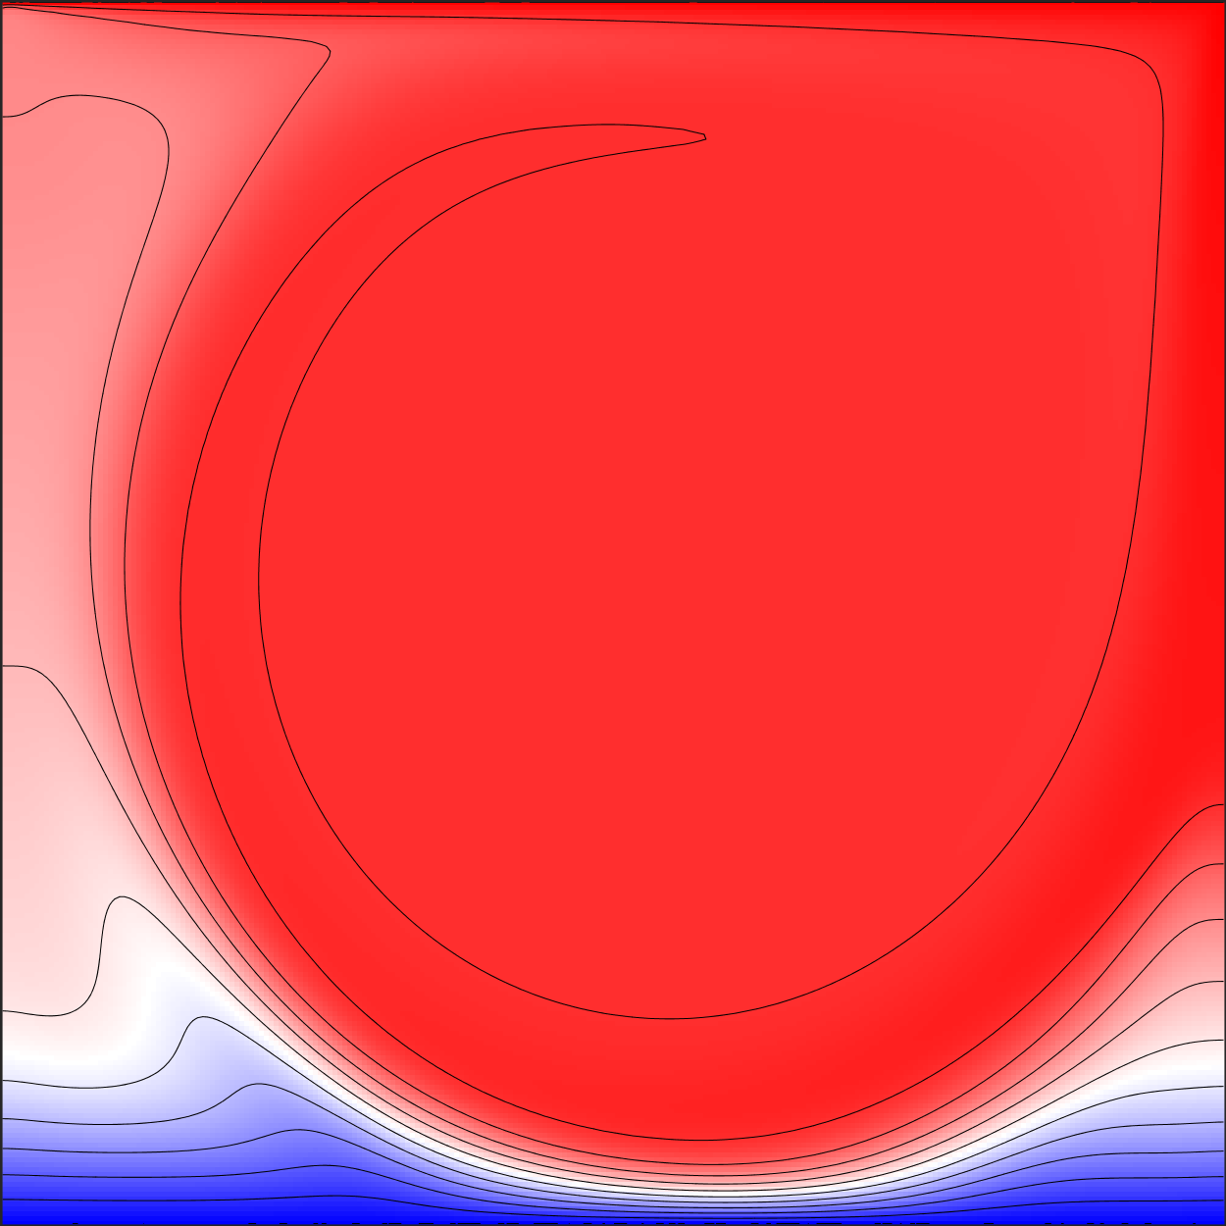
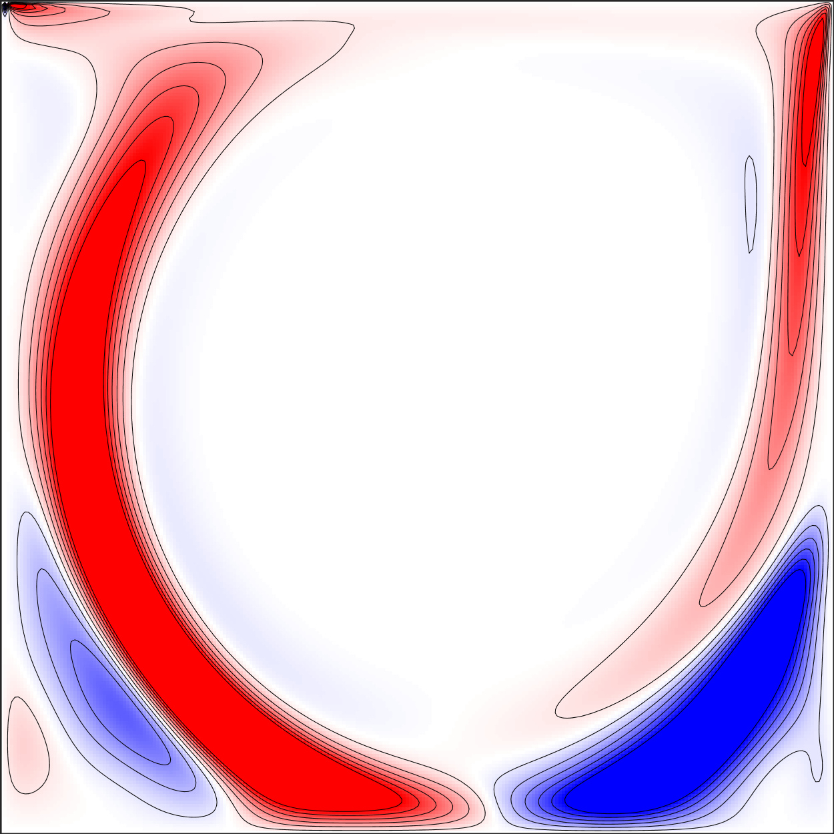
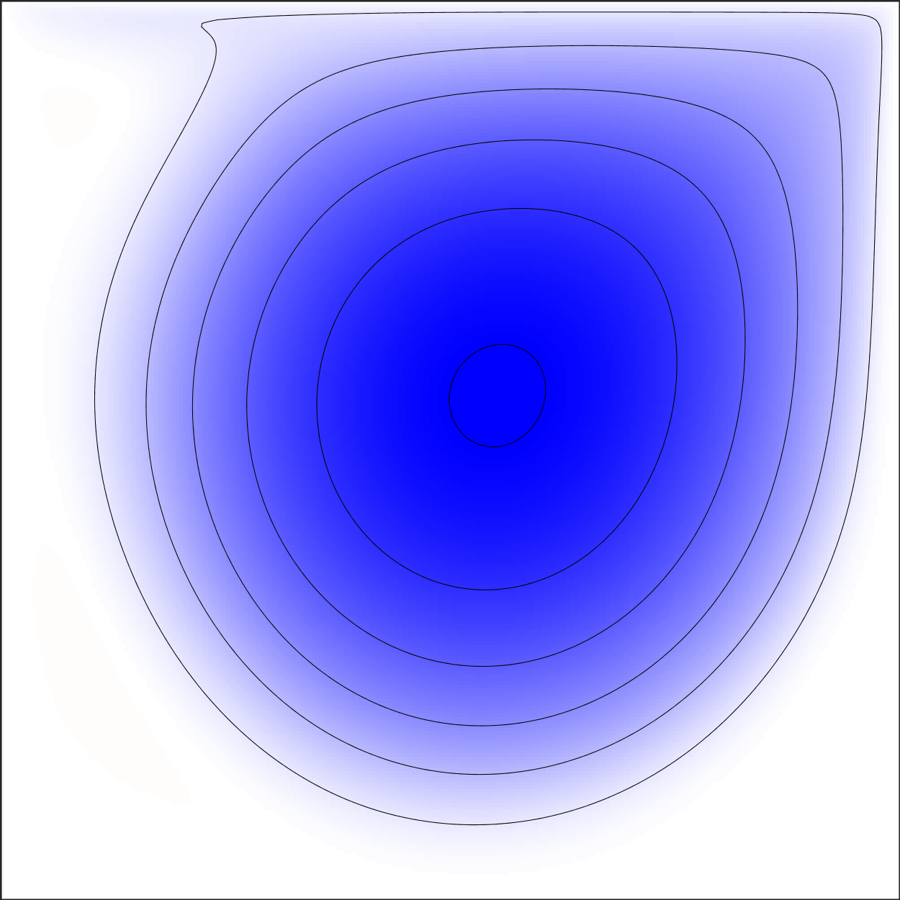
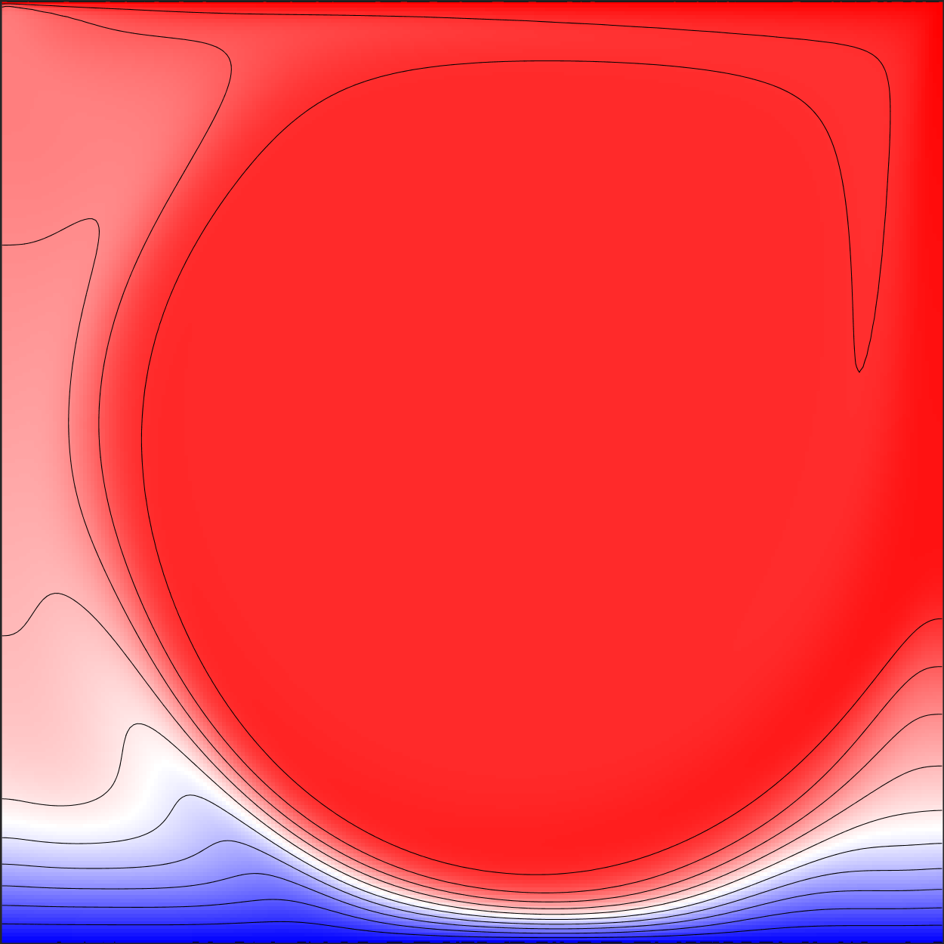
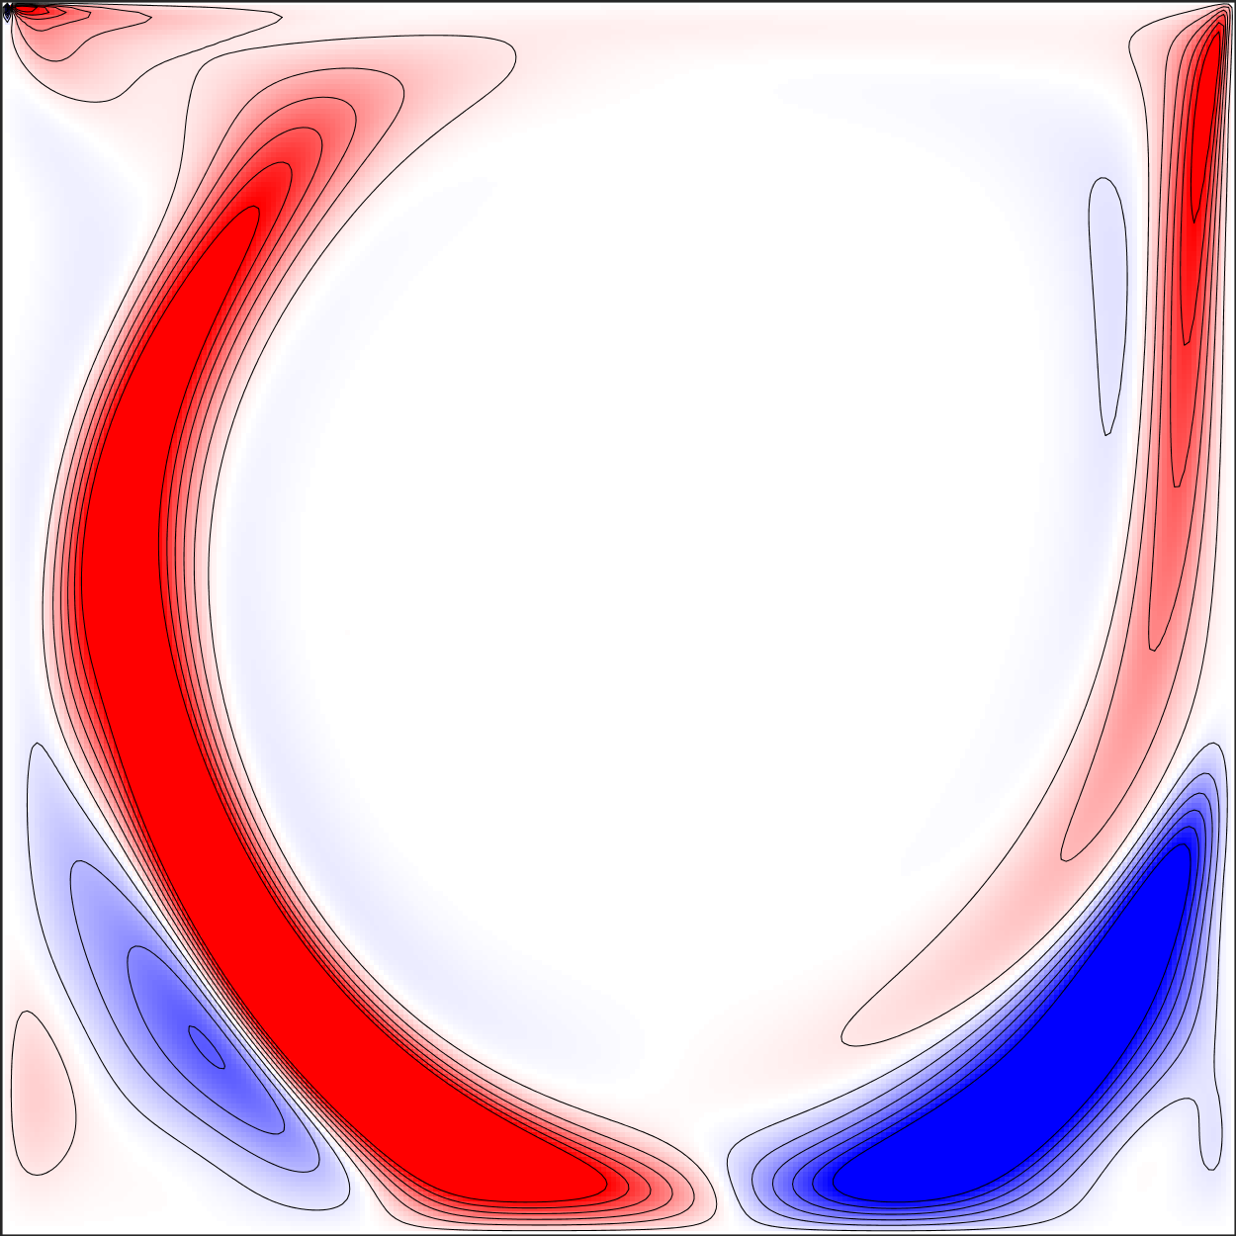
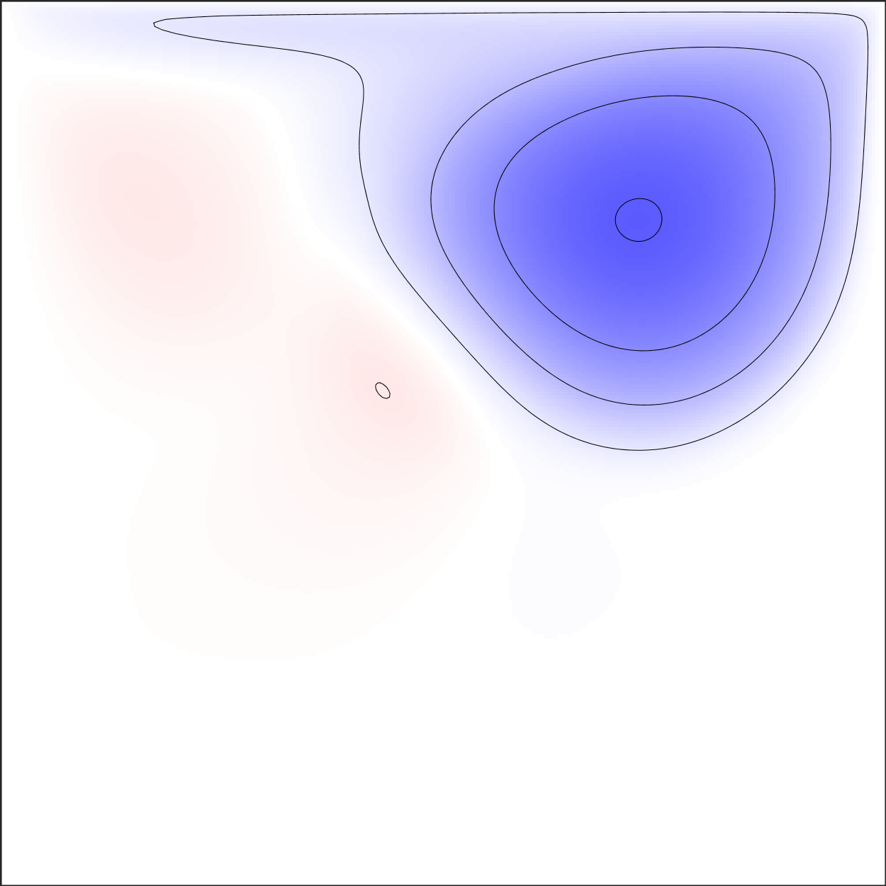
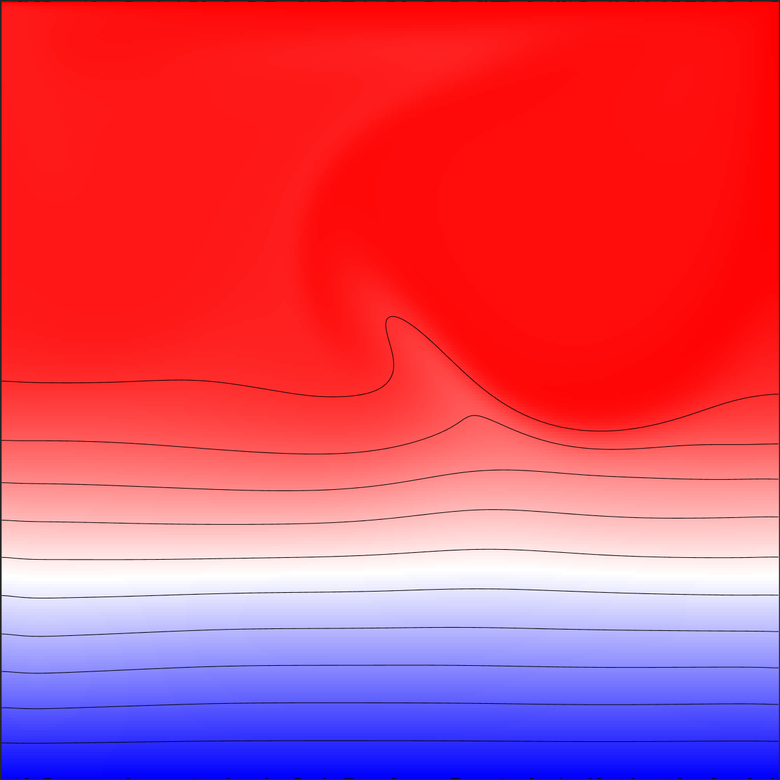
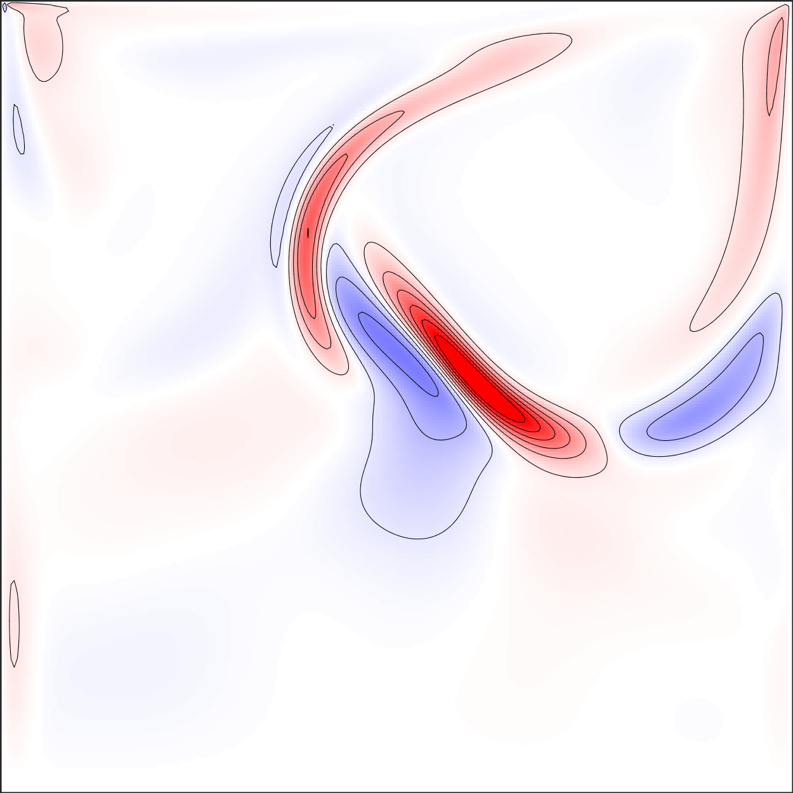
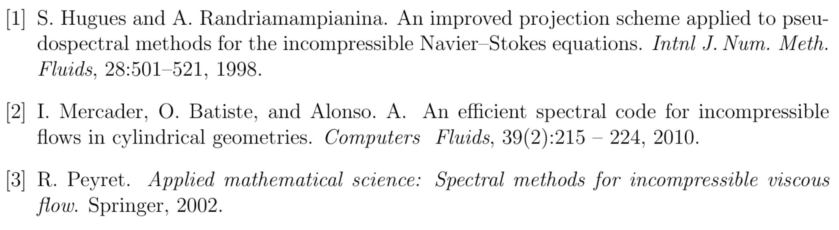
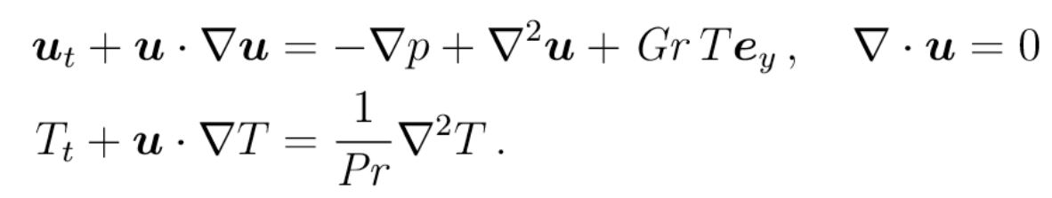
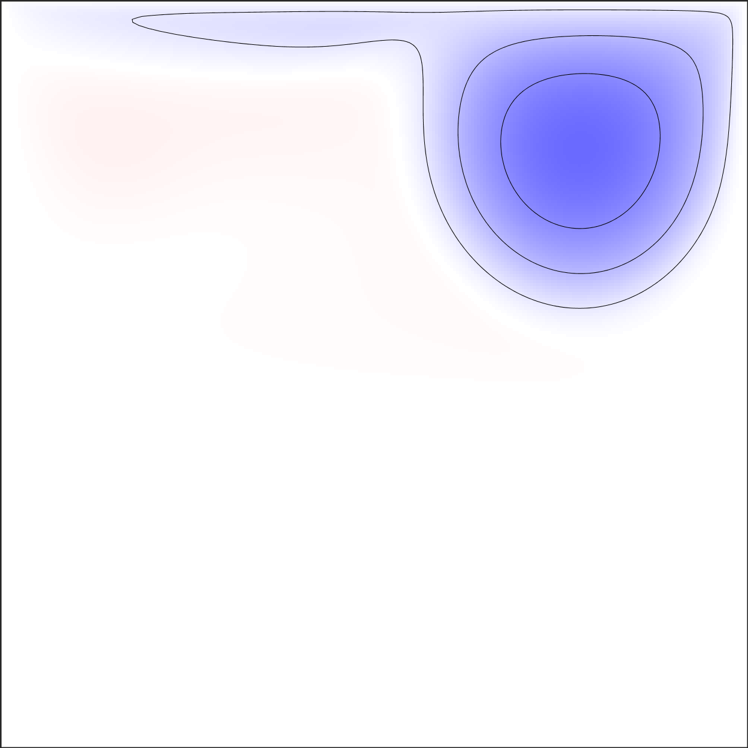
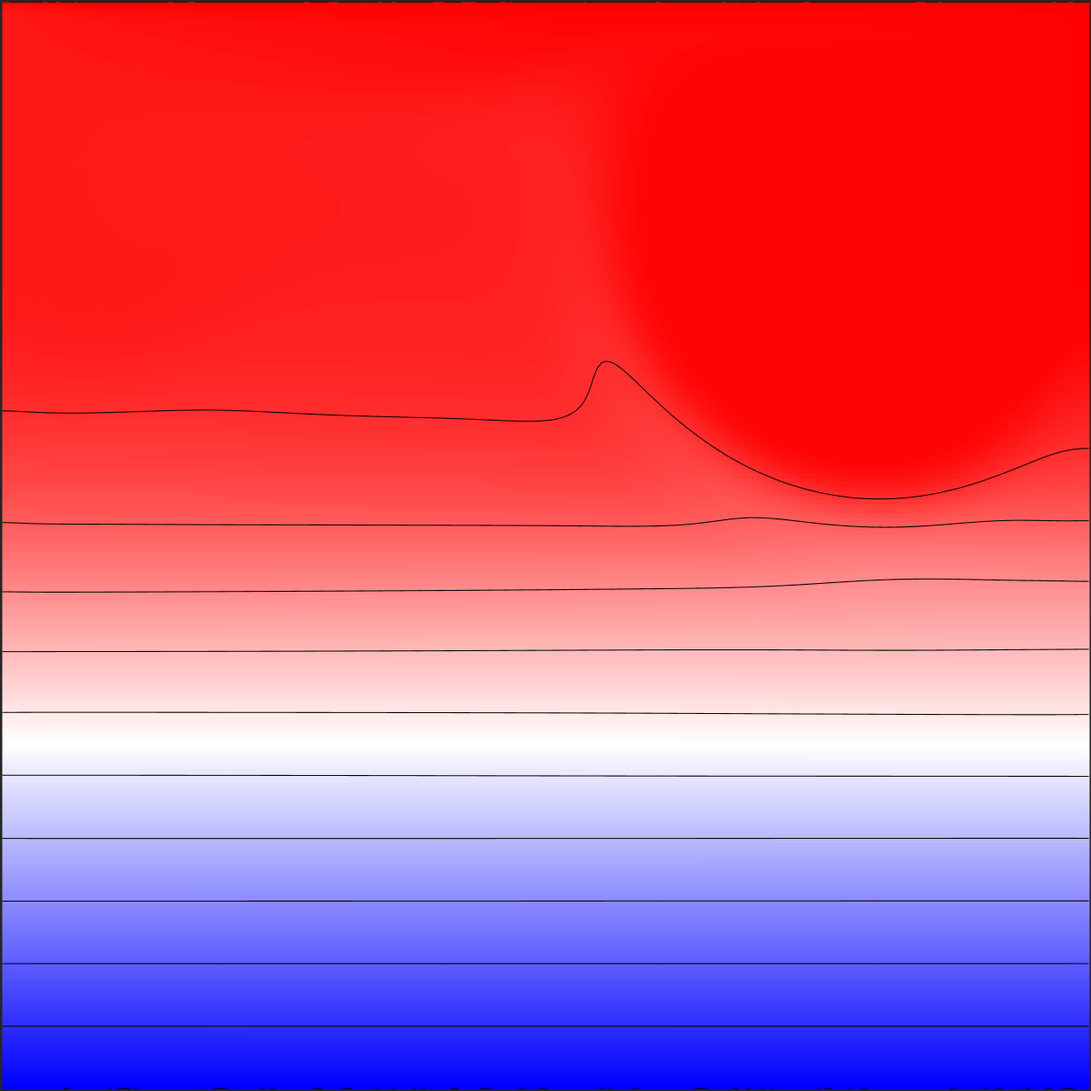
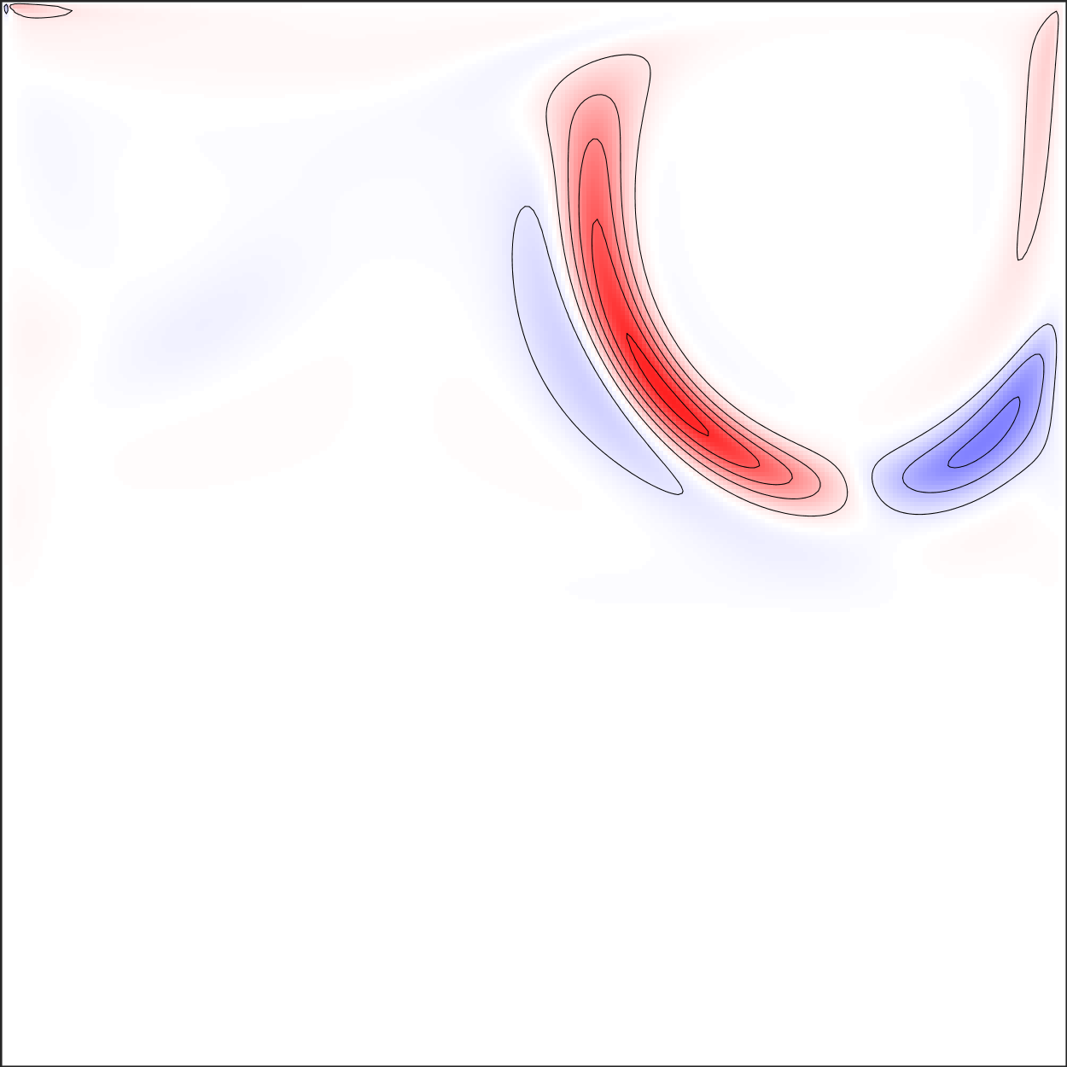
Complex Dynamics in a Stratified Lid – Driven Cavity
Paige Weisman, Ke Wu, Narges Masoumi
https://github.com/ASU-CompMethodsPhysics-PHY494/final-2018-final_project_ke_paige_narges
Overview and Motivation
Code implementation
Discussion
The dynamic response to shear of a fluid-filled squared cavity with stable temperature stratification is investigated numerically. The shear is imposed by a constant velocity on the top lid quantified by associated Reynolds number (Re = 2750).
The stratification which is quantified by the Richarson number (Ri) is imposed by maintaining the temperature as the below scheme:
The global energy is used to quantify the flow dynamics inside the cavity:
Particular attention is paid to the dynamical mechanism associated with the onset of instability of steady state solutions, and to the complex and rich dynamics occurring beyond.
Step 1: Compute Tn+1 from the temperature equation and boundary conditions (Pr =1)
Step 2: Compute the preliminary pressure (P*)
Step 3: Compute the predictor velocity field (U) from the momentum equation
Step 4: Correct the preliminary pressure and preliminary velocity through an intermediate term (Phi)
Step 5: Correct the pressure field on the entire domain and update velocity on the entire domain. For each time step, the equations are linearized as Helmholtz equation and solved by diagonalization procedure [3]
Due to the discontinuities at top wall corners, the top wall velocity profile needs to be regularized by a smooth function.
The chosen resolution which is 128 by 128, is enough to resolve the regularization function.
The solutions will depend on how we regularize the top wall velocity due the change of the boundary conditions.
As we increase Ri, essentially we increase the buoyancy force. So, the roller gets pushed to the top right corner.
Conclusion
The flow loses stability at Ri = 0.195 via a supercritical Hopf bifurcation as we increase Ri
The flow loses stability at Ri = 2.250 via a subcritical Hopf bifurcation as we decrease Ri
The 2.250< Ri<2.700, the steady state solutions and QP solutions co-exist (hysteresis).
For 0.195<Ri<2.700, many states exist, such as LCs, QPs. The solutions will depend on the initial conditions
Weak internal waves are observed for large Ri values
Results
Left to right: Stream, Temperature and gradient of temperature
Top to bottom: Ri = 180, 200, 260 and 260 respectively (Re = 2750)
Computational Method
The problem is discretized on a Chebyshev- Gauss- Lobatto grid whereas spatial differentiation is performed via pseudospectal collocation – Chebyshev method in addition to using Chebyshev differentiation matrix (D) to get partial derivatives in the range [-0.5 , +0.5].
Boussinesq approximation has been used to calculate velocity and temperature at each grid point via Navier – Stokes equations:
The governing equations are solved by the improved projection method proposed by [1], [2].
References

