Slide 1
Back to Basics: Effective Interaction
ASU Hacking Club
Fall 2021
http://asuhacking.club

Slide 2
Step 0: Constant Learning
Searching
Google for errors
Finding documentation
Navigation documentation
Reading
Man pages
Documentation
Specifications

Slide 3

How do you use a computer?

Slide 4

How do you effectively use a computer?

Slide 5
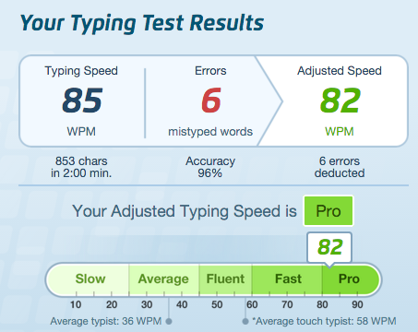
Touch Typing
Seriously, effort at this will pay dividends

Slide 6
Proper Preparation Prevents Piss Poor Performance

Slide 7
Editors
Your editor is your main instrument to craft a program
Chefs use the best knife
Mechanics use the best wrenches
Bakers use the best ovens
And they know the ins and outs of their tool
Invest time in learning your editor

Slide 8
The Mouse is Evil
HCI Keystroke-Level Model (KLM) models how fast different user interactions can be
Pressing a key
0.08 seconds/char fast typist
0.28 seconds/char average typist
1.2 seconds/char slow typist
Move hands from keyboard to mouse (or back)
0.4 seconds
Point mouse
0.8 -- 1.1 seconds

Slide 9
The Mouse is Evil
Using a mouse
Move from keyboard to mouse (0.4)
Point mouse (1.1)
Press a left mouse button (0.08)
Point mouse (0.8)
Press a left mouse button (0.08)
Move from mouse to keyboard (0.4)
Total: 2.82 seconds
In 2.82 seconds, you could type
35.25 characters
10 characters
Or 2.35 characters

Slide 10
Editors
I suggest
vim
Installed everywhere
Dual mode (editing/commands)
emacs
Highly extensible
Single mode (modifier keys for commands)
Whatever
As long as you are efficient!

Slide 11
My quick emacs tips
Lots of beginner tutorials online
http://www.jesshamrick.com/2012/09/10/absolute-beginners-guide-to-emacs/
Map caps lock to control (this is standard on every machine I use)
Prevent "emacs pinky"
Emacs macros are amazing for data manipulation/refactoring
https://sites.google.com/site/steveyegge2/effective-emacs

Slide 12
First Stop: The Command Line
The command line is where you should live
Incredibly efficient (no use of mouse)
Incredibly effective (combine several simple tools together to accomplish a large task)

Slide 13
Show Me Your Command Line
Seriously, everyone get your command line ready
If you’re on Mac, open up Terminal.app
If you’re on Windows, use a linux VM (best, do this later) otherwise WSL or download Cygwin
If you’re on Linux, you probably already know how to open a terminal
Once you’re done, enjoy this flag:
<REDACTED, WATCH THE VIDEO>

Slide 14
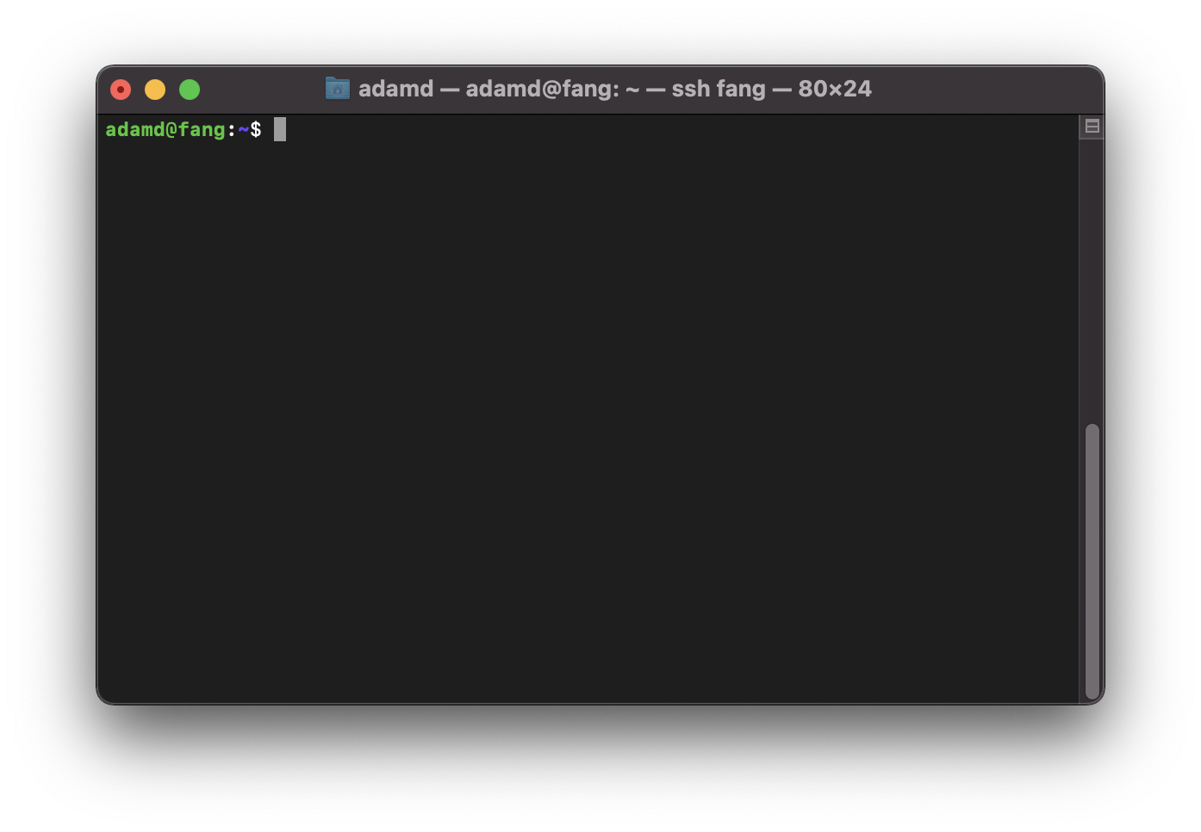

Slide 15
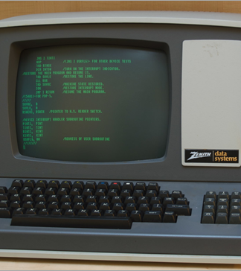
Terminals
For now, roughly interchangeable with command-line
Early computing systems had no local compute, user had to use local “terminal” to connect to the central system
Lots of crazy protocols to allow color, beeps, essentially insanity

Slide 16
Side Note: Beware the Bikeshedding Trap
Bikeshedding
[originally BSD, now common] Technical disputes over minor, marginal issues conducted while more serious ones are being overlooked. The implied image is of people arguing over what color to paint the bicycle shed while the house is not finished.

Slide 17
The Command Line: Doing Stuff
The command line is about executing programs to do stuff
Examples (type these out and try them):
whoami
id
ls
Each example is quite simple and just does one thing, then exits

Slide 18
Command Arguments
For now, we can think of arguments to commands as everything after the command, separated by spaces
Examples:
whoami --help
id -g
ls -l
ls -la /

Slide 19
Useful Command Line Commands
clear
Clear everything from terminal
reset
Fully reset terminal state
cat /bin/ls
Kill current command:
First run cat, then type Control-C to kill it
Terminal Froze?
Likely because you typed Control-S, try Control-Q to get back

Slide 20
Learning to Learn—man
man (short for manual) is your friend
man <command> will bring up documentation on the command
man id
Read through the man page for the id command
How many options does it have? What does it do?
What is the command for printing out the effective group ID of user adamd?
Put answer in as flag for back-to-basics-1

Slide 21
Learning to Learn—help
By convention, most commands also will have help functionality available either as:
<command> -h
<command> --help

Slide 22
The Command Line: Who’s that behind the curtain?
We’re typing in input, where’s it going?
Meet “the shell”
Process that receives your input, parses it to identify the program and arguments, finds the program on the file system, asks the OS to execute the program with the given argument
What’s your shell?
Stored in /etc/passwd
less /etc/passwd
Executed automatically on login (ssh or other)

Slide 23
So, what’s really going on?
Should a program like cat have direct access to the filesystem?
Should a program like cat be able to mess with other programs?
How is this enforced?
Operating System concept: Process

Slide 24
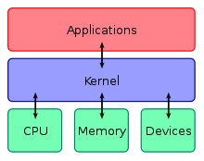
Process
We’ll go into way more detail later, for now we can think that a process does very little, and has to ask the OS to perform almost all interactions such as:
Reading/writing files
Talking on the network
Getting more memory
Executing other processes
…
Terminology:
Process == User Space
System call: Way that a user space program asks the OS to perform some action

Slide 25
Shell is just a process
Important concept to remember is that the shell is just a process
You can write your own shell!
However, the shell is quite important, as we are directly “talking” to it

Slide 26
Shell Life
Waits for our input (which is actually going to the shell from our terminal, but let’s ignore that for now)
When it gets a line of input (which it reads as a string) it then needs to parse the input:
Separate into command (first part)
All arguments (separated by command by space)
Then, needs to find the exact program to execute (more on this later)
Asks the OS to execute the program

Slide 27
Shell Life Example
“ls -la /” is our input
Shell says OK, the first part is “ls”, second part is “-la”, and third part is “/”
Figures out that ls is located in /bin, so first part becomes “/bin/ls”
Shell executes system call to ask OS to execute the “/bin/ls” program and pass it three arguments (WHY THREE?):
ls
-la
/

Slide 28
More Advanced Command Line Arguments
Let’s say that I have a user on my system called Adam D
How would I use id to get information about this user?
Consider
What would the shell ask the OS to execute when given the input
id Adam D

Slide 29
Escape, to the rescue
Need a way to tell the shell parser: “I want a space as part of the argument, not to separate arguments”
Many ways to do this, here are some examples:
id Adam\ D
id "Adam D”

Slide 30
Escaping the can of worms
But now, how do we include a double quote inside a double quote (the second double quote indicates the end of the argument)
MORE ESCAPING:
id "Adam \"D" would parse as:
id Adam "D

Slide 31
How to understand all this?
DOCUMENTATION
https://www.gnu.org/software/bash/manual/bash.html#Quoting
Seriously, this kind of thing is worth your time to read
Appears over and over
Source of many many bugs

