Slide 1


TEAM PROGRESS REPORT · TEAM GODABEG
HealthConnect Ghana
Team Godabeg
Mubarak Tijani
Frontend UI & DevOps
Bernard Marfo Adjei
Backend & Cloud APIs
Liza Aikins
Database, Sync & Analytics
Germain Emil Allotey-Pappoe
Security, Community & Docs
EXPLORE PROGRESS REPORT
PRODUCTION LIVE APP ↗
STAGING LINK ↗
MENU
NEXT
01
Notes:
[OPEN - about 40 seconds. Slow down. Look at the audience, not the screen.]
Good morning, everyone. Before I show you a single screen, I want to tell you a story. It is about a woman, a notebook, and a phone with no signal.
We are Team Godabeg, and this is HealthConnect Ghana. I am Bernard, and I built the backend. Mubarak built the app and the cloud setup, Liza built the database, and Germain looked after security and the documentation.
[Click to the next slide and begin the story.]

Slide 2


The gaps the brief asked us to close:
Too few doctors,
too far away
01 TOO FEW DOCTORS
Ghana has about one doctor for every 10,000 people, and most specialists work in Accra and Kumasi.
02 LONG DISTANCES
Four in ten Ghanaians live more than 5 km from the nearest health facility.
Our answer
One app lets a Community Health Volunteer bring care to the doorstep, even where there is no signal.
03 PAPER RECORDS
Records are kept on paper, so a patient's history does not follow them from one visit to the next.
04 THE OPPORTUNITY
More than 15,000 volunteers already visit homes, and 83% of Ghanaians own a mobile phone.
TEAM GODABEG / PROSIT 2 · ICS 534 CLOUD COMPUTING
MENU
NEXT
02
Notes:
[THE STORY - about 2 minutes. Tell it, don't read it. Pause after the BP numbers.]
Picture this. It is early morning in a village a few hours from the nearest hospital. Akosua is a community health volunteer. She has no medical degree, but everyone in the village trusts her. She walks from house to house with a paper notebook and a cheap, shared phone.
At one house she meets Ama, a 58-year-old grandmother who has been feeling dizzy. Akosua takes her blood pressure: 186 over 118. [PAUSE] That is dangerously high. Ama needs a doctor today.
And this is where the system fails them. Ghana has about one doctor for every 10,000 people, and most specialists work in Accra or Kumasi. Four in ten Ghanaians live more than five kilometres from the nearest health facility. Ama's reading goes into a paper notebook, so when she finally reaches a clinic, nobody knows her history. And Akosua cannot even phone ahead, because there is no signal.
Here is the encouraging part. More than 15,000 volunteers like Akosua already visit homes, and 83% of Ghanaians own a mobile phone. The tool is already in everyone's pocket. What is missing is software built for this reality. That is what we built.
[Note: Akosua and Ama are an illustration. They are also the two demo characters you will see in the live demo.]

Slide 3
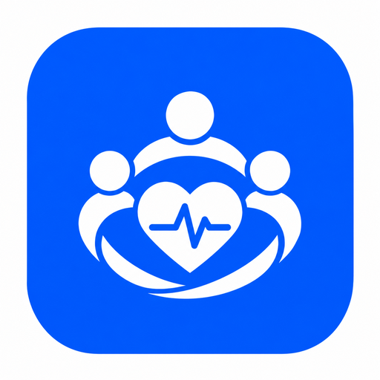
HealthConnect lets them:
01 REGISTER A PATIENT WITH RECORDED CONSENT
Captures spoken, inked thumbprint, or signature consent in the patient's preferred language before any health data is entered.
Health records that
work without signal
02 TAKE VITALS AND GET WARNING FLAGS
Records LOINC-coded Blood Pressure, Temperature, Pulse, Weight & Height with automatic triage alerts (e.g., BP 186/118 -> Refer today).
03 BOOK VISITS AND REFERRALS
Schedules follow-up home visits or urgent referrals to Dodowa District Hospital & CHPS compounds in one seamless flow.
Connecting People to Care
Installable PWA · Works offline on 2G/3G shared Android phones
04 KEEP WORKING OFFLINE, THEN SYNC
Saves every record atomically to local IndexedDB and an oldest-first outbox queue, syncing automatically when signal returns.
TEAM GODABEG · ICS 534 CLOUD COMPUTING
MENU
NEXT
03
Notes:
[OUR ANSWER - about 1 minute]
So what did we build? One app that lets a volunteer like Akosua bring care to the doorstep, even with no signal. It does four things.
One: it registers a patient, but only after recording consent. The patient agrees out loud, or with a signature, or with an inked thumbprint, because the law says health data needs consent.
Two: it records vitals, like blood pressure and temperature, and warns when a reading is dangerous. Ama's 186 over 118 would trigger a red alert that says: refer today.
Three: it books visits and referrals. A referral simply means sending a patient to someone more qualified, like the hospital.
Four, and this is the key idea: it keeps working with no signal. Everything is saved on the phone first, and sent to the server later.
[Transition: Let me show you where the project stands.]

Slide 4
What we added since the progress report
These are the pink parts of the architecture diagram. Each one closes a gap in the brief.
Texts to patients
Serverless functions text the visit reminder, the referral answer and the prescription code.
Video consultations
A doctor and a patient can talk face to face, even on a 2G or 3G connection.
Mobile money payments
The GHS 20 consultation fee is paid with mobile money through Paystack in test mode.
Patient sign-in
Patients sign in with their own phone number and see their visits, readings and fees.
Results and prescriptions
Workers record test results with a photo, and doctors write digital prescriptions.
Backups in a second region
Every database backup is copied to Ireland, so we can recover even if Cape Town is lost.
TEAM GODABEG / PROSIT 2 · ICS 534 CLOUD COMPUTING
MENU
NEXT
05
Notes:
[WHAT WE ADDED SINCE THE PROGRESS REPORT - about 1 minute]
Since our last report we added six things, and each one closes a gap in the brief.
Texts to patients: small programs send the visit reminder, the answer to a referral, and a prescription code. Video consultations: a doctor and a patient can talk face to face, even on a slow 2G or 3G connection. Mobile money payments: the 20 cedi consultation fee is paid through Paystack, in test mode, so no real money moves.
Patient sign-in: patients can log in with their own phone number and see their visits, readings and fees. Results and prescriptions: workers record test results with a photo, and doctors write digital prescriptions. And backups in a second region: every database backup is copied to Ireland, so we can recover even if Cape Town is lost.
All of these are the pink parts on the architecture diagram, which is next.

Slide 5
What we delivered
All planned features delivered. Synthetic data only.
BUILT
Frontend app
Installable PWA with patient, vitals, visit, referral, video call and payment screens for 5 roles. Works offline.
5
roles, each with its own view
BUILT
API and cloud on AWS
Secure API, reminders, texts, video and payments, released by CI/CD to staging and production.
2
environments in Cape Town
BUILT
Database
FHIR-aligned PostgreSQL 17 with row-level security by district and a tamper-evident audit log.
16
tables plus a district view
INTERACTIVE PRESENTATION MENU · CLICK ANY SECTION TO JUMP DIRECTLY:
01 CLOUD ARCHITECTURE
02 DELIVERY PIPELINE
03 DATABASE
04 OFFLINE SYNC & FLOW
05 NEW FEATURES
06 PRIVACY & PROGRESS
LIVE PRODUCTION PWA: https://d2opah5iezm17k.cloudfront.net ↗
LIVE STAGING PWA: https://dwaho59wvxpxe.cloudfront.net/ ↗
TEAM GODABEG / PROSIT 2 · ICS 534 CLOUD COMPUTING
MENU
NEXT
04
Notes:
[WHERE WE ARE - about 45 seconds]
In one sentence: everything we planned is built, and it is running.
There are three parts. The app on the phone, which works offline and has screens for five kinds of users. The API and the cloud: the API is the program on the server that the app talks to, and it runs on Amazon Web Services in Cape Town, as a test copy called staging and a real copy called production. And the database, which has 16 tables.
Everything uses invented data. We never used real patients. The buttons along the bottom let me jump to any section, and both live links are on this slide.

Slide 6
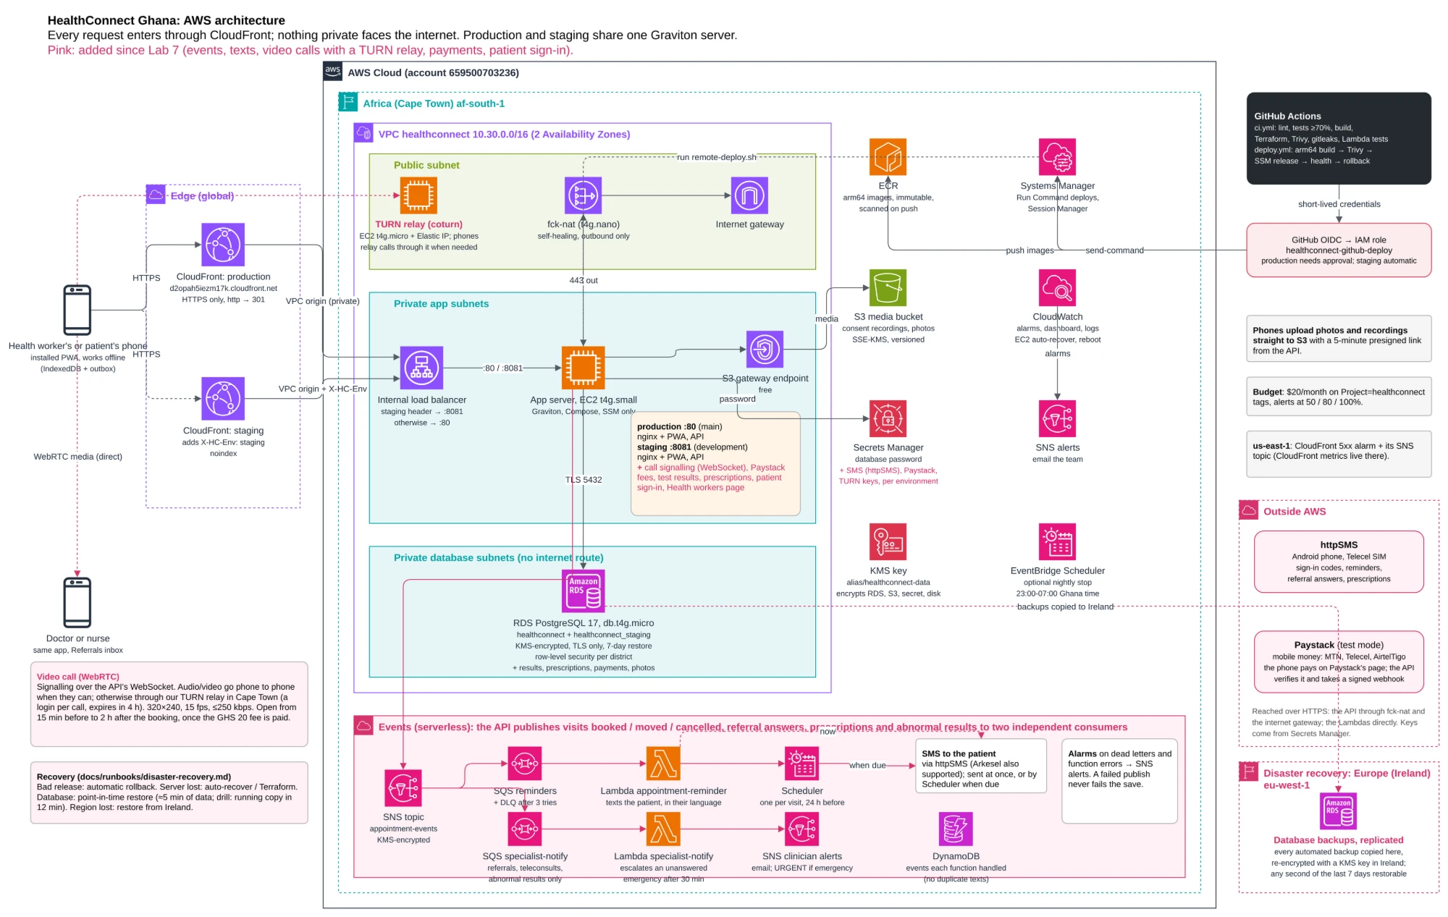
TEAM GODABEG / PROSIT 2 · ICS 534 CLOUD COMPUTING
MENU
NEXT
06
Notes:
[ARCHITECTURE - about 1 minute 15 seconds. Follow ONE request with your finger or pointer.]
This is the architecture: a map of how the pieces connect. Do not worry about every box. Follow one request.
A phone talks to CloudFront, which is Amazon's front door, and the only way in. Behind it sits a private load balancer, and one server that runs our app and our API. That server talks to a database that nobody on the internet can reach. Photos and recordings go to a locked storage bucket, using a short-lived link.
The pink parts are what we added since Lab 6. At the bottom, the serverless reminders: when a visit is booked, one event is sent, and two independent small programs react, one reminding the patient, one alerting the nurse or doctor. On the left, the video call, with a relay server so calls connect on mobile data. On the right, text messages and payments.
We run all of this on a student budget of about two dollars a day.

Slide 7
Delivery pipeline
Nobody logs into a server to deploy. Rolling back is one workflow run with an older commit.
1 Pull request
feature branch into development
2 CI passed
the one required check
3 Staging
updates by itself in about 4 minutes
4 Approval
development into main, approved
5 Production
health check, auto rollback, smoke test
Checked on every pull request (ci.yml)
Lint, format, unit tests with a 70% coverage gate, production build, Docker build, gitleaks secret scan, Terraform validate, Lambda tests, Trivy scan.
Every release (deploy.yml)
arm64 images tagged with the commit, pushed to ECR. Blocked on a fixable critical vulnerability. Short-lived GitHub OIDC credentials, no stored AWS keys.
TEAM GODABEG / PROSIT 2 · ICS 534 CLOUD COMPUTING
MENU
NEXT
07
Notes:
[DELIVERY PIPELINE - about 1 minute]
This slide is how code gets from a laptop to the live site. The important point: nobody logs into the server to deploy.
A developer makes a change and opens a pull request, which is a request for teammates to review it. Robots then run automatic checks: tests, a security scan, and a check that at least 70% of the code is tested. If everything passes, the change reaches staging, the test copy, by itself in about four minutes. After approval, it goes to production, the real site, with a health check. If the new version turns out to be unhealthy, it rolls back automatically to the previous one.
So we can release often, and a mistake does not break the live site.

Slide 8
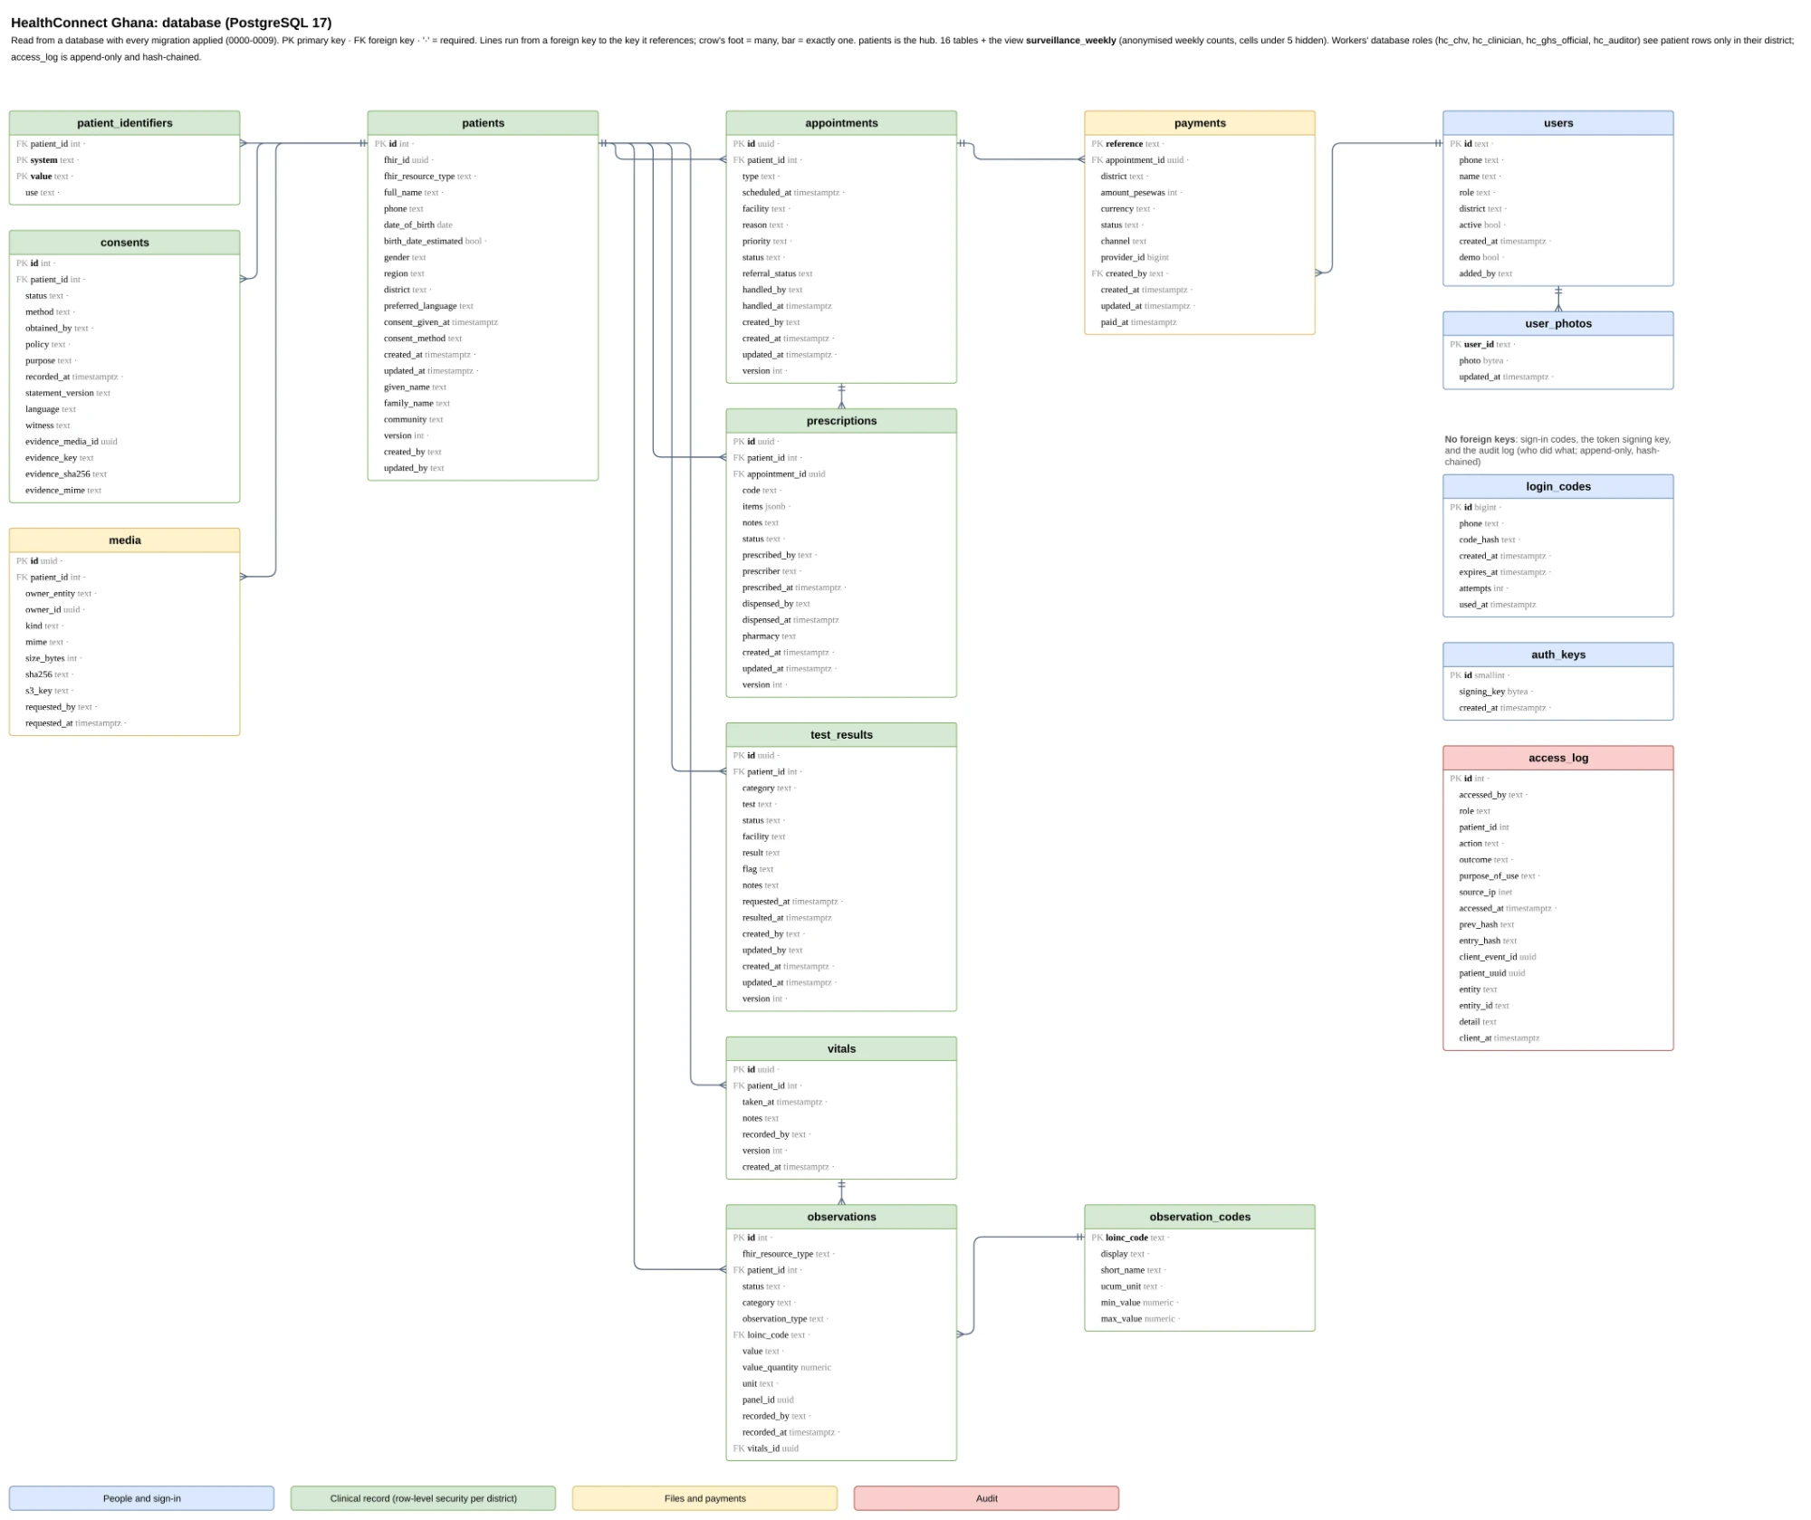
16 tables + 1 view
FHIR-aligned, LOINC codes with UCUM units
Row-level security
By district, with 4 database roles
Audit log
Append-only and hash-chained, so tampering shows
New since Lab 6
Payments, prescriptions, test results
TEAM GODABEG / PROSIT 2 · ICS 534 CLOUD COMPUTING
MENU
NEXT
08
Notes:
[DATABASE - about 1 minute 15 seconds]
The database is the filing cabinet of the system. It has 16 tables and one summary view. The central table is patients, and everything hangs off it: vitals, appointments, consents, payments, prescriptions and test results.
Three things to remember. One: the data follows an international health format called FHIR, and vital signs use standard medical codes, so other health systems could understand it. Two: row-level security. The database itself decides who sees what, by district. A volunteer in one district simply cannot read another district's patients, even if our code had a bug. Three: the audit log. Every access is written to a log that can only be added to, never edited, and each line is linked to the previous one like a chain, so tampering would show.
On the right: the new tables since Lab 6 are payments, prescriptions and test results.

Slide 9
Added since Lab 6:
01 APPOINTMENT REMINDERS (SERVERLESS)
A booking publishes one event. Two Lambda functions react: remind the patient, alert the clinician.
Reminders, texts,
video and payments
02 REAL TEXTS BY SMS
Sign-in codes and reminders go out by text, switched on with one secret. Without it they are only logged.
03 VIDEO CONSULTATIONS
WebRTC calls between patient and clinician, with our own relay so calls connect on mobile data.
Event-driven and encrypted
SQS, Lambda, SNS, KMS, Paystack test mode
04 PAYMENTS BY MOBILE MONEY
Consultation fees through Paystack in test mode: MTN, Telecel, AirtelTigo. A signed webhook confirms payment.
TEAM GODABEG · ICS 534 CLOUD COMPUTING
MENU
NEXT
09
Notes:
[REMINDERS, TEXTS, VIDEO AND PAYMENTS - about 1 minute 15 seconds]
Let me explain how the new parts work, starting with reminders, because it is the cleverest.
When a visit is booked, the app does not call anyone directly. It publishes one message, like dropping a note in a box. Two small independent programs, called Lambda functions, pick up that same note. One reminds the patient in their own language. The other alerts the nurse or doctor. If one fails, the other still works. We call that decoupling. And if a message cannot be delivered, it lands in a safety queue called a dead-letter queue, so nothing disappears silently.
Texts go out through one secret setting that switches real sending on. Video calls use a technology called WebRTC, with our own relay server so calls work on mobile data. And payments use mobile money through Paystack, in test mode.

Slide 10
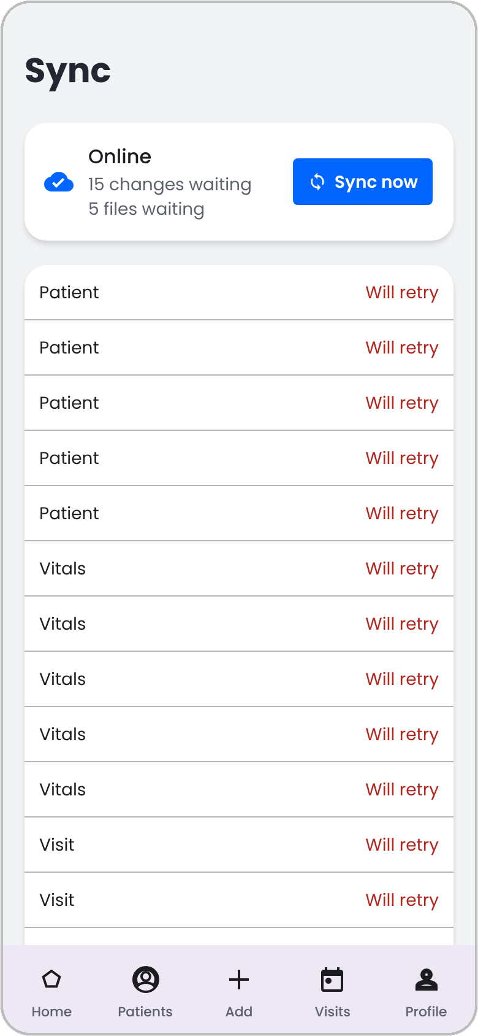
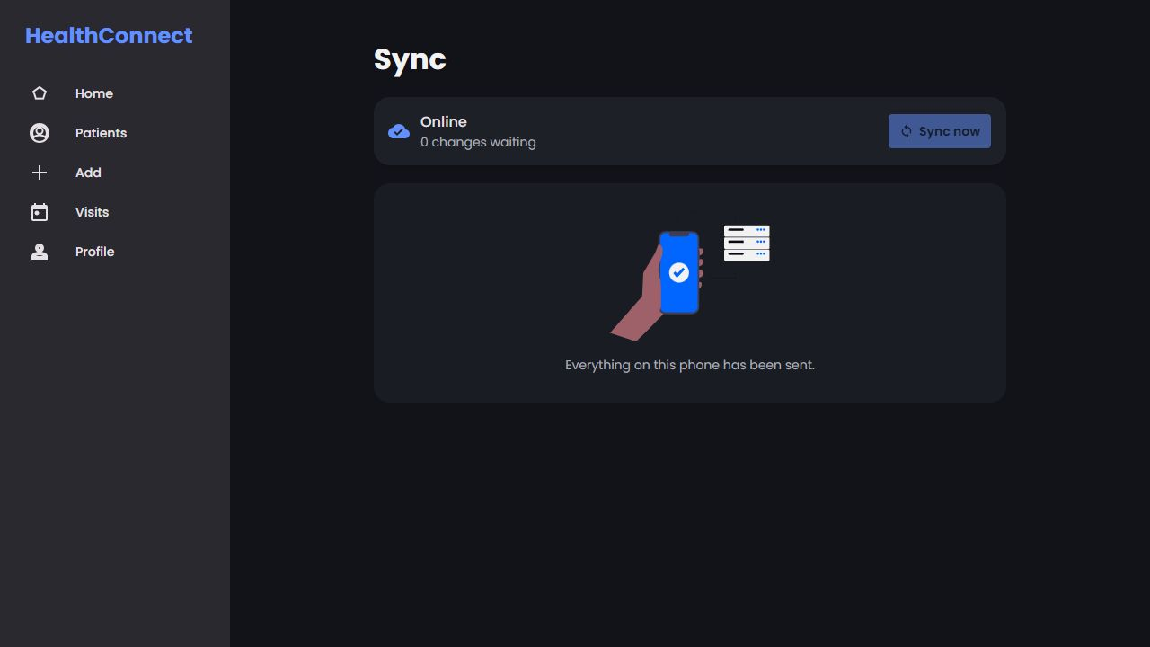
Saved on the phone first
Every record goes into the phone's own database and an outbox in one step, then syncs when there is signal.
On the phone
• IndexedDB with patients, vitals, appointments, media, audit events
• Outbox queue, oldest first
To the server
• PUT /api/<entity>/<id>
• through CloudFront to the API, then PostgreSQL
LIVE CLOUDFRONT SCREENSHOT (/sync)
Captured from dwaho59wvxpxe.cloudfront.net: 'Online · 0 changes waiting · Everything on this phone has been sent.'
1. Ids come from the phone. A retry after a lost reply on 2G is saved once.
2. Every record has a version. A stale one comes back 409 and shows Needs review.
3. Offline is normal. A 503 from the server is treated as no signal and retried.
4. Patient data never goes in the app cache. Only code and icons are cached.
The Sync page shows each change still waiting to be sent, so CHVs never guess if a patient record reached the server.
OUTBOX QUEUED
15 changes · 5 files waiting
ONLINE / ALL SENT
0 changes waiting
SIMULATE SYNC ↻
Mobile Outbox (15 waiting)
TEAM GODABEG / PROSIT 2 · ICS 534 CLOUD COMPUTING
MENU
NEXT
10
Notes:
[SAVED ON THE PHONE FIRST - about 1 minute 15 seconds. This is the heart of the idea.]
This is the idea that makes the whole app work offline. Every record is saved in the phone's own database, and also in a waiting line called the outbox. When there is a signal, the phone sends the outbox to the server, oldest first.
Four rules keep this safe. One: each record gets its ID on the phone, so if the signal drops and the phone sends it twice, the server saves it only once. Two: every record has a version number. If two people change the same patient, the server says "someone changed this first", and a person chooses which version to keep. Three: being offline is normal, not an error. Four: patient data is never left in the browser's shared cache.
The volunteer can always see what is still waiting to be sent, so they never have to guess whether Ama's record arrived.

Slide 11
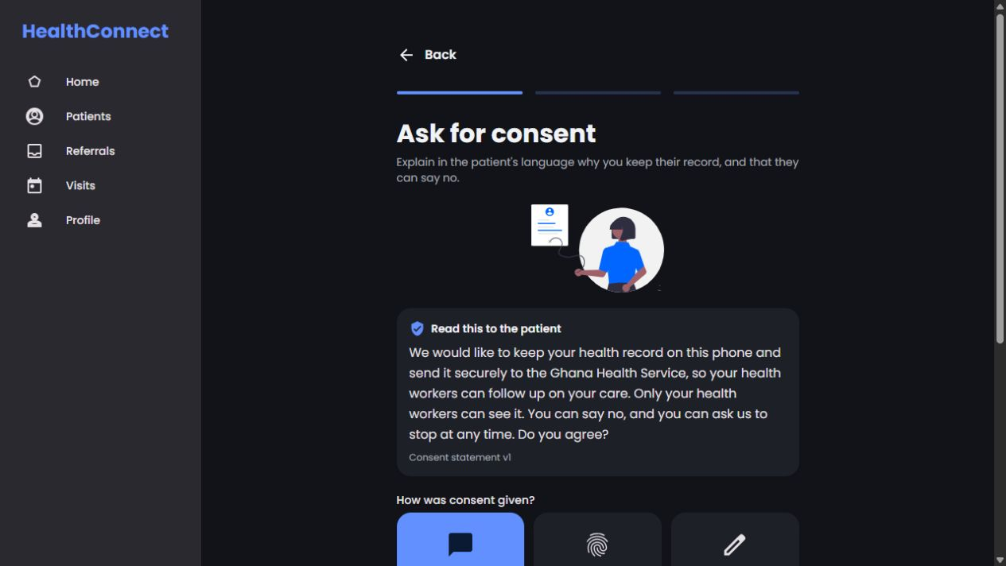
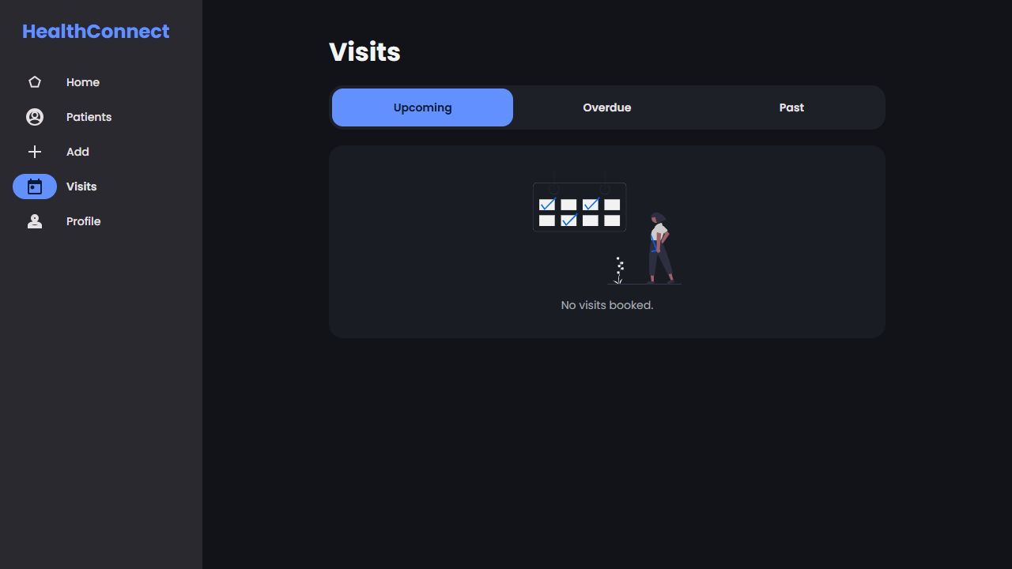
Privacy built in
ENCRYPTED
RDS, backups, secrets, events and the media bucket under our own KMS key
GHANA DATA PROTECTION ACT, 2012 (ACT 843)
Our legal basis is the patient's consent under Ghana's Data Protection Act, 2012 (Act 843).
Nothing is saved without recorded consent, and nothing real goes into the system. Synthetic data only.
PRIVATE
Load balancer, server and database have no public address
LEAST PRIVILEGE
The server reads only its own secrets and bucket. No SSH
LIVE CLOUDFRONT SITE CAPTURES (dwaho59wvxpxe.cloudfront.net)
AUDITED
Every open, change and refused page is logged and hash-chained
Live Consent Gate (/patients/new)
Enforces Spoken/Thumbprint/Signature
Live Visits View (/appointments)
Upcoming, Overdue & Past tabs
ANONYMISED
Officers see counts only, and none under 5
TEAM GODABEG / PROSIT 2 · ICS 534 CLOUD COMPUTING
MENU
NEXT
11
Notes:
[PRIVACY BUILT IN - about 45 seconds]
Health data is sensitive, so privacy is part of the design, not an afterthought. We follow Ghana's Data Protection Act, and our legal basis is the patient's consent. Nothing is saved without it.
Everything is encrypted: the database, the backups, the secrets and the photo storage, using a key we own. The database and servers have no public address. The server has least privilege, meaning it can only reach what it needs. Every open or change is logged. And officers who look at statistics see anonymised counts only, with any number below five hidden so nobody can be identified.
The two captures show the real consent screen and the visits screen on the live site.

Slide 12
Built to recover and to stay cheap
5 min
At most five minutes of server data can be lost.
≈12 min
Our drill on 12 Nov restored the database in about 12 minutes.
7 days
The database can go back to any second of the last 7 days.
$2.25
The whole platform runs for about $2.25 a day.
It heals itself
CloudWatch alarms recover or reboot the server on their own and email the team. A bad release rolls back automatically.
It survives a lost region
Every backup is copied to Ireland and encrypted again there. Phones keep each record until the server confirms it.
We watch the cost
Graviton servers and a small NAT instance keep the bill low, and a budget alert emails us as spending grows.
TEAM GODABEG / PROSIT 2 · ICS 534 CLOUD COMPUTING
MENU
NEXT
13
Notes:
[BUILT TO RECOVER AND TO STAY CHEAP - about 1 minute]
Health systems cannot go down for long, and we are students with a small budget, so we designed for both.
Four numbers. At most five minutes of server data can be lost. In our recovery drill we restored the database in about twelve minutes. The database can go back to any second of the last seven days. And the whole platform runs for about two dollars twenty-five a day.
How: it heals itself, because alarms reboot or recover the server and email the team, and a bad release rolls back automatically. It survives a lost region, because every backup is copied to Ireland, and phones keep each record until the server confirms it. And we watch the cost, using small, efficient servers and a budget alert that emails us as spending grows.

Slide 13
Project Progress & Completion
Live site and cloud analysis - 100% Overall MVP Complete
OVERALL FOUNDATION MVP PROGRESS
100% COMPLETE
Cloud & DevOps
100%
Data & Privacy
100%
Frontend PWA
100%
API & E2E Wiring
100%
• Prod & Staging live on CloudFront
• 16 PostgreSQL 17 tables + 1 view
• 5 roles, each with its own view
• ASP.NET Core API on EC2 + RDS
• Private VPC, ALB & isolated subnets
• LOINC codes for all 6 vital signs
• IndexedDB cache + Outbox sync queue
• Offline outbox syncs to the live API
• Zero-SSH GitHub OIDC -> SSM deploy
• Act 843 consent gate & KMS key
• Video calls, payments, 4 languages
• Reminders, texts, video, payments
• ~$2.25/day in AWS Cape Town
• Anonymised district view (no PII)
• 120+ automated tests passing
• 550+ backend tests, 70% gate
ALL DONE
All four parts delivered and live. Next: native speakers check the Twi, Ewe and Hausa drafts, and real SMS once the sender name is approved.
HealthConnect Ghana · ICS 534 Cloud Computing · Team Godabeg
14 / 14
Notes:
[CLOSE AND DEMO - about 45 seconds, then switch to the live demo]
To close: all four parts are complete and live. The cloud and delivery pipeline, the data and privacy, the app, and the API with everything connected. We have over 550 automated backend tests and over 120 frontend tests.
What is left is not code. Native speakers need to check our Twi, Ewe and Hausa translations, which are drafts. And real text messages will be switched on once our sender name is approved.
Remember Akosua and Ama? Let me show you what happens when Akosua meets Ama, live.
[DEMO ORDER - use the demo logins, code 123456]
1. CHV 020 000 0101 (Akosua): register a patient, record BP 186/118, book the referral. Turn the signal off first if you want to show offline.
2. Nurse 020 000 0102 (Efua): open Referrals, accept the referral.
3. District officer 020 000 0104 (Yaw): the district summary and the fever alert.
4. Auditor 020 000 0105 (Adwoa): the activity log and the tamper check.
[Each number can only request 6 codes per hour. Sign in once per role.]

