Slide 1
The Data Tried to Tell Us Something Impossible.
Here's What It Actually Meant, and Where Ghana's Next Nets Should Go
ICS553 Machine Learning Essentials — Prosit 1 | Mock Ministry of Health Panel
September 21, 2026

Slide 2
Malaria still kills at a scale most policy problems never reach
263 million cases, 597,000 deaths worldwide in 2023 — ~95% of deaths occur in Africa (WHO, Dec 2024).
Ghana's NMEP ran nationwide net distribution in 2023 — but transmission is not uniform.
Interior and border districts carry more burden and are the ones most often left out of national surveys.
WHO World Malaria Report 2024 (December 2024)

Slide 3
One shipment. Limited nets. A committee that needs a defensible answer
Where should Ghana's limited new ITN supply go, and how confident can we be
in the district-level malaria estimates behind that decision?
Target: district-level allocation priority
Unit: cases per 100,000 population (burden); % households with a net (existing coverage)
What actually matters most: confidence, not the point estimate alone

Slide 4
Real data, real limits — three sources, one of them covering just 3 of 16 regions
Household survey (2022 DHS)
District case data (GHS routine)
17,933 households, 618 clusters, 16 regions
Net ownership, wealth index, sampling weights
Licensed extract — confidential
50 real districts — Northern, Upper East, Upper West only
Case counts + region-level net coverage
Ghana Health Service surveillance, 2014-17
13 of Ghana's 16 regions have zero district-level case data. Every finding
from here on is scoped to the north — and we say so, not hide it.

Slide 5
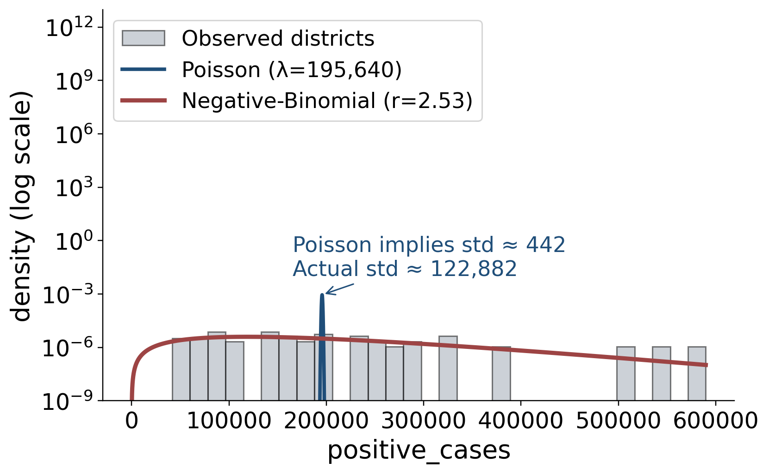
Clue #1: the data is lumpy, and one of our two models can't admit it
Mean: 195,640 cases per district
Variance: 15.1 billion — about 77,000× the mean
Poisson assumes those two numbers should be equal. They aren't close.
Negative-Binomial (r=2.53) has a second dial for exactly this kind of lumpiness.

Slide 6
Clue #2: the raw survey number overstates how protected people already are
-4.2 pts
correction once we account
for deliberate oversampling
The survey oversampled some areas on purpose (e.g. to guarantee rural coverage)
sample_weight corrects each household back to its true population share

Slide 7
Clue #3: pretending villages are independent makes you falsely confident
64.4%–76.4%
Naive bootstrap
(ignores cluster design)
60.8%–77.8%
Cluster bootstrap
(respects survey design)
width 17.0%
vs. 11.9% naive —
the design effect, made visible
Most under-surveyed rural region: 9 clusters, 257 households
2,000 bootstrap resamples; cluster-aware interval correctly comes out wider

Slide 8
Then one number stopped making sense
427,551
cases per 100,000 people
in one district alone
That implies the average resident caught malaria more than four times over the reporting window.
First instinct: a typo in a handful of districts. We checked.

Slide 9
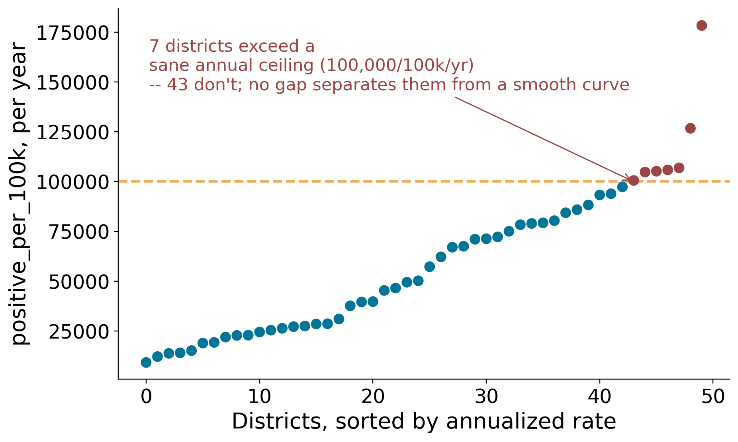
It wasn't a typo. It was every district, on a smooth curve
suspected_cases exceeds population in 50 of 50 districts
No gap separates "broken" districts from "normal" ones — one continuous distribution
Internal ratios stay sane: ~73% test rate, ~58% positivity
Most likely cause: routine facility data counts repeat visits, not unique patients — documented in the literature for this exact surveillance system

Slide 10
We didn't fix an unfixable number — we changed how we use it
Nothing isolated to repair: the pattern is dataset-wide, not a handful of bad rows
Documented, with numbers, in the leakage audit — not silently patched over
Ranking switched from raw magnitude to percentile rank: the ordering across districts survives even when the absolute number doesn't
The data dictionary had already warned us: “treat as a relative burden
indicator, not absolute prevalence.” We just hadn't taken it seriously until now.

Slide 11
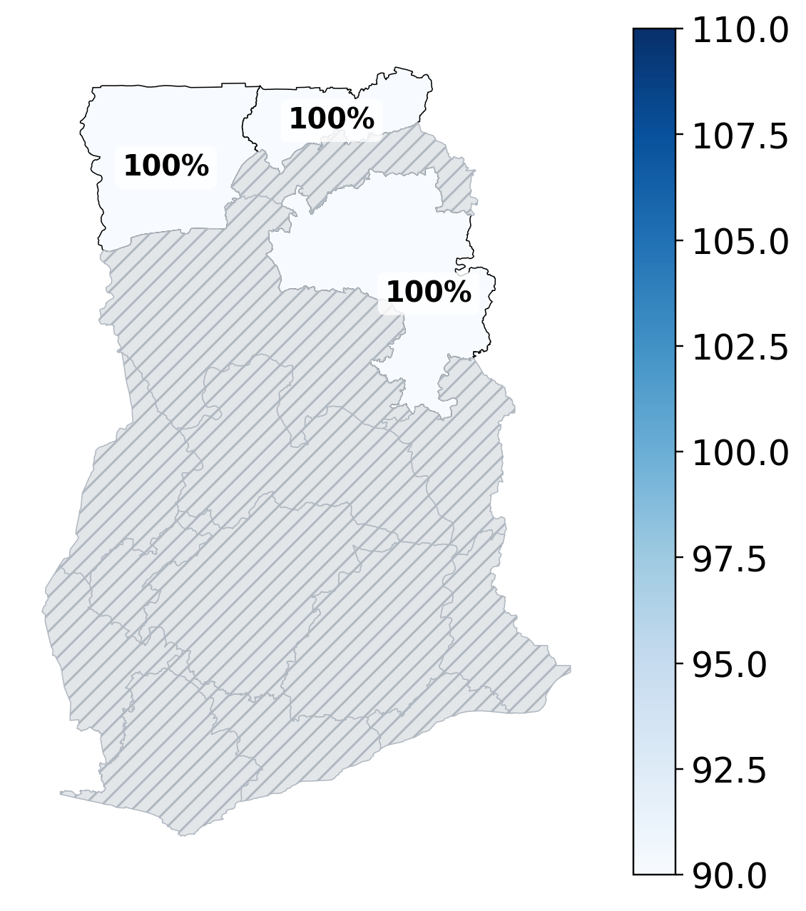
13 of 16 regions were never measured at all
13 / 16
regions with zero
district-level data
Not "low data" — zero.
Silently excluding them implies "no risk." We call them "unknown" instead.

Slide 12
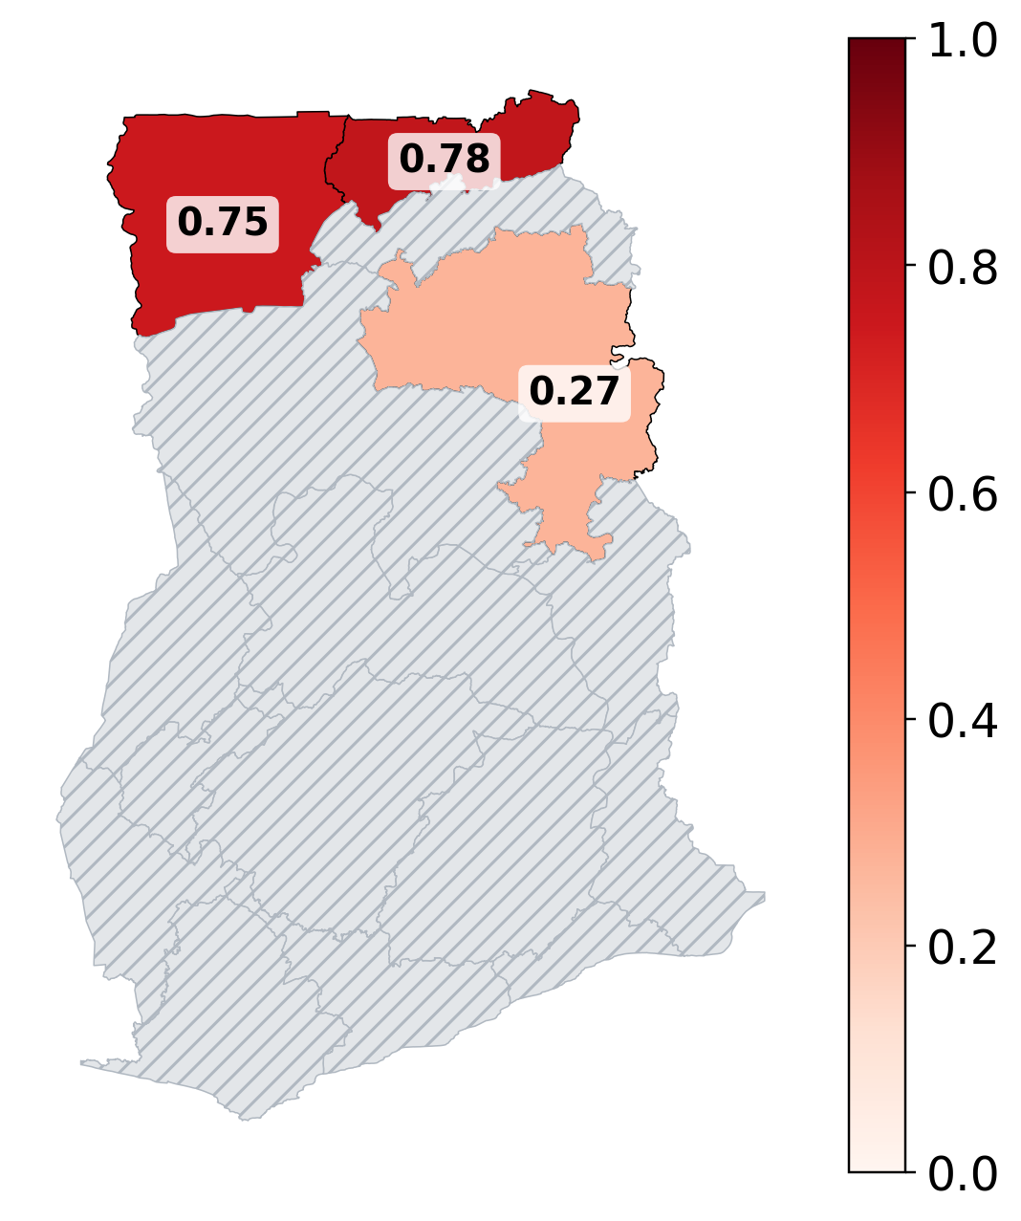
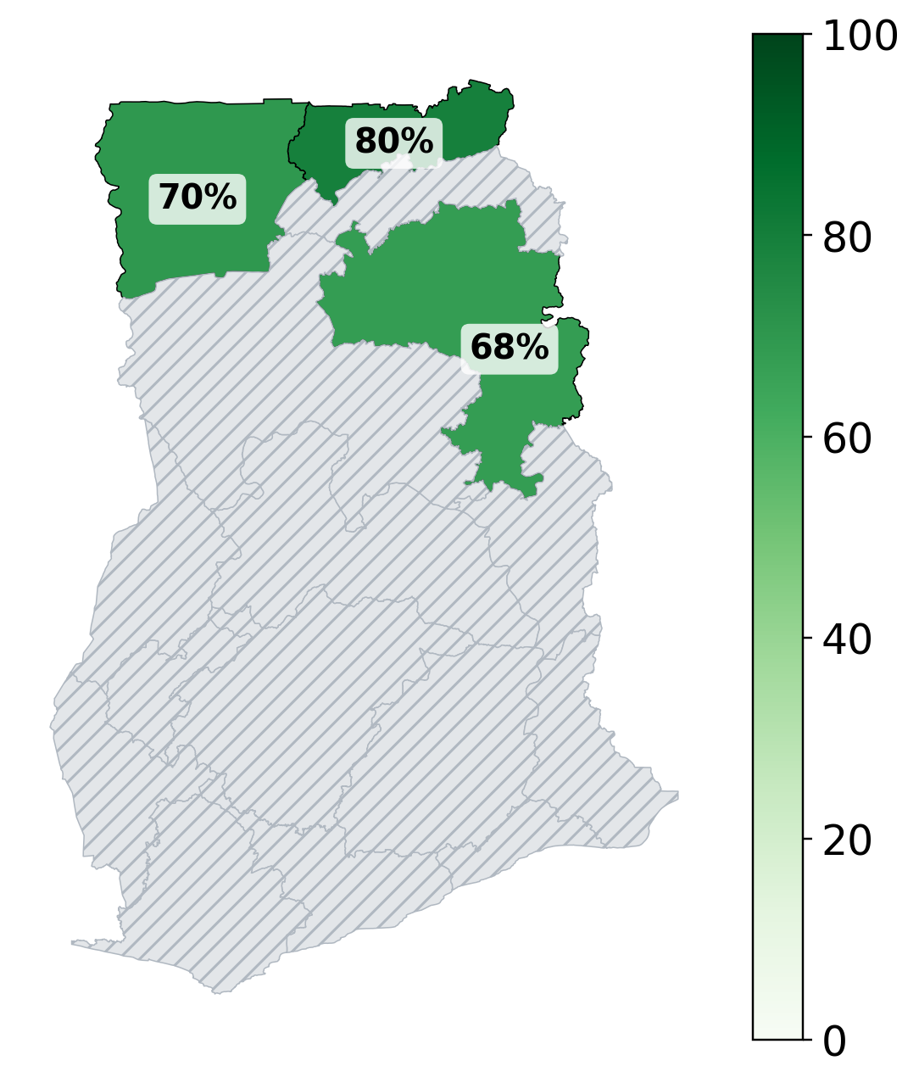
Burden, existing coverage, and confidence — read together, not alone
Burden
Existing coverage
Confidence

Slide 13
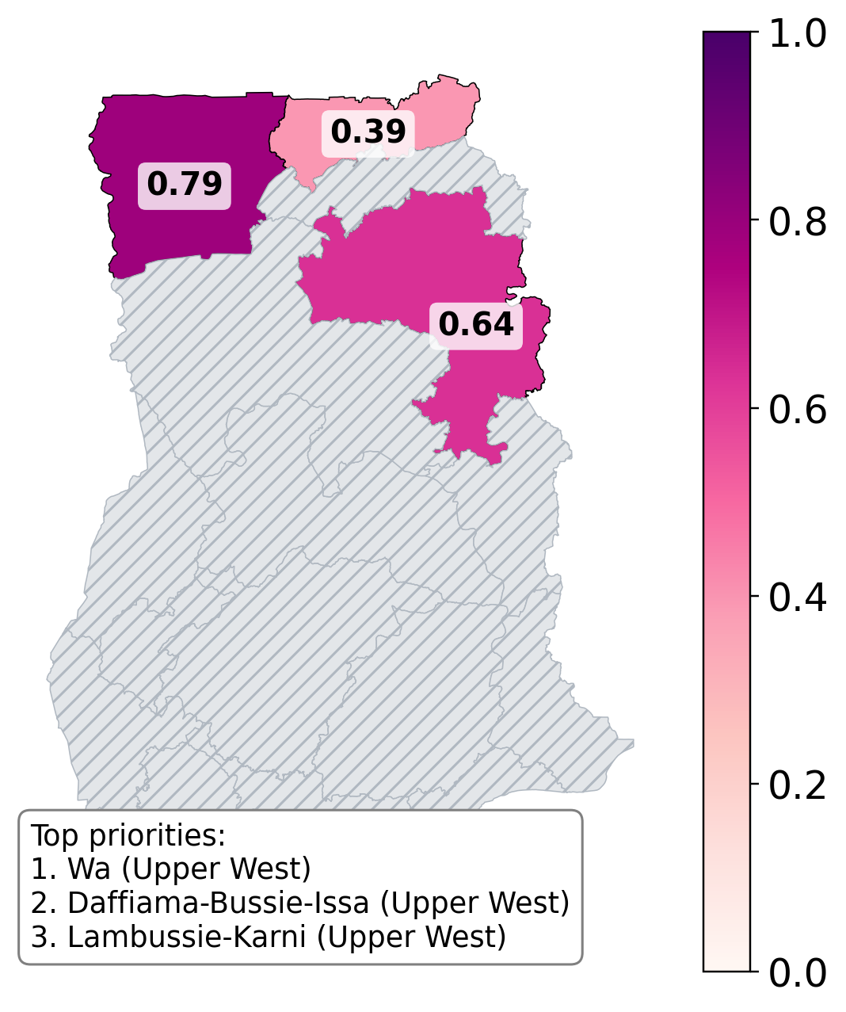
Upper West carries the highest burden and the lowest existing coverage
Immediate priority: Wa, Daffiama-Bussie-Issa, Lambussie-Karni
All three: high burden, high data confidence, lowest existing coverage of the three regions
13 unmeasured regions: flagged for supplementary sampling, not deprioritized by omission

Slide 14
What we're still not sure about
District case data is limited to 3 regions — the recommendation can't speak for the other 13
net_coverage_pct is region-level only — can't differentiate districts within a region
7 districts remain implausible even after annualizing — flagged, not resolved
DHS's own published CI was unavailable (blank) for our bootstrap's target region
2022 net-coverage vs. 2014-17 case window is a temporal mismatch (leakage audit, item 1)

Slide 15
Conclusions
1. The data is genuinely over-dispersed — Negative-Binomial, not Poisson, is the honest model
2. A single "impossible" number turned out to be a real, dataset-wide pattern — investigating beat assuming
3. Percentile ranking survived a data-quality problem that raw magnitude couldn't
4. 13 of 16 regions remain data-blind — equity means naming that gap, not hiding it
Team contact: [team email] | Repository: [github link]

Slide 16
References
WHO World Malaria Report 2024. World Health Organization, December 2024.
Ghana Statistical Service, Ghana Health Service, ICF. Ghana Demographic and Health Survey 2022.
DHS Program. Subnational malaria and ITN indicators, Ghana surveys 2003-2022.
Ghana Health Service. Routine malaria surveillance, Northern/Upper East/Upper West regions, 2014-2017.
geoBoundaries / Humanitarian Data Exchange. Ghana administrative boundaries.

Slide 17
Appendix A
Full leakage audit
1. Temporal: net_coverage_pct (2022) explaining positive_cases (2014-17)
2. Region-reorg: pre-2022 rows missing the 16-region code for split regions
3. Pooled-preprocessing: median mean_population, all data 89,383 vs. train-only 92,010 (diff 2,628)
4. Population-denominator: 50/50 districts exceed population in suspected_cases; annualized rate 9,249-178,339/100k/yr (median 53,777)

Slide 18
Appendix B
Statistical methodology
Poisson: single-parameter (λ = mean); assumes variance = mean by construction
Negative-Binomial: method-of-moments, r = μ²/(σ²-μ); r→∞ recovers Poisson
Sampling weights: hv005/1e6; inverse selection probability from the multi-stage stratified design, adjusted for non-response
Bootstrap: 2,000 resamples, percentile 95% CI; cluster version resamples whole clusters via precomputed per-cluster sums, not individual households

