Slide 1

DATA-DRIVEN RESOURCE ALLOCATION OF ITNs IN GHANA
An Uncertainty-Aware Decision Framework for Allocating 50,000 Indivisible Nets Across 50 Northern Districts
Advisory Presentation to the National Malaria Elimination Programme (NMEP)
Ministry of Health, Republic of Ghana
Group 3 · Master of Science in Intelligent Computing Systems (MICS 2028)
Ashesi University

Slide 2
EXECUTIVE SUMMARY
The Decision Context: Allocating 50,000 Indivisible Nets
Operational Mandate & Constraints
• Strict Resource Ceiling: Exactly 50,000 long-lasting ITNs available for allocation.
• Operational Scope: 50 administrative districts across Northern, Upper East, and Upper West regions.
• Physical Indivisibility: Integer allocations required (no fractional nets; resolved via Hamilton Apportionment).
• Asymmetric Minimax Loss: Under-allocating to an epidemic zone costs lives; over-allocating incurs only minor warehousing friction. We evaluate risk at the 95% upper bound.
Why The Naive Heuristic Fails
⚠ The Clinic Access Bias: Raw cases measure clinic attendance, not infection. Rural areas with no clinics report 0 cases!
⚠ The Referral Hospital Trap: Regional hospitals (Bolgatanga, Wa) log thousands of cases from patients travelling from outside districts.
⚠ Satiation & Diminishing Utility: Upper East already has 79.6% net coverage. Dumping nets there gives zero marginal benefit.
⚠ Ignoring Over-dispersion: High localized spikes are treated as ordinary noise, leaving high-risk zones under-protected.
Ashesi University · ICS553 Machine Learning Essentials · Group 3 · Prosit 1 Advisory Brief
2

Slide 3
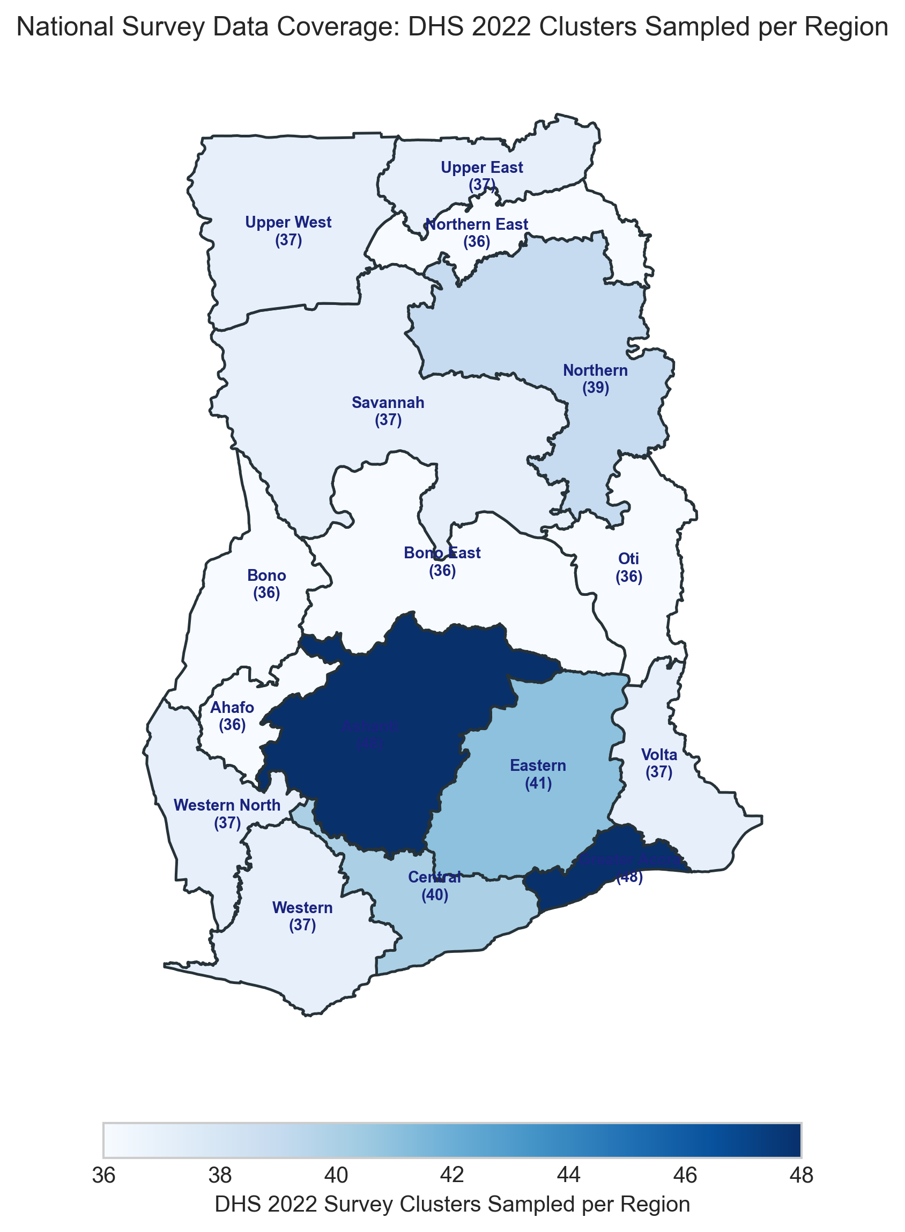
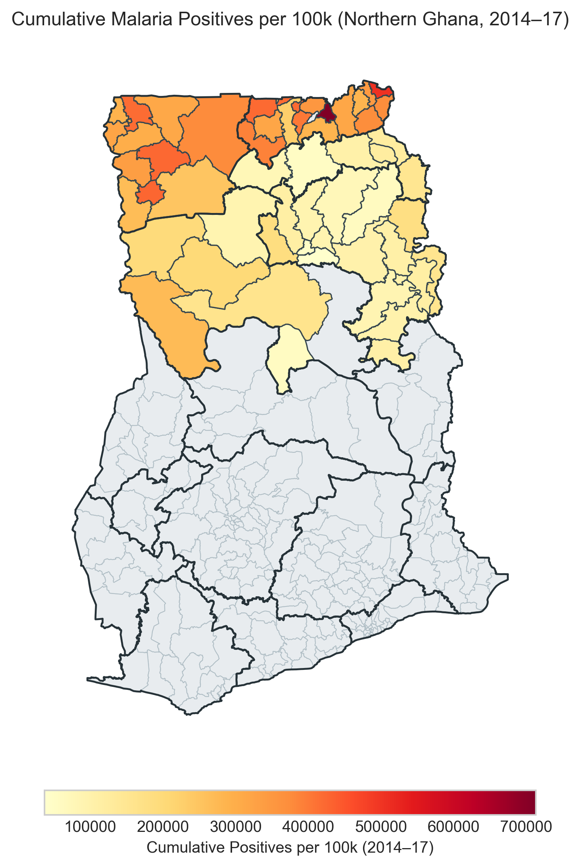
THEME B1 GEOSPATIAL EDA
Geospatial Surveillance & Survey Data Divide
Cartographic Insights
1. Severe Surveillance Divide: 50 northern districts have DHIMS-2 records; 210 southern districts have zero routine data.
2. Survey Density: DHS 2022 sampled 618 clusters nationwide, but rural northern clusters carry wide sampling errors.
3. Survey Weighting: Unweighted net ownership (70.96%) overstates true weighted ownership (66.77%) by 4.19 percentage points.
Ashesi University · ICS553 Machine Learning Essentials · Group 3 · Prosit 1 Advisory Brief
3

Slide 4
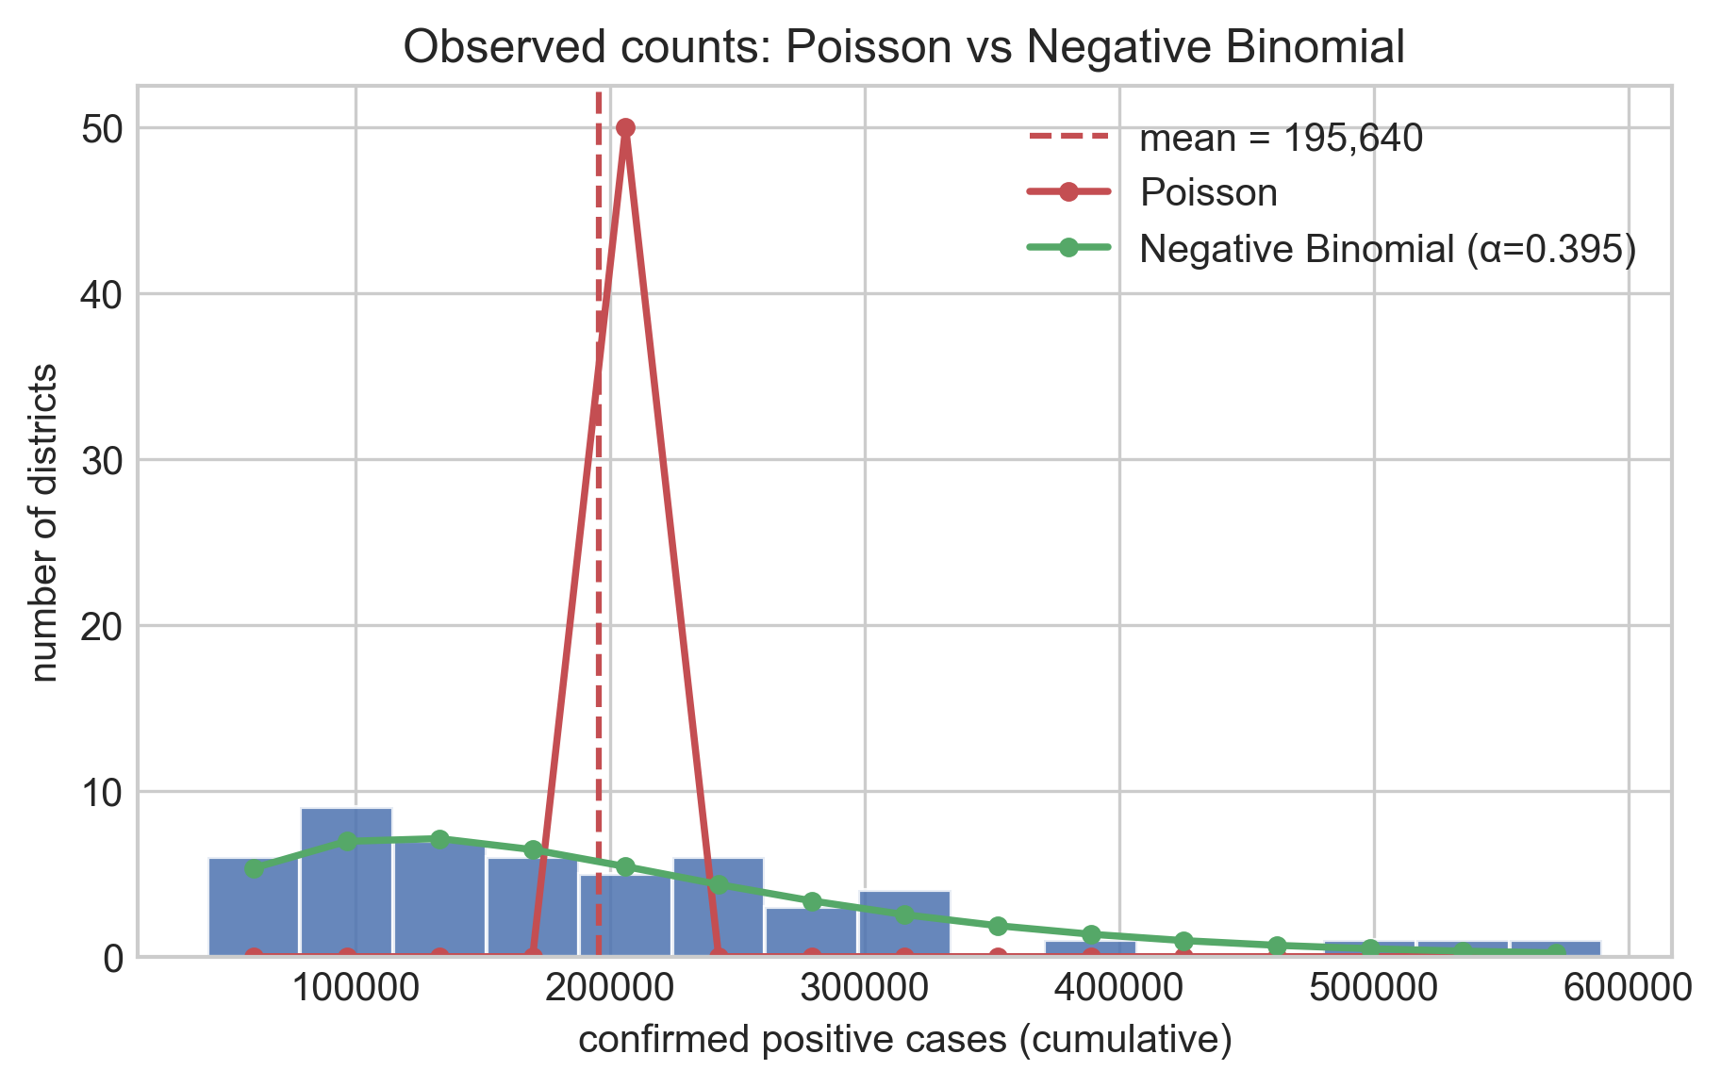
THEME A STATISTICAL MODELING
Over-Dispersion: Why Poisson Regression Crashed
Mathematical Proof of Poisson Failure
The Equidispersion Assumption: Poisson requires Variance = Mean (Ratio = 1.0).
Extreme Real-World Dispersion: In northern Ghana, Variance / Mean = 77,183! Observed SD is 122,882 vs Poisson SD of 442 (278x too narrow!).
Survives Population Offset: Pearson chi2/df = 54,147. Poisson fails catastrophically even after adjusting for district population.
Negative Binomial (NB2): Adds dispersion parameter (alpha = 0.2677), allowing Var = mu + alpha*mu^2. Beats Poisson by 2,393,669 AIC points!
Ashesi University · ICS553 Machine Learning Essentials · Group 3 · Prosit 1 Advisory Brief
4

Slide 5
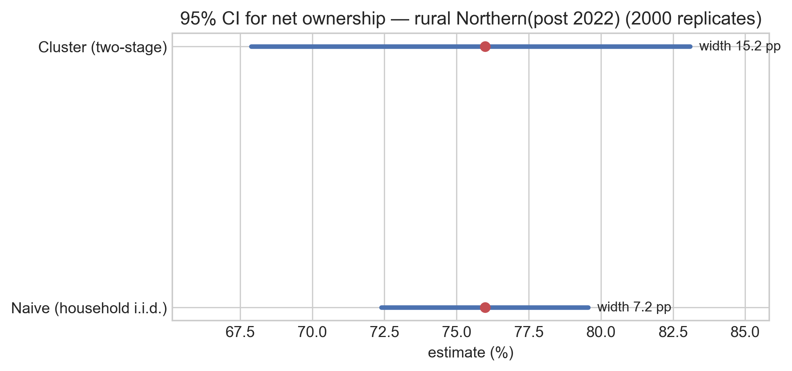
THEME A SAMPLING THEORY
Honest Uncertainty: The Two-Stage Cluster Bootstrap
Survey Design Effects & False Precision
Two-Stage Sampling Structure: DHS samples clusters (villages) first, then 25-30 households per cluster.
Intra-Cluster Correlation: Families in the same village share the same standing water and risk. They are NOT independent.
Naive Bootstrap Danger: Resampling households independently pretends you have 17,933 independent facts, shrinking CI to 7.17 pp (false precision!).
Honest Cluster Bootstrap: Resampling clusters first gives a 15.20 pp interval — 2.12x wider (DEFF = 4.50)!
Validation Benchmark: Survey-weighted net ownership reproduces published 2022 DHS report to 0.09 pp (67.69% vs 67.60%).
Ashesi University · ICS553 Machine Learning Essentials · Group 3 · Prosit 1 Advisory Brief
5

Slide 6
THEME B PIPELINE ENGINEERING
Pipeline Discipline & The Leakage Audit
1. Preprocessing Leak
• Scaling/imputing before split leaks test distribution into training.
• Deflates test RMSE by 212 cases (87,144 vs honest 87,356).
• Prevention: Strict Pipeline and ColumnTransformer encapsulation.
2. Target Encoding Catastrophe
• Encoding district by target mean without out-of-fold regularization.
• Model memorizes training targets, faking R² = 1.0000 (honest 0.4905).
• Prevention: Target encoding rejected entirely.
3. Spatial Autocorrelation
• Random 80/20 train/test splits place neighboring districts on both sides.
• Model 'peeks' at geographic twin; test error drops by 45.5% (47,646 vs 87,356).
• Prevention: Region-stratified holdout split.
Ashesi University · ICS553 Machine Learning Essentials · Group 3 · Prosit 1 Advisory Brief
6

Slide 7
THEME C RESOURCE OPTIMIZATION
The Equitable Need-Weighted Allocation Policy
Three Pillars of the Proposed Allocation Model
1. Upper-Bound Epidemic Risk (mu_upper):
We extract the upper bound of the 95% prediction interval from the Negative Binomial model. This implements an asymmetric minimax hedge, ensuring districts are protected against worst-case epidemic spikes.
2. The Unmet Coverage Gap (1 - Coverage):
Bed nets produce herd immunity. Districts with ~80% coverage experience diminishing marginal returns. Weighting by (1 - coverage/100) directs nets where baseline household ownership is lowest.
3. Hamilton Integer Apportionment:
Guarantees that exactly 50,000 integer nets are allocated (no fractional nets, no budget drops) by awarding floor quotas and distributing remainders to largest fractional deficits.
Weight_i = mu_upper_i x (1 - net_coverage_pct_i / 100) => Allocation_i = Hamilton(Weight_i, Total = 50,000)
Ashesi University · ICS553 Machine Learning Essentials · Group 3 · Prosit 1 Advisory Brief
7

Slide 8
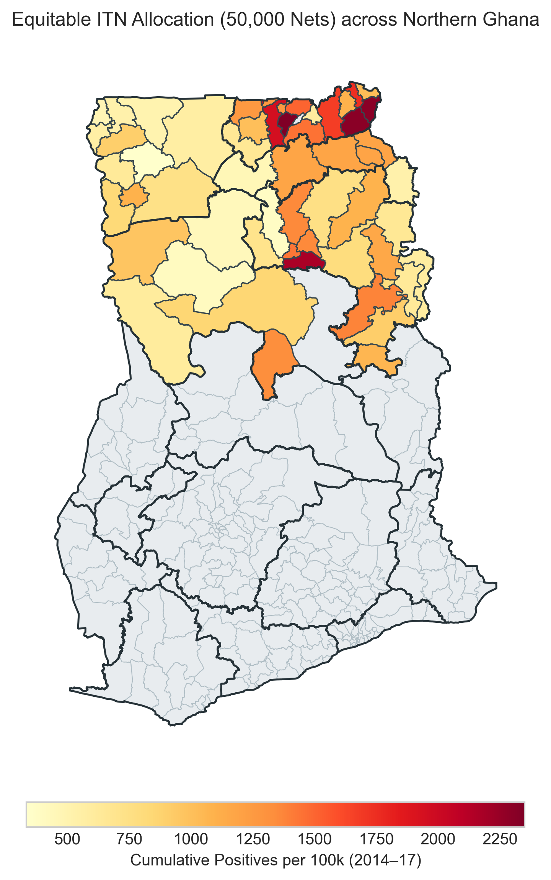
THEME C GEOSPATIAL ALLOCATION
Map Highlight: 50,000 Net Distribution Across Northern Ghana
Regional Consignment Shares
Northern Region Depot (Tamale):
24,980 nets (49.96%) across 26 districts.
Reflects lower baseline net coverage (67.7%) and largest population at risk.
Upper East Depot (Bolgatanga):
17,547 nets (35.09%) across 13 districts.
High historical caseload, but high baseline coverage (79.6%) dampens allocation.
Upper West Depot (Wa):
7,473 nets (14.95%) across 11 districts.
Corrected for hospital referral inflation; nets distributed to rural catchments.
Ashesi University · ICS553 Machine Learning Essentials · Group 3 · Prosit 1 Advisory Brief
8

Slide 9
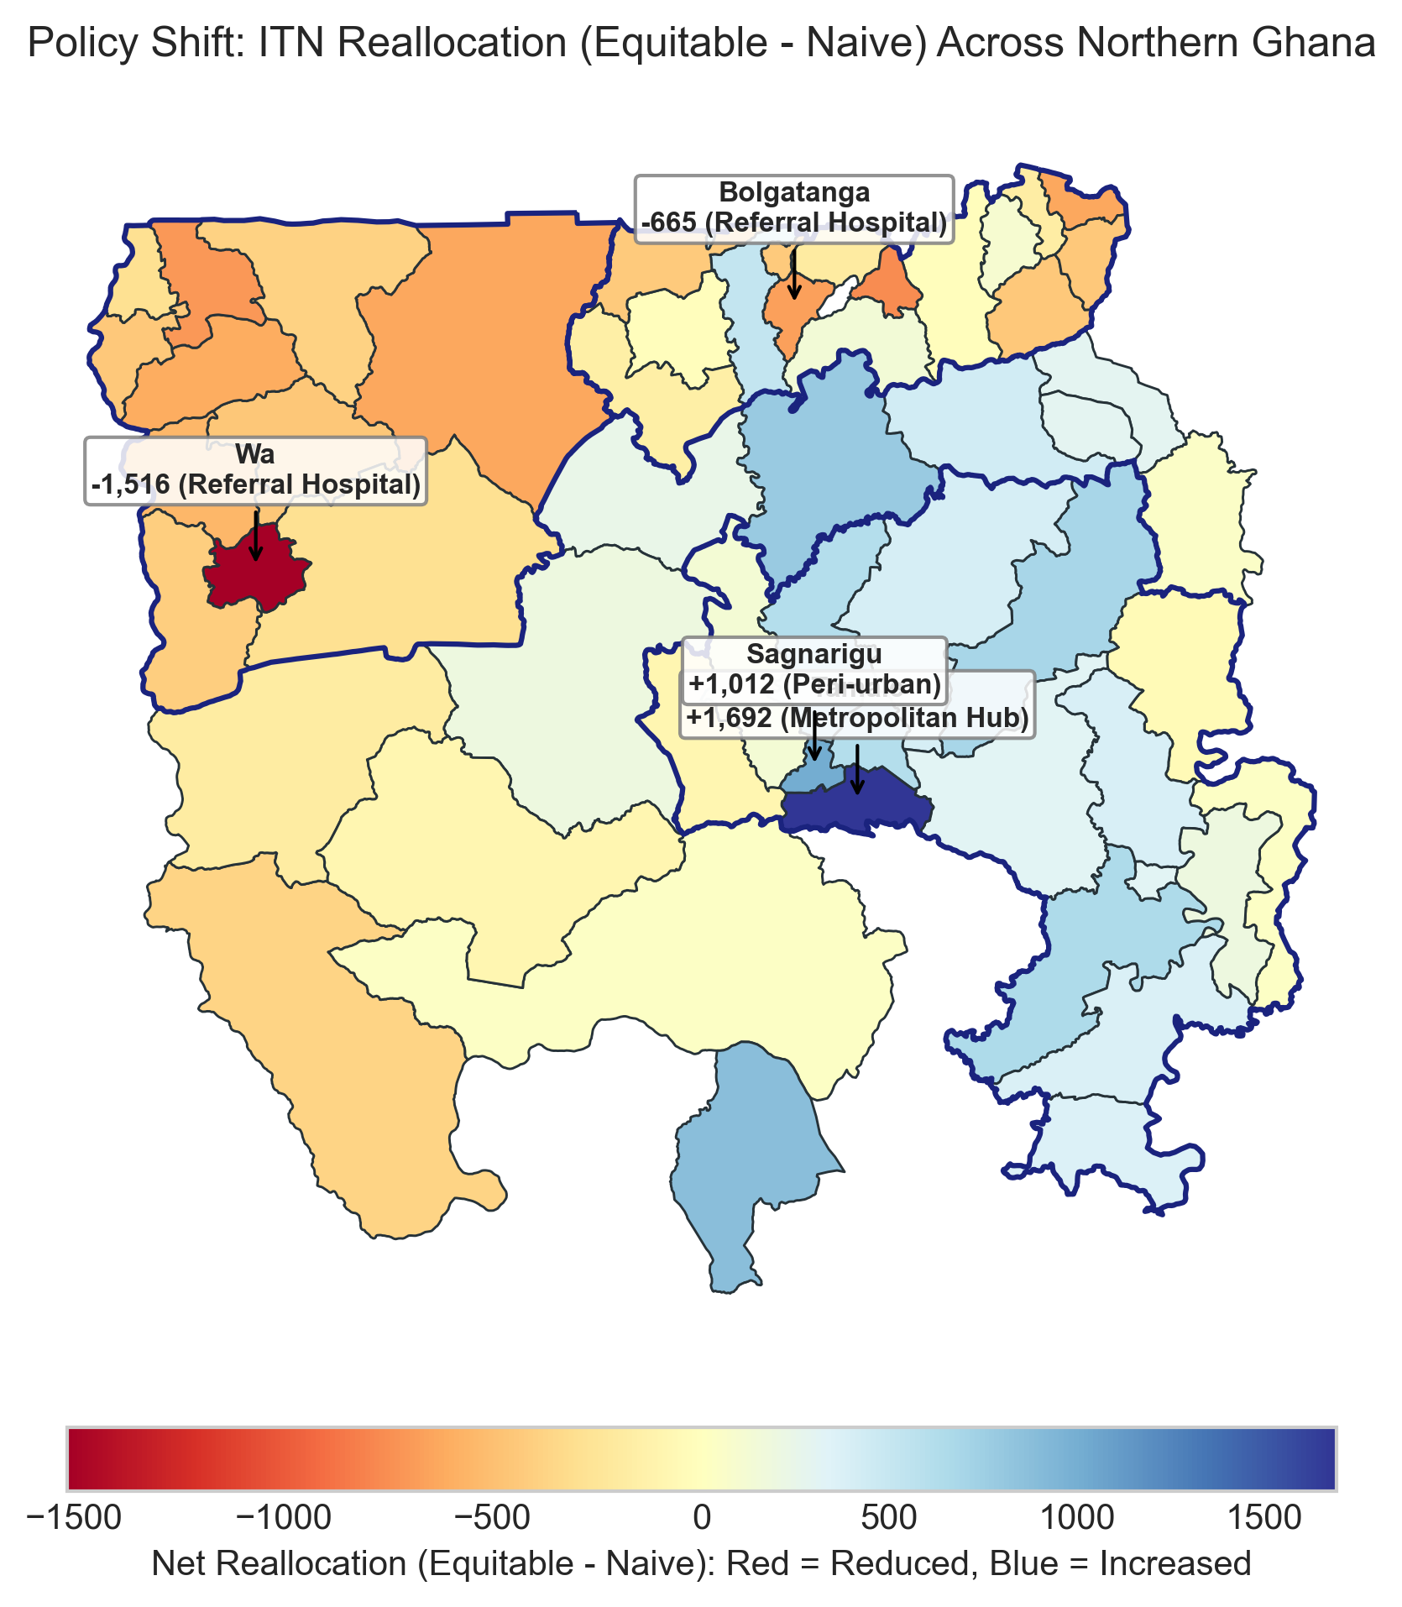
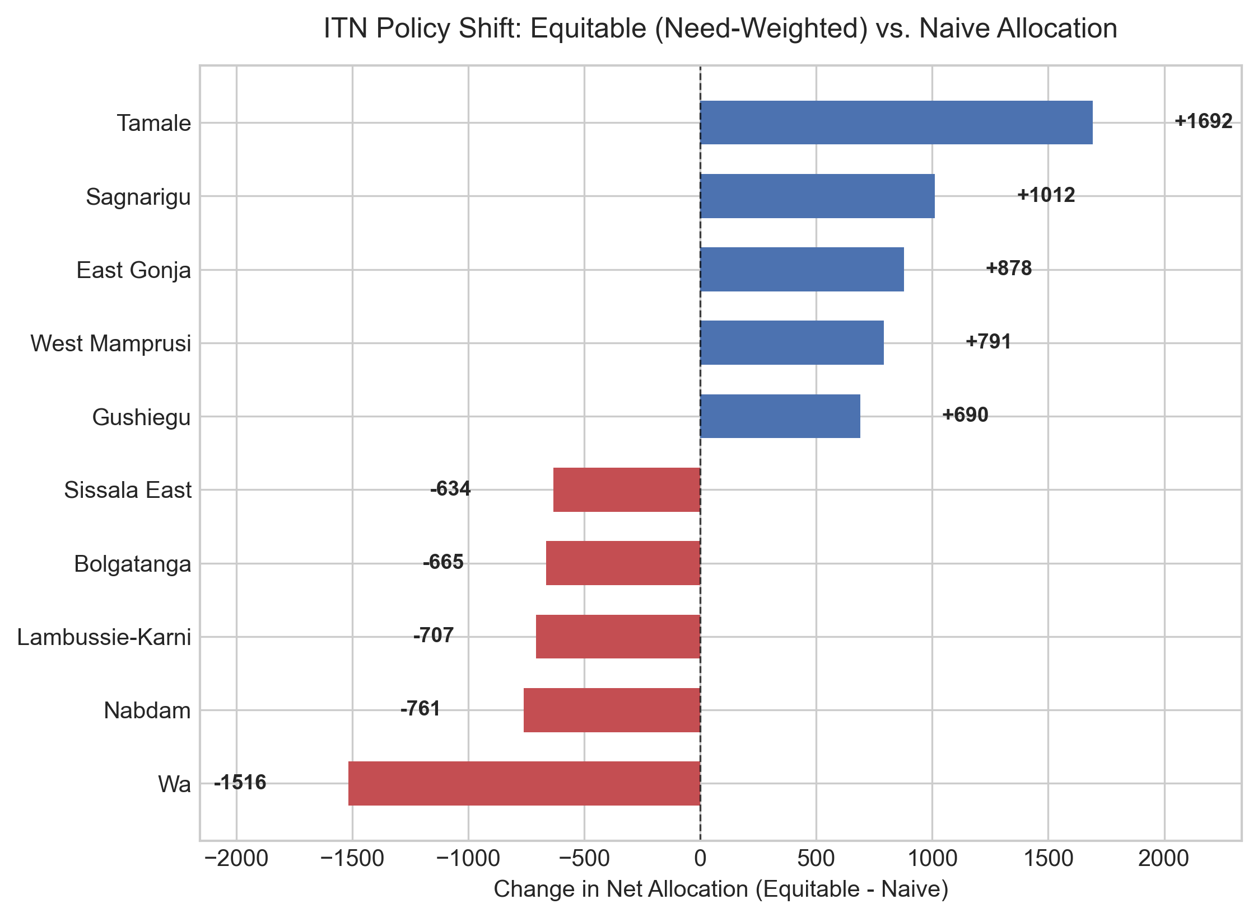
THEME C POLICY IMPACT
Map Highlight: Net Shifts (Equitable vs. Naive)
Ashesi University · ICS553 Machine Learning Essentials · Group 3 · Prosit 1 Advisory Brief
9

Slide 10
THEME C POLICY DEFENSE
Deep Dive: The Referral Hospital Trap Explained
Why Wa (-1,516) & Bolgatanga (-665) Lose Nets
1. Hospital Catchment Distortion: Wa and Bolgatanga host the two regional referral hospitals. Cases are logged at the clinic address, not patient residence!
2. Saturated Baseline Ownership: Upper East has 79.6% net coverage; Upper West has 69.8%. Bolga already has nets in almost every home.
3. Eliminating Waste: Naive allocation gives Bolga 3,015 nets and Wa 2,610 nets. Our model scales them down to honest local community levels.
Why Tamale (+1,692) & Sagnarigu (+1,012) Gain Nets
1. Massive Population at Risk: Tamale has ~255,000 residents; Sagnarigu has ~168,000 residents (the largest urban agglomeration in the north).
2. Critical Unmet Need Gap: Northern Region has only 67.7% baseline coverage. The absolute number of unprotected people is highest here.
3. Correcting Naive Under-allocation: Naive policy awarded Tamale only 483 nets (0.97% of supply)! Equitable allocation restores 2,175 nets.
Ashesi University · ICS553 Machine Learning Essentials · Group 3 · Prosit 1 Advisory Brief
10

Slide 11
THEME D OPERATIONAL STRATEGY
Implementation Roadmap for NMEP Rollout
Four-Phase Rollout Schedule
Phase 1: Regional Warehousing & Staging (Weeks 1-2)
Consignments dispatched to Tamale (24,980), Bolgatanga (17,547), and Wa (7,473) central medical stores.
Phase 2: Last-Mile Delivery via CHPS Compounds (Weeks 3-4)
Bypassing regional hospital gates to distribute directly through Community-Based Health Planning and Services (CHPS), prioritizing pregnant women and children under 5.
Phase 3: Digital Tracking & Traceability (Weeks 4-6)
Barcode scanning of bale deliveries at district health directorates to eliminate supply leakage and diversion.
Phase 4: 6-Month Post-Distribution Audit (Month 6)
Conduct rapid two-stage cluster surveys in recipient communities to evaluate net hanging rates, physical integrity, and local parasitaemia decline.
Ashesi University · ICS553 Machine Learning Essentials · Group 3 · Prosit 1 Advisory Brief
11

Slide 12
ACADEMIC DEFENSE BANK
Viva Oral Defense: Examiner Grill-Me Cheat Sheet
High-Stakes Panel Q&A Scripts
Examiner: 'Why not use Poisson regression?' Answer: In northern Ghana, Variance/Mean is 77,183. Poisson assumes 1.0, underestimating outbreak spread by 278x. Negative Binomial (alpha = 0.2677) accommodates this heavy tail and beats Poisson by 2.39M AIC.
Examiner: 'Why did naive bootstrap fail?' Answer: DHS data is clustered by village. Naive bootstrap pretends households are independent, shrinking the CI to 7.17 pp. Two-stage cluster bootstrap gives an honest 15.20 pp interval (DEFF = 4.50).
Examiner: 'Why cut nets from Bolgatanga when it has the highest case count?' Answer: Bolgatanga Regional Hospital logs cases from surrounding rural districts. Furthermore, Upper East already has 79.6% net coverage. Handing thousands more nets to Bolga causes waste; our model targets true community unmet need.
Examiner: 'What if your budget is cut by 50% to 25,000 nets?' Answer: The priority ranking is invariant. Because Hamilton apportionment scales linearly with relative need weights, the district priority hierarchy remains identical.
Ashesi University · ICS553 Machine Learning Essentials · Group 3 · Prosit 1 Advisory Brief
12

