Slide 1
Where should 50,000 bed nets go?
Allocating bed nets across northern Ghana, with honest uncertainty
Advisory briefing for the National Malaria Elimination Programme
ICS553 Machine Learning Essentials · Group 3 · Ashesi University · September 2026

Slide 2
Our recommendation
For a 50,000-net consignment to the three northern regions: allocate within each region in proportion to population, with regional totals from our negative binomial model.
24,196
nets for Northern Region
26 districts · 8.5 nets per 1,000 people
18,631
nets for Upper East
13 districts · 16.0 nets per 1,000 people
7,173
nets for Upper West
11 districts · 9.2 nets per 1,000 people
Why population within a region: net coverage is measured once per region, so our data cannot tell two districts in the same region apart.
How sure we are: the shares within each region are robust. The regional totals are our base case: a better-fitting model moves 7,720 nets between regions (slide 13).
Notes:
Sources: notebooks/04_allocation.ipynb, cell alloc_cd07 (regional totals), alloc_cd11 (nets per 1,000 people) and alloc_cd13 (7,720 nets moved under the region-effects model).

Slide 3
Averages hide local risk
2%
Greater Accra malaria prevalence, 2022 DHS
Children 6 to 59 months, microscopy
0 to 49%
Predicted prevalence across all 29 Greater Accra districts
2020 household survey and geostatistical model, children 6 months to 10 years, rapid tests
Different ages and tests, so this is not like for like. The point is the spread: one regional figure can hide districts at very high risk. That is why we wanted district-level targeting; the next slide shows how far our data allow it.
Notes:
Sources: Oppong et al., Malaria Journal, doi:10.1186/s12936-025-05724-9 (https://pmc.ncbi.nlm.nih.gov/articles/PMC12829291/); Ghana DHS 2022 final report FR387, Table 12.15.

Slide 4
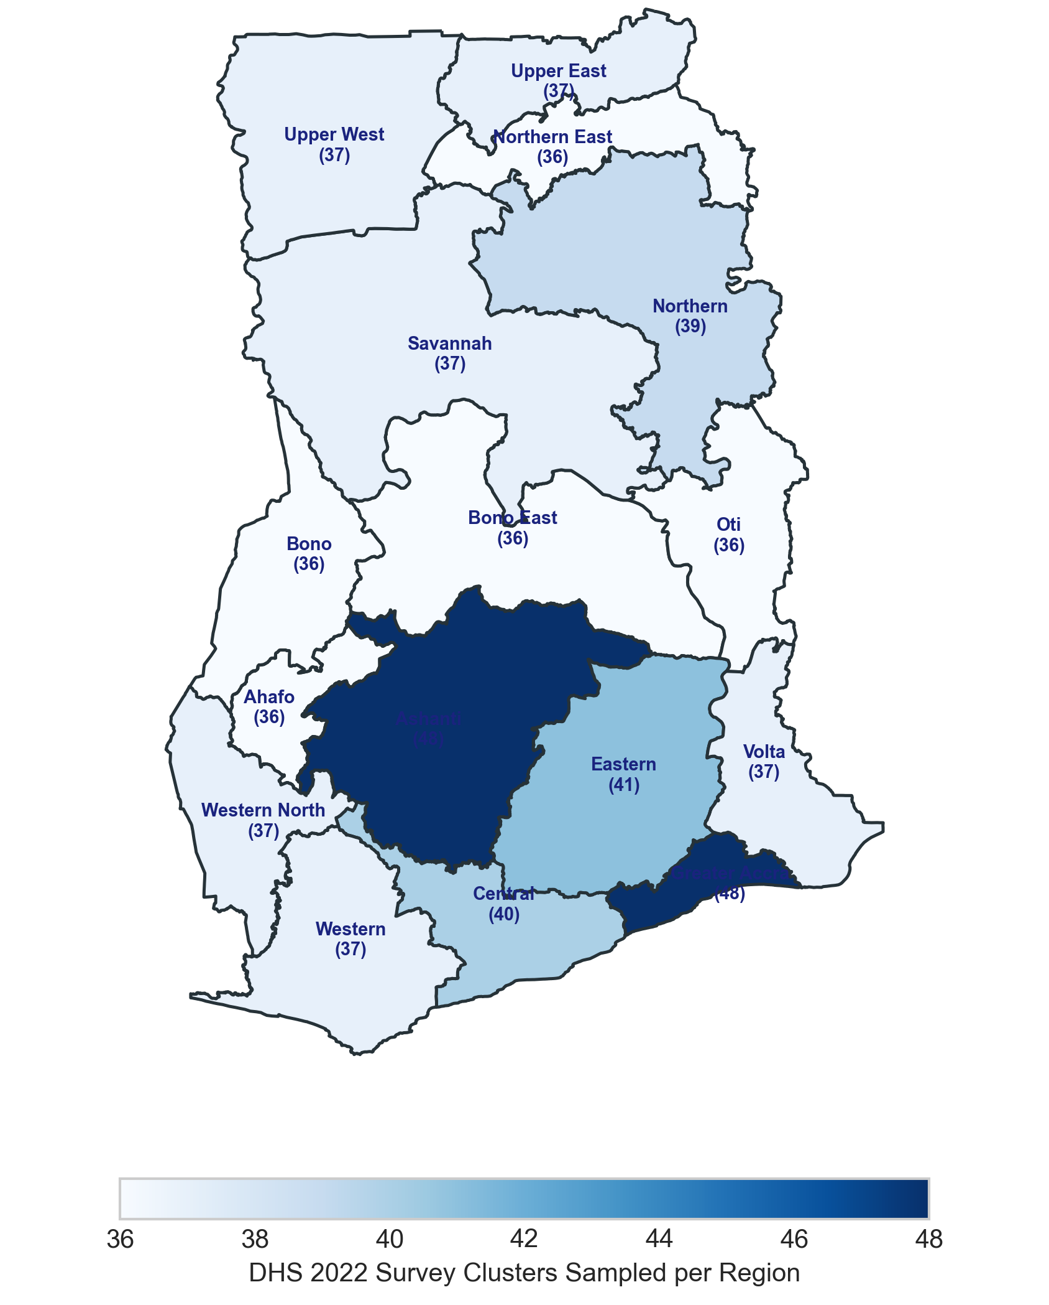
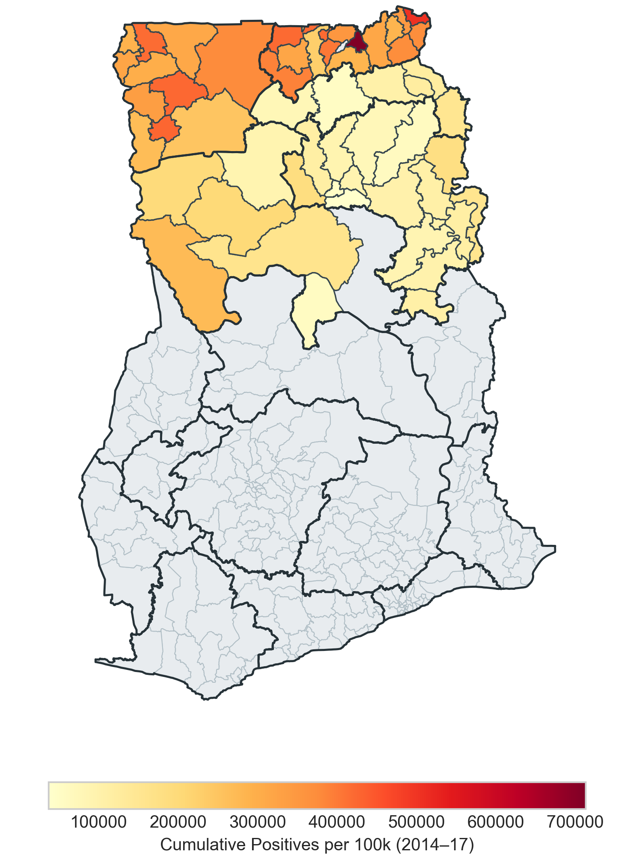
Our data, and where it is thin
What this means
Weights matter. Unweighted, 71.0% of households own a net; weighted, 66.8%.
Different years. Net coverage is from 2022; cases are from 2014-17.
Coarse coverage. Coverage is known only by region: three values for 50 districts.
No district survey data. The survey can rank regions, not districts.
So: our rule, expected cases × the share of households without a net, can separate regions but not districts within a region.
Household survey, DHS 2022. 17,933 households in 618 clusters, all 16 regions; no district identifier.
Routine surveillance, 2014-17. Cases for 50 northern districts only; 207 of today's 260 districts have none in our data.
Notes:
Sources: 17,933 households and 618 clusters: data dictionary and notebooks/02 cell cd03. 71.0% vs 66.8% (claim C-01): notebooks/01_eda.ipynb cell eda_cd05. 50 districts on 53 polygons, 207 of 260 districts without data: scripts/verify_claims.py (map join, same logic as src/viz.py). Maps: figures/b1_data_availability.png and figures/b1_district_case_rate.png from notebook 01, with their titles trimmed.

Slide 5
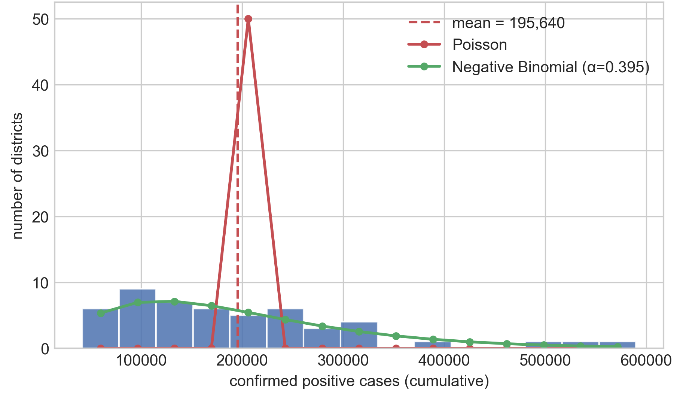
Case counts vary far more than Poisson allows
77,183
variance-to-mean ratio of district case counts; a Poisson model requires 1
442 vs 122,882
spread a Poisson implies (standard deviation) against what we observe: 278 times too narrow
54,147
dispersion left after adjusting for population (Pearson chi-square per degree of freedom)
Working model: negative binomial. Dispersion α = 0.268 with a population offset; it beats Poisson by 2.39 million AIC points.
50 districts, 2014-17. Curves fitted without covariates, so the negative binomial here uses α = 0.395.
Notes:
Sources: notebooks/02_distributions.ipynb cells cd09 (77,183), cd15 (442, 122,882, 278 times), cd18 (0.395), cd25 and cd26 (54,147; alpha 0.2677; AIC gap 2,393,669). Figure: figures/a3_poisson_vs_nb.png, title trimmed.

Slide 6
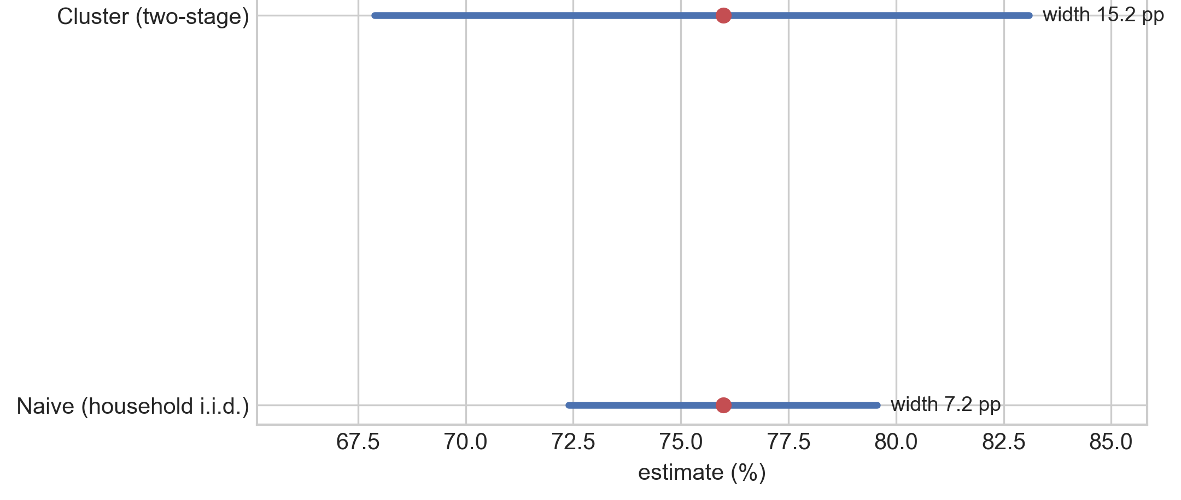
Survey intervals must respect clustering
Households in one cluster share a village, water sources and the last net campaign, so they are not independent.
15.2 vs 7.2 points
Width of the 95% interval for rural Northern net ownership (76.0%): cluster bootstrap against a naive household bootstrap. The honest interval is 2.1 times wider.
Design effect about 4.5
The survey holds the information of a simple random sample about a quarter its size (4.5 to 5.4 across seeds; 4.2 by a design-based formula).
0.09 points
Our weighted estimate for Northern Region against the published DHS figure (67.69% vs 67.60%). This checks our weighting, not our interval: the published ITN intervals are empty.
Rural Northern Region: 582 households in 20 clusters, 2,000 replicates, seed 42. Chosen for its link to our districts; it ranks 10th of 16 regions by rural clusters, so it is not the most under-sampled.
Notes:
Sources: notebooks/02_distributions.ipynb cells cd31 (582 households, 20 clusters), cd33 and cd34 (15.20 vs 7.17, 2.12 times, design effect 4.50), cd37 (published ITN intervals empty, 0 of 76), cd39 (67.69% vs 67.6%). Seed spread 4.46 to 5.39 and design-based 4.18: scripts/verify_claims.py section A. Rank 10th of 16: scripts/verify_claims.py section D. Figure: figures/a4_bootstrap_ci_comparison.png, title trimmed.

Slide 7
Leakage audit: what held up, and what did not
Leak | Broken version | Disciplined version | What we found
Preprocessing | Scaler fitted on all 50 districts before splitting | Scaler fitted inside a Pipeline, on training districts only | Real mechanism, negligible here: 212 cases at seed 42, 44 on average over 500 seeds
Target encoding | Each district encoded with its own case count | Only features that do not use the outcome | Test R² of 1.00 against 0.26: the feature is the answer
Spatial | Random split, or random split stratified by region | Whole region held out | Random and stratified splits agree (about 90,000); a held-out region gives 365,128
Temporal | 2022 coverage used to explain 2014-17 cases | Documented; not read causally | The coverage coefficient reflects region, not the effect of nets
Notes:
Sources: notebooks/03_pipeline_leakage.ipynb cells leak_cd04 (87,144 vs 87,356), leak_cd06 (R² 1.0000 vs 0.2618), leak_cd08 (one seed), leak_cd12 (500 seeds) and leak_cd14 (whole region held out); the table itself is leak_cd10.

Slide 8
Only a held-out region tests new geography
A split stratified by region still puts each test district's neighbors in the training set.
Across 500 random seeds, random and region-stratified splits give the same test error.
Train on two regions, predict the third, and the error is four times larger.
So, the model cannot yet rank districts in a region it has not seen, such as the 207 districts outside our data.
Test RMSE in confirmed cases, Ridge model from notebook 03. Random splits: median of 500 seeds. Held out: Northern 272,529, Upper East 589,777, Upper West 139,143.
Notes:
Sources: notebooks/03_pipeline_leakage.ipynb, cells leak_cd12 (500 seeds) and leak_cd14 (whole region held out, via io.split_data(..., hold_out=region)). Literature: Ploton et al. 2020, Nature Communications 11:4540, doi:10.1038/s41467-020-18321-y; Kattenborn et al. 2022, ISPRS Open Journal of Photogrammetry and Remote Sensing, doi:10.1016/j.ophoto.2022.100018 (up to 28% overestimation of F1-score).

Slide 9
What our rule does with our data
The rule, for each district i
log μ_{i} = log pop_{i} + β₀ + β₁ c_{i}
w_{i} = U_{i} × (1 − c_{i} / 100)
q_{i} = 50,000 × w_{i} / Σ_{j} w_{j}, A_{i} = ⌊q_{i}⌋ or ⌊q_{i}⌋ + 1, Σ_{i} A_{i} = 50,000
Unit: district i. Target: μ_{i}, expected confirmed cases 2014-17, from a negative binomial (variance μ_{i} + αμ_{i}², α = 0.268). Metric: the weight w_{i}. U_{i}: upper 95% confidence bound for μ_{i}. c_{i}: % of homes with a net in i's region. A_{i}: nets, by Hamilton's largest-remainder method.
What it does with our data
c_{i} takes one value per region, so inside a region nets follow population: 8.5, 16.0 and 9.2 per 1,000 people.
U_{i} = μ_{i} × 1.20, 1.34 or 1.16: one multiplier per region, from a confidence interval for the mean.
β₁ = +0.082 per point: more nets went with more malaria, so the split between regions is uncertain.
Nets per 1,000 people by region, with the share of households owning a net (DHS 2022). Upper East has the highest coverage and the most nets per person: the coefficient reflects region, not the effect of nets, so the regional split is uncertain (slide 13).
Notes:
Symbols: i = district (the unit); mu_i = expected confirmed cases, 2014-17 (the target); w_i = allocation weight (the metric); pop_i = population; c_i = % of homes owning a net in i's region (DHS 2022); U_i = upper 95% confidence bound for mu_i; q_i = exact share; A_i = nets.
Sources: notebooks/04_allocation.ipynb cells alloc_cd05 (alpha 0.2677) and alloc_cd11 (beta_1 = +0.0823, p = 1.7e-07; U_i / mu_i = 1.198, 1.342, 1.162; nets per 1,000 people); src/models.py compute_allocation and hamilton. Coverage values: notebooks/02 cell cd06 and scripts/verify_claims.py section D.

Slide 10
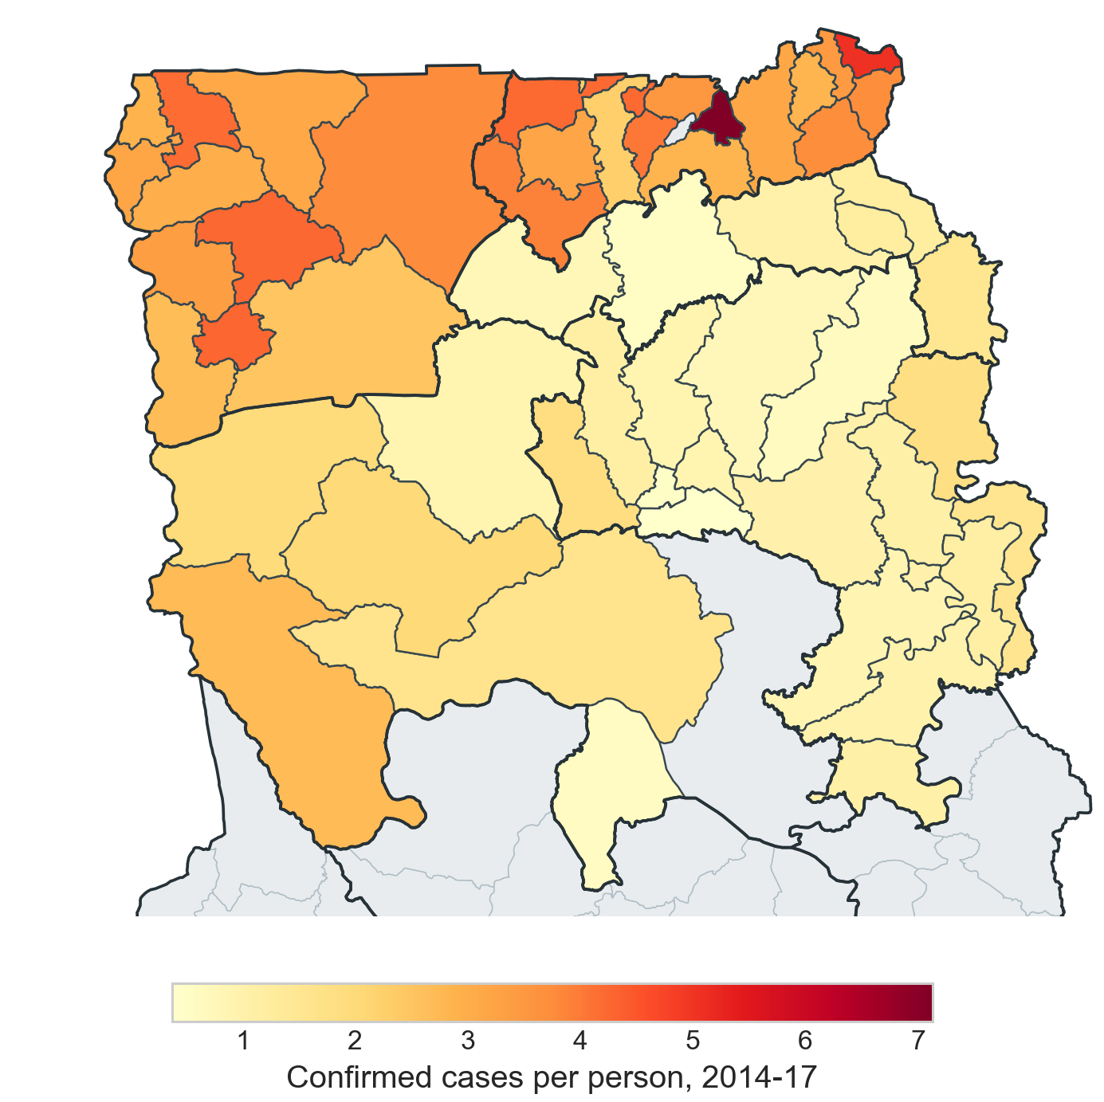
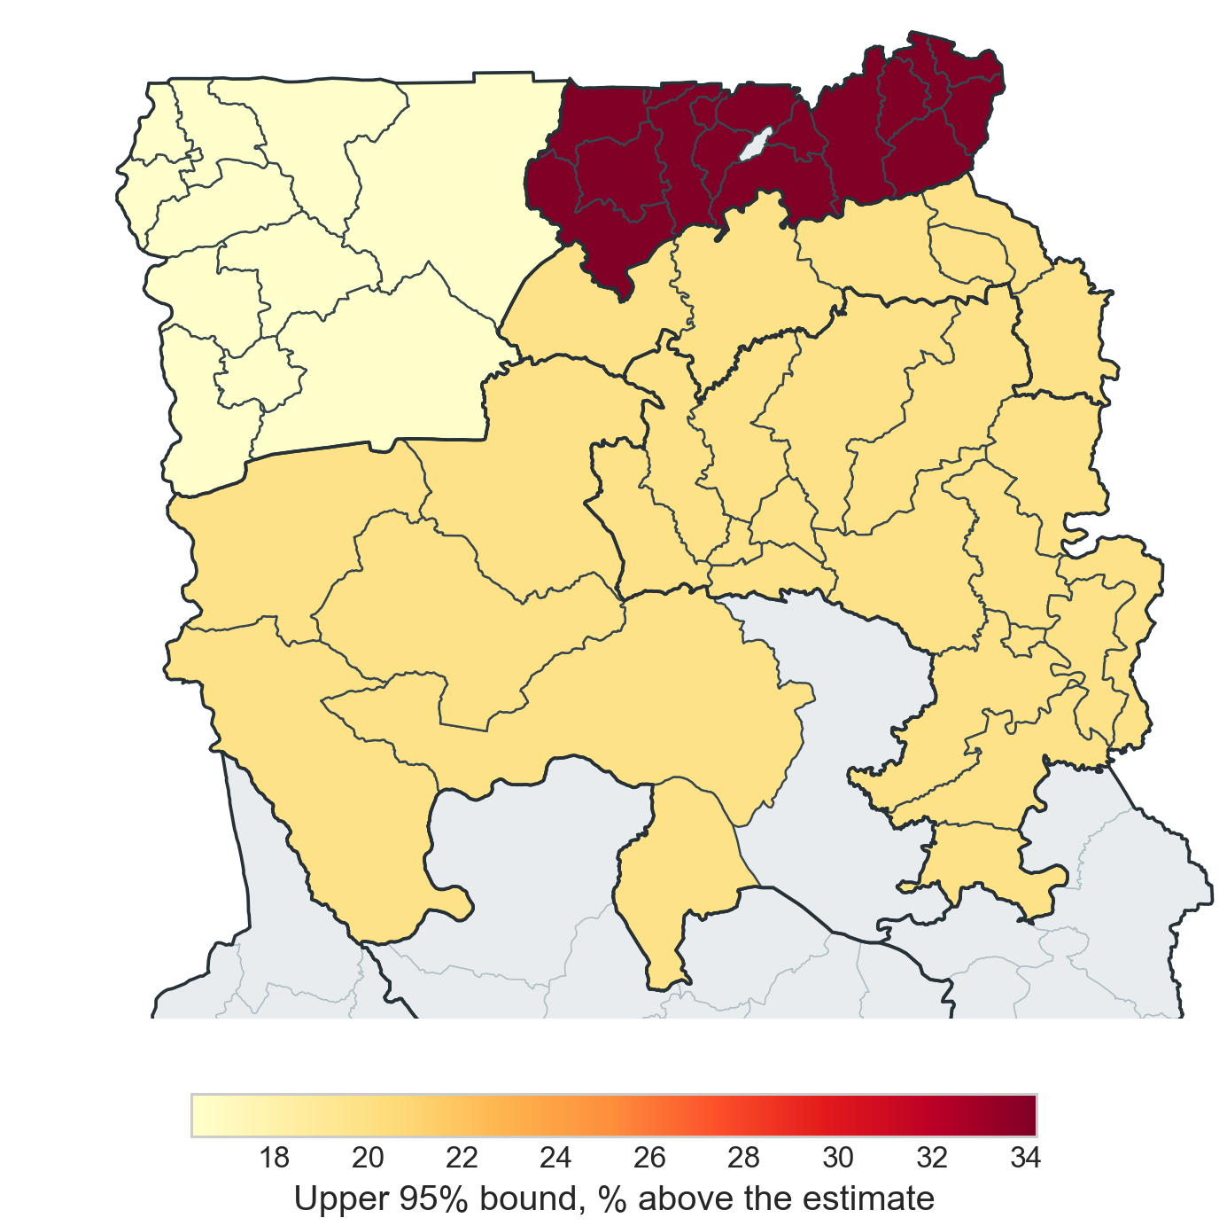
Where the need looks highest, and how sure we are
Reported burden. Confirmed cases per person, 2014-17: highest in Upper East and Upper West, lowest across Northern Region. Grey areas have no case data of their own.
How sure we are. Our upper bound sits 20% above the estimate in Northern, 34% in Upper East and 16% in Upper West: one number per region, because coverage is.
Takeaway: the rule uses the upper bound, so it leans towards the region we are least sure about.
Notes:
Sources: cases per person and the upper-to-expected ratios 1.198, 1.342 and 1.162: notebooks/04_allocation.ipynb cell alloc_cd11. Both maps are drawn with src/viz.plot_district_choropleth from models.compute_allocation, zoomed to the north like the allocation map. The two-map layout (burden next to uncertainty) follows the course roadmap.

Slide 11
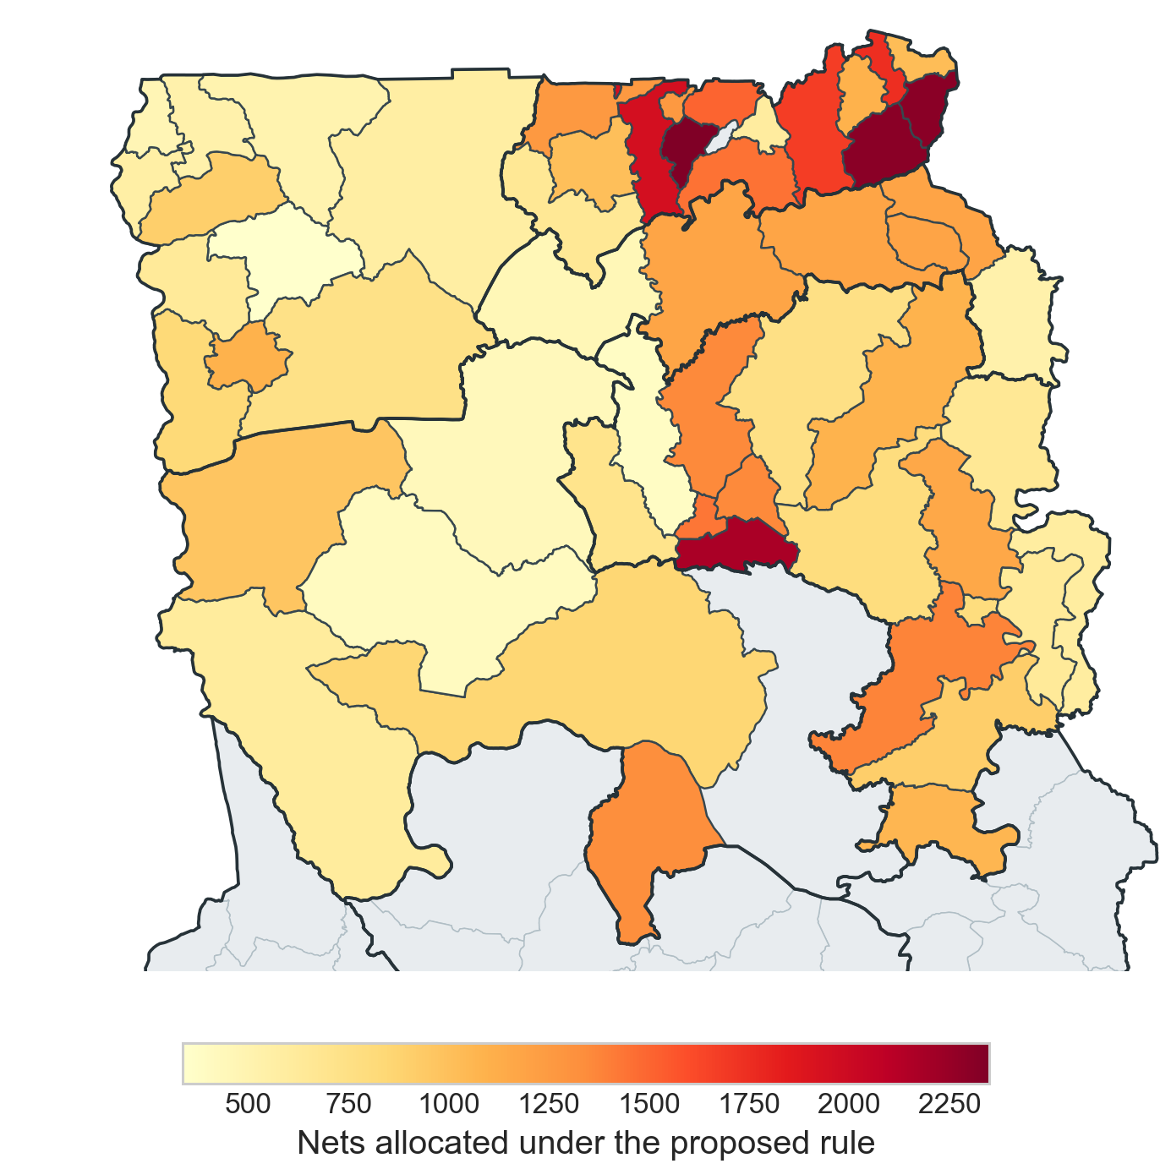
The proposed allocation
Regional totals
Northern 24,196 · Upper East 18,631 · Upper West 7,173
Largest allocations
Bolgatanga 2,350 · Garu-Tempane 2,309 · Tamale 2,175 · Kasena-Nankana 1,954 · Bawku 1,750
Smallest
Daffiama-Bussie-Issa, 335. Every district receives nets, and the total is exactly 50,000.
Notes:
Sources: the 50-district schedule in reports/allocation.md reproduces exactly from notebooks/04_allocation.ipynb (cells alloc_cd07 and alloc_cd09; scripts/verify_claims.py section C checks all 50 rows). Map drawn with src/viz.plot_district_choropleth from the same allocation, zoomed to the north. The three pre-2018 districts later split (Garu-Tempane, Savelugu-Nanton, Bunkpurugu-Yunyoo) show their total on both successor areas.

Slide 12
Who gains, who loses, and why
Our comparator gives nets in proportion to reported cases. It is not Ghana's practice: national campaigns allocate by population, about one net per two people.
Tamale gains most (+1,692): the largest population, and the lowest reported cases per person of all 50 districts.
Within each region, the more cases per person a district reported, the more nets per person it gives up. Nabdam and Bole, the highest in their regions, lose 761 and 376.
We treat everyone in a region as equally at risk. That is a value judgement, and we make it openly.
Referral bias at Wa and Bolgatanga is a hypothesis, not a finding: Tamale hosts the north's only tertiary hospital yet reports the lowest rate.
Change in nets against case-proportional allocation: the five largest gains and losses.
Notes:
Sources: gains and losses: notebooks/04_allocation.ipynb alloc_cd09; cases-per-person ranks: alloc_cd11 (Tamale lowest of 50, Nabdam highest of 50, Bole highest in its region). Ghana's ITN strategy: PMI Ghana Malaria Operational Plan FY2017. Tamale Teaching Hospital as the only tertiary provider for the three northern regions: https://tth.gov.gh/about

Slide 13
What would change the answer
Scenario | Northern | Upper East | Upper West | Nets moved
As proposed | 24,196 | 18,631 | 7,173 | baseline
Point estimate instead of the upper bound | 25,095 | 17,240 | 7,665 | 1,391
Region-effects model (fits better: AIC 1,253.8 vs 1,286.8) | 18,634 | 16,473 | 14,893 | 7,720
Coverage corrected for the 11 districts now in Savannah or North East | 27,686 | 14,891 | 7,423 | 3,740
Northern coverage at its lower interval bound (61.4%) | 22,939 | 18,596 | 8,465 | 1,292
Northern coverage at its upper interval bound (74.0%) | 29,004 | 11,951 | 9,045 | 6,680
Takeaway: within a region, nets follow population in every scenario except the coverage correction. The regional split is the uncertain part, so treat regional totals as a range, not a point.
Notes:
Sources: notebooks/04_allocation.ipynb cell alloc_cd13, which also prints the coverage it uses (Savannah 79.1%, North East 62.8%; published 79.1% and 62.6%, GDHS 2022 Table 12.1) and the Northern cluster-bootstrap bounds 61.4% and 74.0% (as in notebooks/02 cell cd39).

Slide 14
Equity: who this helps, and who it misses
Outside the map
207 of 260
of Ghana's districts have no district case data in our package. This allocation says nothing about them and should not be stretched to them.
Testing access
65%
median test positivity in Northern Region, the highest of the three, yet it reports the fewest cases per person (0.27 a year, against 0.88 and 0.80). That points to under-testing, which a case-based rule would punish.
Interventions we left out
32 and 24
of the 50 districts had indoor spraying and seasonal chemoprevention in 2014-17, including every Upper East and Upper West district. Both change burden, and sprayed districts are excluded from national net campaigns.
Privacy by design
0
data files or notebook outputs in the project's git history. Licensed DHS household records stay out of git and out of this deck; everything shown is an aggregate.
Notes:
Sources: 207 of 260 districts: scripts/verify_claims.py (map join). Test positivity and cases per person by region: scripts/verify_claims.py section E. Spraying and chemoprevention counts: scripts/verify_claims.py section E, from the raw surveillance workbook in the course data package (these columns are not in the curated district file). Campaign rules: PMI Ghana Malaria Operational Plan FY2017. Privacy: git history holds no data files and no notebook outputs (checked 2026-09-22).

Slide 15
Limitations, and what we would do next
Limitations
11 districts coded Northern are now in Savannah (79.1% of households own a net) or North East (62.8%). Correcting this moves 3,740 nets.
39 of 50 districts report more than one confirmed case per resident over 2014-17: repeat episodes, care-seeking across district lines, or undercounted populations.
Coverage is from 2022 and cases from 2014-17.
The survey has no district identifier or parasitaemia data, and published ITN intervals are empty.
Before any real distribution
Refit with today's regions and district-level spraying and chemoprevention.
Model risk with region effects, and use coverage only in the gap term.
Validate by holding out whole regions, and report the spread across seeds.
Deliver through regional medical stores and CHPS compounds, then survey net use after six months.
Notes:
Sources: 11 districts, 3,740 nets, 79.1% and 62.8%: notebooks/04_allocation.ipynb alloc_cd13. 39 of 50 districts: scripts/verify_claims.py section E. Empty ITN intervals: notebooks/02 cell cd37. No district identifier or parasitaemia: notebooks/02 cell cd06.

Slide 16
References
Published sources
[1] Oppong SK, Dosoo DK, Peprah NY, et al. Fine-scale spatial mapping of urban malaria prevalence for microstratification in an urban area of Ghana. Malaria Journal 25:50 (published 18 December 2025). doi:10.1186/s12936-025-05724-9. Slide 3.
[2] Ghana Statistical Service (GSS) and ICF. Ghana Demographic and Health Survey 2022. Accra, Ghana, and Rockville, Maryland, USA: GSS and ICF; 2024. Slides 3, 6 and 13.
[3] U.S. President's Malaria Initiative. Ghana Malaria Operational Plan FY 2017. Published 25 October 2016. Slides 12 and 14.
[4] Ghana Statistical Service, Health Research Unit (Ministry of Health) and ORC Macro. Ghana Service Provision Assessment Survey 2002. Calverton, Maryland; 2003. Slide 12.
[5] Tamale Teaching Hospital. About the hospital. tth.gov.gh/about (accessed 24 September 2026). Slide 12.
[6] Ploton P, Mortier F, Réjou-Méchain M, et al. Spatial validation reveals poor predictive performance of large-scale ecological mapping models. Nature Communications 11:4540 (2020). doi:10.1038/s41467-020-18321-y. Slide 8.
[7] Kattenborn T, Schiefer F, Frey J, et al. Spatially autocorrelated training and validation samples inflate performance assessment of convolutional neural networks. ISPRS Open Journal of Photogrammetry and Remote Sensing 5:100018 (2022). doi:10.1016/j.ophoto.2022.100018. Slide 8.
Data, software and code
[8] Ghana 2022 DHS household data: a de-identified extract of the household recode, used under the course's DHS data-use authorization, with the DHS subnational indicators for Ghana.
[9] Ghana Health Service routine malaria surveillance for 50 northern districts, 2014-17, from the ICS553 course data package.
[10] OCHA. Ghana subnational administrative boundaries (COD-AB), via the Humanitarian Data Exchange. Maps on slides 4, 10 and 11.
[11] Pedregosa F, et al. Scikit-learn: Machine Learning in Python. Journal of Machine Learning Research 12:2825-2830 (2011).
[12] Seabold S, Perktold J. statsmodels: Econometric and statistical modeling with Python. Proceedings of the 9th Python in Science Conference (2010).
[13] Group 3. Project repository, with the notebook cell behind every number (reports/claims_table.md) and the datasheet (reports/datasheet.md): github.com/ASU-MICS-2028/mle-group-3-prosit-1
Notes:
Sources: each reference was checked on 25 September 2026 against the source itself: DOIs and journal details, the publishers' own recommended citations, and the passages the deck relies on (reports/claims_table.md, rows E-01 to E-05).

Slide 17
Thank you. Questions?
ICS553 Machine Learning Essentials · Group 3 · Ashesi University
AI declaration: we used AI tools to help aggregate our information and to generate this presentation from our aggregated information.
Notes:
The footnote is the group's AI declaration. Each member's own AI-use declaration is part of their individual reflection.

