Slide 1
NkwaPay credit scoring
A Kenyan model, a Ghanaian launch, and what stands between them
ICS553 Prosit 2 · Group 3 · 3 November 2026

Slide 2
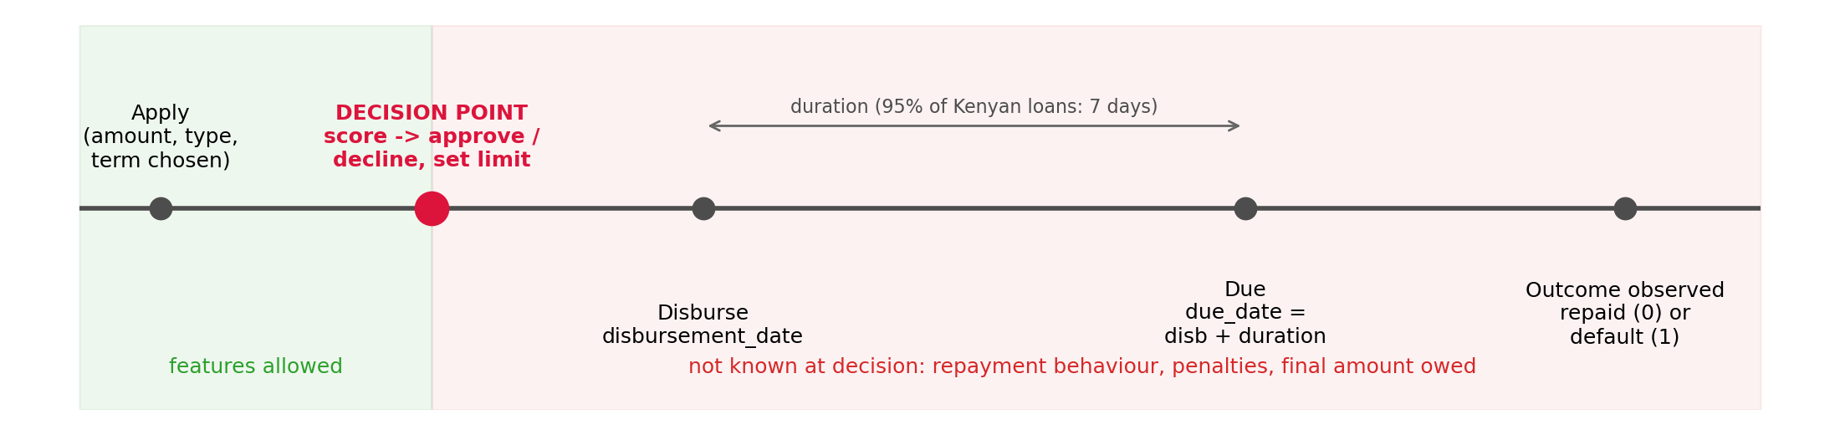
The question
• NkwaPay wants to score Ghanaian loan applications
• We have 66,520 labelled Kenyan loans (1.63% default) and 2,084 unlabelled Ghanaian ones
• Two tasks: will this loan default? how much should we lend?
• Decision point: approval, before disbursement; nothing known after it may be a feature
• Cost matrix (GHS 500 loan): a good loan earns 25, a default loses 380 → decline if P(default) > 0.062
One default wipes out the profit of 15 good loans.

Slide 3
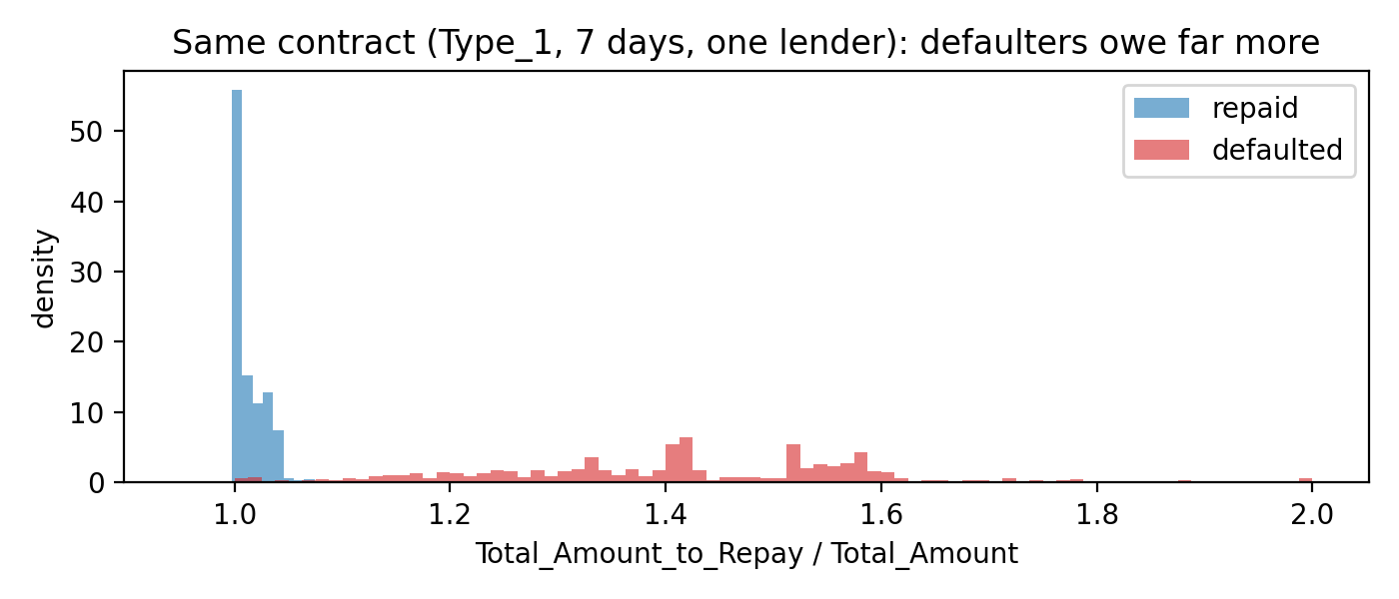
The data gives the answer away, if you let it
• Total_Amount_to_Repay looks like a contract term
• On identical contracts, repaid loans owe +0.7%; defaulted loans owe +41% (penalties added later)
• Alone it predicts default with AUC 0.98
• A naive pipeline scores PR-AUC 0.825; our honest estimate is 0.145
• Also: co-funded loans appear twice; Zindi split by row, so 920 loans straddle Train and Test
We dropped it. A model using it would fail on every real applicant.

Slide 4
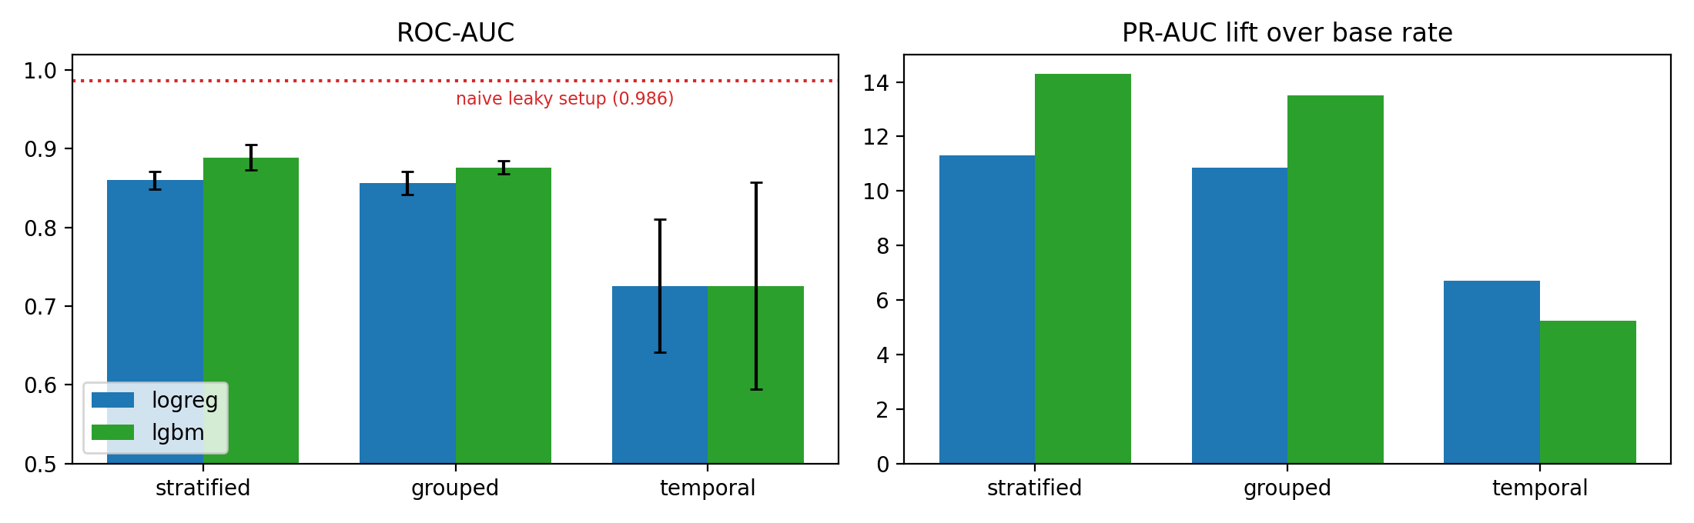
Validation design picks the model
• Stratified CV: LightGBM 0.233 vs LogReg 0.184 PR-AUC
• Temporal CV: LogReg 0.129 vs LightGBM 0.106
• Grouping by customer barely matters (history features are leakage-safe)
• Time is what matters: random CV overstates 1.7–2.7×
Random CV doesn't just inflate the score, it picks the wrong model.

Slide 5
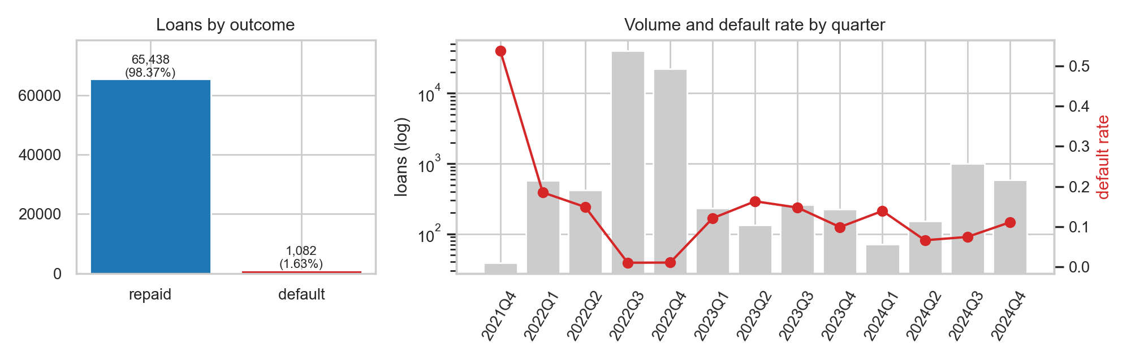
Kenya changed in December 2022
• Type_1, 93% of all loans and ~1% default, stops after 1 Dec 2022
• Afterwards: 9–13% default, mostly new customers
• Both models fall from ROC ~0.8 to ~0.6
• Repeat customers are scored badly too: the market changed, not just the customers
This is our best Kenyan proxy for a new market, and the model barely copes.

Slide 6
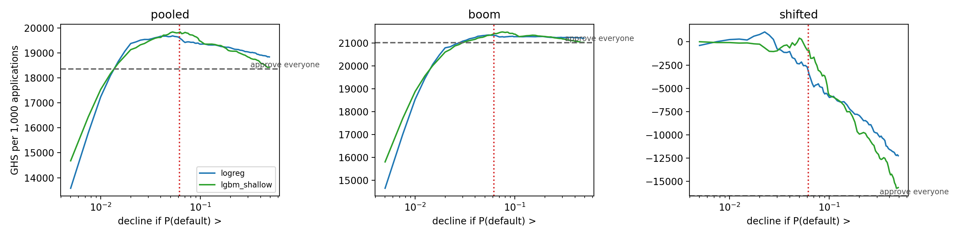
Model choice and the money
• 12 candidates on temporal folds; class weights never helped and broke calibration
• LogReg: best PR-AUC (0.143), best after Dec 2022; shallow LightGBM: best ROC
• Bootstrap: LogReg ≈ LightGBM on PR-AUC overall; LogReg significantly better after Dec 2022
• Per 1,000 applications after Dec 2022: approve-all −16,600 GHS; LogReg at 0.062 −3,500
The model earns its keep exactly where it is least accurate.

Slide 7
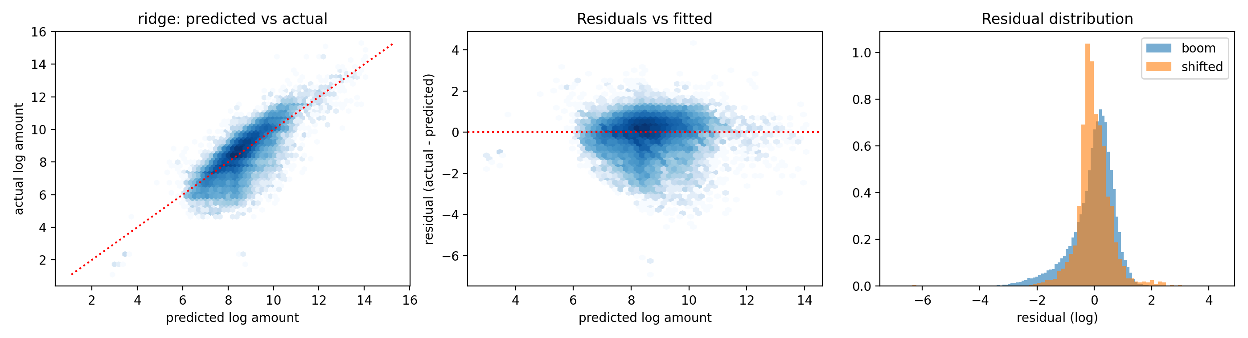
How much to lend
• Ridge on log amount, trained on repaid loans only; median error ≈ 1,930 KES (GHS 150)
• Raw-scale terms extrapolated a 3-year loan to e^57 KES; log scale and a cap fixed it
• 'Lend what they borrowed before' is within 25% more often than any model (38%)
• First-time borrowers over-predicted by ~40% → first-loan cap

Slide 8
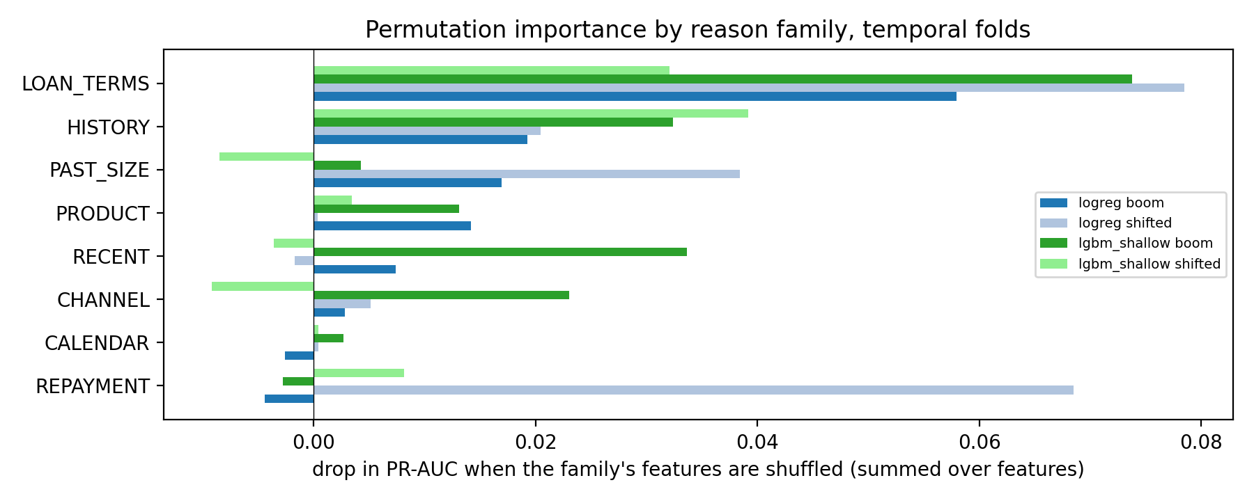
Telling a borrower why
• Logistic log-odds split exactly into reason families; top 3 become plain-language reasons
• Caught: term and amount coefficients cancel, so a 'loan too big' reason pointed the wrong way
• Caught: Ghana applicants on unseen products would be told their product 'had problems'; now: 'new to us, no record yet'
• Calendar features moved scores without predicting anything → removed

Slide 9
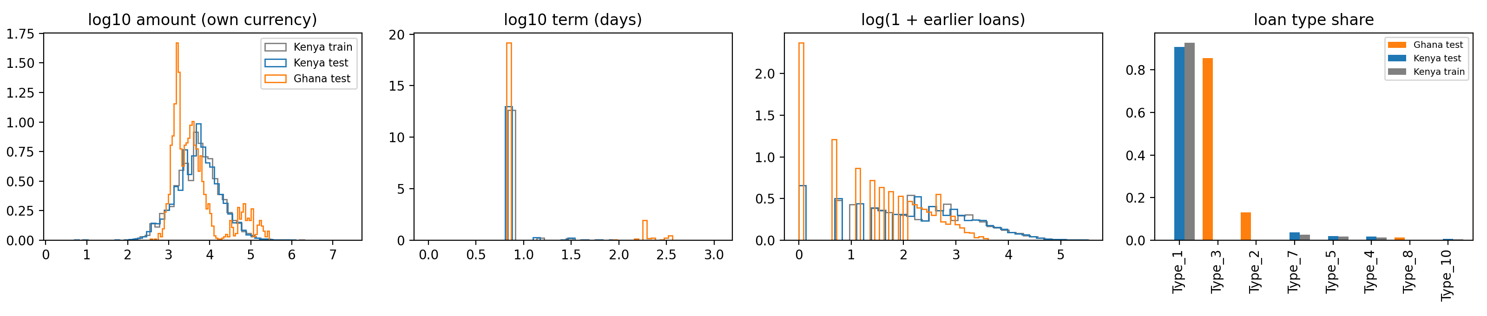
Ghana: out of the model's reach
• 87% of loans on unseen products, 96% on unseen lenders, 66% co-funded
• Domain classifier: AUC 1.000 (0.999 without product, lender, co-funding)
• Importance weighting: effective sample 2.3% of Kenya; scores change, no way to check
• Model would decline 22% (Kenya 6.7%): almost all Type_2/Type_8, 8.5% of Type_3
No automated Ghana decisions until a capped pilot produces Ghanaian outcomes.

Slide 10
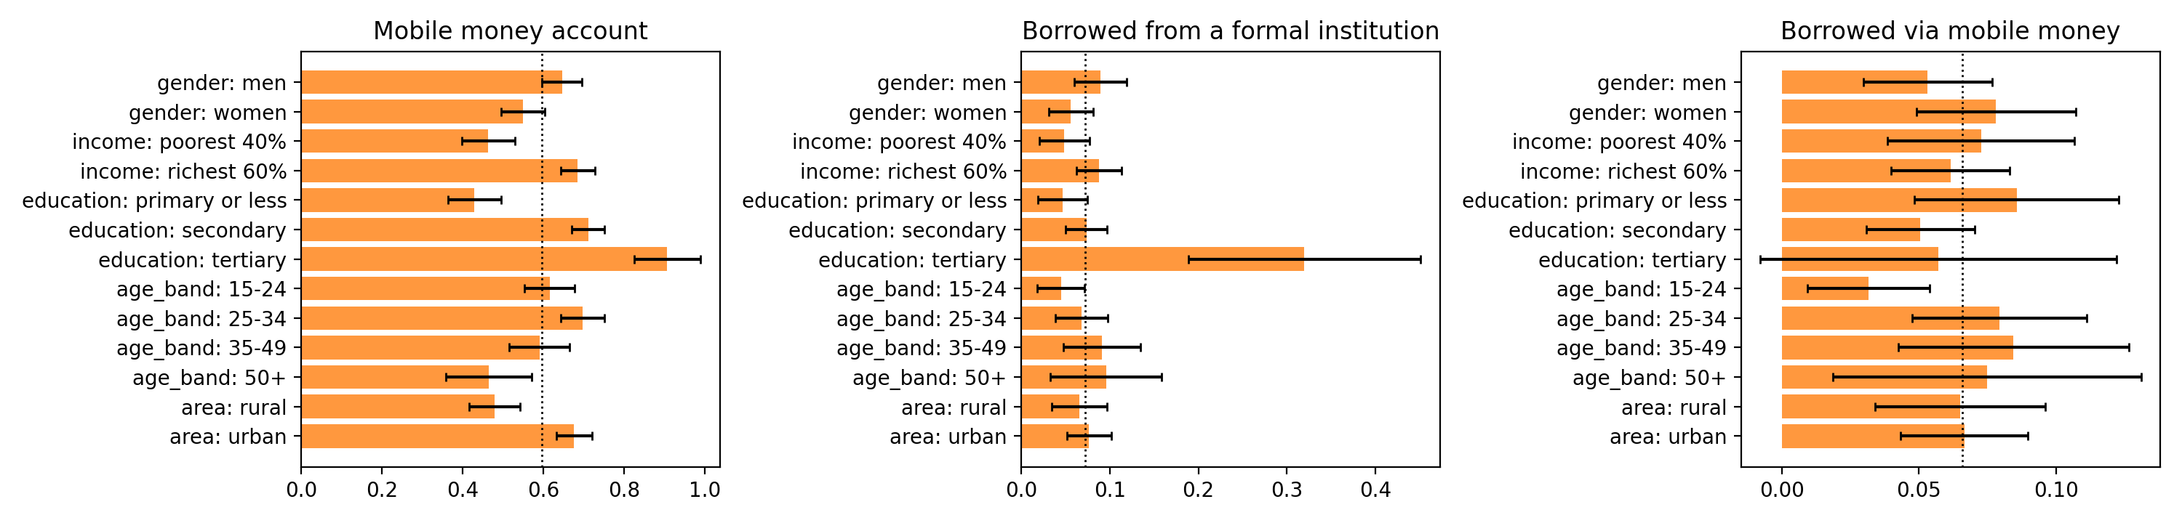
Fairness and the law
• No protected attributes in the data, so we tested proxies
• Thin-file applicants: declined 32%, including 30% of those who would repay
• Dropping history features changes nothing (0.145 → 0.144): the proxy leaks back
• Findex Ghana: account gaps by gender, income, education, area; mobile-money borrowing reaches these groups
• Act 843 s.41: notice + 21-day human review; BoG: 20-day complaints, bureau reporting (not met)
Mitigation is a policy: refer thin-file applicants to a capped starter loan, monitor parity.

Slide 11
Scoring service
• Scorer.score(application, history) → P(default), decision, 3 reasons, offered amount
• Same feature code as training; tested to reproduce training features exactly
• approve · decline · refer (thin-file, or any market other than Kenya)
• ~20 ms per call (p95 32 ms); 115,000 loans/s in batch
• Nine application fields + earlier loans; no personal or sensitive data

Slide 12
What we recommend
• Kenya: deploy logistic regression at the cost threshold, recalibrate monthly, monitor drift
• Thin-file applicants: starter loans and human review, never automatic decline
• Ghana: capped, monitored pilot with human review; collect outcomes, then recalibrate and validate
• Before launch: credit-bureau integration (BoG §7.3, Act 726), consent capture, legal review of Act 726 and Act 1052
• Replace our cost assumptions with NkwaPay's own
The next gain comes from Ghanaian data, not a cleverer Kenyan model.

