Slide 1
ICS553 PROSIT 2 · GROUP 3
Can a Kenyan model decide loans in Ghana?
NkwaPay credit scoring · default prediction, loan sizing, and what stands between Kenya and Ghana
Debrief · 3 November 2026
Notes:
Good morning. We are Group 3. Our task was to build a tool for NkwaPay that decides who gets a loan, how much to lend, and why, and to judge whether a model trained on Kenyan loans can be trusted in Ghana. I will walk you through it with one example applicant, Ama.

Slide 2



Ama applies. The tool must answer three things
Approve or decline?
How much?
Why?
Will she pay it back?
What amount can she handle?
A reason she can understand
66,520
1.6%
2,084
labelled Kenyan loans
of them defaulted, so defaults are rare
Ghana loans, with no answers to check against
Notes:
Ama applies through the app. The tool has to say approve or decline, how much to lend, and give a reason. We trained on about sixty six thousand Kenyan loans. Only one point six percent defaulted, so defaults are rare, and that shapes everything. For Ghana we have about two thousand loans but no outcomes, so we can never directly check how well the model works there.

Slide 3
Our answer in one slide
0.145
6.2%
our honest score. A shortcut in the data gave a fake 0.825
decline when Ama's risk is above this, from cedi costs
Simple wins
Pilot first
logistic regression, about 7 times better than guessing
Ghana is too different. No automatic decisions there yet
Notes:
Here is the whole story first. One, the raw data contains a shortcut that makes any model look brilliant, a fake score of zero point eight two five. Our honest score is zero point one four five. Two, using cedi costs, we decline when the risk is above six point two percent. Three, a simple logistic regression did as well as the complex models and is easier to explain. Four, Ghana is too different from Kenya, so we recommend a small pilot before any automatic decisions.

Slide 4
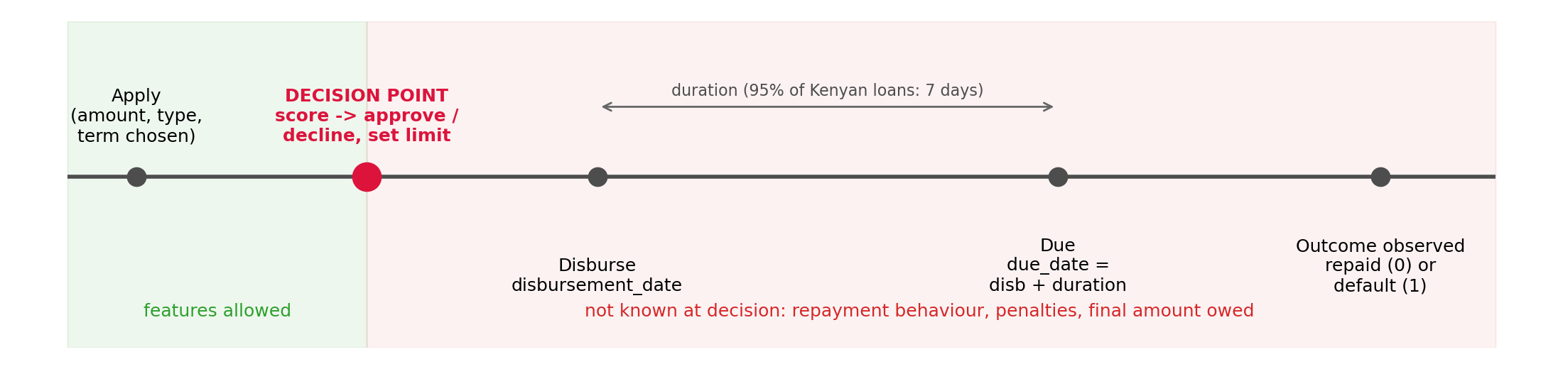

Rule one, use only what we know when Ama applies
The model decides at approval, before any money moves. Anything recorded after that moment, like repayments or penalties, would be cheating, because the real app will not have it.
Notes:
Our first rule. The model decides at the moment Ama applies. She has chosen the product, the amount and the term, but no money has moved. So for every column in the data we asked one question. Did NkwaPay know this when she applied? If not, we cannot use it. We went through all sixteen columns this way. That is our feature audit.

Slide 5
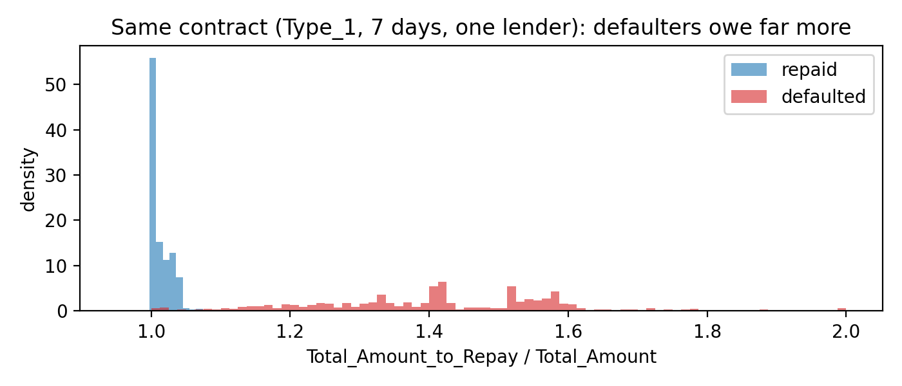
One column gave the answer away
+0.7%
+41%
extra owed by people who repaid
extra owed by people who defaulted
Penalties are added after a default, so Total_Amount_to_Repay records the outcome. We dropped it, and the column made from it.
Same contract (Type_1, 7 days, one lender). Look at what each person ended up owing.
0.825
0.145
score WITH the column. Fake
our honest score
Notes:
This is our most important finding about the data. Total amount to repay looks like a contract term. But we took loans with the exact same contract and compared them. People who repaid owe about zero point seven percent extra. People who defaulted owe about forty one percent extra, because penalties are added after the default. The rule may be known in advance, but the number in this column depends on whether the person defaulted. So using it means giving the model the answer. With it, the score is zero point eight two five. Without it, our honest score is zero point one four five.

Slide 6

Putting cedis on mistakes
Ama borrows GHS 500. These are our assumptions, not NkwaPay data.
She repays
She defaults
NkwaPay earns GHS 25
NkwaPay loses GHS 380
8% fee, minus 2% funding cost, minus 5 to run the loan
70% never recovered, plus funding, running and chasing costs
One default wipes out the profit of 15 good loans
Decline if risk > 25 ÷ (25 + 380) = 6.2%
Notes:
We put a cedi value on each mistake. For a five hundred cedi loan, a borrower who repays earns NkwaPay about twenty five cedis. A borrower who defaults loses about three hundred and eighty. So one default wipes out the profit of fifteen good loans. Approving Ama only makes sense when her risk is below twenty five divided by four hundred and five, which is six point two percent. If NkwaPay recovers more money after defaults, this threshold goes up. If it recovers nothing, it goes down to about four and a half percent. These figures are our assumptions and NkwaPay should replace them with its own.

Slide 7
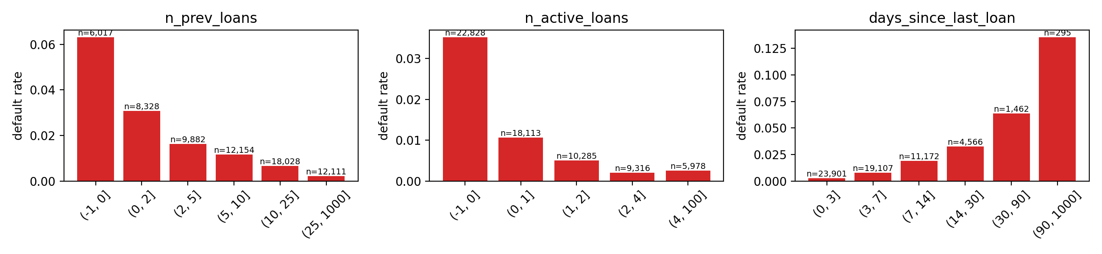
What predicts default is how often Ama borrows
How we built it fairly
Only loans from earlier dates count
A past loan's result counts only once it was due
Tests replay the past to prove nothing from the future leaks in
95% of defaulters never borrow again, so past defaults barely help
Default rate by number of earlier loans, active loans, and days since last loan
6.3%
0.2%
default with no earlier loan
default after 25 or more loans
Notes:
We built fourteen features from Ama's earlier loans. The surprise was that past defaults barely help, because ninety five percent of defaulters never borrow again. What does help is how often someone borrows. People with no earlier loan default at six point three percent. After twenty five loans it is zero point two percent. We were strict about timing. Only loans from earlier dates count, and a past loan's result only counts once it was due. We wrote tests that replay the past to prove no future information leaks in, and they caught a real bug in our first draft.

Slide 8
Test on the future, or you pick the wrong model
Shuffled testing flatters
It overstated our scores 1.7 to 2.7 times, and made LightGBM look like the winner.
Testing on time is honest
Train on older loans, test on newer ones, like NkwaPay will really use it. Logistic regression wins.
Notes:
We tested the same two models three ways. Shuffling all loans randomly. Keeping each customer on one side. And training on older loans, then testing on newer ones. Shuffled testing made our scores look one point seven to two point seven times better than they really are. Worse, it picked the wrong winner. On shuffled data LightGBM wins. On future loans, which is how NkwaPay will really use the model, logistic regression wins. So everything after this was tested on time.

Slide 9
Kenya's market changed in December 2022
Before
1 Dec 2022
After
Type_1 is 93% of all loans, a 7-day, low-risk product. Default about 1%
Type_1 stops
Default jumps to 9 to 13%. The model gets much weaker
Repeat customers were scored badly too, so the market changed, not just the customers. Ghana is an even bigger change.
Notes:
Testing on time revealed something important. On the first of December twenty twenty two, Type one, which was ninety three percent of loans and very low risk, stopped. Afterwards defaults jumped to nine to thirteen percent and the model became much weaker. Even repeat customers with long histories were scored badly, so this was a change in the market itself. We treat it as a warning, because moving to Ghana is an even bigger change.

Slide 10
We tried 12 models. The simple one did best
7×
better than guessing
GHS 13,000
saved per 1,000 applications after Dec 2022
Easy to explain, and gives exact reasons. A bootstrap check shows it clearly beats guessing and ties the best LightGBM.
Notes:
We compared twelve models, all tested on future loans. Logistic regression had the best PR-AUC, zero point one four three. That sounds low, but guessing scores only about zero point zero five here, so it is about seven times better than chance. In money terms, after December twenty twenty two it saves about thirteen thousand cedis per thousand applications compared with approving everyone. A bootstrap check showed it clearly beats guessing and is statistically tied with the best LightGBM overall. We chose it because it is simple and gives exact reasons. We also tried class weights. They made the model predict about twenty nine percent risk on average when the truth is one point six, which breaks the cost threshold, so we rejected them.

Slide 11
What the model gets right and wrong
Model approved
Model declined
Approval rate
38,104
1,135
96.7%
Repaid
good borrowers approved
good borrowers declined
of applicants approved overall
467
188
Defaulted
defaulters approved (GHS 380 each)
defaulters caught
98.8% in the calm 2022 market
68.6% after December 2022
39,894 Kenyan loans, tested on the future, decline if risk > 6.2%
It says no more often only when risk really rises.
Precision 0.14 · Recall 0.29 · F1 0.19
Notes:
The brief asks for a confusion matrix, so here it is for the deployed model on future loans. Of about thirty nine thousand good borrowers, the model approves thirty eight thousand one hundred and wrongly declines one thousand one hundred. Of six hundred and fifty five defaulters, it catches one hundred and eighty eight and lets four hundred and sixty seven through. That looks like many misses, but remember the costs. A wrongly declined good borrower costs twenty five cedis, an approved defaulter costs three hundred and eighty, and the threshold balances those. As a business goal, it approves ninety six point seven percent of applicants overall, almost everyone in the calm market, and sixty nine percent after December twenty twenty two, when risk really rose. These numbers are for the deployed model without calendar features, so F1 is zero point one nine here against zero point two in our model comparison.

Slide 12



How much to lend Ama
Learn from repaid loans only
So the model learns what people like Ama can actually handle, not past mistakes
Typical error about GHS 150
Ridge regression on a log scale. A raw scale once predicted an impossible amount
Cap first loans
First-time borrowers were over-predicted by about 40%, so first loans have a ceiling
Notes:
For how much to lend, we trained only on loans that were repaid, so the model learns what borrowers like Ama can actually handle. We used ridge regression on a log scale. Its typical error is about one hundred and fifty cedis. Honestly, a simple rule, lend what this person borrowed on average before, lands within twenty five percent of the right amount slightly more often than any model. First-time borrowers were over-predicted by about forty percent, so we cap first loans.

Slide 13
Telling Ama why, in plain words
Real output for a declined applicant
Exact, not estimated
Risk 70.9% · Decline
With logistic regression, each feature's push on the score adds up exactly. We group them and show the top three.
The amount and repayment period requested (20,000 over 60 days) are typical of loans that were more often not repaid.
Loans of this product type have had higher repayment problems.
Your recent borrowing pattern differs from that of borrowers who usually repay.
Honest when we don't know
For a product we have never seen, the reason says it is new to us, not that it has a bad record.
Notes:
Every decline comes with three reasons in plain language. This is real output from our saved model for an applicant asking for twenty thousand over sixty days. Because the model is logistic regression, each feature's push on the score adds up exactly, so the reasons are exact, not estimated. We fixed two problems while building this. Amount and term had to be one reason, because separately they pointed the wrong way. And Ghanaian applicants on products we have never seen were about to be told their product had a bad record. Now they are told it is new to us.

Slide 14

Ghana is too different. Pilot first
87%
96%
1.0
of Ghana loans are on products never seen in Kenya
are on lenders never seen in Kenya
AUC of a model asked whether a loan is Kenyan or Ghanaian. It always tells
Recommendation
No automatic decisions in Ghana yet. Run a small, capped pilot with human review, collect Ghanaian repayment results, then recalibrate and retest the model on them.
Notes:
Is the model ready for Ghana? No. Eighty seven percent of Ghana loans are on products the model never saw in Kenya, and ninety six percent are on lenders it never saw. We trained a model to answer one question, is this loan from Kenya or Ghana, and it could always tell, with an A U C of one. Reweighting Kenyan loans to look Ghanaian left only about two percent of the data doing the work. So our recommendation is no automatic decisions in Ghana yet. Run a small pilot with human review, collect real Ghanaian outcomes, then recalibrate and test again.

Slide 15
Fairness, new borrowers get hurt most
32%
30%
60% vs 7%
of applicants with no record are declined
of those who would have repaid are still declined
Ghanaians with mobile money vs formal borrowing (Findex 2021)
Removing the history features did not fix it. The missing record itself points to the same people.
Our fix is a policy, not a feature
No automatic decline for people without a record. Offer a capped starter loan or human review instead, and check decline rates by history group every month.
Notes:
The biggest fairness issue is borrowing history. Applicants with no record are declined thirty two percent of the time, including thirty percent of those who would have repaid. The data has no gender or ethnicity, so we tested proxies. Removing the history features did not fix it, because a missing record points to the same people anyway. This matters in Ghana. Findex shows sixty percent of adults use mobile money but only seven percent borrowed formally, so many applicants will arrive with thin records. Our fix is a policy. No automatic decline without a record. Offer a capped starter loan or human review, and monitor decline rates monthly.

Slide 16

What the law asks, and what we cannot meet yet
We designed for
Not met by the model alone
Act 843 s.41, notice and human review within 21 days for automated decisions
BoG Directive, clear disclosure and complaints answered within 20 days
Minimal data, no sensitive attributes, a plain decline letter
Daily credit bureau reporting (BoG §7.3)
Ghana-specific accuracy
Fairness checks against protected traits
Registration and breach notification
Honest gap. We could not obtain the text of the Credit Reporting Act (Act 726). It reportedly requires a credit report before lending, which our system does not do.
Notes:
We mapped our design to the laws we actually read. The Data Protection Act section forty one gives people a right to notice and human review within twenty one days for automated decisions, so our decline letter offers that. The Bank of Ghana directive requires clear disclosure and complaints answered within twenty days. What the model alone cannot meet is daily credit bureau reporting, Ghana specific accuracy, fairness checks on protected traits, and organisational duties. One honest gap. We could not get the text of the Credit Reporting Act, Act seven two six. It reportedly requires a credit report before lending, which we do not do.

Slide 17
One call gives risk, decision, reasons and an offer
Ama's application | Risk | Decision | Why
Kenya, 7 days, 5,000, five repaid loans | 1.4% | Approve | Offered 3,810, the limit
60 days, 20,000, no history | 75.1% | Refer | No record, so a person decides
60 days, 20,000, two repaid loans | 70.9% | Decline | Three reasons given
Ghana, new product, new lender | 5.8% | Refer | Model not validated for Ghana
Real outputs from our saved model. About 20 ms per call. The app sends 9 fields plus earlier loans, and no personal or sensitive data.
Notes:
This is the finished service. One function takes Ama's application and her earlier loans and returns her risk, the decision, three reasons, and an offer. These four rows are real outputs from our saved model. A regular borrower is approved, but offered three thousand eight hundred and ten, the model's limit, instead of the five thousand she asked for. A risky applicant with no record is referred to a person, not declined. The same loan with a record is declined with reasons. And any Ghana application is referred, because the model is not validated there. Each call takes about twenty milliseconds.

Slide 18
What we recommend
Kenya
Use logistic regression at the 6.2% threshold. Recalibrate monthly
New borrowers
Starter loans and human review, never an automatic no
Ghana
Small pilot with human review, then retrain on Ghanaian results
Before launch
Credit bureau link, consent, legal review of Act 726. Use NkwaPay's own costs
The next improvement comes from Ghanaian data, not a cleverer Kenyan model.
Notes:
To close, our recommendations. In Kenya, use logistic regression at the six point two percent threshold and recalibrate monthly. For new borrowers, offer starter loans and human review, never an automatic no. For Ghana, start with a small pilot and retrain on real Ghanaian results. Before launch, connect to the credit bureau, capture consent, review Act seven two six, and replace our cost assumptions with NkwaPay's own. The next improvement comes from Ghanaian data, not a cleverer Kenyan model. Thank you, we are happy to take questions.

Slide 19
Backup · Why PR-AUC and not ROC-AUC?
ROC-AUC
PR-AUC
How many good customers did we bother, out of ALL good customers? There are so many good customers that this always looks small, so the model looks good.
Of the people we declined, how many were really bad? It only looks at who we flagged, so mistakes cannot hide.
0.725 vs 0.5
0.145 vs ~0.02
our ROC-AUC against guessing
our PR-AUC against guessing, about 7×
Notes:
If asked why PR-AUC. ROC asks how many good customers we bothered out of all good customers. With only one point six percent defaults, there are so many good customers that this looks small and flattering. PR-AUC asks of the people we declined, how many were really bad. That is what costs NkwaPay money, so it is our main metric. We still report ROC. Remember to compare each score to guessing, not to one.

Slide 20
Backup · Assumptions and limits
What counts as default?
Cost figures
The data only says 1 = defaulted. We assume the result is known at the due date. One setting changes it if NkwaPay has a grace period
Fee, recovery and costs are our assumptions. NkwaPay should replace them, and the threshold updates automatically
Kenya after 2022
Act 726
The model is weaker after the market change. Monthly recalibration is needed
Text not obtained. The bureau-check duty is unverified
Notes:
If asked about limits. The data does not define default exactly, so we treat the result as known at the due date, and one setting changes that. Our cost figures are assumptions. The model is weaker after the twenty twenty two market change. And we did not verify Act seven two six from its text.

Slide 21
Backup · Who gets approved, by group
Group | Default rate | Approval rate | F1
No earlier loan | 10.9% | 67.8% | 0.27
1 to 4 earlier loans | 3.9% | 89.1% | 0.17
5 to 19 earlier loans | 1.2% | 98.8% | 0.11
20 or more earlier loans | 0.3% | 99.9% | 0.03
Smallest loans (bottom 20%) | 1.5% | 99.6% | 0.01
Largest loans (top 20%) | 3.1% | 90.2% | 0.27
New borrowers
Approved 68% of the time, against 99.9% for regular borrowers. That is why the service refers them instead of declining.
Not regressive
Small loans are approved more often than large ones, so the tool does not shut out small borrowers.
Notes:
If asked about fairness by group. New borrowers default at about eleven percent and are approved sixty eight percent of the time, against almost everyone for regular borrowers. That is the gap our refer policy addresses. By loan size the tool is not regressive. The smallest loans are approved ninety nine point six percent of the time and the largest ninety percent. Full table with PR-AUC is in reports, thirteen segment PR F1.

