Slide 1

Challenge Launch
Wednesday February 10
The Allstate
Intelligent Virtual Assistant
Challenge

Slide 2
Agenda
Introduction – The Allstate Teams
Introduction – The Challenge Topic
Challenge Details
Key Dates & Deliverables
Submission Template
Logistics
Questions

Slide 3
Introduction – The Allstate Team
Largest publicly held personal lines Property and Casualty (P&C) Insurance company in the US
Founded in 1931
Number 89 on the Fortune 500 list of largest companies in America
More than 70,000 professionals made up of employees, agency owners and staff
Consumer Value Proposition
Leadership Principles
Focus on Innovation
Notes:
CVP – We aim to reinvent protection and retirement to improve customers’ lives.
Leadership Principles – Lead from every seat. Find your purpose and pursue it with a passion.
Innovation has been a focus at Allstate for several years now. 4 years ago specialized teams sought out opportunities to change the way we do business. Our team helped create first version of Quick Foto Claim, which is now used by both Esurance and Allstate. We run internal idea challenges, hackathons and even have a employee resource group focused on “intraprenuership”.

Slide 4

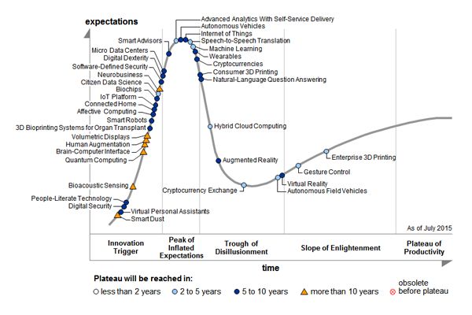
Introduction – The Challenge Topic
Gartner Hype Cycle 2015
Notes:
Gartner Hype Cycle – In 2014 Machine Learning was nowhere to be seen. Big Data was starting it’s decline into the Trough of Disillusionment”. But, by 2015, Big Data is completely gone and Machine Learning is in its place!

Slide 5
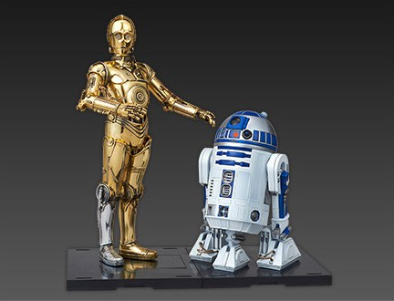
Challenge Details
1st Prize - $2,000 Apple Store Gift Card
2nd Prize - $1,000 Apple Store Gift Card
3rd & 4th - $500 Apple Store Gift Card
Notes:
Create your own Intelligent Virtual Assistant to guide people through a solution to their problem.
Prizes!
Utilize Natural Language Processing, Machine Learning and Ontology-based semantic processing.

Slide 6

Challenge Details
Imitate a human being as closely as possible
Utilize sample files with scripts that call-center representatives use
Train your chat robot based on samples, then think up your own
Notes:
Imitate a call-center representative walking a person through a solution to a problem they are having.
You are given 2 sample files that imitate a knowledgebase article the call-center rep would interpret.
Teach your chat robot to respond to these 2 samples, then expand to your own use cases.

Slide 7
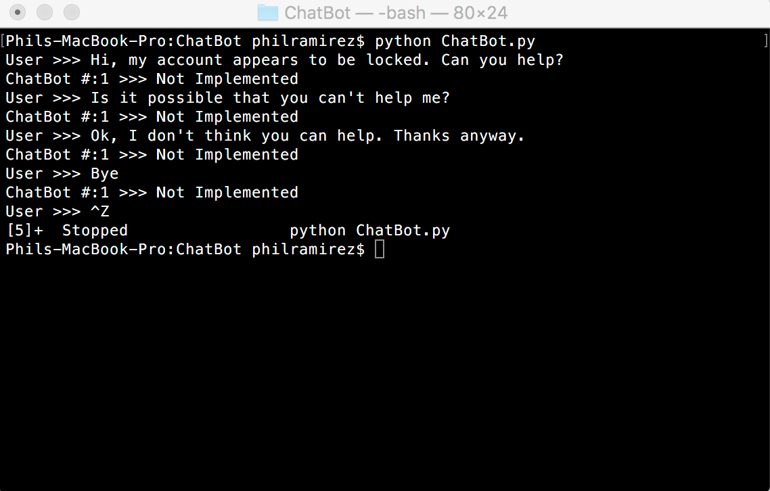
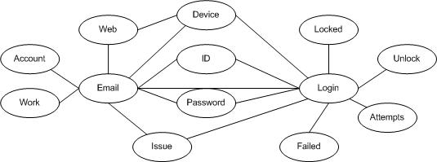
Challenge Details
Chat Robot program AND semantic ontology program
Notes:
A chat robot example will be provided, but it is not very Intelligent.
Build both a semantic ontology based on the sample knowledgebase articles and build a chat robot that diagnoses the problem, finds the solution and guides the user through the steps to complete.

Slide 8
Key Dates & Deliverables
February 10th – LAUNCH!
Sign up!
February 17th – Closing date for team registration
February 24th – Interim pitch review day
Sign up for a timeslot to pitch your idea
A draft of your presentation is helpful, but not necessary
February 29th – Final submissions due by 11:59PM
Sign up for a timeslot to demo your solution
March 2nd – Queens University Belfast Demo in Allstate office, Belfast
March 3rd – Arizona State University Demo in Allstate office, Tempe
30 Minutes for each team to present their solution
TBD – Results & Awards Ceremony in Allstate offices

Slide 9
Team Name – Idea Name
Team Members
Team Member 1
Team Member 2
Team Member 3
Screenshots
Chat Example 1
Ontology Example 1
Chat/Ontology Example 2

Slide 10
Overview
Team and Idea title: Example Team – Our Idea Example
Our team’s approach:
<Describe how you attacked the problem. Did you analyze the data with tools, research technology, follow tutorials or jump right in and code? How did you manage the work effort?>
Our team’s solution:
<Describe how you came up with your solution>
What did you try first?
What tools did you use?
What made you decide to go one direction vs. another? Obstacles?
Why did you choose the language you chose (Python vs. Java)?
<List any libraries used, references or data sources>
Did you use NLTK or OpenNLP?
How did you integrate these into your solution?

Slide 11
Semantic Ontology Solution Details
Team and Idea title: Example Team – Our Idea Example
Please include code snippets with explanations of the main functions your code does.
For example: This code utilizes the Web Ontology Language (OWL) to produce a semantic-based ontology classifying text based on .

Slide 12
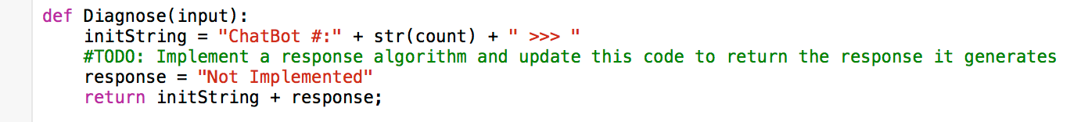
Chat Robot Solution Details
Team and Idea title: Example Team – Our Idea Example
Please include code snippets with explanations of the main functions your code does.
For example: This code creates the response to send back to the user. It is hardcoded to return “Not Implemented”. It does not implement NLTK APIs or an algorithm.

Slide 13
Test Results
Team and Idea title: Example Team – Our Idea Example
Please try your solution out with folks outside the challenge.
What did they think of your Chat Bot?
Was it difficult to distinguish from a human response?
Give them the technical job aids that support analysts currently use to guide users through a problem:
Do they think your Chat Bot guided them through the problem correctly?
Include quotes from people you interview (eg. “I had no idea it was a program responding to my questions!”).
How did your testing inform your solution?

Slide 14
What We Learned
Team and Idea title: Example Team – Our Idea Example
Please include any nuances you found along the way.
For example, we found that the NLTK was great, but documentation was lacking for a specific step in our solution, so we spent a lot of time researching how to accomplish X.

Slide 15
Logistics
Form teams of 2-5 people, come up with a unique team name
Write your Name, Email address, GitHub Username and Team Name on the Registration form
Due by February 17th
Remote students – Email this information to Megan.Shaffer@allstate.com.
As teams register, access will be granted to 1 of 20 available GitHub private repositories
FAQ is at https://github.com/ASU-QUB-Challenge/FAQ/wiki
Add a GitHub Issue if you have a question or problem and we will respond or post it on our wiki
Notes:
If you don’t have a GitHub username, you’ll need to register at GitHub.com

Slide 16
Q&A

