Slide 1

Team Name
Wednesday March 3
The Allstate
Intelligent Virtual Assistant
Challenge

Slide 2
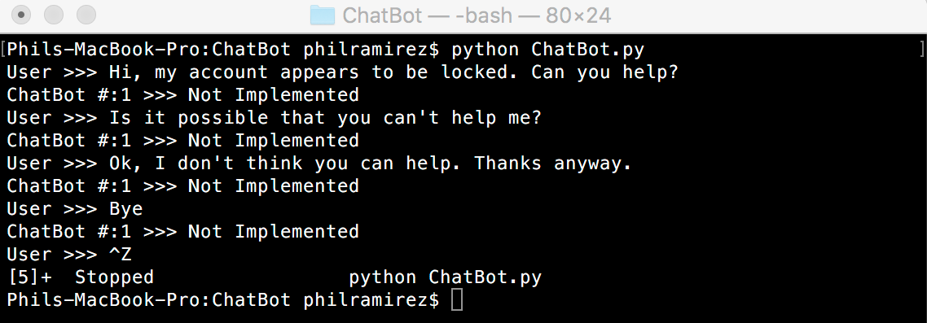
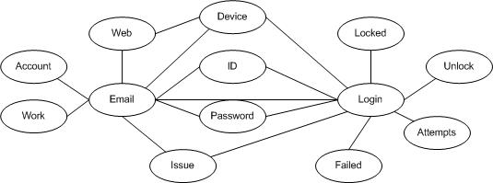
Team Name – Idea Name
Team Members
Team Member 1
Team Member 2
Team Member 3
Screenshots
Chat Example 1
Ontology Example 1
Chat/Ontology Example 2

Slide 3
Overview
Team and Idea title: Example Team – Our Idea Example
Our team’s approach:
<Describe how you attacked the problem. Did you analyze the data with tools, research technology, follow tutorials or jump right in and code? How did you manage the work effort?>
Our team’s solution:
<Describe how you came up with your solution>
What did you try first?
What tools did you use?
What made you decide to go one direction vs. another? Obstacles?
Why did you choose the language you chose (Python vs. Java)?
<List any libraries used, references or data sources>
Did you use NLTK or OpenNLP?
How did you integrate these into your solution?

Slide 4
Semantic Ontology Solution Details
Team and Idea title: Example Team – Our Idea Example
Please include code snippets with explanations of the main functions your code does.
For example: This code utilizes the Web Ontology Language (OWL) to produce a semantic-based ontology classifying text based on .

Slide 5
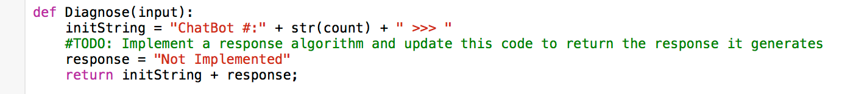
Chat Robot Solution Details
Team and Idea title: Example Team – Our Idea Example
Please include code snippets with explanations of the main functions your code does.
For example: This code creates the response to send back to the user. It is hardcoded to return “Not Implemented”. It does not implement NLTK APIs or an algorithm.

Slide 6
Test Results
Team and Idea title: Example Team – Our Idea Example
Please try your solution out with folks outside the challenge.
What did they think of your Chat Bot?
Was it difficult to distinguish from a human response?
Give them the technical job aids that support analysts currently use to guide users through a problem:
Do they think your Chat Bot guided them through the problem correctly?
Include quotes from people you interview (eg. “I had no idea it was a program responding to my questions!”).
How did your testing inform your solution?

Slide 7
What We Learned
Team and Idea title: Example Team – Our Idea Example
Please include any nuances you found along the way.
For example, we found that the NLTK was great, but documentation was lacking for a specific step in our solution, so we spent a lot of time researching how to accomplish X.

Slide 8
Logistics
Form teams of 2-5 people, come up with a unique team name
Write your Name, Email address, GitHub Username and Team Name on the Registration form
Due by February 17th
Remote students – Email this information to Megan.Shaffer@allstate.com.
As teams register, access will be granted to 1 of 20 available GitHub private repositories
FAQ is at https://github.com/ASU-QUB-Challenge/FAQ/wiki
Add a GitHub Issue if you have a question or problem and we will respond or post it on our wiki
Notes:
If you don’t have a GitHub username, you’ll need to register at GitHub.com

