Slide 1
MLCAD 2025 Contest on ReSynthAI: Physical-aware Logic Resynthesis using AI
Vikram Gopalakrishnan, Atmadip Dey, Rongjian Liang, Yanqing Zhang, Haoxing Ren, and Vidya Chhabria
Notes:
Hello everyone, I’m Vikram from ASU, I am excited to present the MLCAD 2025 Contest — ReSynthAI: Physical-aware Logic Resynthesis using AI.
This contest was jointly organized by ASU and NVIDIA. These are the organizers involved in this contest.

Slide 2
Outline
Motivation and Background
Problem Description
Benchmarks
Evaluation Methodology
Results
Winners
Notes:
This is the outline of this presentation. I will give a motivation and background for this contest, followed by the problem statement. Then I will go over the benchmarks and evaluation methodology of this contest. Finally I will go over the result statistics and announce the winners.

Slide 3
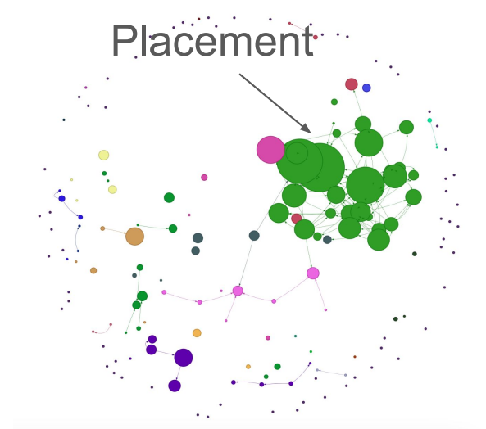
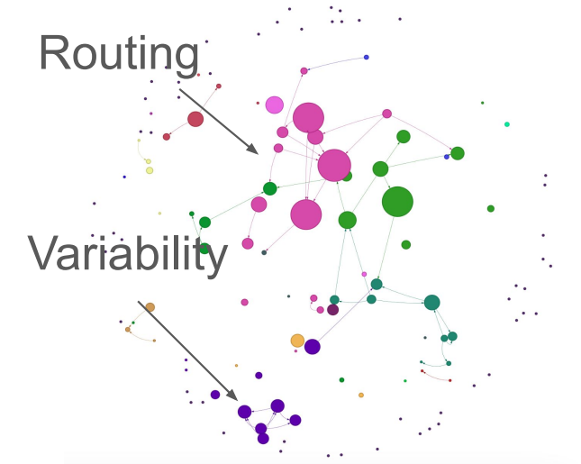
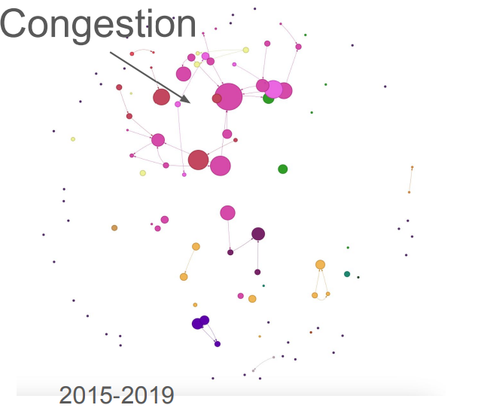
Impact of Contests on the EDA Community
Creates well-defined challenging problems.
Provide standardized benchmarks and evaluation metrics, encouraging reproducibility.
Lowers the barrier to entry for non-experts.
Drive collaboration between academia and industry.
Contests drive research!
ISPD 05/06 – Placement contest
ISPD 07/08 – Routing contest
2005-2009
2010-2014
2015-2019
Picture credit: ISPD 2025 talk on “Mapping Two Decades of Innovation: Lessons from 25 Years of ISPD Research", Dr. Matthew Guthaus (UCSC)
Notes:
Contests play a key role in driving research. They define clear, challenging problems and provide standard benchmarks and evaluation metrics, ensuring fair and reproducible comparisons. They lower the barrier to entry for non-eda experts, and they foster collaboration between academia and industry by aligning research with real-world design problems.
[CLICK]
The picture here is from a talk by Professor Matthew Guthaus at ISPD 2025. As a part of his talk he showed that, there’s a noticeable increase in paper submissions in a particular topic, based on the most recent contest. For example, in ISPD 2005 and 2006 there was a contest on placement and that increased the research in the topic of placement with lot more citations and papers in that area, as shown by the green circles. Similarly, for routing and congestion in the years to follow. This really highlights how critical contests are in shaping and accelerating research.

Slide 4
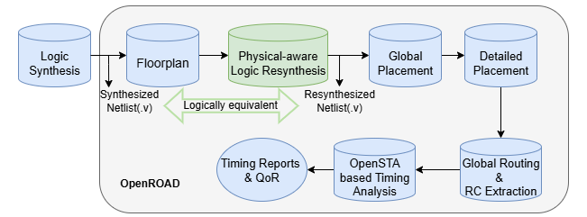
Motivation for Physical-aware Logic Resynthesis
Challenges in logic optimization:
Logic optimization is often optimistic, missing parasitic, and congestion information.
Fixing violations early in synthesis avoids costly downstream ECO loops.
Physical-awareness produces robust designs for faster PPA closure.
Contest focus and flow:
Notes:
We just saw how contests spark innovation and drive research forward. Now, the natural question is — what is the pressing challenge we want to highlight through this contest? One of the biggest gaps today lies in how logic optimization is done.
Traditionally circuit optimization in post-synthesis stage relies on heuristic-based models that are often inaccurate in incorporating physical information. Accurate physical awareness is required to prevent expensive downstream ECO loops. Hence by bringing in accurate physical awareness we can reduce design cycles and can lower time to market and ML can play a big role here — by building models that capture physical effects more accurately.
[CLICK]
Therefore, the focus of this contest is on logic optimization after floorplan stage by incorporating physical information.
The picture here highlights the stage in the PD flow that this contest focuses on. In this contest, once the Floorplanning is done, the participants are required to perform resynthesis of the original netlist in a way that the resynthesized netlist will have better timing numbers with minimal effects on power and routability when it is taken through placement and global routing, while also ensuring logical equivalence with the original netlist.

Slide 5
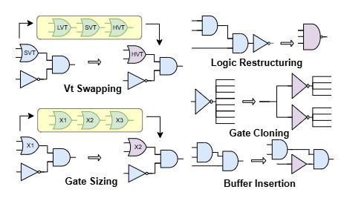
Physical-aware Logic Resynthesis Challenges
Find a suitable timing optimization transformation for each timing path.
The chosen transformation should improve post-PNR timing metrics while having minimal effect on congestion and power.
Challenges:
Multiple transformations to consider
Logical equivalence requirement
Non-convex characteristics of delay models
Large number of near-critical paths
Tradeoff between power and timing
Notes:
As I mentioned goal of physical aware logic resynthesis is to apply timing optimization techniques on the design in a way that the post PNR timing metrics are improved while having minimal increase on congestion and power. Building a physical-aware resynthesis tool is not trivial.
[CLICK] There are multiple transformations such as [CLICK] logic restructuring, [CLICK] vt swapping, [CLICK] gate sizing, [CLICK] logic restructuring, [CLICK] gate cloning and, [CLICK] buffer insertion, and are available and logic optimization requires selection of right transformation or the sequence of right transfromations for each timing path, while ensuring logical equivalence.
[CLICK] The delay models are non-convex, so we need an accurate way to model them.
[CLICK] Additionally, the number of timing paths in the design can be extremely large, where fixing one logic path can introduce violation in the other. [CLICK] Fixing the timing violations should not cause a significant increase in power.

Slide 6
Contributions of This Contest
Lowers the barrier to entry for non-EDA experts by turning EDA problems into ML-solvable ones with an ML-friendly data format.
Shows an example of “ML inside" EDA tools using OpenROAD Python APIs.
Drove the open-sourcing of NVIDIA’s GPU-accelerated gate level simulation tool, GL0AM.
Releases updated benchmarks in ASAP7 FinFET technology node with evaluation scripts to drive logic resynthesis research.
Encourages the creation of an ML/GPU-based resynthesis tool that accounts for the impact on the overall physical design flow, including placement and routability.
“GL0AM.” https://github.com/NVlabs/GL0AM/tree/mlcad2025contest sim, 2024.
“MLCAD 2025 Contest on ReSynthAI: Physical-aware LogicResynthesis using AI.” https://github.com/ASU-VDA-Lab/MLCAD25-Contest-Scripts-Benchmarks, 2025.
Notes:
This contest makes five important contributions.
[CLICK] First this contest lowers the barrier for non-EDA experts by offering ML-friendly formats.
[CLICK] second, We demonstrate ML integration inside EDA tools with OpenROAD APIs.
[CLICK] third, Logical equivalence is a challenge, this contest drove the open sourcing of NVDIA’s GPU accelerated gate level simulation tool called GL0AM, to help quickly eliminate netlists that don't meet logical equivalence.
[CLICK] fourth We provide updated benchmarks in ASAP7, along with evaluation scripts particular to logic resynthesis.
[CLICK] And the last contribution is that we encourage ML and GPU-based resynthesis tools that consider the effect of placement and routing in design optmization.

Slide 7
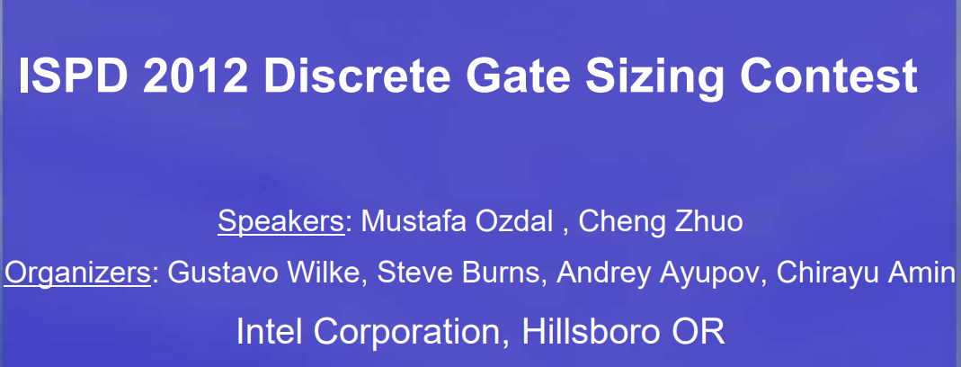
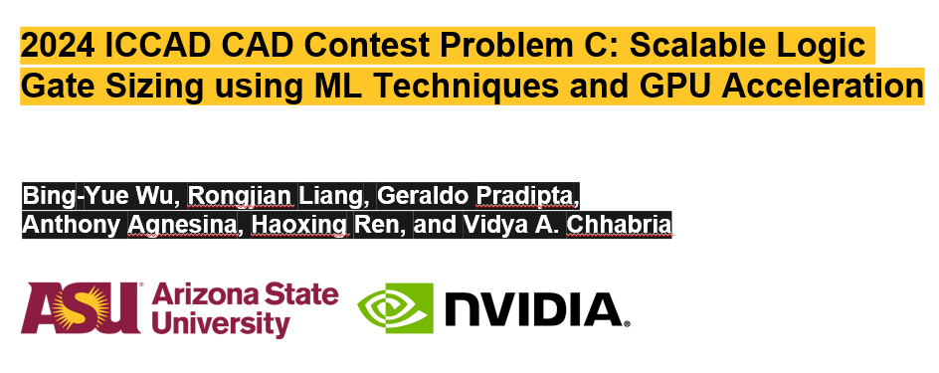
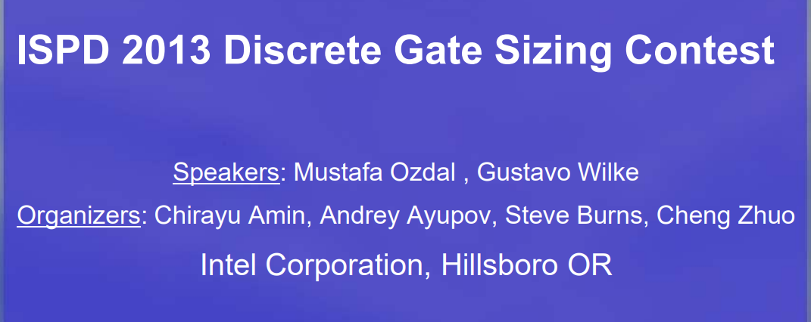
Comparison Against Previous Contests
Promotes ML-friendly formats and Python APIs.
Considers multiple logic transformations like gate sizing, Vt swaps, buffer addition/deletion, logic restructuring, and gate cloning.
Contestants work on post floorplan stage and are evaluated on post global routing metrics, thereby checking the physical awareness of the flow.
Notes:
These are the three closely related contests in the past. All of these three contest are related to the logic gate sizing problem only. These three contests are ISPD 2012, 2013 and ICCAD 2024.
[CLICK]
Compared to the ISPD contests this contest promotes more ML / GPU acceleration techniques by providing ML friendly data formats and python APIs in OpenROAD.
[CLICK] Though ICCAD 24 contest had the ML friendly formats major difference between this and those contests is that we are not constrained only to gate sizing the participants are open to apply any type of transformation.
[CLICK] Unlike ICCAD contest which worked on post placement stage netlist we work on post floorplan netlist and incorporate physical information from after the global routing stage.

Slide 8
Outline
Motivation and Background
Problem Description
Benchmarks
Evaluation Methodology
Results
Winners

Slide 9
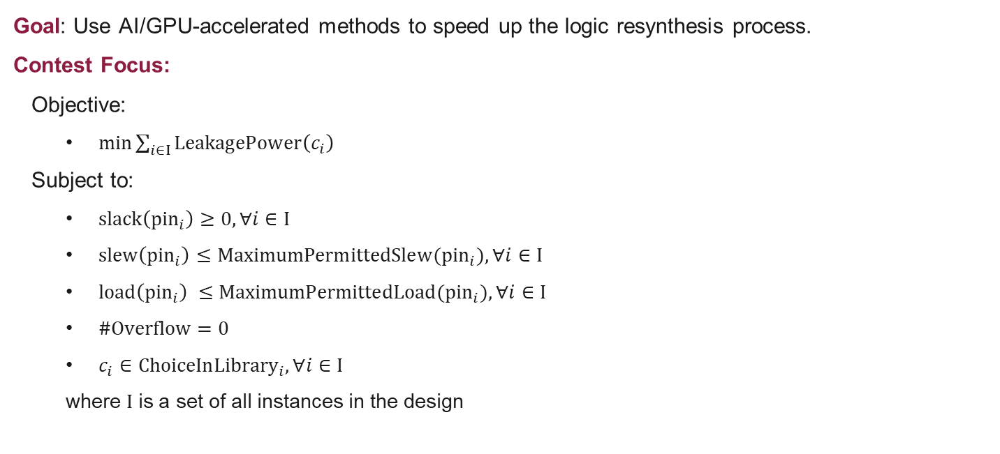
Contest Problem Formulation
Goal: Use AI/GPU-accelerated methods to speed up the logic resynthesis process.
Contest Focus:
Objective:
$min\sum_{i∈I}{LeakagePower\left(c_{i}\right)}$
Subject to:
$slack\left({pin}_{i}\right)≥0,∀i∈I$
$slew\left({pin}_{i}\right)≤MaximumPermittedSlew({pin}_{i}),∀i∈I$
$load\left({pin}_{i}\right) ≤MaximumPermittedLoad({pin}_{i}),∀i∈I$
$\#Overflow=0$
$c_{i}∈{ChoiceInLibrary}_{i},∀i∈I$
where $I$ is a set of all instances in the design
Notes:
The contest is setup as constraint optimization problem, and the goal is to use ML/ GPU accelerated methods to perform logic optimization.
The constraint optimization problem is defined on this slide, where the goal is to minimize leakage power subject to the constraints listed in screen here. Where slack of every pin has to be non negative. Slew and load cap of every pin has to be less than the specified limits and there must be no congestion overflows in any gcell post global route.

Slide 10
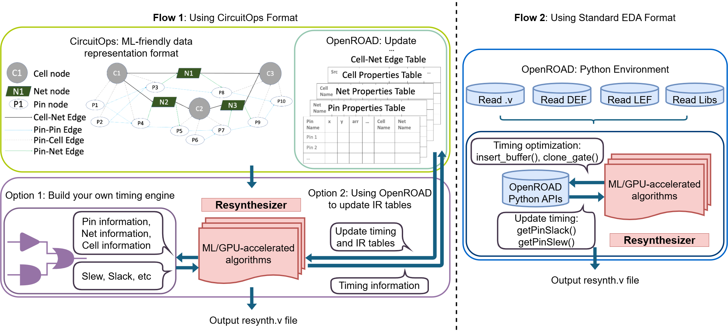
Contest Flow
Flow 1: Using CircuitOps format, perform resynthesis and update IR tables using OpenROAD.
Flow 2: Using standard EDA files, perform resynthesis and update OpenDB.
Flow1: Using CircuitOps Format
Flow2: Using Standard EDA Format
Notes:
The contest provides two flows, both built on top of OpenROAD. The idea is to give participants flexibility in how they develop their resynthesizer.
[CLICK – Flow 1] Flow 1 uses the CircuitOps format. CircuitOps is a ML friendly data format to store EDA design data. It uses LPGs shown here to represent a circuit and it uses Intermediate representation tables , also called as IR tables to store the properties associated with different nodes. This is in csv format. This ML-friendly representation, makes it easier for non-EDA experts or ML researchers to work with circuit data and apply ML or GPU-accelerated approaches without worrying about parsing complex EDA formats.
[CLICK – Flow 2] Flow 2, on the other hand, uses standard EDA files and OpenROAD APIs. This is a more traditional approach, it can be used by people who are more familiar with EDA tools.

Slide 11
Contest Infrastructure and Scripts
Scripts provided:
Example script to perform all logic transformations using OpenROAD Python APIs.
Evaluation script to run placement and global routing using OpenROAD and extract timing metrics.
CircuitOps script to generate updated IR tables at any stage.
Notes:
We provided supporting and example scripts using OpenROAD’s Python API for both flows. We provided scripts to run the entire evaluation that is runnimg placement and global routing using OpenROAD and to extract timing metrics. We also provided circuitops related scripts to generated the IR tables using OpenROAD. In addition to that we provided an example script which has implementation of different logic transformations usingOpenROAD python APIs. This facilitated the participants to easily adopt any of these two flows and implement their resynthesizer.

Slide 12
Outline
Motivation and Background
Problem Description
Benchmarks
Evaluation Methodology
Results
Winners

Slide 13
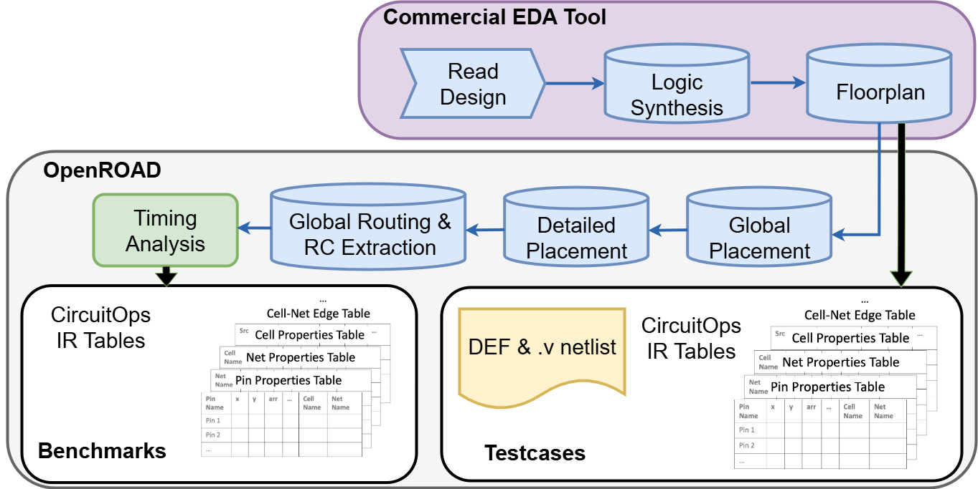
Benchmark Generation
Eight designs from the TILOS MacroPlacement GitHub and four from IWLS 2005 benchmarks.
Commercial tools are used for logic synthesis and floorplanning.
Open-source tool OpenROAD is used for place and route.
“TILOS MacroPlacement.” https://github.com/TILOS-AI-Institute/ MacroPlacement, 2024.
“IWLS 2005 Benchmarks.” https://iwls.org/iwls2005/benchmarks.html,2005.
Notes:
We released 12 benchmarks in ASAP7 tech node for this contest: Among these, 8 designs from the TILOS MacroPlacement repo and 4 from IWLS 2005. The synthesis and Floorplanning of these designs are done with commercial tools, and then the gate level netlist and the floorplan def were taken till global-route stage using OpenROAD. And then RC extraction is done and the timing reports are generated using OpenSTA. This post global route timing metrics were given as the baseline metrics for the contest. As we saw earlier we provided input formats that supported both the flows. [CLICK] For the std format based flow the participants were provided the original gate-level netlist, floorplan def, and SDC file. [CLICK] To enable the CircuitOps based flow we provided the circuitops IR tables at the floorplan and post global route stages.

Slide 14
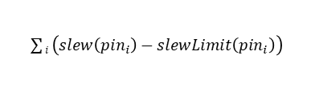
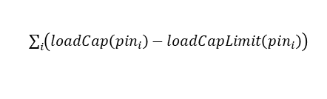
Benchmark Statistics
$\sum{i \left(slew\left({pin}_{i}\right)−slewLimit\left({pin}_{i}\right)\right)}$
MacroPlacment GitHib IWLS 2005 benchmarks
$\sum_{i}{\left(loadCap\left({pin}_{i}\right)−loadCapLimit\left({pin}_{i}\right)\right)}$
Design | Instance Count | Clock Period (ns) | WNS (ns) | TNS (ns) | Total Slew Violation Difference (ns) | Total Load Capacitance Violation Difference (fF) | Leakage Power (uW)
ac97_top | 8029 | 0.12 | -0.068 | -17.921 | 0.506 | 0 | 82.793
aes_cipher_top | 10965 | 0.32 | -0.161 | -18.846 | 9.769 | 6.589 | 29.763
NV_NVDLA_partition_m | 17843 | 0.4 | -0.209 | -11.906 | 54.497 | 344.927 | 161.323
fpu | 19725 | 3.68 | -1.208 | -59.335 | 23.786 | 4.546 | 19.254
NV_NVDLA_partition_p | 58216 | 1 | -0.492 | -747.111 | 1386.116 | 7692.259 | 579.834
NV_NVDLA_partition_p_mod | 58026 | 1.2 | -0.431 | -391.007 | 1199.429 | 7483.045 | 579.445
NV_NVDLA_partition_c | 155686 | 3 | -0.722 | -18.825 | 20854.780 | 66908.070 | 18099.664
Hidden1 | 12130 | 0.6 | -0.423 | -0.423 | 1.788 | 0 | 52.897
Hidden2 | 32795 | 0.8 | -0.338 | -139.020 | 5410.290 | 8087.704 | 347.034
Hidden3 | 112896 | 2.5 | -0.985 | -3532.406 | 17472.954 | 18008.632 | 17539.106
Hidden4 | 150545 | 3 | -1.907 | -13747.954 | 1909.798 | 1446.475 | 3129.803
Hidden5 | 15236 | 0.5 | -0.196 | -7.304 | 41.731 | 298.254 | 129.580
Notes:
This slide shows the baseline metrics of this contest
[CLICK] this column shows the instance count of these testcases. The instance count varies from 10k to 150k instances. [CLICK] WNS of the designs varies from 60ps to 2ns [CLICK] These two columns show the total slew violation difference and total load cap violation difference. The formulas for these are provided here.
[CLICK] And this column shows the leakage power of these designs.

Slide 15
Outline
Motivation and Background
Problem Description
Benchmarks
Evaluation Methodology
Results
Winners

Slide 16
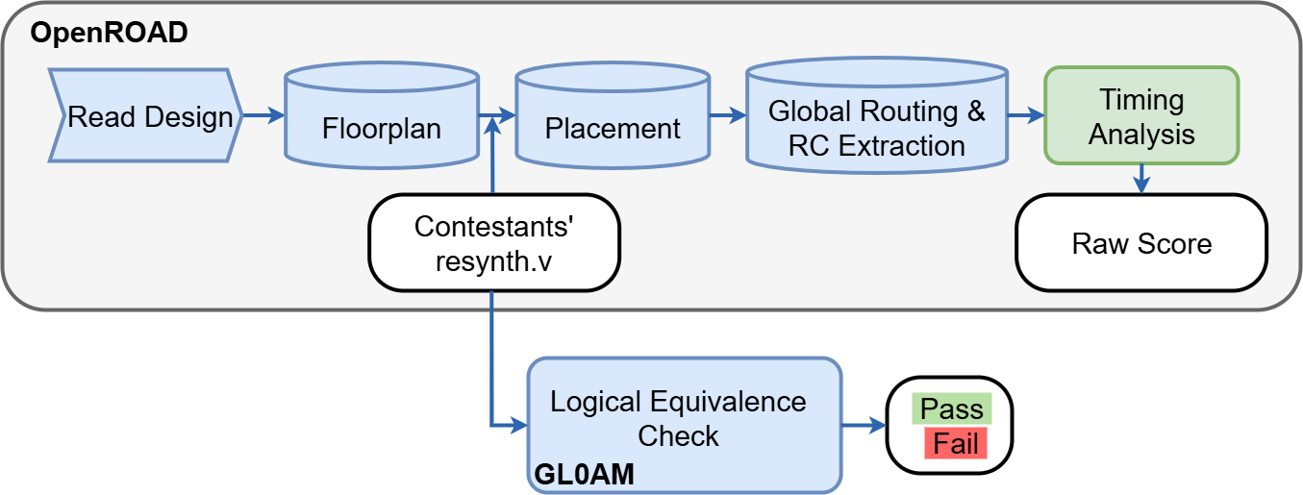
Evaluation Flow
“GL0AM.” https://github.com/NVlabs/GL0AM/tree/mlcad2025contest sim, 2024.
“MLCAD 2025 Contest on ReSynthAI: Physical-aware LogicResynthesis using AI.” https://github.com/ASU-VDA-Lab/MLCAD25-Contest-Scripts-Benchmarks, 2025.
Notes:
For evaluation, we first check logical equivalence using GL0AM. Then we place and route with OpenROAD, extract parasitics, and run timing analysis with OpenSTA. This ensures solutions are tested under realistic physical conditions.

Slide 17

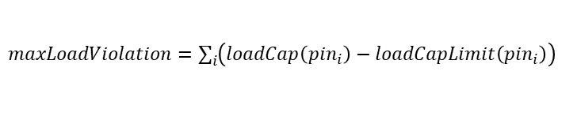
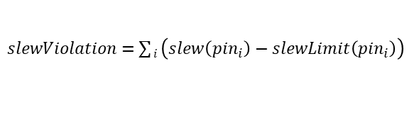


Evaluation Score
Convert the constrained optimization problem into a score function using a penalty approach.
$$RawScore=\left(1+RunTimeF\right) × [\left(\frac{leakagePower}{baselineLeakagePower}\right)$$
$+ p1×$ $\left( \frac{TNS}{baselineTNS} \right)$
$+ p2×$ $\left( \frac{slewViolation}{baselineSlewViolation} \right)$
$+ p3×$ $\left( \frac{maxLoadViolation}{baselineMaxLoadViolation} \right)$
$+ p4× δ×\left( totalOverflow −baselineTotalOverflow\right)$]
$slewViolation=$ $\sum{i \left(slew\left({pin}_{i}\right)−slewLimit\left({pin}_{i}\right)\right)}$
$maxLoadViolation=\sum_{i}{\left(loadCap\left({pin}_{i}\right)−loadCapLimit\left({pin}_{i}\right)\right)}$
$$finalScore=100×\frac{Least RawScore across teams}{RawScore of the team}$$
Evaluation Platform:
4 NVIDIA A100 GPUs and 8 CPU threads
Notes:
For evaluation, we convert the constrained optimization into an unconstrained problem by using the penalty method, we also add in runtime as part of our evaluation. This is the formula used for score computation, as you can see the score is a function of leakage power, TNS, slew violation, max loap violation and overflow. All the metrics are divided by their baseline values that is the value of the benchmark provided, in order to normalize them. Lekaage power, TNS and total overflow are reported from openROAD. The slew violation is calculated as sum of difference between slew of a pin and slew limit of that pin for all pins in the design. Similarly maxload violation is calculated as… here we will consider a testcase invalid if the logical equivalence is not met or the runtime of the tools is more than 4 hours. Once the raw score is obtained for all valid testcases, we get the least raw score for each testcase and each teams raw score is scaled to 100 using this formula. This final score for all tetscases is added together which is the final total score of a team. The winners are decided based on this final total score. All the submission were evaluated in this platform. We thank NVIDIA for giving this infrastructure.

Slide 18
Outline
Motivation and Background
Problem Description
Benchmarks
Evaluation Methodology
Results
Winners

Slide 19
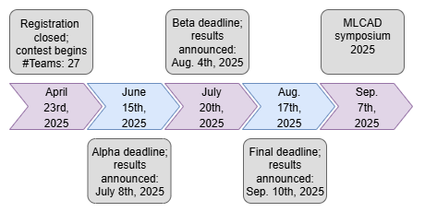
Submission Statistics
Total number of teams registered: 27 ; Total number of teams actively participated: 7
Number of teams submitted alpha submission = 7 teams
Number of teams submitted beta submission = 6 teams
Number of teams submitted final submission = 7 teams
Notes:
There were 27 teams registered for this contest and 7 teams were actively participating. The contest was conducted in three stages alpha, beta and final. The contest tool place over the entire summer with roughly 1 month between each deadlines. The final submission deadline was on aug 17th and we announced the contest winners a couple of days back.

Slide 20
Results Overview
All 7 teams have valid results on at least one test case.
 | Testcase1 | Testcase2 | Testcase3 | Testcase4 | Testcase5 | Testcase6 | Testcase7 | Hidden1 | Hidden2 | Hidden3 | Hidden4 | Hidden5
Team | ac97_top | aes | NV_m | fpu | NV_p | NV_p_mod | NV_c | hidden1 | hidden2 | hidden3 | hidden4 | hidden5
T1 | Pass | Pass | Pass | Pass | Pass | Pass | Pass | Pass | Pass | Pass | Pass | Pass
T2 | Pass | Pass | Pass | Failed | Pass | Failed | Failed | Failed | Failed | Failed | Failed | Failed
T3 | Pass | Pass | Failed | Pass | Failed | Failed | Failed | Pass | Failed | Failed | Failed | Failed
T4 | Pass | Pass | Pass | Pass | Pass | Pass | Pass | Pass | Pass | Pass | Pass | Pass
T5 | Pass | Pass | Pass | Pass | Pass | Pass | Pass | Pass | Pass | Pass | Pass | Pass
T6 | Pass | Pass | Pass | Pass | Pass | Pass | Pass | Pass | Pass | Pass | Pass | Pass
T7 | Pass | Pass | Pass | Pass | Pass | Pass | Pass | Pass | Pass | Pass | Pass | Pass
Notes:
This slide shows the valid results from teams. It can be seen that all the 7 teams had a valid submission for at least one testcase. A submission is marked as invalid if the resynthesizer tool did not generate a netlist or the generated netlist is not logically equivalent to the original netlist.

Slide 21
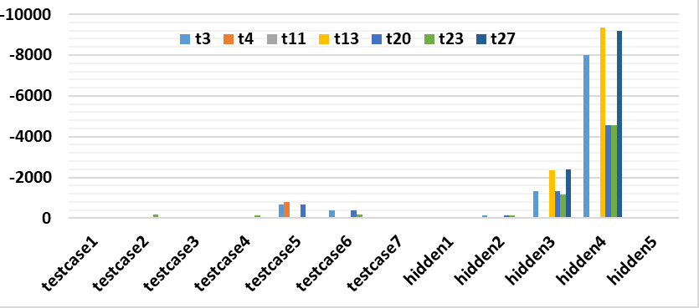
Results: Total Negative Slack
Design | Instance count
testcase1 | 8029
testcase2 | 10965
testcase3 | 17843
testcase4 | 19725
testcase5 | 58216
testcase6 | 58026
testcase7 | 155686
hidden1 | 12130
hidden2 | 32795
hidden3 | 112896
hidden4 | 150545
hidden5 | 15236
unit: ns
Notes:
This slide shows the distribution of Total Negative Slack of the optimized netlist for each testcase across all 7 teams.
You can see that different benchmarks pose very different levels of difficulty. This table shows the variation in the size of each testcase. For most of the testcases the participants were able to bring down the TNS to almost zero, but for larger testcases the teams have struggled more with timing closure. Also an interesting thing to note here is the difference in approaches, we had submissions that used some custom flow that uses OpenROAD’s repair timing inside and some submissions used ML based optimizers. For smaller testcases the repair timing based flow did better but for larger testcases the ML based flow performed a lot better compared to non-ML flows.

Slide 22
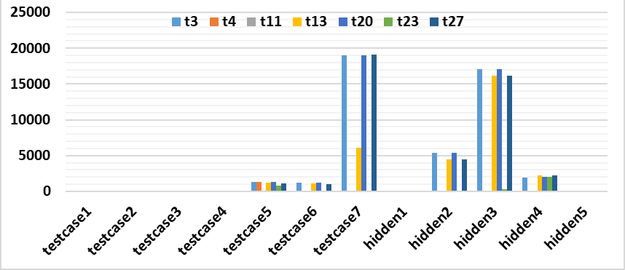
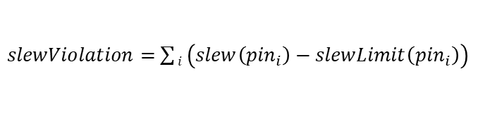
Results: Total Slew Violation Difference
$slewViolation=$ $\sum{i \left(slew\left({pin}_{i}\right)−slewLimit\left({pin}_{i}\right)\right)}$
unit: ns
Notes:
This plot shows the distribution of total slew violation difference. Here also the teams have struggled to meet the slew violation for larger testcases.

Slide 23
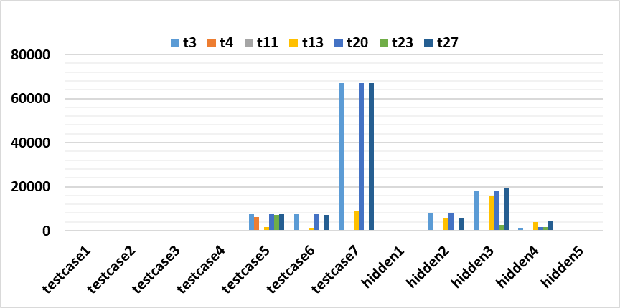
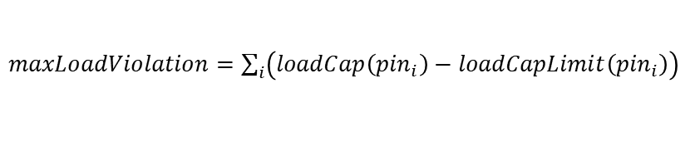
Results: Load Capacitance Violation
$maxLoadViolation=\sum_{i}{\left(loadCap\left({pin}_{i}\right)−loadCapLimit\left({pin}_{i}\right)\right)}$
unit: fF
Notes:
Similar to slew violation, this is the distribution of load capacitance violation. Here both the AI and non AI based flows were able to bring down the violations but the AI based flow did slightly better for larger designs,

Slide 24
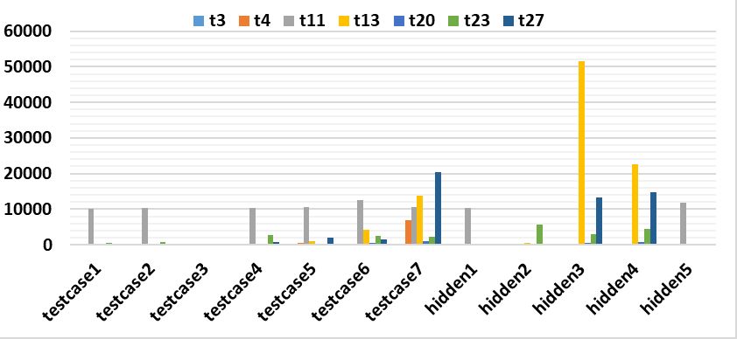
Results: Runtimes
unit: seconds
Notes:
This is the distribution of runtimes of the resynthesizer tool in seconds. All the submissions were evaluated in this platform to ensure fairness. Here the non AI solution have lesser runtimes for smaller designs but the runtimes are increasing at a larger trend with the increase in design size. But for AI based solution even though the runtimes are little high for smaller designs, their runtimes did not scale at a larger trend hence for larger designs those solutions have significantly smaller runtimes.

Slide 25
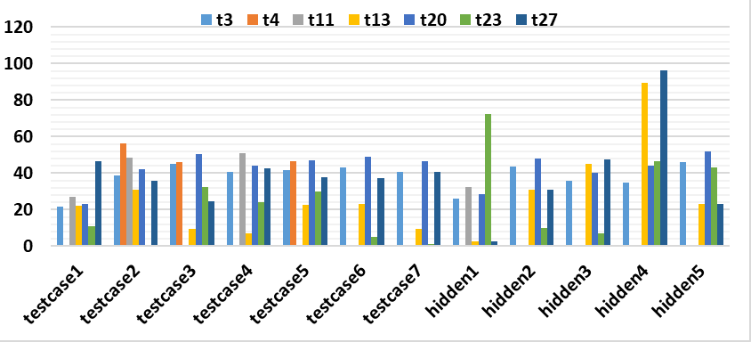
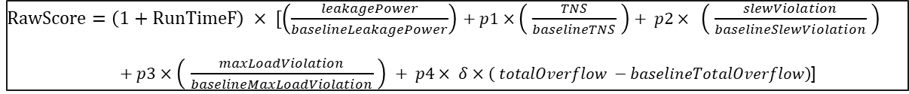
Results: Raw Scores
$RawScore=\left(1+RunTimeF\right) × [\left(\frac{leakagePower}{baselineLeakagePower}\right)$ $+ p1×$ $\left( \frac{TNS}{baselineTNS} \right)+ p2× \left( \frac{slewViolation}{baselineSlewViolation} \right)$
$+ p3×$ $\left( \frac{maxLoadViolation}{baselineMaxLoadViolation} \right) + p4× δ×\left( totalOverflow −baselineTotalOverflow\right)$]
Notes:
This is the distribution of raw scores across all teams, computed by this formula.

Slide 26
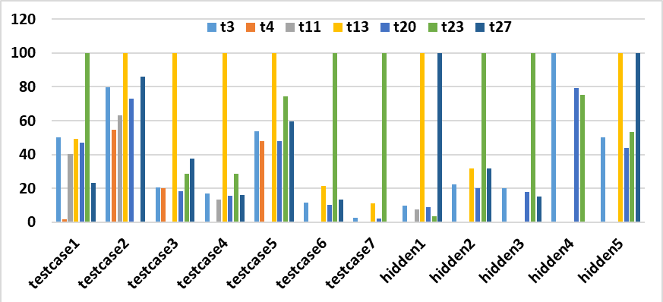

Results: Final Scores
$$finalScore=100×\frac{Least RawScore across teams}{RawScore of the team}$$
Notes:
This is the distribution of scaled scores. Here if a team has scored 100 it means their solution performed best for that particular testcase. A key takeaway from this plot is that no one team dominated across all testcases. Some solutions were performing well for smaller testcases and some for larger testcases.

Slide 27
Key Takeaways as Organizers
Creating benchmarks as to sufficiently challenge either commercial EDA tools and ML optimizers is not easy.
Non-AI based solution | AI based solution
Struggled to fix slacks on larger designs | Delivered better timing closure on larger designs
Unable to consistently fix slew and load violations | Handled slew and load violations more effectively
Runtime scaled poorly with design size | Runtime scaled more gracefully with design size
Notes:
Creating benchmarks which are not too easy and not too hard to optimize was hard. Also we needed the benchmarks to sufficiently challenge both non AI and AI based solutions.

Slide 28


Conclusion
The contest had 7 final submissions.
Innovative solutions with novel ML techniques resulting in highly optimized netlists were seen from the submissions.
Release of visible and hidden benchmarks: https://github.com/ASU-VDA-Lab/MLCAD25-Contest-Scripts-Benchmarks
Scan for the contest GitHub repository
Notes:
To wrap up, the ReSynthAI contest introduced the first physically-aware logic resynthesis challenge. We provided open benchmarks, ML-friendly formats, and a standardized evaluation flow using OpenROAD. The contest had 7 final submissions, and many teams have implemented novel ML techniques in their resynthesizer tool. Both the visible and hidden benchmarks have been released in the contest git hub repository.

Slide 29
WINNERS !

Slide 30

Third Place – Congratulations!
MLCAD SYMPOSIUM 2025
7th ACM/IEEE International Symposium on Machine Learning for CAD
September 8-10, 2025 | SANTA CRUZ, CALIFORNIA
MLCAD 2025 Contest On ReSynthAI
THIRD PLACE
AWARDED TO
ACE-DMA – NXP Semiconductors
Andrew Smith, Animesh Basak Chowdhury, Sreyesh Kalathiparambil,
Will Miler, and Narasimhan Narayanan

Slide 31
Second Place – Congratulations!
MLCAD SYMPOSIUM 2025
7th ACM/IEEE International Symposium on Machine Learning for CAD
September 8-10, 2025 | SANTA CRUZ, CALIFORNIA
MLCAD 2025 Contest On ReSynthAI
SECOND PLACE
AWARDED TO
CSDL – Pohang University of Science and Technology
Howoo Jang, Kyungjun Min, Jeyeong Park, Junhwan Jang, Yeonwoo Shim,
Jeonghyun Choi, Sieun Kang, Hayoung Shin, Mungyu Choi

Slide 32
First Place – Congratulations!
MLCAD SYMPOSIUM 2025
7th ACM/IEEE International Symposium on Machine Learning for CAD
September 8-10, 2025 | SANTA CRUZ, CALIFORNIA
MLCAD 2025 Contest On ReSynthAI
FIRST PLACE
AWARDED TO
PhyMap – Fudan University
Hongyang Pan, Cunqing Lan, Zhiang Wang, Keren Zhu

Slide 33
THANK YOU ☺

Slide 34
Backup slides

Slide 35
Third Place – Congratulations!
Team name | Team members | Affiliation
ACE-DMA | Andrew Smith | NXP Semiconductors
 | Animesh Basak Chowdhury
 | Sreyesh Kalathiparambil
 | Will Miler
 | Narasimhan Narayanan

Slide 36
Second Place – Congratulations!
Team name | Team members | Affiliation
CSDL | Howoo Jang | Pohang University of Science and Technology
 | Kyungjun Min
 | Jeyeong Park
 | Junhwan Jang
 | Yeonwoo Shim
 | Jeonghyun Choi
 | Sieun Kang
 | Hayoung Shin
 | Mungyu Choi

Slide 37
First Place – Congratulations!
Team name | Team members | Affiliation
PhyMap | Hongyang Pan | Fudan university
 | Cunqing Lan
 | Zhiang Wang
 | Keren Zhu

Slide 38
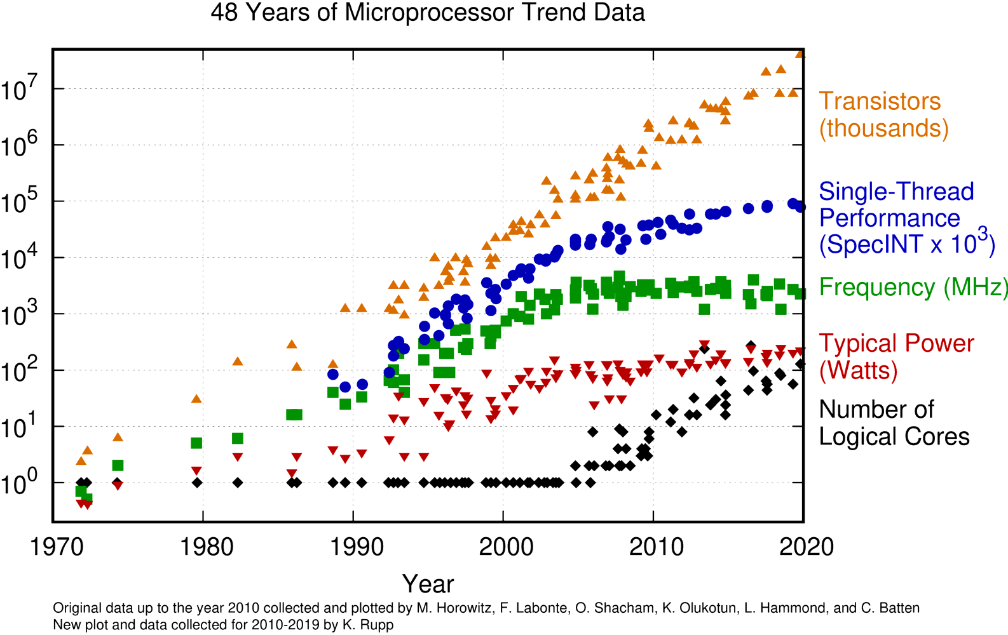

Moore’s Law and the Role of EDA
Transistor counts continue to rise, but performance improvements have slowed.
Moore’s Law
Design capability gap
Software complexity
EDA tools

Slide 39


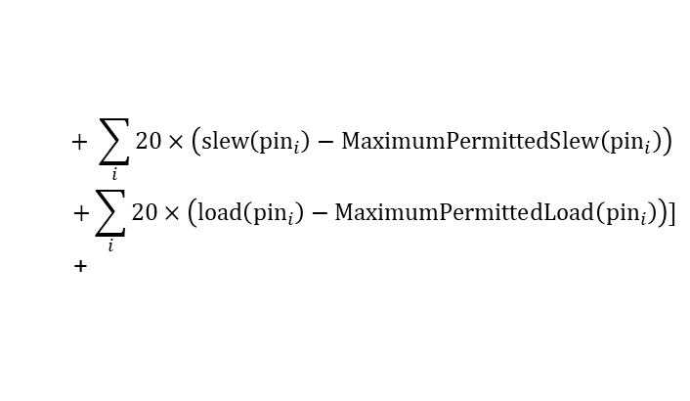
Evaluation Score
Convert the constrained optimization problem into a score function using a penalty approach.
$$RawScore=\left(1+RunTimeF\right) × [\left(\frac{leakagePower}{baselineLeakagePower}\right)$$
slack penalty
$$+ \sum_{i}{20×\left(slew\left({pin}_{i}\right)−MaximumPermittedSlew\left({pin}_{i}\right)\right)}$$
$$+\sum_{i}{20×\left(load\left({pin}_{i}\right)−MaximumPermittedLoad\left({pin}_{i}\right)\right)}]$$
+
slew penalty
load penalty
congestion penalty
$$RuntTimeF=min \left\{\max\left[0.2×\log_{2}\left(\frac{RunTime}{MedianRunTime}\right), − 0.2\right],0.2\right\}$$
Evaluation Platform:
4 NVIDIA A100 GPUs and 8 CPU threads
$$finalScore=100×\frac{Least RawScore across teams}{RawScore of the team}$$

Slide 40
Evaluation Score
Convert the constrained optimization problem into a score function using a penalty approach.
$$RawScore=\left(1+RunTimeF\right) × [\left(\frac{leakagePower}{baselineLeakagePower}\right)$$
slack penalty
$$+ \sum_{i}{20×\left(slew\left({pin}_{i}\right)−MaximumPermittedSlew\left({pin}_{i}\right)\right)}$$
$$+\sum_{i}{20×\left(load\left({pin}_{i}\right)−MaximumPermittedLoad\left({pin}_{i}\right)\right)}]$$
+
slew penalty
load penalty
congestion penalty
$$RuntTimeF=min \left\{\max\left[0.2×\log_{2}\left(\frac{RunTime}{MedianRunTime}\right), − 0.2\right],0.2\right\}$$
Evaluation Platform:
4 NVIDIA A100 GPUs and 8 CPU threads
$$finalScore=100×\frac{Least RawScore across teams}{RawScore of the team}$$

